Slide 1
Benign skin tumors
MUDr. Anna Žáková
I.DVK FNUSA a LF MU

Slide 2
They growth expansively, so they can push to around tissue, but they don´t grow inside them, and they don´t destroy them
They keep structural and functional maturity

Slide 3
Epithelial
Seborrhoic keratosis
Adnexal
Syringoma
Cylindroma
Trichoepithelioma
Mesenchymal
Fibroma
Hemangioma
Lipoma
Keloidal scar
Dermatofibroma
Vessel‘s
Hemangioma
(capillare, cavernosum, senile, angiokeratoma)

Slide 4
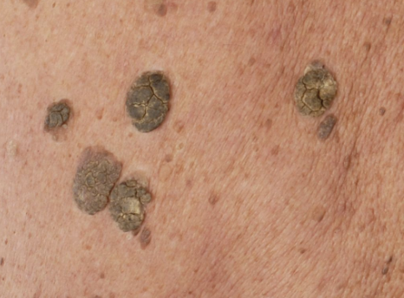
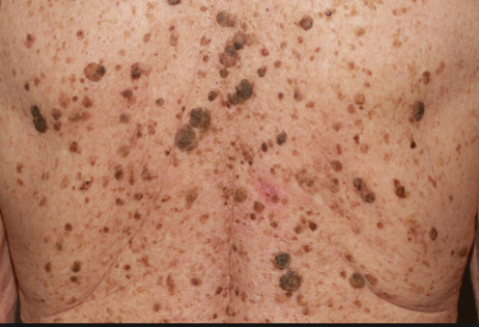
1) Benign epithelial tu = epithelioma
Seborrheic keratosis (verruca seborrhoica, senile lentigo)
Is the most common benign skin tumor, almost every
elderly person has several
Are most common on the: trunk (mostly back), head
They start as well-circumscribed skin-colored or tan
maculas, then they slowly become darker, thicker and larger
Léser Trelát sign – is sudden eruption of numbers verrucas- can be the sign of malignant tumor of organs (gastrointestinal systema, hematopoetic sys.)
Theraphy – no therapy is needed, but patients usually desire removal for cosmetic reasons – curettage or cryotheraphy, excision

Slide 5
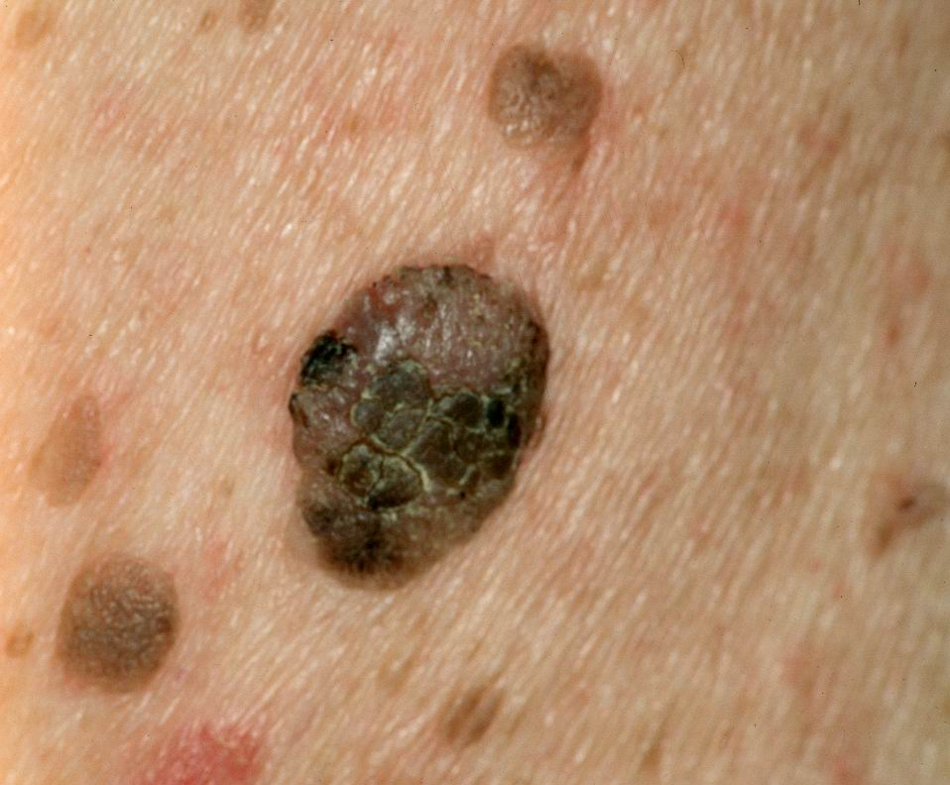
Veruca seborrhoica

Slide 6
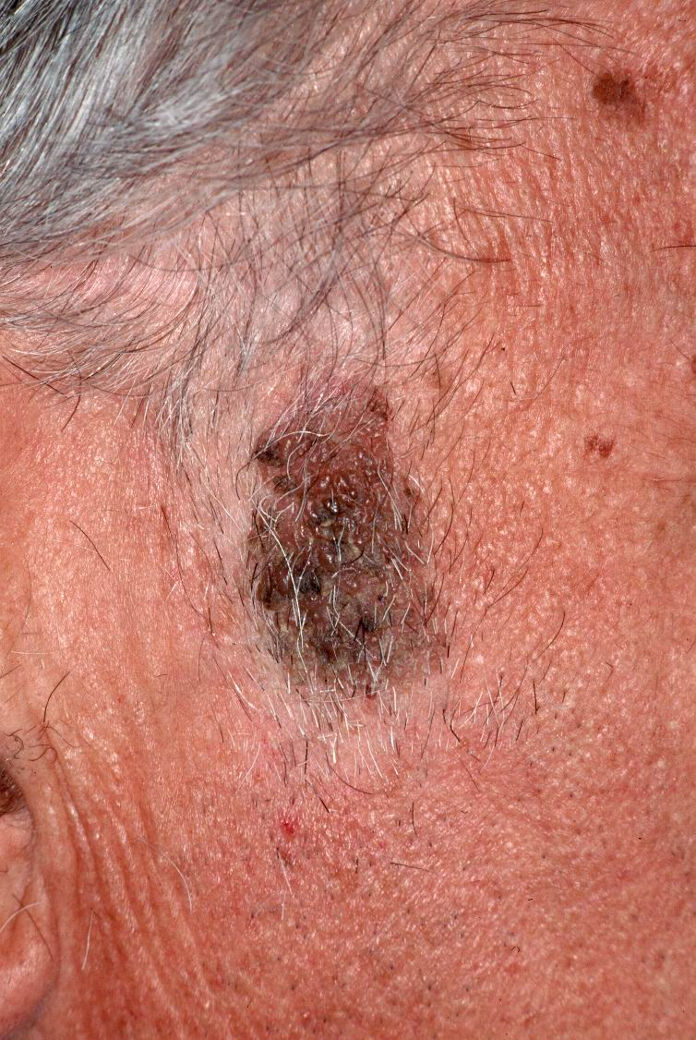
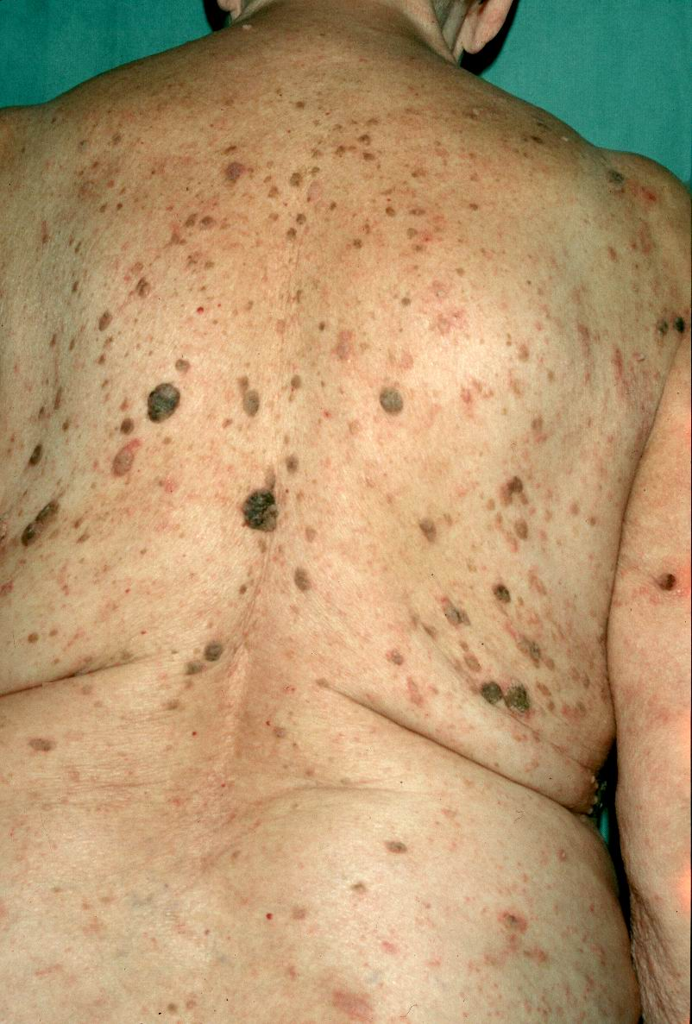

Slide 7
2) adnexal tumors = adenomas
This is large family of tumors with features of eccrine, apocrine, sebaceous, or hair follicle differentiation
All can be treated by excision

Slide 8
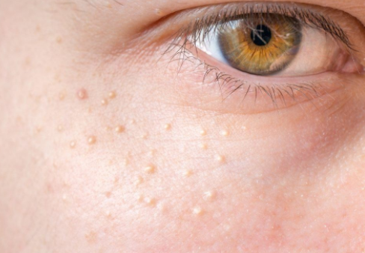
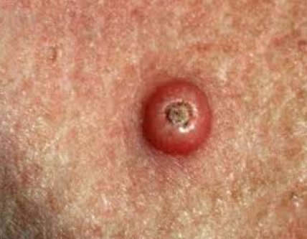
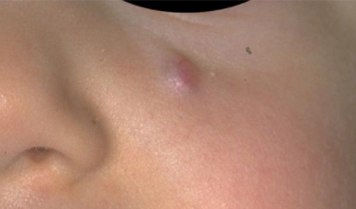
2) adnexal
Syringoma
Cylindroma
Pilomatrixom
Kerathoakanthoma

Slide 9
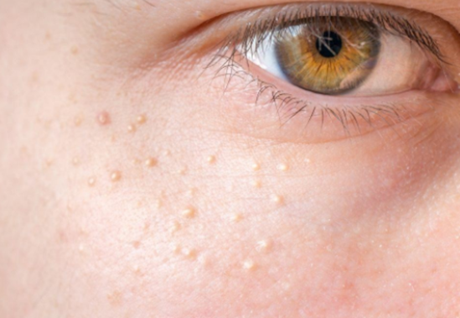
Syringoma
- From the infundibulum of the sweat glands
- 2 forms – usually periorbital, sometimes disseminated
- Clinically – multiple tiny skin-colored papules around the eyes
- Therapy – excision of solitary

Slide 10
Cylindroma
- Epithelioma with apocrine differentiation
- It appears in early adult age, gradually increasing during the time
- Usually occurs on the scalp, at the begining few papules or nodules skin-colored, or red, gradually increasing the number of nodules, so they can cover whole hair - described as „turban tumour“
- Therapy – surgical excision

Slide 11
Pilomatrixom
- Epithelioma of the hair follicle
- Common cystic childhood tumor
- Usually on the scalp or cheek
- Therapy - excision

Slide 12
Kerathoakanthoma
- From supraglandular part of hair follicle
it is formed in sun-exposed parts of the body (face, neck, hands) in people around 60 years, or immunosuppressed people
fast-growing solitary semicircular nodule reaching up to 2 cm in diameter within a few weeks with bulging edges and a central crater filled with horn
On the edges there are many teleangiektasias
It could spontaneously regress with scar
- Therapy - excision

Slide 13
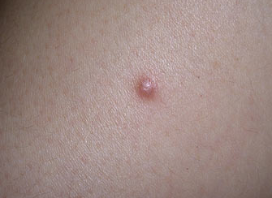
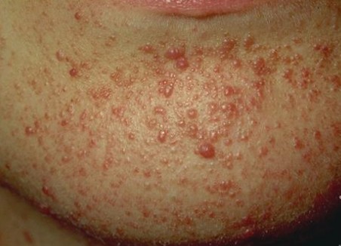
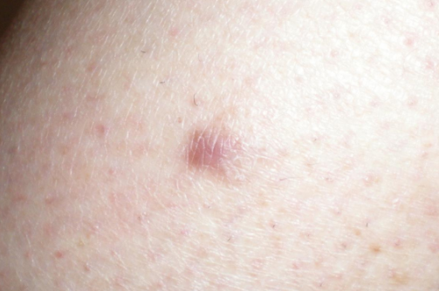
3) Mezenchymal tumors
Histiocytoma, dermatofibroma
Keloid, hypertrofic scar
Fibroma molle
Angiofibroma
Leiomyoma
lipoma

Slide 14
Histiocytoma fibrosum, dermatofibroma
One of the most common skin tumors
Mainly appears at younger people on extremities, sometimes on trunk
It is reactive inflamation after bite of insect or injury
It looks like solitar flat leassion or small nodule, red-brown
Therapy isn´t needed, but possible is excision

Slide 15
Keloid, hypertrofic scar
A keloid results when the reparative process extends beyond bounds of the original scar
Typical are – middle chest, following cardiac surgery or ear lobes after piercing
Black individuals are more likely to develop keloids
Therapy – treatment is difficult, any maniulation may result in a worst keloid, best results are obtained with shave excision, cryotherapy, interelesional corticosteroids combined with compression
Hypertrofic scar is confined to the side of the tissue damage

Slide 16
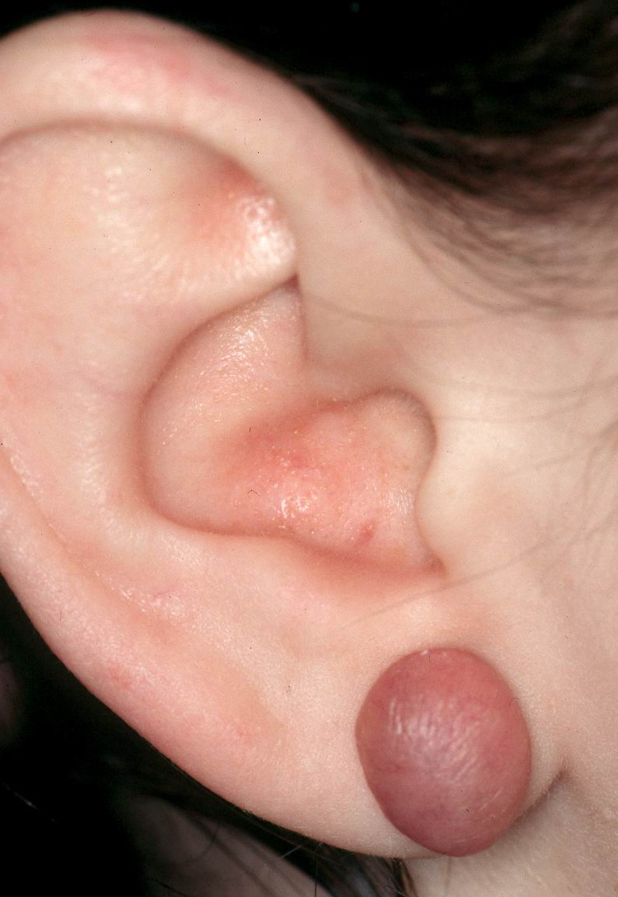
Keloid

Slide 17
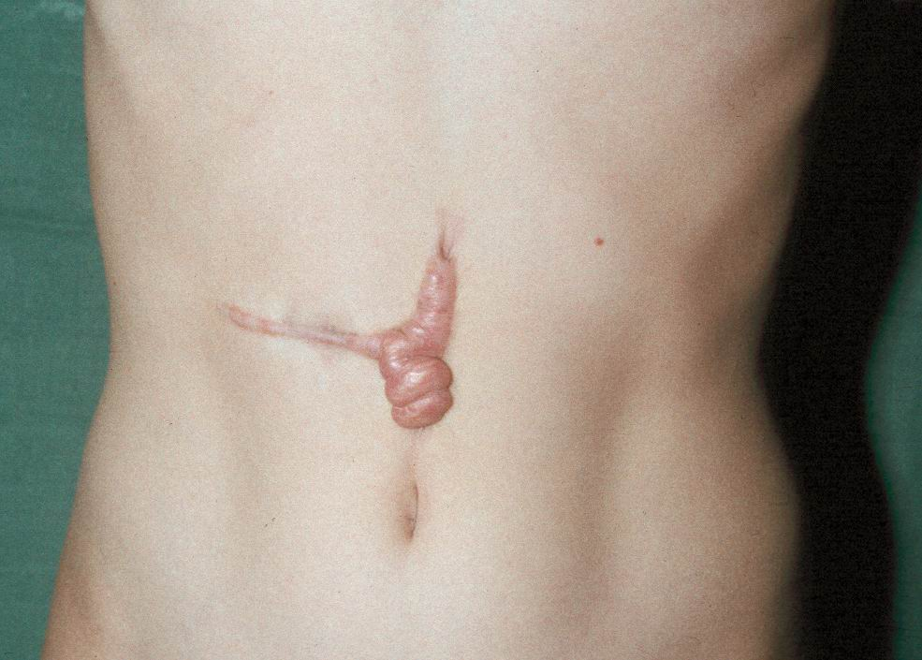

Slide 18
Skin tags (Fibroma molle)
- Tinny skin colored or tan papules
Typicaly on neck, axillae or groin
More common in overweight and older individuals
Small lessions can be treated by kauter or scissor‘s excision

Slide 19
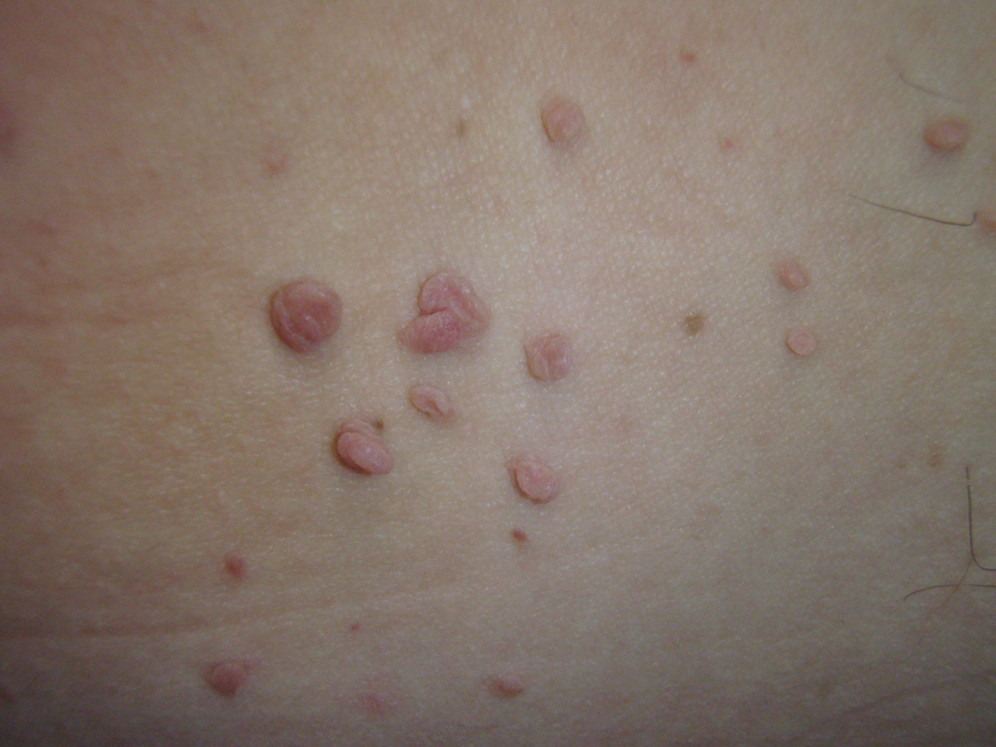
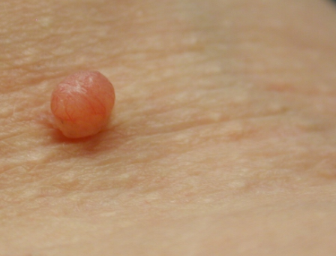

Slide 20
Angiofibrom
This is proliferation of small vessels with perivascular fibrosis
Very often create from intradermalnevus after regretion of pigmentation
Variants:
Fibrous papule of the nose – small solitary inconspicuous nasal papule
Tuberous sclerosis – facial papulos
Therapy – excision (solitary), laser (multiple leasions)

Slide 21
Lipom
Bordered proliferation of subcutis fat tissue
They are solitary or multiple
They‘re located in subcutaneous mass like soft, elastic oval free movable against skin and the base
It doesn‘t resolve with weight loss
Unpainful (normally)
Therapy – all can be easily excised if they‘re functionally or cosmeticaly disturbing or painful

Slide 22
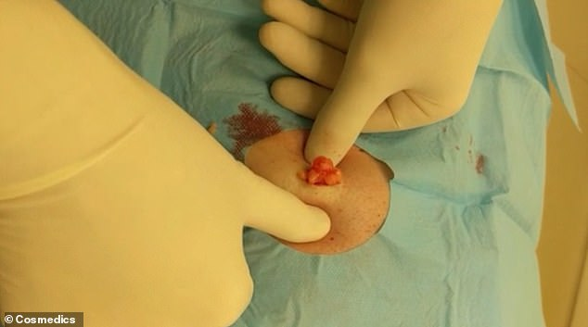
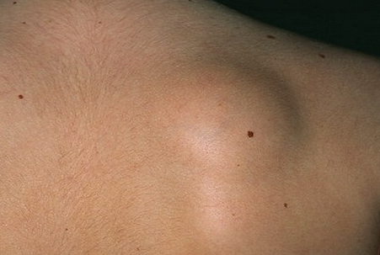
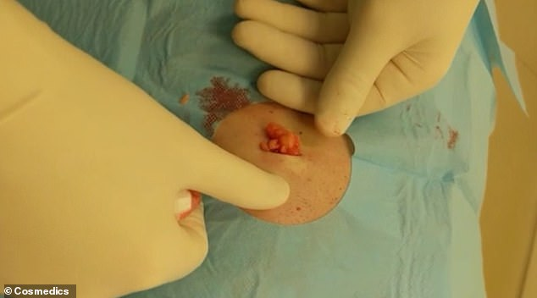

Slide 23
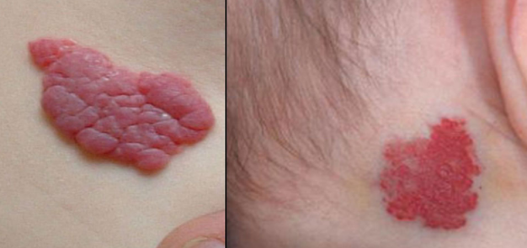
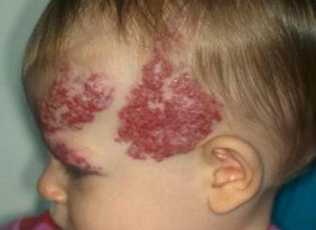
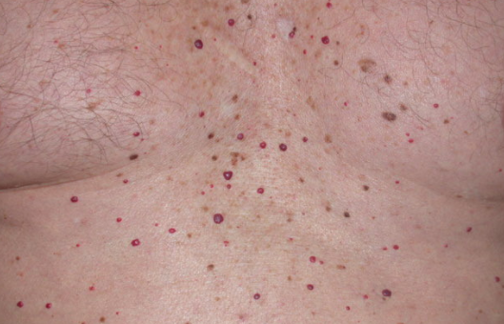
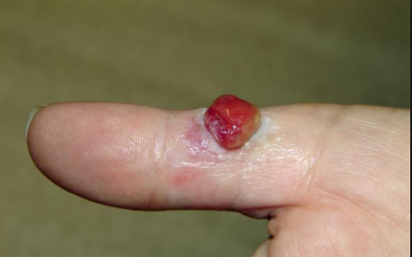
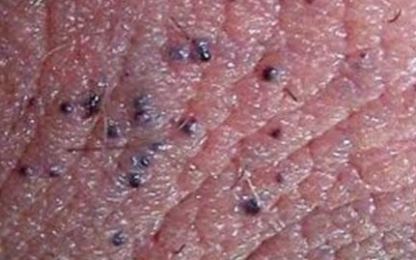
4) Vascular
Hemagioma capillare
Hem. Cavernosum
Hem. Senile
Granuloma pyogenicum
Angiokeratoma
lymfangioma

Slide 24
Hemagioma capillare
- This is the most common vascular lesion
The greatest risk factor is low birth weight, it is present after birth or in first months of life
The common localization is on head and neck, start as blanchet makula with telangiectahes an evolves into rubbery red tumor
During regression it develops a gray sheen and heals with scarring
50% - have resolved by 5 years
70% – by 7 years
Larger takes long to resolve and leave cosmetics defects

Slide 25
Hemagioma capillare
- Complication includes:
- ulceration
- scarring
- periorbital and periorificial risk of amblyopia sometimes interferes with eating or breathing
- vascular problems risk of shunting and high output cardiac failure
- agressive growth

Slide 26
Hemagioma capillare - Therapy
observation for low-risk lesion
Early cryotherapy may induce regression
Topical or intralesional corticosteriods and excision or laser
High risk leasons:
Systhematic corticosteroids or interferon alpha

Slide 28
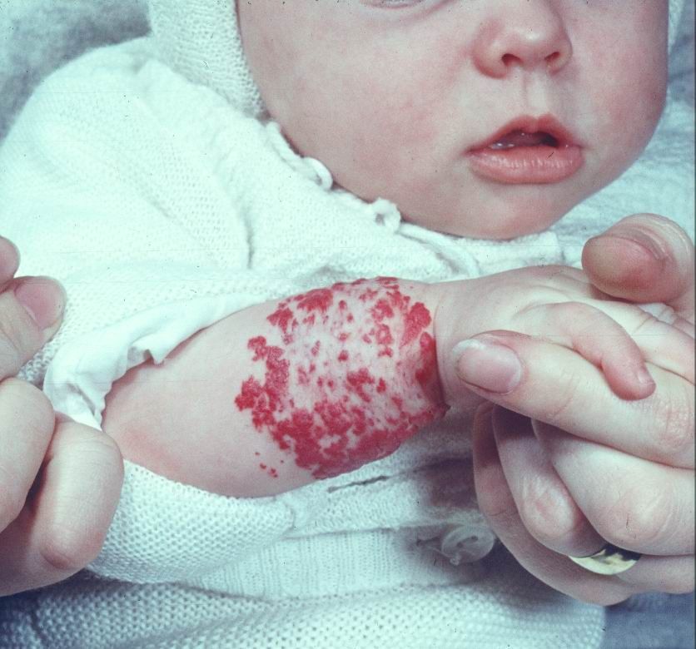

Slide 29
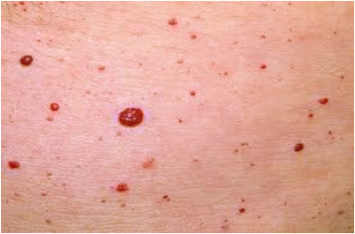
Hemangioma senile
It creates in older age on the trunk
Dark red papulas with strike borders (1 - 6 mm)
Cosmetic problems
Therapy:
diathermokoagulation
Laser and cryotherapy

Slide 30
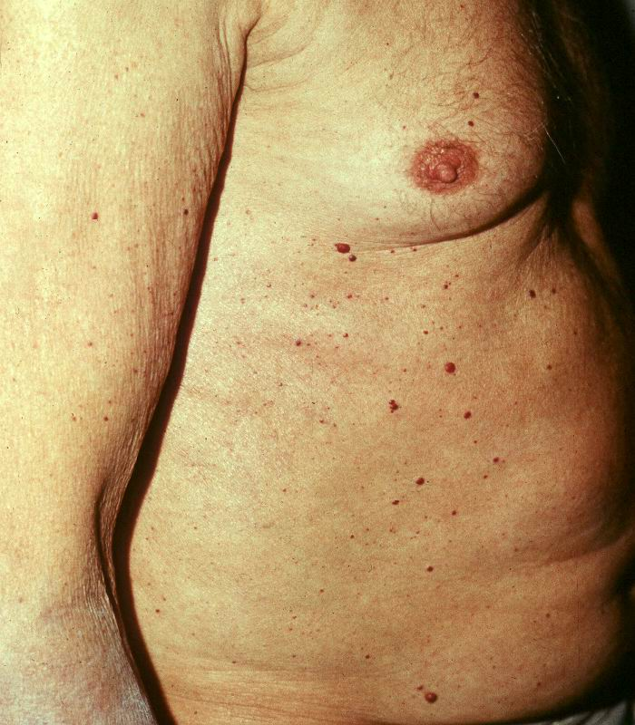
Hemangiom

Slide 31
Pyogenic granuloma
A reactive vascular proliferation in response to trauma
Charakterized by red nodule, that is usually friable with a bloody surface
Therapy:
Chemical / electrical cauterization
Laser destruction

Slide 32
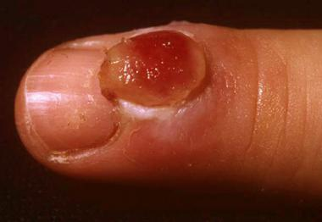

Slide 33
Thank you for your attention

