Slide 1
(XIV.) Ergometry
Physiology I - practicals

Slide 2
Ergometry deals with evaluation of performance (work, power).
Its name comes from two Greek words: „ergon“´= work, „metron“ = measure.
The test is a part of complex examinations evaluating responses and adaptation of organism to exercise. It is used to diagnose, to decide about the treatment and/or evaluation of its effectiveness. In the sport medicine, it is used mainly for evaluation of fitness.

Slide 3
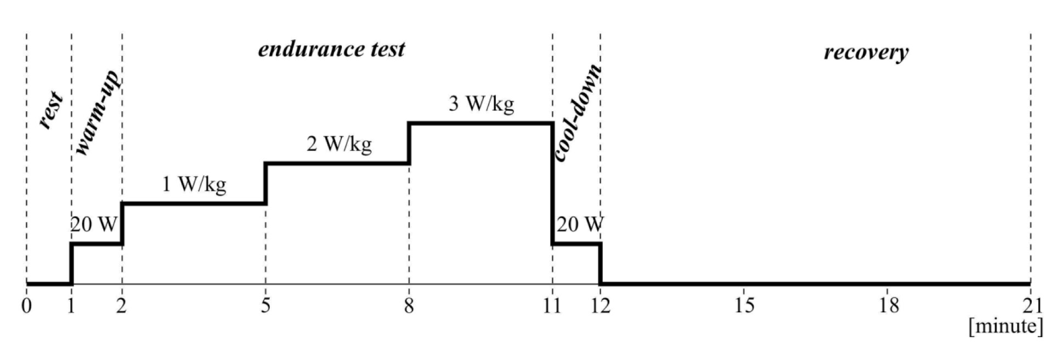
Examination phases:
recording of resting values
exposure of examined person to graduated physical work
workload of low intensity supporting catabolites removal (lactic acid), helping heart rate recovery, reducing vertigo and collapses (due to after-work hypotension)
application of low workload in order to increas tissue perfusion and improve joints mobility
follow-up after exercise

Slide 4
Basic protocol types :
Single stage test
Intermittent incremental steps
Continuous incremental step
„ramp“ protocol

Slide 5
Heart rate change:
Up to 180 beats/min heart rate increases LINEARLY
(if workload increases continually)
200
180
160
Heart rate [beat/ min]
W₁₇₀ : Index describing work capacity at heart rate of 170 beats/min.
140
untrained individual
120
trained individual
100
90
W₁₇₀
W₁₇₀
Performance [W] or [W/kg]
trained
untrained

Slide 6
Heart rate change:
W₁₇₀ : Index describing work capacity at heart rate of 170 beats/min
Population norms (Heller, 2005)
A G E | Men |  | Women
 | [W] | [W/kg] | [W] | [W/kg]
18 | 178 | 2,7 | 103 | 1,8
20 | 185 | 2,7 | 106 | 1,8
22 | 190 | 2,7 | 107 | 1,8
25 | 193 | 2,7 | 109 | 1,8
30 | 194 | 2,6 | 112 | 1,8
35 | 195 | 2,6 | 115 | 1,8
40 | 195 | 2,5 | 118 | 1,8
45 | 195 | 2,4 | 121 | 1,8

