Slide 1

Regulation
in cardiovascular system

Slide 2
The role of nervous system
ANTICIPATION
Cortex
Potential input
Potential output
Cortex
Integration
Sensor
Input
Output
Effector
REGULATION

Slide 3
Types of regulation
- general view
2 basic types:
Nervous regulation
Humoral regulation
    Feedback control - negative
    - positive
    autoregulation – local regulation – system regulation

Slide 4
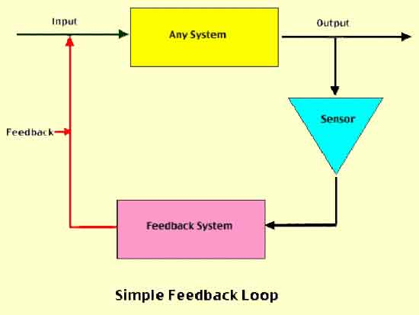
Feedback regulation
http://www.slideshare.net/drpsdeb/presentations

Slide 5
REGULATION
IN CARDIOVASCULAR SYSTEM
Main function:
keep relatively constantaneous arterial blood pressure
Keep perfusion of tissues

Slide 6
Regulation of vessels tone
Tone of the vessels = basic tension of the smooth muscle inside of the wall
(vasoconstriction x vasodilatation)
Regulation - local autoregulation
- system regulation

Slide 7
Autoregulation
Autoregulation – the capacity of tissues to regulate their own blood flow
Myogenic theory – Bayliss phenomenon (as the pressure rises, the blood vessels are distended and the vascular smooth muscle fibres that surround the vessels contract; the wall tension is proportional to the distending pressure times the radius of the vessels – law of Laplace:
T=P x r)

Slide 8
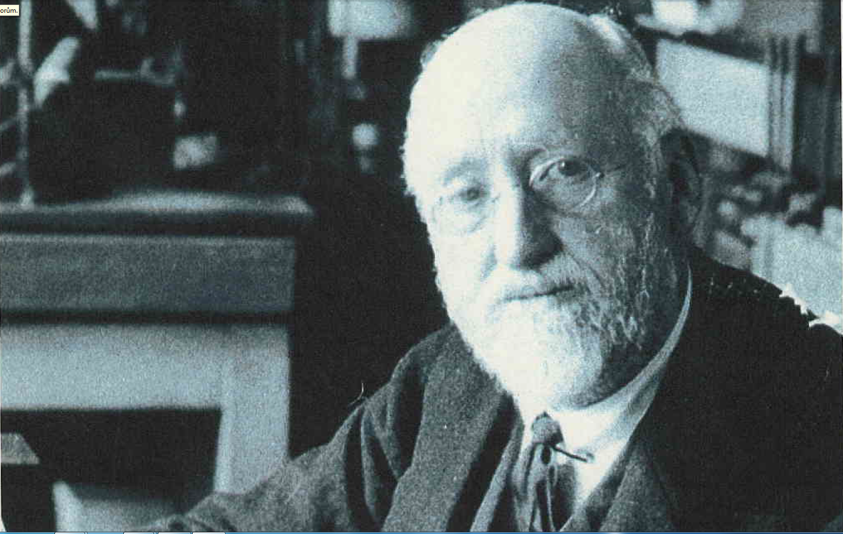

Slide 9
Autoregulation
Metabolic theory – vasodilator substances tend to accumulate in active tissue, and these metabolites also contribute to autoregulation
  ending products of energetic metabolism – CO₂, lactate acid, K⁺
  effect of hypoxia (circulation: vasodilatation x pulmonary circulation: vasoconstriction)
  Adenosin – coronary circulation: vasodilatation

Slide 10
Autoregulation
by substances which releasing from:
  endothelium
  tissues

Slide 11
Substances secreted by the ENDOTHELIUM
Vasodilatation:
Nitric oxide (NO) from endothelial cells
(originally called: EDRF)
Prostacyclin is produced by endothelial cells
Vazoconstriction:
Endothelins (polypeptids – 21peptides)
three isopeptides: ET 1, ET 2 , ET 3

Slide 12
Substances secreted by the tissues:
Histamine – primarily tissue hormones.
General affect: vasodilatation - decrease periphery resistence, blood pressure
KININS: 2 related vasodilated peptides
Bradykinin + lysylbradykinin (kallidin).
Sweat glands, salivary glands
10x strongers than histamine
Relaxation of smooth muscle, decrease blood pressure

Slide 13
Systemic regulation
By hormones
Catecholamines – epinephrine, norepinephrine - effect as activation of sympathetic system
RAAS - stress situation
ADH - general vasoconstriction
Natriuretic hormones - vasodilatation

Slide 14
Neural regulatory mechanism
Autonomic nervous system
Sympathetic: vasoconstriction
All blood vessels except capillaries and venules contain smooth muscle and receive motor nerve fibers from sympathetic division of ANS (noradrenergic fibers)
Regulation of tissue blood flow
Regulation of blood pressure
Parasympathetic part: vasodilatation
Only sacral parasympathetic cholinergic fibres (Ach) inervated arteriols from external sex organs

Slide 15
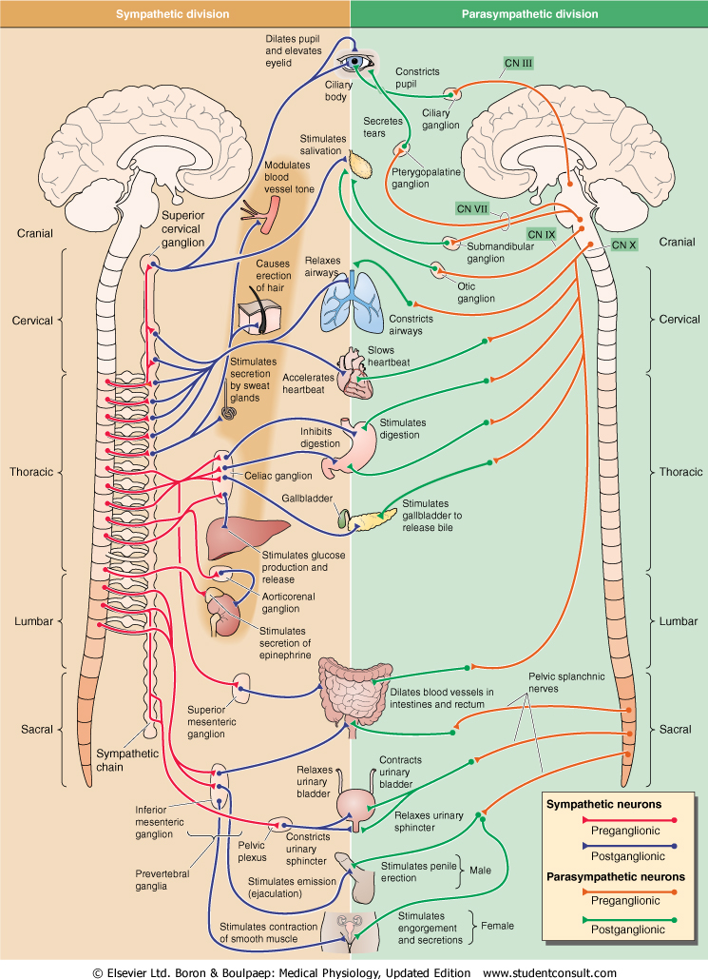
Sympathetic nervous system
Fight or flight response
Energy/store consumption
Preganglionic neuron
– Spinal cord
-Thoraco - lumbar system
Ganglia Paravertebral
Truncus sympathicus
Majority
Prevertebral
-Plexus aorticus
Mostly diffuse effect
Parasympathetic nervous system
Rest and digest response
Energy conservation/en. store production
Preganglionic neuron
– Brain stem and spinal cord
– cranio-sacral system
Ganglia
Close to target organs or intramurally
Mostly local effect

Slide 16
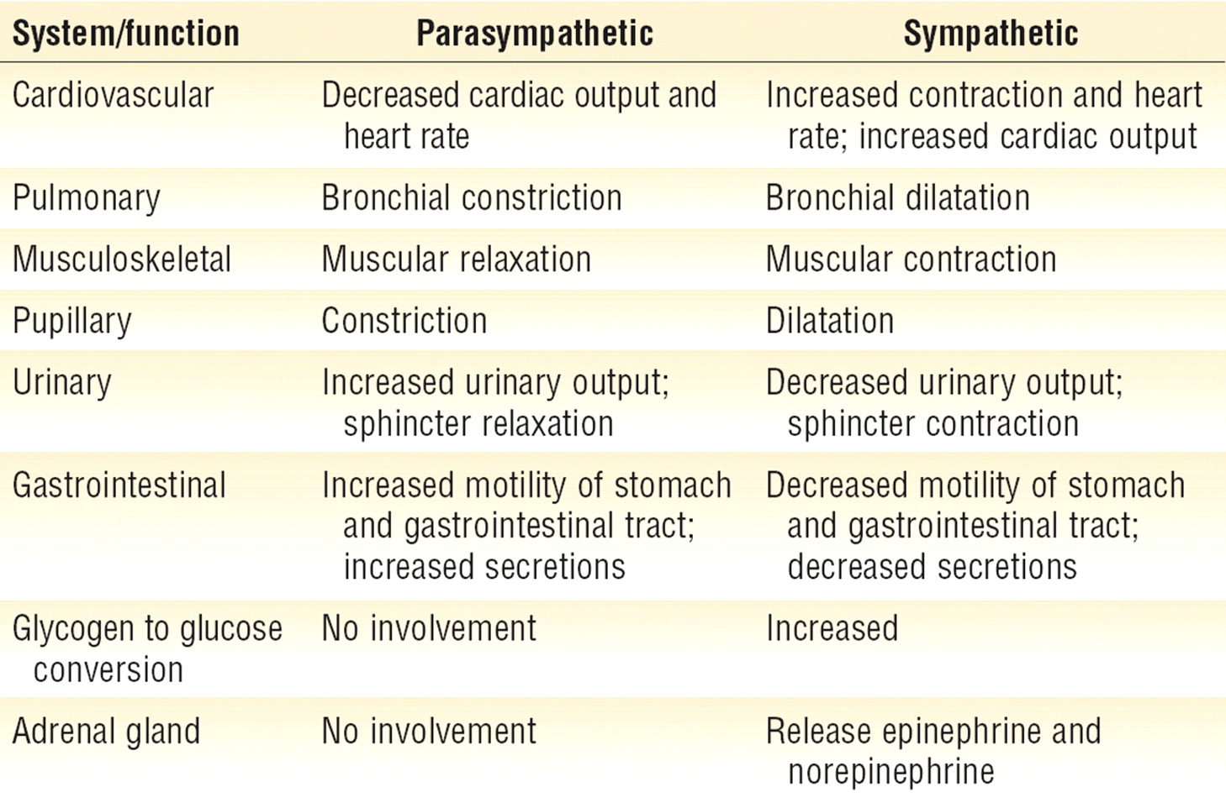
Sympatthetic nervous system
Fight or flight response
Energy/store consumption
Preganglionic neuron
– Spinal cord
-Thoraco - lumbar system
Ganglia Paravertebral
Truncus sympathicus
Majority
Prevertebral
-Plexus aorticus
Mostly diffuse effect
Parasympathetic nervous system
Rest and digest response
Energy conservation/energy store production
Preganglionic neuron
– Brain stem and spinal cord
– cranio-sacral system
Ganglia
Close to target organs or intramurally
Mostly local effect

Slide 17
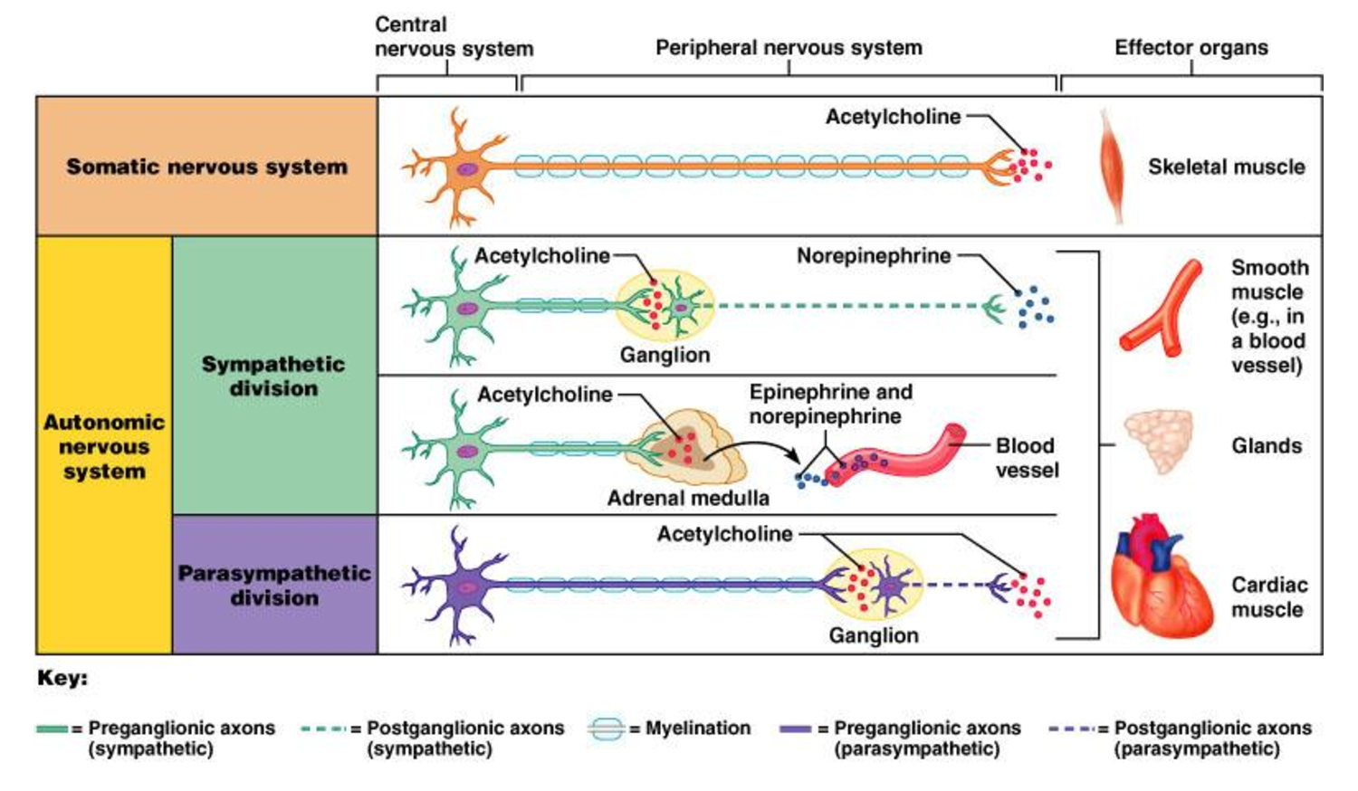
Mediators of somatic and autonomic nervous system
https://www.google.cz/url?sa=i&rct=j&q=&esrc=s&source=imgres&cd=&ved=0ahUKEwjujdLGieLPAhVJOhQKHay0BnUQjBwIBA&url=http%3A%2F%2Fimg.docstoccdn.com%2Fthumb%2Forig%2F105365259.png&psig=AFQjCNFxrUy63llCAlny-Vhlyse4FHDMaw&ust=1476801796194278

Slide 18

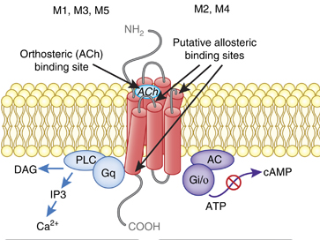
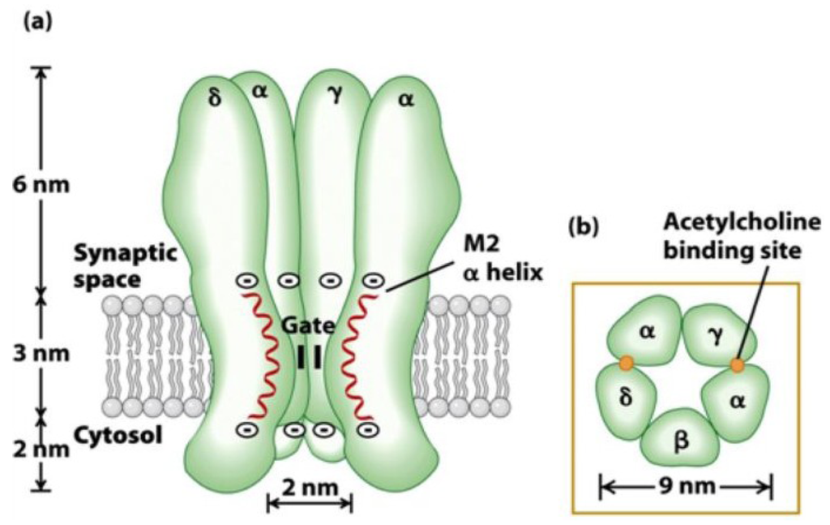
Acetylcholine
Preganglionic fibers
Postganglionic fibers
Sympathetic
Parasympathetic
Nicotinic receptor
  Ligand-gated ion channels
  Na+, K+, Ca2+
  Neuronal (N_{N}) and muscle (N_{M}) type
  Excitatory
Parasympathetic
Muscarinic receptor
  G-coupled
  Excitatory
    M1, M3, M5
  Inhibitory
    M2, M4
http://www.mdpi.com/marinedrugs/marinedrugs-12-02970/article_deploy/html/images/marinedrugs-12-02970-g013-1024.png
https://s-media-cache-ak0.pinimg.com/originals/ea/6c/3e/ea6c3e44afe638dca65fb4a3014bc095.jpg

Slide 19

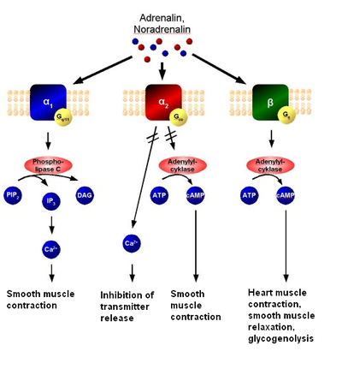
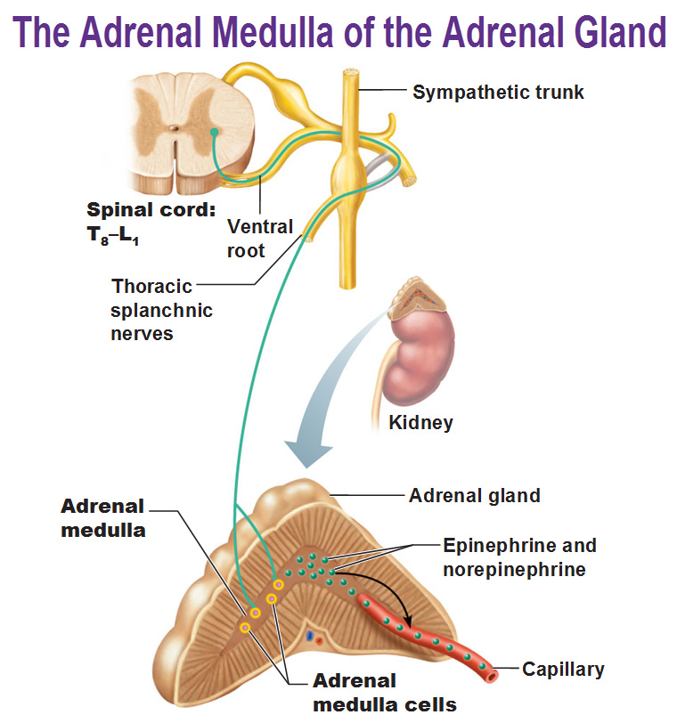
Norepinephrine
Postganglionic sympathetic fibers
Adrenergic receptor
  G-coupled
  α type– generally excitatory (contraction)
  β type – generally inhibitory (relaxation) with an exception of !!! heart !!!
Adrenal medulla
  Modified sympathetic ganglion
  „Transmitters“ (stress hormones)
  secreted into the blood stream
    Norepinephrine
    Epinephrine
Dřeň nadledvin
  Modifikované sympatické ganglion
  „Transmitery“ (stresové hormony) vylučuje do krve
    Noradrenalin
    Adrenalin
http://antranik.org/wp-content/uploads/2011/11/the-adrenal-medulla-of-the-adrenal-gland-epinephrine-norepinephrine-splanchic-nerves.jpg
http://antranik.org/wp-content/uploads/2011/11/the-adrenal-medulla-of-the-adrenal-gland-epinephrine-norepinephrine-splanchic-nerves.jpg
https://en.wikipedia.org/wiki/Adrenergic_receptor

Slide 20
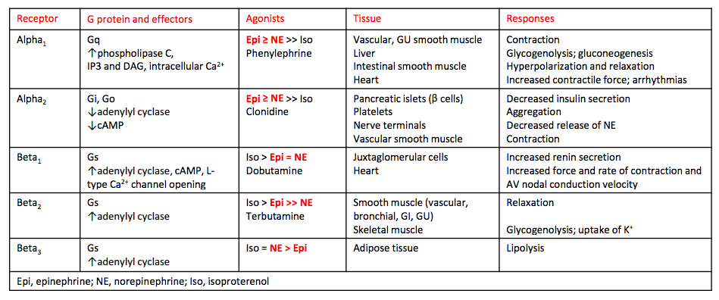
Norepinephrine
Postganglionic sympathetic fibers
Adrenergic receptor
  G-coupled
  α type– generally excitatory (contraction)
  β type – generally inhibitory (relaxation) with an exception of !!! heart !!!
Adrenal medulla
  Modified sympathetic ganglion
  „Transmitters“ (stress hormones)
  secreted into the blood stream
    Norepinephrine
    Epinephrine
Dřeň nadledvin
  Modifikované sympatické ganglion
  „Transmitery“ (stresové hormony) vylučuje do krve
    Noradrenalin
    Adrenalin
http://antranik.org/wp-content/uploads/2011/11/the-adrenal-medulla-of-the-adrenal-gland-epinephrine-norepinephrine-splanchic-nerves.jpg
http://antranik.org/wp-content/uploads/2011/11/the-adrenal-medulla-of-the-adrenal-gland-epinephrine-norepinephrine-splanchic-nerves.jpg
https://en.wikipedia.org/wiki/Adrenergic_receptor
https://s3.amazonaws.com/classconnection/769/flashcards/5928769/png/screen_shot_2014-11-04_at_92935_am-1497B7358A4552ACB39.png

Slide 21
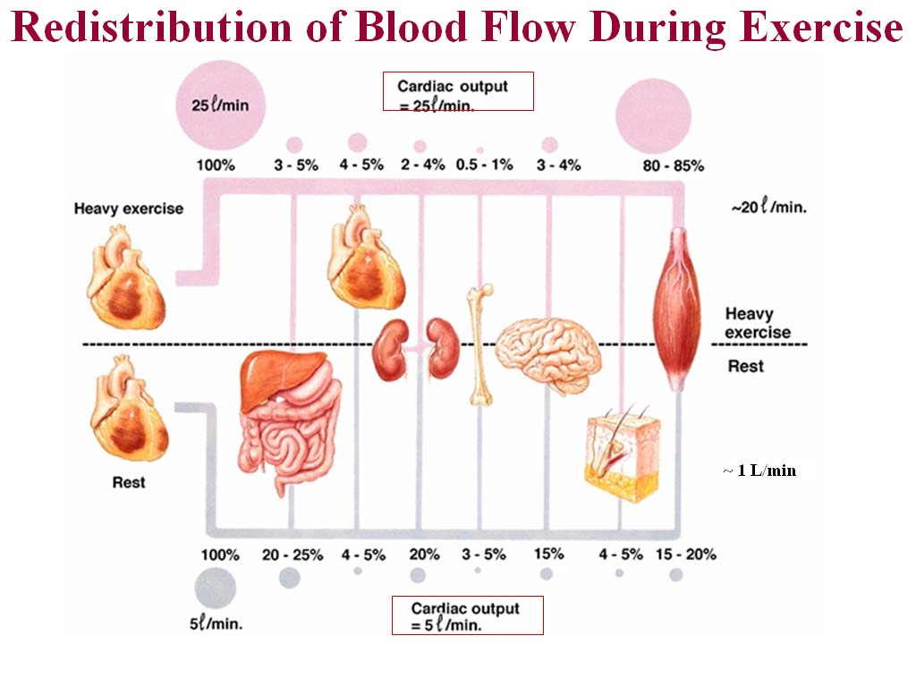
http://2.bp.blogspot.com/_MJ0CEYnSB4U/S99IJTUruOI/AAAAAAAAACs/NPzsh8ydzjQ/s1600/redistributionofbloodflow.jpg

Slide 22
Autonomic nervous system regulates the activity of individual organs and mutually coordinates the activities of all the organs systems.
http://2.bp.blogspot.com/_MJ0CEYnSB4U/S99IJTUruOI/AAAAAAAAACs/NPzsh8ydzjQ/s1600/redistributionofbloodflow.jpg

Slide 23
INTEGRATION of regulation in cardiovascular system
The regulation of the heart:
  Rami cardiaci n. vagi
Cardiac decelerator center - medula oblongata (ncl.dorsalis, ncl. ambiguus) – parasympathetic fibres of nervus vagus
: vagal tone (tonic vagal discharge)
Negative chronotropic effect (on heart rate)
Negative inotropic effect (on contractility)
Negative dromotropic effect (on conductive tissue)

Slide 24
INTEGRATION of regulation in cardiovascular system
The regulation of the heart:
  nn. cardiaci
Cardiac accelerator center – spinal cord, sympathetic ganglia – sympathetic NS
Positive chronotropic effect (on heart rate)
Positive inotropic effect (on contractility)
Positive dromotropic effect (on conductive tissue)

Slide 25
INTEGRATION of regulation in cardiovascular system
Vasomotor centre (regulation for function of vessels)
Medula oblongata
presoric area (rostral and lateral part –vasoconstriction – increase blood pressure
depresoric area (medio-caudalis part – vasodilatation, decrease of blood pressure)

Slide 26
INTEGRATION of regulation in cardiovascular system
Influence by central nervous system
  cerebral cortex
  limbic cortex
  hypothalamus

Slide 27
Regulation of blood pressure
Short - term regulation
- baroreflex
Middle - term regulation
- humorals regulation
sympathetic - catecholamines
RAAS (decrease perfusion pressure in kidney – secretion of renin)
ADH
Long – term regulation
- kidney regulation

Slide 28
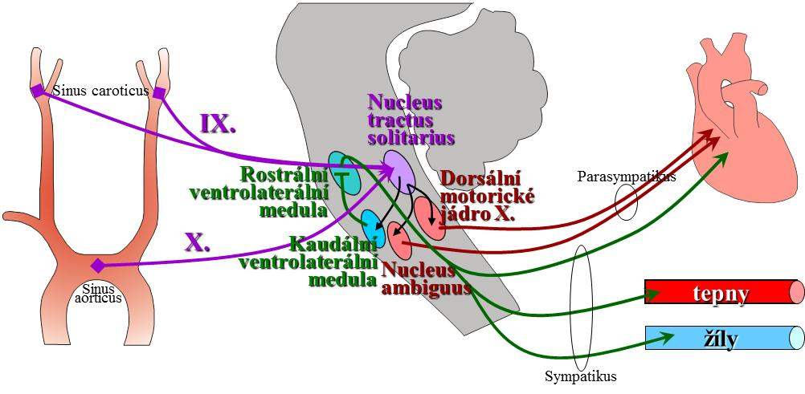
Short term regulation
BAROREFLEX

Slide 30
Noninvasive continuously beat-to-beat measurement of finger arterial pressure
Prof. Jan Peňáz, MD, PhD
Teacher and researcher on the Department of Physiology, Masaryk university, Brno
Patent 1969

Slide 32
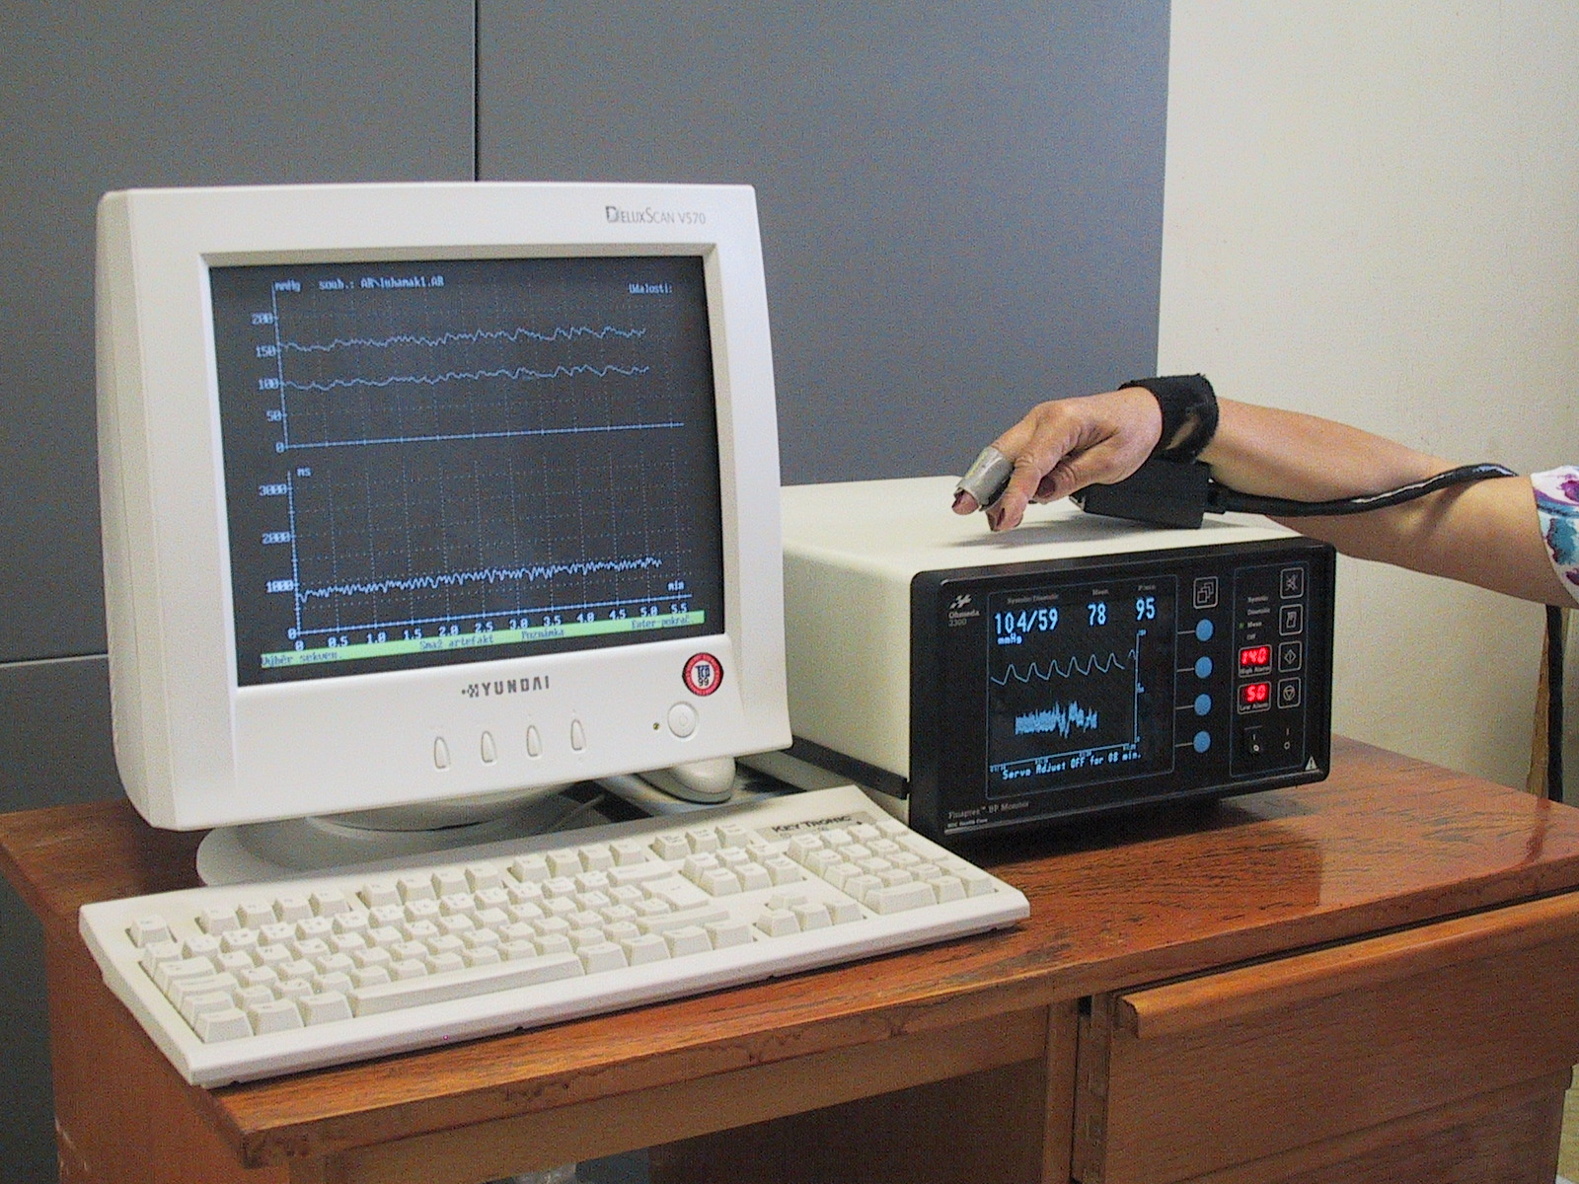
Finapres (Ohmeda, USA)

Slide 33
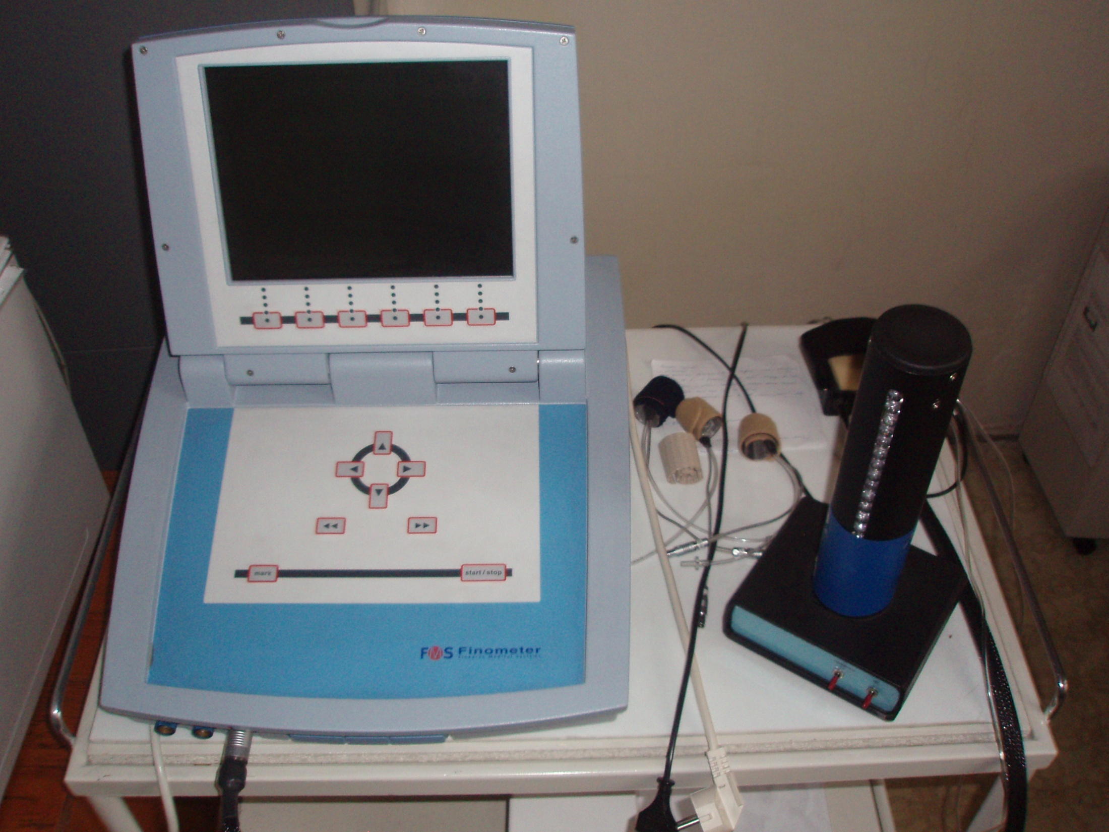
Finometr (FMS, Nizozemí)

Slide 34
We need than pressure in the cuff corresponded to the pressure of the digital artery
Method: photopletysmography
Recorded photoelectric plethysmogram
The new term: Transmural pressure – Pt (the pressure across the wall of the artery)
BP, Pc (pressure in cuff), Pt
We estimated: BP=Pc - - - Pt=0 - - - photoplethysmogram registered the highest amplitude of oscilation --- we measure the MAP
Step by step increase of Pc, in the moment of the highest amplitude – feed-back loop started for obtained(keeping) the constant volume of the finger

Slide 35
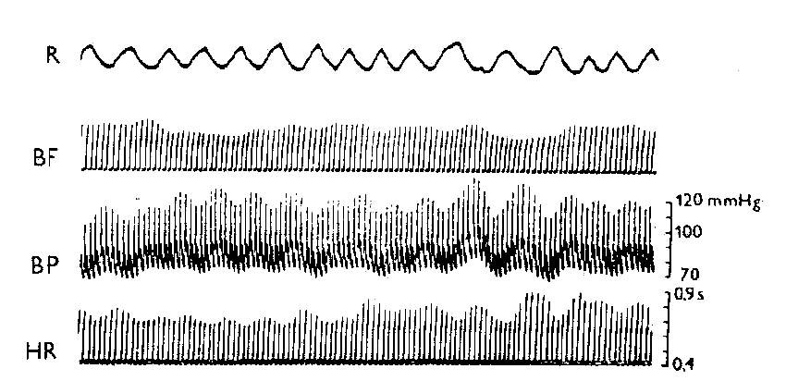
Records of circulatory parameters

Slide 36
Variability of circulatory parameters
Heart rate
Blood pressures – systolic and diastolic
variability expresses its fluctuation around the average value at certain time intervals (or in various conditions)

Slide 37
Heart Rate Variability (HRV)
Informs us about the activity of the vagus nerve (tonic activity of n.vagus = vagal tone)
Time analysis:
from Holter monitoring ECG or 5 - 30min records ECG
It is basically a statistical evaluation +/-standard deviation
Disables intervals differing by more than 20% from the average, thus further processed only normal (NN) intervals and evaluated by the standard deviation of all NN sequence for 24h

Slide 38
Spectral analysis:
Carried out under standard conditions at various maneuvers (supine, standing); evaluated with 300 representative intervals RR / NN /
Another mathematical processing (Fourier transform) -length RR intervals are converted to cycles in Hz
The spectrum is divided into several components - low (LF: the sympathetic modulation) and high frequency (HF: vagal modulation)
People with reduced heart rate variability have a 5 times higher risk of death

Slide 39
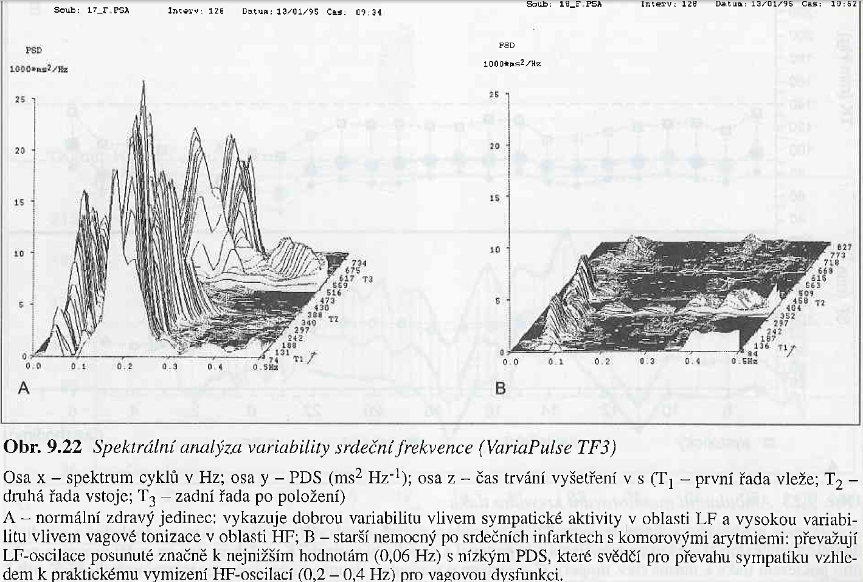

Slide 40
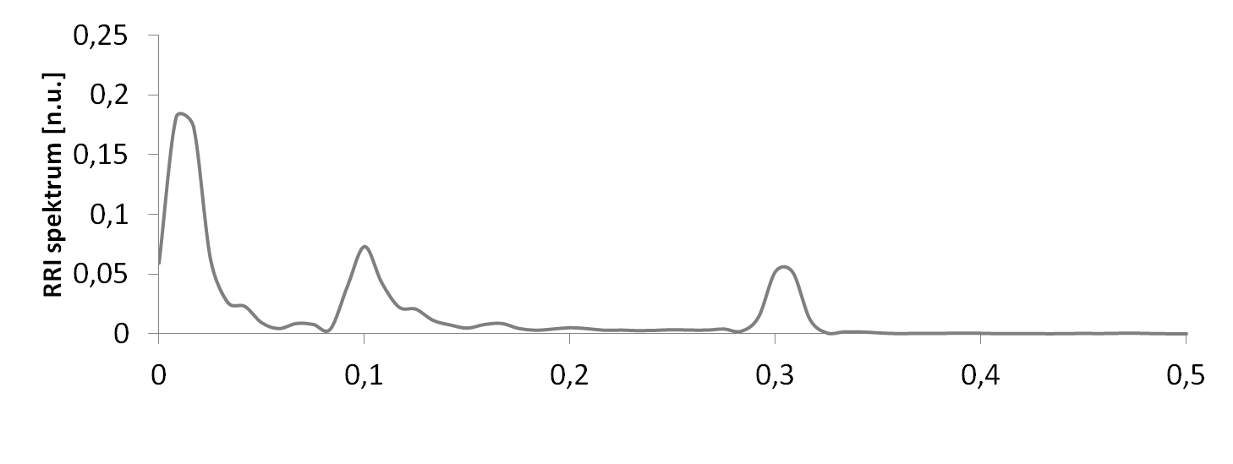
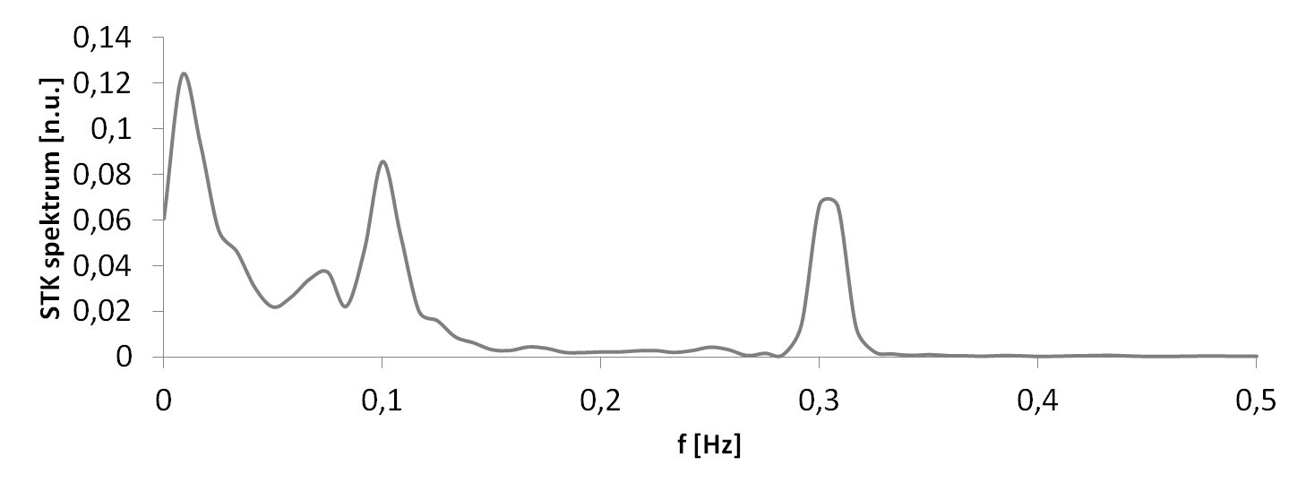
VARIABILITY of circulatory parameters
parasympathicus
sympathicus
Respirační sinusová arytmie
Baroreflex
Respiratory sinus arrhythmia
Baroreflex
Změny nitrohrudního tlaku
changes in intrathoracic pressure

Slide 42
CIRCULATORY FAILURE
The main function of circulation is keep a good organ and tissue perfusion
BP = CO x TPR
Circulatory failure is a generalized inadequate blood flow in the body that causes tissue damage due to reduced blood flow - reduced transport of oxygen (and other nutritional factors). The cardiovascular system itself (cardiac muscle, vascular walls, vasomotor system, and other parts of circulation) worsens when coming „circulatory shock“

Slide 43
CIRCULATORY FAILURE
BP = CO x TPR
CO decrease:
lower volume in circulation – lower venous return
decrease of filling pressure and by Frank- Starling principle decrease of CO
Clinical: e.g. hemorrhagic shock, hypovolemic shock
Therapy: infusion (e.g. of physiological solution)

Slide 44
CIRCULATORY FAILURE
BP = CO x TPR
CO decrease:
vasodilatation of venous system - sudden periphery vasodilatation – e.g. sudden loss of vasomotor tone : vasomotor syncope (neurogenic shock-brain damage, deep anesthesia)
emotional activation of parasympathetic signals to slow the heart and also activation of inverse sympathetic signals to dilate the peripheral vasculature : vasovagal syncope (emotional disturbance-fainting in young people)

Slide 45
CIRCULATORY FAILURE
BP = CO x TPR
CO decrease:
lower pumping function of the heart
e.g. myocardial infarction, severe dysfunction of the heart valves, cardiac arrhythmias
Resultes: cardiogenic shock
= circulatory shock, which results from the weakened ability of the heart as a pump;
(85% of people who develop a cardiogenic shock will not survive)

Slide 46
CIRCULATORY FAILURE
BP = CO x TPR
TPR decrease:
toxic vasodilatation (by histamin-allergy) – anaphylactic shock (e.g. bee sting, wasp sting)
Dysbalance of autonomy nervous system – sympathetic part – decrease of sympathetic tone of vessels

Slide 47
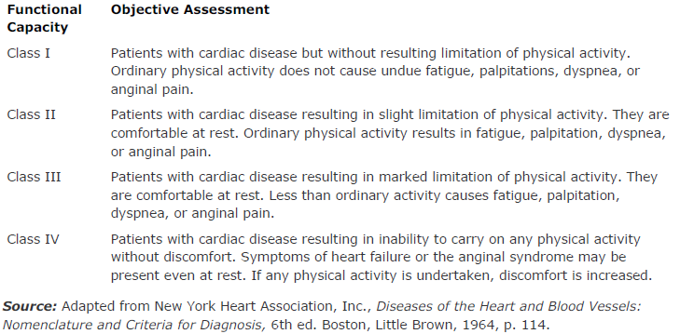
NYHA classification

