Slide 1
Smith-Lemli-Opitz syndrome

Slide 2
A case of children whose total blood cholesterol was too low

Slide 3
Case report 1
SLOS did not occur in the girl´s family
from the 7th pregnancy, the mother did not visited the gynecological department
the gestational week was find out by estimation
birth weight 2 650g, birth length 43 cm, pelvic delivery
description of the newborn: microcephaly, dolichocephaly, anteverted nostrils, hypertelorism, eyelid ptosis, gothic floor in the oral cavity, low-set dysplastic lobes, partial syndactyly of the 2nd and 3rd fingers on lower limbs, polydactyly on upper limbs
Other disabilities: atrial septal defect and left renal dystopia

Slide 4
The child was fed by tube for drinking and swallowing disorders
karyotype 46, XX - normal female
gradually developed severe retardation of verticalization
total cholesterol (Chol): 1.93..1.45..2.01 mmol / l (standard 2.6-4.8), 7- dehydrocholesterol (7-DHC) 0.53 mmol / l (standard 0)
according to the phenotype, SLOS was suspected
molecular genetic testing of DHCR7 gene was performed: genotype c. [452G> A]; [470T> C] resp. p. [(Trp151 *)]; [(Leu157Pro)]
we initiated therapy with an increased dose of cholesterol in the diet, 50 mg/kg/day, which the child tolerated clinically poorly
the girl did not thrive for a long time, she died at the age of 2 years

Slide 5
Case report 2
SLOS does not occur in the family
The child from the 1st pregnancy, spontaneous delivery in the 38th week of pregnancy, birth weight 2310g, birth length 43 cm, Apgar score in the norm
stigmatized hypotrophic newborn: microcephaly, dolichocephaly, short nose with wide root, anteverted nostrils, hypertelorism, small chin, low-set dysplastic ears, syndactyly of the 2nd and 3rd fingers on the lower limbs, polydactyly on the upper limbs, ambiguous genitalia, persistent aortic ductus and anomalous distance of the left branch of the pulmonary artery, renal anomaly (cyst)
karyotype 46, XY, normal male karyotype
from biochemical examination: Chol 1,1..0,6..1,4 mmol / l (standard 2,6-4,8), 7-DHC 0,233mmol/l (standard 0)
suspected SLOS, confirmed by molecular genetic testing of the DHCR7 gene, genotype: c. [964-1G> C]; [976G> T] resp. p. [?]; [(Val326Leu)]

Slide 6
we initiated therapy with an increased dose of cholestrol in the diet, Cholesterol Module por sol® (food pro special medical purposes), at the planned dose of 50-100 mg/kg/day
we administered ursodeoxycholic acid to improve absorption of Cholesterol Module (10-15mg/kg/ day, Ursofalk, por. sus.®), the child tolerated therapy poorly
home child care insufficient, she was placed in a children's center
for retardation of verticalization we performed rehabilitation, diet via PEG (percutaneous endoscopic gastrostomy)
signs of adrenal insufficiency not observed clinically or laboratory
at 9 months of age: hypotonic psychomotor retarded unwell infant [weight 4.2 kg, length 64 cm, head circumference 36.5 cm, (BMI 10.25; below the 3rd percentile)], whose condition is complicated by recurrent respiratory infections
ambiguous genitalia-solution according to the overall condition and the resulting perspective of the child

Slide 7
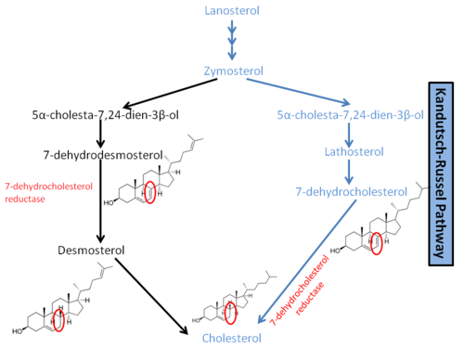
Smith-Lemli-Opitzův syndrome (SLOS) (MIM 270400)
disorder of sterol biosynthesis
multisystem diseases that are associated with dysmorphia and various types of skeletal dysplasia
in the case of SLOS it is a defect of the last step in the synthesis of cholestrol, namely a deficiency of 3β-hydroxysterol ∆7-reductase (EC 1.3.1.21), which is caused by mutations in the DHCR7 gene (602 858)
the inheritance of the disease is autosomal recessive
the estimated incidence of the disease is 1: 20,000-40,000 children

Slide 8
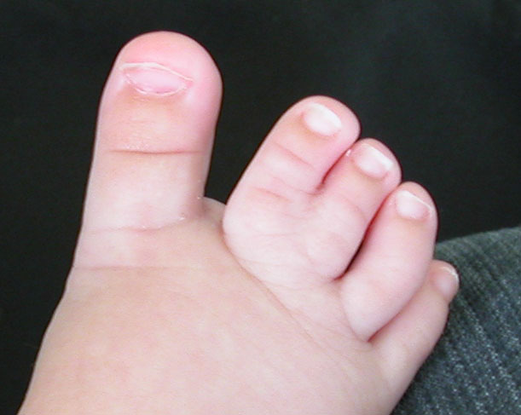
Symtoms
growth retardation
usually low birth weight
craniofacial dysmorphia (microcephaly, micrognation, anteverted nostrils, ptosis, hypertelorism, low set ears, wide gaps between teeth)
strabismus
syndactyly, postaxial polydactyly, short thumbs and orthopedic defects of the lower limbs
congenital heart defects, lungs anomalies, anomalies of the external and internal genitalia, adrenal insufficiency, renal impairment (renal agenesis, cysts, hydronephrosis), congenital defects of the digestive tract
mental disability
behavioral disorders, learning difficulties, sleeping disorders, autism

Slide 9
a typical laboratory symptom is a decrease level of total cholesterol and an increase in 7-dehydrocholesterol in the blood
hypocholesterolemia is defined as an abnormally low concentration of cholesterol in the blood below the 5th percentile due to age, sex and race
in children, the lower limit is most often considered to be 2.8 mmol/l, resp. 2.5 mmol/l,
about 10% of patients with SLOS may have normal total cholesterol levels
confirmation of dg.: molecular-genetic examination of the DHCR7 gene
pathological sequence variants are the most common in our population: c.452G> A, formerly termed p.W151X (35% of population), non-sense, c.976G> T, formerly designated p.V326L (28% of population), missense, and c.964-1G> C, formerly known as IVS8-1G> C (11% of population), splicing mutation.
pathological sequence variants of c.452G> A and c.964-1G> C are very difficult and the prognosis of their carriers, and therefore also of our probands, is not favorable.
Treatment: increased dose of cholesterol, bile acids, possibly statins (simvastatin)

Slide 10
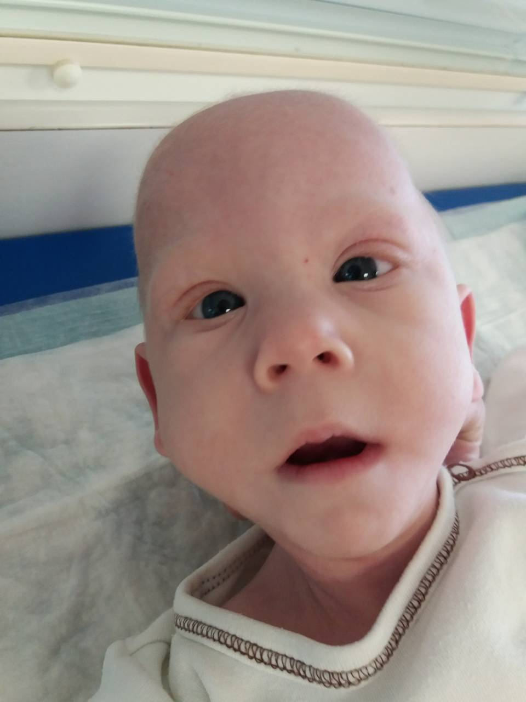
https://ex.fnbrno.cz/owa/#
SLOS: craniofacial dysmorphia-microcephaly, micrognation, short nose with wide root, anteverted nostrils, hypertelorism, low set ears

Slide 11
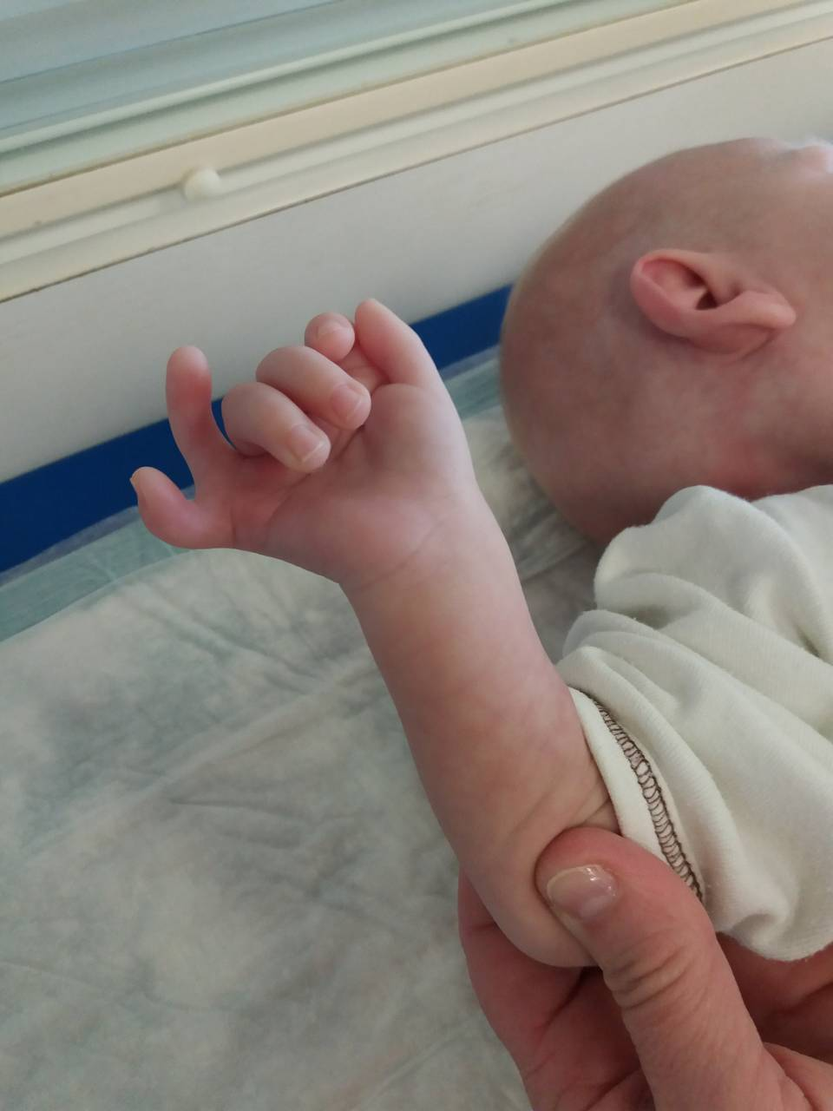
SLOS: polydactyly on the upper limb

Slide 12
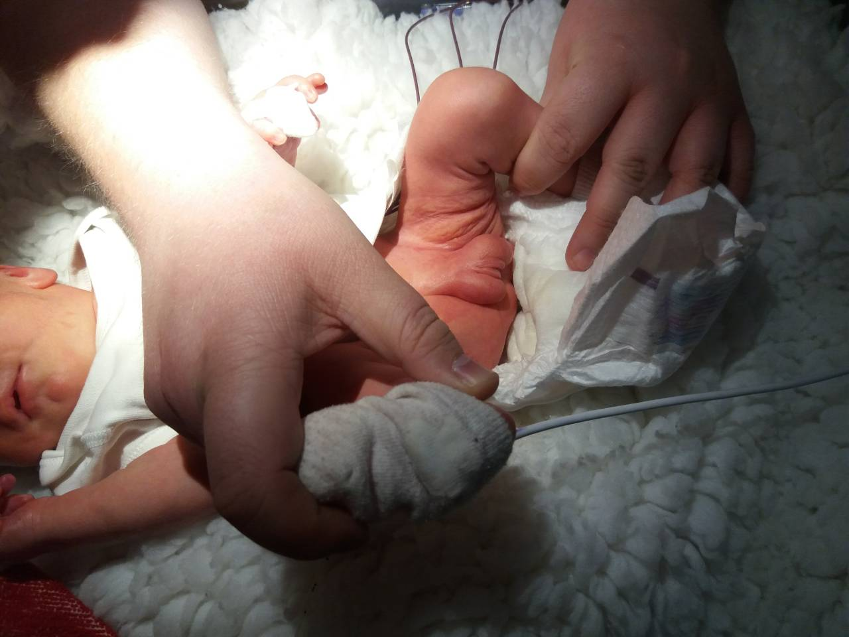
SLOS: external genitalia of the ambiguous type

Slide 13
SLOS has a wide range of phenotypic manifestations from multiple severe congenital malformations to mild psychomotor developmental disorders with insignificant abnormalities
the ability to perform molecular genetic confirmation of the diagnosis is essential for the family of the affected child
examination is crucial for genetic counseling and possible future prenatal or preimplantation diagnostics
the causal treatment of SLOS is unknown

