Slide 1
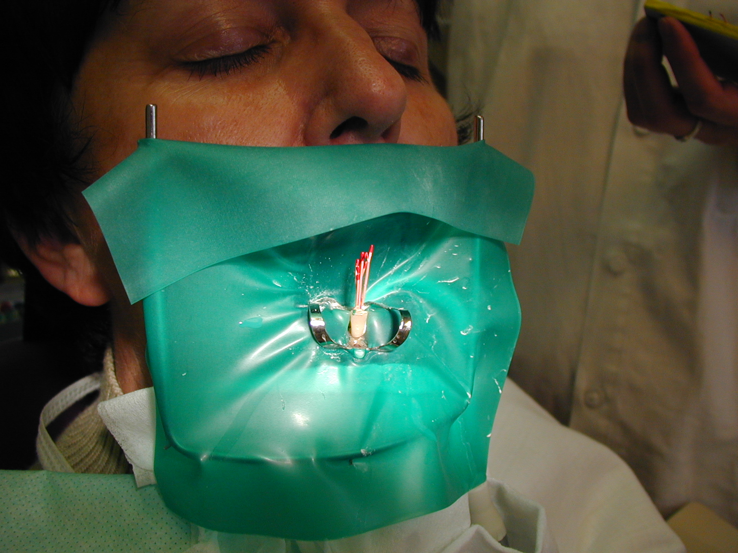

Slide 2

Root canal filling

Slide 3
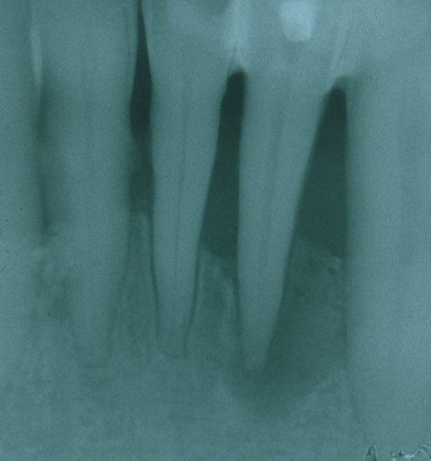
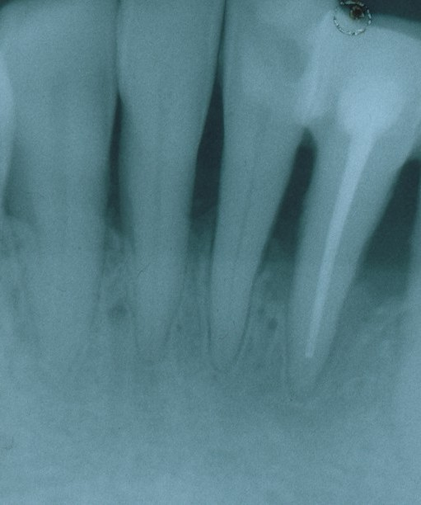
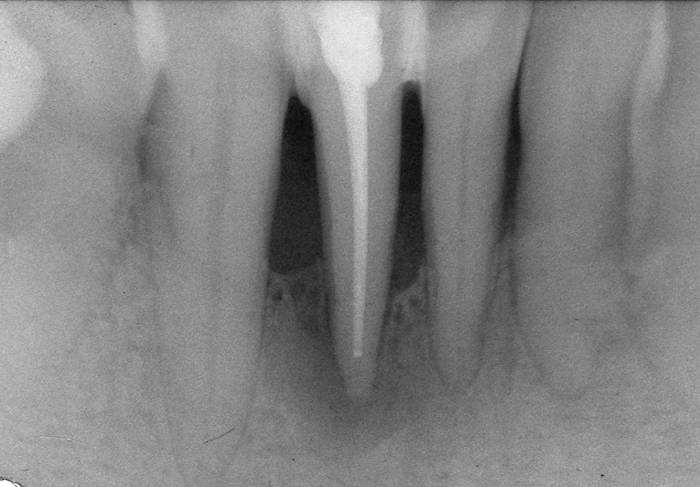
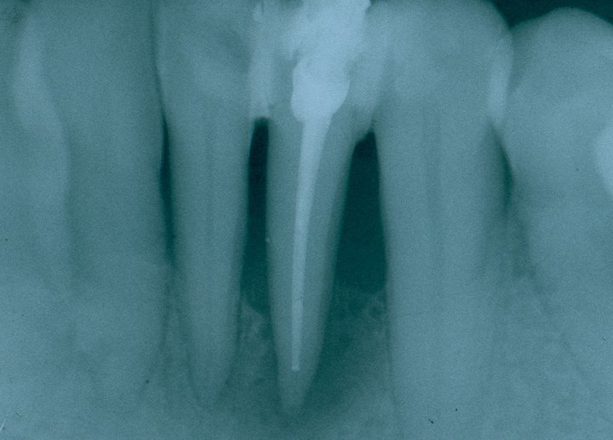
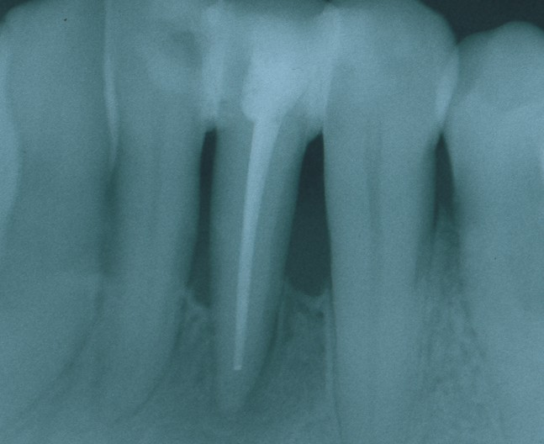

Slide 4
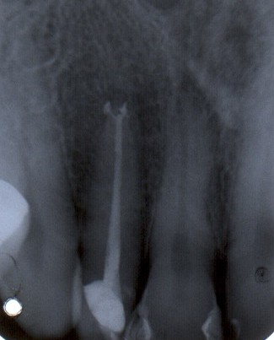
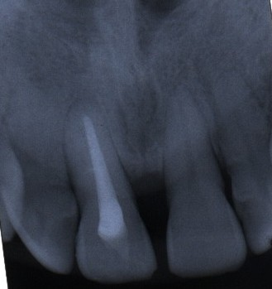
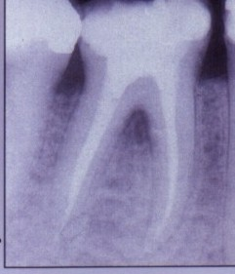

Slide 5
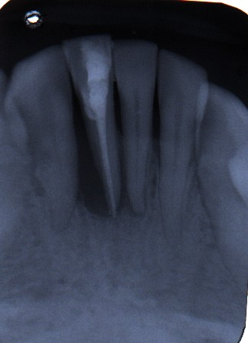
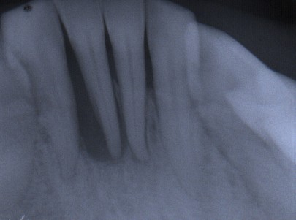
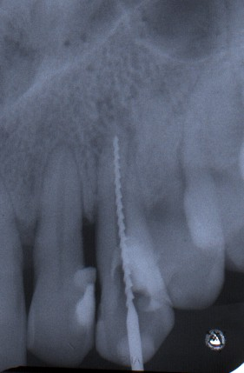
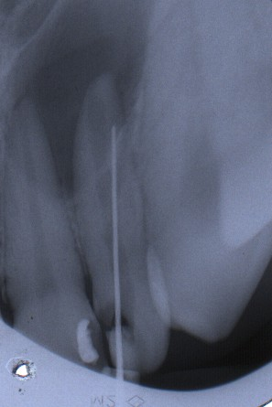
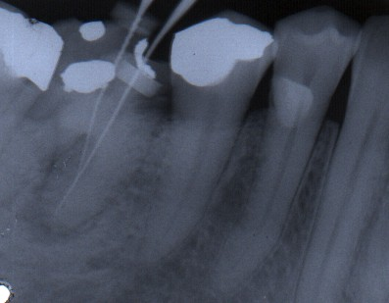

Slide 6
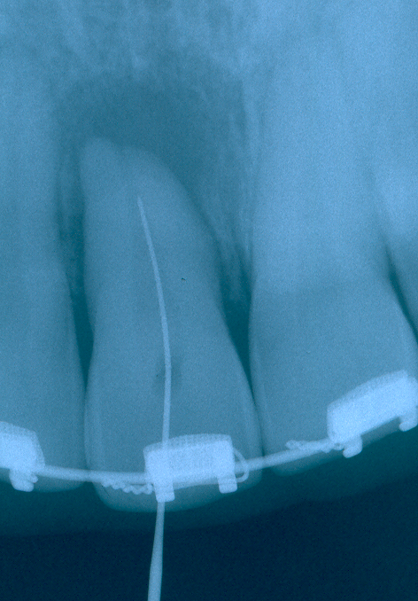
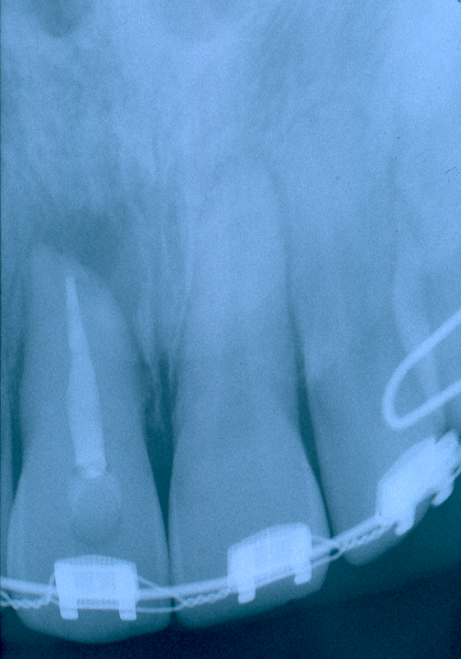

Slide 7
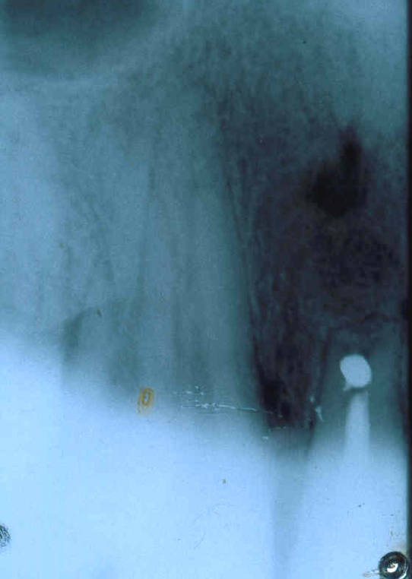
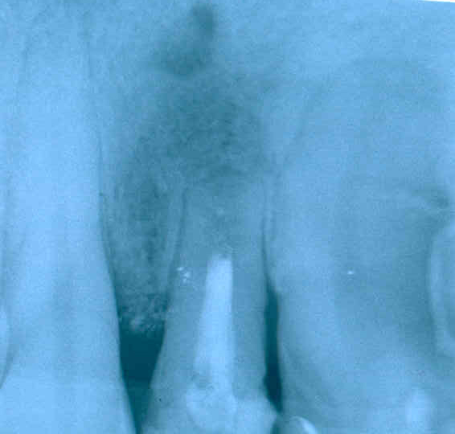
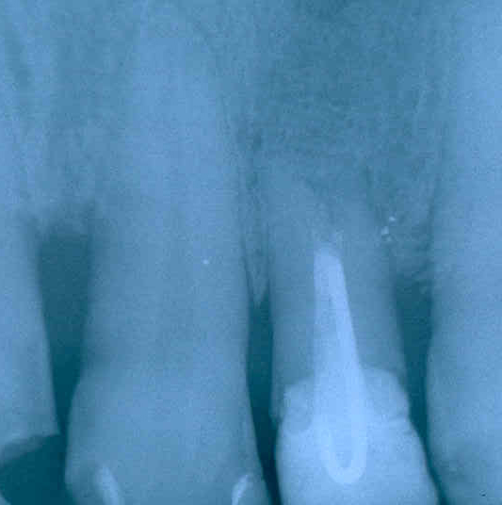
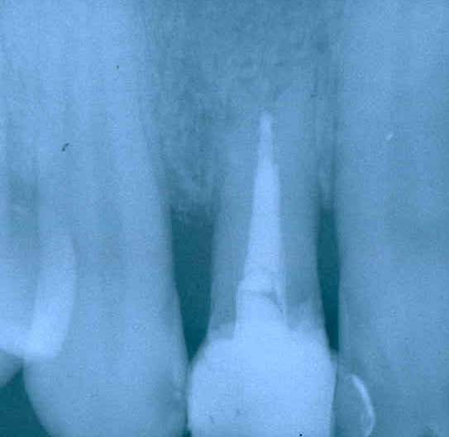

Slide 8
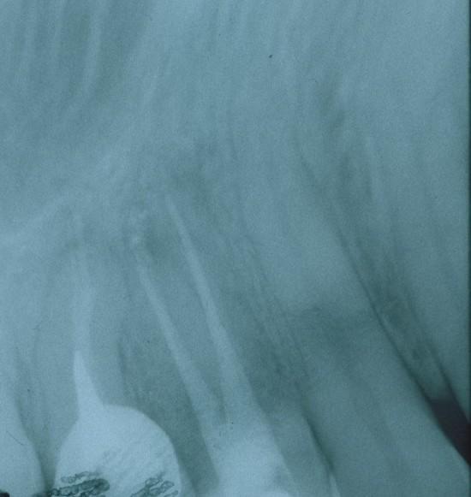
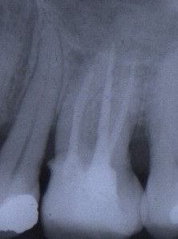
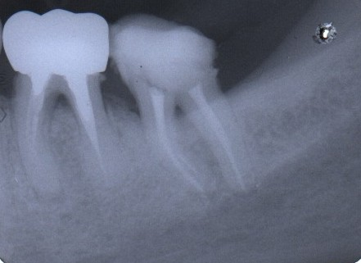

Slide 9
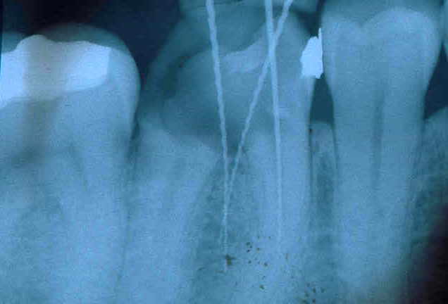
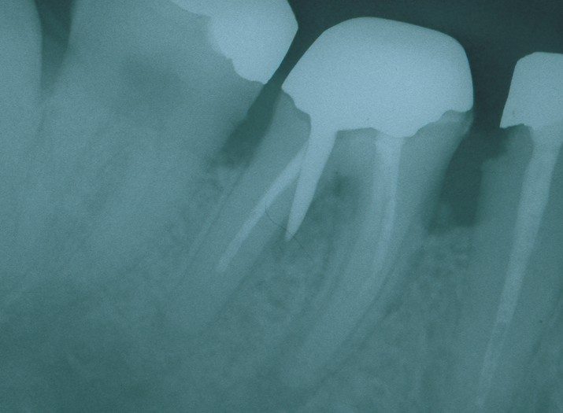
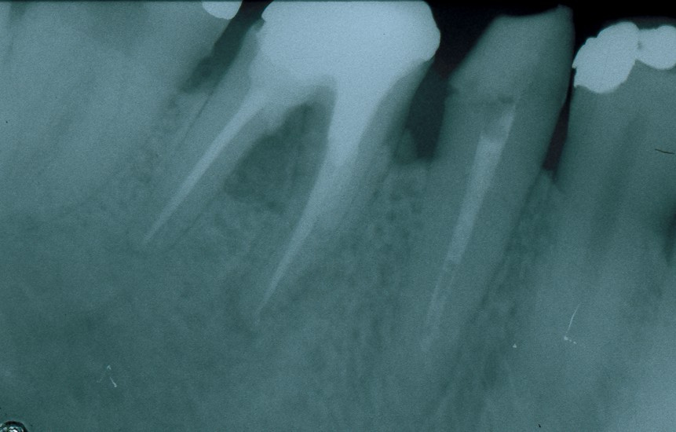

Slide 10
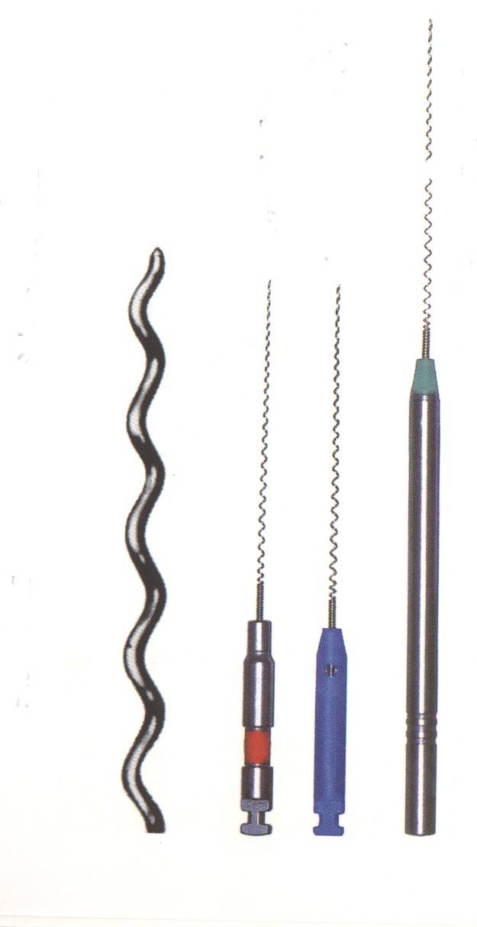
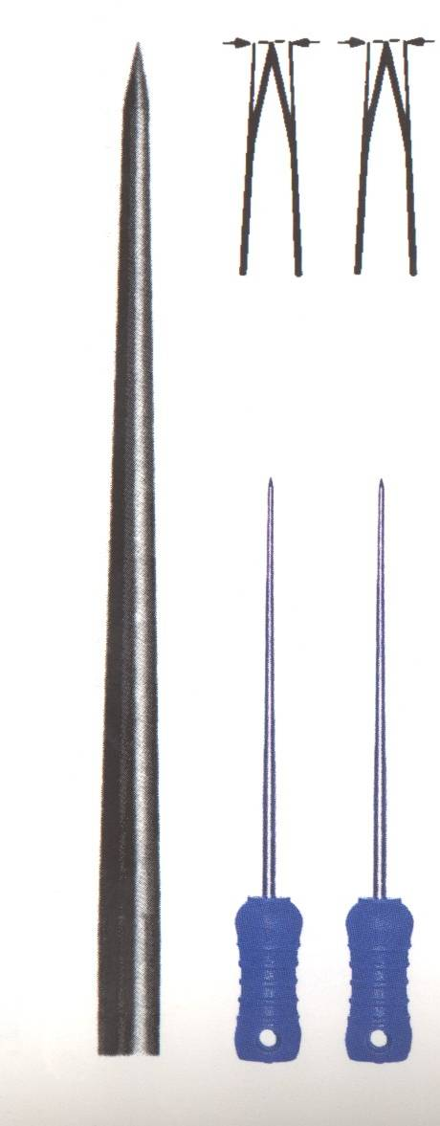
Lentulo
Spreader

Slide 11
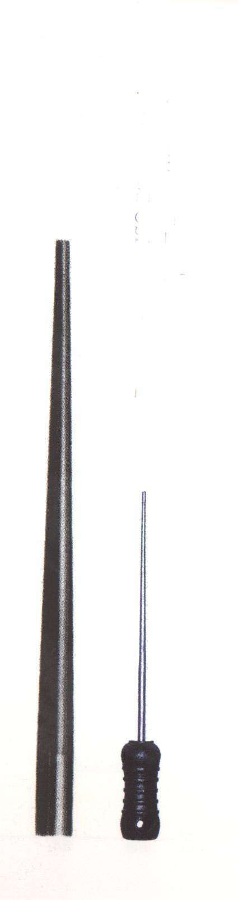
Plugger - compactor

Slide 12
Root canal filling
Guttapercha
Sealer

Slide 13
Root canal filling

Slide 14
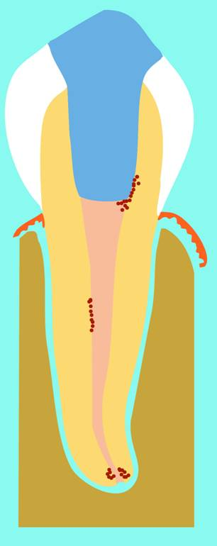
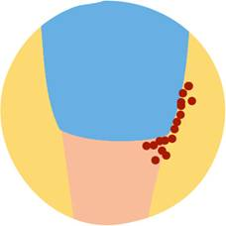
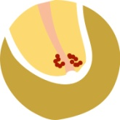
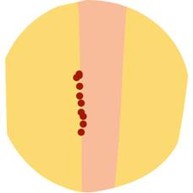
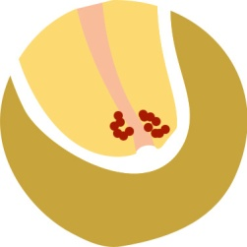
Root canal filling
1
  Good coronal,
  Middle
  Apical seal.
2
3
Quality guidelines for endodontic treatment,
European Society of of Endodontology (ESE), 1994

Slide 15
Root canal fillings
Sealers
Cones
Guttapercha
Resilon
Silver/titanium
Pasts
Zinkoxid
eugenol
Polyketons
Epoxy
resins
Glasionomers
Calcium
hydroxide
Silicons
Composits/
adhesives

Slide 16
Ideal root canal filling
(Grossman 1988)
Easy mixing
Sufficient working time
Good seal
X- ray contrast
Easy removal
No shrinkage
Long term volume stability
No bacterial growing
No permeability for fluids
Biocompatibility
No staining

Slide 17
Classification of root canal fillings
Solid
Semisolid
Pastes

Slide 18
Guttapercha
Dried juice of the Taban tree (Isonandra percha)
(gutta)
1,4 - polyisoprene
Crystallin structure (60%)
Brittle

Slide 19
Guttapercha
Beta phase
Alpha phase 42 – 49 °C
plastic
Gamma phase 56 – 62° (amorfní)
Cooling process
very slowly (less than 0,5°C) – alpha phase
normal cooling– beta phase

Slide 20
Composition of guttapercha materials in endodontic
Guttapercha 19% – 22%
Zinc oxide 59 - 79%
Heavy metal salts 1% - 7%
Wax or resin 1% - 4%

Slide 21
Resilon
(Pentron)
Thermoplastic synthetic polymer
Points or material for injection
Composition:
Polyester polymers
Bioactive glass
Radioopaque fillers (bismuthum oxichlorid a and
baryum sulphate)

Slide 22
Silver or titanium cones
No good seal
Silver cones - corrosion

Slide 23
Sealery
Chemically curing plastic materiáls
Good adhesion to root canal walls as well as solid cones
X- ray contrast
Biocompatibility

Slide 24
Sealers
Zinc Oxide-Eugenol
Chloropercha
Calciumhydroxide
Resins
Glasionomer
Silicone

Slide 25
Sealers
Importance
Filling of the spaces between the solid cones
Seal of the root canal filling

Slide 26
Zinc - Oxid Eugenol
Powder:
Zinc oxide
Liquid:
Eugenol
Acidic resins
Good adhesivity, antimikrobial effect, cytotoxic. resorbable)

Slide 27
Zink Oxid Eugenol sealers
Pulp Canal Sealer (Kerr, USA))
Tubuli- Seal (Kerr, USA)
Caryosan (Spofa Dental, ČR)

Slide 28
Chloropercha
Powder
Canadian balsam
Resins
Guttapercha
Zinc oxide
Liquid:
Chloroform
Resins

Slide 29
Chloroperča
Vlastnosti:
Good adhesivity
Shrinkage
Toxicity

Slide 30
Calciumhydroxide sealers
Base ( powder)
Calcium hydroxide
Zinc oxide
Other components and vehicula

Slide 31
Kalciumhydroxidové sealery
Catalystr (paste)
Zinc stearat
Titanium dioxide
Baryum sulphate
or
Eugenol,. Eukalypt
others

Slide 32
Kalciumhydroxide sealers
Increase of the healig potential of periapical tissues
Antibacterial effect
Easy manipulation
But!
Resorbable if not homogeneus
Not suitable for the single cone technique

Slide 33
Resins
Rezorcin formaldehyd
Epoxide
Polyketone
Metacrylate

Slide 34
Rezorcin – formaldehyd resins
Toxicity
N2, Endomethason, Riebler´s paste, Foredent

Slide 35
Epoxide resin
Base (powder, paste)
Bismuth oxid
Titanium dioxide
Hexametylentetramine
(Silver)
Catalyst (liquide, paste)
Bisphenoldiglycidylether

Slide 36
Epoxid resin (advantages)
Long working time
Hydrophilic (good penetration)
Good adhesion to the root canal walls
Volume stability
No dissolution
Antibacterial

Slide 37
Epoxidové pryskyřice
(disadvantages)
Difficult removal
Staining
Initiatiory roxicity
No suitable for the single cone technique !

Slide 38
Polyketone
Base
Zinc oxide
Bismuth phosphate
Hexametylentetramine
Liquid
Bisphenolglycidylether and other components

Slide 39
Polyketon resins
Advantages
Good adhesion
No contraction
No dissolution
Disadvantages
High stickness
Not removable
Products: Diaket, Diaket A (3M ESPE)

Slide 40
Methacrylate resins
Endo ReZ (Ultradent) – UDMA
For injection – single cone technique
Epiphany (Pentron)
Bis- GMA, etoxy bif- GMA, hydrophilic bifunctional
methacrylates
Calcium hydroxide, baryum sulphate, baryum glass
silica.
Sealer in combination with Resilon

Slide 41
Glasionomer sealers
Base (powder)
Aluminium silicate glass
Liquid
Polyacrylic acid, polymaleic acid, tartaric acid

Slide 42
Glasionomer sealers
(Advantages and disadvantages)
Advantages:
Curing under wett conditions, chemical bonding to hard
dental tissues, no staining
Disadvantages
Short working time, difficult removal,
porous
Products
Ketac Endo (3M ESPE), Endion (VOCO)

Slide 43
Silicon based sealers
Polyvinylsiloxane (ev. in mixture with powdered
guttapercha
Biocompatibility
Hydrofillic
Further investigation desirable.

Slide 44
Root canal filling
A cone inside the sealer – core material
Guttapercha
Resilon
Silver cones
Custom cones

Slide 45
Root canal filling
Guttapercha
Trans isomer of polyisoprene
2 crystalline forms (alpha, beta)
Beta – room temperature
Alpha after heating
Various process of cooling
Extremly slow cooling: Aplha phase recrystalize.
65°.
Less shrinkage, more dimensionally stable

Slide 46
Root canal filling
Guttapercha
20% gutta-percha
65% zink oxide
10% radioopacifiers
5% plasticizers

Slide 47
Root canal filling
Guttapercha
Cones: conventional and standardized sizes
Conventional: dimension of the tip and body
Standardized cones are designed to match the
taper of the instrument.

Slide 48
Root canal fillings - forms
Points (Cones)
Materials for injection
Plastic materials

Slide 49
Instruments
Lentulo
Compactors
Compactors - carriers
Others

Slide 50
Lentulo
delivers pastes
1,5 – 2 mm ahead
at most for Ca (OH)₂

Slide 51
Compactors
Spreader
Pointed
Vertical introduction
Lateral condensation
technique

Slide 52
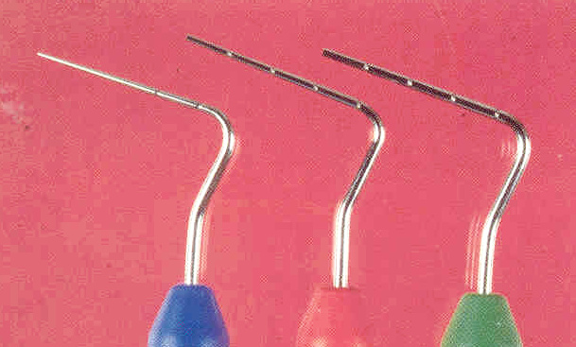
Compactors
Plugger
Not pointed
Vertical introduction
Vertical condensatuion
- compaction

Slide 53
Filling techniques
Cold
Warm

Slide 54
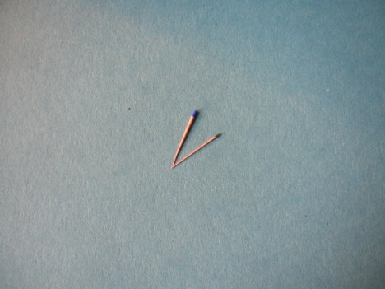
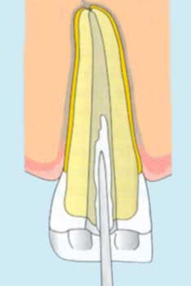
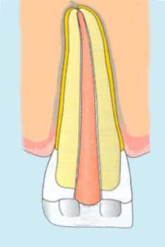
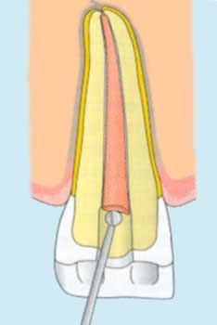
Single cone technique
Easy
Fast
Good control of WL
Standard round preparation – risk of leakage
Wesselink, P.: Root filling techniques, Textbook of Endodontology; p. 286-299,
Blackwell Munksgaard 2003, Oxford

Slide 55
Paste only
Shrinkage, difficult removal

Slide 56
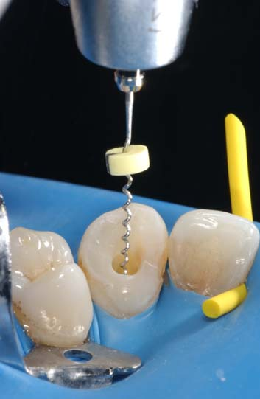
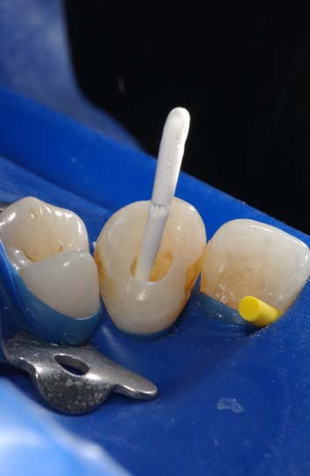

Slide 57
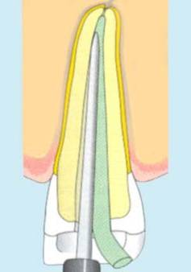
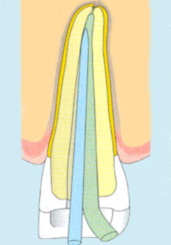
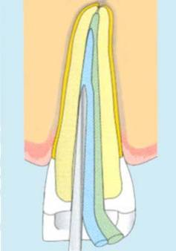
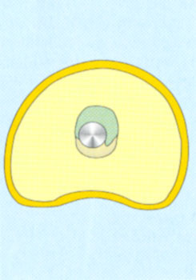
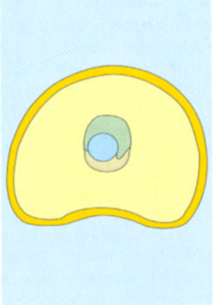
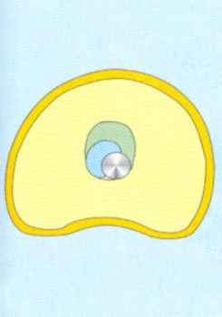
Lateral condensation
Lateral compaction
Standard cold technique
Wesselink, P.: Root filling techniques, Textbook of Endodontology; p. 286-299,
Blackwell Munksgaard 2003, Oxford

Slide 58
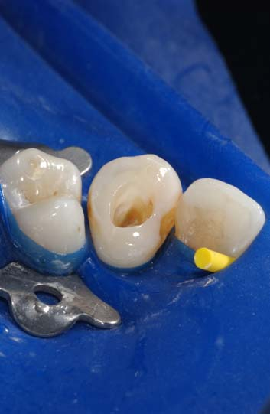
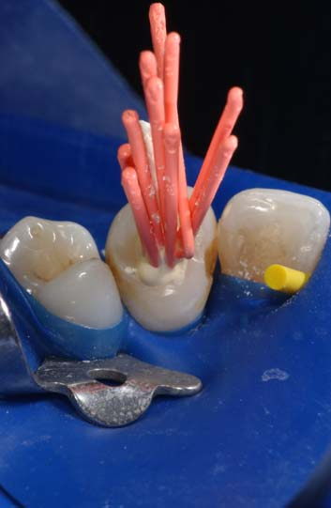

Slide 59
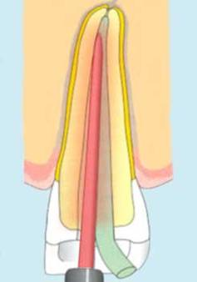


Warm lateral condensation

Slide 60


Slide 61
Laterální kondenzace
Centrální čep

Slide 62






Vertical condensation

Slide 63


Slide 64
Injection
Rychlá technika
Možná extruze sealeru
Teplo

Slide 65


Perfektní hermetický uzávěr i u kanálků s nepravidelným tvarem

Slide 66




Fáze plnění 2. Backfill
BeeFillem hermeticky uzavřeme a zaplníme zbývající část kanálku kulatého i oválného a uzavřeme postranní ramifikace ve vrchních částech kanálku.

