Slide 1
Operating microscope in endodontics
Clinical morphology of root canal system
Restorative dentistry
Endodontics II.
15.4.2021

Slide 2
Dentistry
Working field is limitated to small space of oral cavity.
Difference in size of dental instruments and size of hand of dentists.
Magnification increases amount of visual informations -> increased precision.

Slide 3
History of magnification
1876 oftalmologist Edwin Seamisch started using binocular loupes in general surgery.
1978 started development of special microscope for use in dentistry.
1981 DentiScope
1990 Dr Gabriele Pecora presented for the first time use of DOM during root apectomy with retrograde obturation.
1990 Garry Carr introduced DOM with galileans optics.

Slide 4
Possibilities of magnification
Reduce the distance between the object and eye
Loupes
Dental operating microscope

Slide 5
Working distance
It is determined by high -> individual parameter.
Ergonomical perfect position.
Focusing object of interest into working distance.

Slide 6
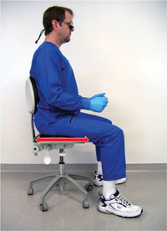
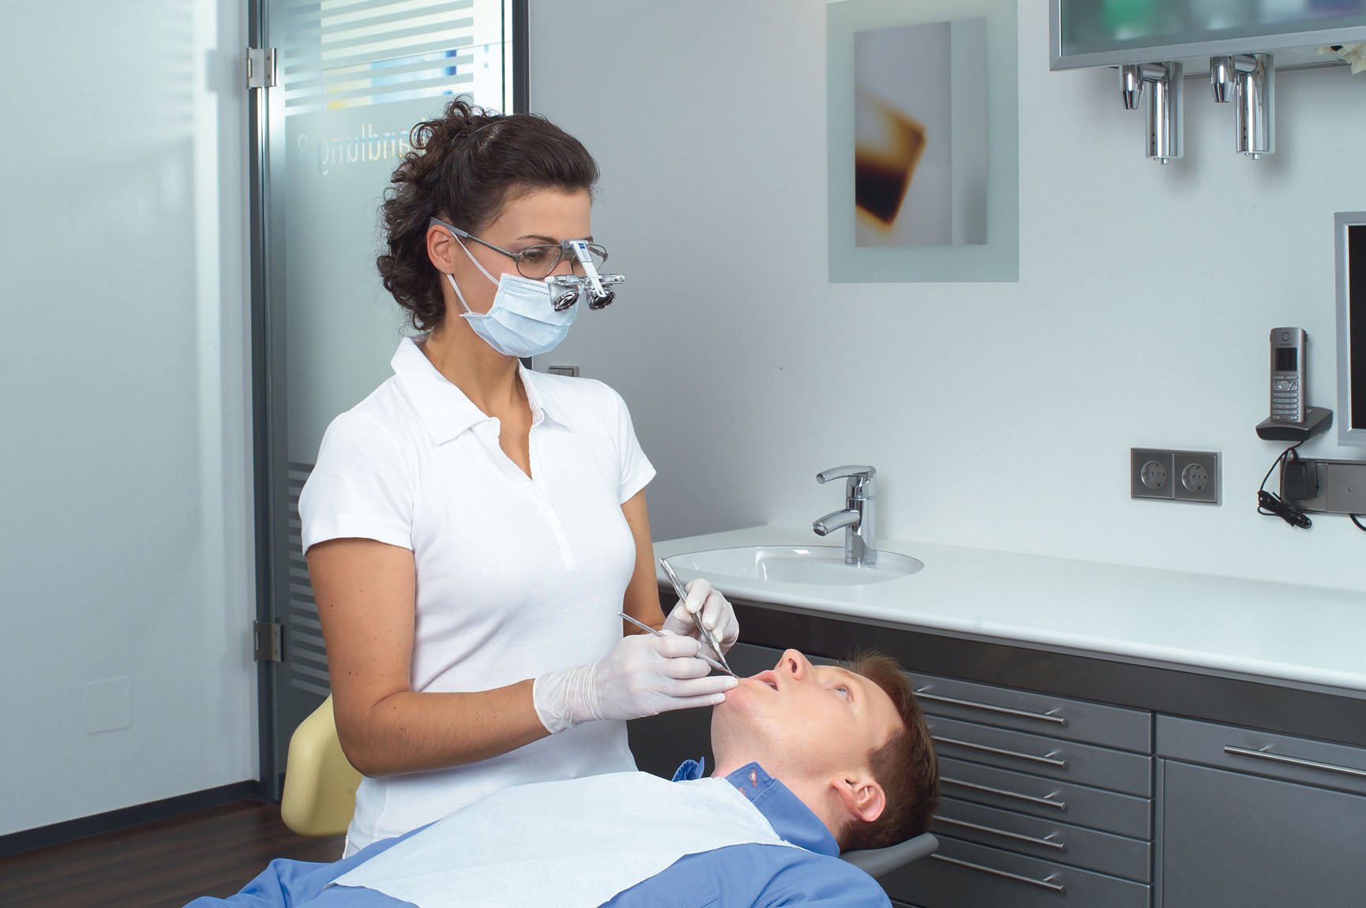

Slide 7
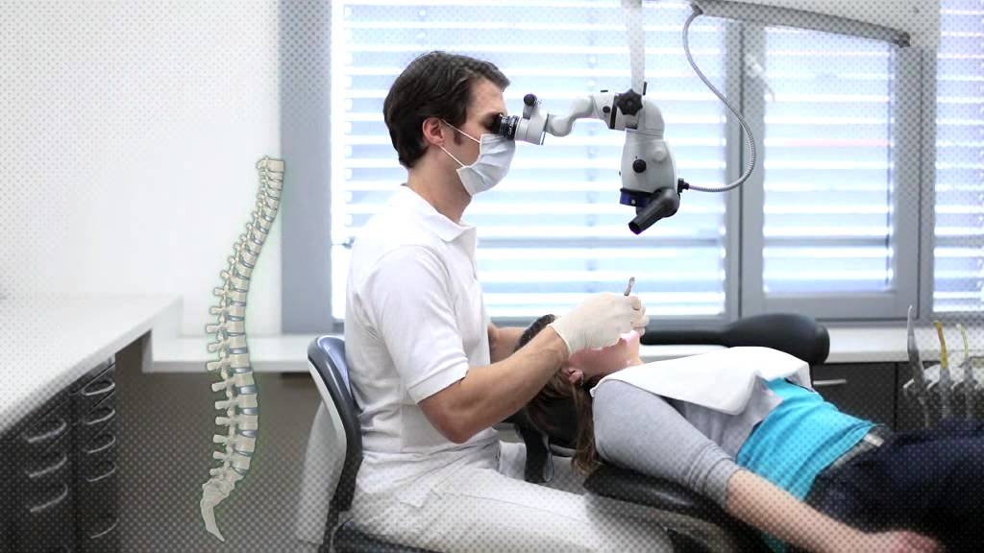

Slide 8
Depth field
Effective focus range
It is the distance between the nearest and farthest objects in a scene that appear acceptably sharp in an image.

Slide 9
Human eye
It can detect maginal ridge of size 0,2mm.
It can control hand movement in 1-2mm precision.
Minimal focusing distance is 15cm.
Magnification only by bringing eye closer to point of interest.
From practical point of view bring face of dentists to the face of patients is not possible.
Ability eye to focus to close objects decrease with age.
Low level of ergonomics.

Slide 10
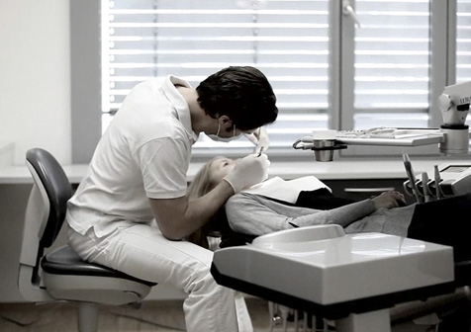

Slide 11
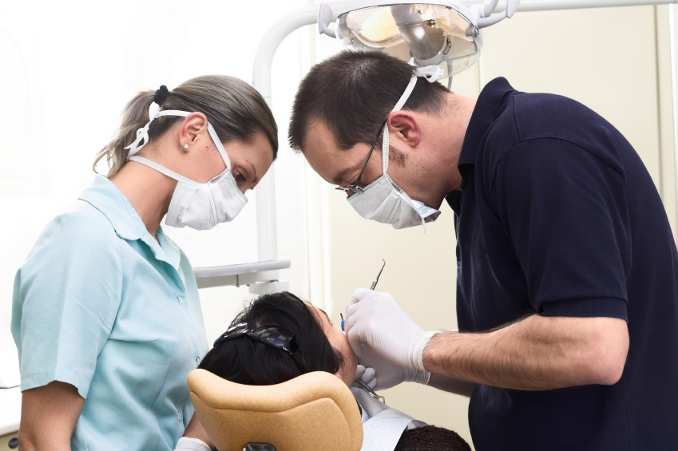

Slide 12
Loupes
Allows to focus to one object.
Working distance and magnification determined by construction of loupes.
Eye convergence -> not suitable for long period of time.

Slide 13
Loupes
Galilean design
Prizmatic – Kepler design

Slide 14
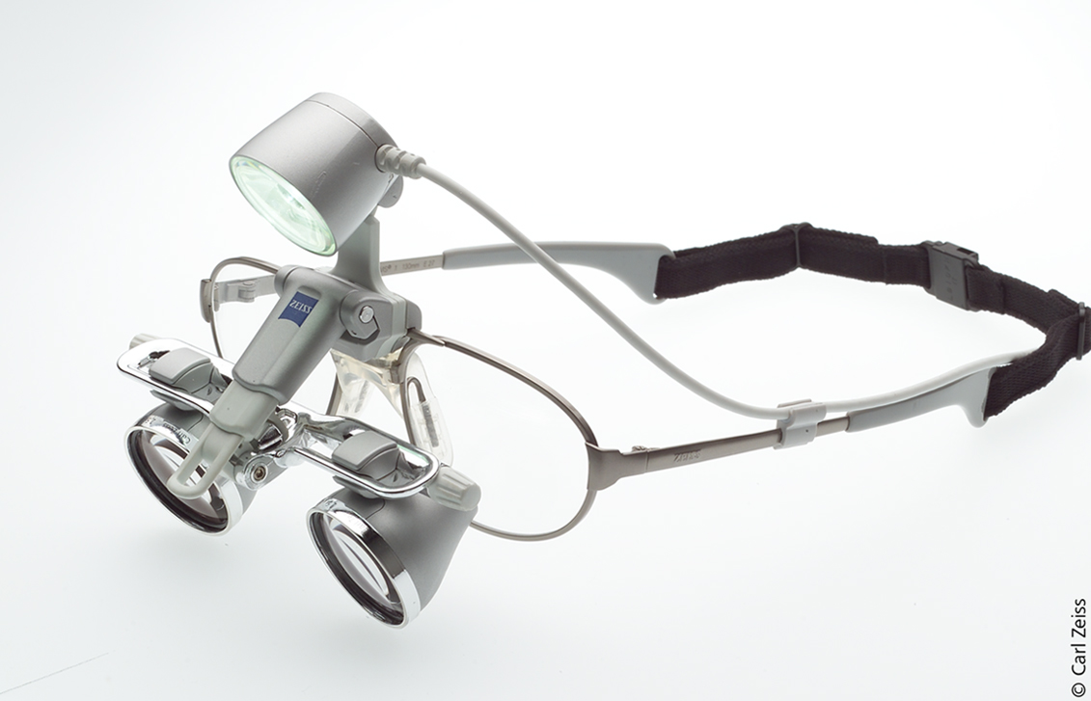
Galilean design
Wider field of view
Lighter
Magnification limited
Optical aberations?

Slide 15
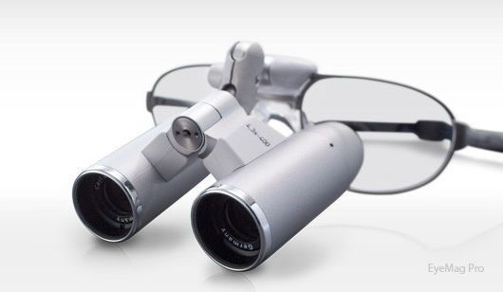
Prizmatic – Kepler design
Bigger construction
Supreme quality of optical system
Heavier
Magnification up to 6x

Slide 16
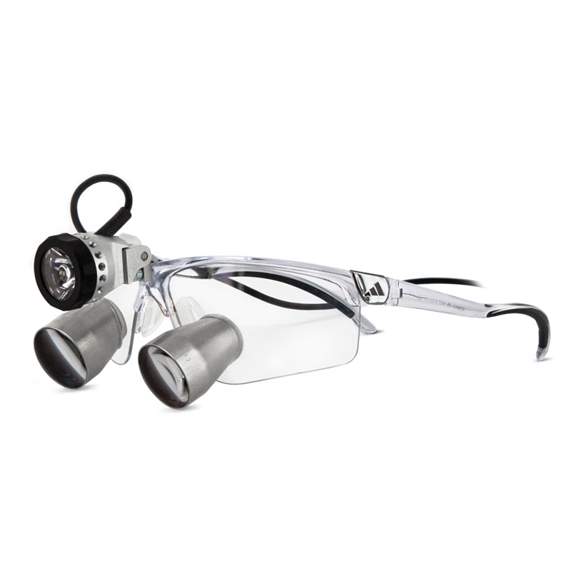
TTL – throught the lens

Slide 17
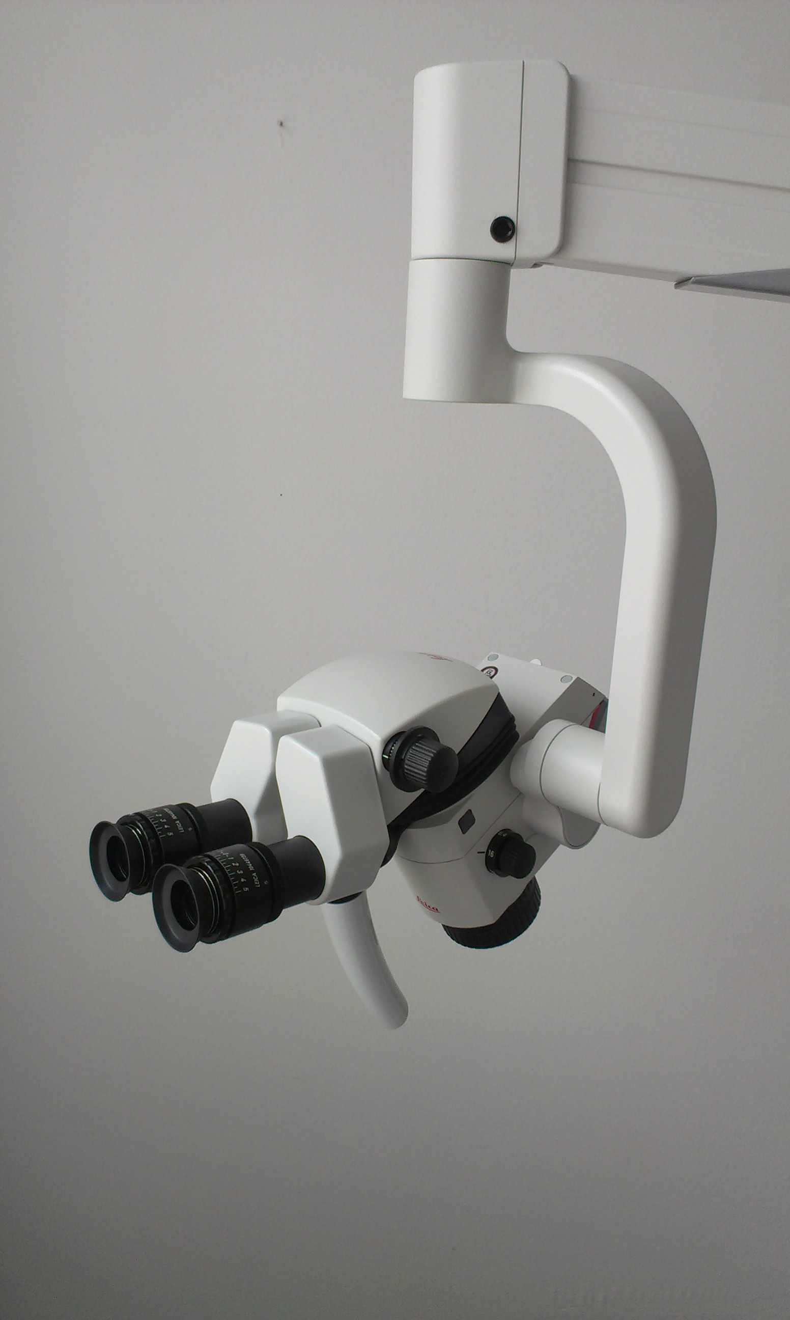
Dental operating microscope
Magnification 4x-40x
High cost
High performance magnification.
Four hand dentistry
At 20x human eye can differentiate detail 0,006 mm.
At 20x magnification we can control hand movement
in range 0,01 – 0,02 mm.

Slide 18
Advantages of using DOM
Ergonomics
Quality of treatment
Comunication with patients
Documentation
Marketing

Slide 19
Ergonomics

Slide 20
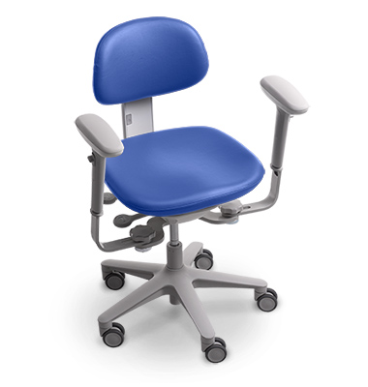

Slide 21
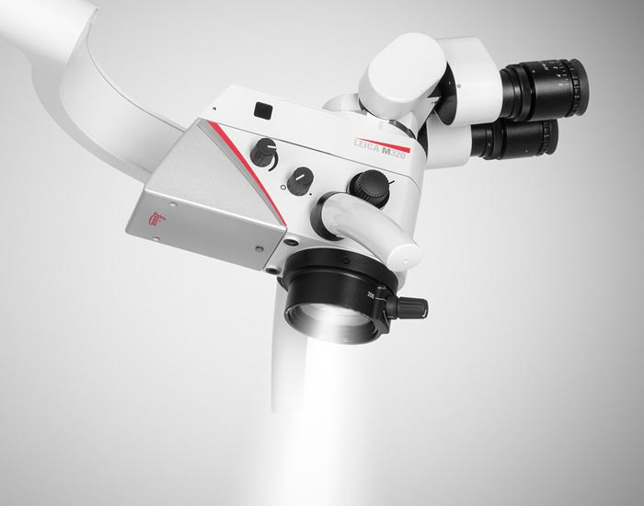

Slide 22
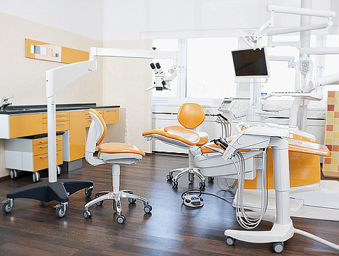
Mounting DOM
Notes:
https://www.youtube.com/watch?v=DW9Q5UNAEsI

Slide 23
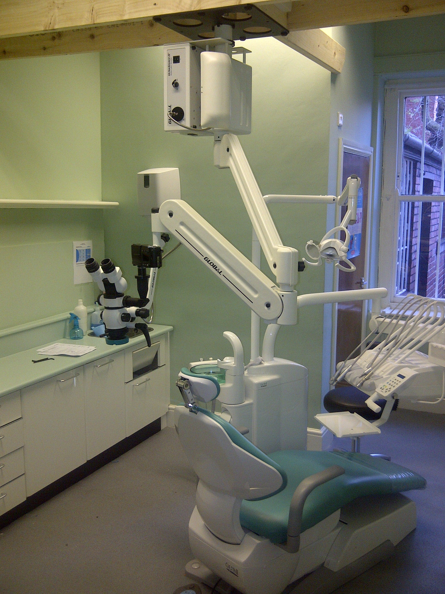
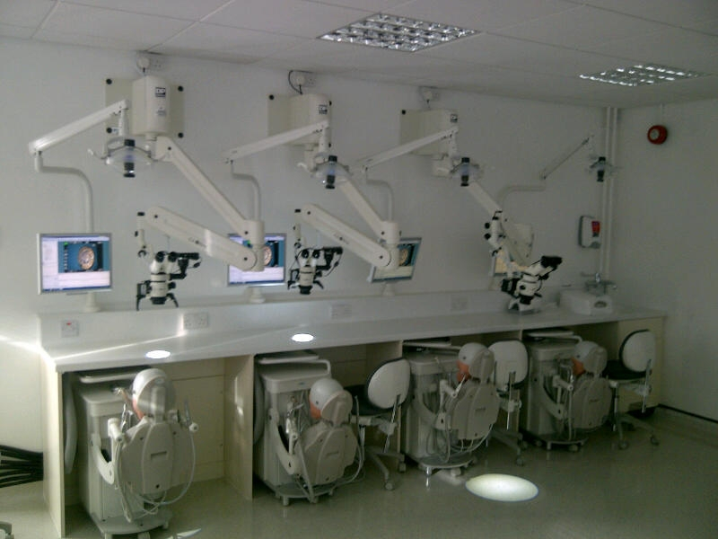

Slide 24
Accessories
Beam splitter for assistance or for camera.

Slide 25
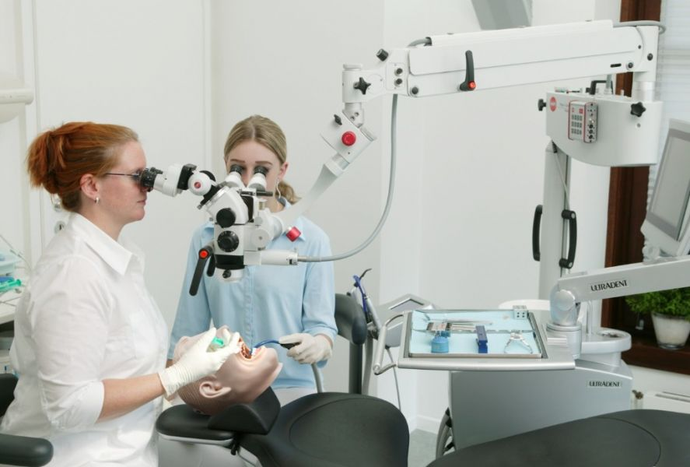

Slide 26
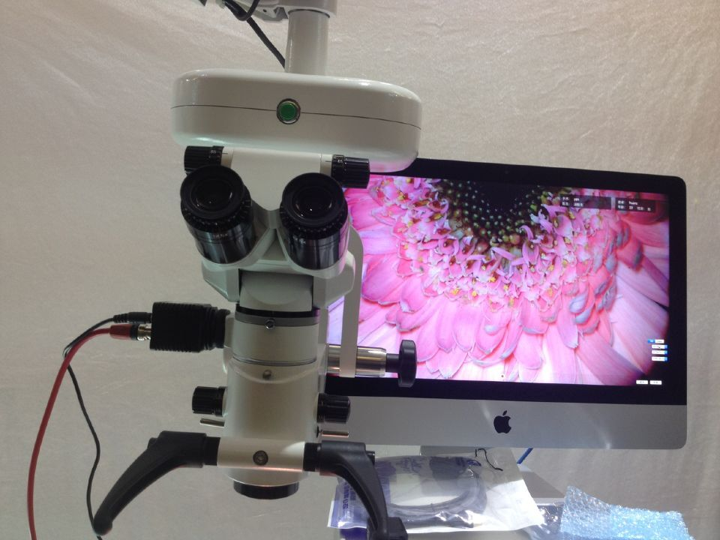

Slide 27
Way of communication
Photography
Video
Live streaming of treatment or examination

Slide 28
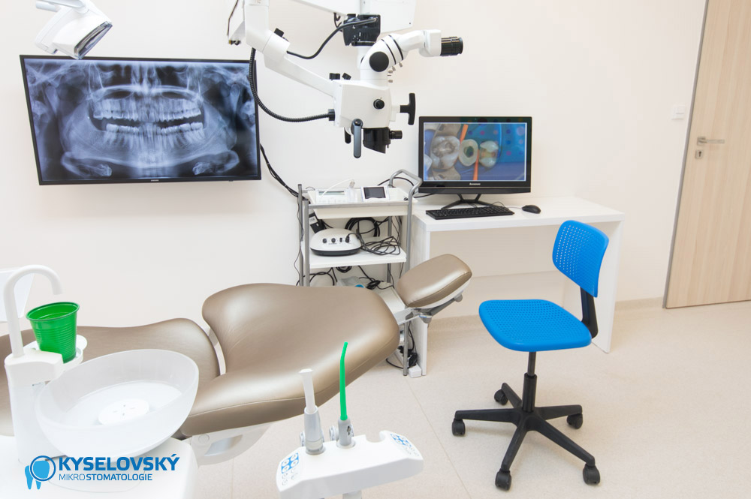

Slide 29
Documentation
Photography and video
Patients files
Analysis of treatment protocols

Slide 30
Dental operating microscope in dentistry
Direct illumination of operation field.
Easier and accurate identification of root canal orifices.
Identification of root canal anomalies.
Minimal invasive approach.
Lower fatigue.
Communication with patient.

Slide 31
Clinical morphology of root canal system

Slide 32
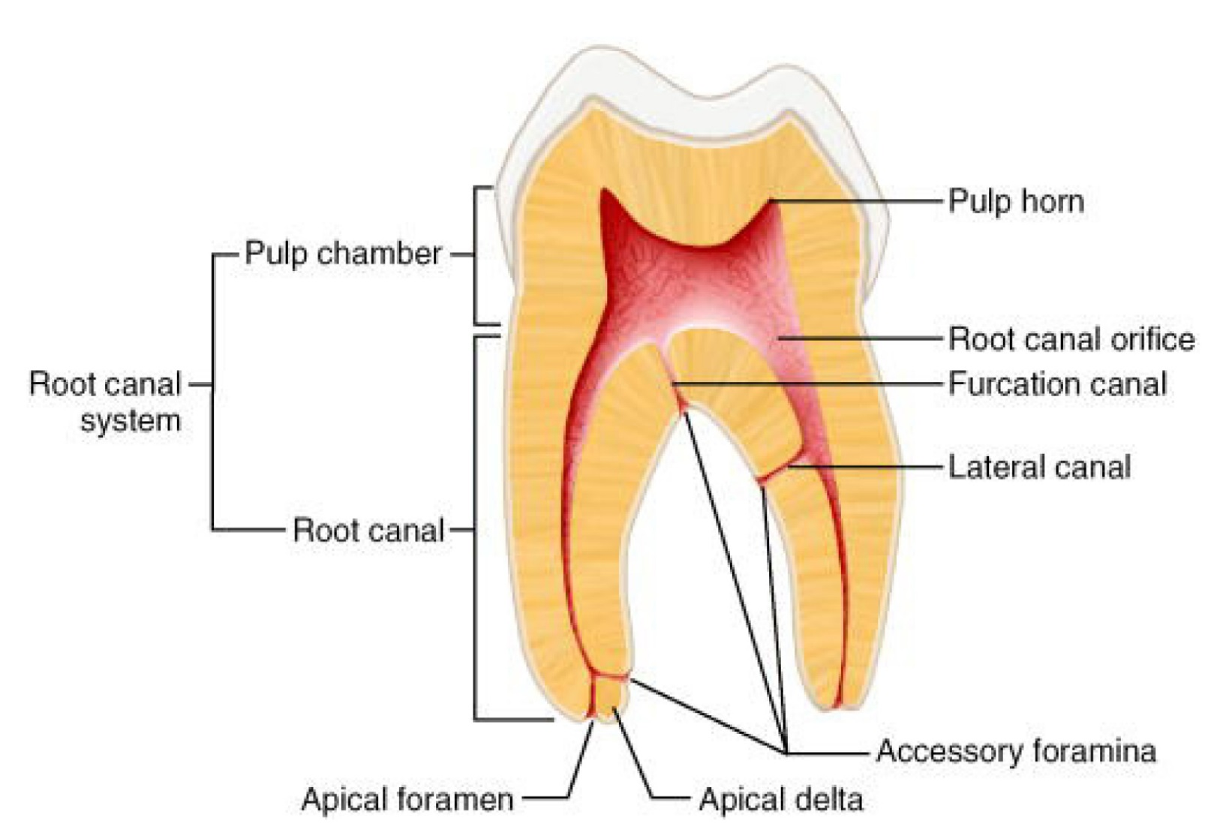
Terminology

Slide 33
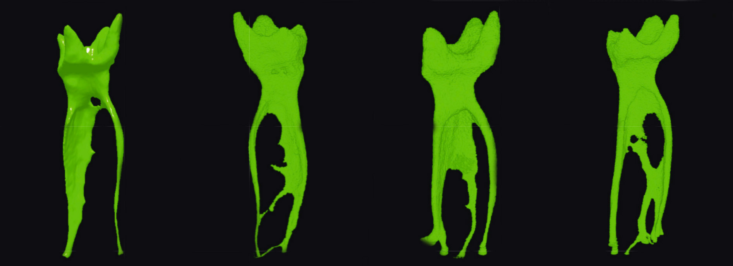
Root canal doesn’t run in straight line, usually its mesially curved. It can split in branches, not rounded diameter.

Slide 34
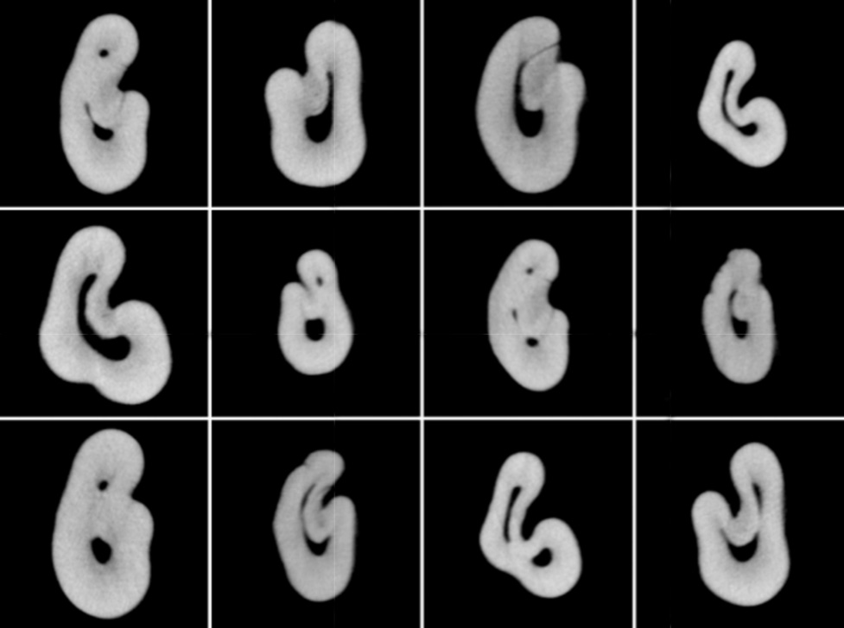

Slide 35
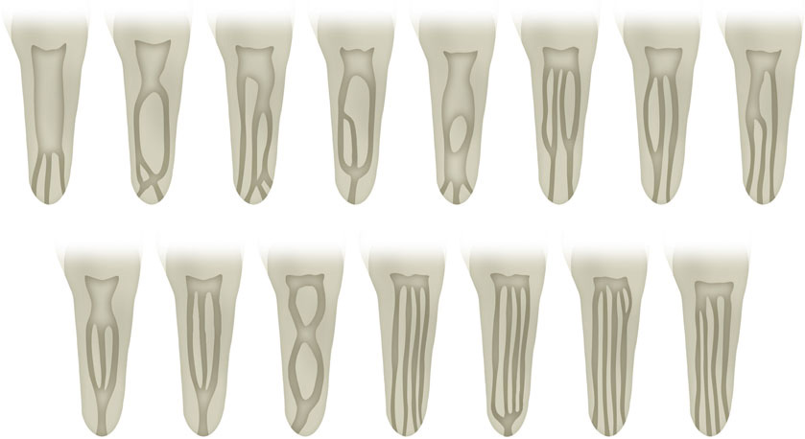

Slide 36
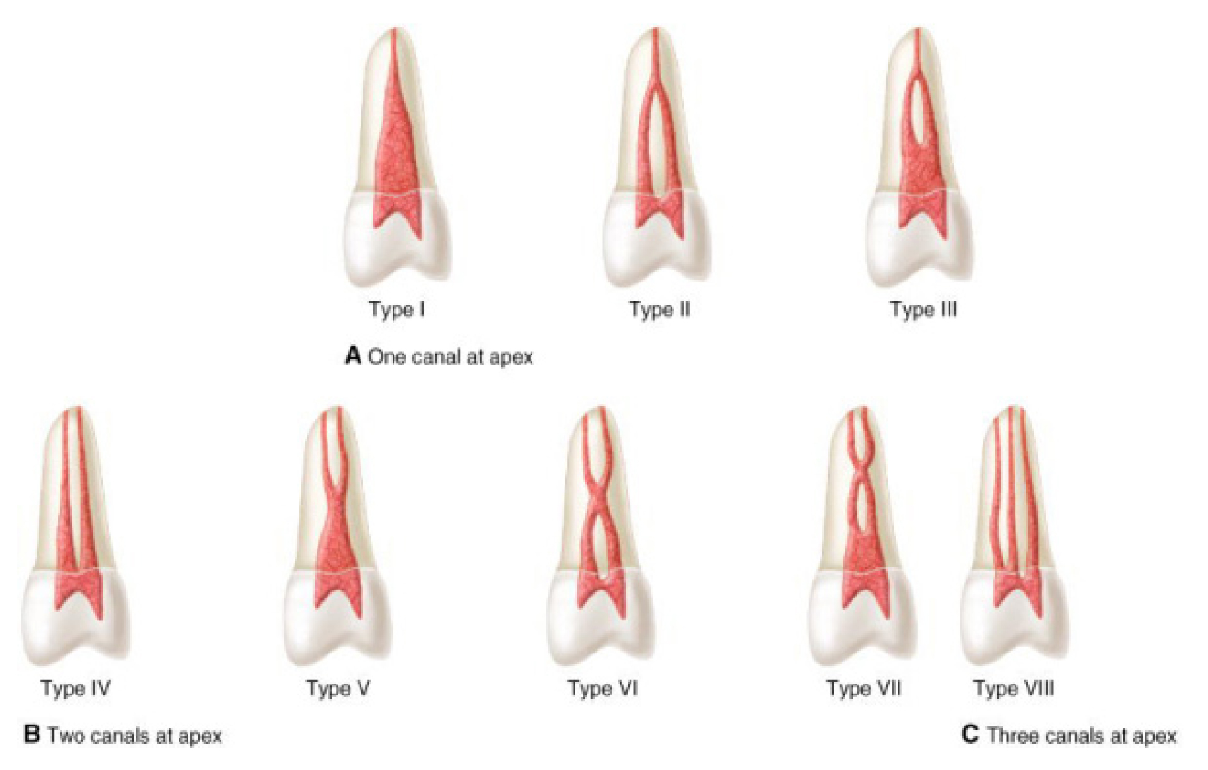

Slide 37
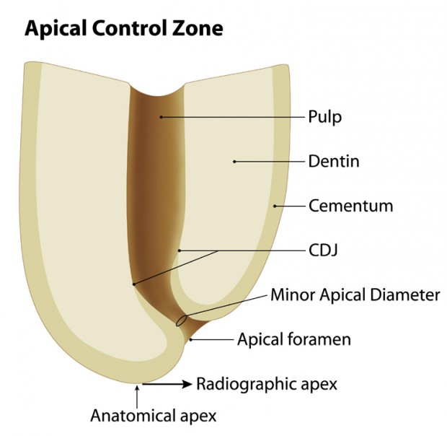
Apical anatomy
http://theendoacademy.com/wp-content/uploads/2013/04/apex-LargeType-001-620x604.jpg

Slide 38
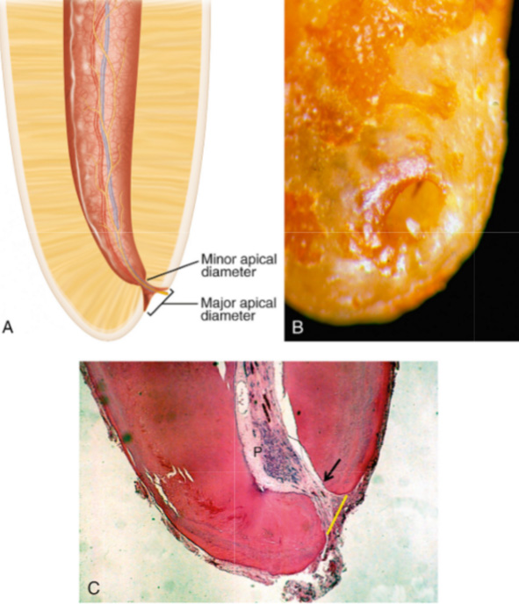
Apical anatomy

Slide 39
Guidelines for localization orifices of root canals
Centrality: The floor of the pulp chamber is always located in the center of the tooth at the level of the CEJ.
Symmetry: Except for the maxillary molars, canal orifices are equidistant from a line drawn in a mesiodistal direction through the center of the pulp chamber floor. Except for the maxillary molars, canal orifices lie on a line perpendicular to a line drawn in a mesiodistal direction across the center of the pulp chamber floor.
Color change: The pulp chamber floor is always darker in color than the walls.
Orifice location: The orifices of the root canals are always located at the junction of the walls and the floor; the orifices of the root canals are always located at the angles in the floor-wall junction; and the orifices of the root canals are always located at the terminus of the roots’ developmental fusion lines.
More than 95% of the teeth these investigators examined conformed to these spatial relationships

Slide 40
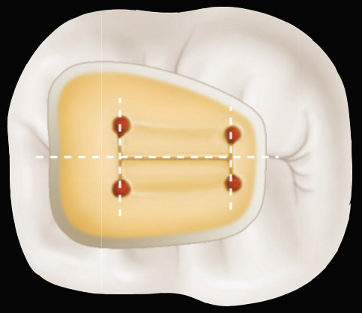

Slide 41
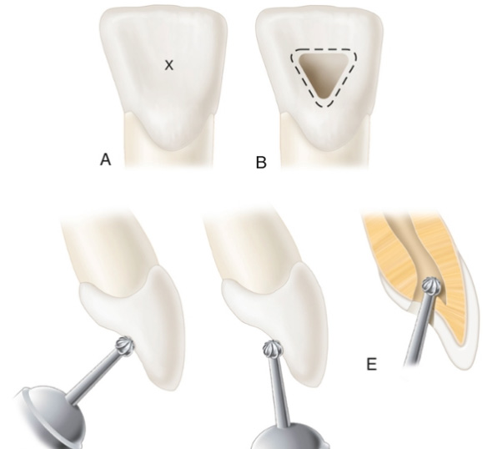

Slide 42
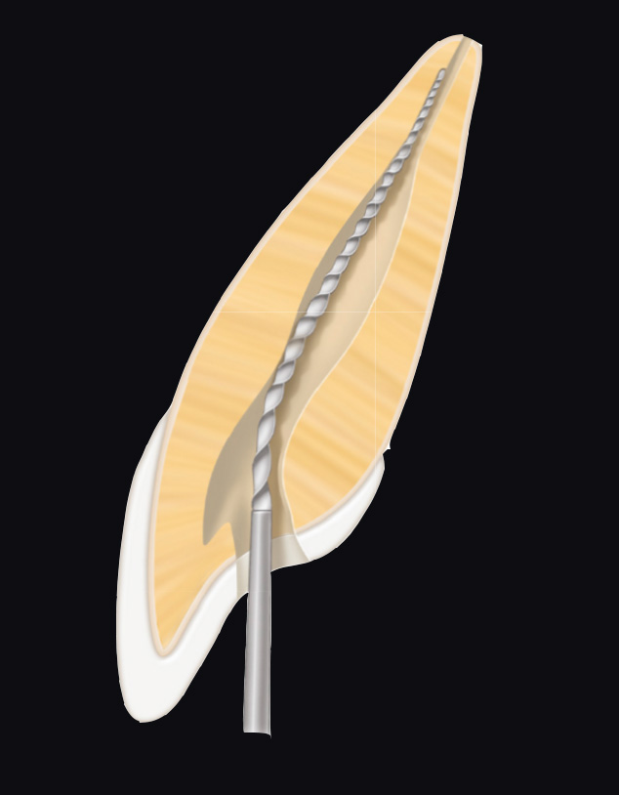
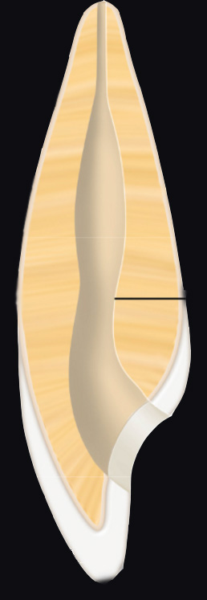

Slide 43
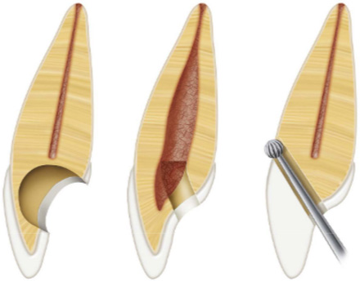
Failures during access preparation

Slide 44
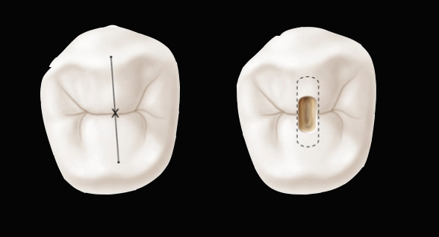
Opening access is localized on line between vestibular and oral cusp.

Slide 45
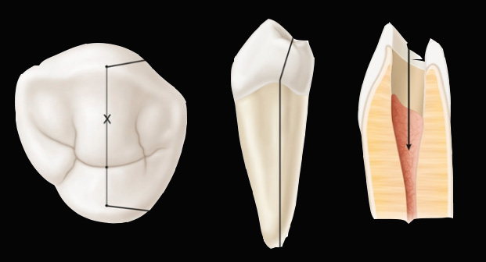
For lower premolars the opening access must respect lingual inclination of crown.

Slide 46
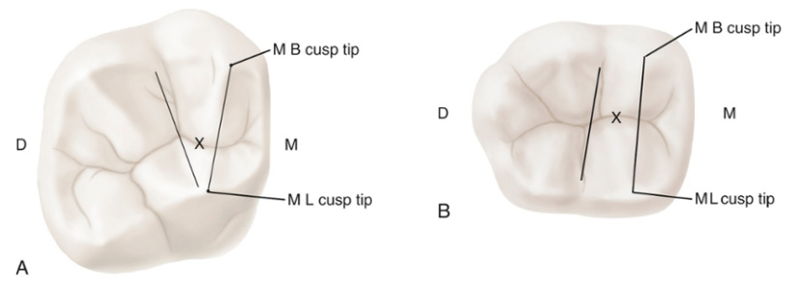
For molars the correct starting location is on the central groove halfway between the mesial and distal boundaries.

Slide 47
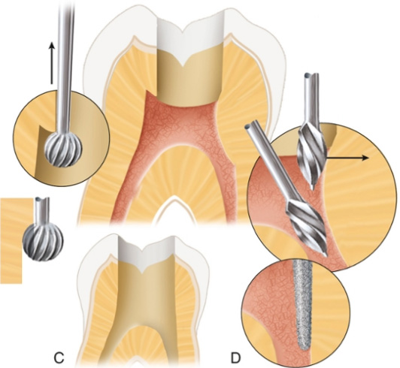
Completly remove roof of pulp chamber.
Straight line access into root canal.

Slide 48
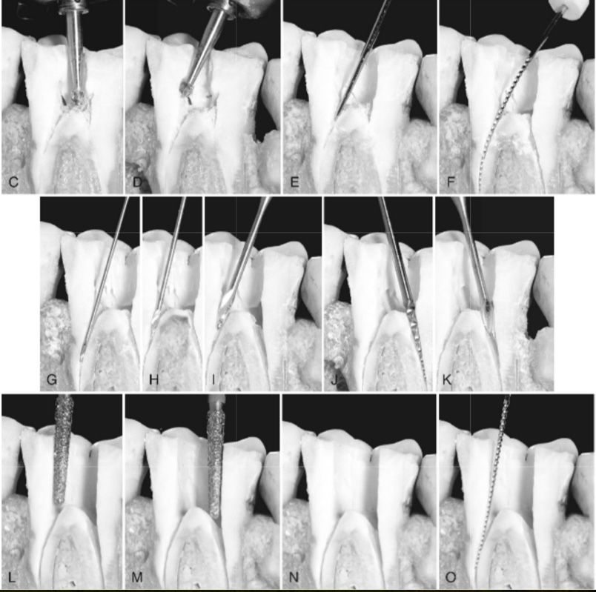

Slide 49
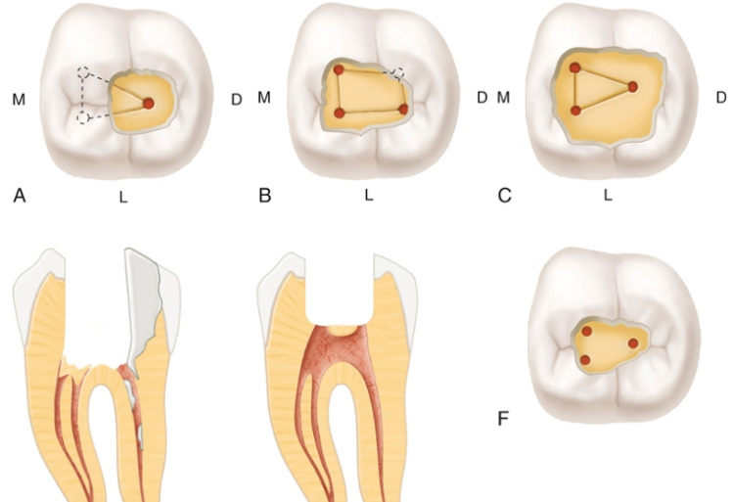
Failures during access preparation

Slide 50
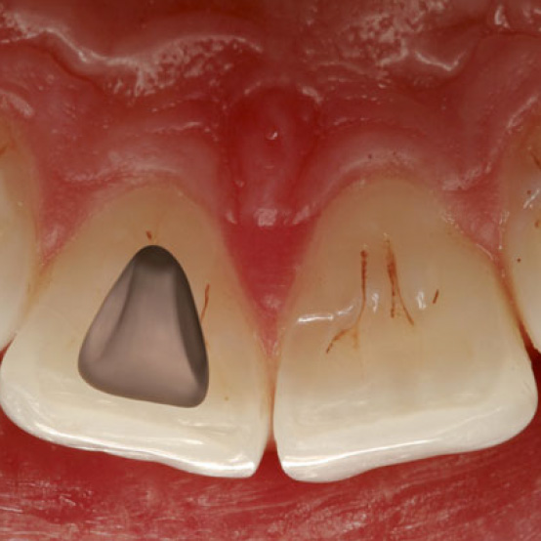
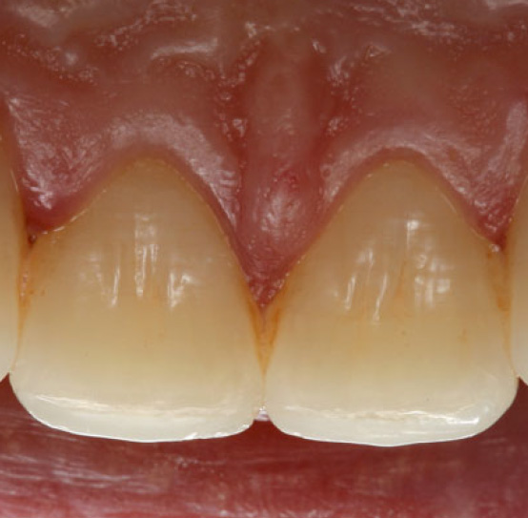
Maxillary central incisor
The access cavity has triangular outline.
1 root – 1 root canal

Slide 51
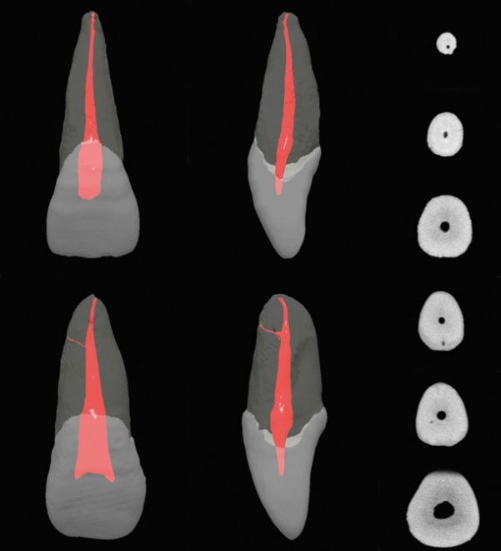

Slide 53
Maxillary central incisor
Length of tooth | 23,5mm
Length of crown | 10,5mm
Length of root | 13mm
Width of crown | 8,5mm
Width of cervical area | 7mm

Slide 54
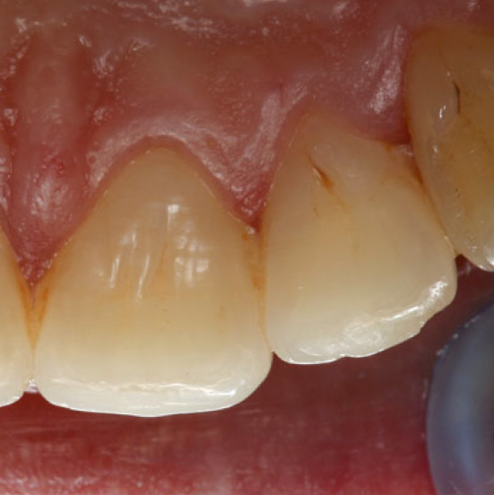
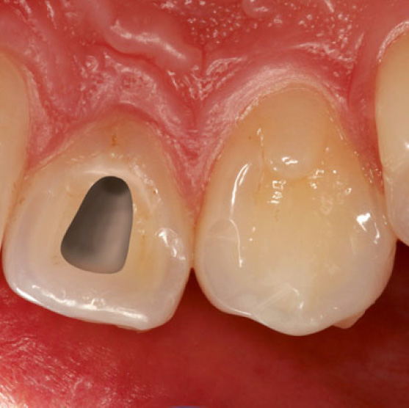
Maxillary lateral incisor
The access cavity is triangular and reproduces the shape of the endodontic space.
1 root – 1 root canal

Slide 55
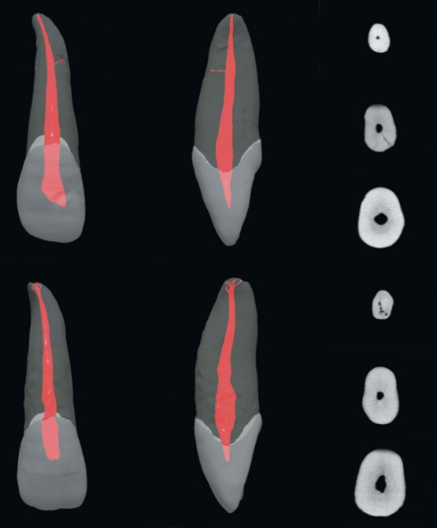
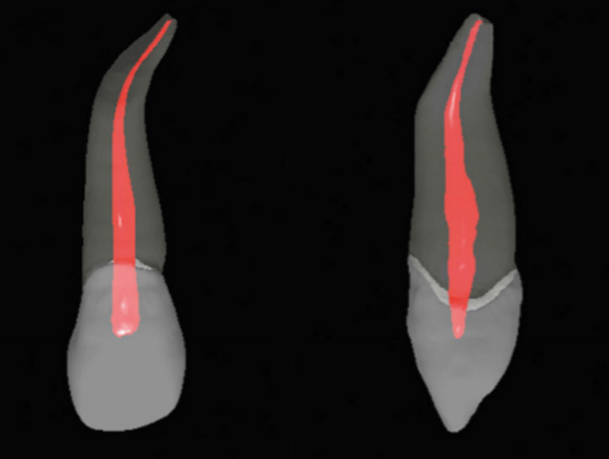
In 53% cases we can find distal curvature in the apical third of the root.

Slide 56
Maxillary lateral incisor
Length of tooth | 22mm
Length of crown | 9mm
Length of root | 13mm
Width of crown | 6,5mm
Width of cervical area | 5mm

Slide 57
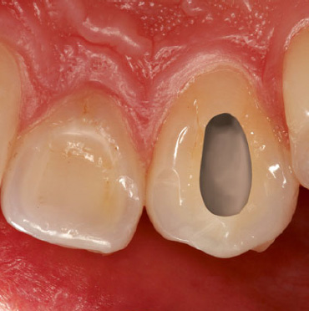
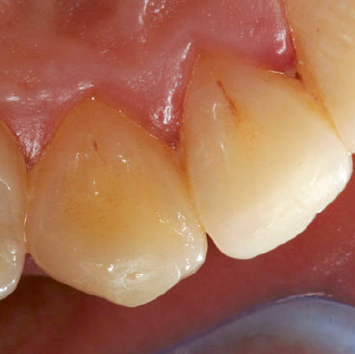
Maxillary canine
The access cavity of the pulp chamber has an oval shape, going from the cusp to the cingulum of the coronal cervical one-third.
1 root – 1 root canal.

Slide 58
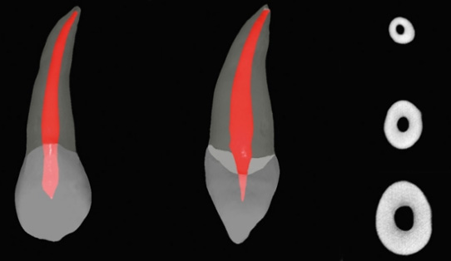

Slide 59
Maxillary canine
Length of tooth | 27 mm
Length of crown | 10 mm
Length of root | 17 mm
Width of crown | 7,5 mm
Width of cervical area | 7mm

Slide 60
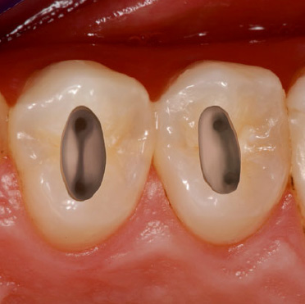
Maxillary first premolar
Vestibular and palatal pulp horn.
The access preparation for the maxillary first premolar is oval or slot shaped.
P root – 1rc.
V root – 1rc 95 %, 2rc 5%.

Slide 61
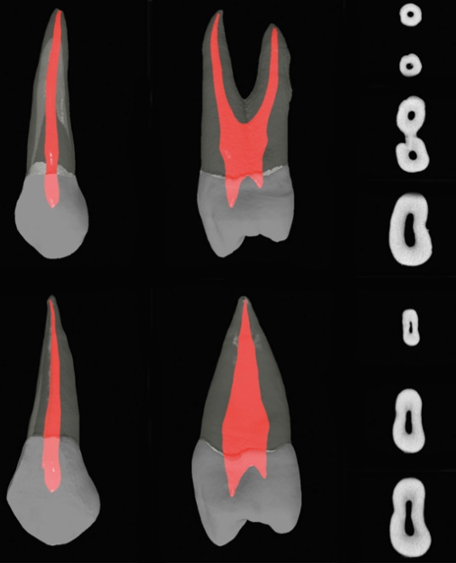
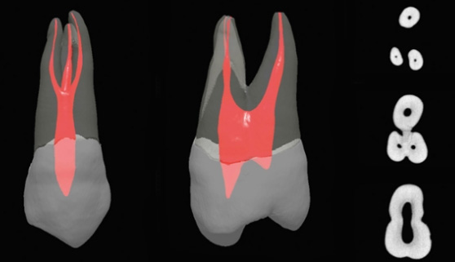

Slide 62
Maxillary first premolar
Length of tooth | 22,5 mm
Length of crown | 8,5 mm
Length of root | 14 mm
Width of crown | 7 mm
Width of cervical area | 5 mm

Slide 63
Maxillary second premolar
Vestibular and palatal pulp horn.
The access preparation for the maxillary second premolar is oval or slot shaped.

Slide 64
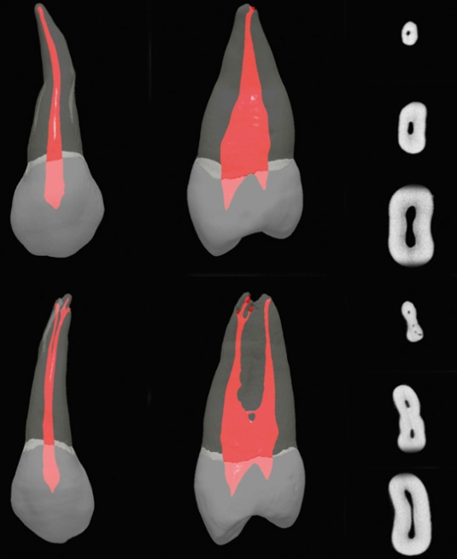

Slide 65
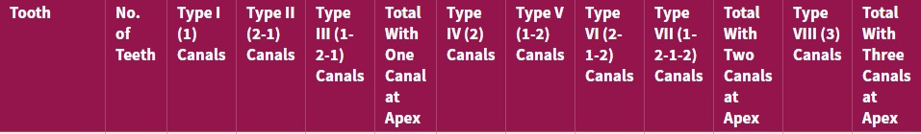


Slide 66
Maxillary second premolar
Length of tooth | 22,5 mm
Length of crown | 8,5 mm
Length of root | 14 mm
Width of crown | 7 mm
Width of cervical area | 5 mm

Slide 67


Maxillary first molar
The maxillary first molar is the largest tooth in volume and one of the most complex in root and canal anatomy.
The access cavity has a rhomboid shape, with the corners corresponding to the four orifices.
P root – 1rc (55% B curved).
DB root – 1rc 96%, 2rc 4%.
MB root – 1rc 5-40%%, 2rc 95-60%

Slide 68



Slide 69


Slide 70

MB2
Localised on the line connectin MB a P root canal, under dentin shoulder.
Removing shoulder-> US StartX 2.

Slide 71
First upper molar
Length of tooth | 20/22mm
Length of crown | 7,5mm
Length of root | 12/13mm
Width of crown | 10mm
Width of cervical area | 8mm

Slide 72

Second upper molar
When four canals are present, the access cavity has a rhomboid shape
If only three canals are present, the access cavity is a rounded triangle with the base to the buccal.
If only two canals are present, the access outline form is oval
P root – 1rc (37% B curved).
DB root – 1rc.
MB root – 1rc 57%, 2rc 23%.
MB and DB fused – 16%.

Slide 73



Slide 75
Second upper molar
Length of tooth | 19/21mm
Length of crown | 7mm
Length of root | 11/12mm
Width of crown | 9mm
Width of cervical area | 7mm

Slide 76


Mandibular central and lateral incisor
High difficulty – tiny proportions of tooth
The external outline form may be triangular or oval, extended to incizal edge.
1 root – 1 root canal 75%, 2 root canals 25%

Slide 77


Slide 78
Mandibular central incisor
Length of tooth | 22 mm
Length of crown | 9,5 mm
Length of root | 12,5 mm
Width of crown | 5 mm
Width of cervical area | 3,5 mm

Slide 79
Mandibular lateral incisor
Length of tooth | 23,5 mm
Length of crown | 9,5 mm
Length of root | 14 mm
Width of crown | 5,5 mm
Width of cervical area | 4 mm

Slide 80


Mandibular canine
The access cavity for the mandibular canine is oval or slot shaped.
1 root – 1 rc in 94%, 2 rc in 6%

Slide 81


Slide 82
Mandibular canine
Length of tooth | 23 mm
Length of crown | 10 mm
Length of root | 17 mm
Width of crown | 7,5 mm
Width of cervical area | 5,5 mm

Slide 83


Mandibular first premolar
Two pulp horns. Lingual inclination of crown.
The access preparation is oval or slot shaped.
1 root – 1rc 74%.

Slide 84


Slide 85


Slide 86
Mandibular first premolar
Length of tooth | 24,5 mm
Length of crown | 8,5 mm
Length of root | 14 mm
Width of crown | 6 mm
Width of cervical area | 5 mm

Slide 87
Mandibular second premolar
Two pulp horns. Lingual inclination of crown.
The access preparation is oval or slot shaped.
1 root – 1rc 97%.

Slide 88


Slide 89
Mandibular second premolar
Length of tooth | 24,5 mm
Length of crown | 8,5 mm
Length of root | 14 mm
Width of crown | 7 mm
Width of cervical area | 5 mm

Slide 90


Mandibular first molar
It is often extensively restored, and it is subjected to heavy occlusal stress. Consequently, the pulp chamber frequently has receded or is calcified.
The access cavity is typically trapezoid or rhomboid, regardless of the number of canals present.
M root – 1rc 12%, 2rc 87%, 3rc 1%
D root – 1rc 70%, 2rc 30%.

Slide 91


Slide 92


Slide 93


Slide 94
Mandibular first molar
Length of tooth | 21,5mm
Length of crown | 7,5mm
Length of root | 14mm
Width of crown | 11mm
Width of cervical area | 9mm

Slide 95
Mandibular second molar
The access cavity is typically trapezoid or rhomboid.
M root – 1kk 27%, 2kk 73%.
D root – 1kk 92%, 2kk 8%.

Slide 96


Slide 98
Mandibular second molar
Length of tooth | 20mm
Length of crown | 7mm
Length of root | 13mm
Width of crown | 10mm
Width of cervical area | 8mm

Slide 99
Sources
Cohen Pathways of the Pulp - 10th edition
Cohen Pathways of the Pulp - 9th edition
Laser in endodontics

