Slide 1

ORTHODONTICS
Classification of orthodontic anomalies
MUDr. Alena Bryšová, Ph.D.

Slide 2
ORTHODONTICS
Stomatological specialisation dealing with prevention, diagnostics and therapy of irregular tooth position, relationship of tooth arches and jawbones

Slide 3
MALOCCLUSION is a manifestation of genetic and environmental interaction on the development of the orofacial region

Slide 4
GOALS OF TREATMENT:
Ideal functional occlusion
Ideal soft tissue proportions and adaptation
Ideal jaw, skeletal and dental relationship

Slide 5
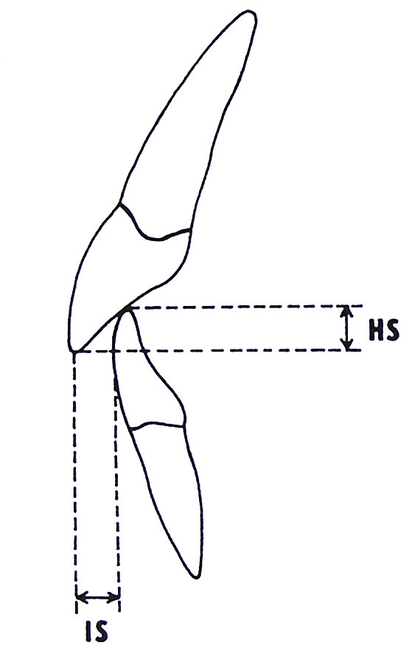
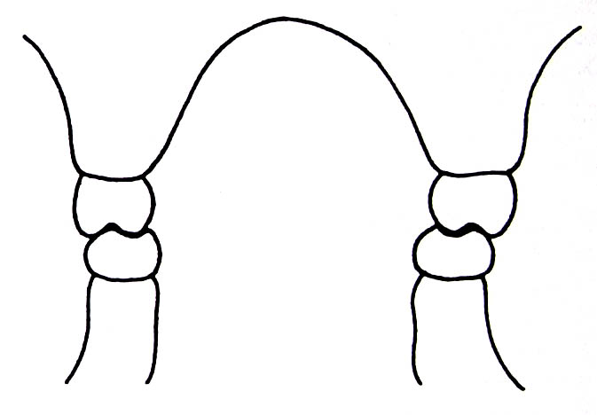
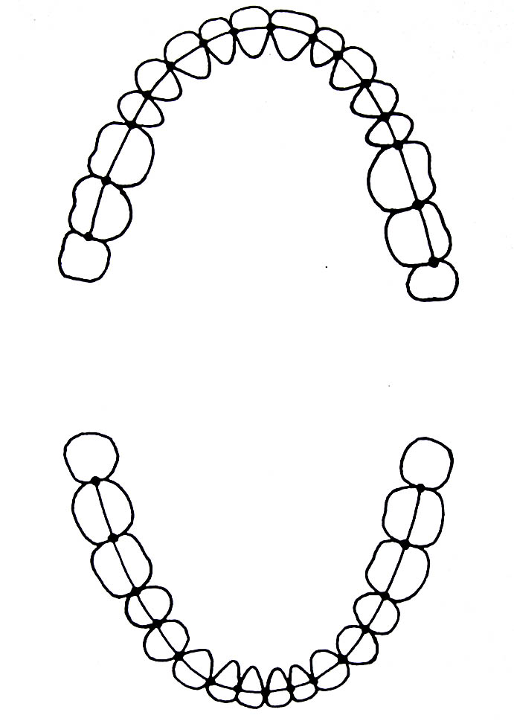
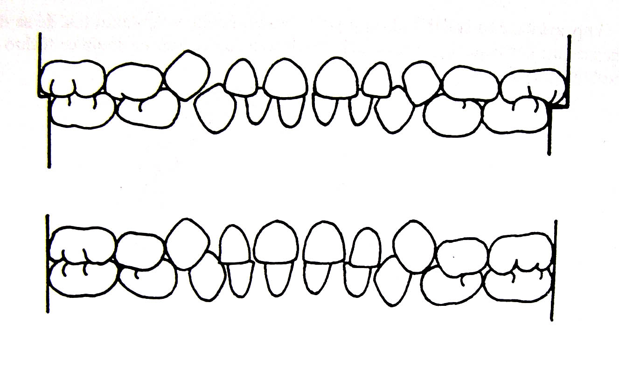
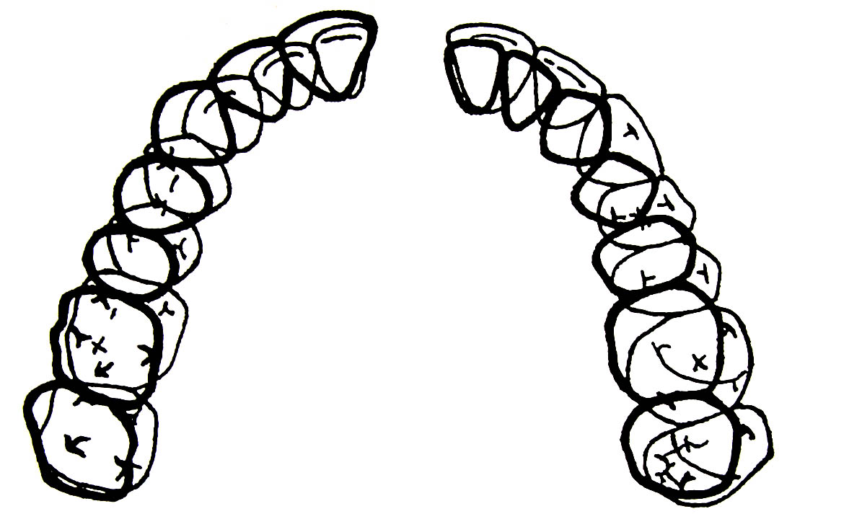
Ideal occlusion
correct relationship of molars
correct overjet and overbite
Correct intercuspidation of teeth
Points of contact are lined in an regular arch
Deciduous dentition is ended either by a small step or the posterior teeth facets are aligned
Correct dentition has 6 keys of correct occlusion- Andrews

Slide 6
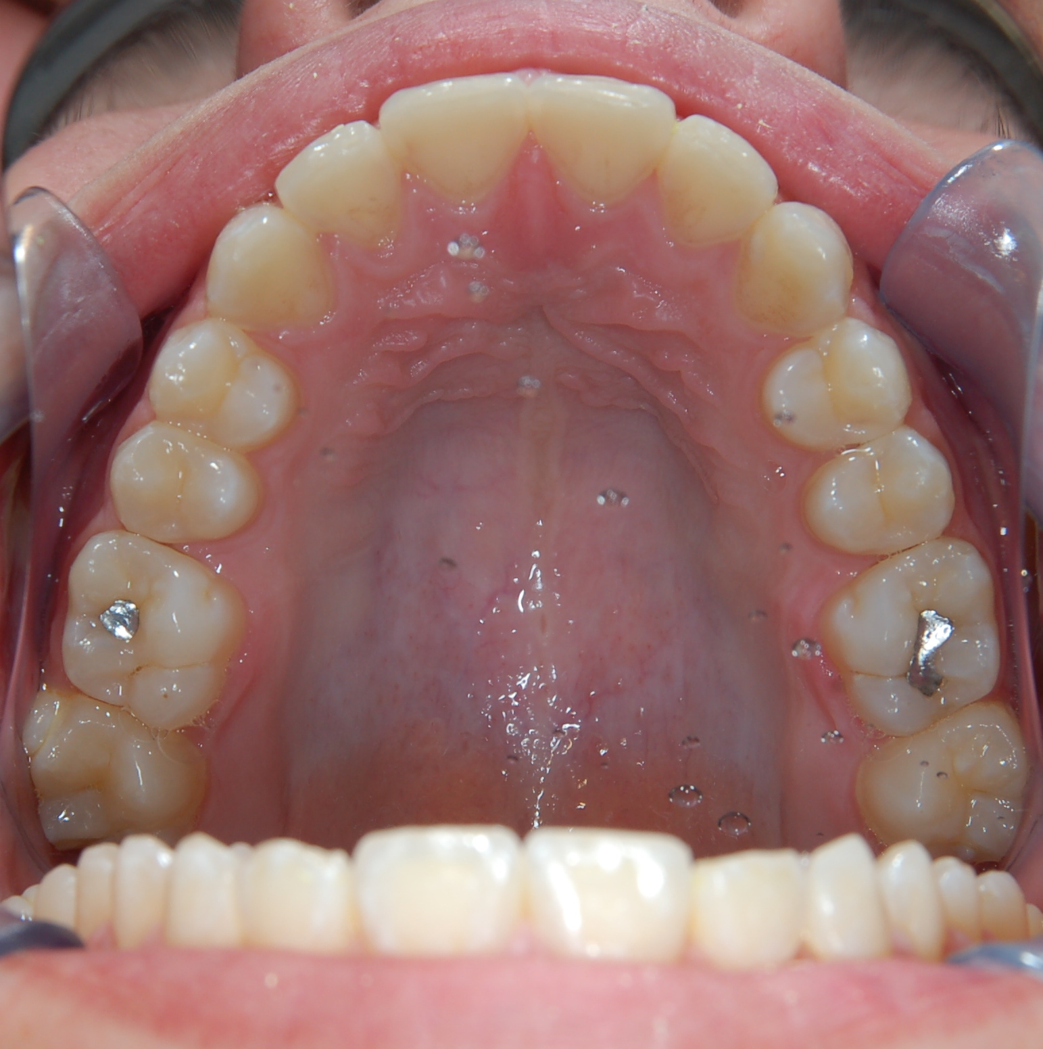
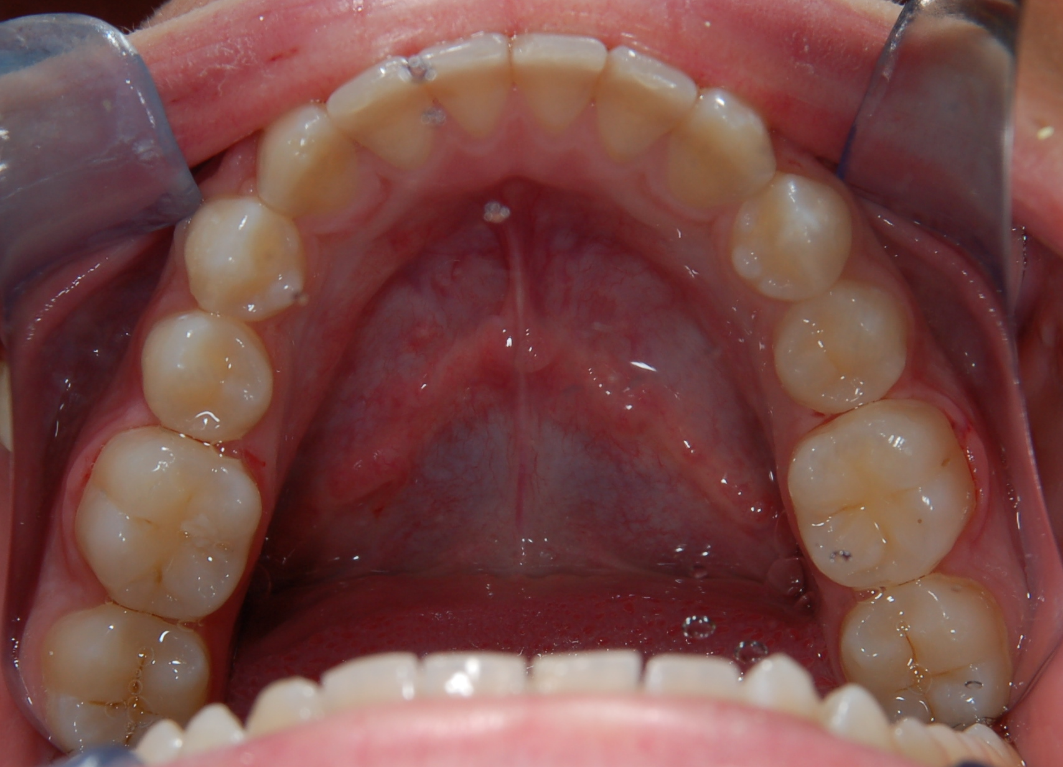
Ideal occlusion

Slide 7
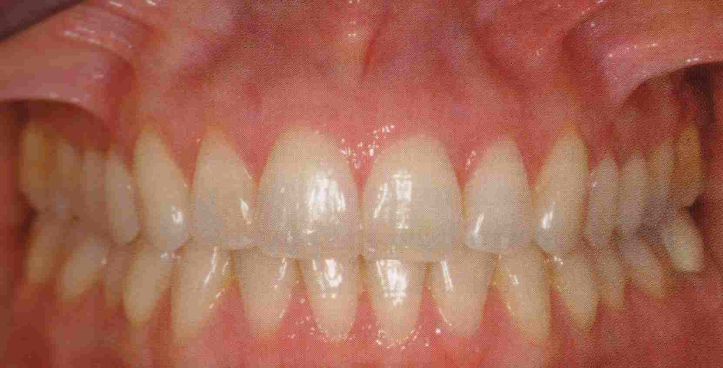
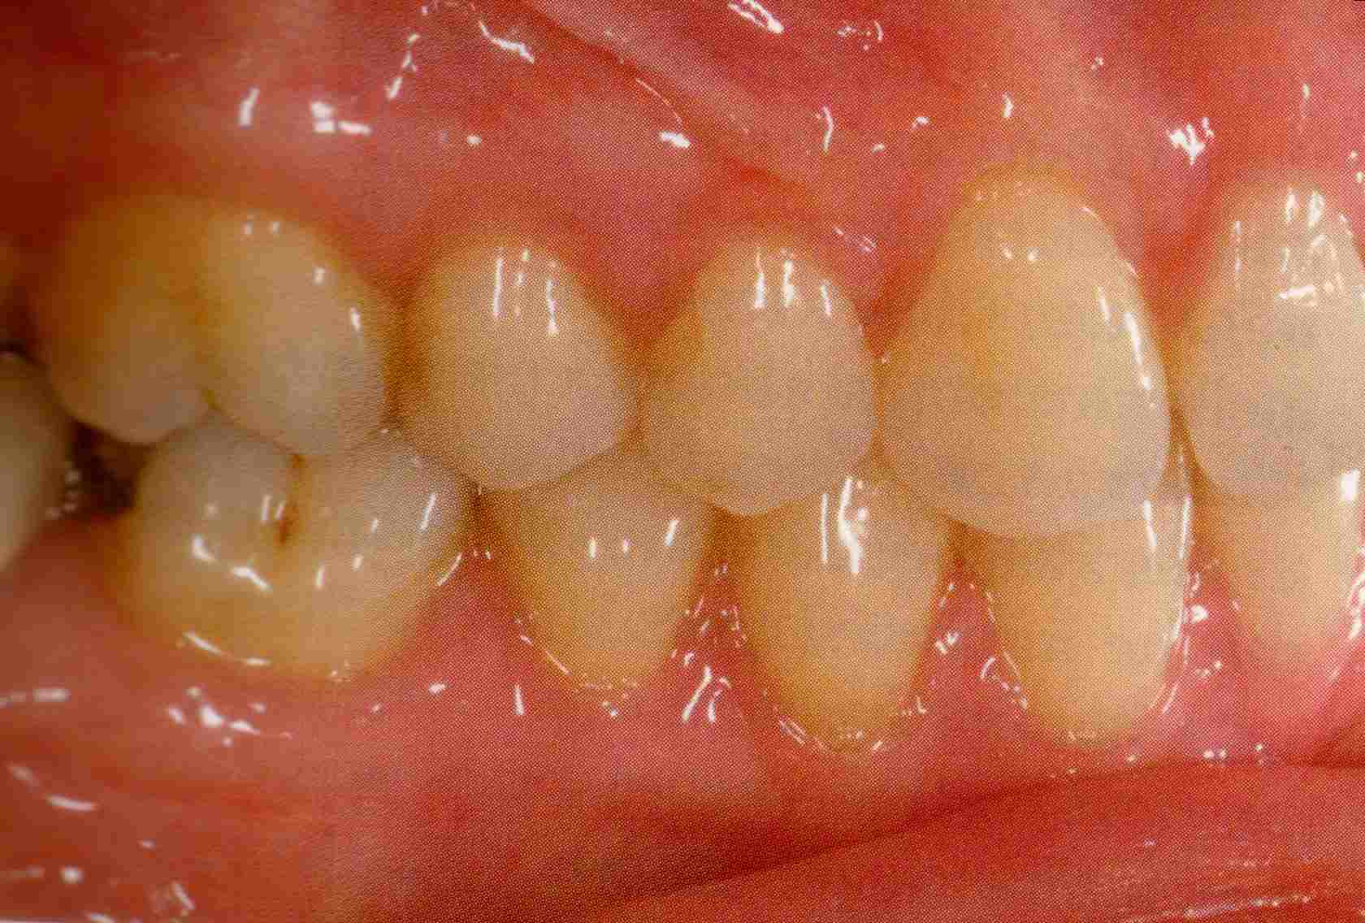
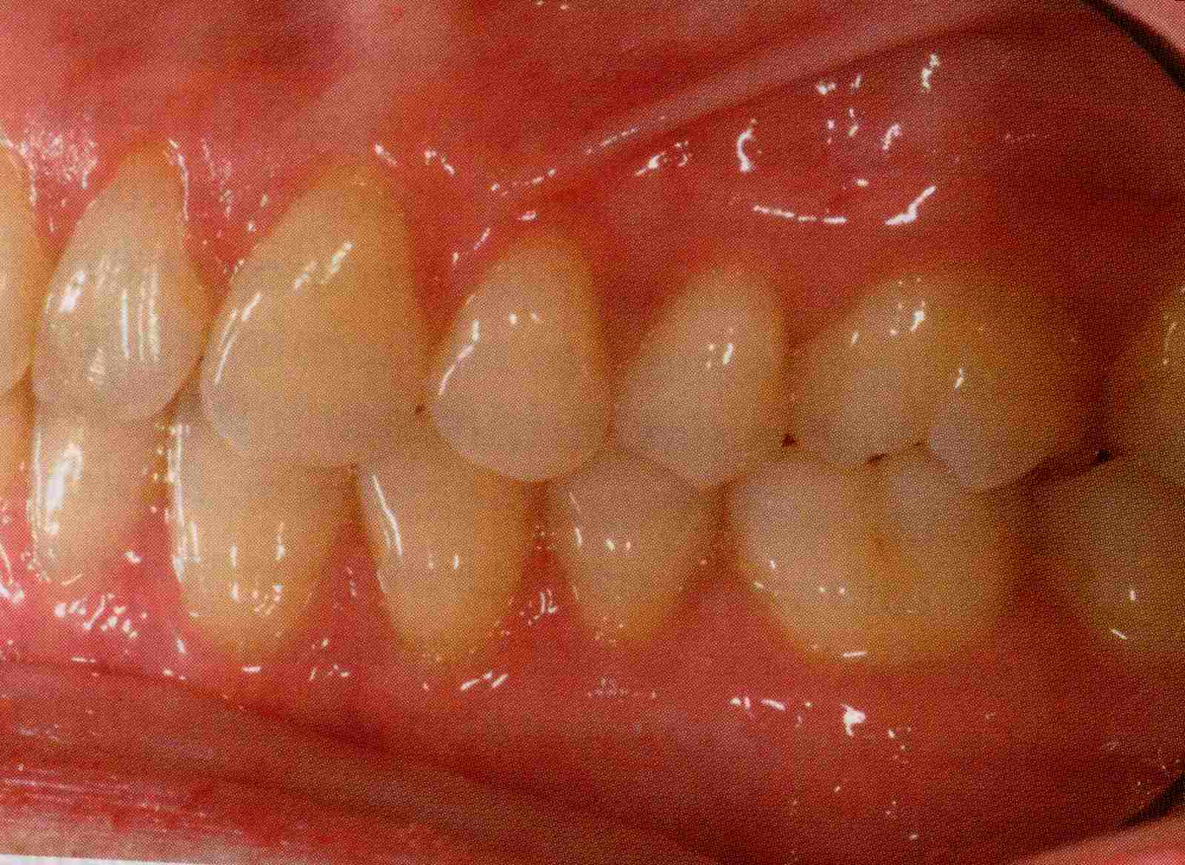

Slide 8
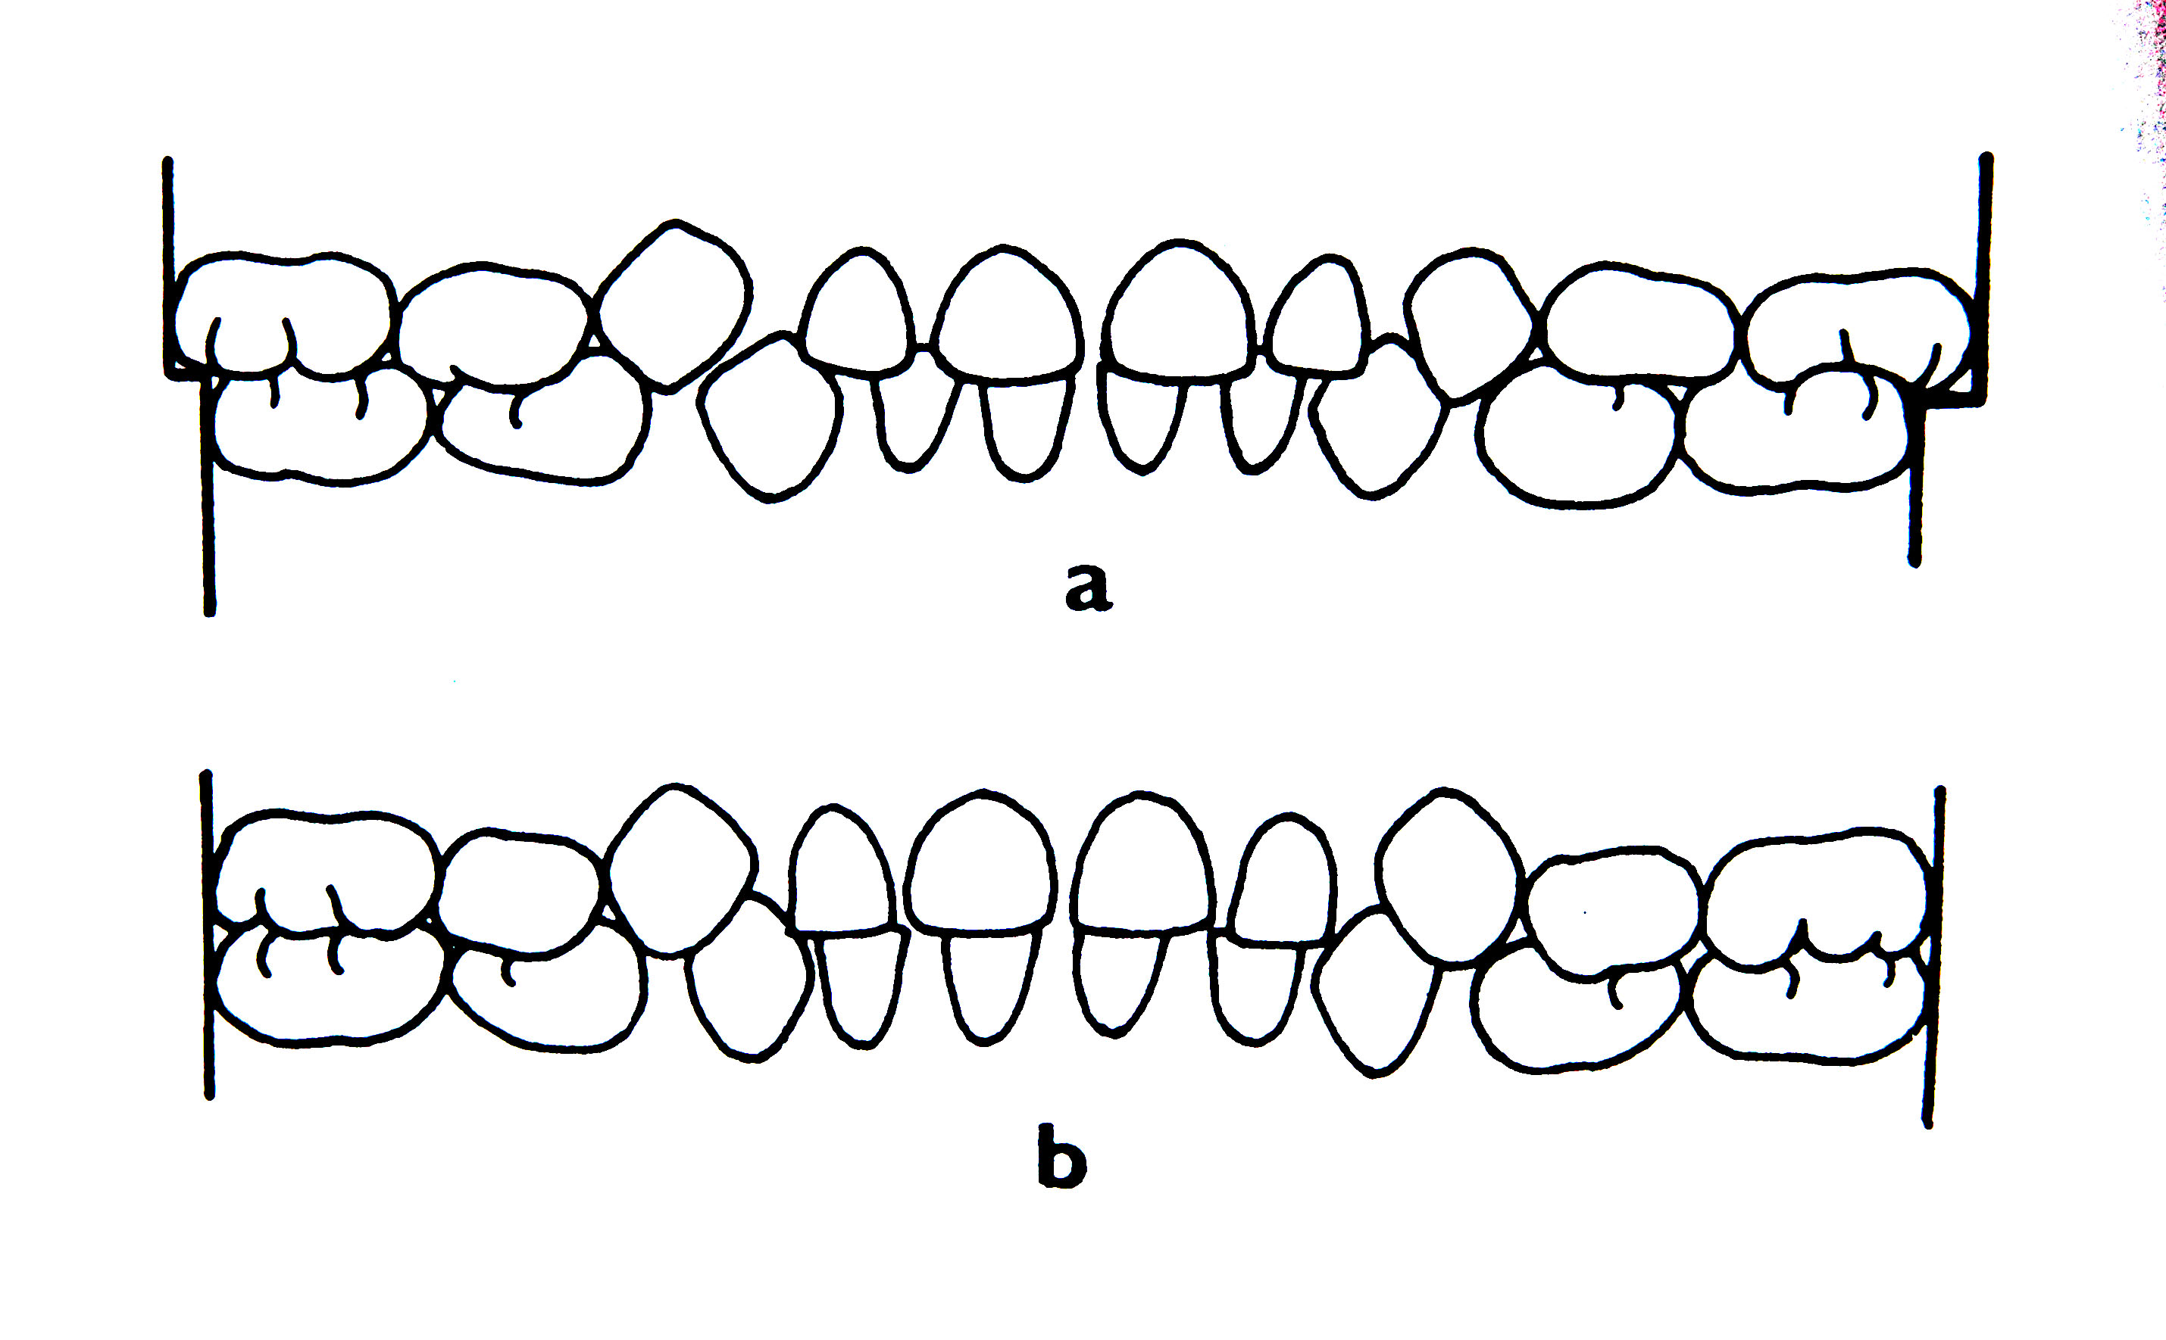
Deciduous teeth

Slide 9
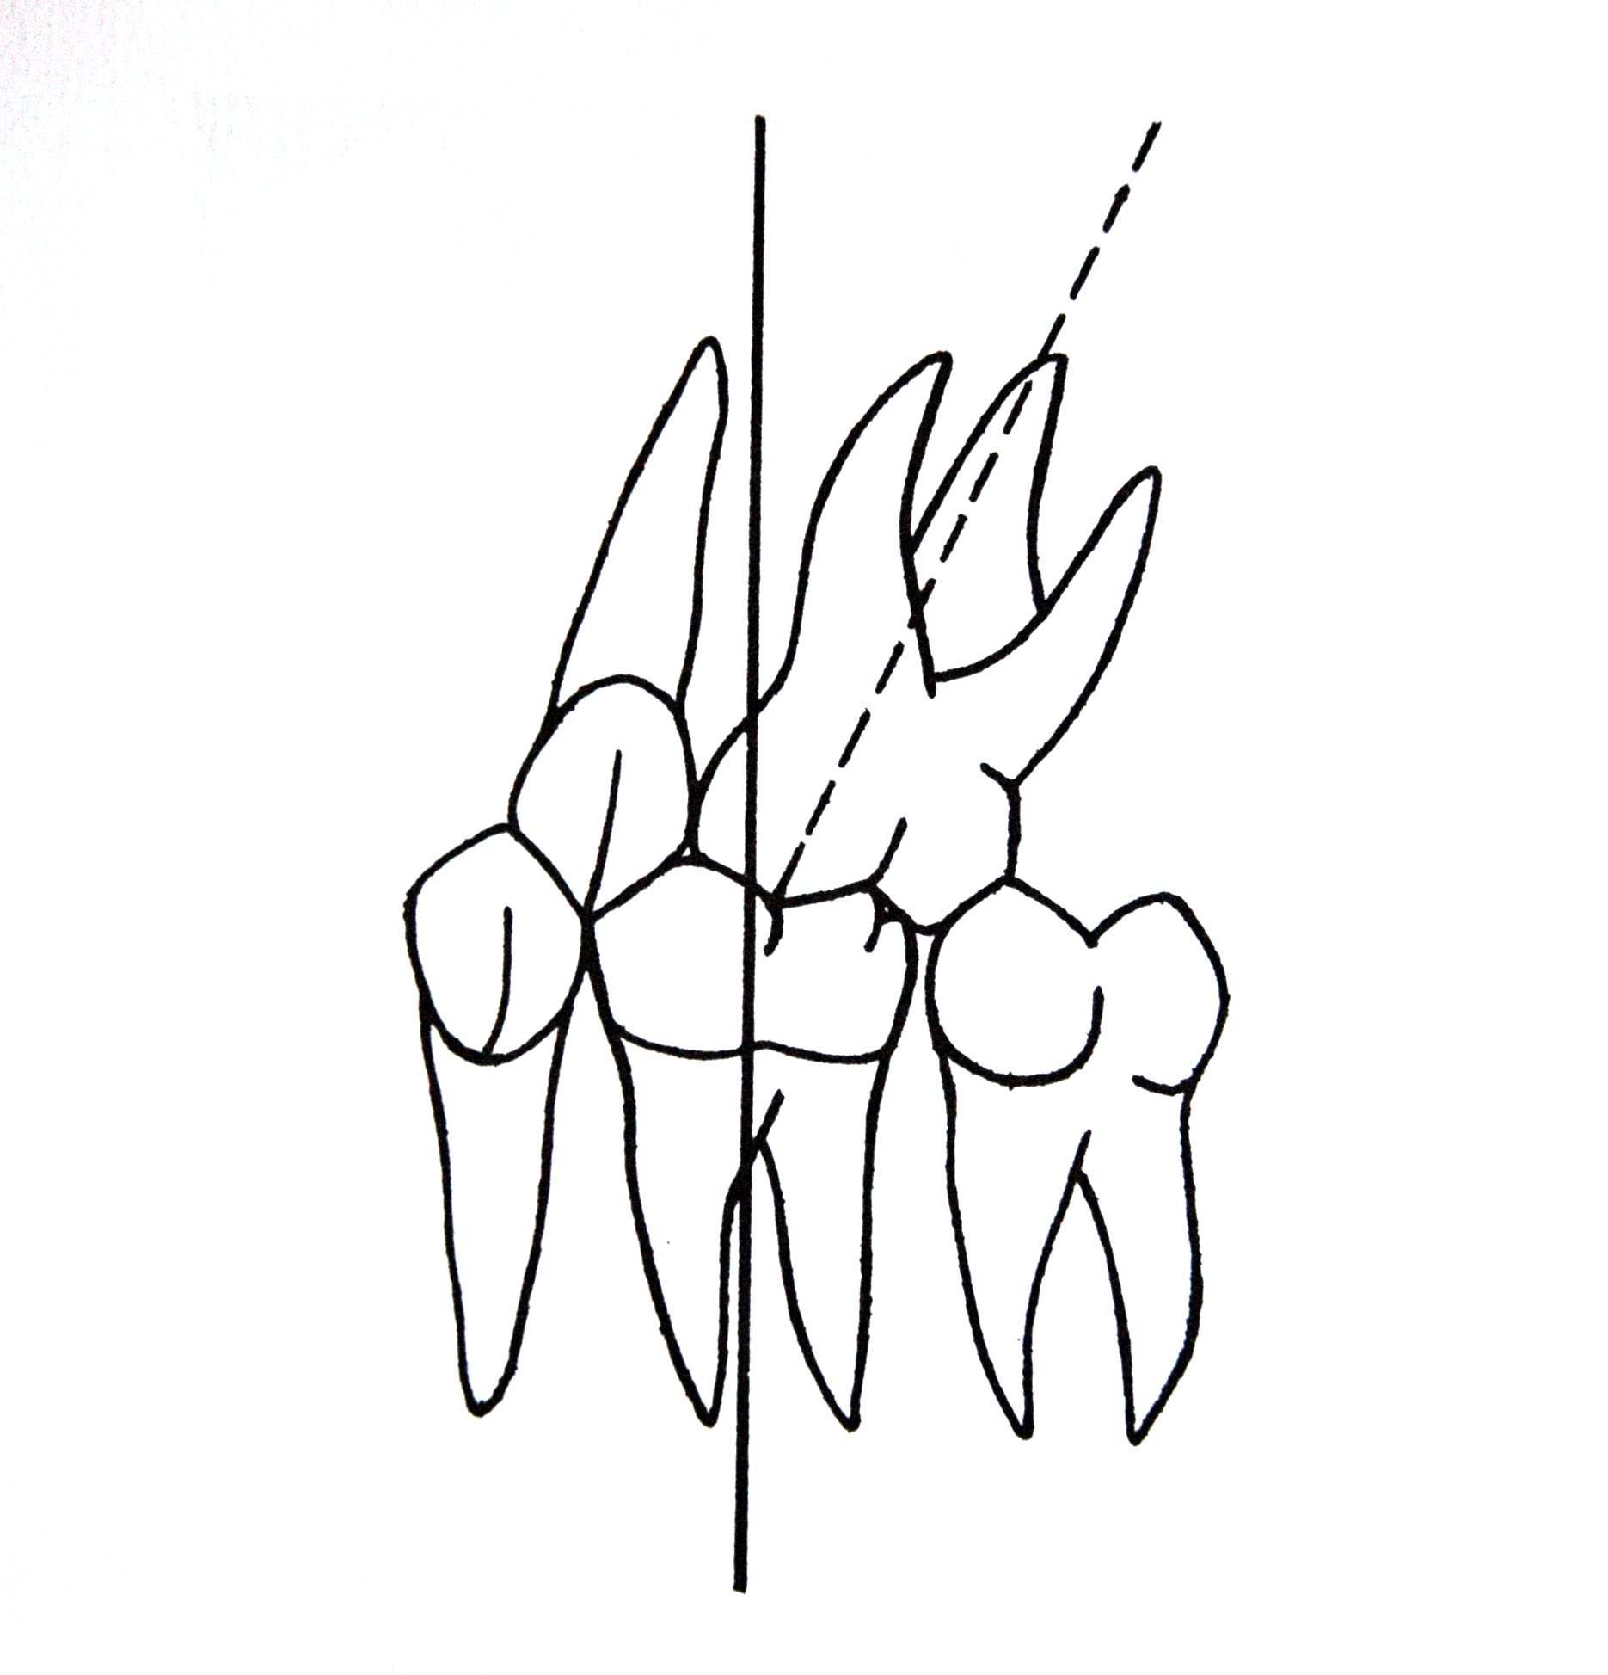
6 keys of occlusion according to Adrews
1. Correct relationship of molars – mesiobuccal cuspid of first upper molar is projected between buccal cuspids of first lower molar. Distal facet of distobuccal cuspid of first upper molar is in contact with mesial facet of mesiobuccal cuspid of second lower molar

Slide 10
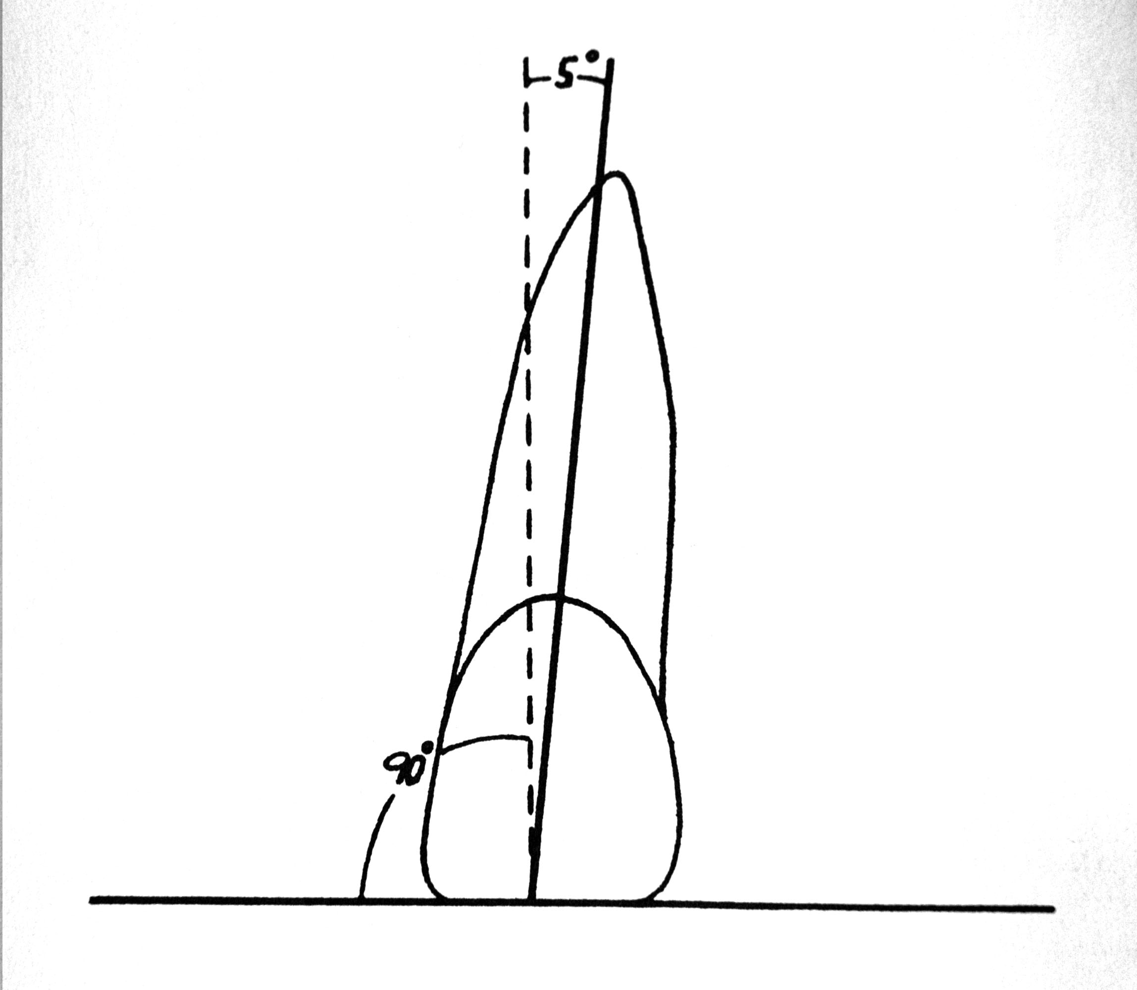
6 keys of occlusion according to Adrews
2. Crown angulation – gingival parts of long axis of all crowns are more distal than the occlusional parts. All teeth are slightly tipped mesially

Slide 11
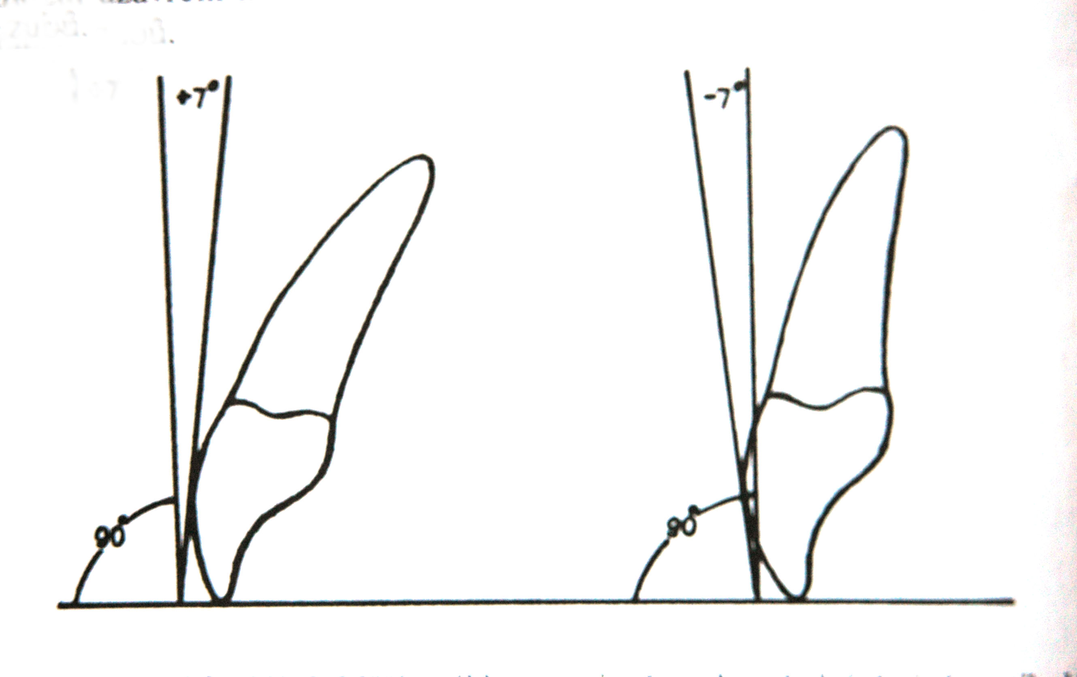
6 keys of occlusion according to Adrews
3. vestibulo-oral inclination of crowns –it is measured with the angle between a tangent to middle third of vestibular facet and the line vertical to the occlusion plane. This angle is positive by upper incisors and negative by all other teeth.

Slide 12
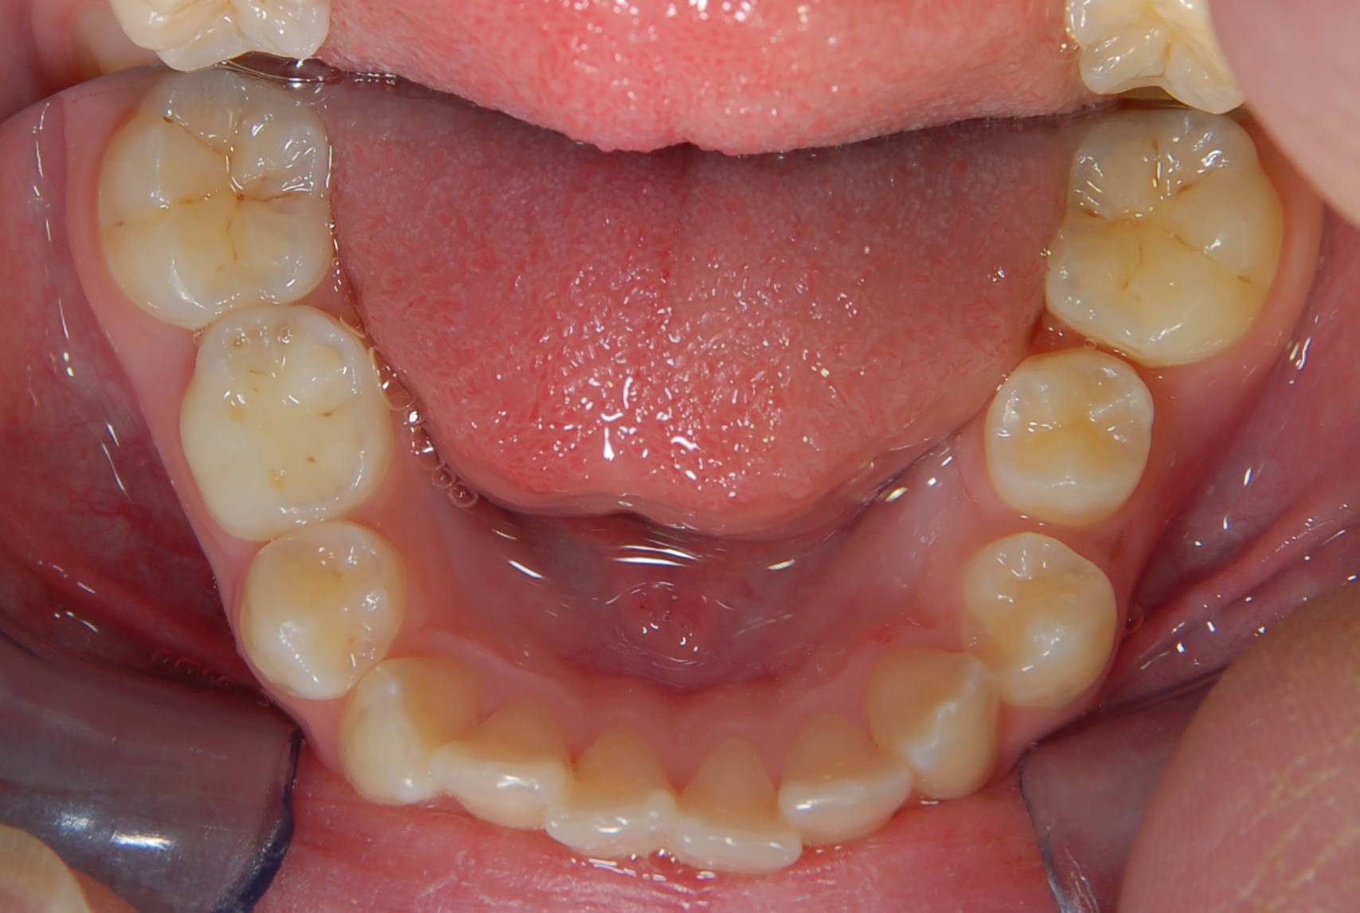
6 keys of occlusion according to Adrews
4. No rotated teeth – rotated molar and premolar occupies more space than regular one, rotated incisors and canine occupies less space than regular one.
It also does not allow correct intercuspidation

Slide 13
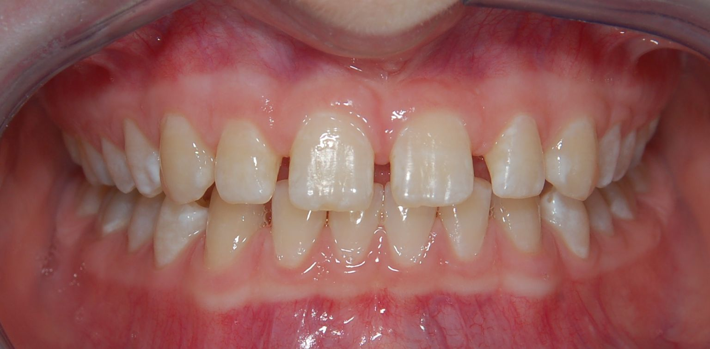
6 keys of occlusion according to Adrews
5. No spacing
It also does not allow correct intercuspidation

Slide 14
6 keys of occlusion according to Adrews
6. Plane of occlusion – it is almost flat or slightly deformed according to the curve of Spee. Significantly deformed occlusal plane disallows correct articulation and changes also the sagittal ralationship of arches.

Slide 15
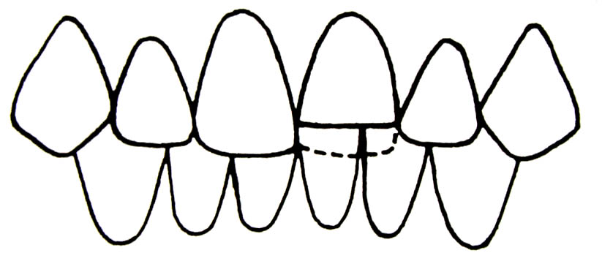
Classification of orthodontic anomalies
1. Anomalies of single tooth
Inclination – tooth tipping mesially,distally,
vestibular =protrusion, oral=retrusion, vestibular, lingual, palatal eruption
Vertical anomalies - supraocclusion, infraocclusion

Slide 16
Classification of orthodontic anomalies
Anomalies of single tooth
Nonocclusion – buccal, lingual, palatal
upper teeth are not in contact with lower teeth
Transposition – change of sequence of teeth in one arch, eg. the canine and first premolar or canine and lateral incisor

Slide 17
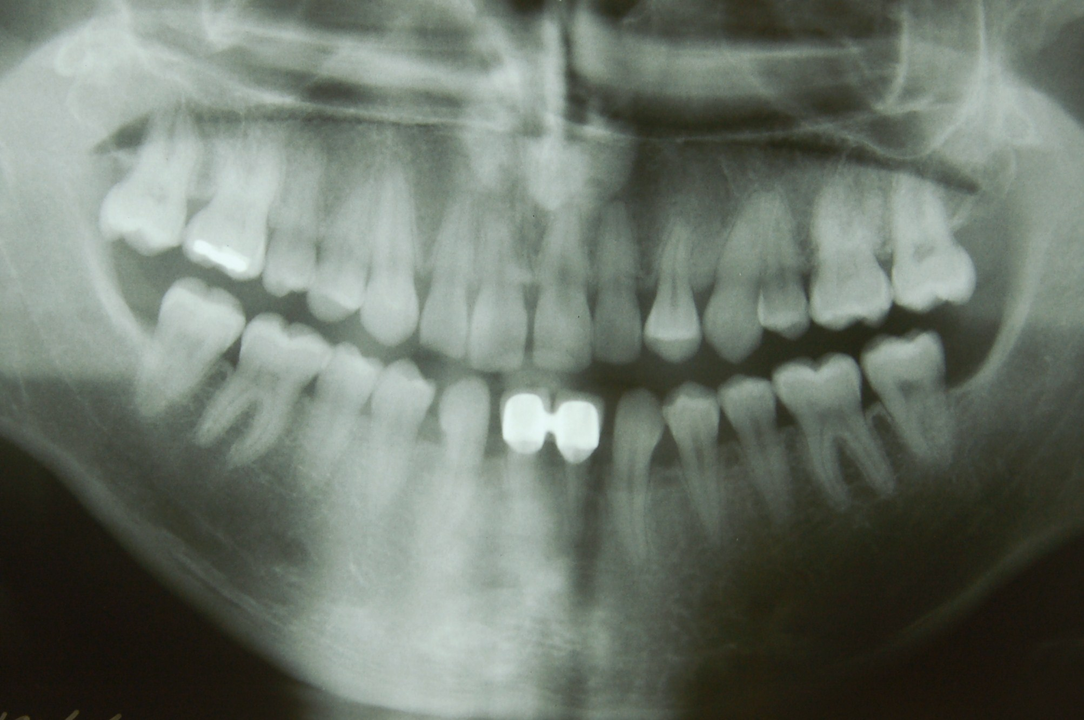
transposition

Slide 18
Classification of orthodontic anomalies
1. Anomalies of single tooth
Rotation - mesial, distal
Retention – the teeth is developed, but not erupted, most often: wisdom teeth, upper canine
Hyperodontia – the number of permanent teeth is higher [supernumerary teeth, most frequently- mesiodens, upper incisors]
Hypodontia – the correct number of teeth is reduced because some teeth are absent due to agenesis of their germs [most frequently- upper lateral incisors, third permanent molars, premolars]

Slide 19
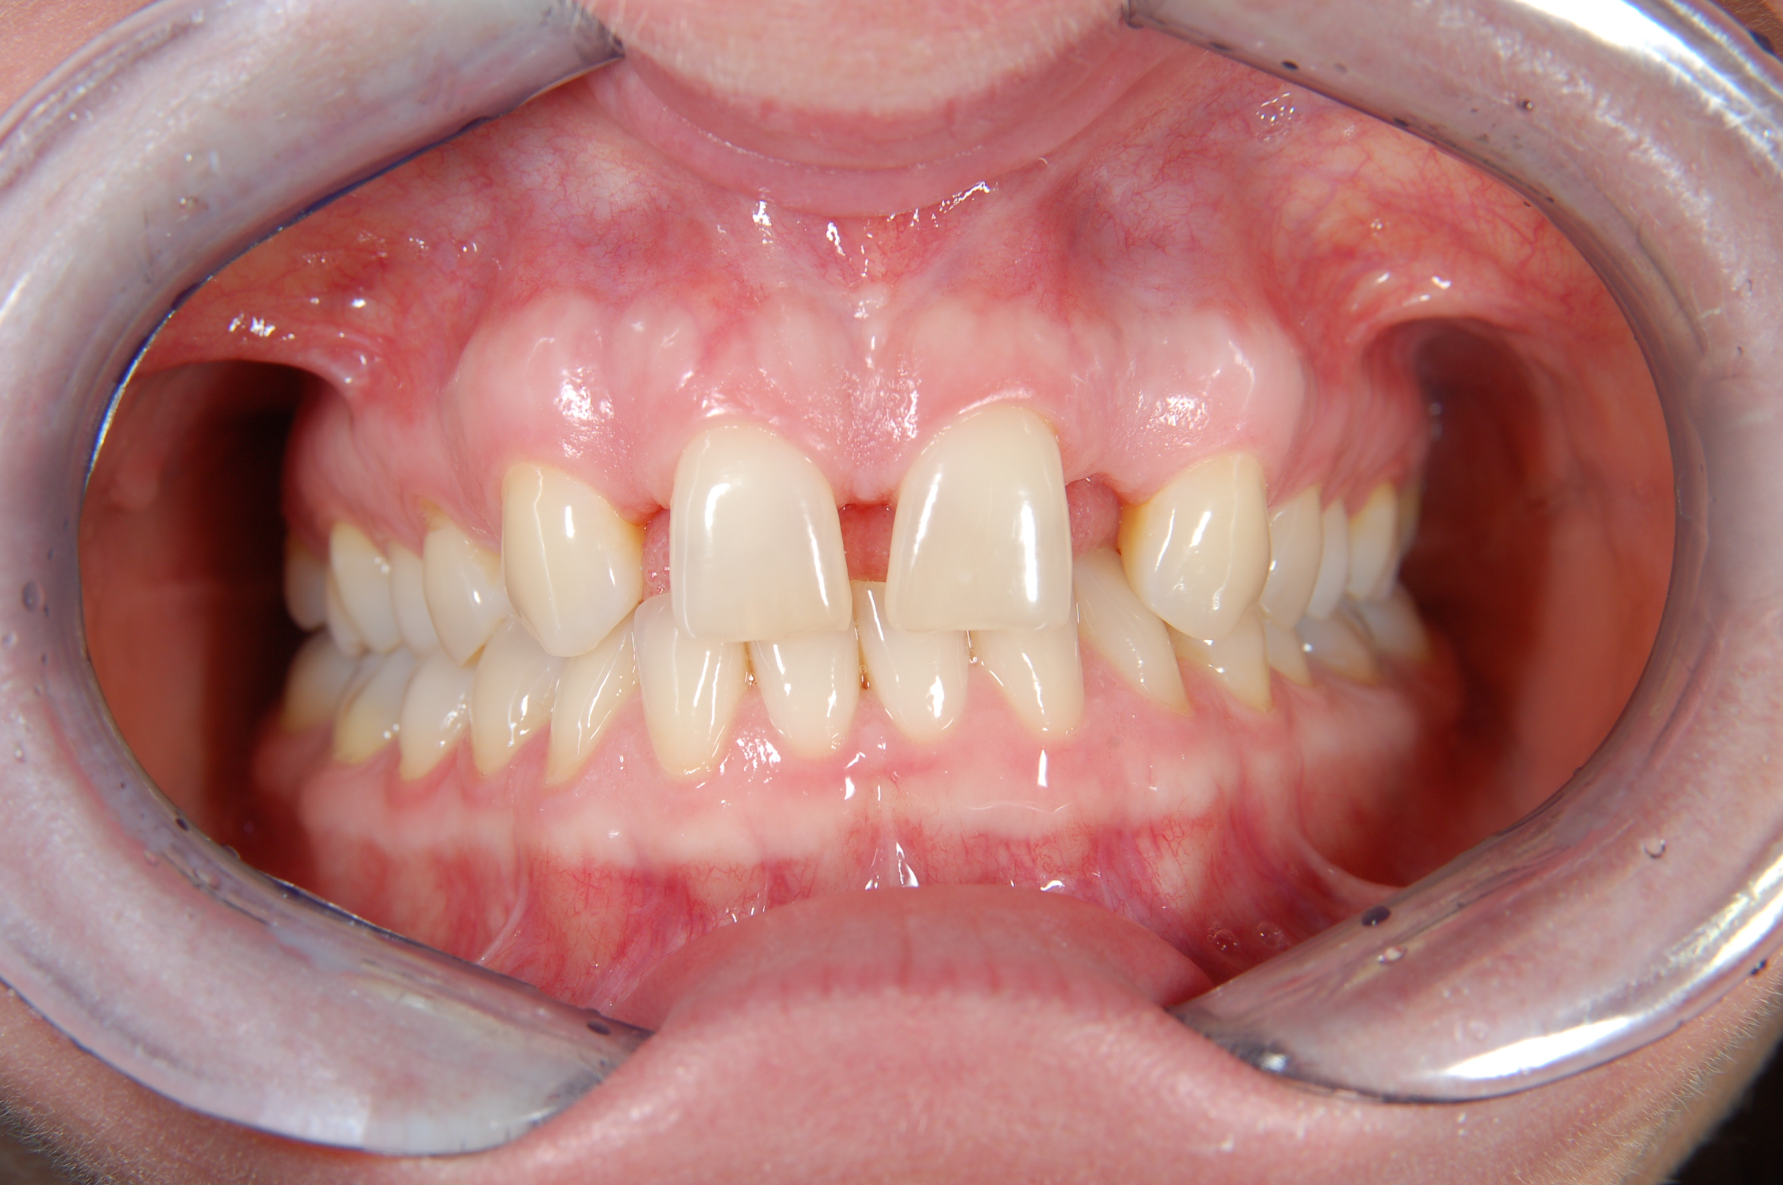
Hypodontia

Slide 20
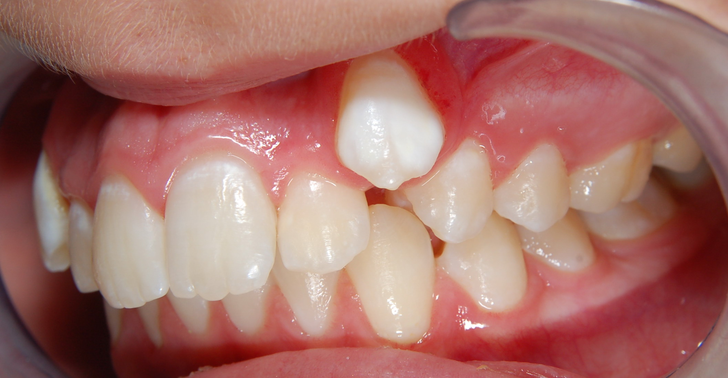
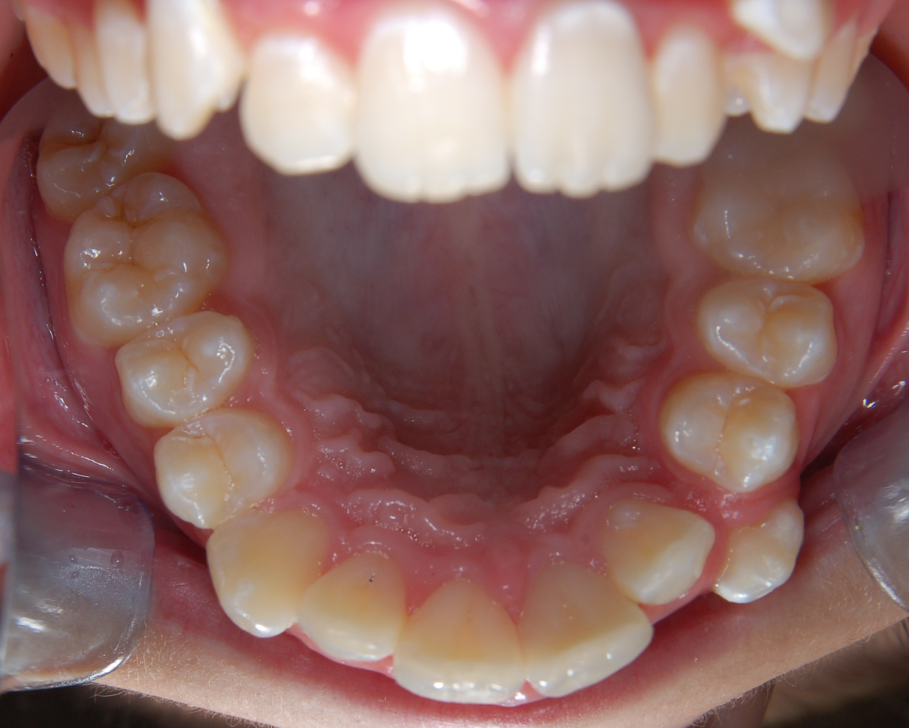

Slide 21
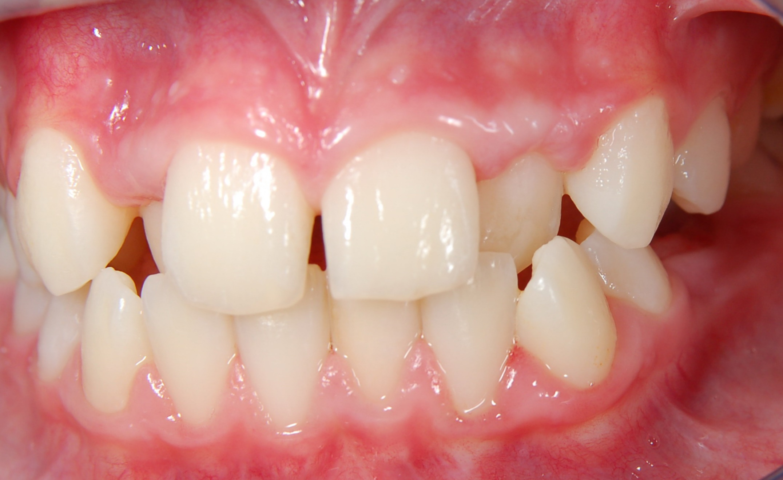
Palatal eruption

Slide 22
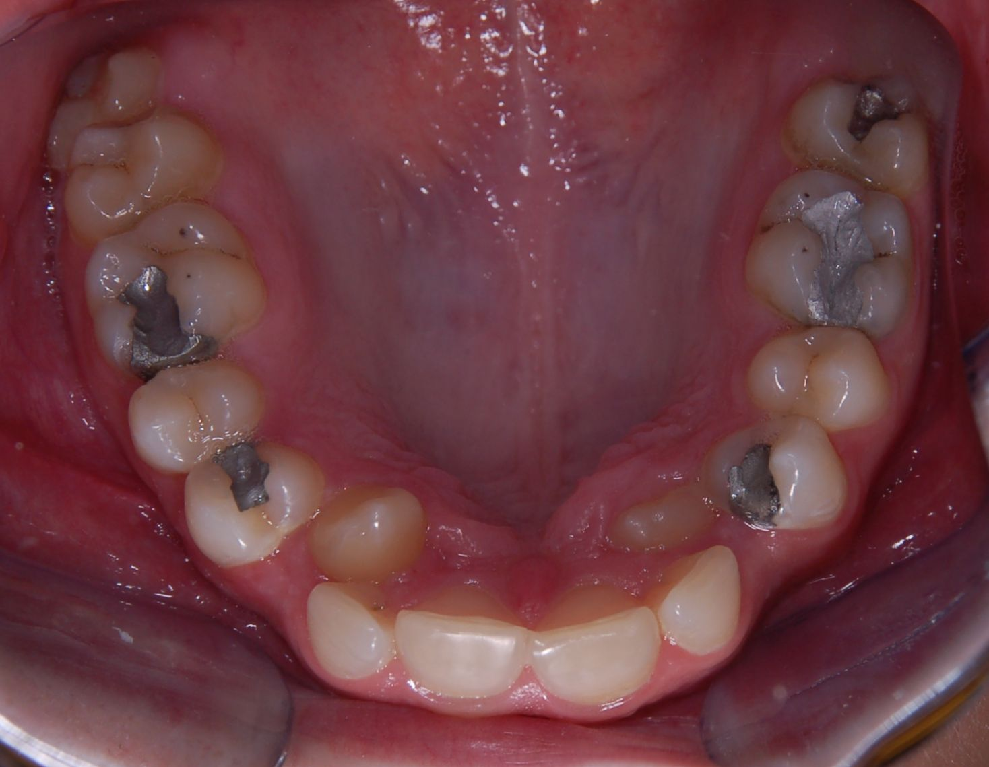
Palatal eruption

Slide 23
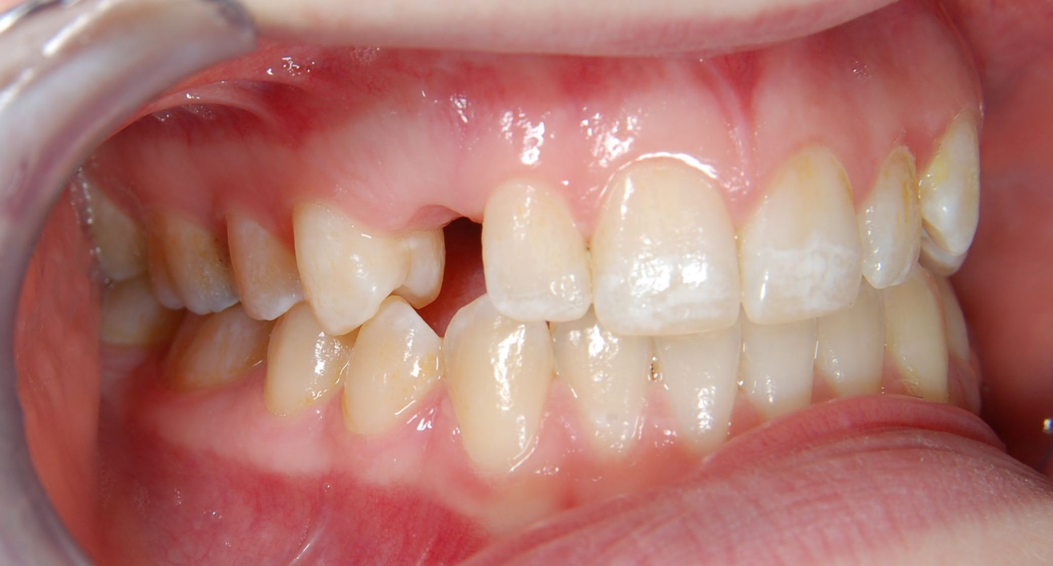
Retention of canine

Slide 24
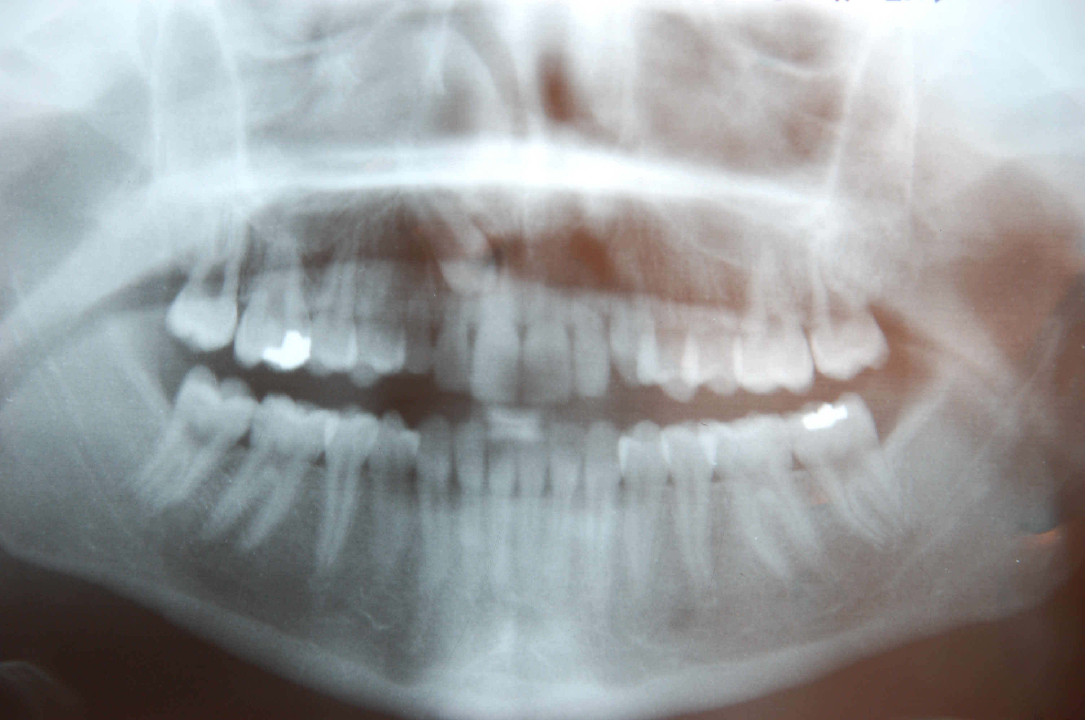
Retention of canine

Slide 25
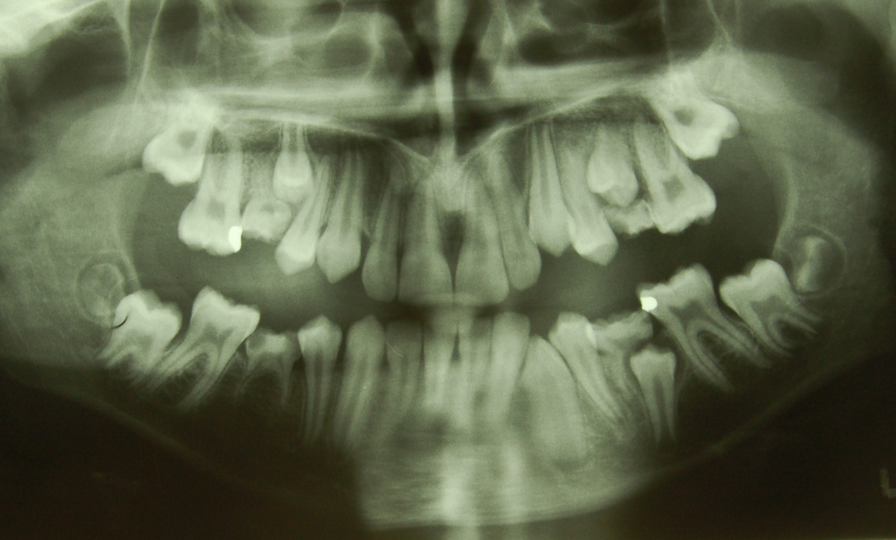
Infraocclusion

Slide 26
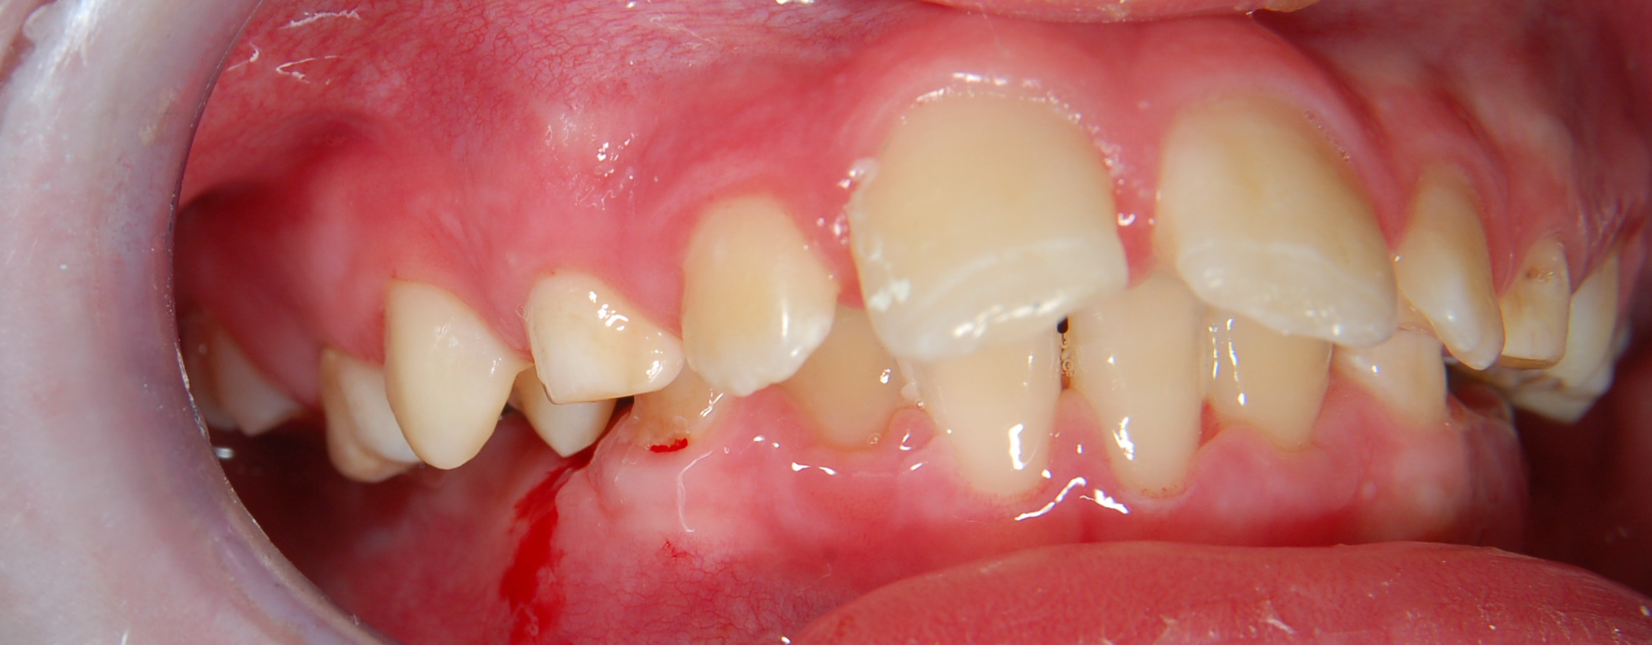
Buccal nonocclusion

Slide 27
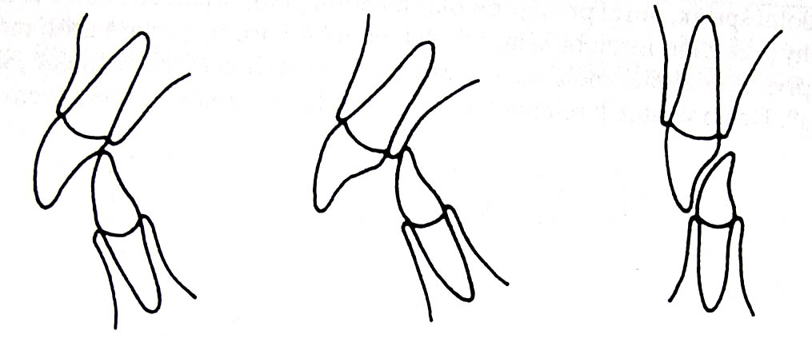
Classification of orthodontic anomalies
2. Anomalies of groups of teeth
groups of teeth are in irregular position
Protrusion, retrussion
Inverted bite – is in the frontal part – lower tooth is more anteriorly than the upper tooth

Slide 28
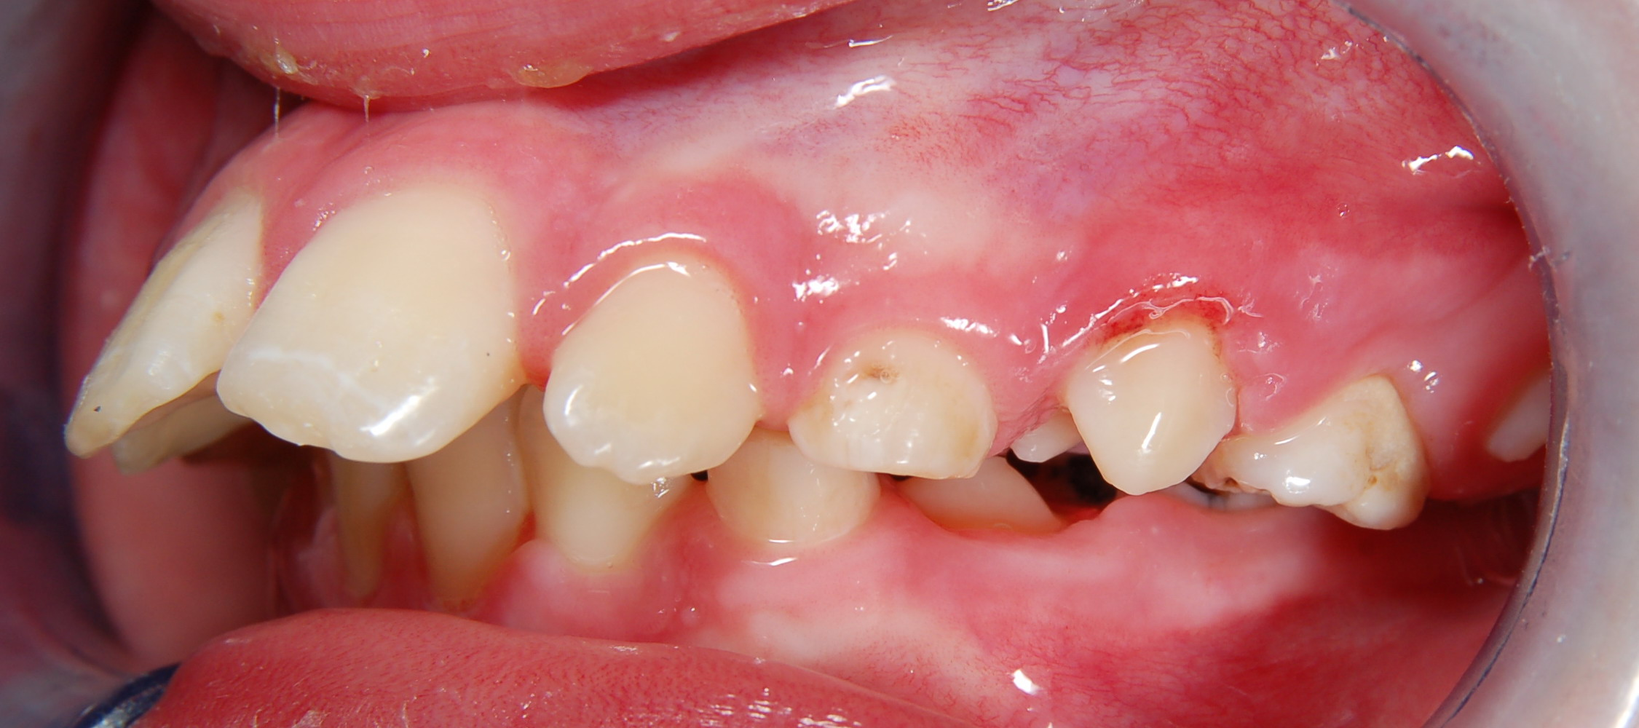

Slide 29
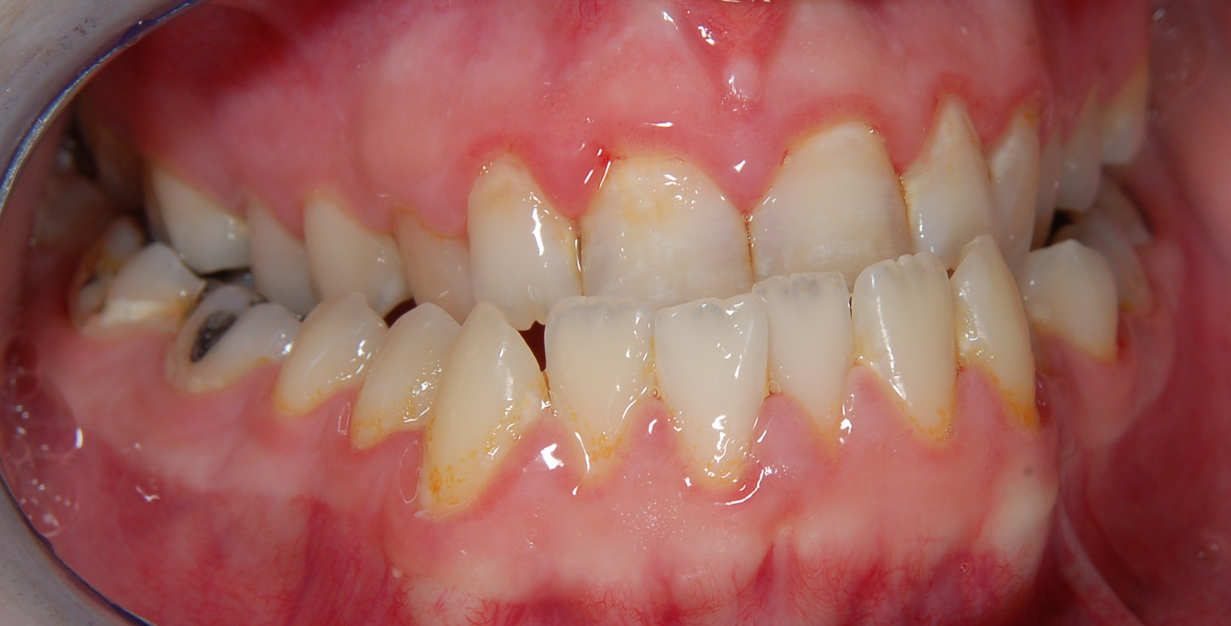
Inverted bite, cross bite

Slide 30
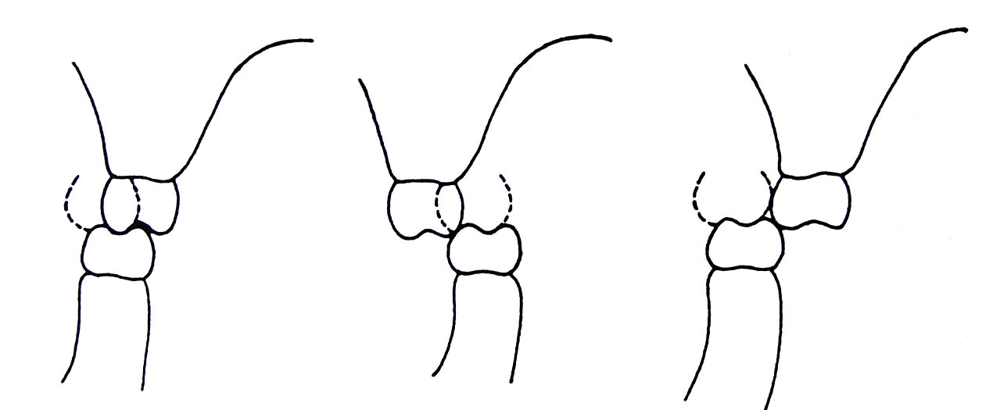
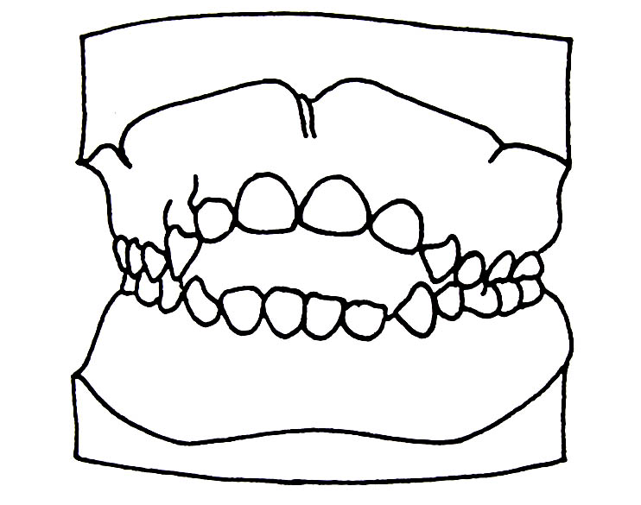
Classification of orthodontic anomalies
2. Anomalies of groups of teeth
Cross bite – in lateral part the buccal cuspids of lower molars are more buccally
Open bite - negative overbite

Slide 31
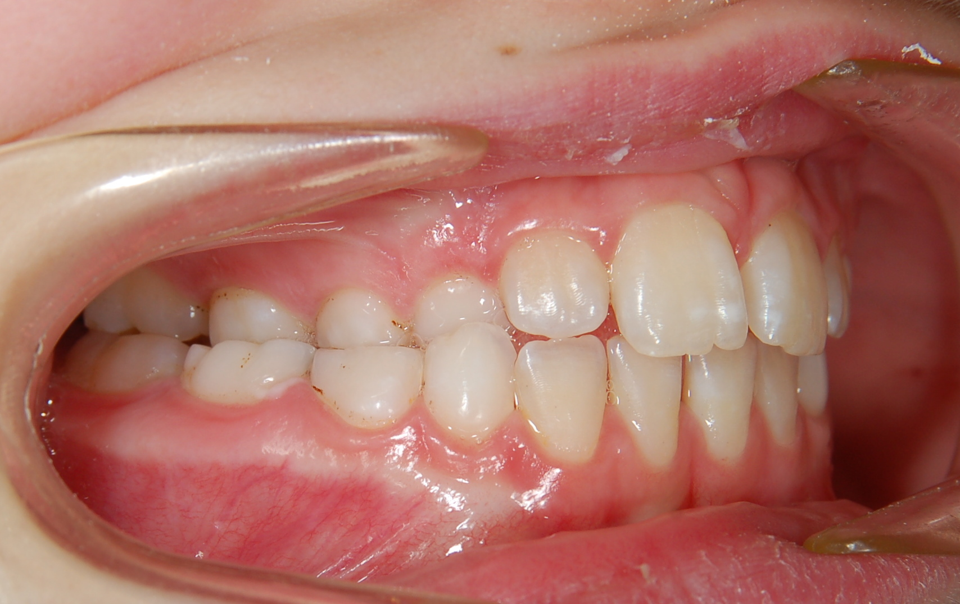
Cross bite

Slide 32
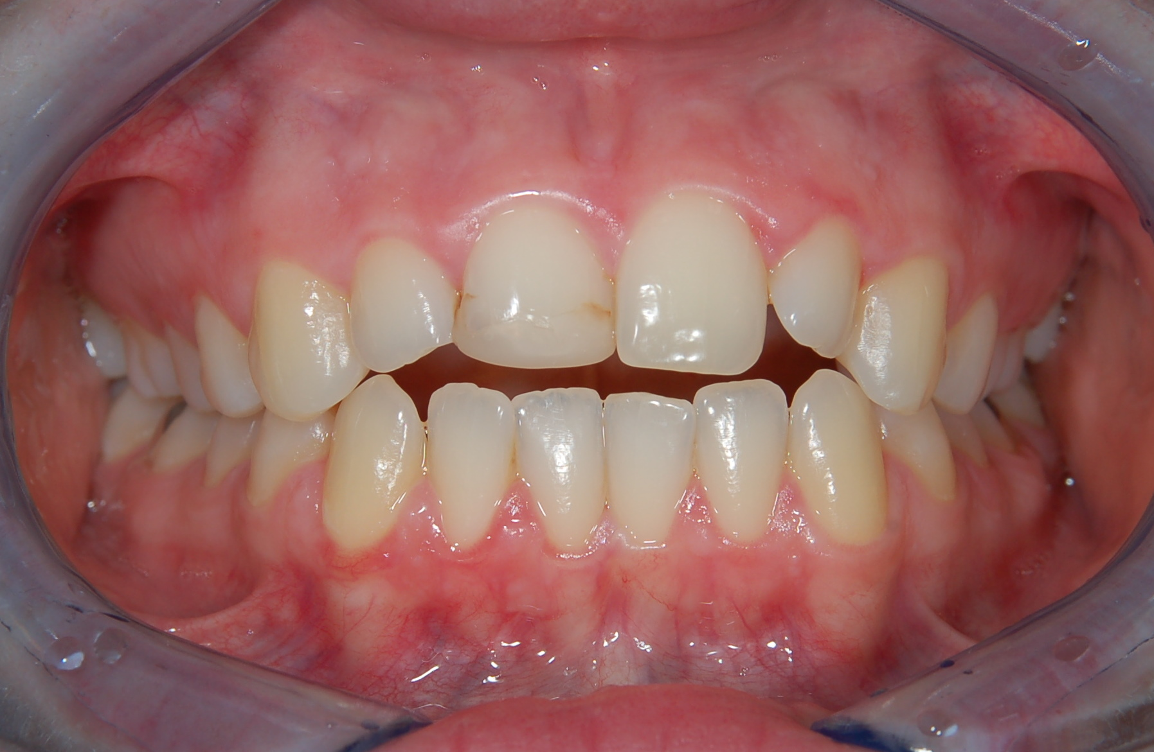
Open bite

Slide 33
Classification of orthodontic anomalies
2. Anomalies of groups of teeth
Deep bite – the overbite is increased, the upper incisors cover more than the incisal third of the lower incisors
Spacing, diastema
Crowding – primary, secondary, tertiary

Slide 34
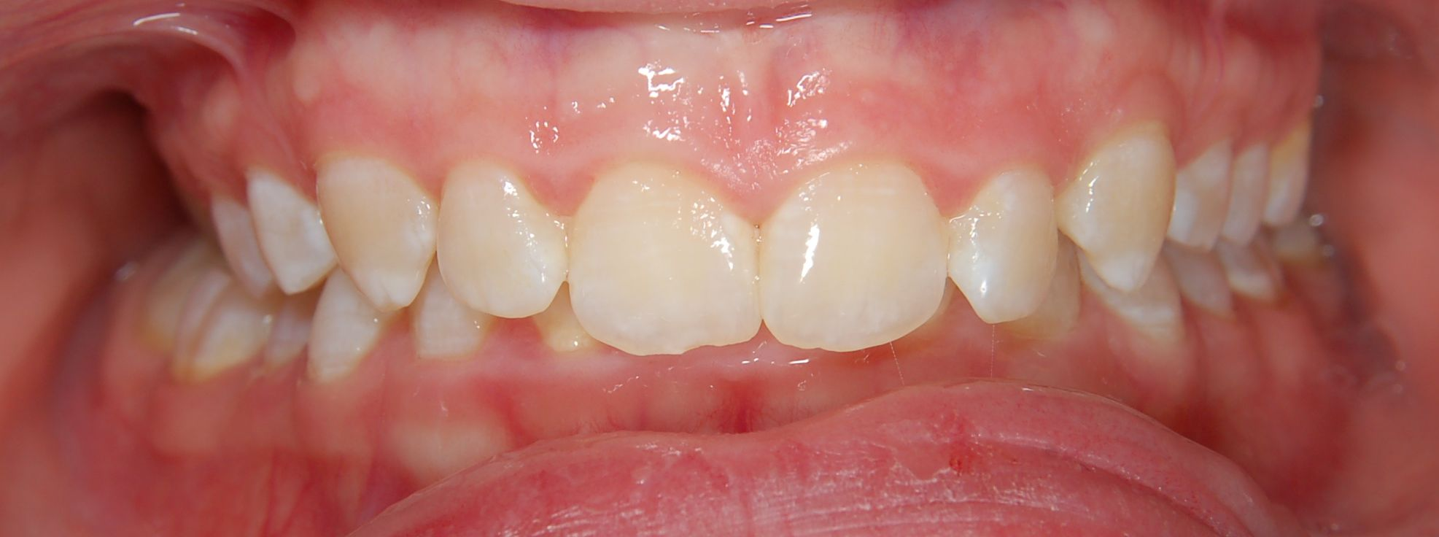
Deep bite

Slide 35
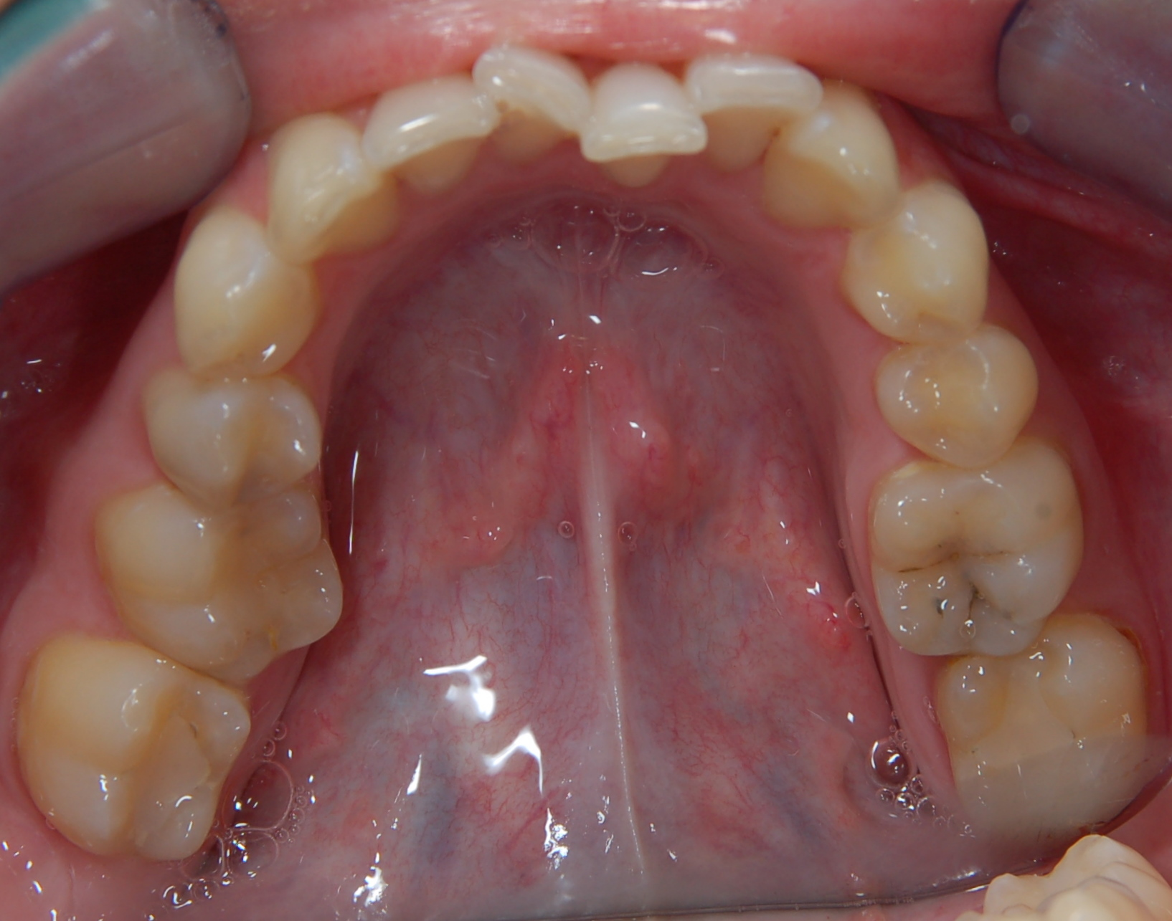
Crowding

Slide 36
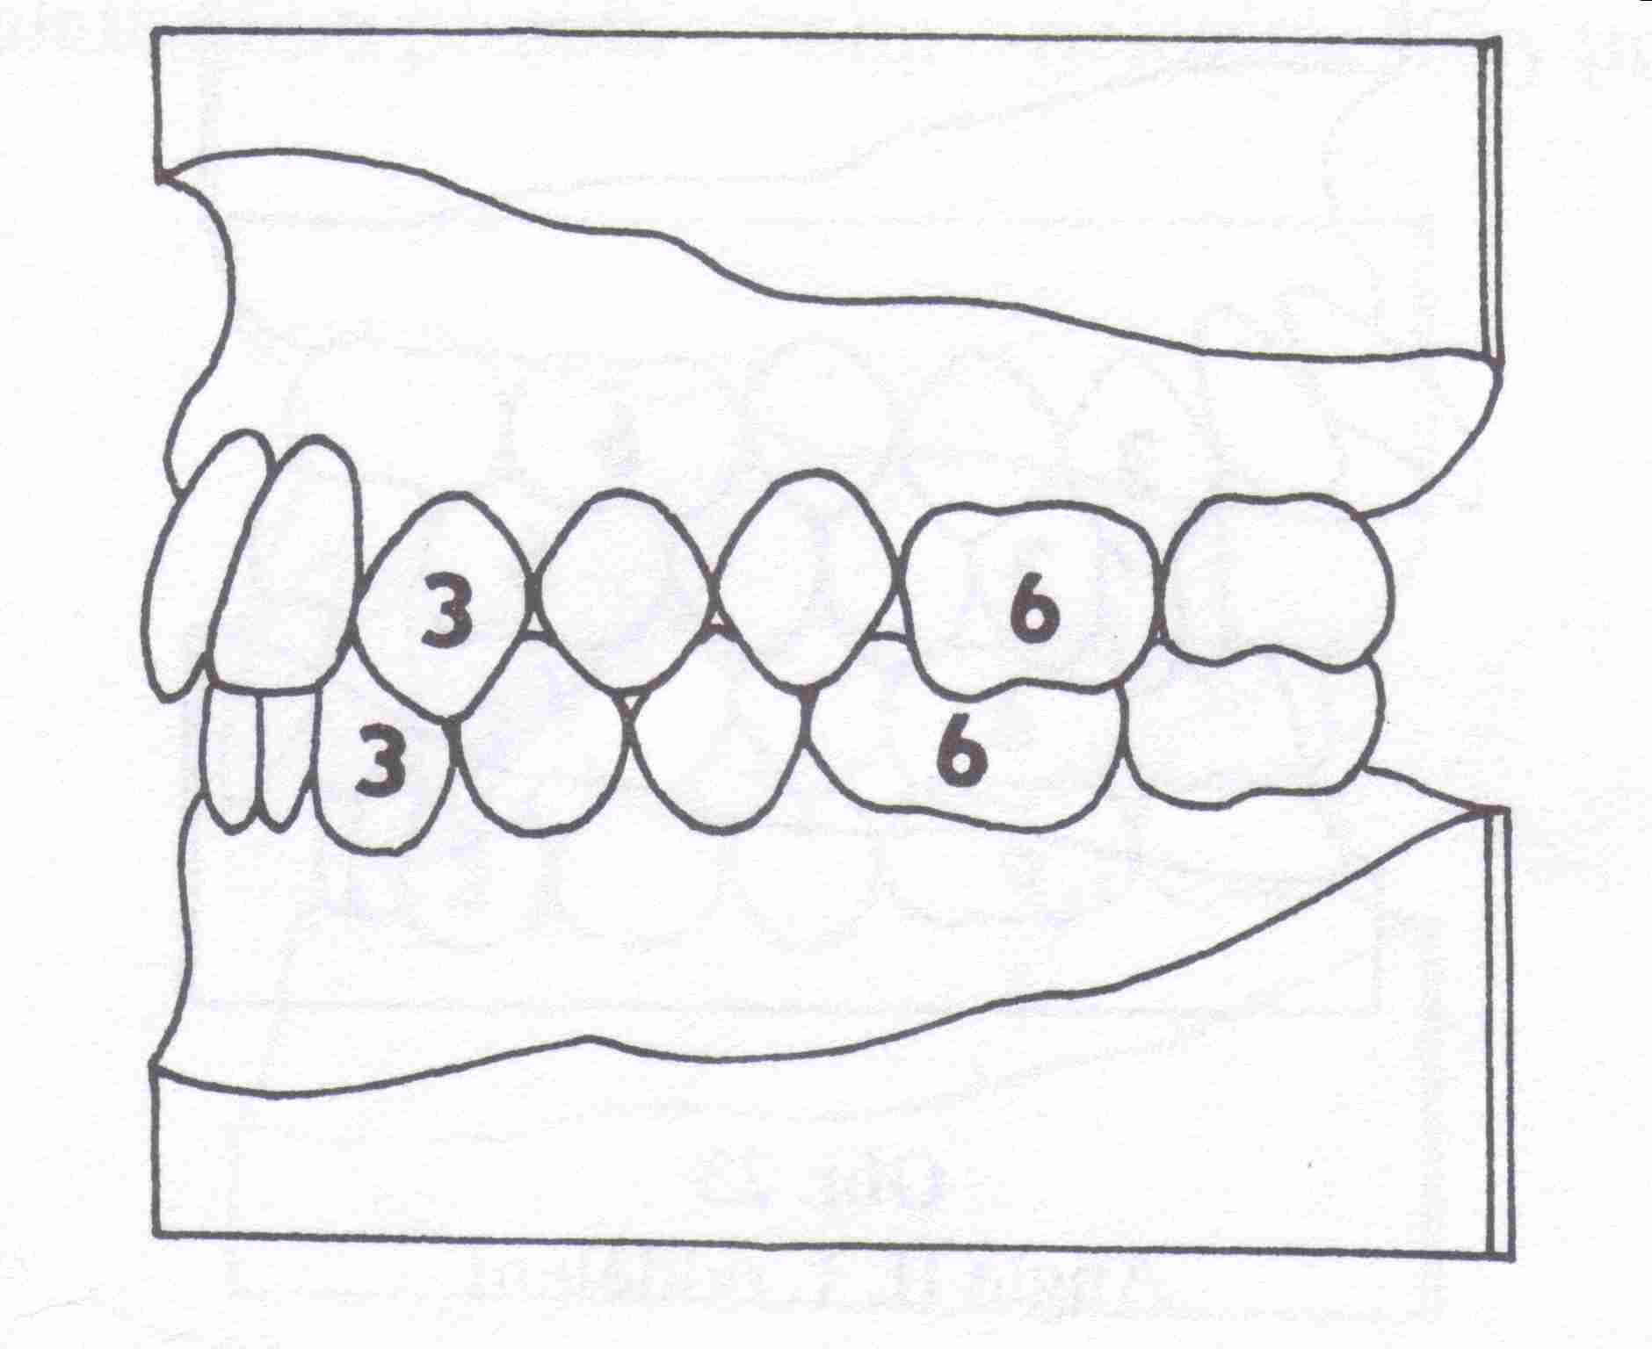
3. Anomalies of the relationship of dental arches = Angles classification
Class I . normoocclusion

Slide 37
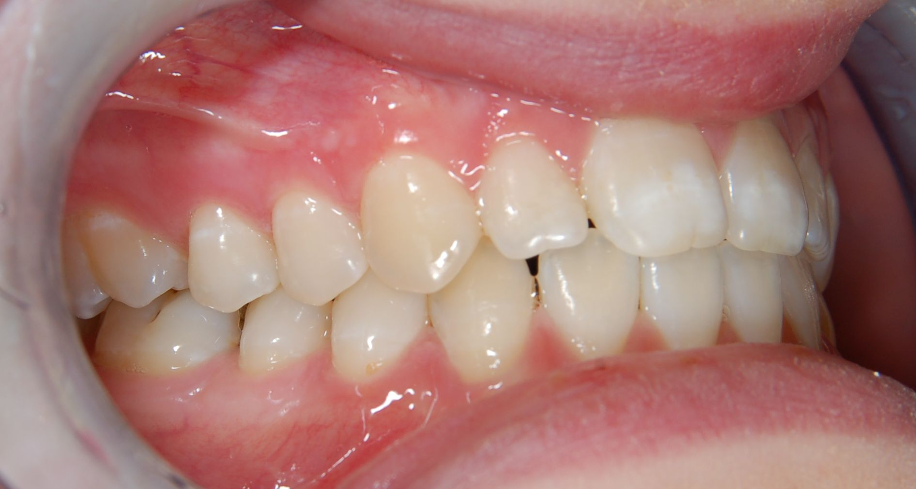
Angle I

Slide 38
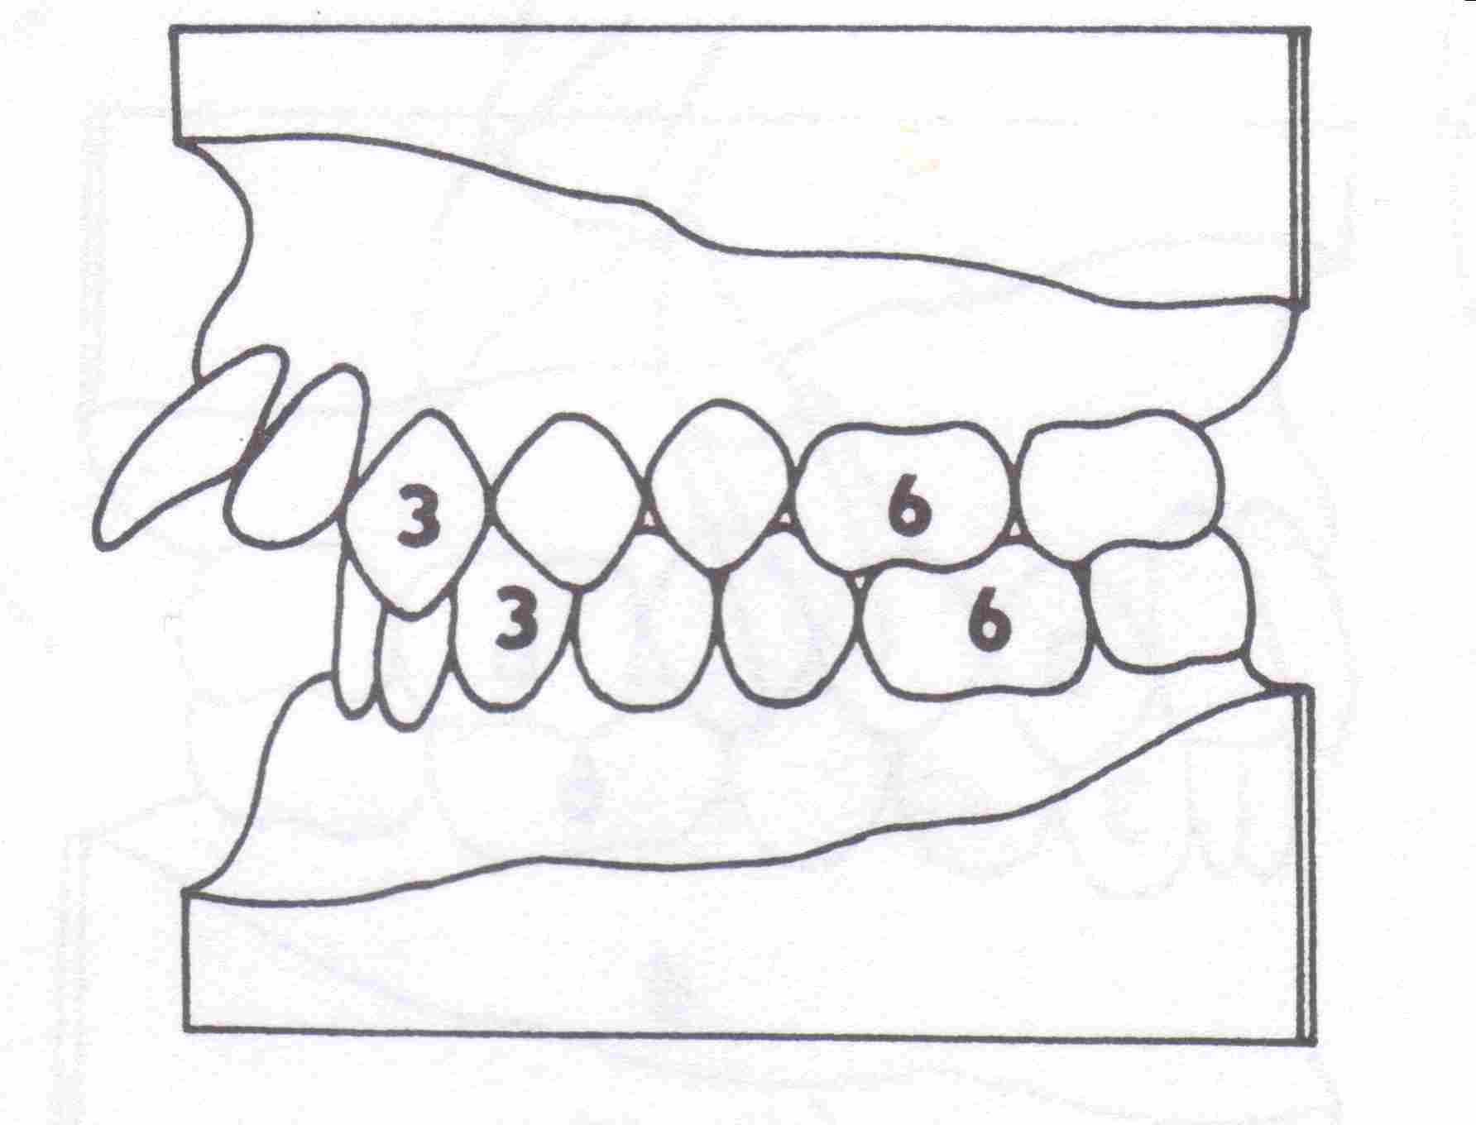
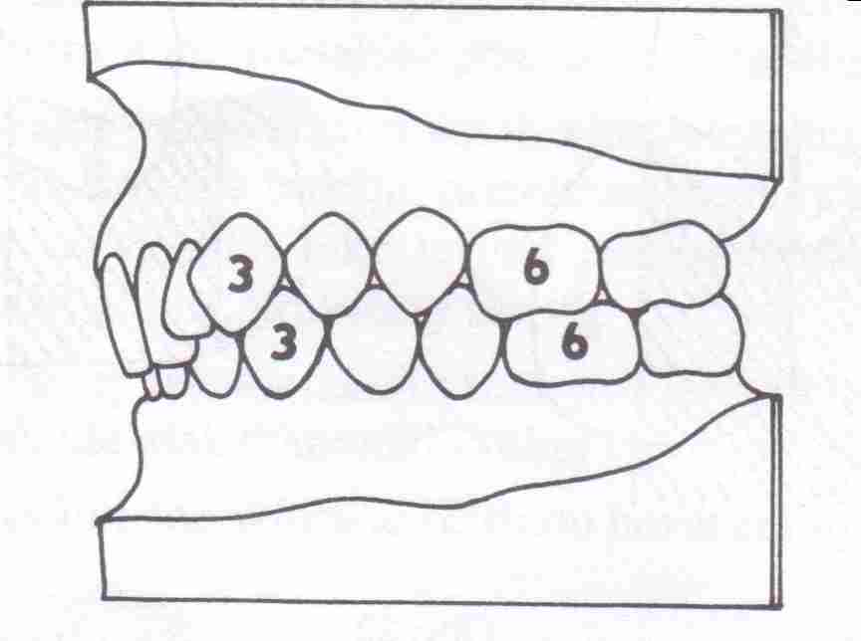
Classification of orthodontic anomalies
Class II : distal occlusion
- with protrusion of upper incisors
- with retrusion of upper incisors

Slide 39
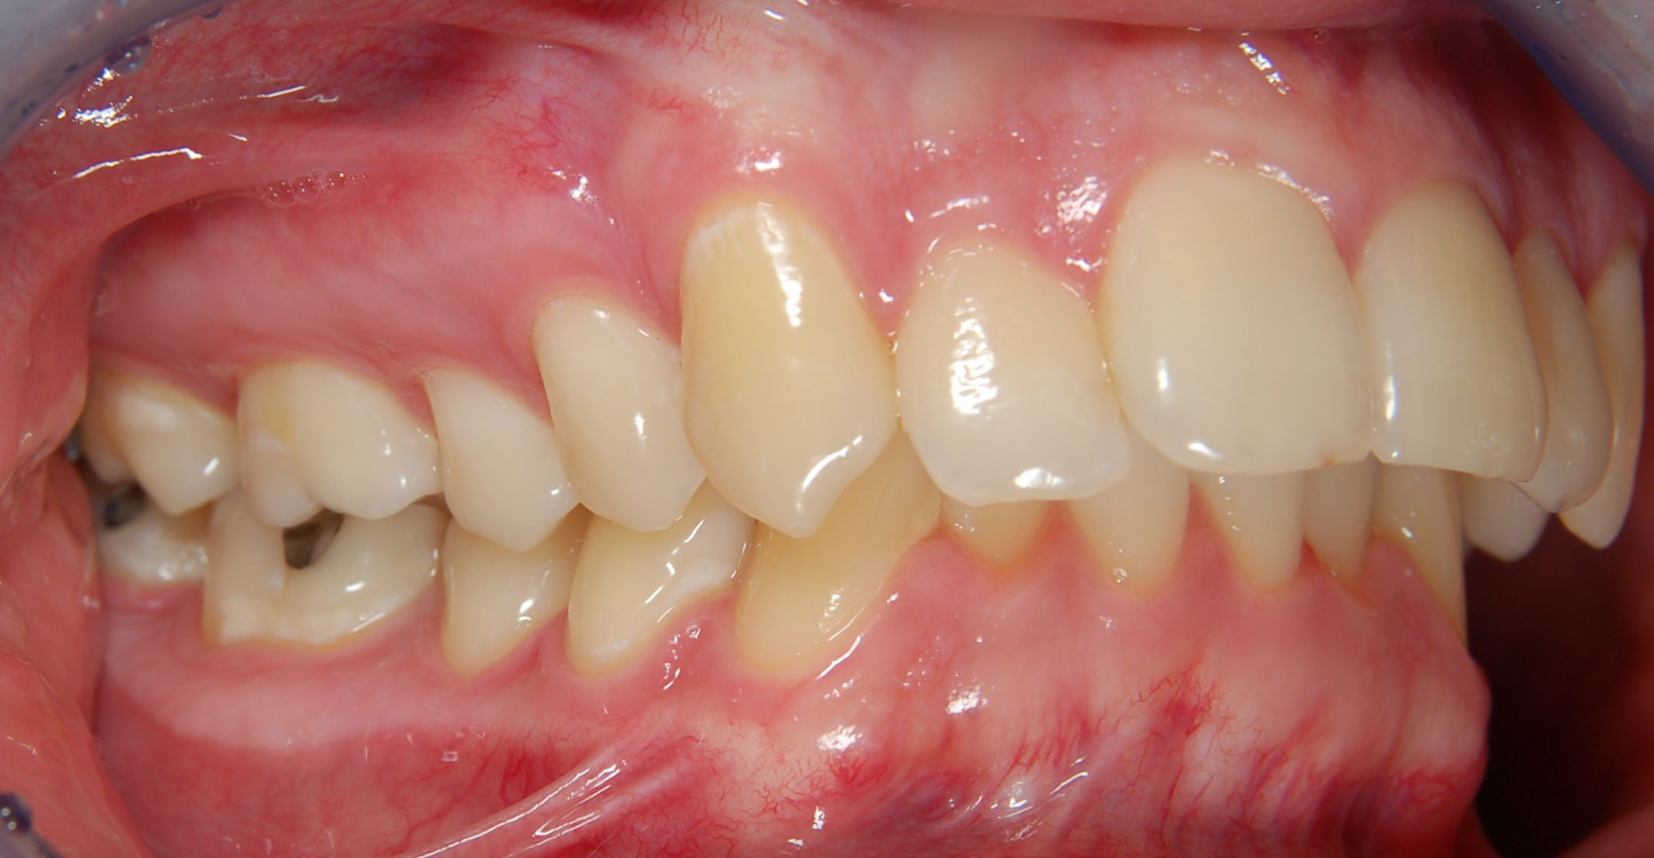
Angle II

Slide 40
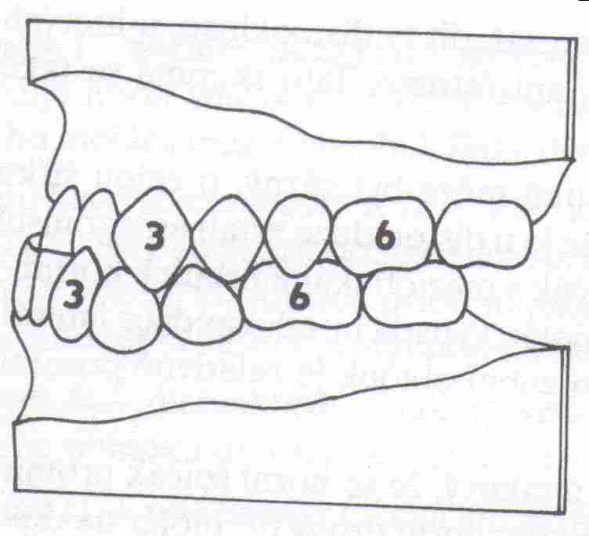
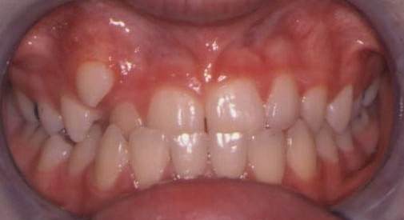
Classification of orthodontic anomalies
Class III : mesial occlusion

Slide 41
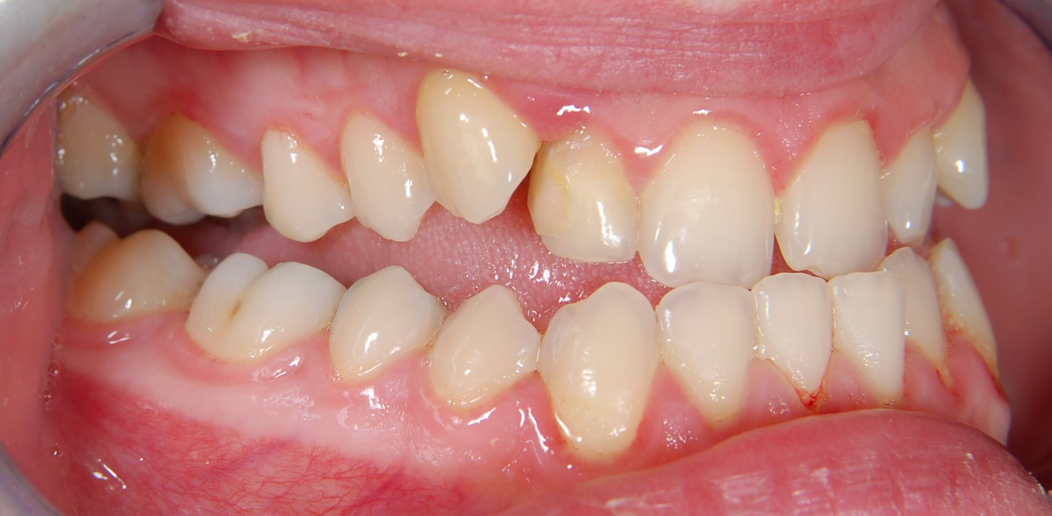
Angle III

Slide 42
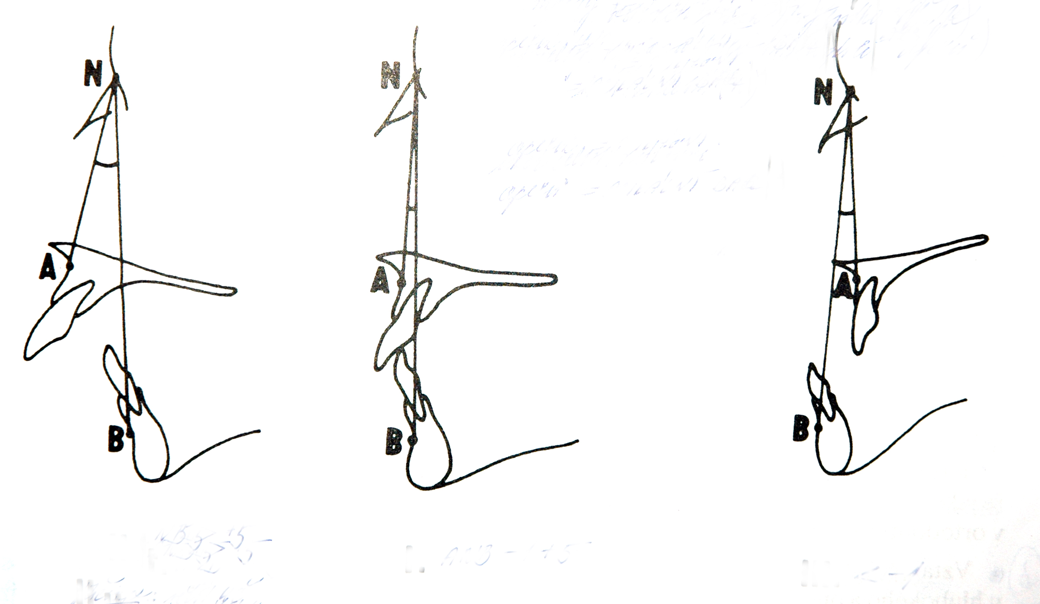
Classification of orthodontic anomalies
4. Anomalies of position, size and relationship of the jaws-bones

Slide 43
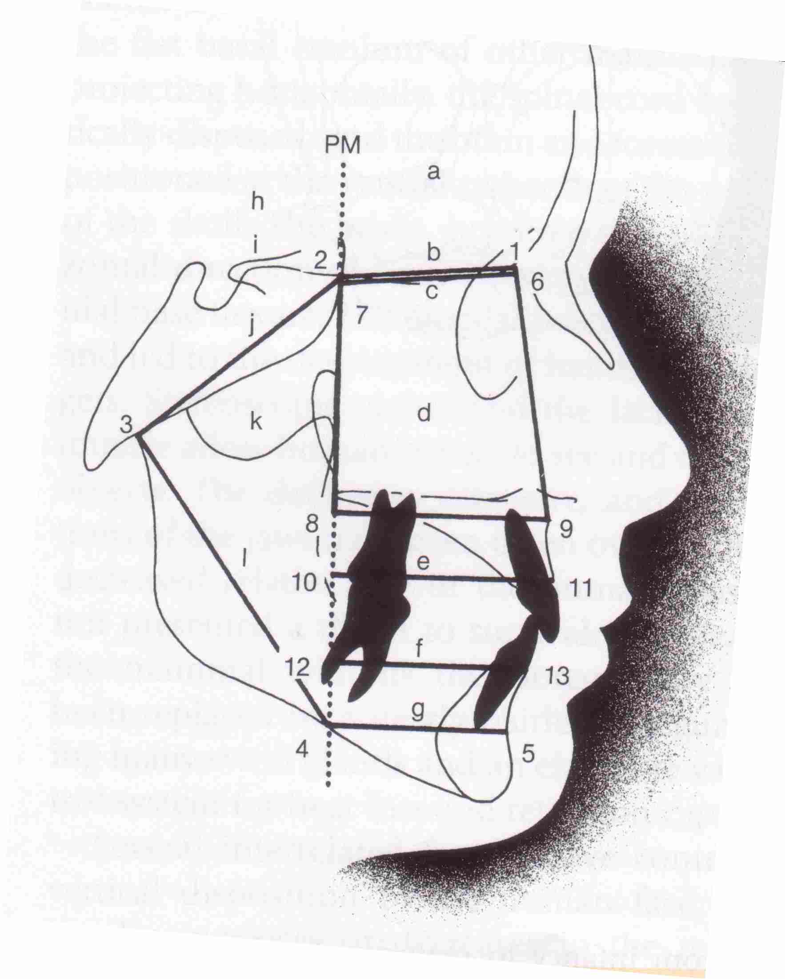
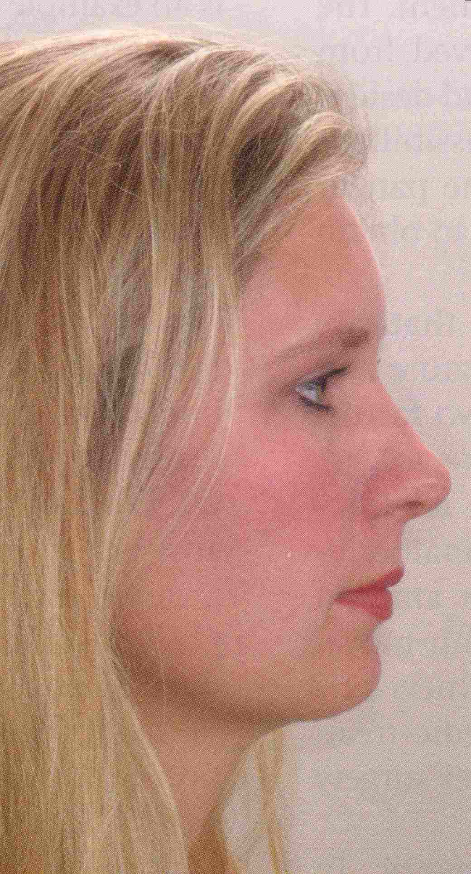
4. Anomalies of position, size and relationship of the jaws-bones
Skeletal class I : relationship of jaws without any deviation

Slide 44
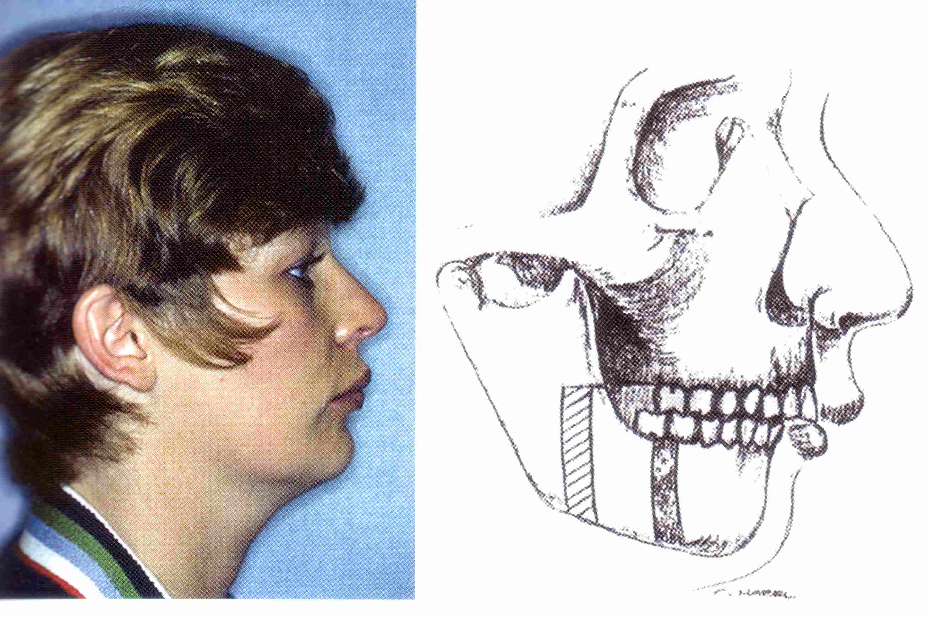
Classification of orthodontic anomalies
Skeletal class II : the lower jaw is more distally to the upper jaw (small lower jaw, large upper jaw)

Slide 45
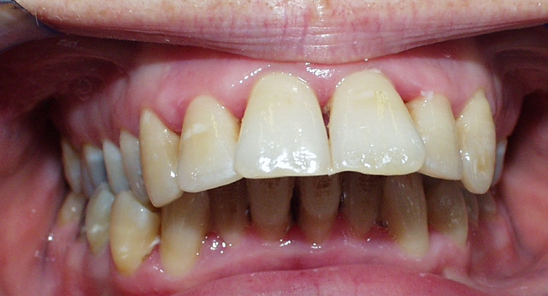
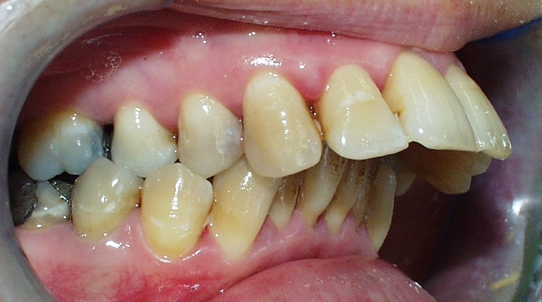






Slide 46





Slide 47

Angle II

Slide 48

Classification of orthodontic anomalies
Skeletal class III : the lower jaw is ventral to the upper jaw (progenia – large mandible,pseudoprogenia – small maxilla)

Slide 49

Angle III, skeletal cl. III

Slide 50


Skeletal class III

Slide 51

Classification of orthodontic anomalies skeletal deep bite skeletal open bite

Slide 52


skeletal deep bite skeletal open bite

Slide 53


Thank You four Your attention
Questions – email – alena.brysova@fnusa.cz
Consultation – Orthodontic department - St. Anne's Hospital, building D2b – Thursday 1-2 p.m.

