Slide 1
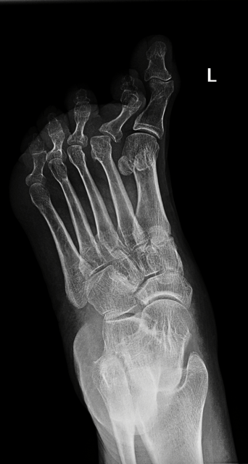
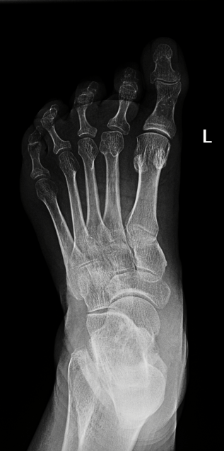
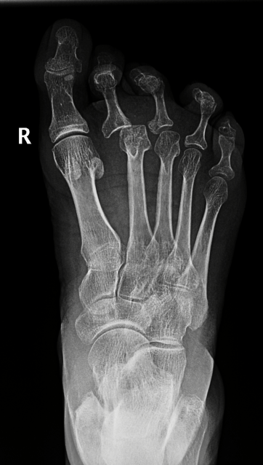
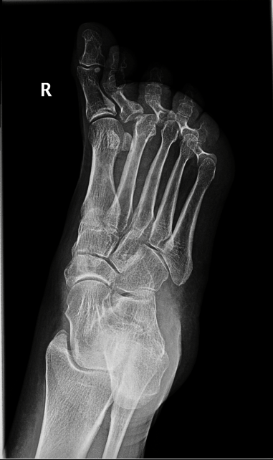
Transverse flatfoot – examination and therapy
R. Zítka, M. Maršálek
FN Brno ORTK 22. října 2014

Slide 2
Metatarsalgia
Metatarsalgias are forefoot pains localized distally from Lisfrank‘s joint
The clinical manifestation is the transverse extension of the forefoot – transversely flat foot
This static deformity is defined by divergence of marginal MTT, big toe valgosity, MTT varosity
followed by I. MTT and V. MTT insufficiation and overload of II. -IV. MTT

Slide 3
"The leg is an work of art composed of 26 bones, 107 ligaments and 19 muscles" - once written by Leonardo da Vinci.
The arch of the foot has three components on which it depends – the bone component consisting of the bones of the foot, their shape, the connective component formed by the ligmentous apparatus and the muscular component, the role of which is especially in the dynamic load of the foot

Slide 4
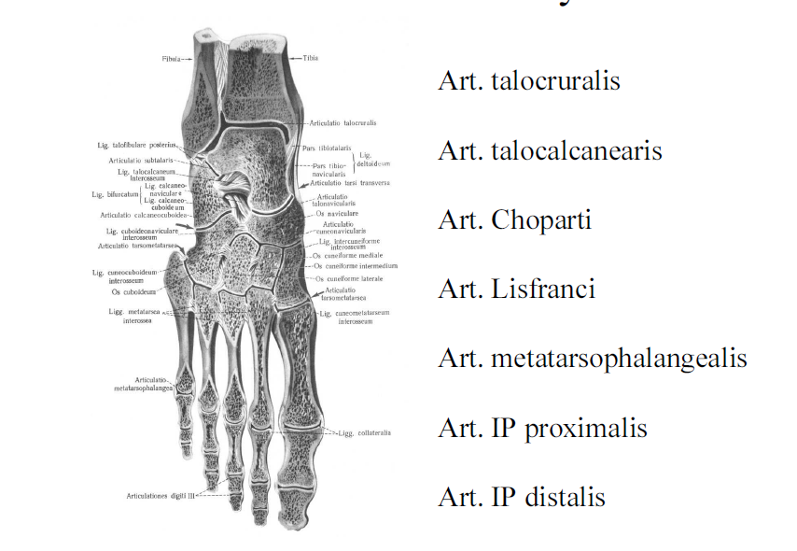

Slide 5
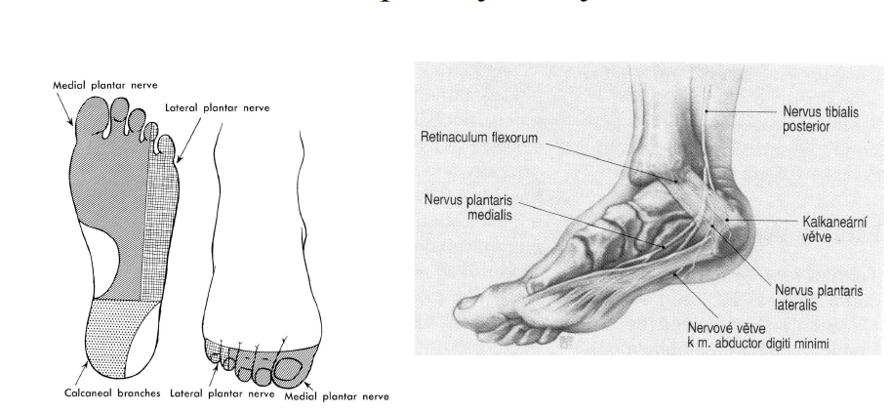
Inervation of the foot

Slide 6
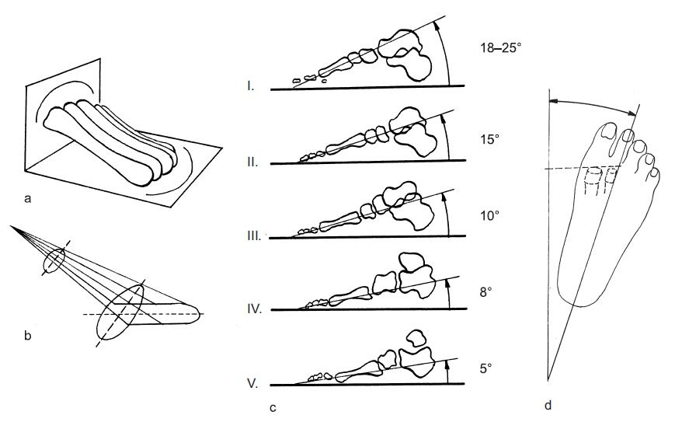
Lake (1952) describes metatarses as a conical segment, slightly stretched by the ante-posterior direction, the individual heads touch the groung in the arc, with the convex shape forward

Slide 7
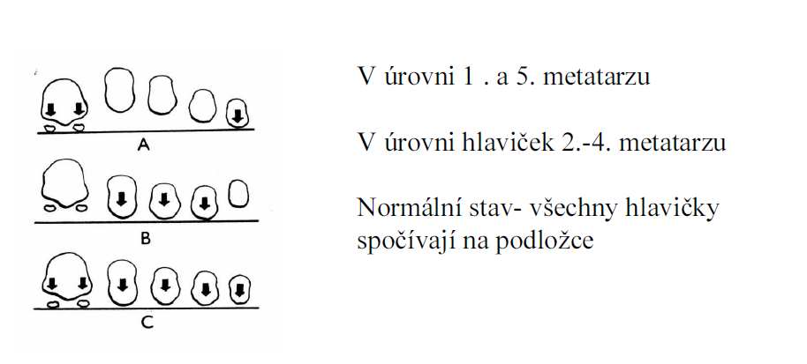
Transverse Arch

Slide 8
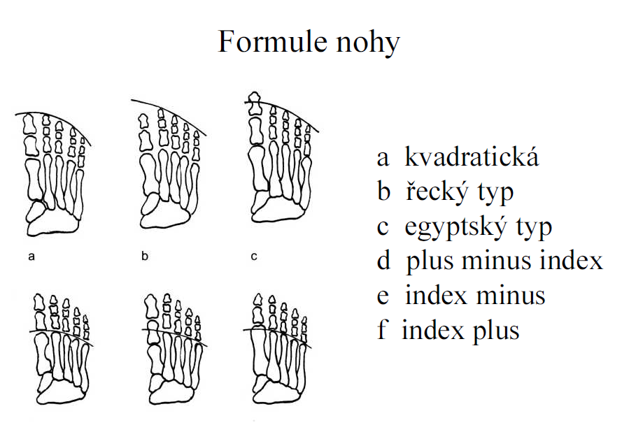
Viladot 1975
28%
56%
16%
d
e
f

Slide 9
Metatarsalgia
Viladot - overload of the front of the leg
- Women with high heels, pes cavus, pes equinus
- Involvement of MTT itself, there is a change in pressure under load on the foot
- Short I.MTT, hypermobility of I.MTT, after osteotomies (first ray insuficiency syndrome)
- Long I.MTT (first ray overload syndrome)
- Neurological and congenital impairment (central ray overload syndrome
- Long metatarses (central ray overload syndrome)

Slide 10
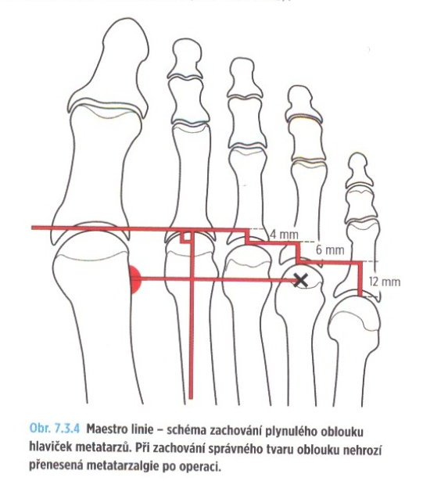
1995

Slide 11
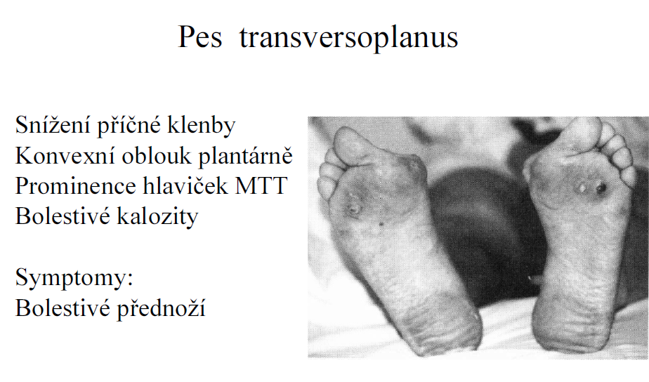
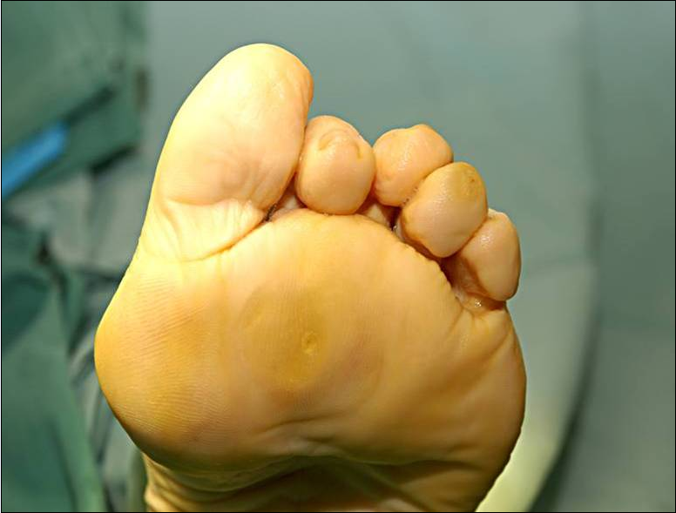
Kladívkové deformity prstů

Slide 12
Possible causes
Fractures from overload (no. II and III MTT)
Congenital short/long MTT, MTT hypoplasia
Freiberg - Köhler disease (Kölher II)
Morton neuralgia, tarsal tunnel syndrome
Plantar fibromatosa
Post-stress state, scars, contractures (peroneal, m. triceps surae)
Tumors
Systemic diseases – RA, collagenosis, psoriasis, on. blood vessels, DM
Spinal root afectation during intervertebral disc protrusion
Nerve diseases – DMO, paresis, myopathy
Diseases of the connective system - Marfan's sy, Ehlera-Danlos sy, Down sy.
Iatrogeny – after surgery at I. MTT (shortening),

Slide 13
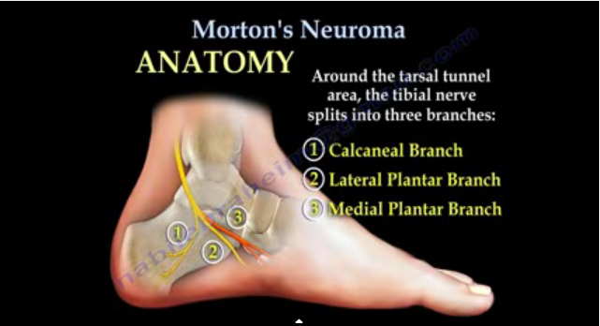
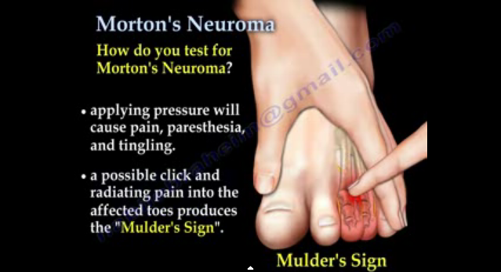
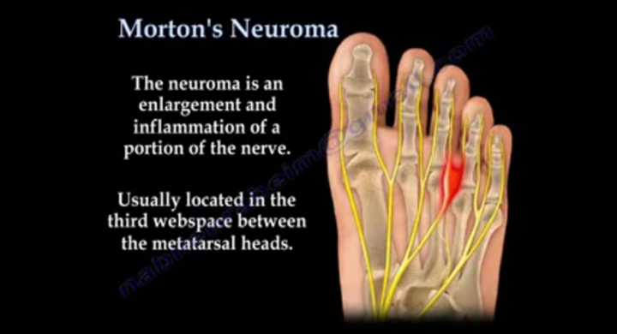

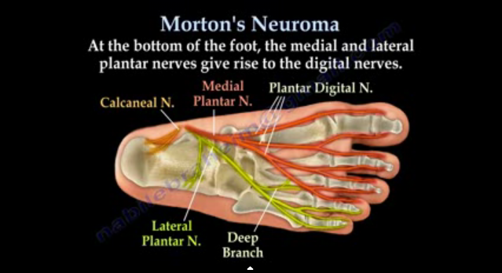
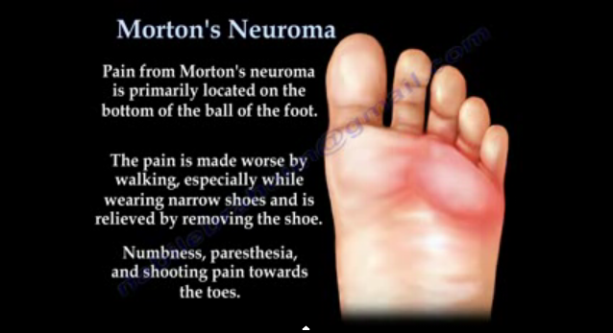
Útlak III. digitálního nervu předním okrajem
plantární fascie

Slide 14
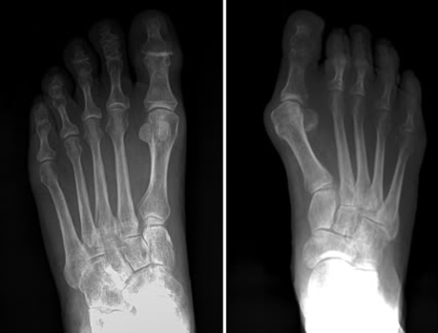

Slide 15
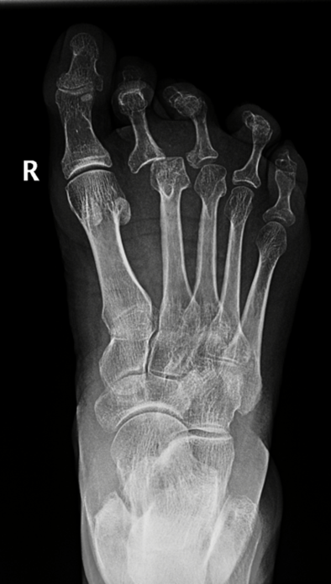
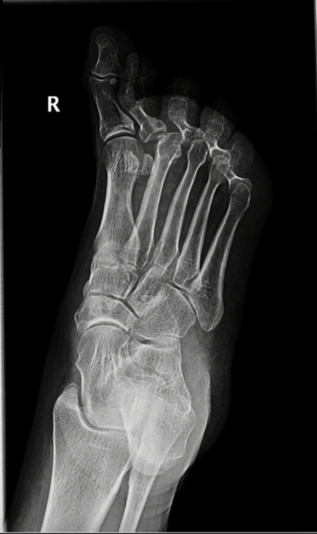

Slide 16
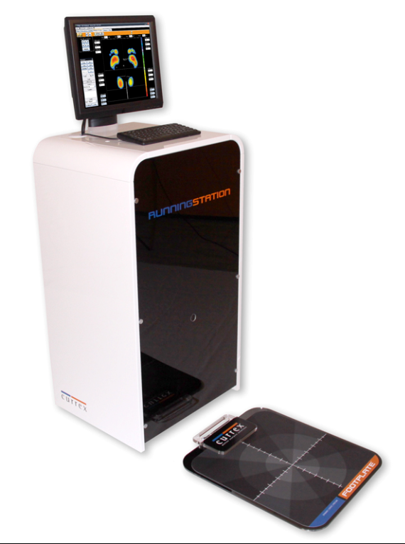
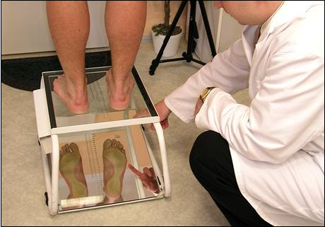
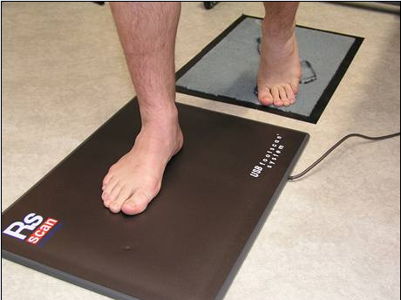
Examination
Clinical, medical history
X-ray legs AP image in the load, oblique, lateral projection in the load
Podoscopy, pedogram

Slide 17
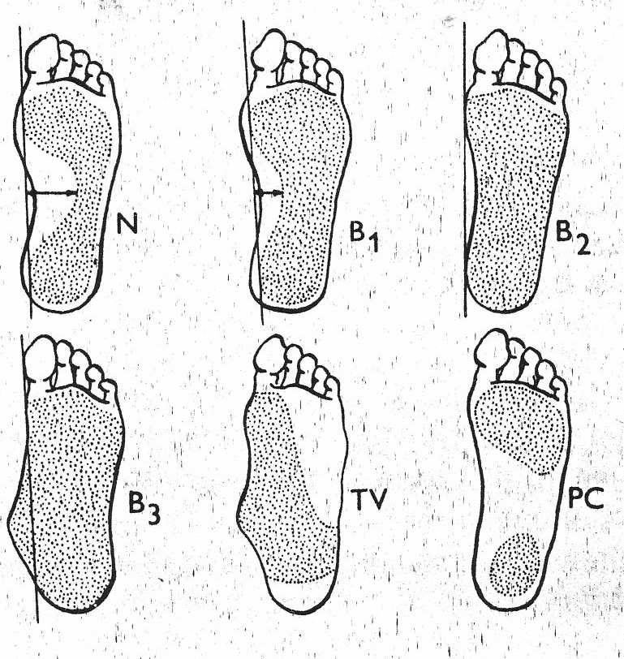
Podoscopy, pedogram
Classification B1, B2, B3

Slide 19
Conservative therapy
- Wearing high-quality footwear with longitudinal vault support and heel guide (fixed heel)
- Load reduction, weight reduction
- Treatment of varicose veins, compensation of DM
- Stimulation and facilitation of the face in everyday life – walking barefoot in soft uneven terrain (grass, sand)

Slide 20
Conservative therapy
Passive support – orthopaedic inserts according to functional examination, individually manufactured shoes according to the podoscopy
retrocapital pelota (hearts), increase of the outer edge of the insert, which ensures proper conduction of the wall heel.
- Corticosteroid injection
- Active therapy – physiotherapy

Slide 21
Rehabilitation / physiotherapy
The basis of physiotherapy is sensomotor exercises
foot facilitation
training of pressure distribution on the foot, training of support of three points, small legs in the centered position of the joints of the lower limb
soft tissue techniques are used, mobilization of the joints of the foot is carried out
relaxation and stretching in hypertone and in shortening

Slide 22
Rehabilitation / physiotherapy
From physical therapy:
antiedematous procedures – manual and instrumental lymphatic drainage
water treatment – alternating and pedal baths, cold hot tubs are indicated
For muscle relaxation we can use ultrasound, electrotherapy (diadynamic DD currents, TENS – transcutaneous electrical neurostimulation)

Slide 23
Surgical treatment
Shortening osteotomy of metatarses
Combination with hallux valgus operations
Preoperative, free movement in MTP joints must be
Hoffman 1912
Mau 1940
Giannestras 1945
Wolf 1973
Helal 1975
Weil surgery 1985 - in the treatment of metatarsalgia is preferred in patients with restriction of movement, in subluxation and luxation in MTP joints
BRT osteotomy 1991
M. Vitek, V-TEK system 2009

Slide 24
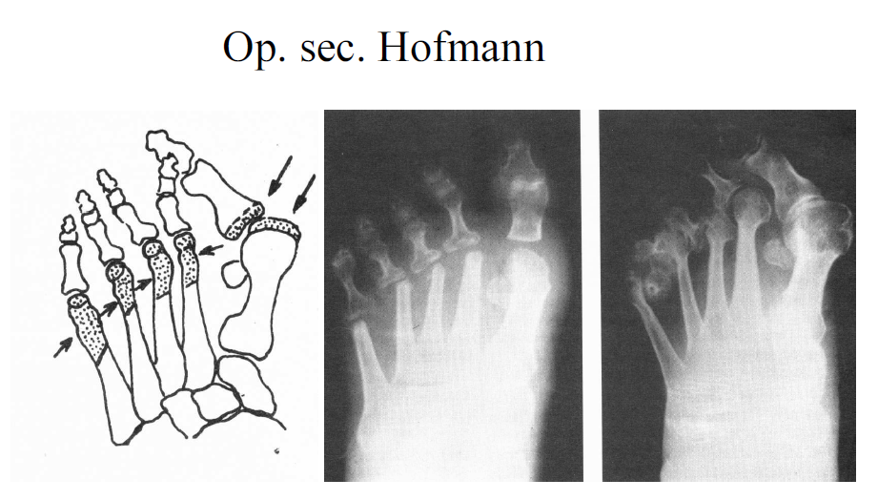

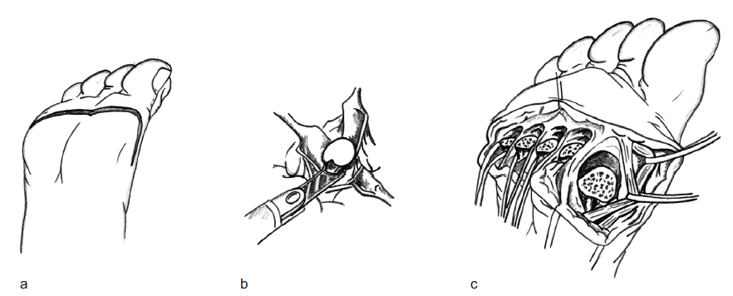
(1912)

Slide 25
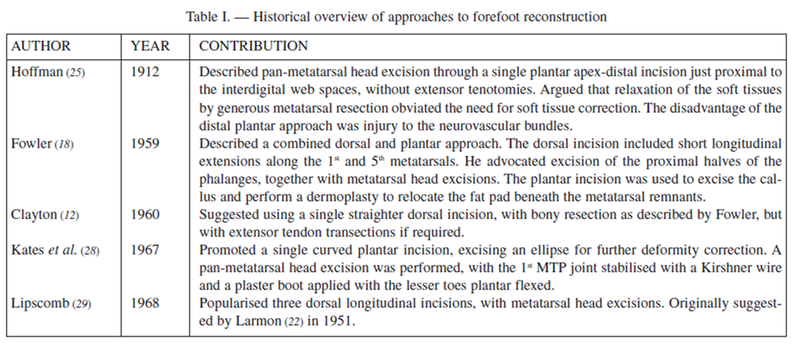

Slide 26
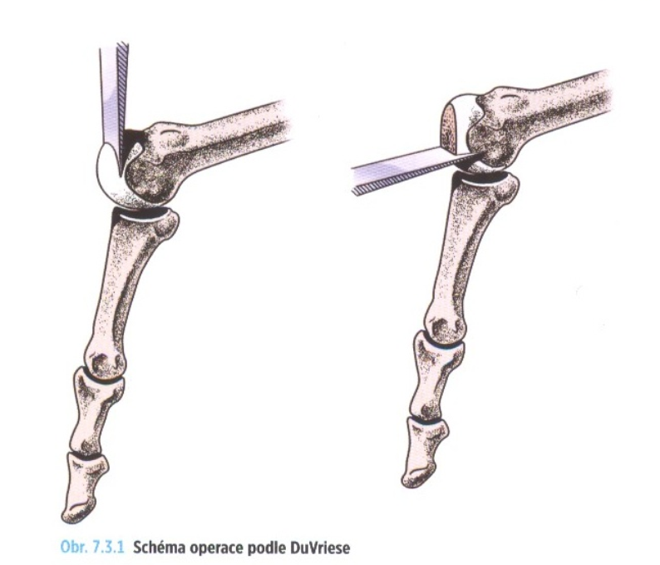
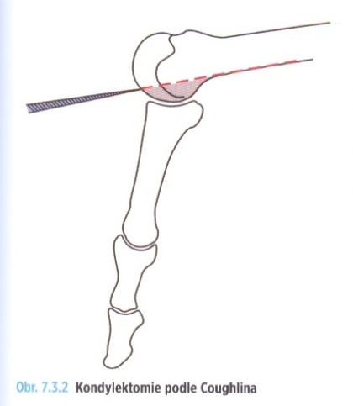
Du Vries (1953)
Mann a Coughlin

Slide 27
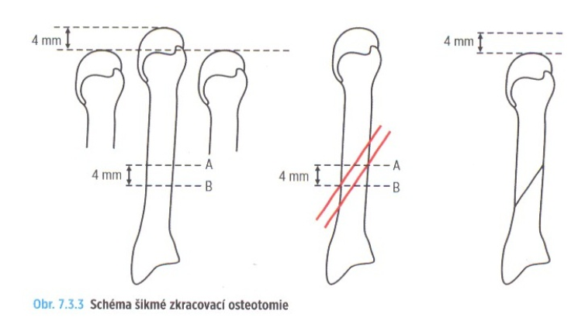
Giannestras (1945), modified later by Coughlin

Slide 28
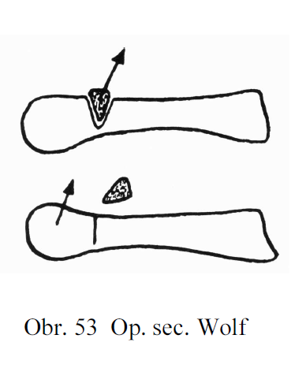
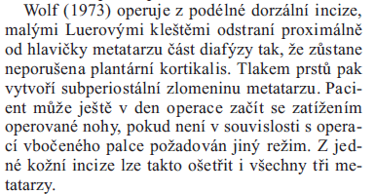


Slide 29
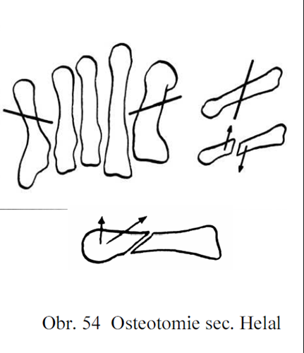
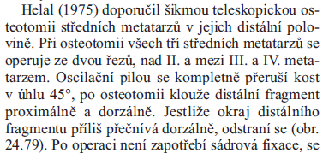

Success rate 88%
Pakloub 15%
Turan and Lindren - same type of fixation operation
Screw

Slide 30
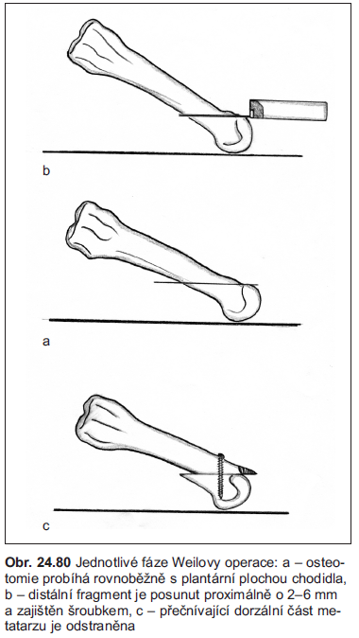
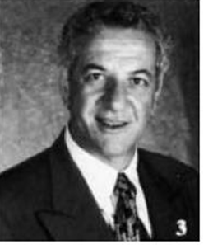
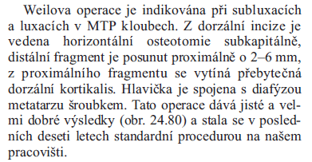
Lowel Scott Weil (Chicago, USA) 1985
Osteotomy length 2.5- 3cm
"Z" sculpture of extensors

Slide 31
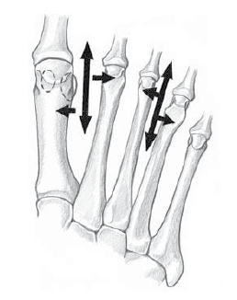
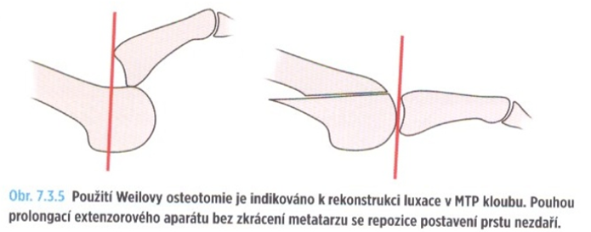
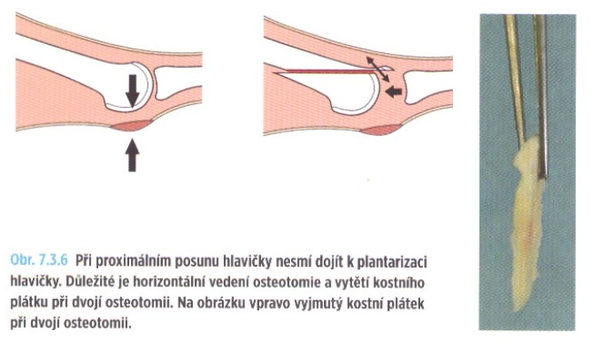
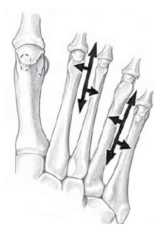

Slide 32
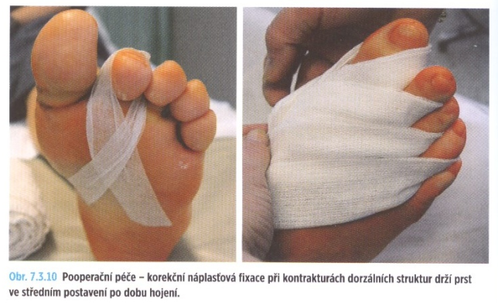
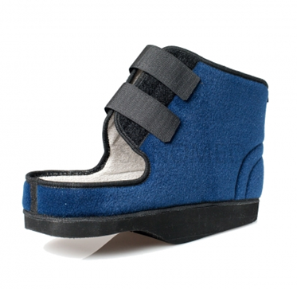
Postoperative care
Limb to an elevated position 90% of the time in the first 10 poop. Days.
Correction fixation in light plantar flexion
Passive finger flexion exercises
Removal of stitches in 14 days
Verticalization in a special postoperative shoe 4-6 weeks
X-ray feet AP under load and oblique scan 6 weeks after surgery

Slide 33
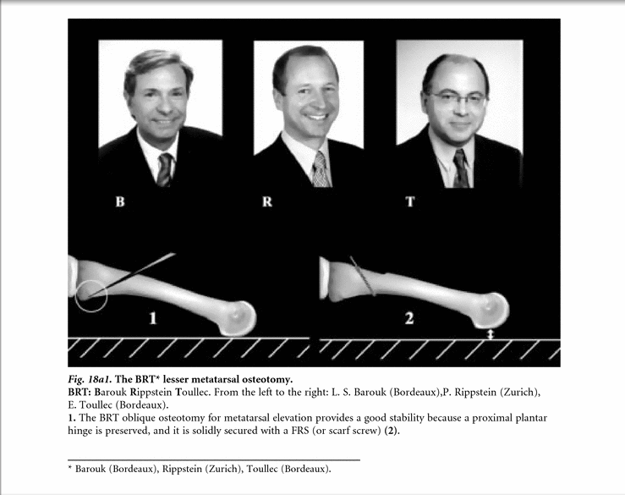
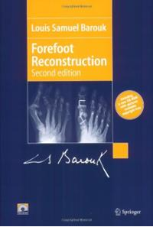
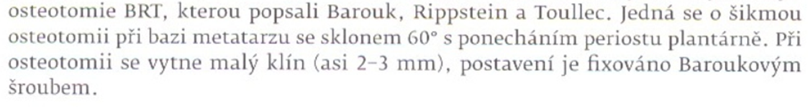
1991, 2nd. 2005

Slide 34
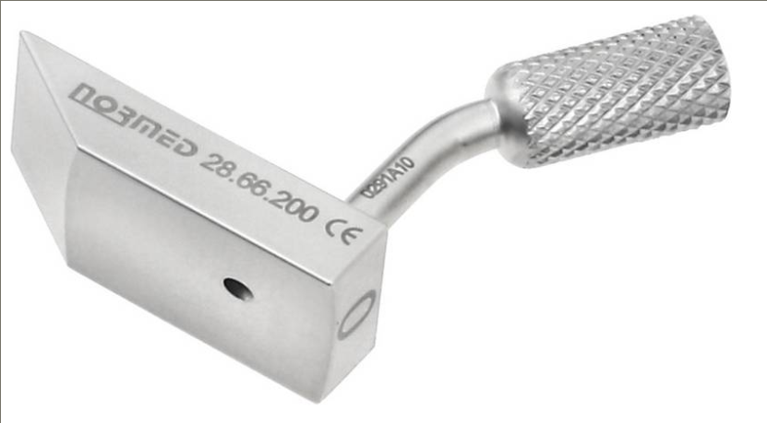
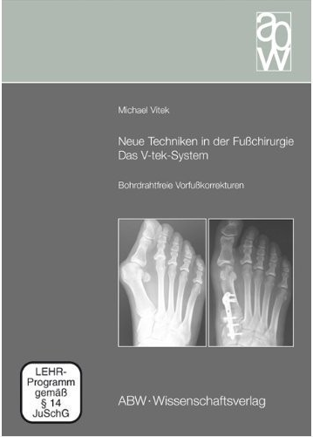
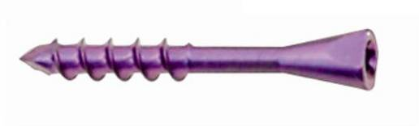
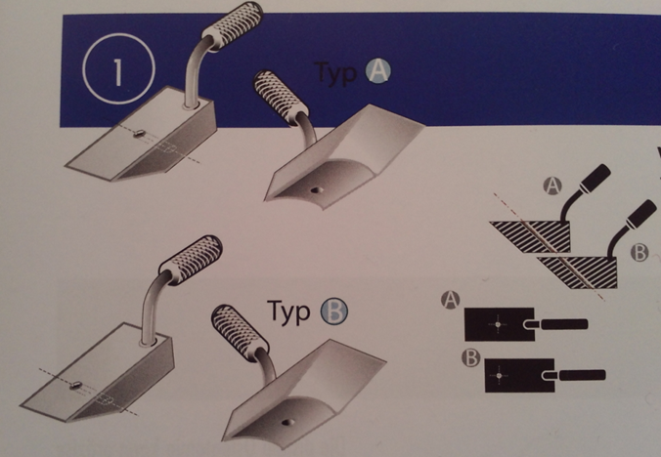

Slide 35


Slide 36

Hammer toe surgery
Gocht (1925)
Post (1882)
- při rigidní extenzní kontraktuře MTP kl.

Slide 37



Slide 38
http://www.uloz.to/xcM3dfo/4hd-weilova-osteotomie-mpg
http://www.foothyperbook.com/elective/metatarsalgia/metatarsalgiaSurg.html

Slide 39

In the reconstruction of the hip, knee, or any other joint, preoperative planning is necessary for avoiding mistakes during surgery. Since 1995, the authors have been doing this before forefoot surgery to increase the accuracy of the surgery. As much as possible, they try to correct only the lesion and to avoid preventive or extensive surgery on adjacent rays, except if the correction leads to a modified dysharmonious new morphotype with high risk of transfer lesion. The tolerance length seems to be 2 mm, particularly on the middle metatarsals (M2 and M3). This surgery should be performed only if the midfoot and backfoot are correct and if the gastrocnemius muscle has been checked on to eliminate a retraction needing stretching exercises before and generally after surgery.

