Slide 1

Lecture 5 : RNA-seq analysis
Modern Genomic Technologies (LF:DSMGT01 )
Vojta Bystry
vojtech.bystry@ceitec.muni.cz

Slide 2

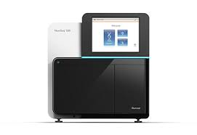
NGS data analysis
de-multiplexing
Raw data
.fastq
Experiment design
QC
Not known
reference
Not ”classic” reference
Genome/Transcriptome Reference Mapping
.bam
Metagenomics
Reference assembly
Immunogenetic
VDJ-genes
CRISPR
sgRNA
QC
Methylation
Bisulfide-seq
Interaction
analysis
CHIP-seq
Expression analysis
RNAseq
Variant analysis
WES
…
2

Slide 3
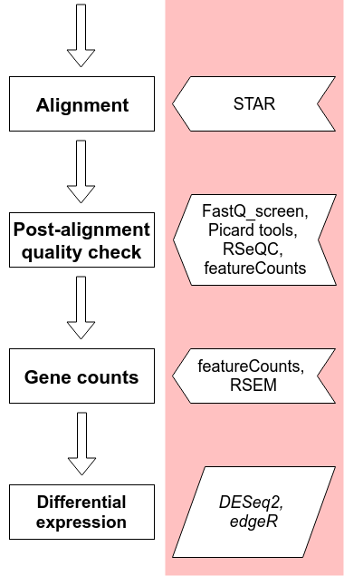
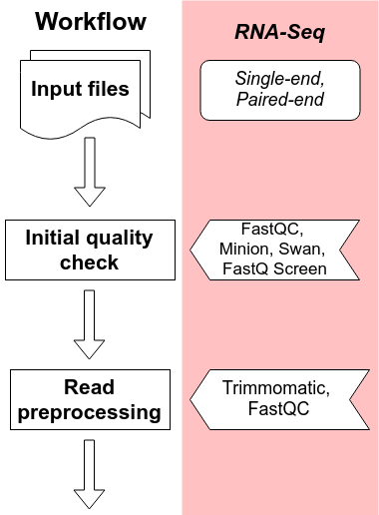
The RNA-Seq workflow

Slide 4
Alignment
Mapping to genome or transcriptome?
Genome
  Requires spliced alignment
  Can find novel genes/isoforms/exons
  Information about whole genome/transcriptome
Transcriptome
  No spliced alignments necessary
  Many reads will map to multiple transcripts (shared exons)
  Cannot find anything new
  Difficult to determine origin of reads (multiple copies of transcripts)

Slide 5
Alignment
Our choice is the STAR aligner
It performs genome alignment
Offers a lot of settings to support splicing, soft-clipping, chimeric alignments, ...
Other techniques (Salmon or Kallisto) do not use alignment per se and can give you the gene count information right away
  They use only transcriptome as a reference and are very quick
  Drawback is you see only what’s in the transcriptome and nothing else

Slide 6
Duplication removal - UMI
PCR duplicates
Optical duplicates
How the tools recognize duplicates
  Maps to the exact same place
Problem is it could be identical fragment not PCR duplicate
UMI helps
  Maps to the exact same place
  AND have identical UMI sequence

Slide 7
Post-alignment QC
Post-alignment QC gives us information about the mapping
  Number of mapped reads - unique + multi mapped
  Mapped locations
  Duplication rates
  Library strand specificity
  Captured biotypes
  rRNA contamination
  5’ to 3’ end coverage bias
  …

Slide 8
Post-alignment QC - Tools
STAR alignment results - number of mappings and others
RSeQC - mapped locations (Read Distribution), library strand specificity
featureCounts biotypes - summary of mappings to gene biotypes
FastQ screen (not exactly Post QC) - residual content of rRNA, tRNA, general mapping percentage to the genome (if selected)
Qualimap - general alignment statistics focused on RNA-Seq (rnaseq) including gene body coverage

Slide 9
Post-alignment QC - RSeQC
RSeQC is a general tool for many QC results
Few of them are
  Read distribution - calculates assignment of reads to different genomic features
  Infer experiment - test strand specificity of the library
  Inner distance - calculates approximate distance between read pairs

Slide 10
Post-alignment QC - FastQ_screen
FastQ screen is a quick scan of potential mapping locations on different references
We can use it to do a quick scan of contaminations (various organisms) as well as estimate residual rRNA content
  In polyA selection based libraries we expect to have less then 2% rRNA content
  In rRNA libraries we can have up to 10-15% of rRNA and still consider it a good library
Biobloom other option more computationally expensive

Slide 11
Post-alignment QC - Qualimap
Qualimap performs a numerous checks of the alignment
  One of the modules is rnaseq which is focused directly on RNA-Seq alignments
One of the main information we can get from this module is the gene body coverage
  We would like to see a nice and even read mapping coverage along the whole length of the genes
  The coverage, however, depends on the library fragmentation (low RIN, FFPE samples but also depends on the used library kit (Lexogen QuantSeq)!

Slide 12
Note: Gene body coverage
Often, libraries with high fragmentation (and low RIN numbers) combined with polyA selection might have strong 3’ end bias
  This is a result of polyA “pulled” fragments
Some kits, however, target only the polyA tail or sequences close to it
  An example is Lexogen QuantSeq which sequences only one read per mRNA molecule close to polyA tail

Slide 13
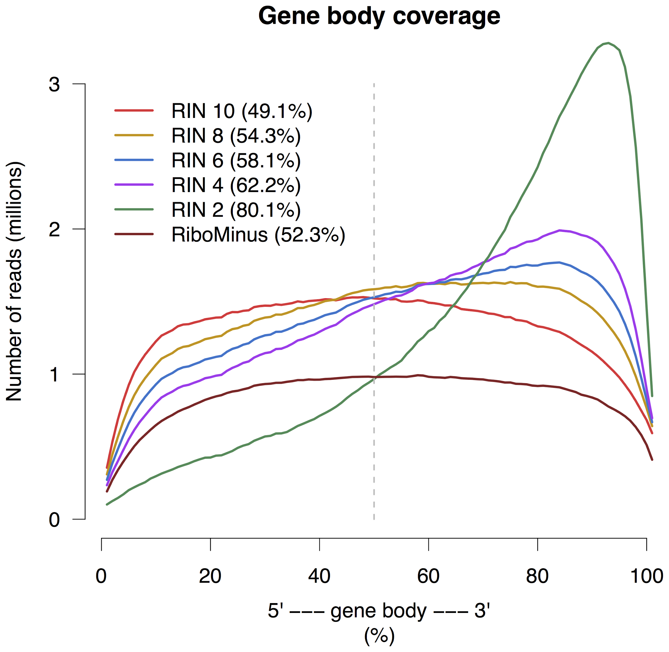
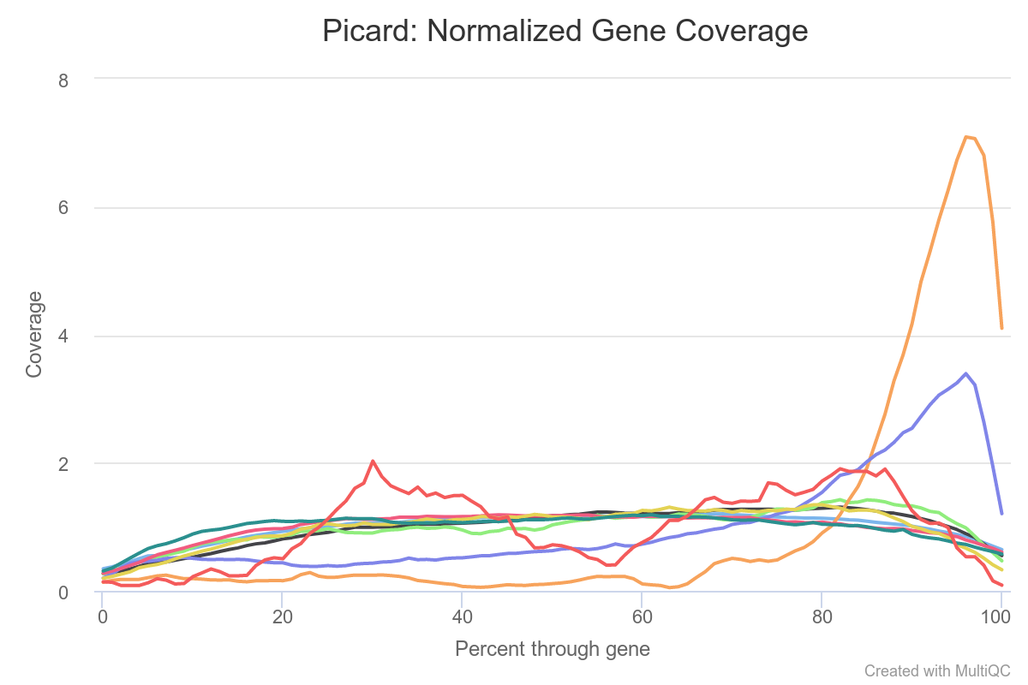
Note: Gene body coverage II
Source: Sigurgeirsson et al. PLoS ONE 2014
Examples

Slide 14
Mapping QC

Slide 15
Mapping QC
Examples

Slide 16
Feature counting
Now, when we know our alignments are solid we need to get the number of reads mapped to a gene (or other feature)
  From there, we can calculate the differential expression
The question is, how do we summarize the counts
  Do we want only uniquely mapped reads
  Do we want also multi mapped? And how do we assign them? All? One random? Somehow else?
  And what if we have multiple genes which overlap each other?

Slide 17
Strand specific library
We can basically have three strand specificities
  Non stranded/Unstranded - not very common anymore
    Direction of the read mapping is completely random (50/50)
  Forward (sense) stranded - common for target kits and “bacterial kits”
    Direction of the read mapping is the same as the gene it originates from
  Reverse (antisense) stranded - “default” for Illumina and NEB kits
    Direction of the read mapping is the opposite as the gene it originates from
In case of paired-end sequencing it’s measure by the first (R1) read orientation (FR, RF)

Slide 18
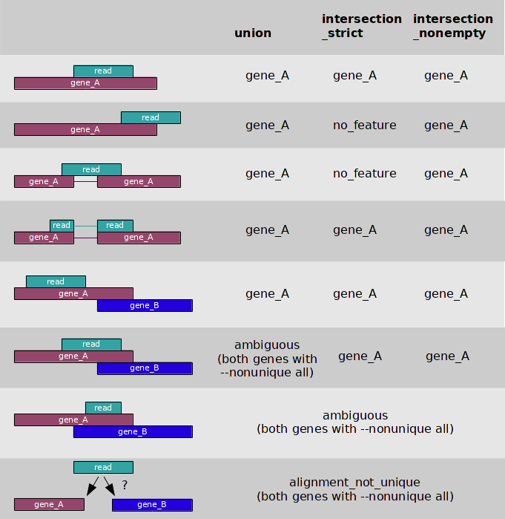
Notes:
Read to gene assignment
Figure 2 | Key criteria for evaluation of strand-specific RNA-seq libraries. (a–d) Categories of quality assessment were complexity (a), strand specificity (b), evenness of coverage (c) and comparison to known transcript structure (d). Double-stranded genome with gene ORF orientation (blue arrows) and UTRs (blue lines) are shown along with mapped reads (black and red arrows, reads mapped to sense and antisense strands, respectively).
https://galaxyproject.github.io/training-material/topics/transcriptomics/tutorials/rb-rnaseq/tutorial.html

Slide 19
Feature counting
The regular settings are - summarize reads mapping to exons (-t exon) and sum them up to gene id (-g gene_id)
Other possibilities:
  Count per exons
  Include introns
  …

Slide 20
Gene counts - Tools
featureCounts is build around the “classic” read to gene assignment
  By default, assigns only uniquely mapped reads an only reads uniquely assignable to a single gene (but both can be changed)
  Gives you raw read counts per gene
RSEM is efficient in counting also multi mapped reads and can estimate expression of individual gene isoforms
  Tries to “weight” the probability a mapped position of a multi mapped read and assign it correctly to the real source
  Gives you estimated counts per gene as well as per isoform and normalized TPM = Transcripts per million transcripts
But, there is a big differences in the minimal required “good” aligned reads

Slide 21
Minimal number of reads and expression I
Source: Roberts et al. Nature Methods 2013
RSEM is less precise in low read counts (<40-50M reads) and for low expressed RNAs (difficult to estimate)
For lower read counts it’s safer to go for featureCounts
Our best practices for a minimal read count for each tools:
  Less than 40-50M aligned reads (to the good stuff) -> featureCounts
  More than 40-50M aligned reads (to the good stuff) -> RSEM
But if you want isoforms!!! -> RSEM
Notes:
RSEM, Salmon and Kallisto give slightly better estimates of the “real” expression because they don’t discard any mapped read. Because even if the read is multi mapped it’s still real.

Slide 22
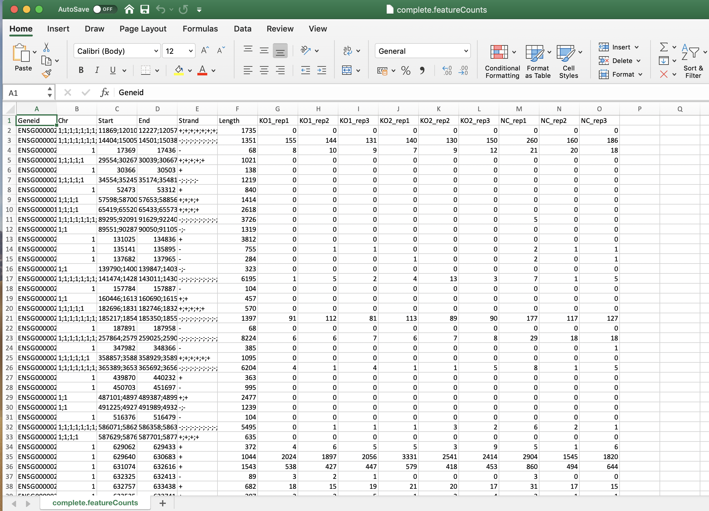
Feature count results

Slide 23
Differential expression
We have our raw read counts but we need to find the real differences
We want to figure out the change comparing the before and after treatment
What are the changed genes? Are there even any? Is there even difference between the samples? And what about the experimental design - paired samples - does it affect the evaluation?
The tools for the differential expression have to account for different libraries depths, model and “fix” outliers, account for different levels of expressions, and many other things
Luckily, there are few tools that have all of this and can be used

Slide 24
Differential expression - tools
DESeq2
  More specific
edgeR
  More sensitive
The important part of the calculation is the design
  Assignment of a group/condition to a sample
  If the samples are paired (the same patient twice) we have to account for this as well!
  Technically, the pairing of the samples is a batch effect so it is similar to have a technical noise in your data

Slide 25
Pairing of the samples/batch effect
Paired samples are not the same as paired-end sequencing!

Slide 26
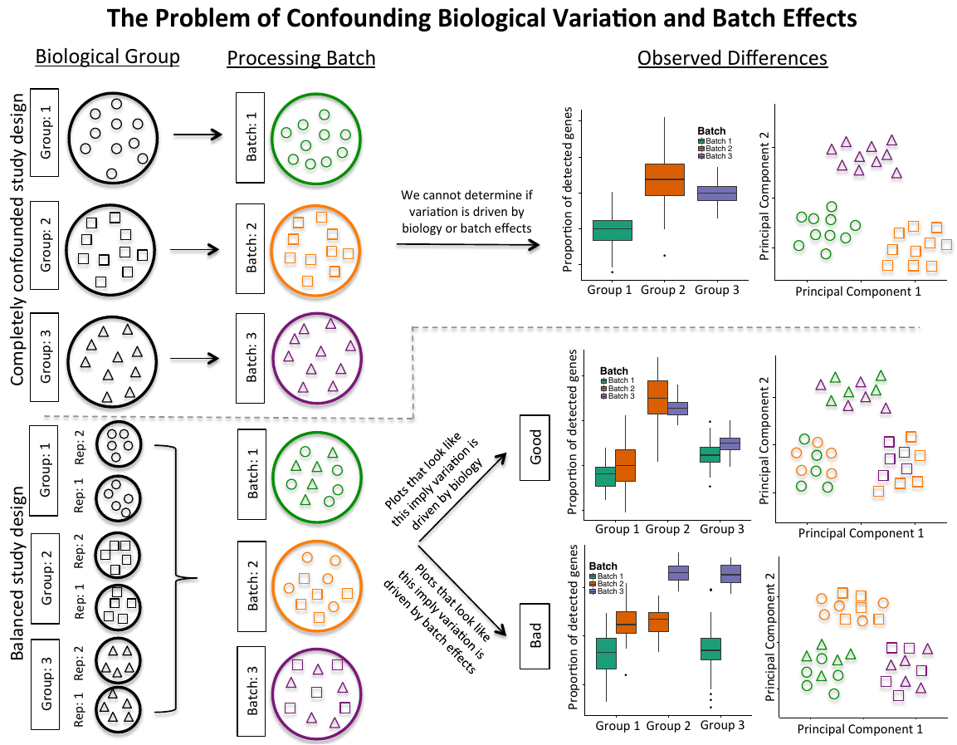
Pairing of the samples/batch effect
There is a bad experimental design and a good experimental design
Very simply - more randomization gives you better results
Notes:
Supplemental Figure 1: The problem of confounding biological variation and batch effects. The top
section depicts a completely confounded study design of processing individual cells from three biological groups
(represented by shapes) in three separate batches (represented by colors). In this case, we cannot determine if
biology or batch effects drive the observed variation. The bottom section depicts a balanced study design consisting
of multiple replicates (rep) split and processed across multiple batches. The use of multiple replicates allows observed
variation be attributed to biology (cells cluster by shape) or batch effects (cells cluster by color).

Slide 27
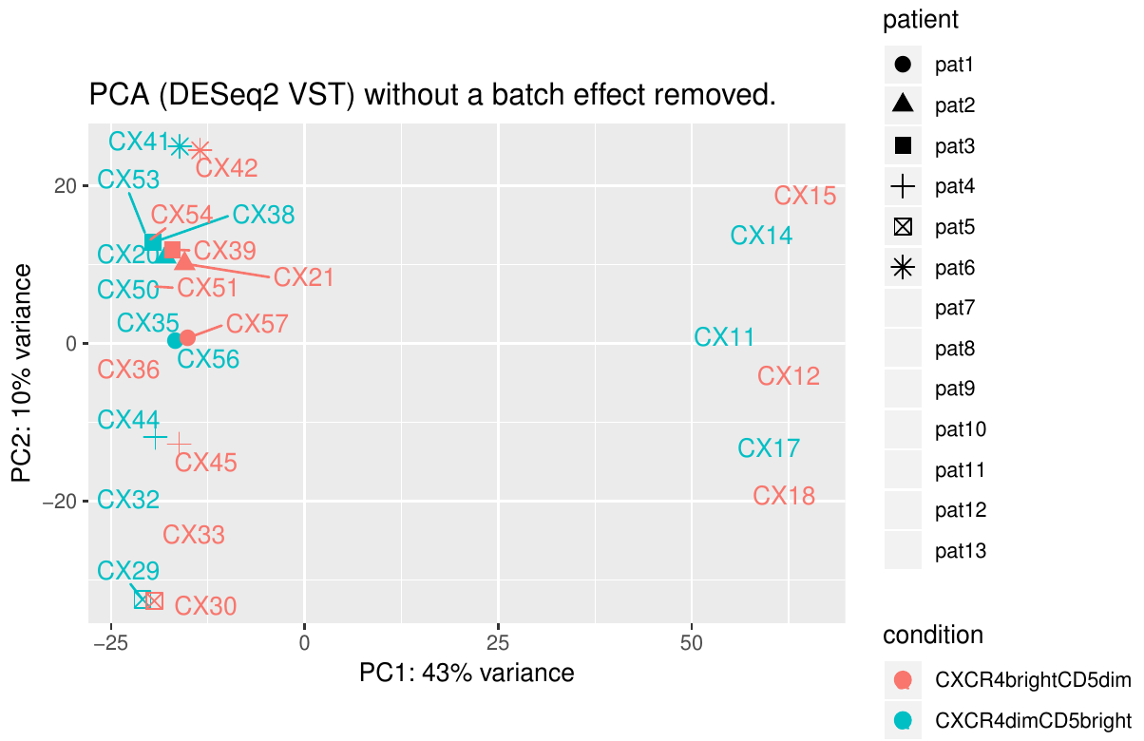
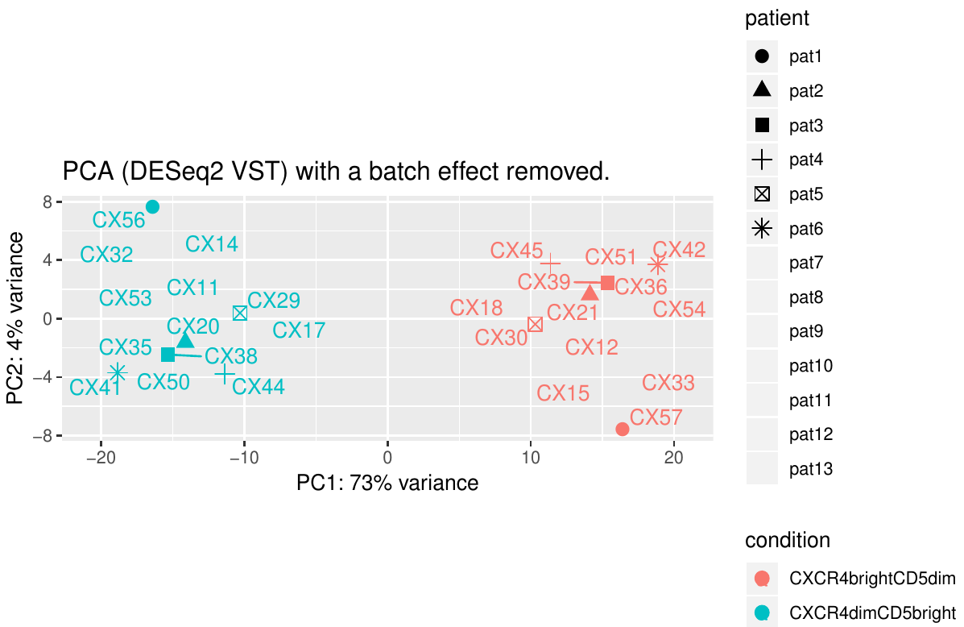
Pairing of the samples/batch effect
And example pairing of the patients AND different sequencing years - double batch
Notes:
1st figure - no batch effect/pairing of the samples included - we can see that individual sequencing years are separated (left and rigth) and also that individual patient samples are clustered together (even and odd numbers). We don’t see clustering of CXCR4bright and CXCRdim samples together:(
2nd figure - batch effect/pairing of the samples was included in the calculation and voila - samples are nicely clustered according to the condition and not according to the patient pairing and/or year of the sequencing.
Without accounting for the batch effect/pairing of the samples we wouldn’t get any reasonable results and what even more - we might get completely wrong results!

Slide 28
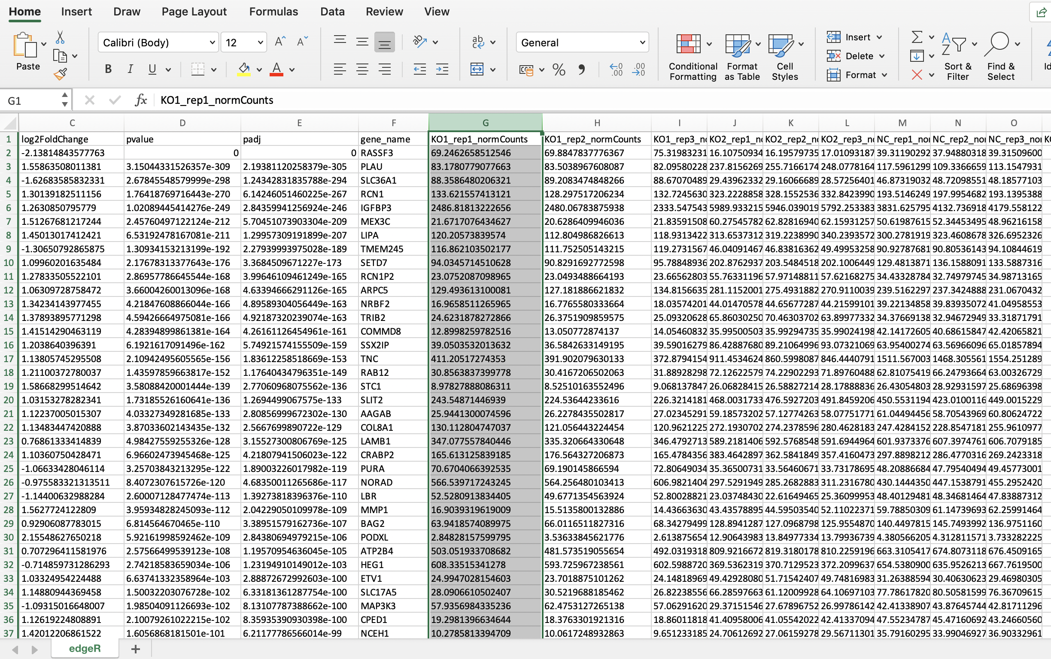
Differential expression results

Slide 29
Count normalisation
Normalize to:
  Gene size
  Library size
rpkm - Reads Per Kilobase of transcript per Million mapped reads
fpkm - Fragments Per Kilobase of transcript per Million mapped reads
tpm - Transcripts Per Million (TPM)
  for every 1,000,000 RNA molecules in the RNA-seq sample, x came from this gene/transcript
Never ever use normalized counts for any comparisons
  ...except comparing a single gene in a single experiment for the samples
  If you really, really need to use any kind of normalized counts to compare use TPM

Slide 30
log2(fold-change)
Fold-change is usually calculated by average expression of all samples of condition 1 vs average expression of all samples of condition 2
Example:
  geneA expression in pre is 5, in post is 10; fold-change of post/pre is 2 = gene is up-regulated 2x
  geneB expression in pre is 10, in post is 5; fold-change of post/pre is 0.5 = gene is down-regulated 1/2x … (O_o)
Solution: Adding log2 gives us log2(2) = 1, log2(0.5) = -1
Nice and even distribution around 0 and clear interpretations

Slide 31
log2(fold-change)
But it might be misleading
Large log2FC on low-expressed genes are most likely not biologically relevant
Small log2FC on highly-expressed genes might be biologically relevant
Example: “Common” cut-off value of fold-change of 2x (log2FC=+/-1) or 1.5x (log2FC=+/-0.58)
  geneA expression in WT is 10 and in KO is 4, log2FC = -1.32 YES (?)
  geneB expression in WT is 1,000,000 and in KO is 500,001, log2FC = -0.99 NO (?)

Slide 32
P-value and adjusted p-value
P-value tries to give you “a number” saying if the differences you are observing are robust and the differences are not “random” between the compared conditions/samples
Adjusted p-value adds a correction for the multiple testing we are doing - tries to add correction of getting a p-value just by accident
But is adjusted p-value 0.049 really better than 0.051?
Number of replicates highly influences the estimates
  The observations might be the same but the statistical significance might be lower

Slide 33
How many differentially expressed genes I have?
It depends how many you want…:)
Selection of the differentially expressed (DE) gene is completely up to you
Some people use p-value, some adjusted p-value and some people log2fc and their combinations, some just take top n genes
Statistical significance ≠ biological relevance!!!
Scientists rise up against statistical significance, Nature 567, 305-307 (2019), doi: 10.1038/d41586-019-00857-9
Notes:
https://www.nature.com/articles/d41586-019-00857-9

Slide 34
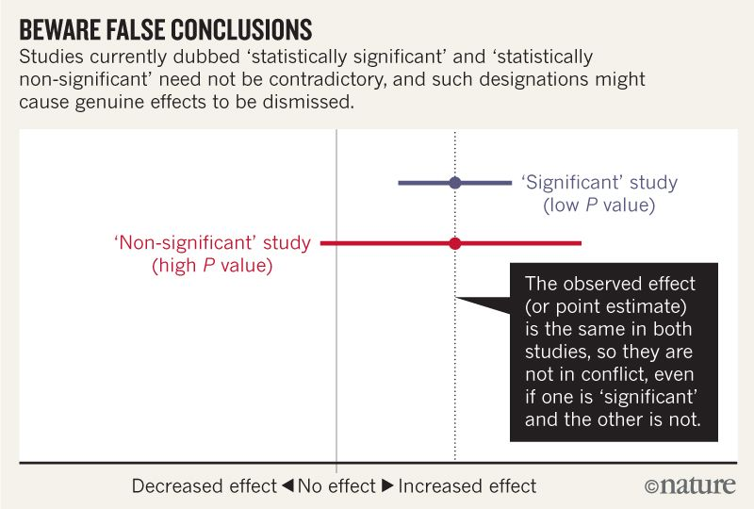
P-value significance

Slide 35
Differential expression output
Example

Slide 36
CEITEC
@CEITEC_Brno
Thank you for your attention!
Vojta Bystry
vojtech.bystry@ceitec.muni.cz
www.ceitec.eu

