Slide 1

Lecture 5 : ChIP-seq
Modern Genomic Technologies (LF:DSMGT01 )
Vojta Bystry
vojtech.bystry@ceitec.muni.cz

Slide 2

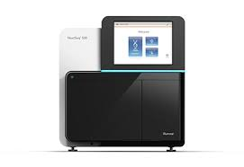
NGS data analysis
de-multiplexing
Raw data
.fastq
Experiment design
QC
Not known
reference
Not ”classic” reference
Genome/Transcriptome Reference Mapping
.bam
Metagenomics
Reference assembly
Immunogenetic
VDJ-genes
CRISPR
sgRNA
QC
Methylation
Bisulfide-seq
Interaction
analysis
CHIP-seq
Expression analysis
RNAseq
Variant analysis
WES
…
2

Slide 3
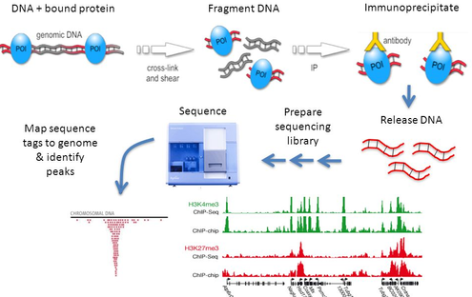
ChIP-seq
Very laborious and hard laboratory preparation
Not a good success rate

Slide 4
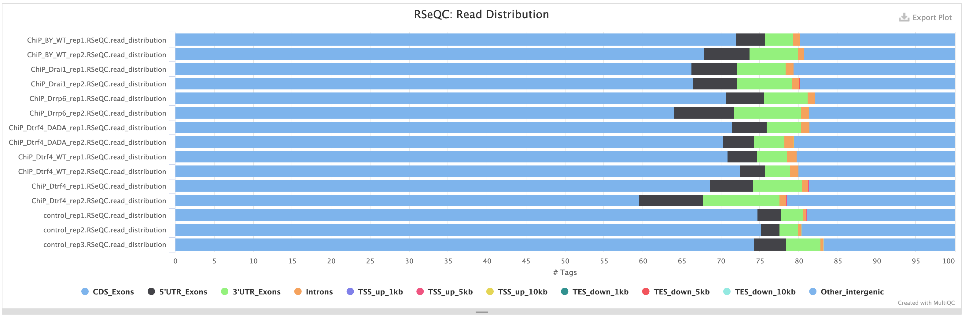
Primary analysis + QC
Alignment – standard DNA (RNA for CLIP)
QC standard
  Check sequencing quality
  RSeQC – Read Dstribution

Slide 5
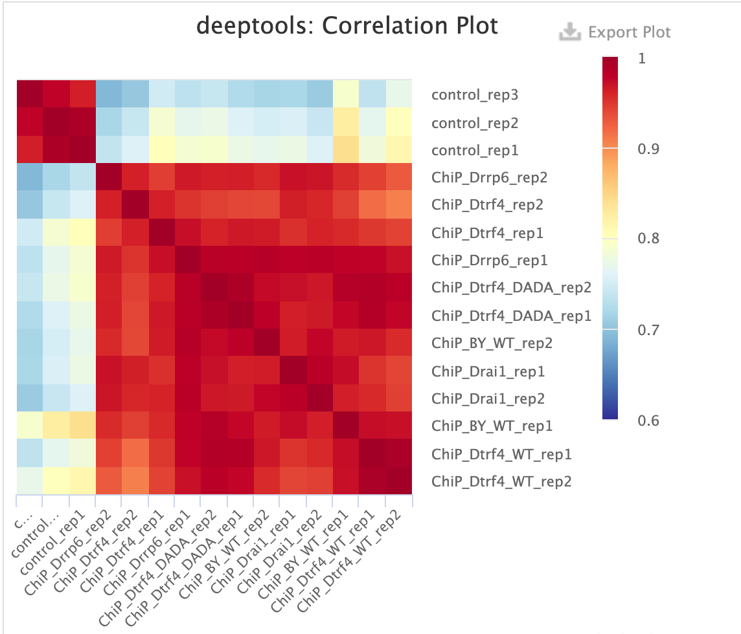
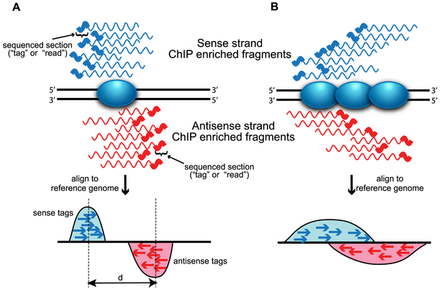
Primary analysis + QC
IP experiment quality control
  Sample correlation
    Replicates control treatment
  Strand cross-correlation
    Shift of strand mapping
    Shift should correlate with expected fragment size

Slide 6
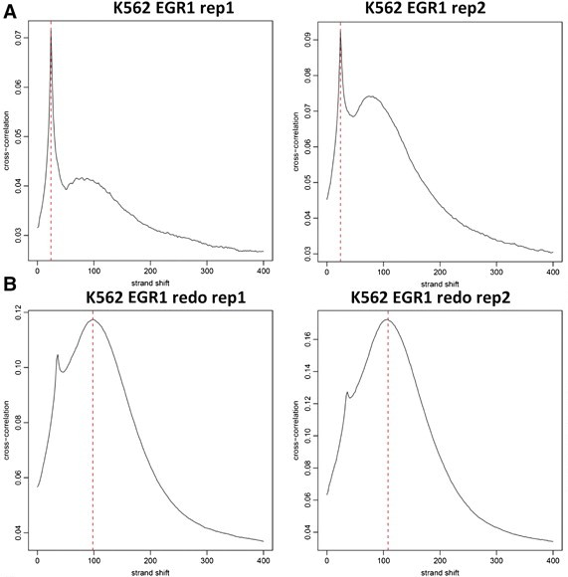
Primary analysis + QC
IP experiment quality control
  Sample correlation
    Replicates control treatment
  Strand cross-correlation
    Shift of strand mapping
    Shift should correlate with expected fragment size

Slide 7
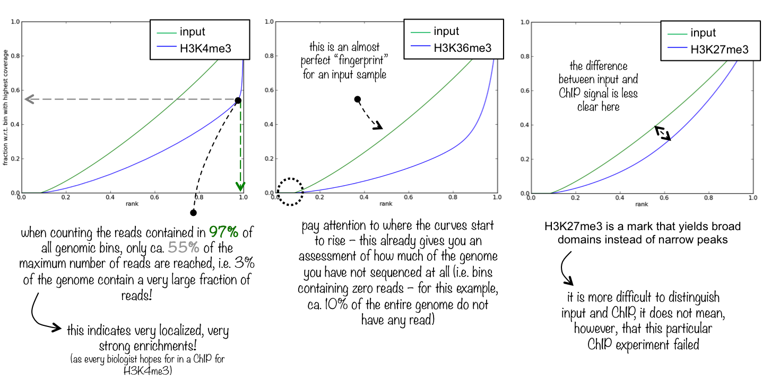
Primary analysis + QC
Fingerprint profile
  profile of cumulative read coverages
  how evenly are the reads distributed over the genome

Slide 8
Deduplication
Remove all duplicates!
  It is very low probability that the fragment would be cut at exactly same position
  Usually experiments without UMIs

Slide 9
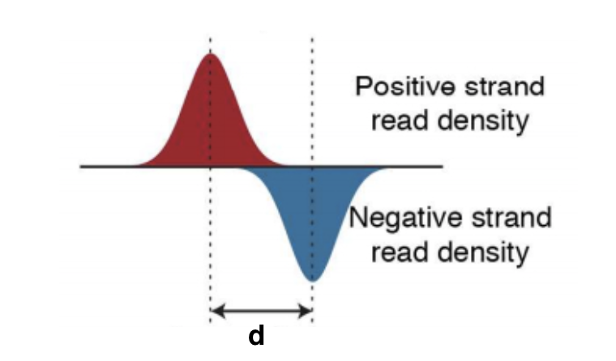
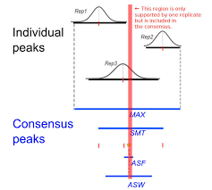
Peak calling
Read extension

Slide 10
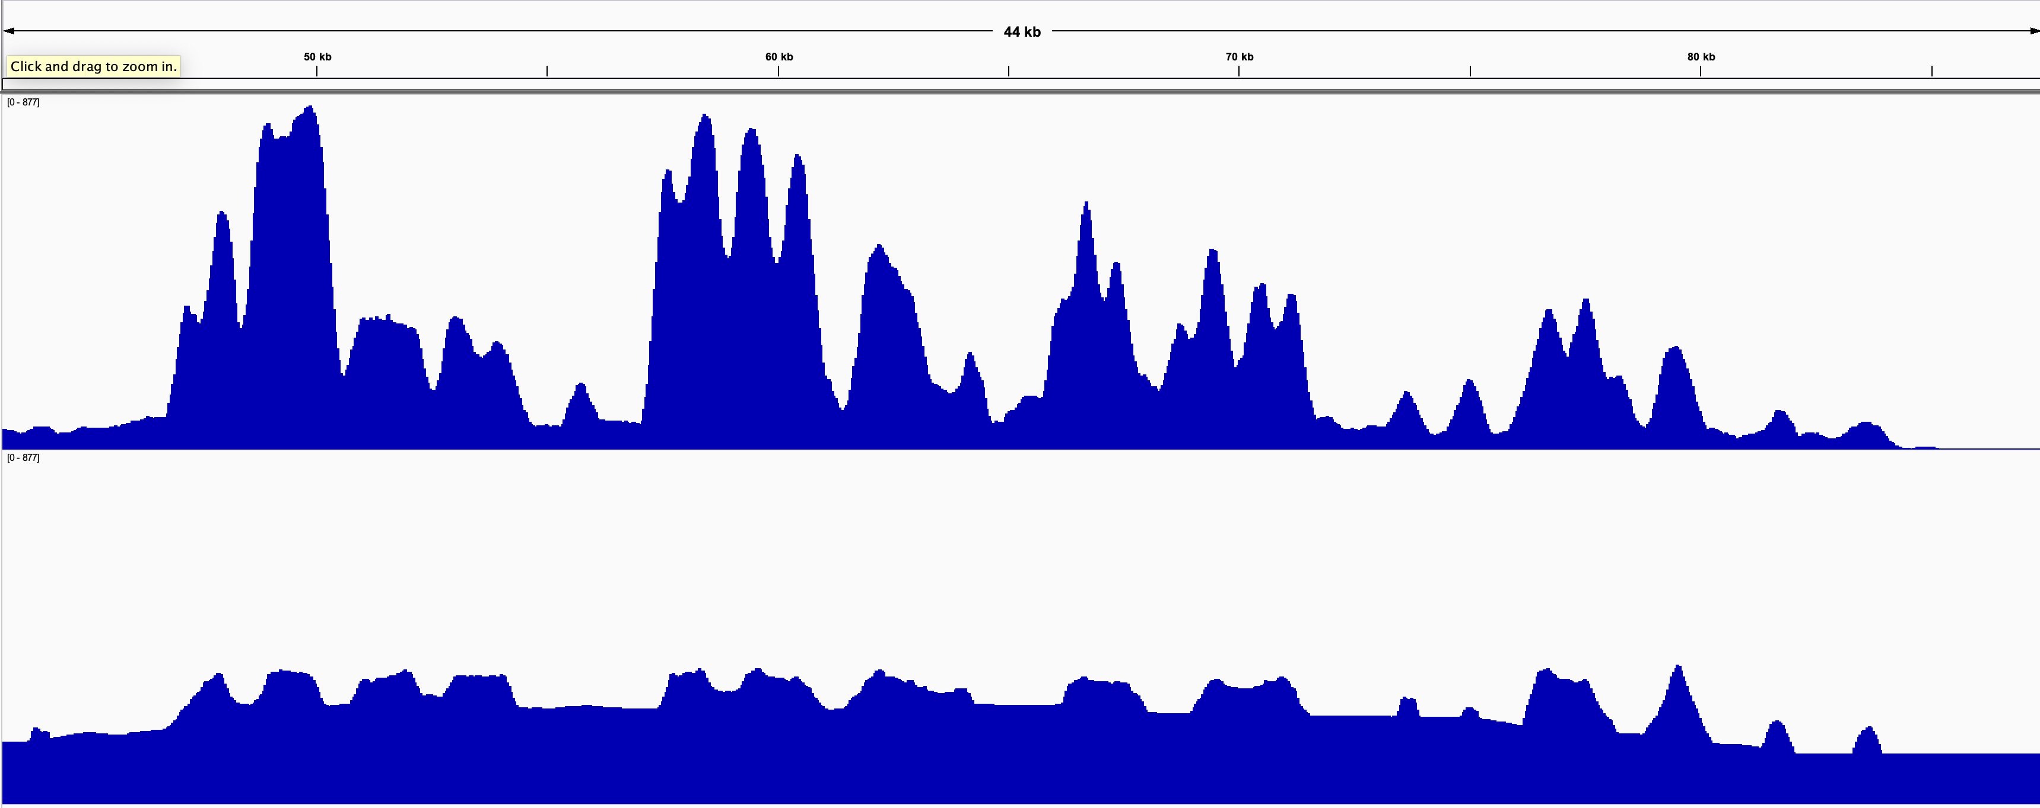
Peak calling
Statistical assessment of peaks against background
Background
  Control sample – recommended
  Model background from overall coverage of the sample
Peak calling annotation
Differential peak calling

Slide 11
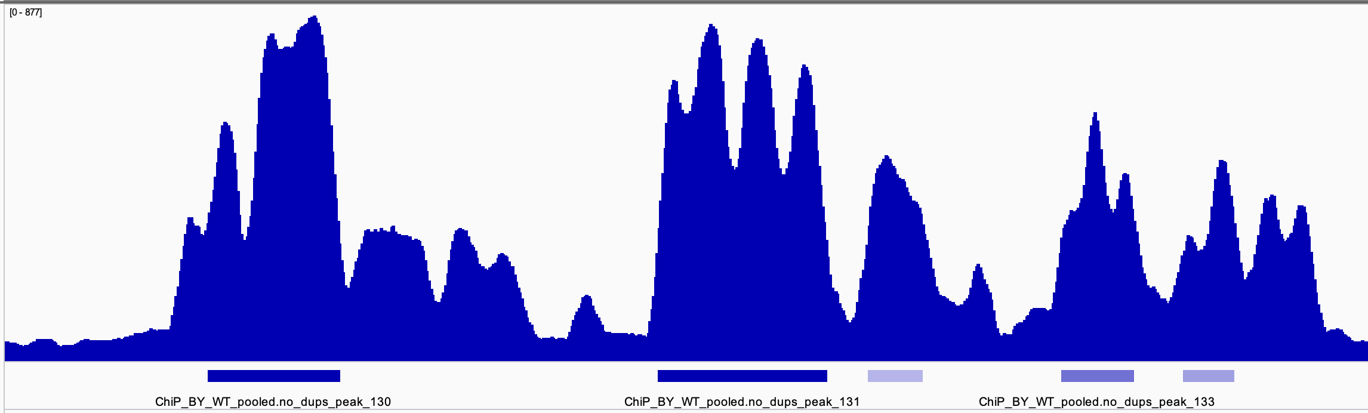
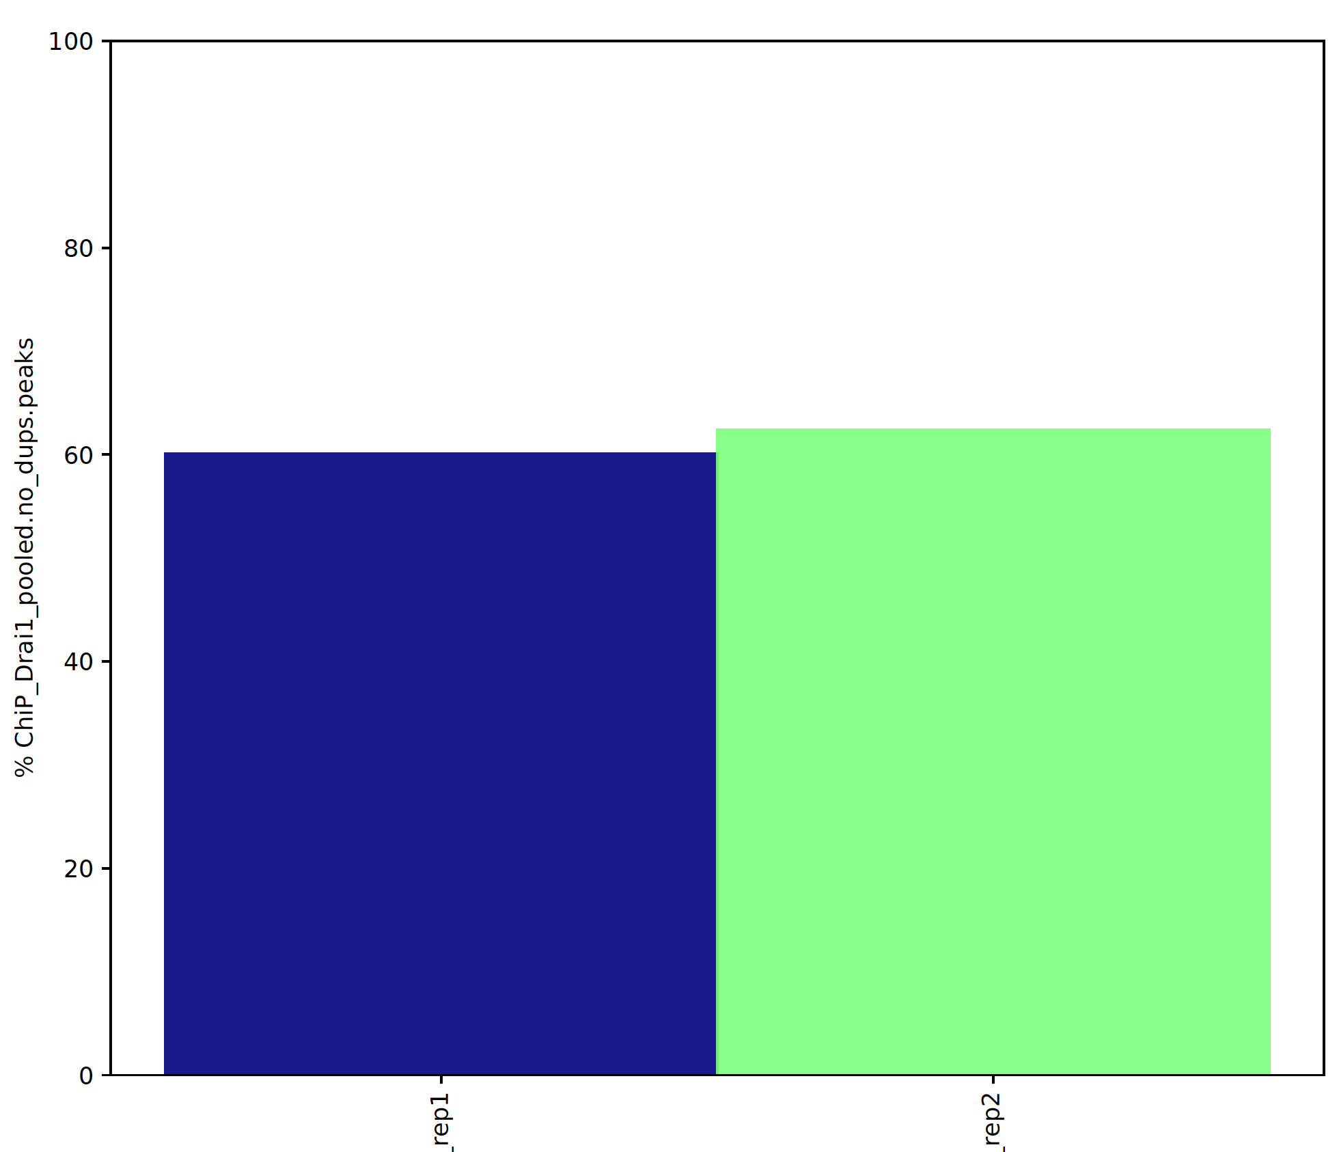
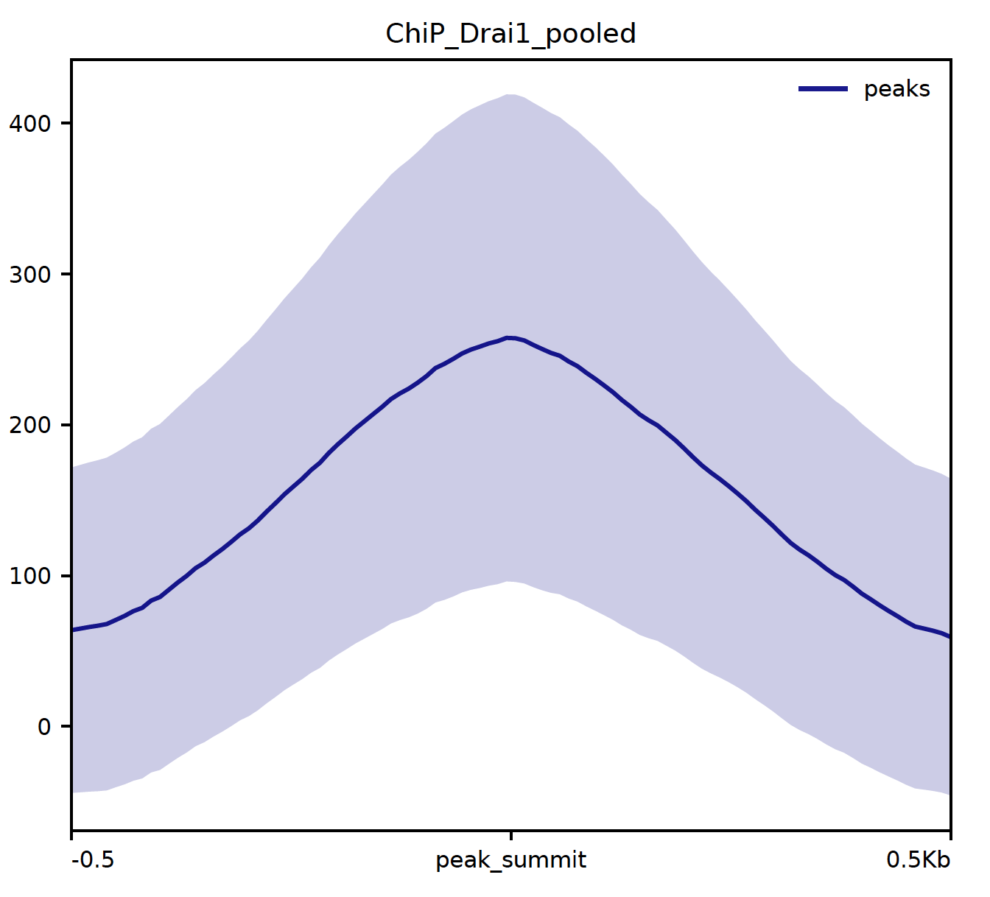
Post peak calling QC
FRIP score = fraction of reads in peaks
  High number is good
  However can be low in specific experiments and still the experiment be OK
Average peak profile

Slide 12
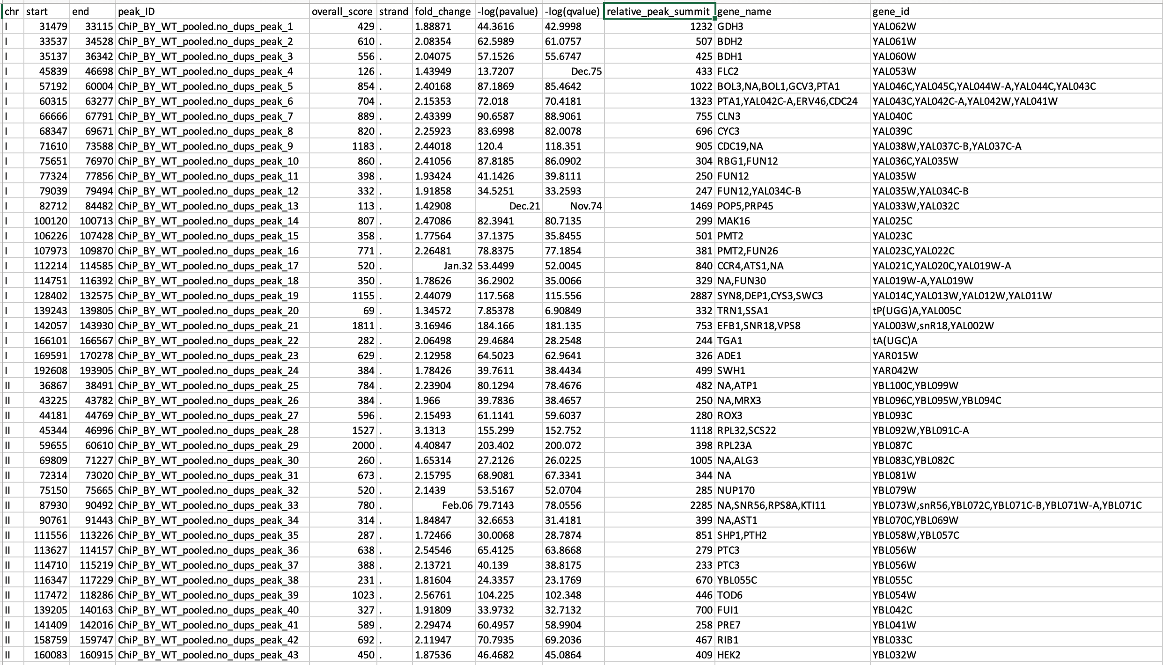
Peak calling results

Slide 13
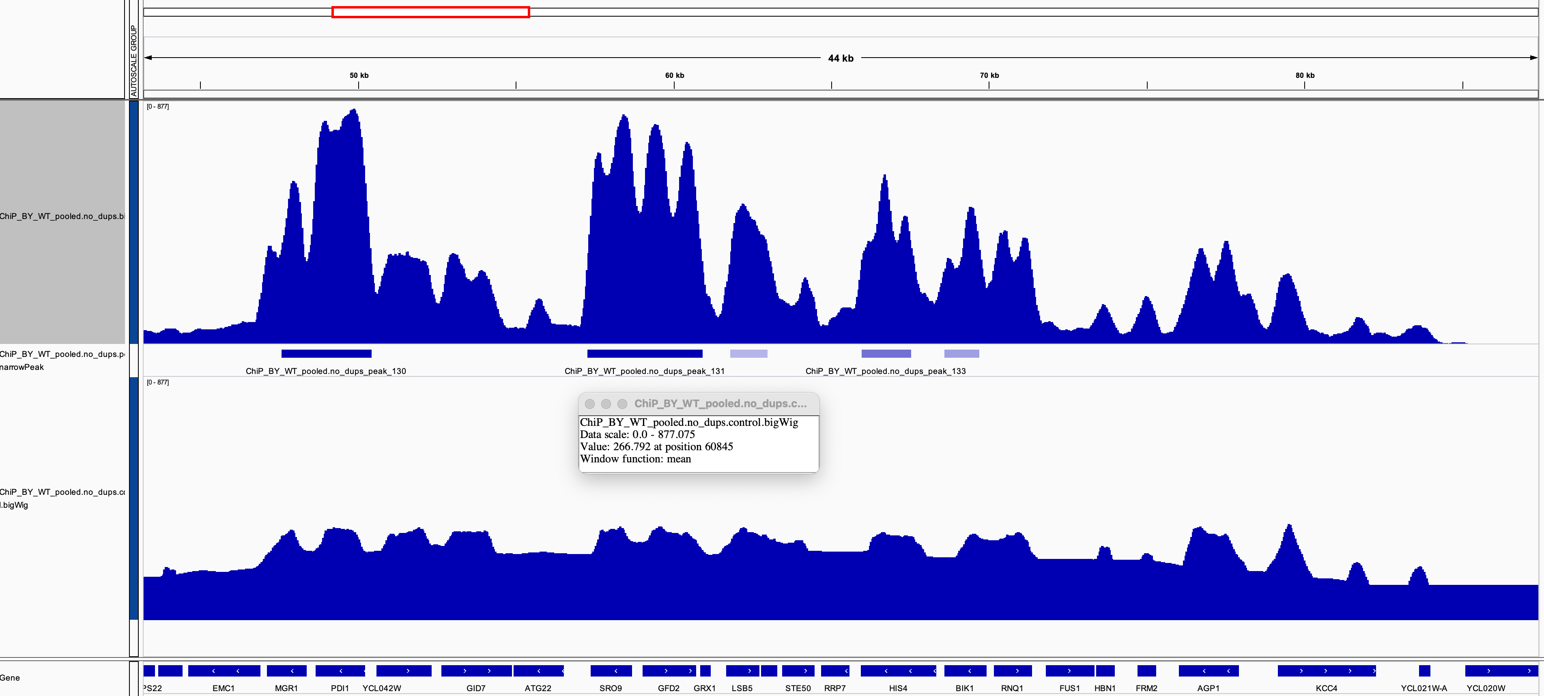
Peak calling results
peaks.annotated.bed
control.bigWig
bigWig

Slide 14
CEITEC
@CEITEC_Brno
Thank you for your attention!
Vojta Bystry
vojtech.bystry@ceitec.muni.cz
www.ceitec.eu

