Slide 1
Metabolism of sacharides, lipids and proteins. Energy metabolism.

Slide 2
Introduction
At steady state, the energy input must correspond to the energy output
  Energy expenditure = external work + energy reserves + heat
  Intermediate: various chemical, mechanical and thermal reactions
Saccharides, lipids, proteins
Conversion of proteins and sugars into fats - efficient energy storage
Conversion of proteins into sugars - the need for fast energy
BUT: there is no significant conversion of fats into sugars

Slide 3
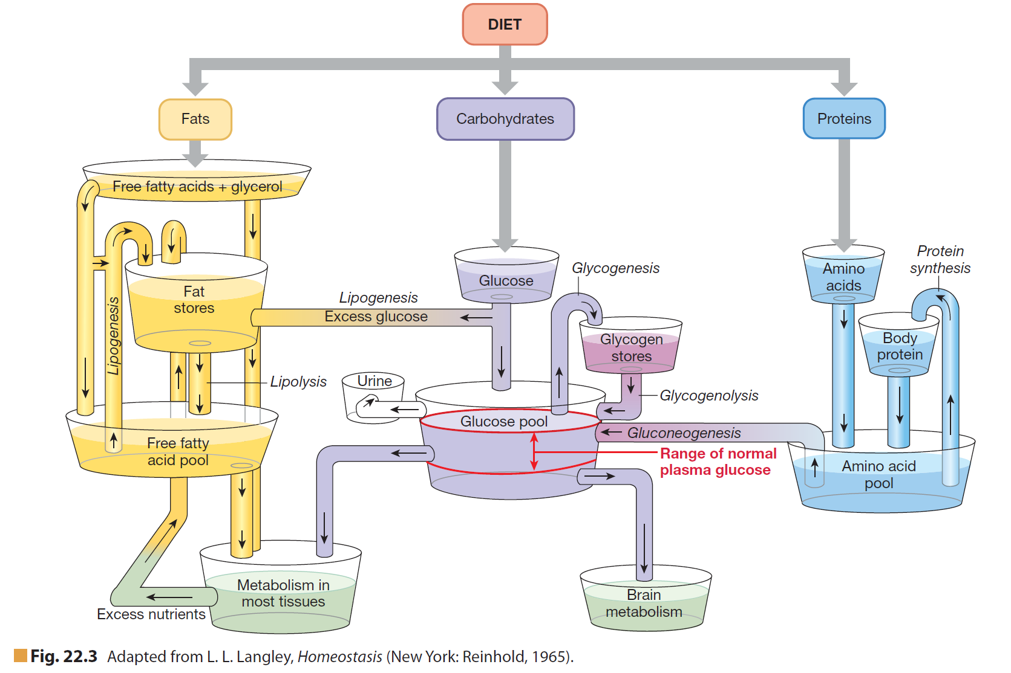
Nutrient pools and metabolism

Slide 4
Metabolism of saccharides
Energy source
Functions of saccharides:
  Part of glycoproteins and glycolipids
  Inevitable for nucleic acids and coenzyme synthesis
  Part of extracellular matter
Saccharides:
  Monosaccharides
  Oligosaccharides
  Polysaccharides
Digestion and absorption
  Saliva (salivary amylase)
  Pancreatic juice (a-amylase)
  Epithelium of duodenum and jejunum (isomaltase, maltase, saccharase, lactase)

Slide 5
Metabolism of saccharides
The key substrate is glucose
Postprandial plasma glucose level: 3.5 – 5.5 mmol/l
Glycemia. Hypoglycemia, hyperglycemia
Glycolysis, gluconeogenesis
Glycogenolysis, glycogenesis

Slide 6
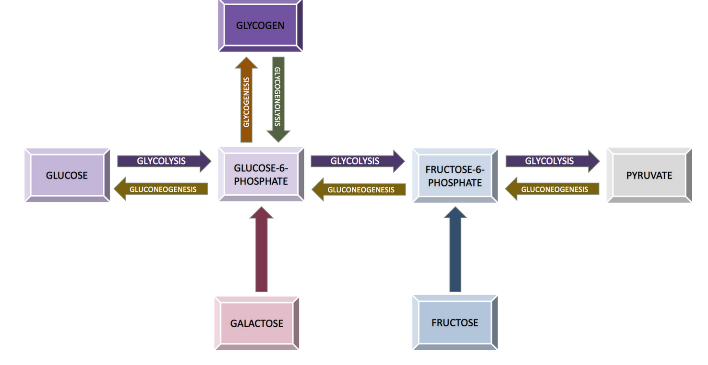
Metabolism of saccharides
Morning glucose intake - 70% consumed by peripheral tissues (muscles), 30% - splanchnic organs (liver)

Slide 7
Metabolic disorders - saccharides
Diabetes mellitus
McArdle syndrom (glycogenesis from deficiency of myophosphorylase
accumulation of glycogen in muscles: muscle stiffness, rigor during exercise, lower tolerance of load)
Galactosemia(inherited deficiency of phosphogalactosauridyltransferase; disorders of growths and development)

Slide 8
Metabolism of lipids
Main and most profitable form of energy store
Lipid functions:
  Part of biological membranes - fospholipids
  Energy storage
  Protective cover for organisms
  Precursors of some important substances
  Vitamin solvents (A, D, E, K)
Lipids:
  Triglycerides
  Sterols
  Phospholipids
Digestion and absorption
  Bile acids salts (emulsification)
  Pancreatic lipase, cholesterol-estherase, phospholipase a₂, enteric lipase(deestherification)

Slide 9
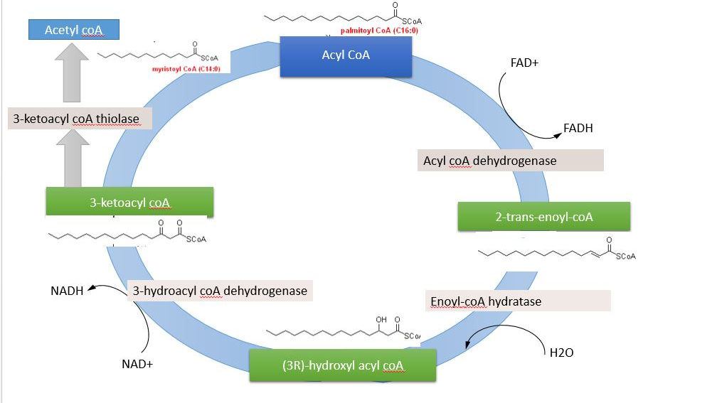
Metabolism of lipids

Slide 10
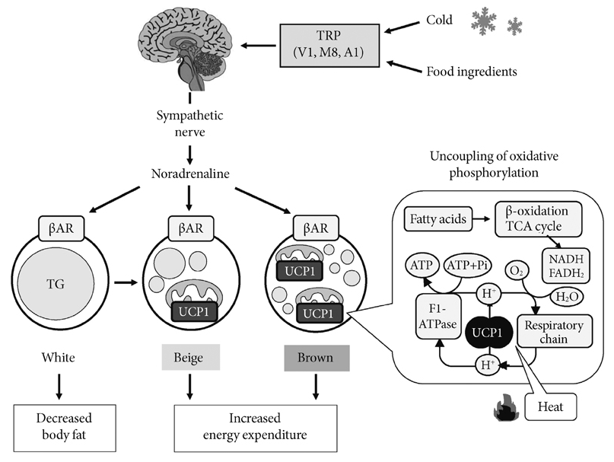
Fat tissue
http://www.e-dmj.org/ViewImage.php?Type=F&aid=284781&id=F1&afn=2004_DMJ_37_1_22&fn=dmj-37-22-g001_2004DMJ

Slide 11
Metabolic disorders - lipids
Hyperlipidemia
Hyperlipoproteinemia
Infrequent disorders of lipid metabolis

Slide 12
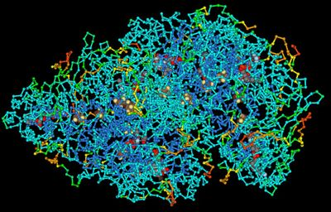
Metabolism of proteins
Total proteins in body: 10 kg
Protein minimum: 0.5 g / kg of body mass
Protein optimum: 0.7 g / kg of body mass
Increased supply (growth, convalescence, pregnancy, lactation): 1.5 – 2.0
Aminoacides
  Essential (not synthesised)
  Non-essential (from glucose metabolism – citrate cycle)
  0.5 – 1.5 g / day

Slide 13
Metabolism of proteins
Digestion and absorption
  Stomach (pepsin)
  Duodenum (trypsin, chymotrypsin, carboxypeptidase)
  Jejunum (membrane peptidases)
Functions of proteines:
  Structural (collagen, elastin, …)
  Motoric (actin, myosin, …)
  Informational (protein hormones)
  Protective (immunoglobulins, complement, antigens, …)
  Transport (albumin)

Slide 14
Metabolic disorders – proteins
Proteinemia = plasmatic level of proteins.
Dysproteinemia = change in representation of particular proteins (fractions shift) – nephrotic syndrome, cirrhosis, inflammatory reactions
Paraproteinemia = presence of pathological imunoglobulines (with no antibodies specificity) – monoclonal immunopathy
Defect proteinemia = some components of plasma proteins are missing or lowered – syndromes of immunodeficiency, polyclonal hypergamaglobulinemia

Slide 15
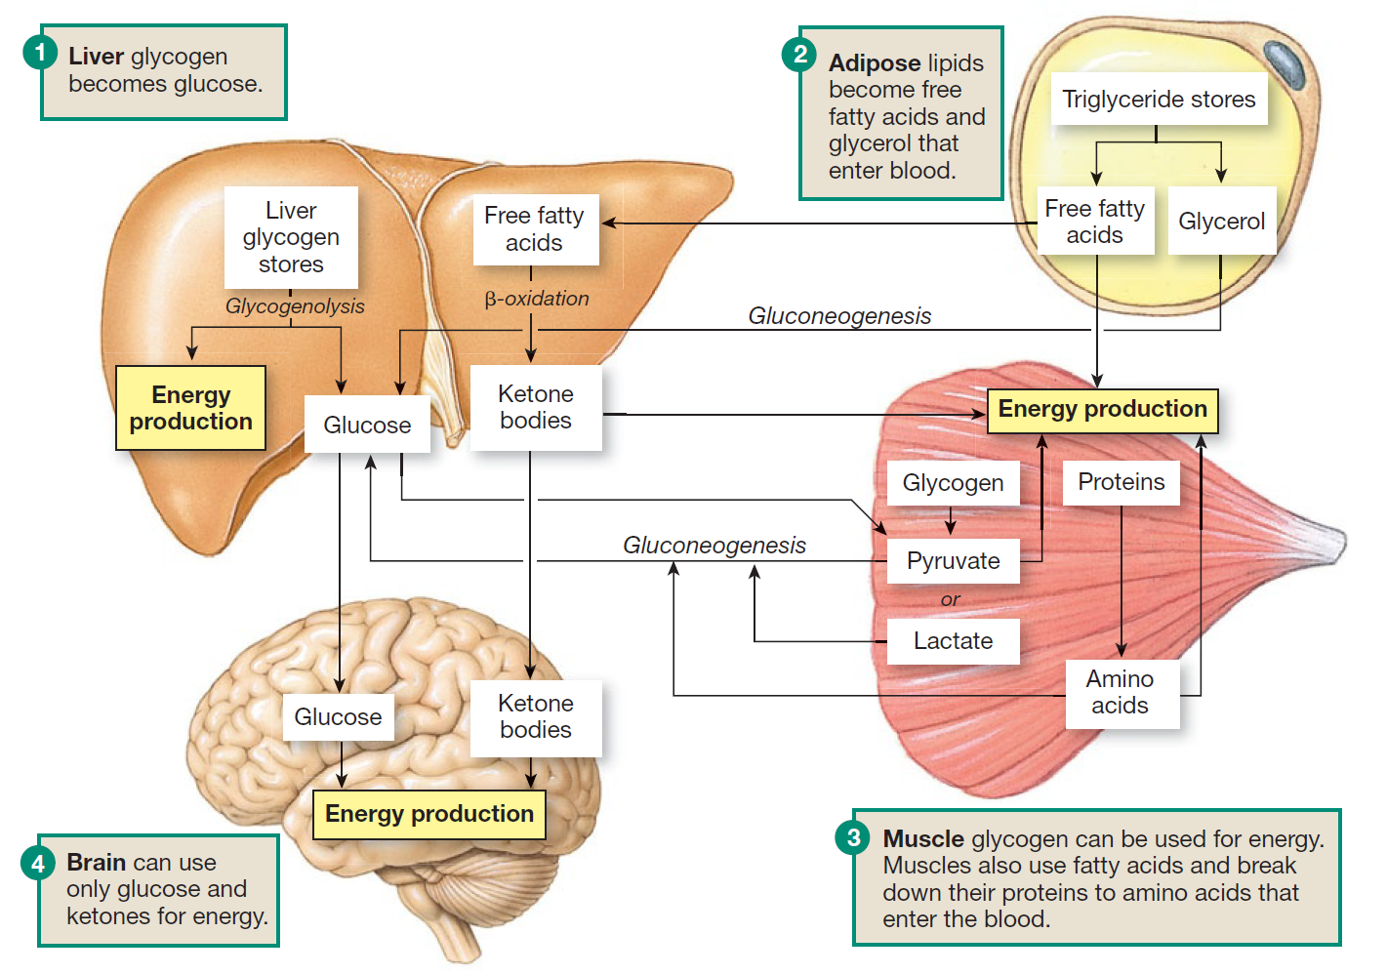
Energy storage

Slide 16
Metabolism
= summary of all chemical (and physical) processes included in:
Production of energy from internal and external sources
Synthesis and degradation of structural and functional tissue components
Excretion of waste products and toxins from body

Slide 17
Metabolic rate
Physical work (oxygen debt compensation)
Specific-dynamic effect of food (assimilation of nutrients in the body)
External temperature
Height, weight and body surface
Gender
Age
Emotions
Body temperature
Thyroid hormone level (T4, T3)
Adrenaline and norepinephrine levels

Slide 18
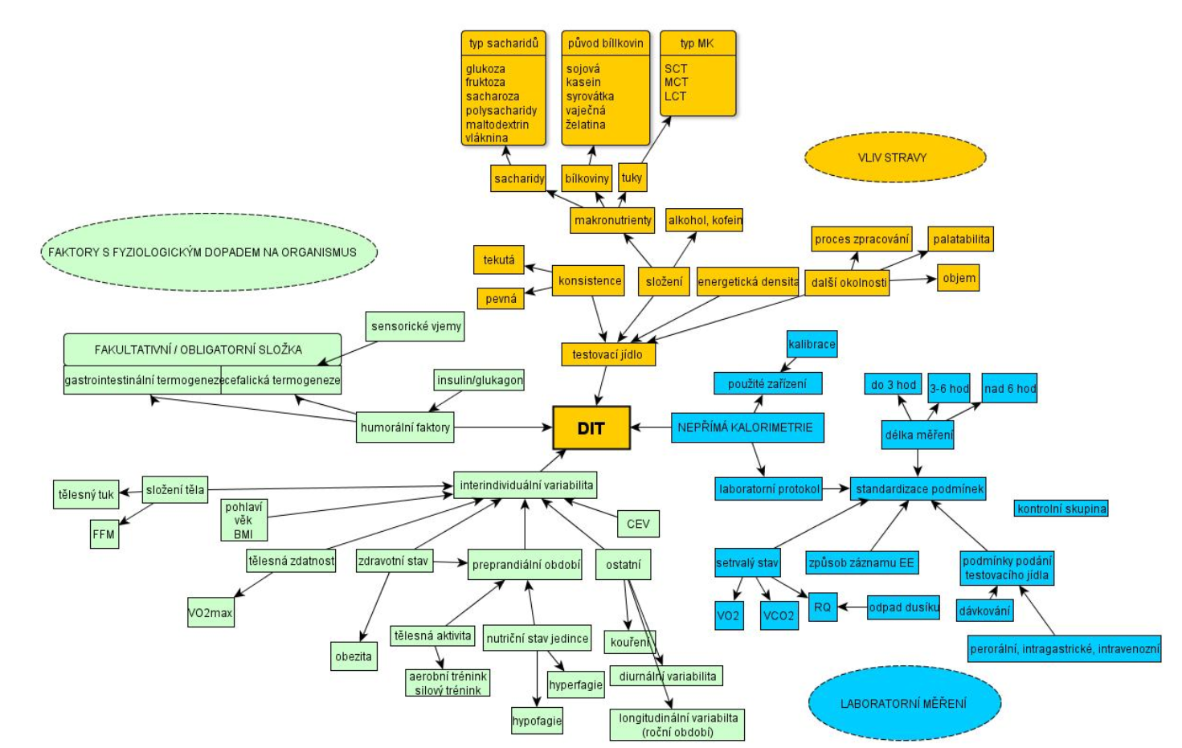

Slide 19
Bazal metabolic rate (BMR)
Energy for maintaining all vital functions
Thermoneutral environment
12 - 14 hours after a meal
24 hours without exhausting physical work
Elimination of all negative physical and mental factors

Slide 20
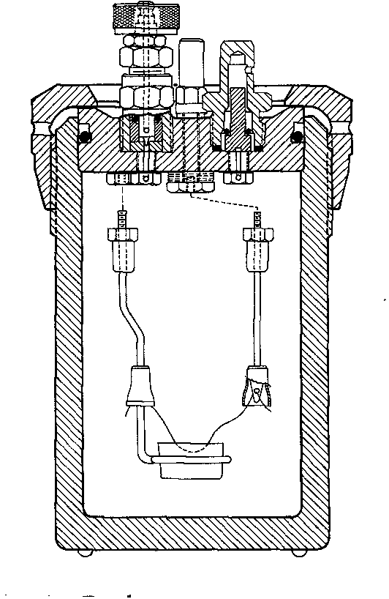
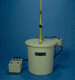
Direct calorimetry
= measuring the energy released by burning food outside the body
(oxidation of compounds in a calorimeter )
Calorimetry:
  adiabatic = heating of the calorimeter content
  isothermal = generated heat is dissipated

Slide 21

Direct calorimetry
Noooooooooooooo!!!!

Slide 22
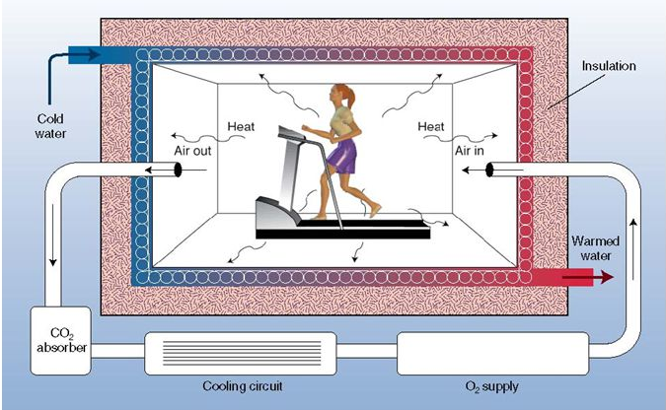
Direct calorimetry

Slide 23
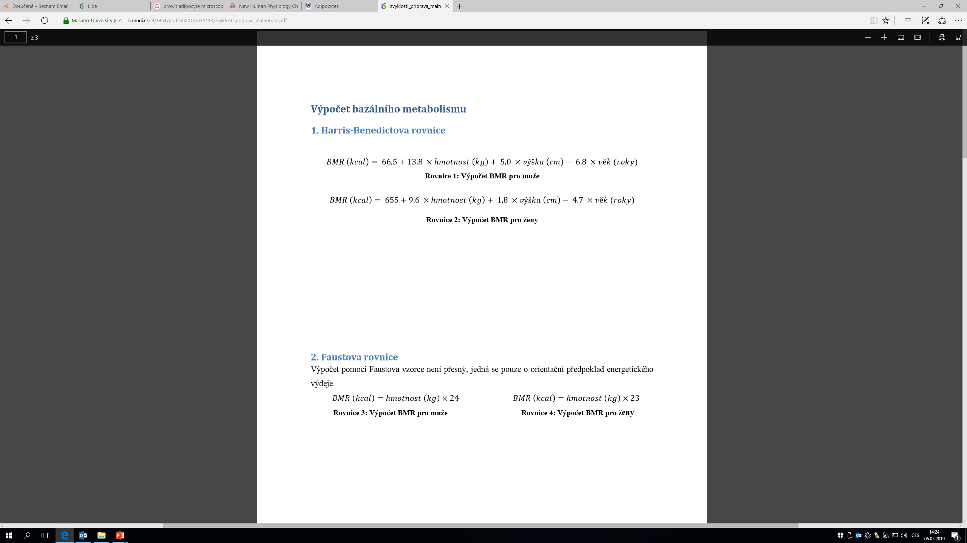
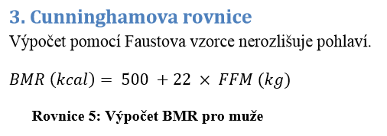
BMR. Calculation

Slide 24
Energy expenditure
ENERGY EQUIVALENT (EE):
the amount of energy released when consuming 1 liter of O₂
The thermal oxygen coefficient of individual nutrients differs, so the EE also differs
EE saccharides 21.1 kJ = 5.05 kcal
EE proteines 18.0 kJ = 4.31 kcal
EE lipides 19.0 kJ = 4.55 kcal
In a mixed diet (60% carbohydrates, 30% fat, 10% protein):
EE = 20.1 kJ = 4.81 kcal

Slide 25
Indirect calorimetry
The amount of consumed O₂
Influence of diet composition - energy equivalent = universal constant for calculation of energy expenditure under the assumption of mixed diet intake
Open system
Close system

Slide 26
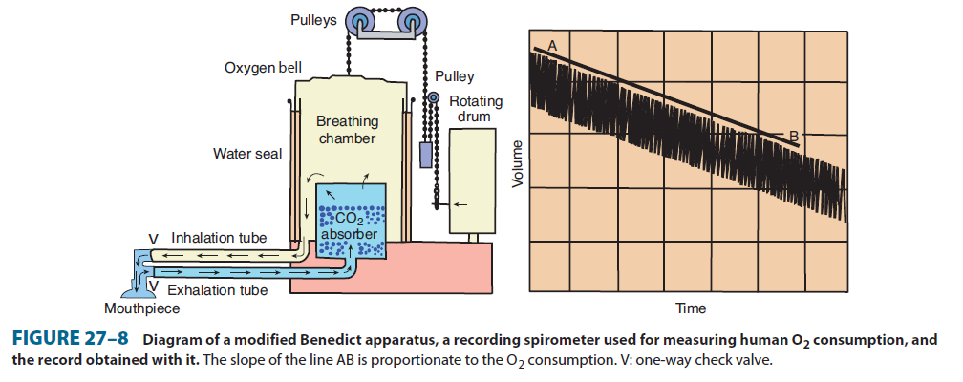
Indirect calorimetry
Barret, K.E., Boitano, S., Barman, S.M., Brooks, H.L. Ganong´s Review of Medical Physiology. 23rd Ed. McGraw-Hill Companies 2010

Slide 27
Respiratory quotient
RQ = VCO₂ : VO₂
Saccharides (glu)
  C₆H₁₂O₆ + 6O₂ = 6CO₂ + 6H₂0
  RQ = 6/6 = 1.00
Lipides
  2 C₅₁H₉₆O₆ + 145 O₂ = 102 CO₂ + 98 H₂O
  RQ = 102/145 = 0.703 (0.70)

Slide 28
Respiratory quotient
Substrate or metabolic process | RQ
saccharides/glycogen | 1
lipids | 0.7
proteins | 0.9
glucogenesis | 0.4
lipolysis | 0.7
lipogenesis | 2.75
Hyperventilation RQ decreasis
Workload RQ increases
Acidosis RQ increases
Alkalosis RQ decriases

Slide 29
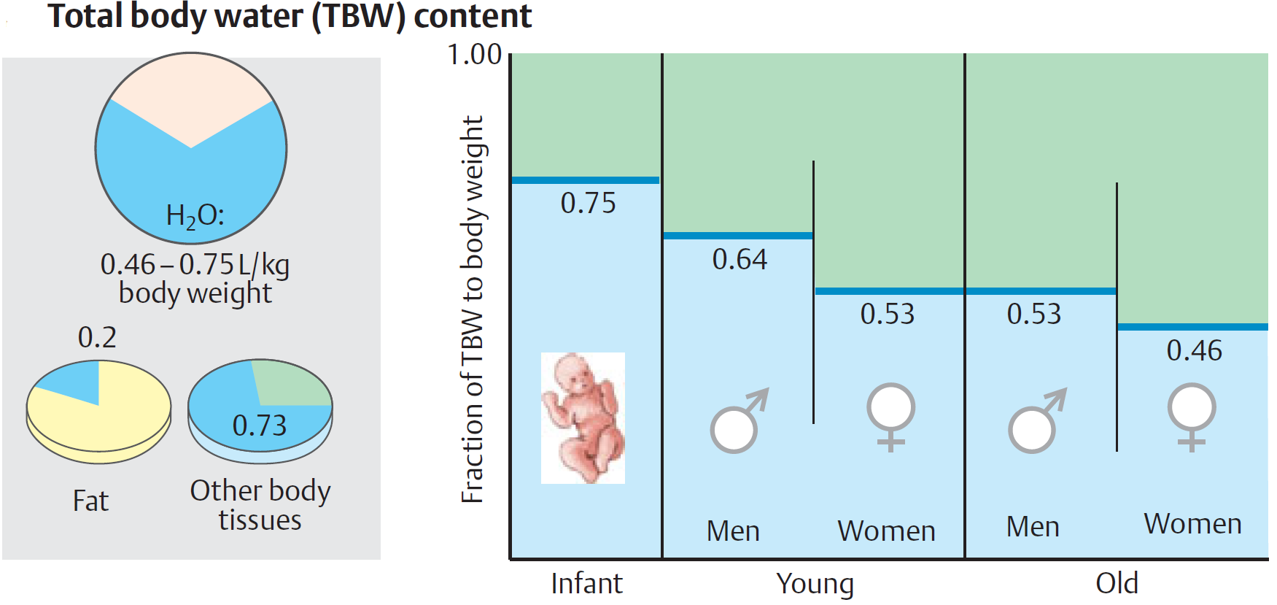
Water
50-70% of body mass, newborns
2/3 intracellularly, and 1/3 extracellularly
metabolism
compartmentalisation
functions in the human body:
  the transport medium
  solvent
  wetting
  protection of the mucous membranes

Slide 30
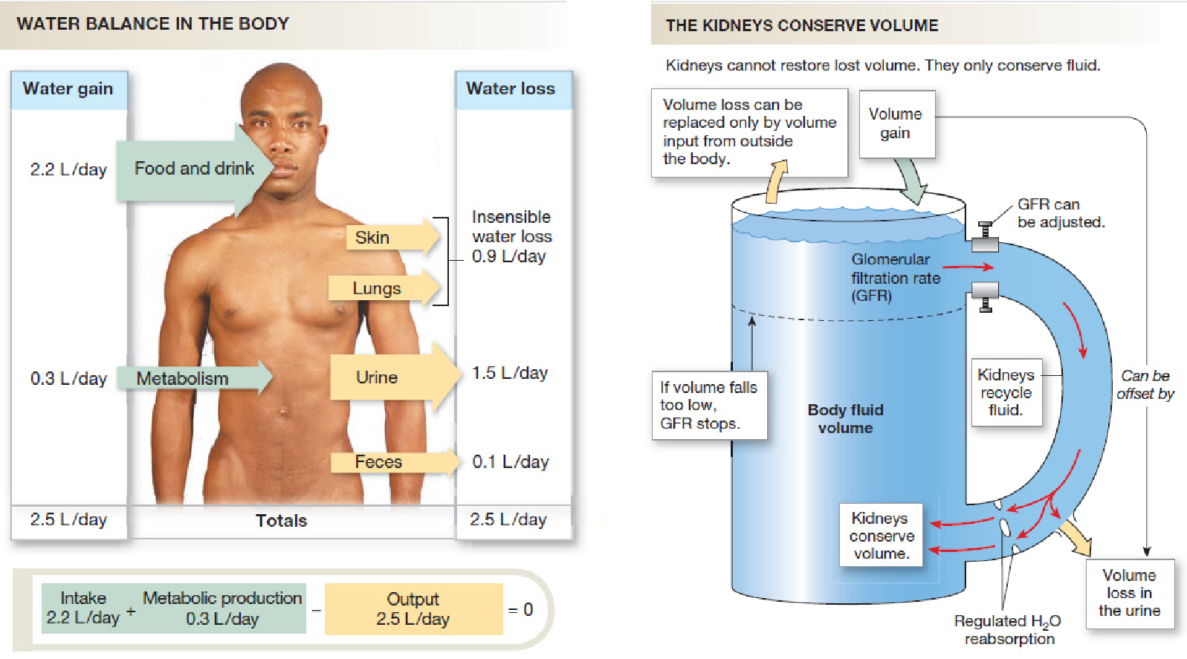

Slide 31
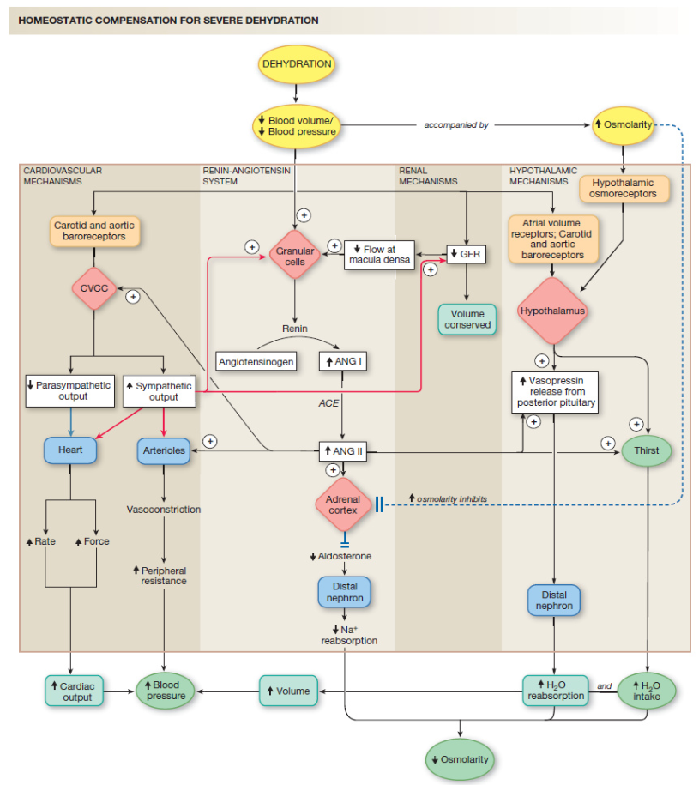

Slide 32
Vitamins
all organic compounds of diet, necessary for life, health and growth;
NO source of energy;
soluble in:
in water
in lipids

Slide 33
Vitamin | Deficiency disease(s) | Overdose syndrome/symptoms | Food sources
Vitamin K | Bleeding diathesis | Decreased anticoagulation effect of warfarin | Leafy green vegetables such as spinach; egg yolks; liver
Vitamin E | Deficiency is very rare; mild hemolytic anemia in newborn infants | Possible increased incidence of congestive heart failure | Many fruits and vegetables, nuts and seeds, and seed oils
Vitamin D | Rickets and osteomalacia | Hypervitaminosis D | Eggs, liver, certain fish species such as sardines, certain mushroom species such as shiitake
Vitamin A | Night blindness, hyperkeratosis, and keratomalacia | Hypervitaminosis A | from animal origin: fish in general, liver and dairy products; from plant origin: orange, ripe yellow fruits, leafy vegetables, carrots, pumpkin, squash, spinach

Slide 34
Vitamin | Deficiency disease(s) | Overdose syndrome/symptoms | Food sources
Vitamin C | Scurvy | Stomach Pain, Diarrhoea and Flatulence | Many fruits and vegetables, liver
Vitamin B₁₂ | Vitamin B₁₂ deficiency anemia | None proven | Meat, poultry, fish, eggs, milk
Vitamin B₉ | Megaloblastic anemia and deficiency during pregnancy is associated with birth defects, such as neural tube defects | May mask symptoms of vitamin B₁₂ deficiency; other effects. | Leafy vegetables, pasta, bread, cereal, liver
Vitamin B₇ | Dermatitis, enteritis |  | Raw egg yolk, liver, peanuts, leafy green vegetables
Vitamin B₆ | Anemia, Peripheral neuropathy | Impairment of proprioception, nerve damage (doses > 100 mg/day) | Meat, vegetables, tree nuts, bananas
Vitamin B₅ | Paresthesia | Diarrhea; possibly nausea and heartburn | Meat, broccoli, avocados
Vitamin B₃ | Pellagra | Liver damage (doses > 2g/day) and other problems | Meat, fish, eggs, many vegetables, mushrooms, tree nuts
Vitamin B₂ | Ariboflavinosis, glossitis, angular stomatitis |  | Dairy products, bananas, green beans, asparagus
Vitamin B₁ | Beriberi, Wernicke-Korsakoff syndrome | Drowsiness and muscle relaxation | Pork, whole meal grains, brown rice, vegetables, potatoes, liver, eggs

Slide 35
Thank you for your attention

