Slide 1
Rehabilitation after Injuries of Shoulder Girdle and Elbow Joint
Mgr. Alena Sedláková

Slide 2
SHOULDER GIRDLE
_{Traumatic Lesions}
_{1) Soft Tissues Injuries}
_{Impingement syndrome}
_{Rotator cuff tears}
_{Biceps tendon rupture}
_{Glenohumeral dislocation}
_{Acromioclavicular dislocation}
_{Sternoclavicular dislocation}
_{2) Proximal Humeral Fractures}
_{3) Post-traumatic Instability} (_{Glenohumeral instability)}

Slide 3
Impingement Syndrome
The term “impingement” means a “pinch”
A painful compression of soft tissues (coracoacromial ligament, supraspinatus tendon and subacromial bursa) by impinging on the fornix humeri (comprised of the acromion and the coracoacromial ligament) during abduction between 70-120°
This condition occurs as a result of structural or functional changes in the shoulder girdle
Structural causes - include changes in the inferior surface of the acromion, anatomical anomalies of bony structures, such as a hooked type acromion, bone spur on the anterior aspect of the acromion, prominent AC articulation, post-injury and degenerative changes of the rotator cuff
Functional causes - include an internally rotated humerus, shoulder protraction with thoracic kyphosis, supraspinatus weakness, biceps brachii spasm and other deficits in muscle coordination between the abductors and external rotators and scapular stabilizers, which results in scapulo-humeral rhythm dysfunction during shoulder abduction

Slide 4
Impingement syndrome
The principle of supraspinatus tendon impingement syndrome

Slide 5
Symptoms
_{Clinical Presentation}
Pain during loading and at rest is the main subjective symptom. Night pain is typical and the patient is unable to lie on the affected side
Objective findings include pain with supraspinatus tendon palpation and a positive painful arc
_{Painful Arc}
The patient performs maximal shoulder abduction. Under normal conditions, the freedom of movement is 180 degrees and it is painfree. If pain occurs, it suggests various pathologies in the shoulder region.
Pain to 30 degrees of abduction can be a manifestation of a supraspinatus muscle injury.
Pain between 30-60 degrees often suggests involvement of the subacromial bursa.
Pain between 60-120 degrees is typical for rotator cuff involvement.
Pain occurring at 180 degrees of abduction when maximum rotation of the lateral portion of the clavicle occurs suggests acromioclavicular joint involvement.

Slide 6
Neer Classification
Based on the severity of pain and the degree of degenerative structural changes, three stages are distinguished:
I. Stage - dull pain, painful arc with 90° abduction, positive resistive test, decreased strength with abduction and external rotation
II. Stage - pain with movement, pain at night, limited range of motion, fibrosis, inflammation of compressed tissues
III. Stage - changes in bone tissue, osteophyte formation, supraspinatus tendon calcification, greater restriction in active range of motion than passive range of motion, rotator cuff muscle atrophy

Slide 7
Treatment
Treatment selection depends on the degree of tendon involvement.
_{Grade I and II}
Treatment is based on addressing the causes and their consequences during the development of the impingement syndrome, at first, by evaluation of the joints and the muscles of the shoulder girdle, assessment and mobilization of the cervical and thoracic spine and rib restrictions and an assessment of the spinal stabilization system. This will identify the source of the scapulo-humeral rhythm dysfunction and the loss of active external rotation of the humerus
Trigger points are often found in the supraspinatus itself, upper and middle trapezius, deltoid, rhomboids, pectorales and biceps brachii
_{PIR}
A change in the activity of the lower and upper stabilizers is important during movement into abduction with emphasis on relaxation of the trapezius, especially in the initial 60° of abduction
Activation of the lower scapular stabilizers
Traction and mobilization of the glenohumeral joint and the scapula
Modalities - application of shockwave ultrasound, analgesic current (interferential currents, laser, ultrasound)

Slide 8
_{Grade III}
Surgery is indicated with subacromial decompression, coracoacromial ligament resection and partial distal acromioplasty
In surgeries involving the subacromial space, which are most often decompressions or bursectomies, immobilization is not needed for tissue healing. In contrast, the effort is to prevent adhesion formation
Passive exercises are initiated one day after drainage removal. Active shoulder mobility exercises are implemented when postsurgical pain subsides
_{Aquatic therapy}
Electrical stimulation of mainly the external rotators
Gentle isometric exercises, closed-kinetic chain exercises and finally open-kinetic chain exercises are initiated
Activation of the lower scapular stabilizers

Slide 9
Rotator Cuff Tears
Rotator cuff tears are closely linked to an impingement syndrome
Most often, it occurs with chronic degenerative changes in the rotator cuff tendons, which are a result of chronic overloading and microtraumas or emerge after non-indicated and repeated local application of corticosteroids
An acute rotator cuff tear is rare
Subjective findings typically include chronic shoulder pain during activity and at rest and pain at night
Objective findings are dominated by limited active shoulder range of motion up to a seeming extremity “pseudoparesis”; passive range of motion is not restricted
Rotator cuff atrophy, especially in the supraspinatus and the deltoid
Classification according to Gschwend – 4 types (the 4th is the most severe)

Slide 10
Treatment
Rotator cuff tears are most often treated by surgery. The surgical procedure consists of suturing the tendons or their reinsertion. A subacromial decompression is often a component of this procedure
Following surgery, the extremity is immobilized for 6 weeks in an abductor immobilizer set at 60° of abduction
Following rotator cuff surgery that included sutures or reinsertion to the humeral head, active contraction of the reinserted muscles is not allowed for at least 6 weeks post-surgery. During this period, the patient performs passive movements administered by a physical therapist or by a continuous passive motion machine. It is recommended to perform the exercises in shorter time intervals (10-15 minutes), two or three times per day. Active abduction and flexion are strictly prohibited
After 6 weeks, the patient begins active assistive exercise. Movement synkinesis of the scapula at the beginning of movement needs to be prevented. Exercises include open and closed kinetic chain
_{Aquatic therapy}

Slide 11
Biceps Tendon Rupture
It occurs during forceful shoulder abduction and extension, after repeated application of local corticosteroids, lifting heavy objects in 90° of elbow flexion
Clinically, this condition is manifested by retraction of the muscle belly and a localized hematoma
Treatment – surgical repair is indicated for the torn tendon or re-insertion of the torn tendons
Active exercise is initiated based on the surgeon‘s guidelines (approximately 4-6 weeks post-surgery)
When the sutures are removed, gentle and pain-free elbow range of motion is performed. Later, passive shoulder and elbow range of motion in all planes followed by isometric exercises, closed kinetic chain exercises and later dynamic exercises against resistance, gentle post-isometric relaxation techniques. Exercise intensity is modified based on the patienťs tolerance and the possibility of pain during shoulder or elbow movements.
Modalities include aquatic therapy or electrotherapy

Slide 12
Glenohumeral Dislocation
A loss of contact between the joint surfaces of the humeral head and the glenoid socket, as well as, damage to the joint capsule, lower glenohumeral ligament and the glenoid labrum
Anterior dislocation - during falls on the upper extremity while the shoulder is in abduction and external rotation and the impact results in its hyperextension
A posterior dislocation is rare and occurs during falls on an upper extremity while it is in flexion, adduction and internal rotation
In an anterior dislocation, the shoulder joint is deformed, the head of the humerus is palpable on the anterior aspect of the joint, the extremity is in anantalgic alignment, active and passive ROM cannot be performed
The treatment is conservative and consists of glenohumeral joint repositioning and shoulder girdle stabilization.
Following the first glenohumeral dislocation, immobilization is vital during treatment. The extremity is immobilized in adduction and internal rotation by a Desaulťs bandage. The extremity is immobilized for six weeks. Recurrent dislocations occur when correct immobilization principles are not adhered to.

Slide 13
Rehabilitation
The length of immobilization needs to be respected during rehabilitation
In the acute stage, modalities include cryotherapy
During immobilization, physical therapy focuses on the surrounding segments - the cervical and thoracic spine, wrist and hand
Upon discontinuation of immobilization, rehabilitation can focus directly on the glenohumeral joint
Starting at 6 weeks, isometric exercises with joint approximation are implemented. Permitted movements include active movement into flexion, extension, internal rotation against slight resistance, and movement into abduction to 45°
Starting at 8 weeks, active movement to 90° of abduction is continued and movement into external rotation is initiated
Up to 3 months after injury, movements into full abduction and external rotation are contraindicated
Exercices for activation of the rotator cuff muscles and the lower scapular stabiliz- ers

Slide 14
Acromioclavicular Dislocation
An acute dislocation of the acromioclavicular joint occurs either by falling on the shoulder , by an impact to the shoulder joint from the outside or by falling on the elbow. During the trauma, the ligaments and the capsule of the AC joint are torn
Objective findings - edema, AC joint deformation and pain upon palpation, active shoulder range of motion above the horizontal is restricted, full passive range of motion can be achieved, but it is painful, elevation of the lateral aspect of the clavicle may be present. Three grades are distinguished ranging from distortion to joint dislocation
Trearment- conservatively - Desaulťs bandage for 2-3 weeks
Dislocation involving a complete rupture of the acromioclavicular and coracoacromial ligaments is treated operatively
During immobilization, physical therapy focuses on the surrounding segments - the cervical and thoracic spine, wrist and hand, isometric and stabilization exercises
In 2 weeks, active exercise to pain is implemented, closed kinetic chain exercise

Slide 15
Sternoclavicular Dislocation
A sternoclavicular (SC) joint dislocation most often occurs by falling on the shoulder. With a fall on the anterior shoulder, an anterior dislocation of the me- dial clavicular end occurs
With a fall on the posterior side of the shoulder, a posterior dislocation of the me- dial end of the clavicle occurs; however, it is rare
Treatment - 2-3 weeks immobilization by Desaulťs bandage
Rehabilitation - during immobilization, physical therapy focuses on the surrounding segments - the cervical and thoracic spine, wrist and hand, isometric and stabilization exercises
In 2 weeks, active exercise to pain is implemented, closed kinetic chain exercise

Slide 16
Proximal Humeral Fractures
Proximal humerus fractures are the third most common fracture type in individuals older than 65 years, after distal radius and proximal femur fractures
Minimally displaced or nondisplaced fractures are treated conservatively with immobilization and early motion
15% to 20% are displaced and treated operatively
The Neer classification system includes 4 segments - I, II, III, and IV - and also rates displacement and vascular isolation
The 4 segments are as follows:
- greater tuberosity
- lesser tuberosity
- humeral head
- shaft
Two-part fractures involve any of the 4 parts and include 1 fragment that is displaced
Three-part fractures include a displaced fracture of the surgical neck in addition to either a displaced greater tuberosity or lesser tuberosity fracture
Four-part fractures include displaced fractures of the surgical neck and both tuberosities.

Slide 18
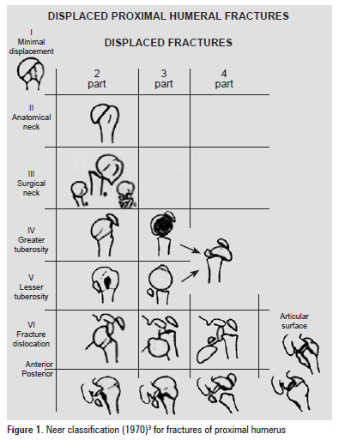

Slide 19
Symptoms
pain and swelling
decreased motion
Treatment
Nonoperative - start early range of motion within 14 days
sling immobilization followed by progressive rehab
indications
85% of proximal humerus fractures are minimally displaced and can be treated nonoperatively including
minimally displaced surgical neck fracture (1-, 2-, and 3-part)
greater tuberosity fracture displaced < 5mm
fractures in patients who are not surgical candidates

Slide 20
Operative
CRPP (closed reduction percutaneous pinning) - Simple fracture patterns may be treated by placing metal pins through the skin and into the bone fragments to hold the fragments in position as they heal
ORIF – plates
intramedullary nails
hemiarthroplasty
indications
anatomic neck fractures in elderly or those that are severely comminuted
4-part fractures and fracture-dislocations (3-part if stable internal fixation unachievable)
rotator cuff compromise
glenoid surface is intact and healthy
chronic nonunions or malunions in the elderly
head-splitting fractures with incongruity of humeral head
detachment of articular blood supply (most 3- and 4-part fractures)
total shoulder arthroplasty

Slide 21
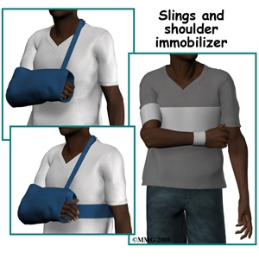

Slide 22
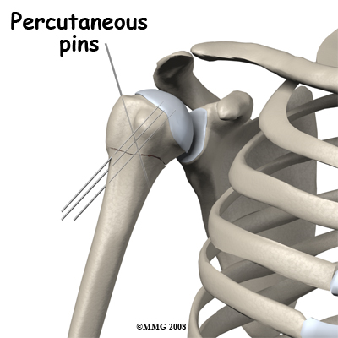
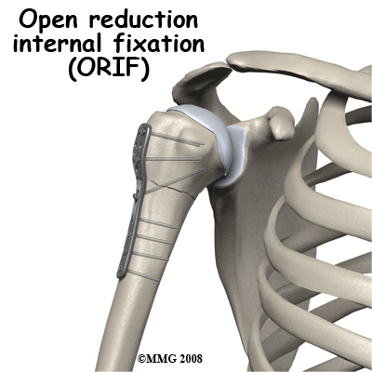
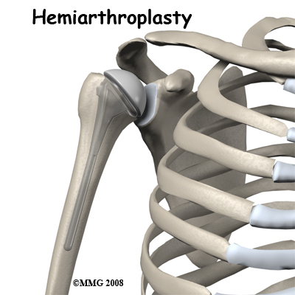

Slide 23
CRPP
A: two part surgical neck fracture
B: after treatment with closed reduction and percutaneous pinning

Slide 24
Intermedullary nail
A displaced 2-part proximal humeral fracture

Slide 25
ORIF
Internal fixation by plate

Slide 26
Hemiarthroplasty

Slide 27
Complications
Damage to nerves and blood vessels, rare complication of proximal humerus fractures
The most dreaded complication of proximal humerus fractures is avascular necrosis of the humeral head. This occurs when the fracture damages the blood supply to the humeral head
The most common complication after a proximal humerus fracture is a reduced range of motion. This can occur for many reasons including poor alignment of the fracture once it is healed or from weakness in the muscles that move the shoulder. Scar tissue around the shoulder can create restriction to motion
Preventing loss of motion is one of the key reasons physical therapy is recommended as part of the treatment of this fracture.

Slide 28
Rehabilitation
Best results with guided protocols (3-phase programs)
early passive ROM for first 6 weeks
active ROM and progressive resistance
advanced stretching and strengthening program
Prolonged immobilization leads to stiffness
Most proximal humerus fractures heal in about three months
Surgical treatment – rehabilitation program depands on solidness of fixation

Slide 29
Rehabilitation
According to Bastlova et al. (2004), the entire course of rehabilitation of proximal humeral fractures is divided into 4 phases:
Subacute phase rehabilitation - prevention of reflexive and dystrophic changes
Mobility restoration in the scapulo-thoracic articulation
Neuromuscular stabilization of the glenohumeral joint
Rehabilitation of specific motor skills of the shoulder girdle

Slide 30
Phase I
In simple fractures, phase I begins within a few days after the injury.
For complex fractures, it begins in the second week
Treatment focuses on improving cervical and thoracic segmental mobility, their straightening and the optimal alignment of the scapula
Active exercise of unaffected segments – elbow, wrist, fingers

Slide 31
Phase II
Gradual discontinuation of immobilization
Manual therapy - restoration of correct function of the scapula and its surrounding muscles. These include the tendons and tendinous structures of the muscles surrounding the lower scapular angle (medially and dorsally the rhom- boid major and the teres major; medially and ventrally the serratus anterior and laterally the teres major)
Soft tissue mobilization of muscles levator scapula, upper trapezius
Exercices for activation of the lower scapular stabilizers and the rotator cuff muscles
Rhythmic shoulder stabilization
Active arm exercises are initiated 2-3 weeks after the injury or surgery
The patient is taught pendular movements of the arm while they are in a forward bend position and leaning on the bed with the contralateral forearm. The movements can be performed into either flexion or extension or an imaginary figure “eighť, which can gradually increase in size

Slide 32
_{Pendular Movements}

Slide 33
Phase III
The strategy of phase III rehabilitation following proximal humeral fractures includes neuromuscular compensation, or substitution of damaged surrounding structures that ensures passive shoulder joint stabilization (Bastlova, 2004)
Movements in the open kinetic chain are continued in the form of pendular arm movements, as well as, exercises in closed kinetic chains, in which axial loading through the humerus is gradually increased. The arm can be supported through the forearm or the hand
Pressure through the extremity using unstable surfaces - soft foam, ball, etc. can be used

Slide 34
Phase IV
The last phase of intensive rehabilitation begins in non-complicated and early rehabilitated patients the end of four weeks after the injury, sometimes during the second month (Bastlova, 2004)
Specific exercises of the shoulder girdle musculature include practicing the stabilization function through support and through training of the muscles ability to alternate its concentric and eccentric activity
Perform by resistance from elastic bands or by throwing balls of various weight against the wall
The overall time for satisfactory resolution of shoulder girdle function following proximal humeral fracture with intensive and complete rehabilitation is usually 3-4 months. However, rehabilitation needs to be continued to the end of 6 months in the form of a home program and physical therapy visits every 2-3 weeks for follow up regarding the regular home exercise program

Slide 35
Rythmic Shoulder Stabilization

Slide 36
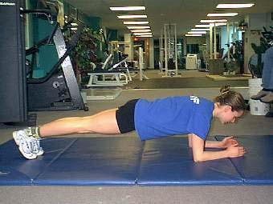
Closed Kinetic Chain Shoulder Exercises

Slide 37
Resume
In acute phase during immobilization
Cryotherapy and balling to reduce swelling and pain
Active exercise of unaffected segments (elbow, wrist, fingers, cervical and thoracic segmental mobility)
Isometric exercise
Mobilization phase
To restore ROM – passive movements, soft tissues mobilization, PIR
AROM, closed and open kinetic chain exercise
Exercise for activation of the lower scapula stabilizers and the rotator cuff muscles
Rhythmic shoulder stabilization
PIR or stretching of shortened muscles (pectorales, levator scapula, upper trapezius)
Strenthening of weak muscles (lower scapula stabilizers, external rotator muscles)
Modalities – megnet therapy, whirpool; aquatic therapy

Slide 38
ELBOW JOINT
_{Overuse Soft Tissue Injuries}
Lateral epicondylitis (tennis elbow)
Medial epicondylitis (javelin throwers or golfers elbow)
_{Traumatic Lesions}
_{Dislocation}
_{Pediatric fractures}
_{Adult fractures}
Adult Fractures at the Elbow Region
_{Distal humeral fracture}
_{Olecranon fracture}
Fracture of the head of the radius

Slide 39
Lateral Epicondylitis (Epicondylitis Radialis Humeri)
Lateral (radial) epicondylitis (tennis elbow) is an injury to the origin of the wrist extensors (most notably the extensor carpi radialis brevis), finger extensors and the supinator muscle at the radial condyle of the humerus and the radial head
The clinical presentation includes pain with loading (lifting, carrying heavy objects) and with gripping.
Acute epicondylitis demonstrates edema
Chronic epicondylitis demonstrates soft tissue hypotrophy at the origin of the muscles. The wrist and finger extensors usually demonstrate increased tone and the muscle bellies present with multiple reflexive changes

Slide 40
Medial Epicondylitis (Epicondylitis Ulnaris Humeri)
Ulnar epicondylitis (golfers, javelin throwers elbow) is an injury to the origin of the wrist and finger flexors and the pronator teres at the medial epicondyle of the humerus
The clinical presentation: increased tone and reflexive changes are found in the muscle bellies of the wrist and finger flexors and in the pronator teres. Resisted wrist flexion is painful and elbow springing into extension and supination is limited

Slide 41
Rehabilitation in Enthesopathies
_{Acute Form}
It most often develops as a result of relatively uncommon prolonged work (screwing, yard work, uncommon athletic performance)
Treatment- rest and sometimes short-term immobilization until the acute pain subsides
Modalities include cryotherapy and sometimes diadynamic currents
Gentle and specific soft tissue mobilization and lymphatic drainage are indicated
Pharmacotherapy includes mainly non-steroidal anti- inflammatories that can be applied either locally (cream, gel) or systemically (oral medication). A local injection of an anesthetic mixed with a corticosteroid is also indicated

Slide 42
_{Chronic Form}
The chronic form is most often the result of chronic overuse of the tendinous region, usually due to muscle imbalance in the upper extremity and the upper half of the trunk (postural imbalance - especially the upper crossed syndrome)
Enthesopathy can also develop in a posturally symmetrical individual as a result of chronic inadequate loading
In therapy, increased tone and trigger points of the corresponding muscles need to be addressed (post-isometric relaxation, soft tissue techniques)
Joint mobility needs to be restored and preserved (traction, mobilization, active and passive range of motion)
Muscle coordination and activity need to be improved (sensorimotor component, close kinetic chain exercises)
Modalities include heat, electrotherapy, ultrasound, laser, shockwave ultrasound and magnetic therapy
Therapeutic treatment also includes ergonomie assessment and modification with a possible change in work activity and orthotic devices (epicondylar brace)

Slide 43
_{Dislocations}
A loss of contact between joint surfaces
Complications -an avulsion of the joint surface‘s rim, which is known as a dislocation fracture and damage of the neurovascular bundle in the elbow area
A dislocation occurs most often during falling on a flexed elbow joint
_{Treatment}
Closed or open repositioning of the elbow joint is performed under general anesthesia. Following the reduction, the extremity is immobilized by a splint or an orthosis. The length of immobilization is recomanded by the physician

Slide 44
Adult Fractures at the Elbow Region
_{Distal humeral fracture}
_{Olecranon fracture}
Fracture of the head of the radius

Slide 45
Distal Humeral Fracture
Nonoperative treatment depends on the fracture type
Casting and immobilization can be used for nondisplaced fractures, particularly with medial, lateral, and supracondylar process fractures (extra-articular and extracapsular)
Operative intervention (ORIF) in case of intra-articular fragment displacement, supracondylar comminution and displacement, open fractures, neurovascular injury, compartment syndrome

Slide 46
Distal Humeral Fracture
After surgury

Slide 47
Olecranon Fracture
The goals of olecranon fracture treatment must be individualized to the needs of the patient. In young active individuals, restoration of the articular surface, preservation of motor power, restoration of stability, and prevention of joint stiffness are important. In older patients, minimization of morbidity is the most important goal
Nondisplaced olecranon fractures with intact extensor mechanisms (as demonstrated by the ability to actively extend the elbow) are generally treated nonoperatively – by cast immobilization
Surgical treatment (K-wires, plates) is indicated for the following:
- fractures with significant displacement (>1-2 mm)
- all patients lacking active extension of the elbow
- most fractures associated with elbow instability
- cases in which nonoperative treatment has failed

Slide 48
K-wires
ORIF - plate

Slide 49
Rehabilitation in Traumatic Lesions
It is up to the physician to determine when physical therapy should be initiated
The goals of rehabilitation treatment
_{Edema control}
_{Increased range of motion}
Correction of muscle imbalance and inclusion of the extremity into total body movements
_{Physical therapy techniques}
Soft tissue techniques for the release of muscles, ligaments and the joint capsule
Stretching of shortened structures
Gentle elbow joint mobilization
Relaxation techniques (PIR, anti-gravity relaxation) of muscles with increased tone
To increase ROM – passive movements, closed and open kinetic chain exercises
Physical therapy also needs to address the additional segments of the affected upper extremity (wrist, hand and shoulder), ensure scapular stabilization and treat cervical and thoracic spine
The modalities - anti-inflammatory procedures, manual or mechanical lymphatic drainage, hydrotherapy (Whirlpool, contrast baths) and procedures that speed up soft tissue and bone healing (magnet therapy)

