Slide 1
Rehabilitation after Wrist and Hand Injuries
Mgr. Alena Sedláková

Slide 2
Traumatic Lesions
_{Soft tissue injuries}
_{Dislocations}
_{Fractures}

Slide 3
Soft Tissues Injuries
An indirect or blunt force can lead to injuries of the tendons or the neurovascular bundles.
Tendon Injuries of the Wrist and the Hand (Flexors, Extensors)
Tendon disruption can be either isolated or it can occur as a component of an associated wrist or hand injury, in which the tendon injury involves the hand bones and the neurovascular bundles

Slide 4
Injuries of the Neurovascular Bundle
Most often, the neurovascular bundle is injured on the volar aspect of the distal forearm
Injury by a sharp object (slash or cut)
During this injury, damage (cut) of the median nerve, ulnar nerve, radial artery or ulnar artery can occur, a finger flexor injury is also common
Fracture of the distal forearm with subsequent neurovascular bundle compression by a fragment or edema can be another cause of damage

Slide 5
Treatment of Tendon and Neurovascular Bundle Injuries
Surgical suture of the tendon is the foundation of treatment
In an isolated injury, ideally a primary tendon repair is performed within 6-12 hours of the injury
Restoration of skin coverage of the involved tendon is a prerequisite for correct tendon healing, otherwise necrosis develops.
In associated wrist and hand injuries, the primary treatment involves the nerves, arteries and fracture. Tendon repair can be performed at the same time as fracture stabilization or secondarily
In a concurrent injury of the tendon and the neurovascular bundle, repair of the nerve, tendon, and at least one digital artery, all at one time, is indicated within 24 hours

Slide 6
Rehabilitation in Tendon Injuries
Currently, early rehabilitation is administered
The tendon repair needs to be maintained without tension during rehabilitation
The Kleinert method of semiactive mobilization – the extremity is stabilized in a splint, but movement in the affected segment is preserved and allowed through a pulley system. In a flexor repair, the segment is passively ranged into flexion and active movement is administered against resistance into extension. The situation is reversed in an extensor repair
Passive mobilization of the affected segment by continuous passive motion
Tendon healing time is 4-6 weeks and the tendon can be gradually loaded after this time period. The exercises are performed analytically based on Kenny or by using PNF
New rehabilitation approaches, the pyramidal system of loading has been beneficial, which is used strictly during rehabilitation of finger flexors. It is a graduated system of exercises comprised of several steps that vary in difficulty
Modalities include anti-inflammatory therapy ultrasound, lymphatic drainage and hydrotherapy including whirlpool
Occupational therapy, especially addressing fine motor skills and grasping

Slide 7
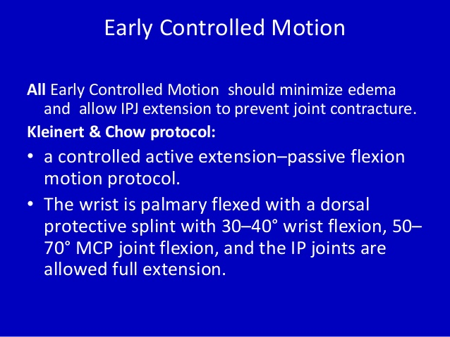

Slide 8
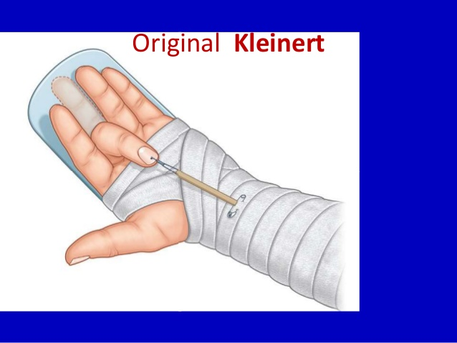

Slide 9
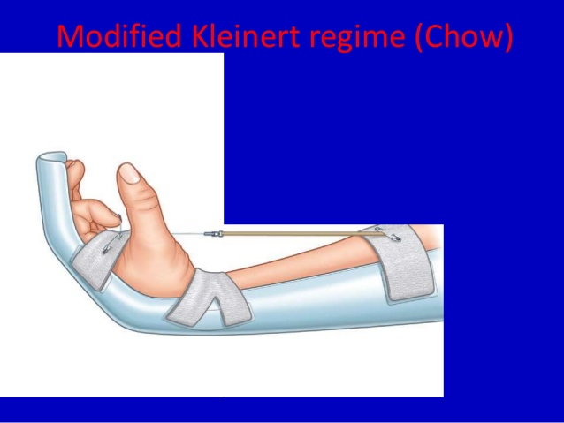

Slide 10
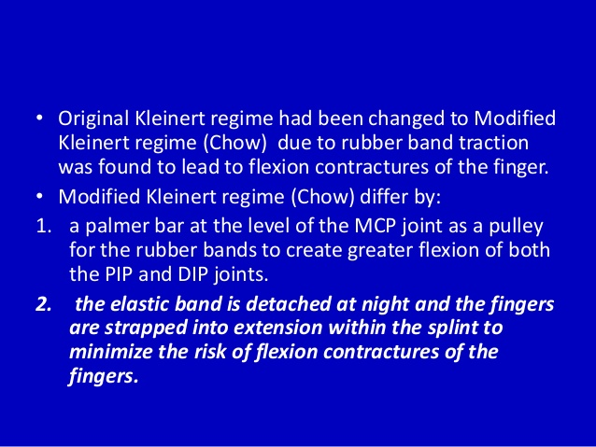

Slide 11
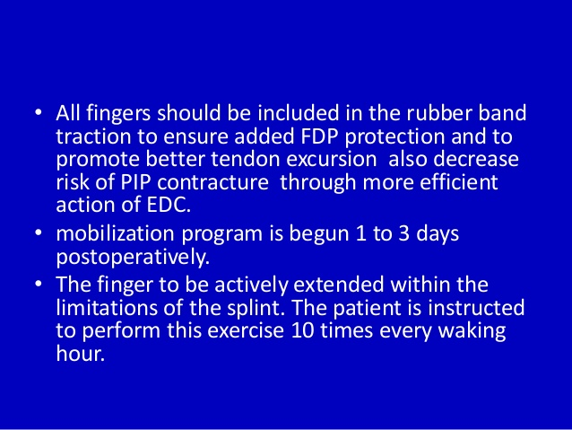

Slide 12
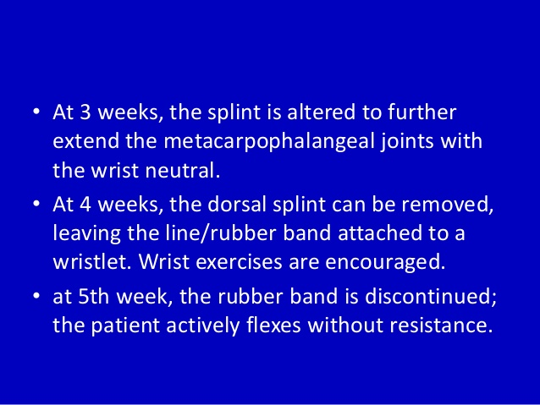

Slide 13
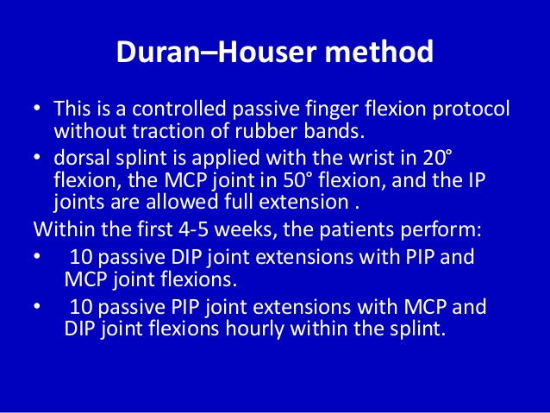

Slide 14
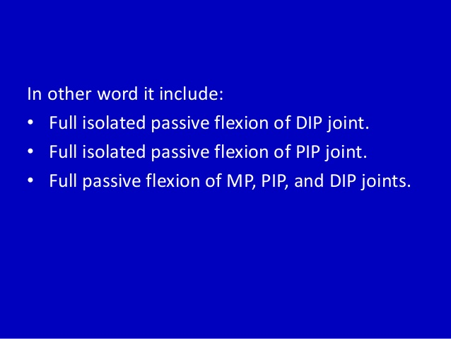

Slide 15
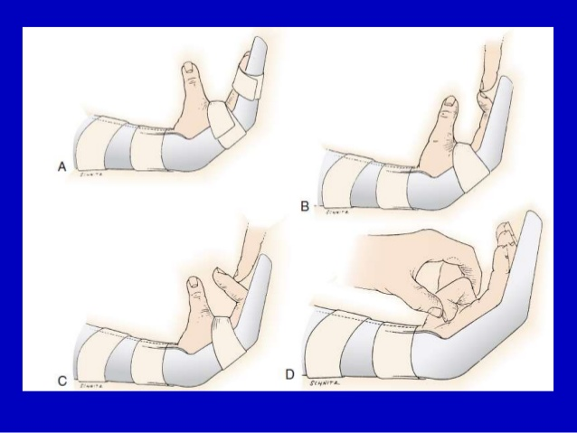

Slide 16
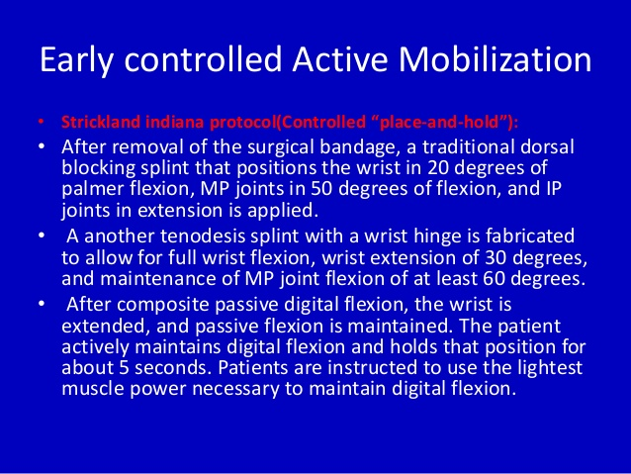

Slide 17
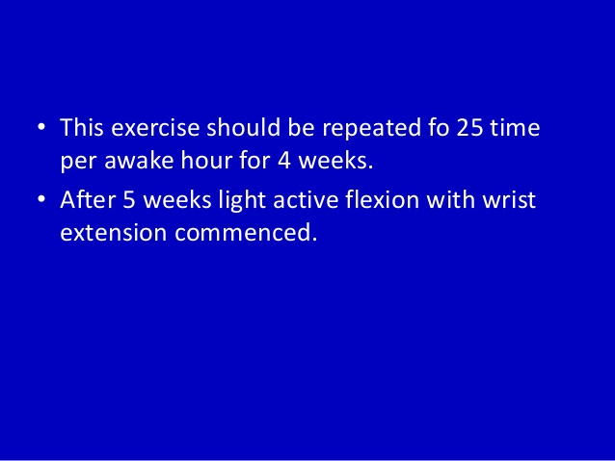

Slide 18
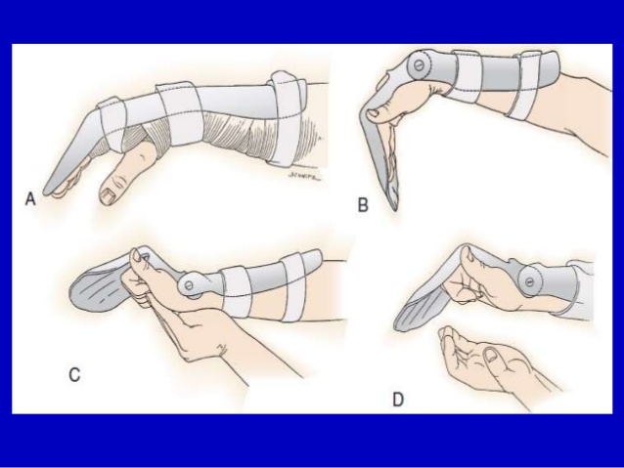

Slide 19
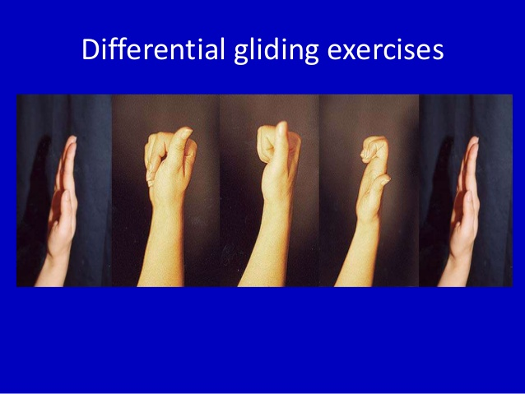

Slide 20
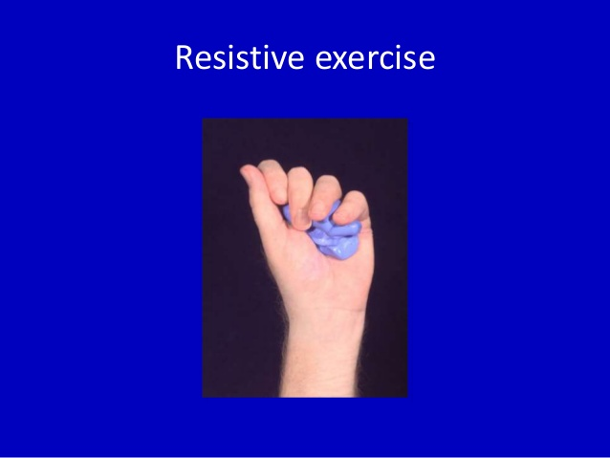

Slide 21
Fractures
Distal forearm fractures are one of the most common injuries of the skeleton. Next to proximal femoral fractures and compression fractures of the vertebral bodies, they are often associated with the clinical picture of severe osteoporosis
This group also includes a Colles fracture as a “loco typico” (“typical location”) fracture. It occurs during a fall on the forearm in the long axis when the wrist is in dorsal extension and it is defined as a fracture of the distal radius and dislocation of the peripheral fragment in the dorsal direction
Smith‘s fracture – during a fall on the wrist in volar flexion – fracture of the distal radius with volar dislocation
Complex regional pain syndrome (CRPS) formerly known as Sudecks algoneurodystrophy is the most common complication of distal forearm fractures

Slide 22
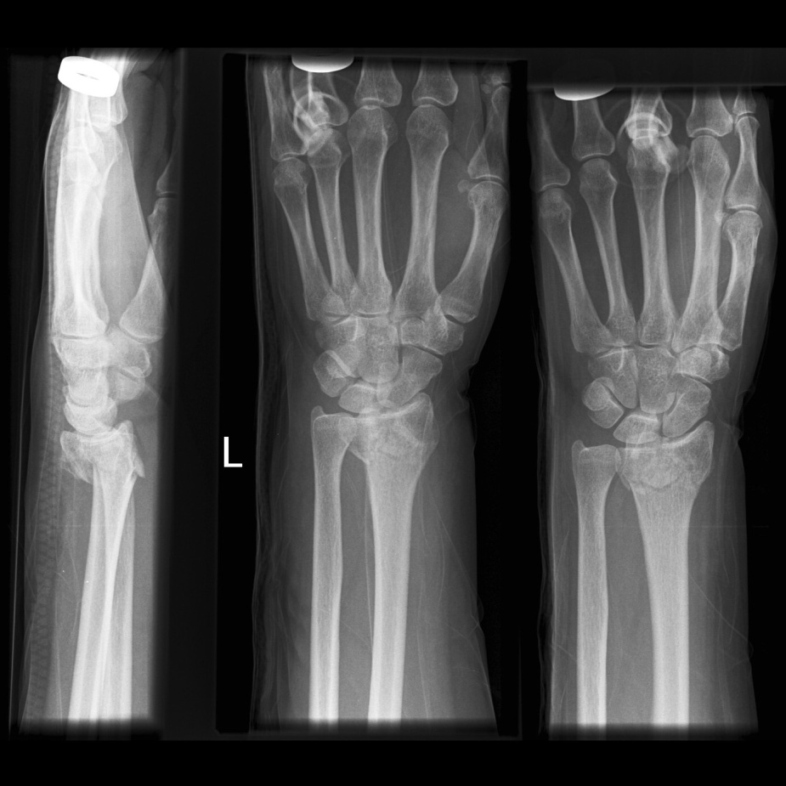
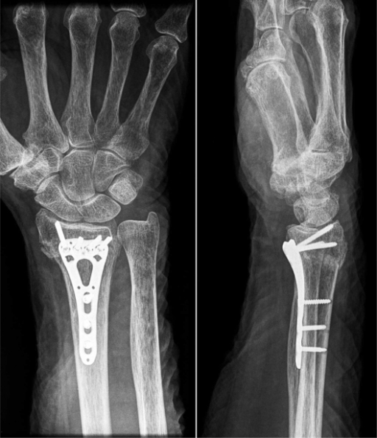
Coles Fracture
ORIF

Slide 23
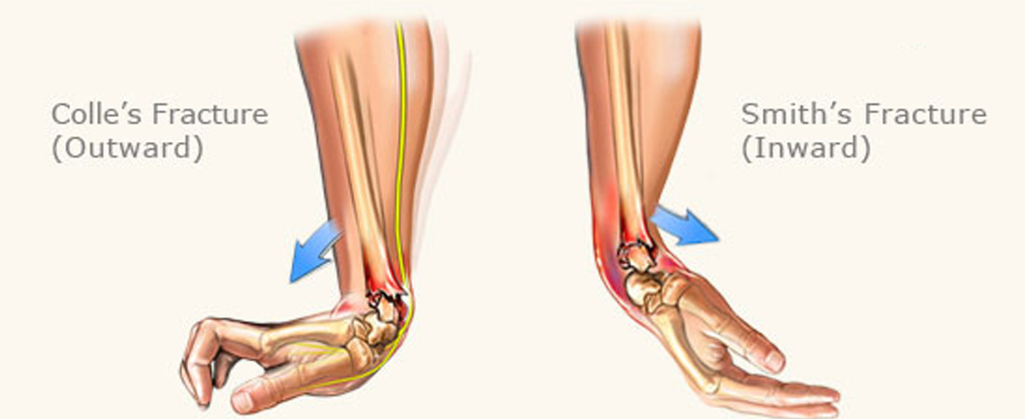

Slide 24
Treatment of Dislocations and Fractures of the Wrist and Fingers
Following surgical treatment, repositioning and stabilization of a displaced fracture, a splint or a brace is applied to immobilize the affected segment
The immobilization period is usually 2-6 weeks and the length of immobilization is determined by the treating orthopedist or a traumatologist based on radiological findings and clinical assessment

Slide 25
Rehabilitation in Dislocations and Fractures
Even during immobilization, modalities can be applied to accelerate the healing process. Pulsed magnetic field and distant electrotherapy are most commonly applied
Physical therapy treatment is initiated following the immobilization period. The goal of therapy includes range of motion restoration in the affected segment while maintaining its stability
Occupational therapy is an important component of rehabilitation for wrist and hand injuries - to restore hand function including grasping and fine motor skills

Slide 26
Immobilization Phase
Cryotherapy (application of ice reduces swelling and pain), forearm elevation
Modalities – magnet therapy
Exercises non-immobilizated parts of arm – fingers, elbow, shoulder, cervical spine exercise

Slide 27
Rehabilitative Phase to Restore ROM
Modalities – cryotherapy, magnet therapy (promotes fracture healing), hydrotherapy – whirpool (reduces swelling a relieves pain)
Soft tissues mobilization (PIR, balling) – to release contracted muscles, tendons and fascia
Joint mobilization – to restore joint play
PROM – passive range of motion exercises, AAROM – active assisted range of motion, AROM – active range of motion
Resistance exersice to improve muscle strength
To restore hand function – grasping, fine motor skills

Slide 28
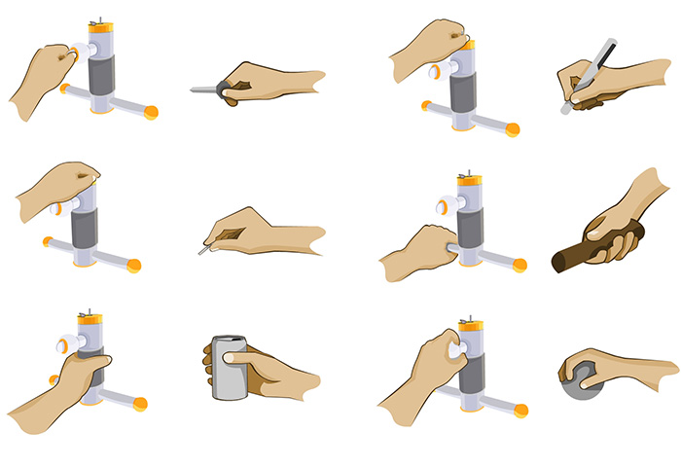
Grasp Patterns

Slide 29
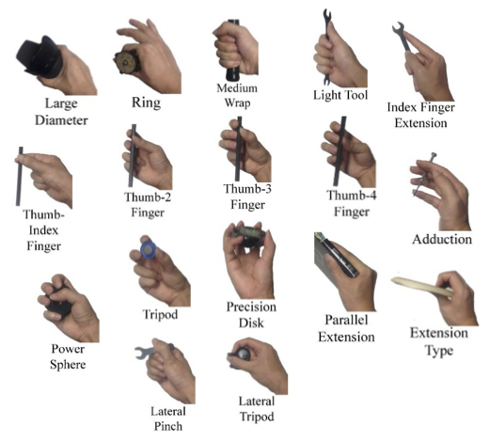
Grasps

Slide 30
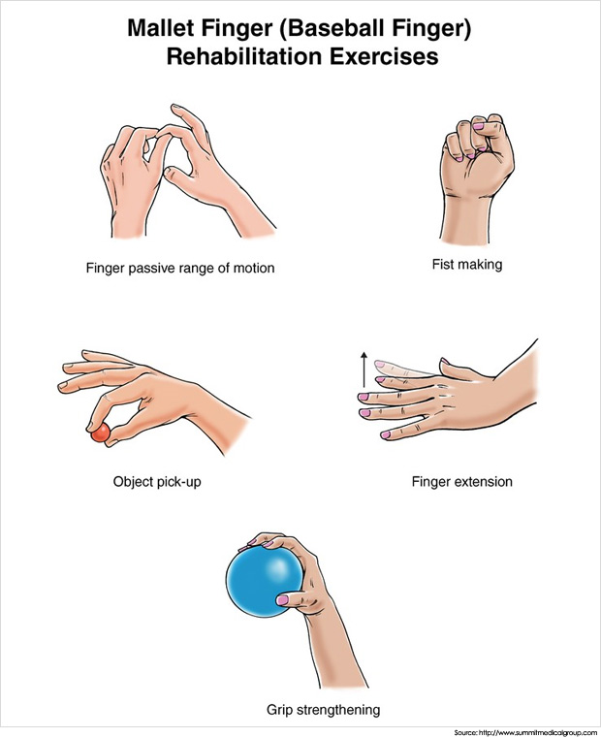

Slide 31
Complex Regional Pain Syndrome (CRPS)
Complex regional pain syndrome is a term denoted to various pain conditions that occur mainly as a result of an injury
They are localized and present with most significant clinical changes distal to the initial injury. The clinical changes do not overreach in their intensity or duration from the expected course of initial injury
They can result in significant deficits in movement function and demonstrate a various progression over time
CRPS needs to be considered as a manifestation of systemic dysregulation, characterized by an inability of autonomie mechanisms to control and gradually limit anti-regulatory mechanisms whose center is the area of microcirculation
A stasis with edema and hypoxia develops within the capillary network leading to connective tissue, muscle and bone tissue dystrophy with a severe deficit in joint function that can become irreversible
Bones show a various degree of porosity, from simple thinning of the trabecular framework to Sudeck osteoporosis

Slide 32
Types of CRPS
Type I CRPS (reflex sympathetic dystrophy)
Is a syndrome that occurs after the effects of the initial harming injury
Spontaneous pain or allodynia/hyperalgesia is present that is not limited to the area of an isolated peripheral nerve and it is not proportional to the eliciting injury
Edema has occurred with deficits in circulation and skin perspiration in the injured area
Diagnosis of type I CRPS is eliminated by circumstances that can explain the pain intensity and degree of involvement

Slide 33
_{Type II CRPS}
Is linked to an injury known up until now as causalgia
It occurs much less often than type I CRPS
It is a syndrome that occurs with a nerve injury
Spontaneous pain or allodynia/hyperalgia is present and may not only be limited only to the area of the injured nerve
Other characteristics of type II CRPS are identical to type I CRPS

Slide 34
Etiology and Pathophysiology of CRPS
The pain mechanisms found in type I and II CRPS have yet not been explained
Overview of the most common reasons for CRPS onset:
External - injury (bones, soft tissues, nerves), surgery, burns, frostbite, muscle and ligament overuse, incorrect and painful types of treatment, especially a tight cast or painful rehabilitation
Internal - inflammation (specific, non-specific), myocardial infarction, stroke, tumor congestion, barbiturate intoxication, anti-tuberculosis treatment
Undoubtedly, psychological changes, especially negative life events and personality traits, including autonomie stigmatization, all contribute to the onset of CRPS

Slide 35
Clinical Presentation of CRPS
Basic clinical symptoms (spontaneous pain, hyperalgia and allodynia) and other signs, such as circulation deficits, perspiration, edema, trophic changes and movement alterations are typical clinical signs that include the basic clinical criteria for correct diagnosis
Changes are most often located in the upper extremities and in a large number of cases, they develop as a result of injury and incorrect treatment
The deficit can be limited to only one extremity, especially its distal aspect
With disease progression into more advanced states, an ascending myoskeletal reaction occurs, in the context of tissue changes and an overall deficit in statodynamics - shoulder-hand syndrome in the upper extremity, muscle atrophy and thoracic spine scoliosis
Cases have also been known to include unilateral extremity involvement, in which the deficit initially begins in the upper extremity and subsequent symptom progression affects the lower extremity on the same side, or even the trunk and the head

Slide 36
Clinical Presentation of CRPS
Sensory deficit - pain is the main symptom
Initially, pain is limited to the affected region, most often an extremity, but can spread until it gradually encompasses a large part of body either unilaterally or even contralaterally
Pain is often spontaneous, but can be paroxysmal in the sense of paresthesias or dysesthesias
In nerve involvement (type II CRPS), burning sensation is common and the intensity is variable and often prevents the patient from performing any activity
Pain worsens with movement, which needs to be remembered especially by the physical therapists
It worsens with visual, auditory and psychological stimuli (stress), similarly to some other pain syndromes

Slide 37
_{Autonomie dysfunction}
Is manifested as marble-looking skin or its reddening, cyanosis and changes in skin temperature
It can be present in 75-90% of type I CRPS
It is apparent that the skin can be either warm from peripheral vasodilation or, in contrast, cold from vasoconstriction
Pseudomotor anomalies are common (hypo or hyperhidrosis)
_{Trophic deficit}
Commonly occurs in the later stages, usually weeks or months after the initial injury
Changes can affect skin, subcutaneous tissue as well as muscles, joints and bones
Thin skin, rough nails prone to breakage, an increase or decrease in hair growth and involvement of ligaments, aponeuroses, joints and bones

Slide 38
_{Motor deficit}
_{Is the most common}
It includes muscle weakness, tremor, dystonia, etc.
According to some authors, motor deficits are an integral component of CRPS
Decreased muscle strength is found in nearly all patients
The fact that range of motion and muscle strength are limited mainly by pain are clinically valuable signs of CRPS

Slide 39
Stages of CRPS
If CRPS is not correctly treated, there is no exception that the symptoms will persist for many months or years in the form of one of the three clinical stages, in which the course of the disease is commonly classified as follows :
Acute stage - increased circulation, edema
Dystrophic stage - decreased circulation, increased edema, range of motion restrictions, 3-6 months after the initial injury, can still be reserved
Atrophy stage - muscle and connective tissue involvement, irreversible

Slide 40
_{Symptom} _{Characteristics}
_{Pain} Dull, deep, poorly localized, intense, persistent.
It increases with activity. Non-anatomical location!
_{Weakness} Non-anatomical distribution! Difficult to assess, performance fluctuates, limited more by pain than muscle performance. Grows with time.
_{Mobility} Passive and active range of motion are limited equally, limited by pain in the acute stage and by contractures in chronic stage.
_{Sensation} Hyperesthesia of all senses (non-dissociated), occurs in dystrophic and atrophic stage, usually feeble
_{Trophic changes} Livedo reticularis, changes in all tissues, bone remodeling (radiology, scintigraphy), development of skin changes form hyperproductive phenomena to atrophy with loss of appendages
_{Perspiration}
_{disturbances} Highly correlates with prognosis, however; requires quantitative methods of assessment, which are not available in the Czech Republic.They are graded as plus or minus.
_{Vasomotor activity} Gross changes in regulation of vascular motility and permeability of the vessel wall.
_{Edema} Soft or lymphostatic edema in acute and later dystrophic phase.

Slide 41
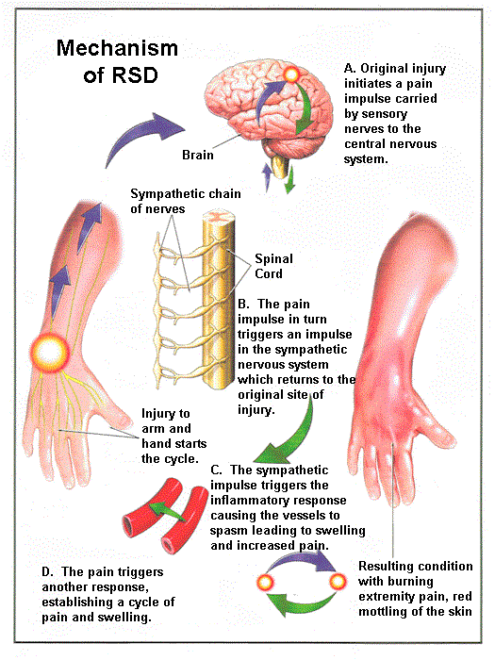
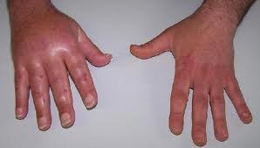

Slide 42
Treatment
The diagnosis is often incorrectly established and the condition classified under a different clinical unit or set of symptoms
Diagnosis and treatment require a multidisciplinary approach if the whole group of structures is affected (soft tissues, bones, joints, central or peripheral nervous system)
The patient can also be incorrectly treated because they are assessed from only a limited perspective within a certain specialty. It is not an exception, that in the initial phases of the disease, the affected segment is immobilized because of an incorrect diagnosis
A whole spectrum of treatment approaches is used to treat CRPS. They are mainly aimed at pain and edema control, improving the vasomotor state and restoration of restricted mobility
The fundamental treatment strategy in CRPS includes restoring night sleep, decreasing pain, decreasing microcirculation deficit, influencing localized changes and restoring restricted mobility

Slide 43
Rehabilitation
Treatment rehabilitation plays an important role in the treatment of this syndrome
Pain-free techniques and methods are the main requirement for treatment
Individual approaches and methods are selected based on the stage of CRPS
In the acute stage - isometric exercises, passive exercises are contraindicated
In the acute stage, the patient does not tolerate any stimuli in the affected segment
Locally, non-contact and aperceptive (patient does not feel the procedure) procedures – distant electrotherapy (DE, on VAS 07 equipment analgesic currents L1-L5) and low frequency pulsed magnetic therapy
Soft tissue mobilization techniques, balling
_{Vasopneumatic therapy}
_{Priessnitzs wraps}
Heat procedures are contraindicated

Slide 44
Rehabilitation
In dystrophic and atrophy stages, circulation needs to be increased and the development of dystrophic changes prevented
Early detection of the primary signs and initiation of adequate treatment can prevent irreversible dystrophic changes (third stage) and chronic pain
Modalities -distant electrotherapy and magnetic therapy to promote bone and soft tissues healing
Vasopneumatic therapy is indicated to improve extremity blood circulation and lymphatic drainage
Ultrasound - in the case of chronic edema
When blood vessel reactibility normalizes, heat hydrotherapy procedures (whirlpol) or dry heat can be initiated and applied locally
A consensual reaction of the vascular system can also be used, in which the application of a warm procedure to an uninvolved area on the extremity leads to vasodilation and improved perfusion on the affected extremity
Vibration exercises, active exercise of the affected area including large-scale exercises, in which the affected area is included into global movement (yoga and tai-chi), Vojtas therapy

Slide 45
Rehabilitation
In all phases - minimizing skin sensitivity
Stroking and similar techniques, balling
Mobilization techniques are combined with active exercises
Application of microcurrents was observed to provide beneficial effects
Other modality options - TENS, ultrasound and magnetic therapy
Psychological or psychotherapeutic intervention is often needed because, based on clinical experiences, CRPS most often occurs in neuroautonomically more labile individuals
_{Pharmacologic treatments}

