Slide 1
Total hip replacement
MUDr. Jan Emmer, I. Ortopedická klinika FNUSA v BRně

Slide 2
History
1891 Profesor Themistocles Glück (Germany)
  Femoral head replacement made of ivory (post TBC)
Further attempts with interposition arthroplasy (fascia lata, xenogenic tissues)
1925 Marius Smith-Petersen – glass, stainless steel
1953 George McKee
  Co-Cr acetabular component + cemented Thompson´s stem (stainless steel)

Slide 3
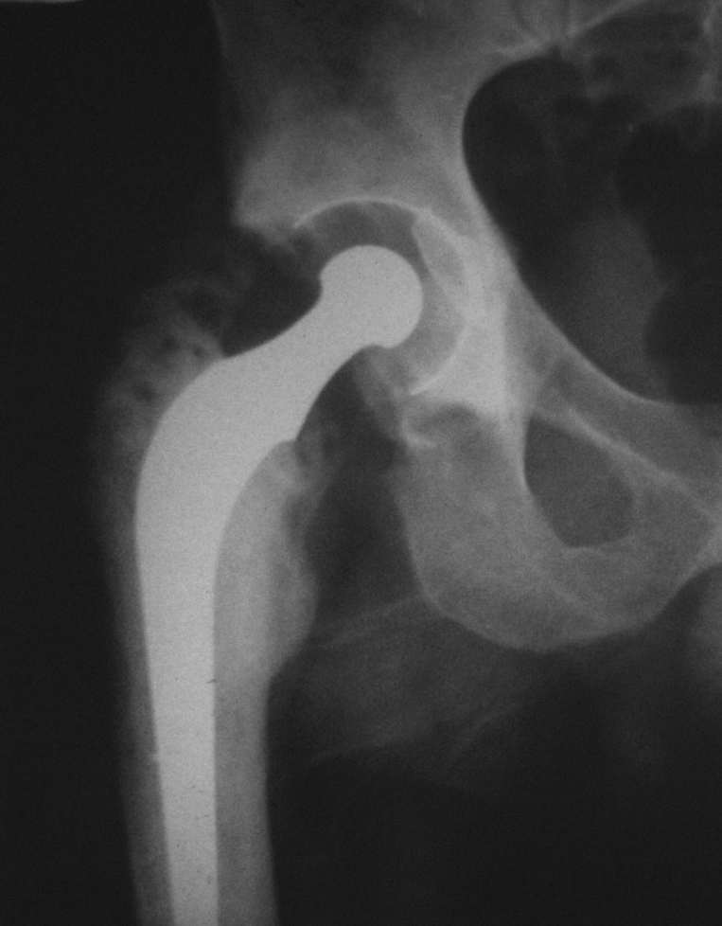
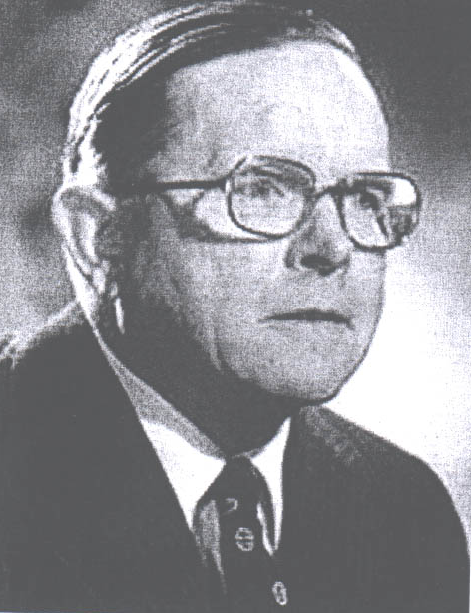
History
1960´ Sir John Charnley – Low friction artroplasty
  Bone (dental) cement, polyethylen, alloy
  1. st modern functional THR

Slide 4
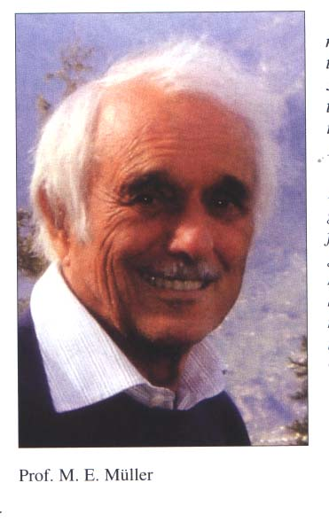
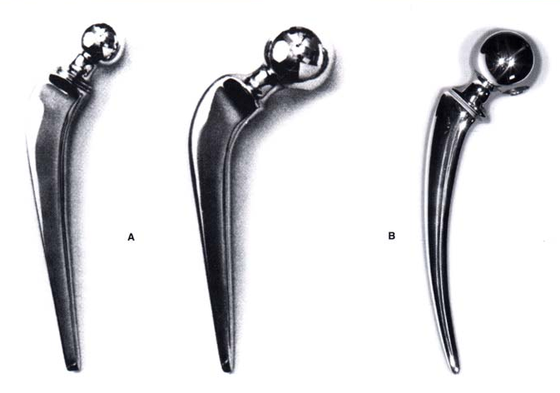
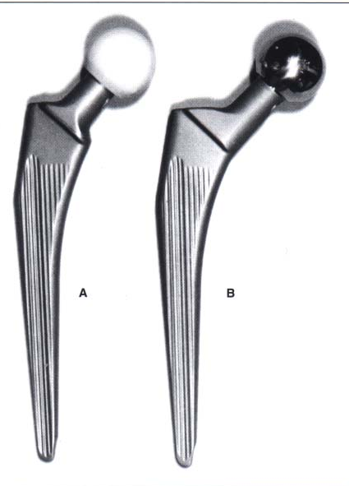
History
  1964-1965 1966
  Setzholzprothese Banana – shaped
  1977 Geradeschaft

Slide 5
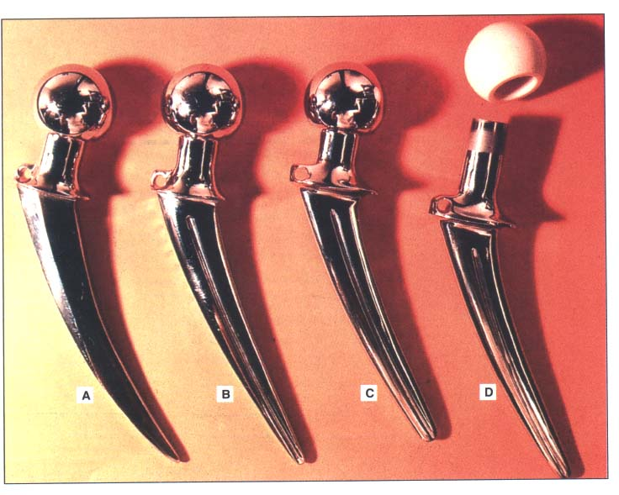
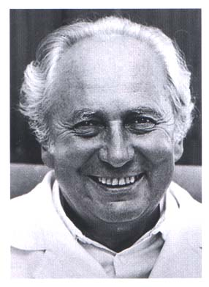
History
Prof. MUDR. Oldřich Čech, DrSc. (1928-2020)
Stems Poldi – Čech 1969 – present days

Slide 6
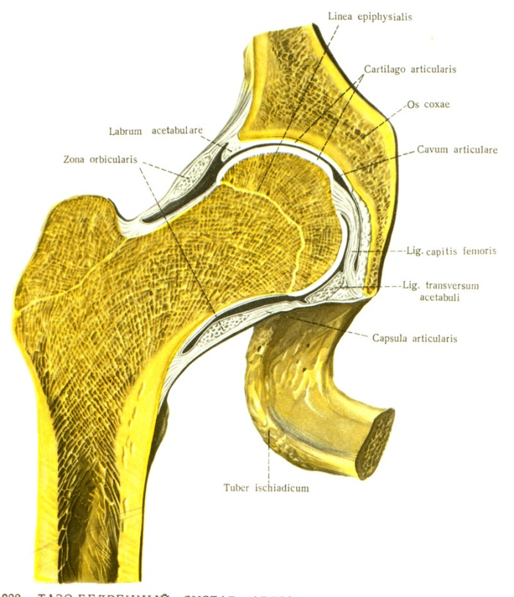
Anatomy
Enarthrosis – simple joint
Ball – socket, limited ROM
Acetabulum - hemisphere
Femoral head
  2/3 surface of ball
  Diameter aprox 2,5 cm

Slide 7
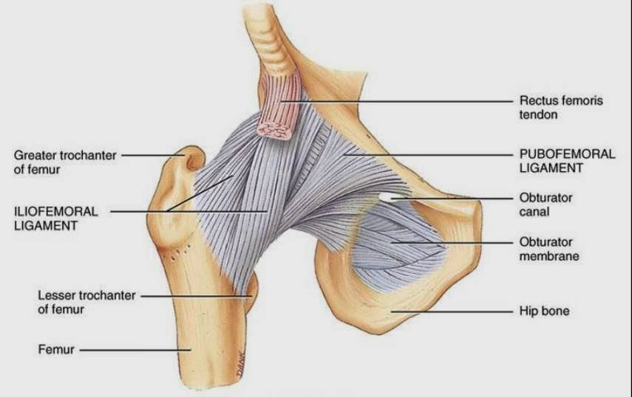
Anatomy
Ligaments:
  Lig iliofemorale
  Lig pubofemorale
  Lig. ischiofemorale
  Zona orbicularis
  Lig. Capitis femoris
  Joint capsule

Slide 8
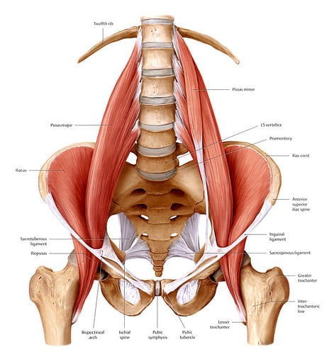
Anatomy
Muscles of hip joint – flexors
  M. iliopsoas (flexon + aditional hip adduction; n. femoralis, plexus lumbalis)
Muscles of hip joint – extenzors, abductors
  M. gluteus maximus (extension + ER + abduction; n. gluteus inferior)
  M. gluteus medius (abduction, IR; n. gluteus superior)
  M. gluteus minimus (IR; n. gluteus superior)
  M. tensor fasciae latae (aditional flexor, abductor, IR; knee extension at standing position; n. gluteus superior)

Slide 9
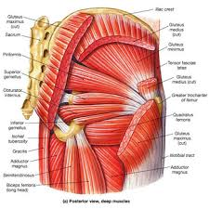
Anatomy
Muscles of hip joint - pelvitrochanteric muscles
  M. piriformis (abduction in flexion, ER ; plexus sacralis)
  M. gemellus superior (ER, plexus sacralis)
  M. gemellus inferior (ER, plexus sacralis)
  M. obturatorius internus (ER, plexus sacralis)
  M. quadratus femoris (ER, plexus sacralis)

Slide 10
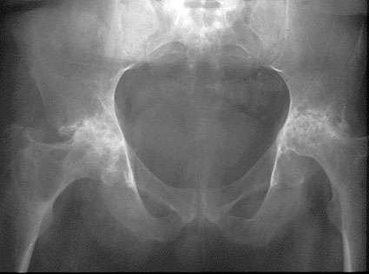
THR indications
Painfull hip joint condition
Poor effect of conservative therapy
Life comfort deteriorated
No salvage surgeries indicated

Slide 11
THR indications
OA primary
OA secundary
Psoriatic arthropathy
Aseptic femoral head necrosis
Rheumatoid arthropathy
Tumors
Intracapsular femoral neck fracture, no indication for OS or conservative therapy (vital indication!)

Slide 12
THR contraindications
Poor general condition, poor physical status (ASA IV)
Persistent infection
Severe comorbidity with poor prognosis
Extreme obesity
Strong malcompliance

Slide 13
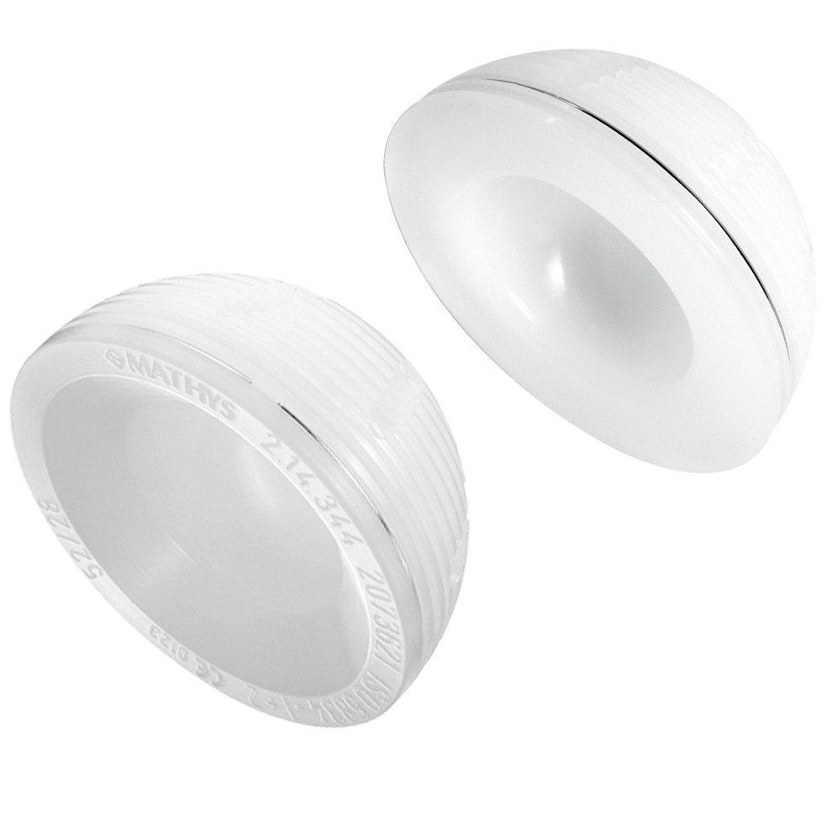
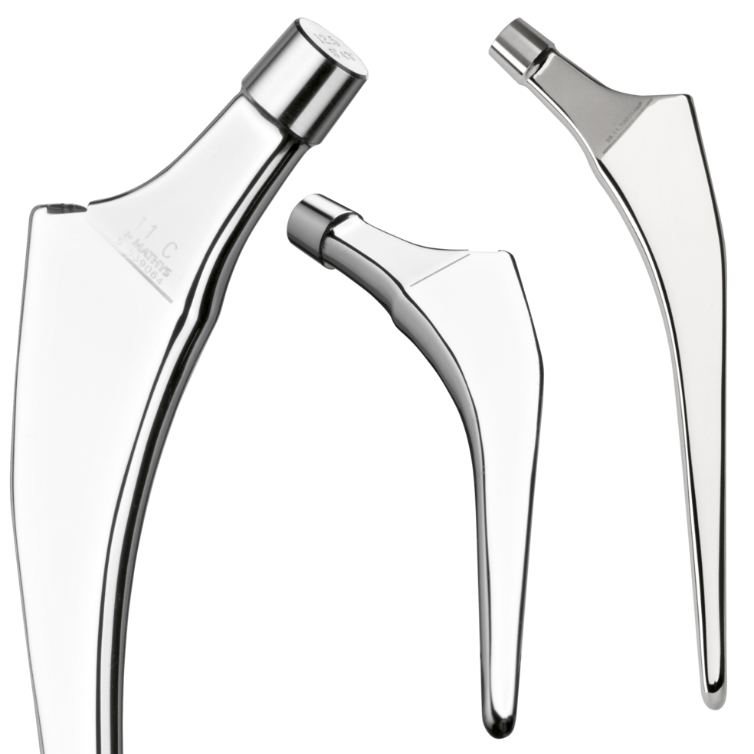
THR fixation options
Cemented
  Both components fixed with bony cement
  Older patients > 70 y.o.
  Poor bone quality - osteoporosis
  Inferior implant survival
  The cheepest option

Slide 14
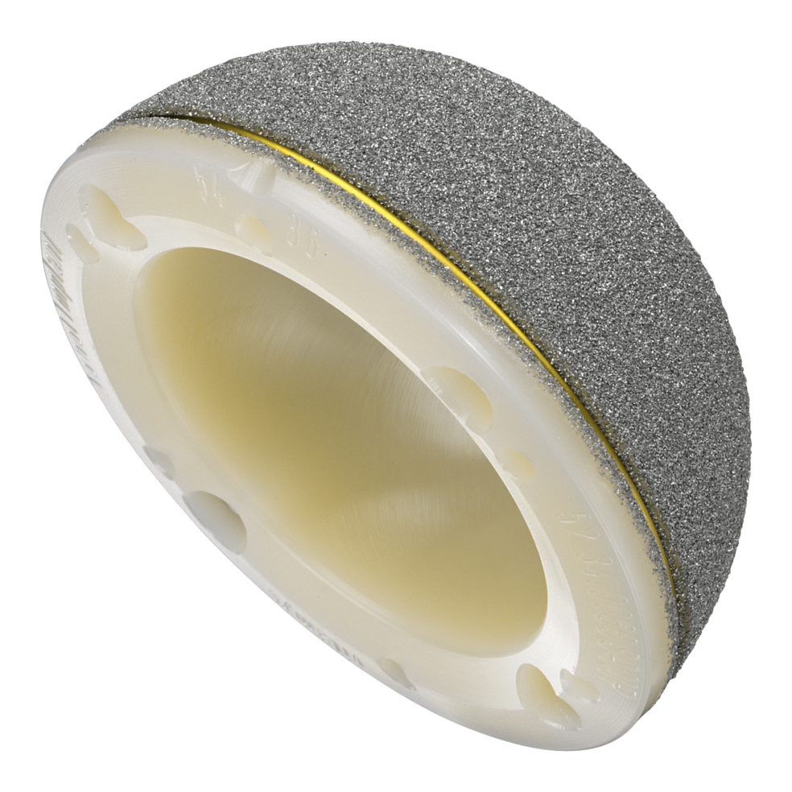
THR fixation options
Hybrid
  One component fixed with bone cement (femoral)
  65-70 y.o.
  Compromise bone quality
  Better implant survival
  Price?

Slide 15
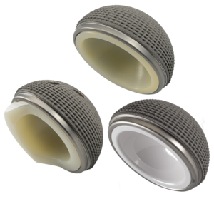
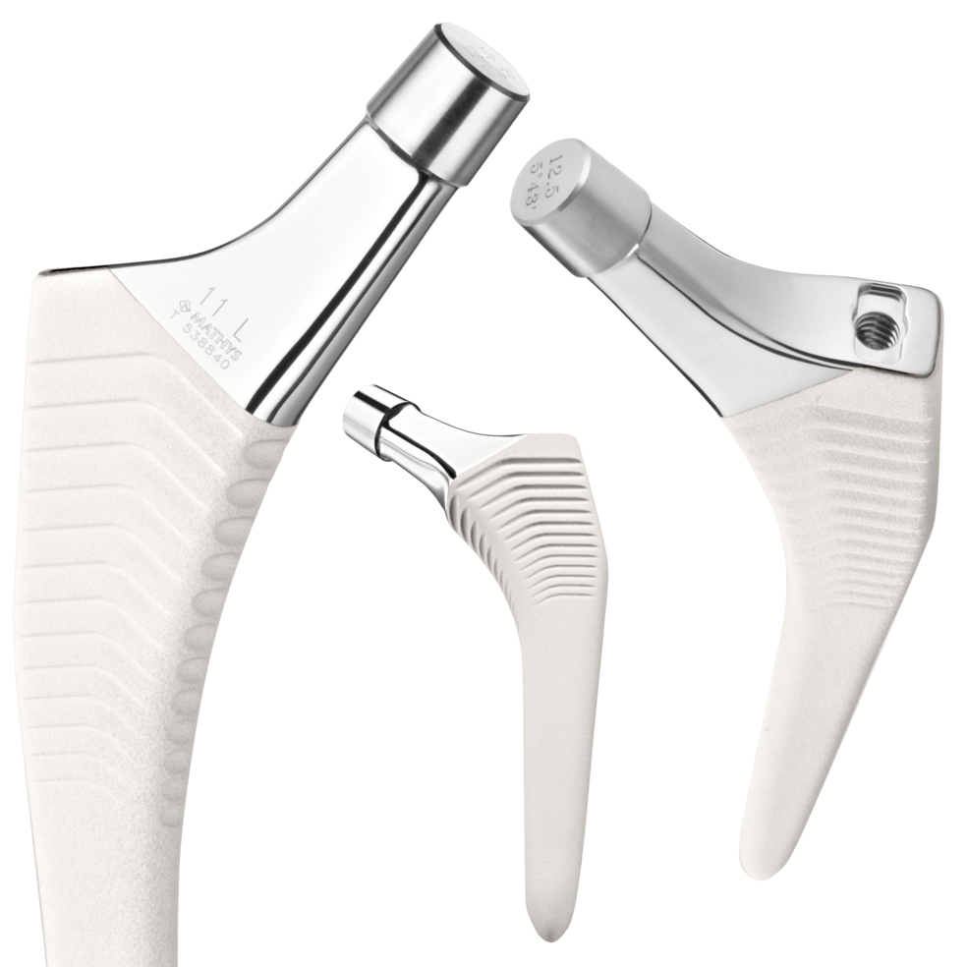
THR fixation options
Cementless
  Both components fixed with no bone cement
  <65 y.o.
  Good bone quality
  Contraindication for bone cement (alergy, right ventricle function)
  Best implant survival
  The most exepensive

Slide 16
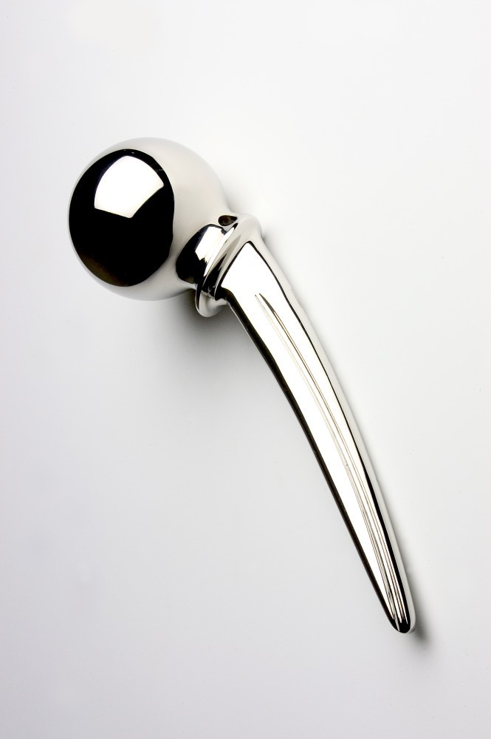
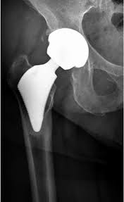
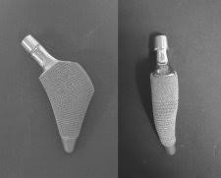
Hip replacement range
Cervicocapital replacement
  Not frequently nowdays, fracture if patient polymorbid
  Acetabular abrasion
  Inferior results
Total
Methafyseal conservative stems - why?

Slide 17
materials
Polyethylen
  Longest used material for cup
  Viscoelastic
  Plastic deformation (cold flow)
  Higer wear rate
  Oxidative degradation

Slide 18
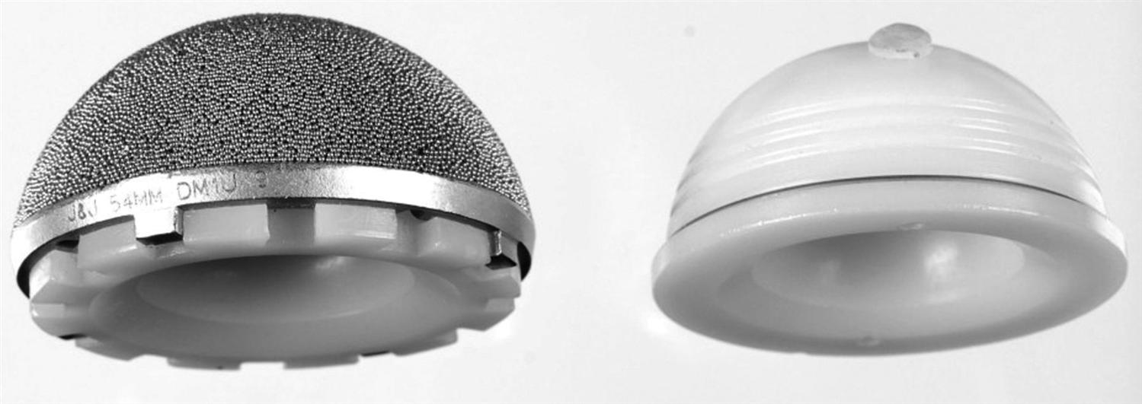
Materials
Polyethylen
  UHLMWH - Ultra high molecular weight polyethylen
  HXLPE – cross - linked
  Tocoperol doped PE (vit E)
  Aim:
    Wear reduction
    Oxidative degradation reduction
    Keeping elasticity modulus

Slide 19
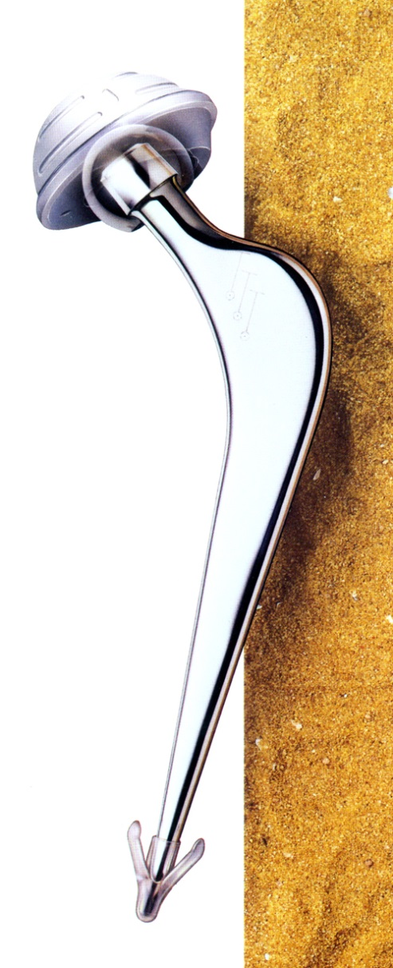
Materials
Femoral component - requirements
  Biocompatibility
  Mechanical strenght
  Osteointegration (cementless implants)
  Antialergic implants (if metal allergy presented)
  Future? Biofilm resistance

Slide 20
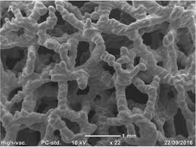
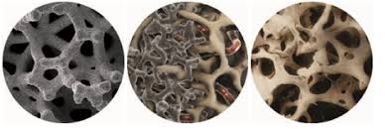
Materials
Cementless implants requirements – bone adjacent surface
  Trabecular titan
  Trabecular tantal
  Hydroxyapatite surface

Slide 21
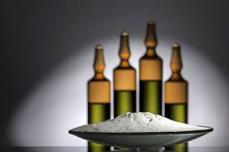
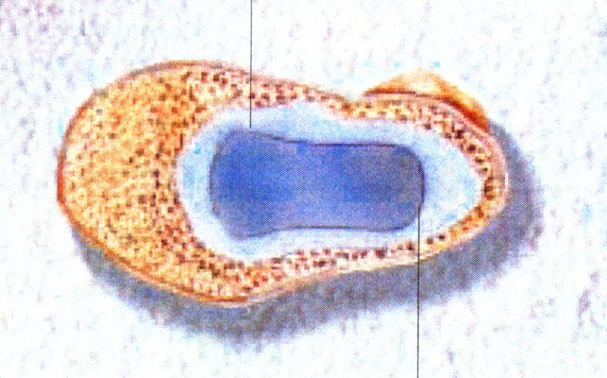
Materials – bone cement
Poly methyl methacrylate (metylesther metacrylic acid)
Powder polymer, liquid monomer
Exotermic response
Stabilisation of the implant in 10 minutes
Cytotoxic effect
Protein coagulation (termical + chemical)
Microembolisation

Slide 22
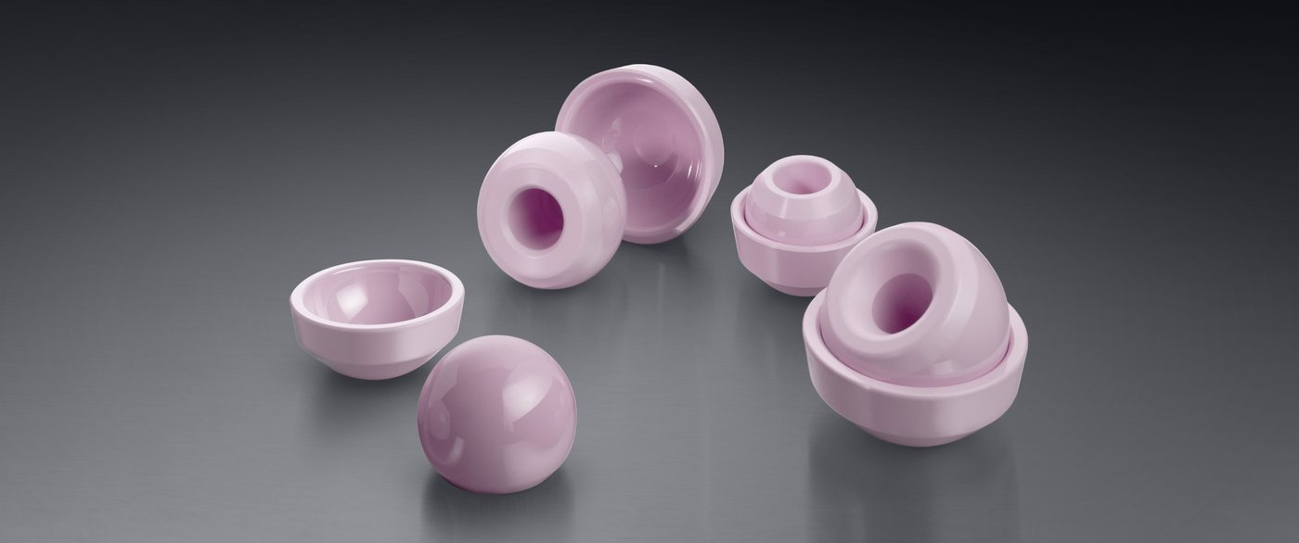
Materials – ceramic
Pure aluminium oxide - AL₂O₃ - corundum
ZrO₂ – zirkonium oxide
Extremely smooth surface, minimal friction ratio
An order of magnitude smaller wear rate comapare to metal
Fragile
Expensive

Slide 23
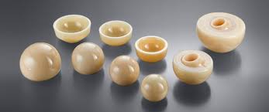
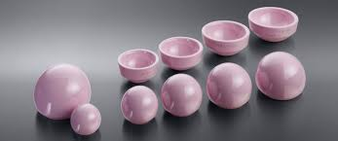
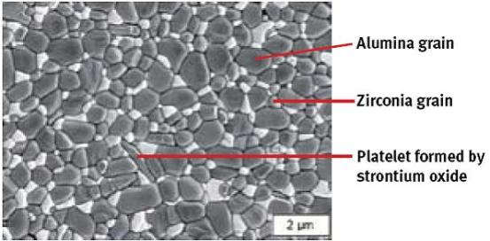
Materials – ceramic
Biolox forte
  Pure AL₂O₃ (yellow)
Biolox delta
  Stronger
  Lower grain size – even more smooth
  More homogenic
  Pink
  AL₂O₃
  ZrO₂
  Zirconium oxides stabilized by Ytrium

Slide 24
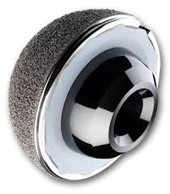
Materials – Oxinium
Zirconium oxides
Combines properties of alloy and ceramic
2x harder than ceramic
Abrasion and scratch resistant
Fracture resistance
Trace amount of Ni only (hypoallergenic)
20% lighter than CoCr

Slide 25
Acetabular comoponent cemented
Cement + PE, monobloc
RTG marker (metal wire around)
Structured surface for cement retention

Slide 26
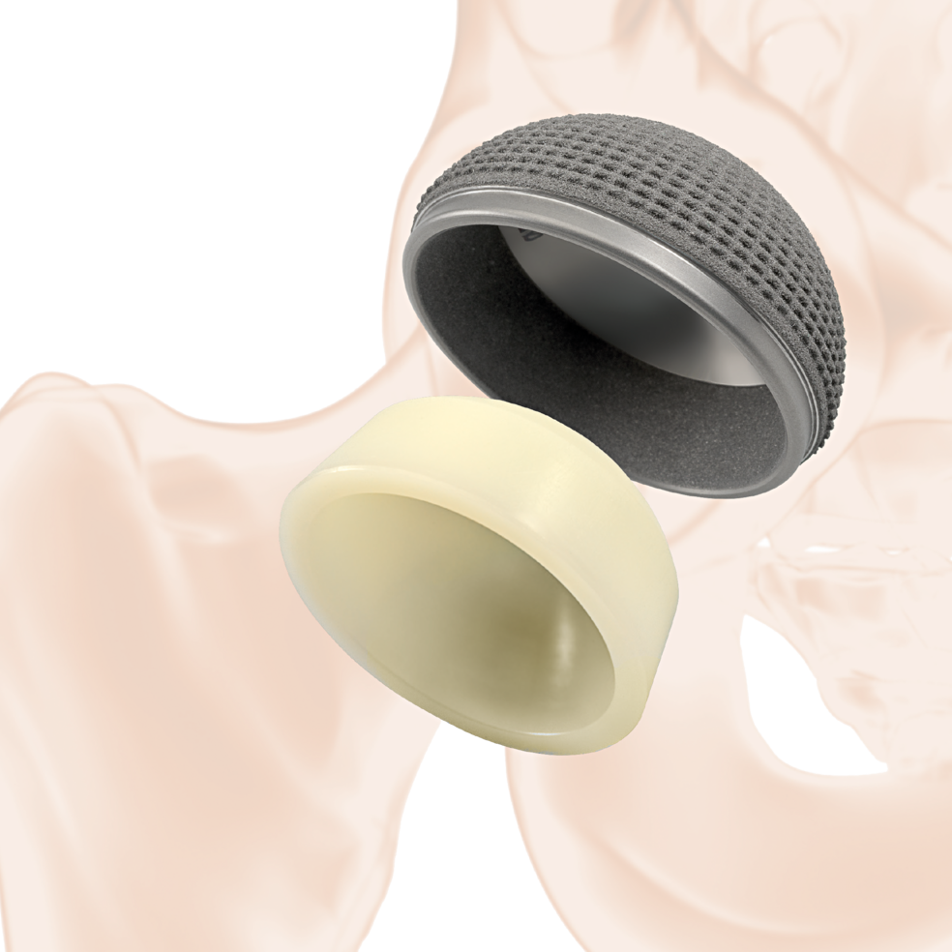
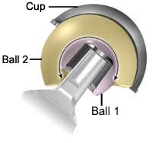
Acetabular comoponent cementless
Metalback + inlay (ev. monobloc)
Material of inlay variable
Offset optional
Double cup – lower displacemet risk
Osteoinductive surface

Slide 27
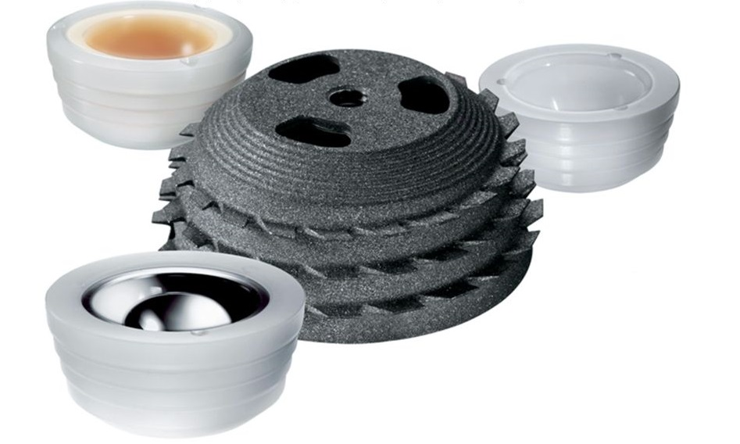
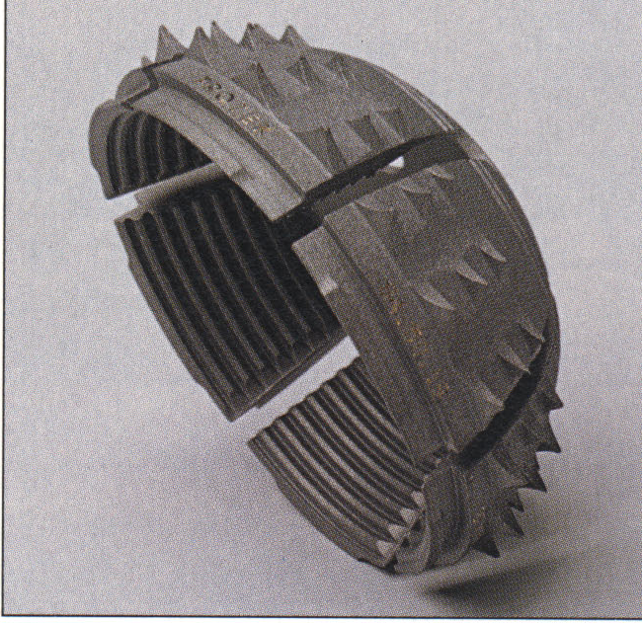
Acetabular comoponent cementless
Press fit Threaded Expansion

Slide 28
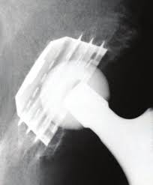
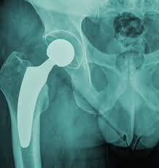
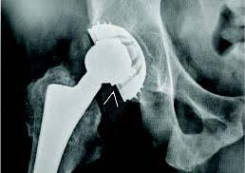
Acetabular comoponent cementless
Press fit Threaded Expansion

Slide 29
Acetabular comoponent cementless
Press fit
  Golden standard, most cases
Theraded
  Best primary fixation
  Postdisplastic arthritis, shellow acetabulum, low / defect ac. wall support
  Partial acetabular defects
Expasion
  Obsolent, worse results
  PE/bone contact
  Failure – leafs breaking off

Slide 30
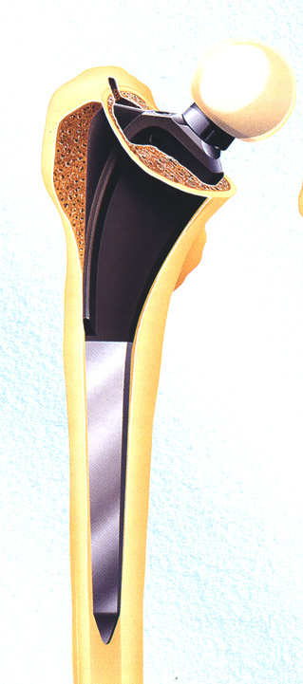
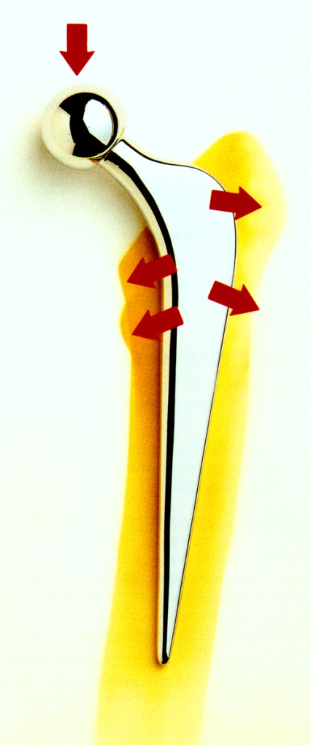
Femoral component
Smooth polished surface
  cement
Porous osteoinductive surface
  Non cement
Different designs
  Straight
  Anatomic
  Banana - shaped
  Metaphyseal conservative
Revision, Tumorous, total femur…

Slide 31
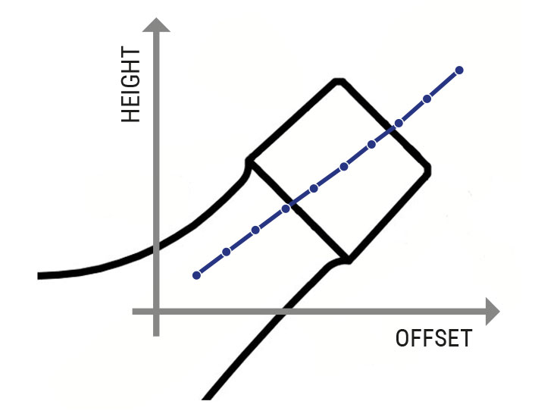
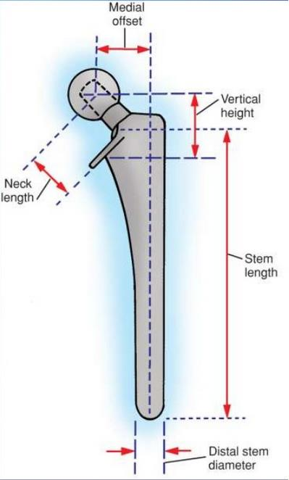
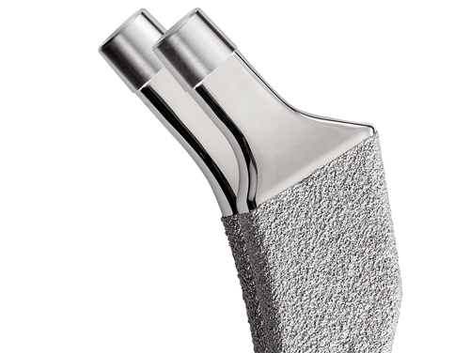
femoral comoponent
Colodiafyzar angle (CCD)
  Pysiolgical 126°
  Always respect anatomy!
  115-140° range
  High offset option

Slide 32
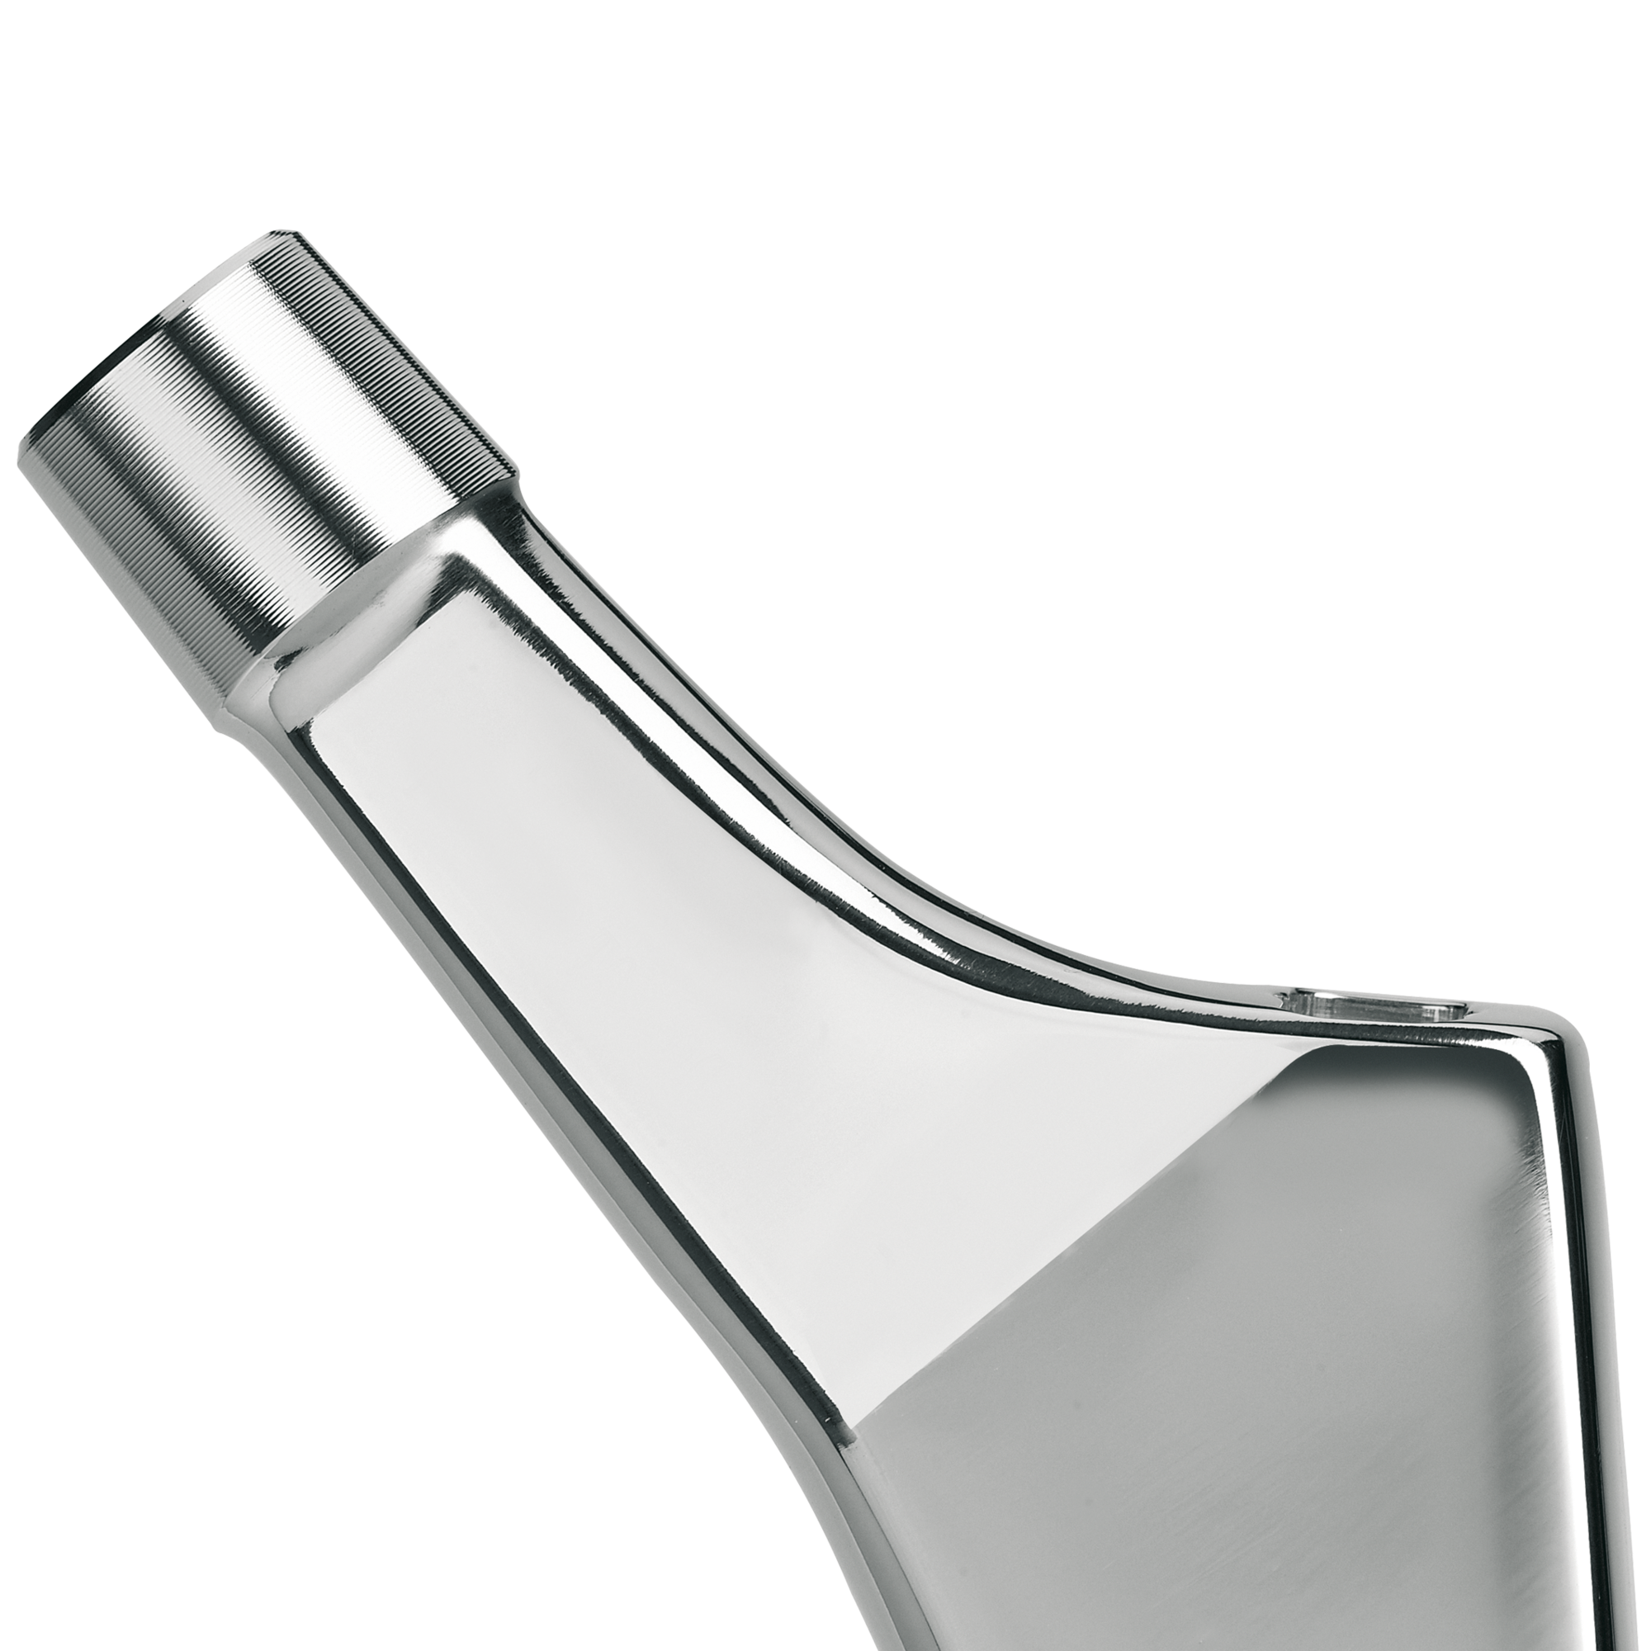
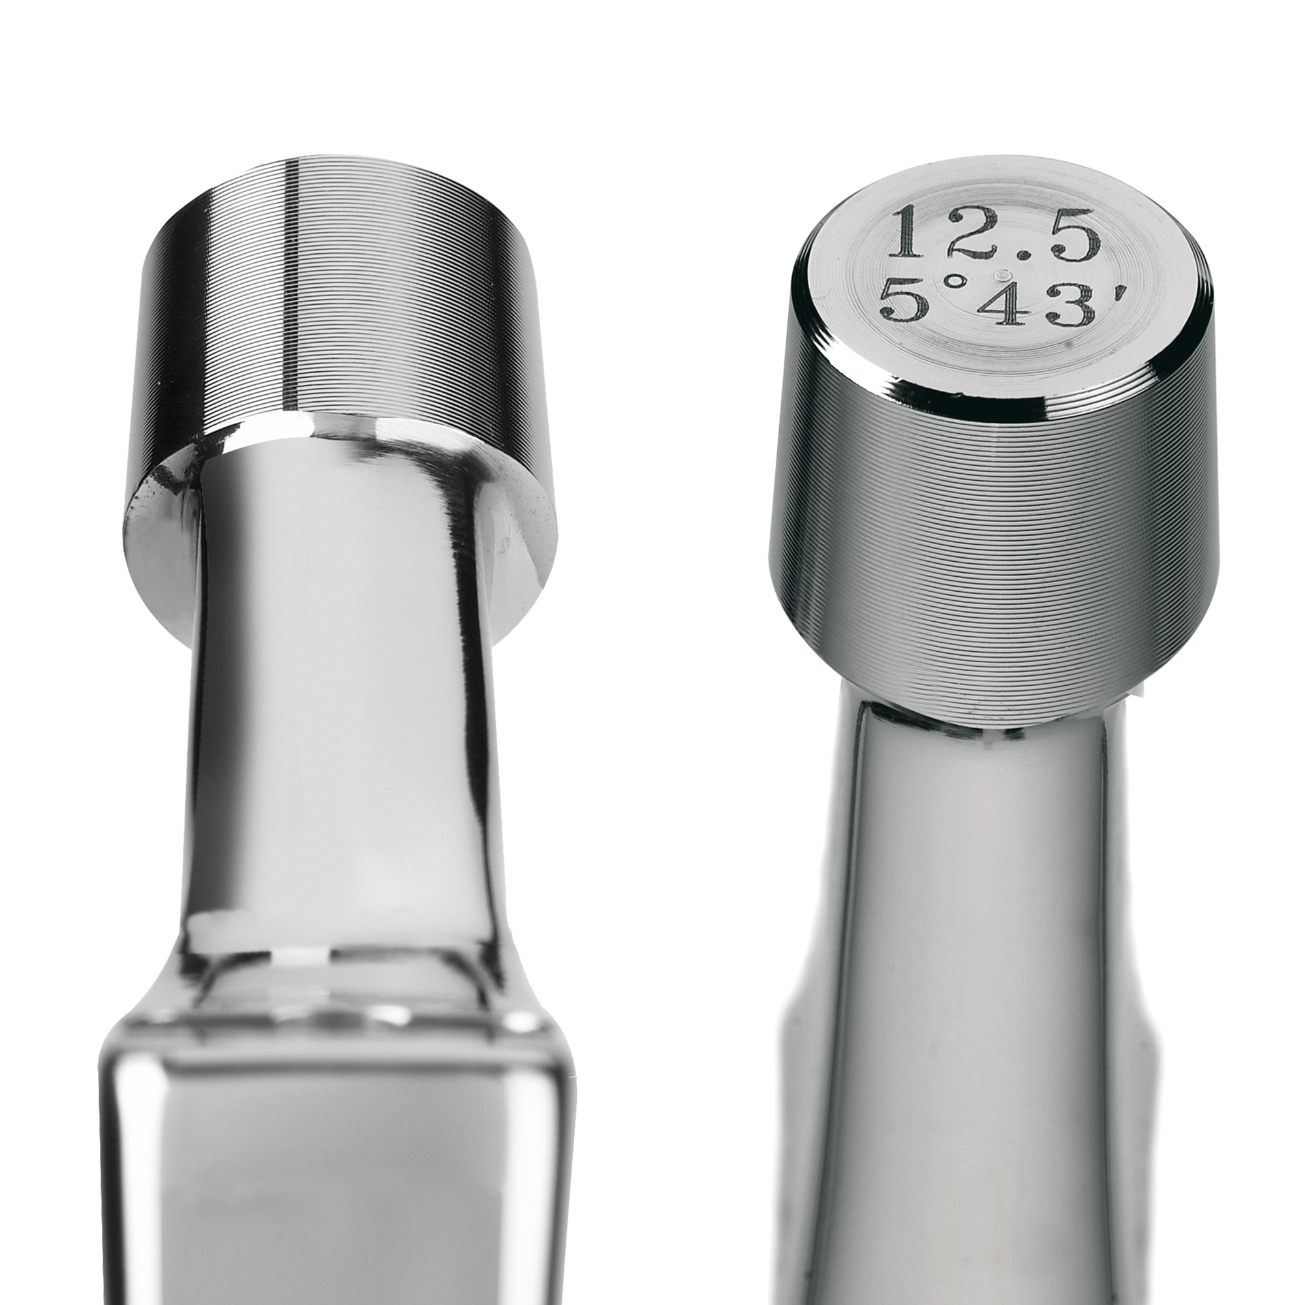
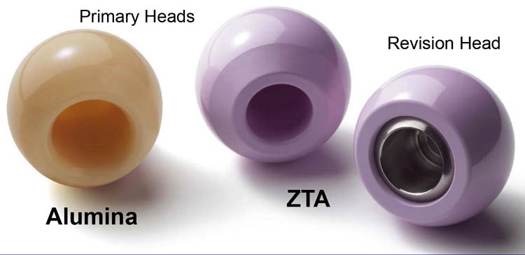
femoral comoponent
Cone:
  12/14mm
  Always use compatible head/stem, never mix producers!
  Structured surface for head retention
  If ceramic head replaced, always use revision!

Slide 33
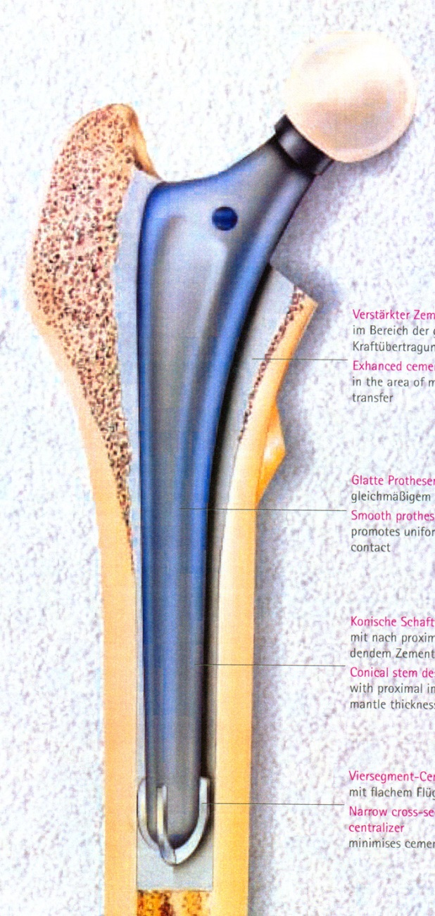
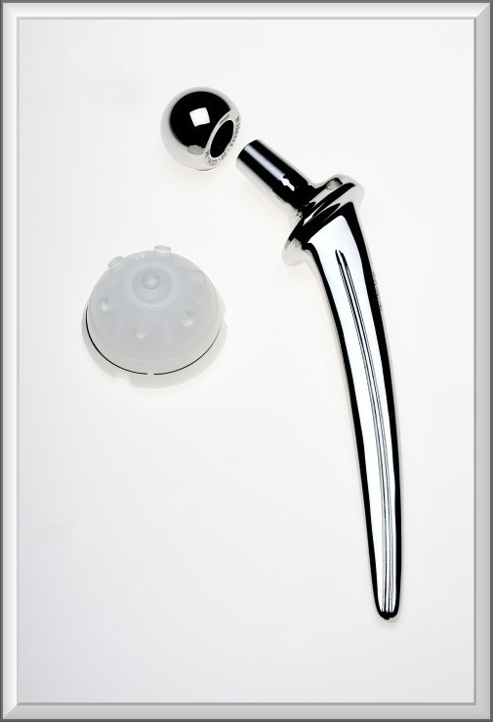
femoral comoponent cemented
Highly polished surface
Dirct x anatomical shape
Equally cemet layer around the stem!
Never direct contact stem x bone
Centraliser
Obturator

Slide 34
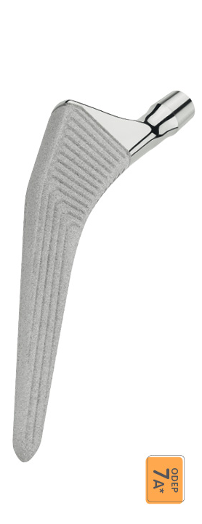
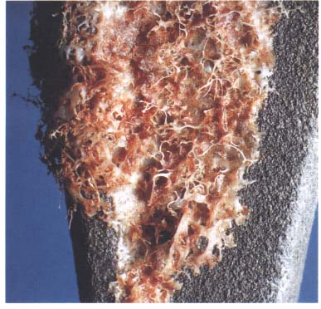
femoral comoponent cementless
Osteoinductive surface
Metafyzar x diafyzar anchoring

Slide 35


Head
Alloy x ceramic x oxinium
28, 32, 36 mm
„head lenght“ – depth of bore for cone
Bigger head diameter incerases ROM and stability

Slide 36

Articulation surfaces matching
PE/alloy head
PE/ceramic head
Ceramic inlay/ceramic head
Alloy/alloy head
Oxinium

Slide 37
Surgical techniques
Standardized, routine
Standardized approaches
  Anterolateral (Watson Jones)
  Dorzal (Moore, Langenback)
  Anterior (Smith – Petersen)
  Lateral (Harding)
MIS

Slide 38
Surgical techniques
Operation field overview
Gentle soft tissue treatment
Lavage – PAO development prevention
Standardized approaches – minimal nerve and vessels leasions risk
Correct compoent alignment – impotrant for ROM and stability
Reliable suture!

Slide 39
Preoperative examination
ASA risk ratio
Infection focus exclusion (neg FW, CRP), stomatological examination incl. OPG
CAVE!
  Warfarin
  NOAK
  NSAID
  PAD

Slide 40
periprosthetic joint infection (PJI) prevention
Preop. Examination!
ATB perioperatively – Cefazolin i.v. 1 dose before + 3 doses post op.
Drainage EX in 24h
If urinary catheter present - ATB
Strict régime at op. theater
Wound care till healing
Lege artis diagnostic and therapy protocol of eventual PJI

Slide 41
Post op. management
ICU (post op ward) one day if no complication
Hospitalization at orthopedic ward for 5 days
Verticalization fhe first post op. day
Complex rehabilitation protocol, rehabitalitation nurse obligatory
6. day – transfer to rehabilitation ward
Spa – in CZ covered by public health insurance in 3 post op. months
DVT prevention – 6 weeks
Displacment prevention – no adduction, no deep flection, no axial extremity traction!
Trends: Shortening inpation period (risc of nosocomial infection, economic aspects)
Fast track physiotherapy
Outpatient surgery?

Slide 42
Follow up
Standardized
First check up by orthopedical surgeon in 6 weeks (X ray included)
Second in 3 months, then 6 month
Further each 2 years (X ray included) if no problem present
EDUCATION, EDUCATION, EDUCATION!
  Activity, limitation and régime with TKR
  PJI prevention
  Urgent check – up if suspected PJI

Slide 43
Complications
Peri and early pos op. morbidity and mortality
  Nervous and vascular injury
  Blood loss
  Perioperative fracture
  Hip displacement (luxation)
  Pulmonary embolism
  IM
  General decompensation
  Development of delirium

Slide 44

Complications
THR luxation (displacement)
  Shortening and (extra)rotation of extremity, pain, no active hip flexion
  No active walking and no weight - bearing
  Downfall
  Risky movement (adduction in hip, deep felxion)
  Wrong mainpulation with pac. (Axial leg traction)
  Primary instable prosthesis (incorrect implantation)
  Therapy:
    Close hip redduction attempt. Hip orthosis with reduced ROM obligatory
    If close reduction impossible, revision, identification of cause, solution
    Different („longer“) head, stabilisation elements
    If malposition of components present, replantation

Slide 45
Complications
Peri and early pos op. morbidity and mortality
  Nervous and vascular injury
  Blood loss
  Perioperative fracture
  Hip displacement (luxation)
  Pulmonary embolism
  IM
  General decompensation
  Development of delirium

Slide 46
Complications
THR luxation (displacement)
  Shortening and (extra)rotation of extremity, pain, no active hip flexion
  No active walking and no weight - bearing
  Downfall
  Risky movement (adduction in hip, deep felxion)
  Wrong mainpulation with pac. (Axial leg traction)
  Primary instable prosthesis (incorrect implantation)
  Therapy:
    Close hip redduction attempt. Hip orthosis with reduced ROM obligatory
    If close reduction impossible, revision, identification of cause, solution
    Different („longer“) head, stabilisation elements
    If malposition of components present, replantation

Slide 47
Complications
Peri and early pos op. morbidity and mortality
  Nervous and vascular injury
  Blood loss
  Perioperative fracture
  Hip displacement (luxation)
  Pulmonary embolism
  IM
  General decompensation
  Development of delirium

Slide 48
Complications
THR luxation (displacement)
  Shortening and (extra)rotation of extremity, pain, no active hip flexion
  No active walking and no weight - bearing
  Downfall
  Risky movement (adduction in hip, deep felxion)
  Wrong mainpulation with pac. (Axial leg traction)
  Primary instable prosthesis (incorrect implantation)
  Therapy:
    Close hip redduction attempt. Hip orthosis with reduced ROM obligatory
    If close reduction impossible, revision, identification of cause, solution
    Different („longer“) head, stabilisation elements
    If malposition of components present, replantation

Slide 49
Complications
Periprosthetic infeciton (PJI) – 1-2% primo, 5-10% revision
  Early – up to 2 weeks after surgery
  Late hematogenic
  Diagnostic
    General symptomas of infection
    Local condition, persistant pain
    Punction + aspiration, cultivation + PCR
    Synovasure (α defensine) test perioperatively
    Implant sonication + cultivation
    Fistula with purulent secretion
    Radiolucent periprosthehic lines around implant on X ray (chronic PJI)

Slide 50
complications - Periprosthetic infection (PJI)
Therapy
  Up to 2 weeks from manifestation - DIAR (debridement, ATB, implant retention)
  Uprard of 2 weeks – revision, debridement, replantation
    One stage – dubious outcome
    Two stage – cemented ATB spacer, after healing ínfection revision and new implant possible
    ATB supression of chronic infection optional (old patients with no perspective to surgery)
ATB therapy
  Cultivation (punciton + aspiration, perioperativly samples, sonication of implant)
  ATB i.v. 2 weeks minimum
  6 weeks p.o.

Slide 51
complications - Periprosthetic infection (PJI)
ATB spacers
  Custom – made
  Ready - made

Slide 52
complications - Periprosthetic infection (PJI)
Ultimum refugium – sec. Girdlestone

Slide 53
aSeptic loosening
Most frequent THR revision reason
Macrophage-induced inflammatory response resulting in bone loss and implant loosening
PE particle inducted granuloma

Slide 54


aSeptic loosening - therapy

Slide 55
aSeptic loosening - therapy
Revision, replantation
Revision systems, augments, spongioplasty (alografts)…
Double ATB combination – higer infection risk
Higer complication rate
Inferior outcome
Lower ROM
Longer no full weight bearing period (3M)
Higer mortality
Higer displacement risk ratio

Slide 56
aSeptic loosening - therapy

Slide 57
aSeptic loosening - therapy
Revision, replantation
Revision systems, augments, spongioplasty (alografts)…
Double ATB combination – higer infection risk
Higer complication rate
Inferior outcome
Lower ROM
Longer no full weight bearing period (3M)
Higer mortality
Higer displacement risk ratio

Slide 58


aSeptic loosening - therapy
Revision stems:
Modular x monobloc
Wide range of option
Cemented x cement less

Slide 59


aSeptic loosening - therapy
Revision acetabular component systems
Spongioplasty x augments
Trabecular metal, titan tantal
Cemented x cement less
Pelvis discontinuity often

Slide 60


Acetabular defects
Classification - Paprosky

Slide 61



Acetabular defects
Solution - mechanic
  Bone cement

Slide 62



Acetabular defects
Solution - mechanic
  Augmentation

Slide 63


Acetabular defects
Solution - biologic
  Impact grafting

Slide 64


Acetabular defects
Solution - biologic
  Solid allograft

Slide 65



Acetabular defects
Ring and cage reconstruction

Slide 66


Acetabular defects
Ring and cage reconstruction

Slide 67

Periprosthetic fracture
Relatively frequent complication
Femur in the most cases, acetabulum rarely
Starší pacienti, v horším klinickém stavu
Older patients, worse general condition
Osteoporosis, poor implant retention
High mortality and morbidity rate
High compliction rate
Demanding surgeries (experienced surgeon)

Slide 68

Periprosthetic femoral fracture - classification
Vancouver
  Frequently used
  Guide to therapy

Slide 69


Periprosthetic femoral fracture - therapy
Conservative
  No/minimal displacecement
  Implant retention
  Poor patient genetal condition
Surgiclal
  Revision stem + cerclage (cables, wires)
  Ostheosynthesis (LCP x cables/wires)

Slide 70

Periprosthetic femoral fracture - therapy
OS (LCP, control cable )

Slide 71
Thank you for yor attention

