Slide 1
MICROCIRCULATION

Slide 2
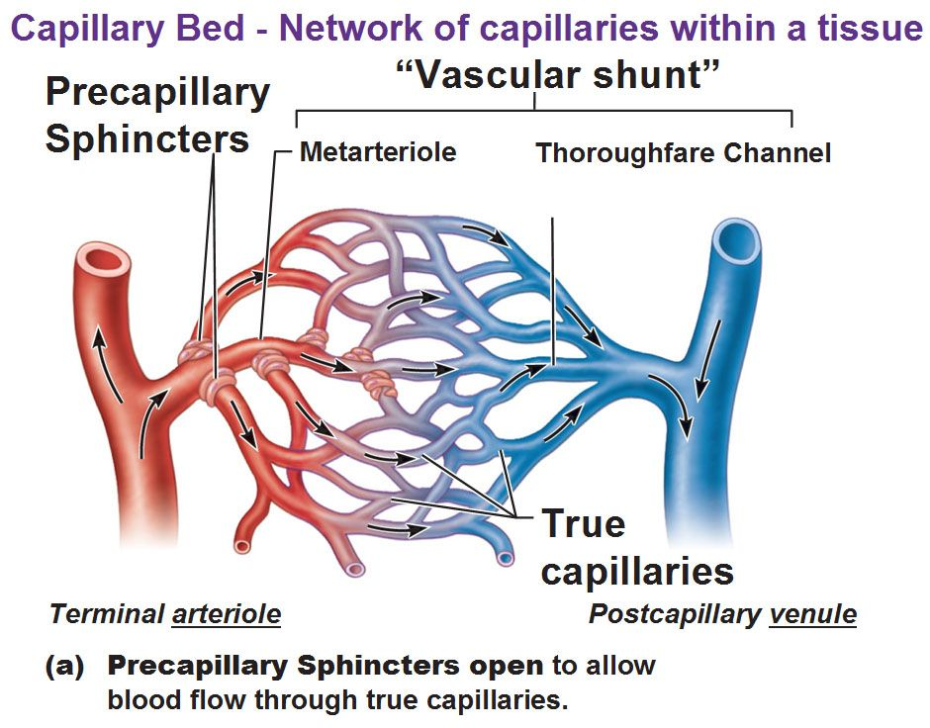
FUNCTIONAL ANATOMY
Microcirculation is circulation of the blood through the smallest vessels of the body – arteriols, capillaries and venules.
The principal function of the microcirculation is to permit the transfer of substances (water, solutes, gases) between the vascular system and the tissues.
Notes:
Microcirculation
The most purposeful function of the circulation is microcirculation: It allows transport of nutrients to the tissues and removal of cell excreta. The principal parts of circulatory system where the microcirculation occurs are arterioles, capillaries and venules. The small arterioles control the blood flow to each tissue, and local conditions in the tissues in turn control the diameters of the arterioles. Thus, each tissue, in most instances, controls its own blood flow in relation to its individual needs.
Arterioles are the small-diameter blood vessels (20-50 μm) that extend and branch out from an artery and lead to capillaries. Arterioles have continuous muscular walls (usually only one to two layers of smooth muscle) and are the primary site of vascular resistance.
The terminal parts of arterioles that connect arterioles to the capillary networks are called metarterioles. Metarterioles do not have a true tunica media (muscle layer is not continuous but rather irregularly interrupted). At the point where each true capillary originates from a metarteriole, a smooth muscle fibre usually encircles the capillary. This muscle fibre is called precapillary sphincter. Precapillary sphincters regulate the flow of blood into the capillaries. If most or all of the precapillary sphincters associated with a capillary network contract simultaneously, blood is moved directly from the arterial to the venous system through the metarteriole. In this situation, the metarteriole is acting as a thoroughfare channel, and the entire capillary network is bypassed. Because each metarteriole regulates blood flow into a specific number of capillaries, blood flow through any tissue is finely controlled. Blood delivery to a particular tissue can be quickly increased, decreased, or even temporarily halted in order to respond to the current metabolic activity of the tissues they supply.
Precapillary sphincters are controlled predominately by the concentration O₂ in the tissue. The reduction of O₂ concentration, high levels of CO₂ and associated acidosis cause the sphincter to open. When the tissue no longer needs freshly oxygenated blood and the balance is returned, the sphincter closes to allow other tissues to receive blood.
Capillaries are the smallest blood vessels in the body (diameter 4-9 μm): they convey blood between the arterioles and venules. These microvessels are the site of exchange of many substances with the interstitial space surrounding them. Substances which exit include water (proximal portion), oxygen, and glucose; substances which enter include water (distal portion), carbon dioxide, uric acid, lactic acid, urea and creatinine.
Venules are larger than the arterioles and have a much weaker muscular coat. However, the pressure in the venules is much less than that in the arterioles, so that the venules still can contract considerably despite the weak muscle.

Slide 3
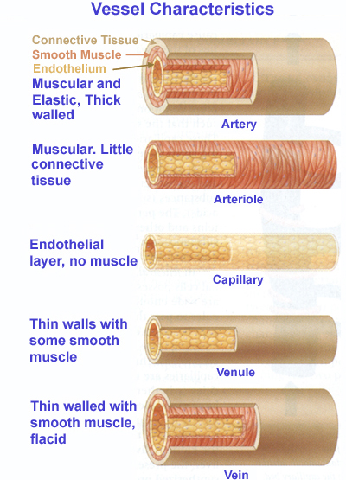
STRUCTURE OF VESSEL WALL
1
The capillary wall is about 1 μm thick.
2
The total area of all the capillary walls in the body exceeds 500 m².
3
The rate of blood flow in capillaries is 0.2 - 1 mm/s.
4
Transit time from arterial to venular end of a capillary is 1 - 2 seconds.
Notes:
Structure of vessel wall
The arteries and veins have three layers:
• The inner layer (tunica intima) is the thinnest layer. It is a single layer of flat cells glued by a polysaccharide intercellular matrix, surrounded by a thin layer of subendothelial connective tissue interlaced with a number of circularly arranged elastic bands called the internal elastic lamina. A thin membrane of elastic fibers in the tunica intima run parallel to the vessel.
• The middle layer (tunica media) is the thickest layer in arteries. It consists of circularly arranged elastic fiber, connective tissue, polysaccharide substances, the second and third layer are separated by another thick elastic band called external elastic lamina. The tunica media may (especially in arteries) be rich in vascular smooth muscle, which controls the caliber of the vessel. Veins don't have the external elastic lamina, but only an internal one. The tunica media is thicker in the arteries than in the veins.
• The outer layer (tunica adventitia) is the thickest layer in veins. It is entirely made of connective tissue. It also contains nerves that supply the vessel as well as nutrient capillaries (vasa vasorum) in the larger blood vessels.
Capillaries consist of a single layer of endothelial cells with a supporting subendothelium consisting of a basement membrane and connective tissue. Length of the capillaries is most often between 0.5 and 1 mm. The basic characteristics of the capillaries allowing the efficient exchange of solutes between the capillary and interstitial space are summarised on the slide.

Slide 4
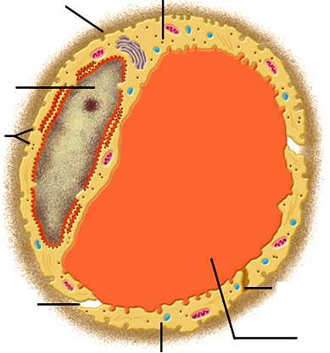
ULTRASTRUCTURE OF CAPILLARY
Basement membrane
Endothelial cell
Nucleus
Vesicles
5-10 μm
Fenestrationes
Intercellular cleft
Lumen
Endothelial cell
Notes:
Passageways allowing transport of fluid and solutes through capillary wall
Intercellular clefts. Very small passageways connecting the interior of the capillary with the exterior. Each cleft is interrupted periodically by short ridges of protein attachments that hold the endothelial cells together, but between these ridges fluid can percolate freely through the cleft. The cleft normally has a uniform spacing with a width of about 6 to 7 nanometers.
Because the intercellular clefts are located only at the edges of the endothelial cells, they usually represent no more than 1/1000 of the total surface area of the capillary wall. Nevertheless, the rate of thermal motion of water molecules as well as most water-soluble ions and small solutes is so rapid that all of these diffuse with ease between the interior and exterior of the capillaries through the clefts. Intercellular clefts can be typically found in so called continuous capillaries, e.g. in the brain or skeletal muscle.
Fenestrations. Passageways through endothelial cells allowing the exchange of larger molecules. Fenestrated capillaries are “leakier” than continuous capillaries and can be found e.g. in kidneys where numerous small oval windows called fenestrae penetrate all the way through the middle of the endothelial cells, so that tremendous amounts of small molecular and ionic substances (but not the large molecules of the plasma proteins) can filter through the glomeruli without having to pass through the clefts between the endothelial cells. The fenestrated capillaries are also present in the endocrine glands, intestines or pancreas.
Note: A special type of large pores between endothelial cells can be found is sinusoidal capillaries or discontinuous capillaries. In these capillaries, the pores between the endothelial cells are wide open, so that almost all dissolved substances of the plasma, including the plasma proteins, can pass from the blood into the interstitial space. Such a large pores can be found e.g. in capillaries of the liver or bone marrow.
Plasmalemmal vesicles. The larger molecules such as albumin and other large proteins pass through the endothelial cells by means of plasmalemmal vesicles. These form at one surface of the cell by imbibing small packets of plasma or extracellular fluid. This transport process is called transcytosis.

Slide 5
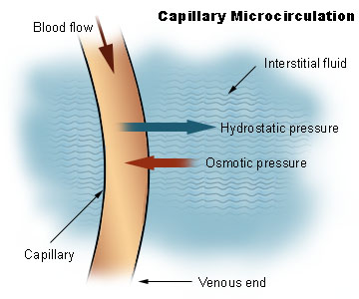
MOVEMENT OF FLUID ACCROSS CAPILLARY WALL
Effect of hydrostatic pressure
filtration
Effect of oncotic pressure
resorption
diffusion
The diffusion, filtration and resorption of water across capillary wall occur through Intercellular clefts, pores and fenestrations.
Notes:
Movement of fluid across capillary wall
By far the most important means by which fluid is transferred between the capillary and the interstitial space is diffusion. Diffusion results from thermal motion of the water molecules. As the blood flows along the lumen of the capillary, tremendous numbers of water molecules diffuse forth and back through the capillary wall, providing continual mixing between the plasma and interstitial fluid. However, because the thermal movement of water molecules in both directions is balanced, the total diffusional flux of water across the capillary wall is zero.
The hydrostatic pressure in the capillaries tends to force the fluid through the capillary gaps into the interstitial spaces, causing filtration. Conversely, osmotic pressure induced by the plasma proteins (colloid osmotic pressure) tends to cause fluid movement by osmosis from the interstitial spaces into the capillaries, leading to resorption. This osmotic pressure normally prevents significant loss of fluid volume from the blood into the interstitial spaces. Under physiological conditions, the movement of water molecules due to filtration is higher than the opposite movement caused by resorption resulting in the net flux of water out from the capillary.
To sum up, the diffusion is the principal factor in providing exchange of plasma fluid between the capillaries and tissue cells. However, the diffusional fluxes in both directions are the same. Only about 2% of the plasma passing through the capillary is filtered and absorbed, with filtration being greater than reabsorption.

Slide 6
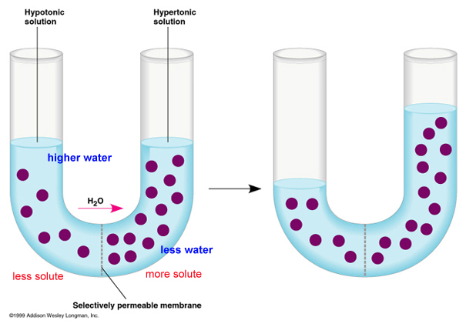
OSMOTIC PREASURE
equilibrium
osmotic (oncotic) pressure
osmotic (oncotic) pressure
hydrost. pressure difference
Notes:
Osmosis occurs when two solutions containing different concentrations of solute are separated by a selectively permeable membrane. Solvent molecules pass preferentially through the membrane from the low-concentration solution to the solution with higher solute concentration. The transfer of solvent molecules will continue until equilibrium (the same concentration of solute on both sides) is attained.
Osmotic pressure is the minimum pressure which needs to be applied to a hypertonic solution to prevent the flow of the pure solvent across a semipermeable membrane into this solution (yellow arrow). Therefore, in the figure above, the osmotic pressure is equal to the hydrostatic pressure difference (blue arrow) given by the different levels of solution on both sides of the tube.

Slide 7
PRESSURE GRADIENTS ACROSS THE WALL OF CAPILLARY
arteriole
venule
capillary
Hydrostatic pressure diference:
P_{c}- P_{i} = 36 mmHg
Oncotic pressure diference:
π _{c}- π _{i} = 25 mmHg
Hydrostatic pressure diference:
P_{c} - P_{i} = 16 mmHg
Oncotic pressure diference:
π _{c}- π _{i} = 25 mmHg
INTERSTITIAL SPACE
P_{c}
P_{c}
π _{c}= 25
37
filtration
resorption
17
P_{i} = 1
π_{i} ≈ 0
CAPILLARY HYDROSTATIC PRESSURE P_{c} = 37 - 17 mmHg
INTERSTITIAL HYDROSTATIC PRESSURE P_{i} = 1 mmHg
CAPILLARY ONCOTIC PRESSURE π_{c} = 25 mmHg
INTERSTITIAL ONCOTIC PRESSURE π_{i} ≈ 0 mmHg
Notes:
Pressure gradients across the wall of capillary
There are four primary forces that determine whether fluid will move out from the capillary into the interstitial fluid or in the opposite direction. These forces, called “Starling forces” in honour of the physiologist who first demonstrated their importance, are:
1. The capillary pressure (P_{c}), which tends to force fluid outward through the capillary membrane.
2. The interstitial fluid pressure (P_{i}), which tends to force fluid inward through the capillary membrane.
3. The capillary plasma colloid osmotic pressure (π_{c}), which tends to cause osmosis of fluid inward through the capillary membrane.
4. The interstitial fluid colloid osmotic pressure (π_{i}), which tends to cause osmosis of fluid outward through the capillary membrane.
Note that P_{c} decreases from ∼37 mmHg at the arterial end of the capillary to ∼17 mmHg at the venous end of the capillary. It is also worth noting that, in majority of cases, π_{c} is nearly constant (∼25 mmHg) along the capillary and P_{i} as well as π_{i} are very small.

Slide 8
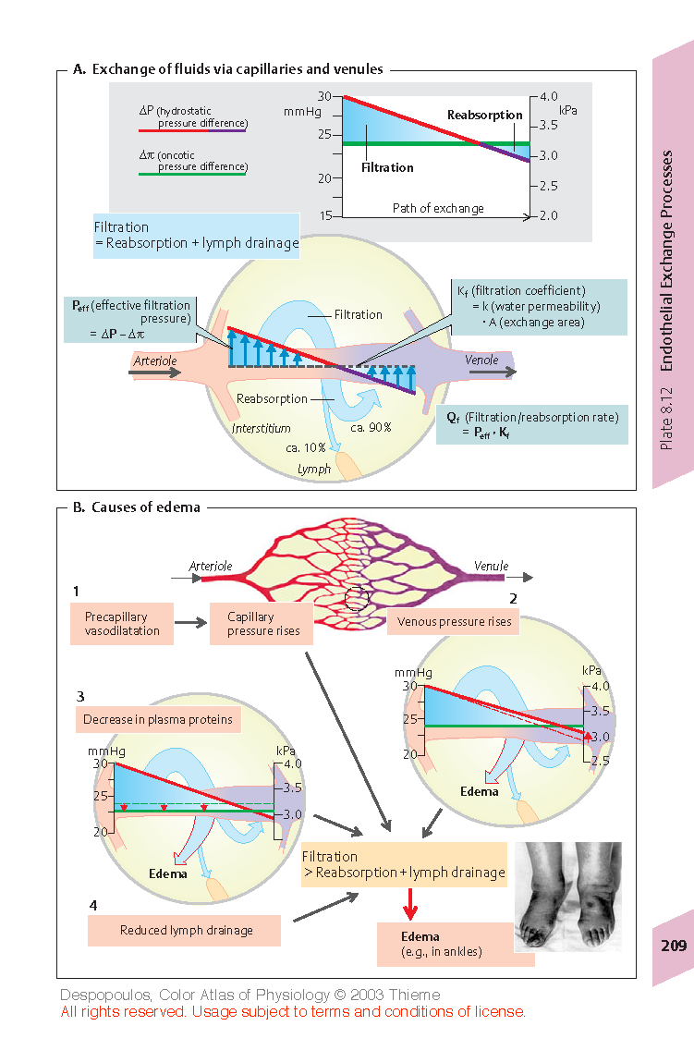
EXCHANGE OF FLUID VIA CAPILLARIES
Hydrostatic pressure diference
Oncotic pressure diference
([P_{c} − P_{i}] − σ [π_{c} − π_{i}]) - effective (net) filtration pressure
Notes:
Exchange of fluid via capillaries
If the sum of the Starling forces, the effective filtration pressure, is positive, there will be a net fluid filtration across the capillaries. If the sum of the Starling forces is negative, there will be a net fluid absorption from the interstitial spaces into the capillaries. The effective filtration pressure (P_{eff}) at a given point of the capillary can be calculated from the hydrostatic pressure difference (P_{c}-P_{i}) and oncotic pressure difference (π_{c}-π_{i}) across the capillary wall according to the relation:
P_{eff}=(P_{c}-P_{i}) − (π_{c} − π_{i}) .
Normally, about 20 L/day of fluid is filtered (excluding the kidneys) into the interstitium from the body’s exchange vessels. About 18 L/day of this fluid is thought to be reabsorbed by the venous limb of these vessels. The remaining 2 L/day or so make up the lymph flow and thereby return to the bloodstream (through left an right subclavian vein).
Lymphatic System
The lymphatic system represents an accessory route through which fluid can flow from the interstitial spaces into the blood. Most important, the lymphatics can carry proteins and large particulate matter away from the tissue spaces, neither of which can be removed by absorption directly into the blood capillaries. This return of proteins to the blood from the interstitial spaces is an essential function without which we would die within about 24 hours.

Slide 9
STARLING'S EQUATION
J_{v} - NET FLUID MOVEMENT ACROSS CAPILLARY WALL
K_{f} - Filtration coefficient
P_{c} - capillary hydrostatic pressure
P_{i} - interstitial hydrostatic pressure
π_{z} - capillary oncotic pressure
π_{i} - interstitial oncotic pressure
σ - coefficient permeabilty
Notes:
Starling´s equation
In most tissues, the mean P_{eff} along the capillaries is slightly positive under normal conditions, resulting in a net filtration of fluid into the interstitial space. Except for P_{eff}, the rate of fluid filtration in a tissue is also dependent on the number and size of the gaps in each capillary (clefts, fenestrations and pores), on the number of capillaries through which blood is flowing and on the permeability of capillary wall to proteins. These factors are involved in the Starling equation:
J_{v} = K_{f}(P_{c} − P_{i}) − σ(π_{c} − π_{t}),
by means of capillary filtration coefficient (K_{f}) and reflection coefficient for proteins (σ, between 0 and 1). σ is 1 if capillary membrane is not permeable to plasma proteins and decreases with an increase of membrane permeability to these proteins.
Note: In some sources like Text of Medical Physiology (Guiton and Hall) or Atlas of physiology (Silbernagel&Despopoulos) the reflection coefficient is not included in the Starling’s equation. In this case, it is already included in the formulation of both oncotic pressures. In my presentation, I formulated the Starling’s equation according to the textbook of Medical Physiology by Boron, which is the recommended source for the study of General Medicine in our school. Nevertheless, both descriptions are compatible.

Slide 10
CAUSES OF INCREASED INTERSTITIAL FLUID VOLUME (EDEMA)
1
2
3
Increased capillary permeability
4
Reduced lymph drainage
Notes:
In most tissues, under normal conditions, the amount of the fluid that enters the interstitial space by filtration is the same as the amount of the fluid that returns back to the capillaries by reabsorption plus amount of the fluid that is removed from the interstitial space by lymphatic vessels. If the volume of filtered fluid is higher than the amount of the fluid returned to the blood (by both the reabsorption and lymphatic drainage) the fluid accumulates in the interstitial space and edema occurs.
Causes of edema:
1) Increased capillary pressure (↑P_{c}) due to precapillary vasodilation or increased venous pressure caused, for example, by venous thrombosis or cardiac insufficiency (cardiac edema).
2) Decreased concentration of plasma proteins, especially albumin, leading to a drop in π_{c} due, for example, to loss of proteins (proteinuria), decreased hepatic protein synthesis (e.g., in liver cirrhosis), or to increased breakdown of plasma proteins to meet energy requirements (hunger edema).
3) Increased capillary permeability for proteins (σ↓) due, for example, to infection or anaphylaxis (histamine etc.).
4) Decreased lymph drainage due, e.g., to lymph tract compression (tumors), severance (surgery), obliteration (radiation therapy) or obstruction (bilharziosis).
Note: Increased hydrostatic pressure promotes formation of edema in lower regions of the body (e.g., in the ankles).

Slide 11
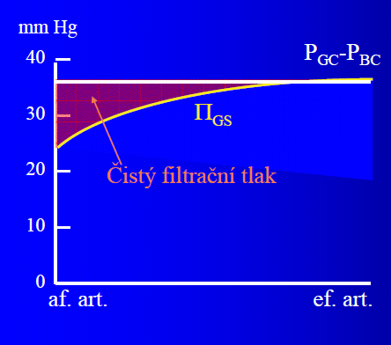
SPECIAL CASES
Glomerular microcirculation
P_{GC} and P_{BC} are ~45 and 10 mmHg, respectively. Effective filtration pressure (P_{eff}) at the arterial end of the capillaries equals 10 mmHg (red coloured area). Because of the high filtration fraction, the plasma protein concentration and, thus, glomerular oncotic pressure (Π_{GS}) along the glomerular capillaries increase and P_{eff} decreases. Thus, filtration ceases (near distal end of capillary) when Π_{GS} rises to about 35 mmHg, decreasing P_{eff} to zero.
Effective filtration pressure P_{eff} = P_{GC} - P_{BC} - Π_{GS}
P_{GC} – glomerular capillary pressure
P_{GC} – pressure in Bowman’s capsule
Pulmonary microcirculation
The hydrostatic and osmotic pressure gradients in the lung capillaries are small (∼10 mmHg) and nearly balanced under physiological conditions ensuring equilibrium between filtration and reabsorption. Any excess of filtration over reabsorption is drained via pulmonary lymphatic.
Notes:
The pressure gradients across the wall of capillary are substantially different especially in the kidneys and lungs. Look at the figure and text on the slide to understand the related differences in glomerular and pulmonary microcirculation.

Slide 12
MOVEMENT OF SOLUTES ACCROSS CAPILLARY WALL
• DIFFUSION - if there is, for a certain solute, a concentration difference between the plasma and interstitial space the solute diffuses across the capillary wall. Lipid-soluble molecules (e.g. O₂ ,CO₂) move across the capillary wall directly while lipid insoluble molecules (e.g. ions, urea) move across the capillary wall by Intercellular clefts, pores or fenestrations.
• SOLVENT DRAG - The dissolved particles are dragged through the capillary wall along with filtered and reabsorbed water.
Notes:
Although dissolved particles are dragged through capillary walls along with filtered and reabsorbed water (solvent drag), diffusion plays a much greater role in the exchange of solutes. Net diffusion of a substance occurs if its plasma and interstitial concentrations are different.

Slide 13
!!! TO REMEMBER !!!
Four forces known as Starling forces determine net fluid movement across the capillary membranes.
P_{c}= Capillary Pressure→ Tends to push fluid out of the capillary.
P_{i}= Interstitial Fluid Pressure→ Tends to push fluid into the capillary.
π_{c} = Plasma Colloid Osmotic Pressure→ Tends to cause osmosis of fluid into capillary.
π_{i} = Interstitial fluid colloid osmotic pressure→ Tends to cause osmosis of fluid out of the capillary
Effective filtration pressure = ((P_{c}-P_{i}) – (π_{c}- π_{i}))
The diffusion is the key factor in providing exchange of gases, substrates and waste products between the capillaries and the tissue cells.

Slide 14
CAUSES OF EDEMA DEVELOPMENT:
Capillary Pressure - P_{c} (↑hydrostatic pressure, heart failure)
Plasma Proteins (nephrotic syndrome, liver cirrhosis)
Capillary Permeability - K_{f} (infections, inflamations)
Lymph drainage- π_{i} (lymphatic blockage)

