Slide 1
Local and general anesthaesia
1^{st Dpt. of Surgery}
University hospital of Saint Anne
Medical Faculty of Masaryk University, Brno

Slide 2
Goals
Understand the:
  definition
  difference
  indications
  advantages
  disadvantages

Slide 3
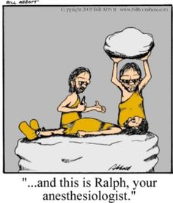
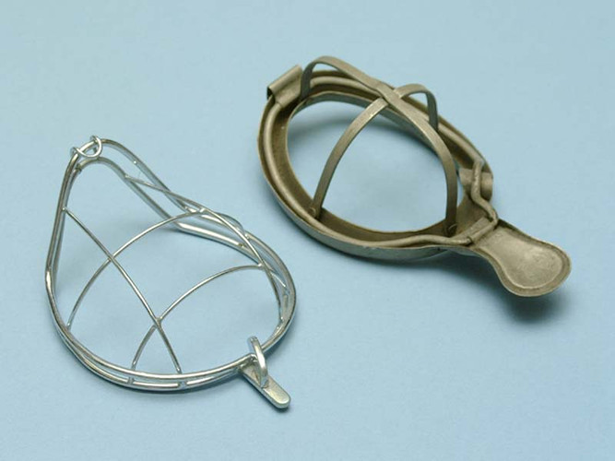
History
Acient Egypt and Mezopothamy, Greece and Rome, Mid-Age (opium, mandrake, alcohol…)
1846 - Aether inhalatory anesthesia William Morton (removal of mandibular tumour)
30th of 20.century - artificial ventilation
BOOOM!!!....

Slide 4
General anesthesia
Definition :
targeted loss of perception of all sensations (touch, pain, heat, cold) - farmacologicaly induced coma (unconsciousness) – targeted intoxication
Goal:
Assure non-paifull surgery for patient and secure desired conditions for surgery - neurovegetative stability of patient during operation (trauma, stress reaction)
Parts:
Loss of consciousness (hypnotic phase)
Analgesia - opioids, NSAIDs, local anesthaesia
Muscle relaxation - central (BZD, inhalatory anestetics) v.s. peripheral
Vegetative stability - decreases stress reaction of organism

Slide 5
Types of anesthesia
Balanced- iv, inhalatory drugs, analgetics, transquillizers, myorelaxans
Combined – general + local
Sedation - shallow loss of consciousness
Analgosedation – analgesia + shallow loss of consciosness
Neuroleptanalgesia – sedation, analgesia, vegetative stabilisation
Local anesthesia – loss of pain perception

Slide 6
Types of general anesthesia
Inhalatory
Intravenous (TIVA) (TIVA – Total intravenous anesthesia)
Combination (start iv. + ihhalatory) – mostly used

Slide 7
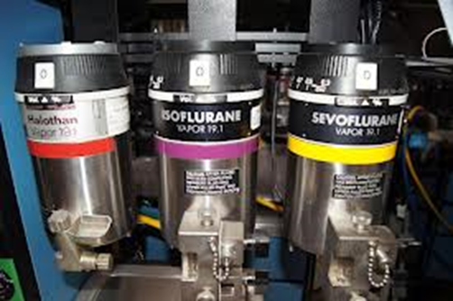
Depth of GA - stages (Guedel)
Used only for clear inhalatory anesthesia
I. – falling asleep
II. – excitation - motoric response, instability of circulation , high risk of vomiting
III. – tolerance
IV. intoxication

Slide 8
Monitoring of pacient
Saturation – oxygenation of pacient
ECG – beats per minut (tachycardia, bradykardia), arrhytmias (atrial / ventricular fibrilation, extrasystoly, asystoly), ST denivelation
Blood pressure – non – invasive or invasive
Conciousness
Deep of relaxation
Temperatur
Inhale and exhale gas concentration – O2, CO2, N2O, inhalatory anesthetics

Slide 9
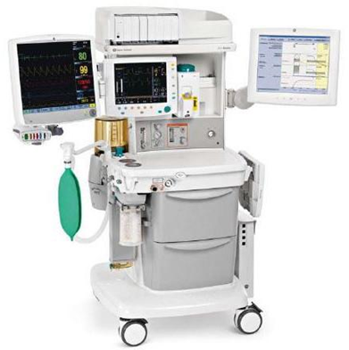
What do you need before you start anesthesia
Intravenous approach
Anesthetics machine – control before every use
Devices for secure airways - laryngoskope
Drugs
Nurse

Slide 10
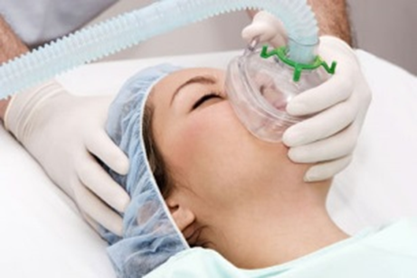
Step by step
i.v. approach
Preoxygenation with facemask - 100% O2 for 5 minut
Anesthetic drugs – anesthetics + analgetics + myorelaxans
Manual ventilation with face mask
Intubation
Arteficial ventilation – inhalatory anesthetics
Start of surgery

Slide 11
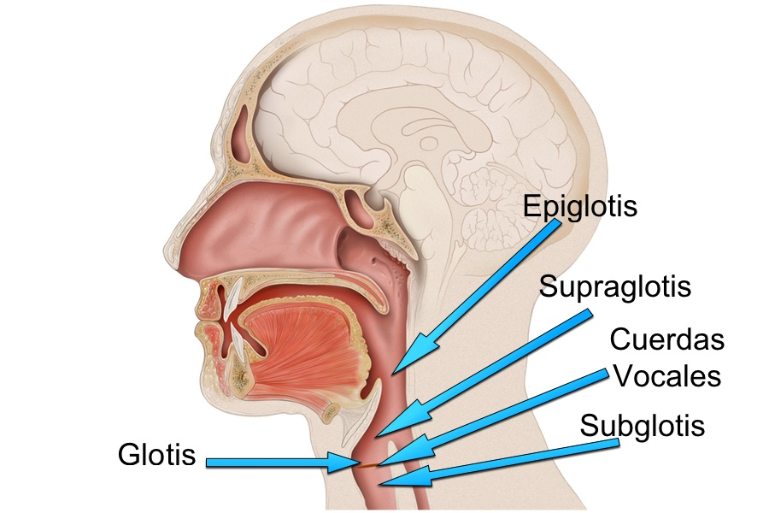
Airway secure
Face mask
Supraglottic devices
Infraglottic devices
Cricothyrotomy
Tracheotomy

Slide 12
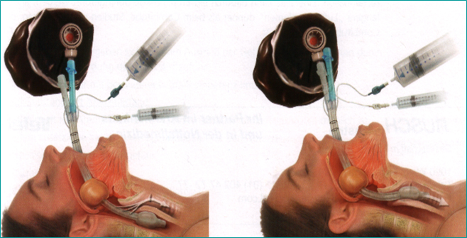
Supraglottic devices
Combitube – obsolent, two orifices – between balons and in the end

Slide 13
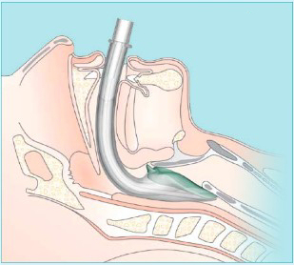
Laryngeal mask
+ easy to use
- Not 100% safety for airway

Slide 14
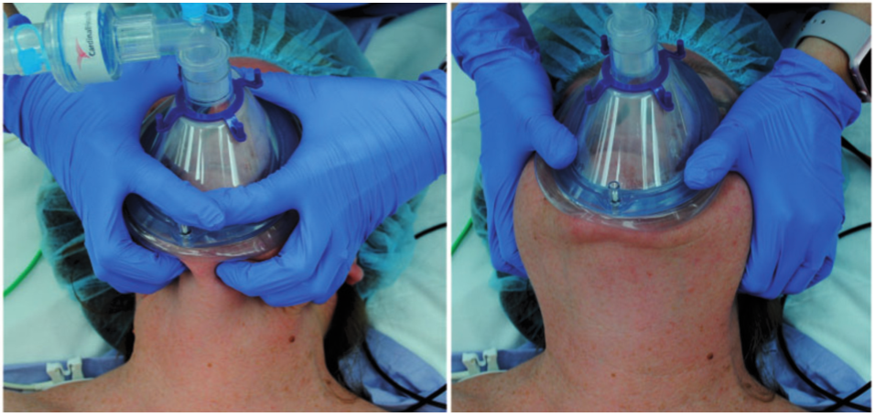
Face mask ventilation

Slide 15
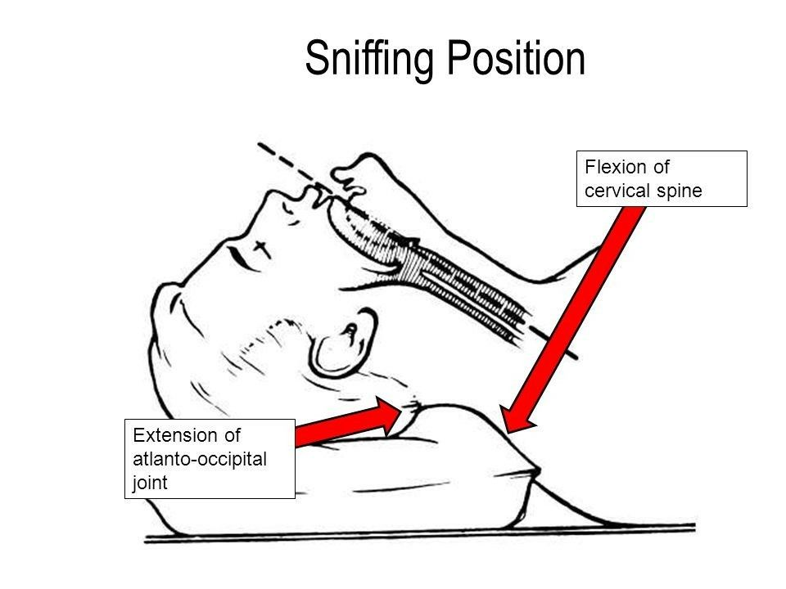
If it doesn‘t work?
Optimize head position – sniffing position

Slide 16
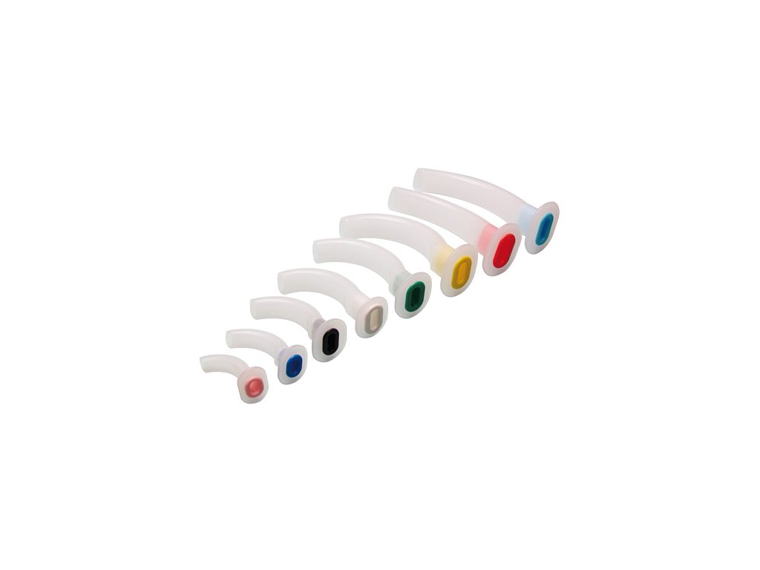
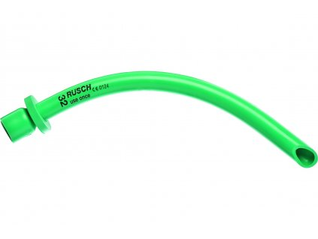
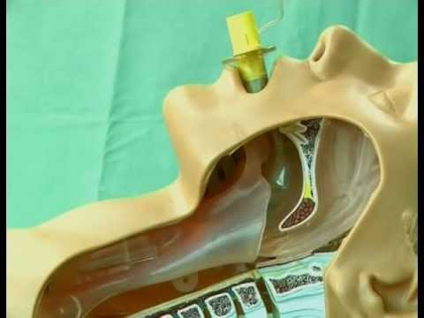
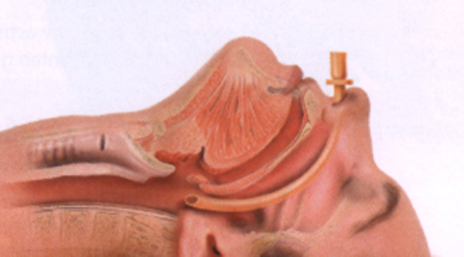
Still it doesn‘t work?
Use Guedel‘s oral or Wendel‘s nasal airduct (size from mouth/nose to ear)

Slide 17
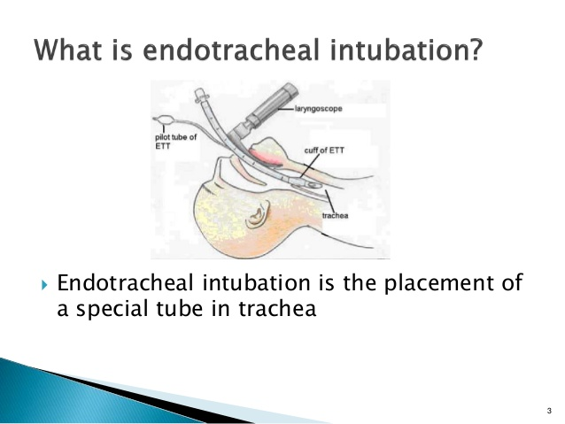
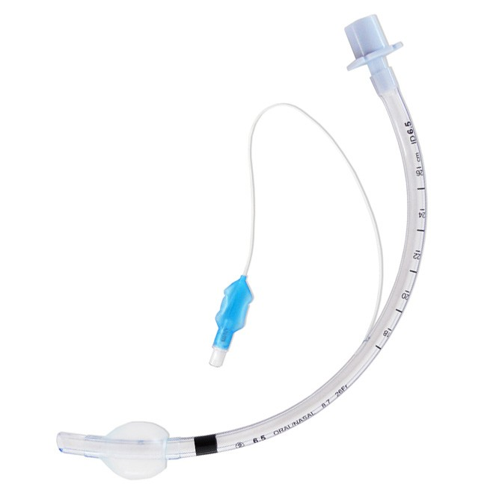
Then intubate

Slide 18
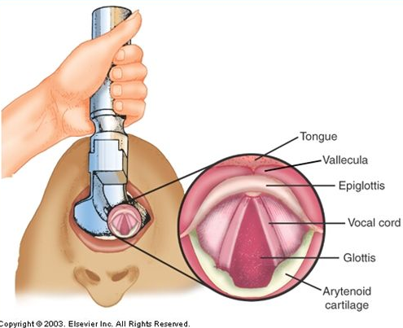
What should you see

Slide 19
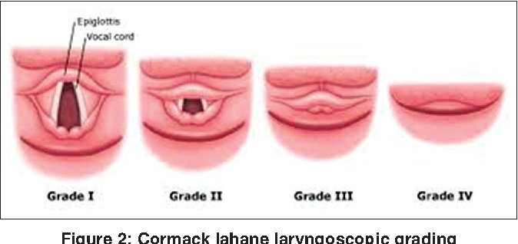
What else can you see
Grade III a IV predict difficult airway management

Slide 20
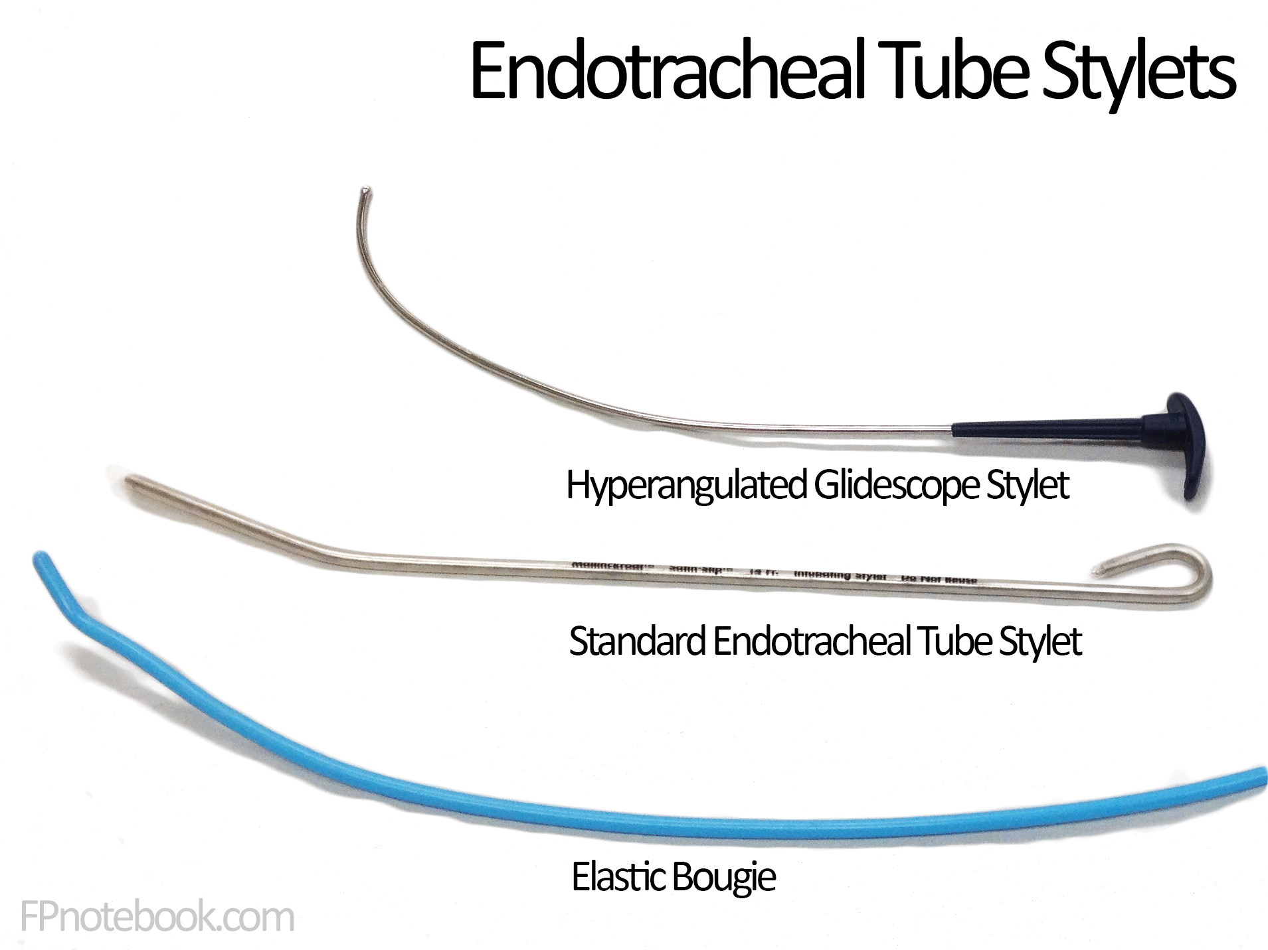
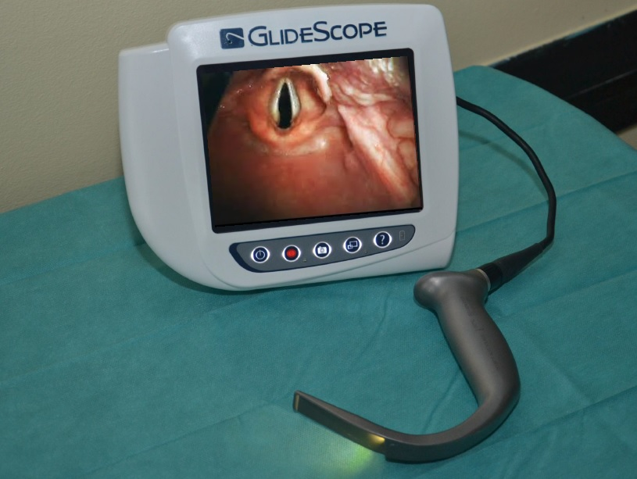
Devices that can you help
Videolaryngoscope

Slide 21
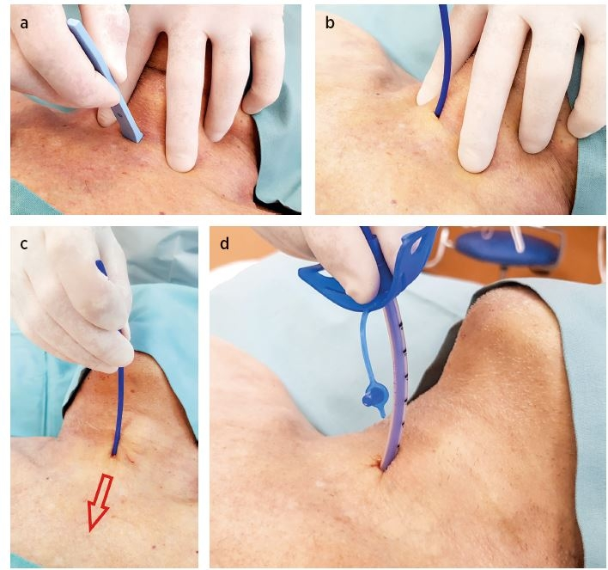
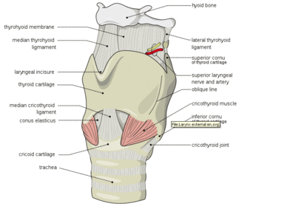
If you can‘t intubate
Cricothyrotomy - rescue procedure

Slide 22
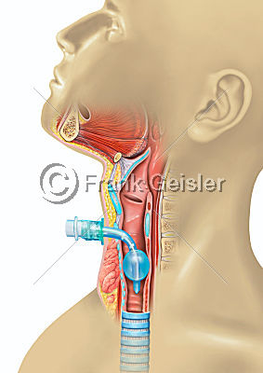
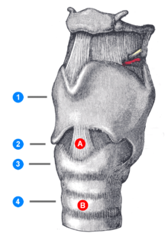
Or tracheotomy – you need more time
A: cricothyrotomy
B: tracheotomy

Slide 23
RISKS and COMPLICATIONS
Airways: obstruction, dislocation of cannula, bronchospasm, aspiration…
Failling to secure airways
Shallow anesthesia
Hypotension, hypertension, arytmia
HYPOTHERMIA!!! - lethal triade!
Malignant hypertermia
Alergic reaction

Slide 24
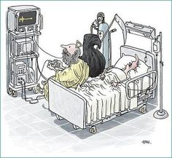
Postoperative care - next time

Slide 25
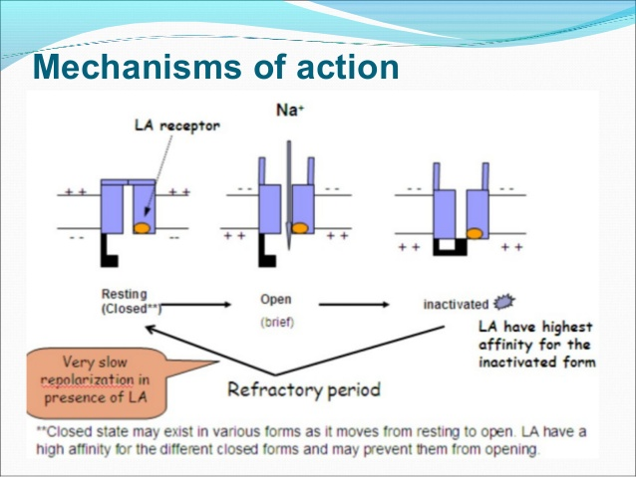
Local Anesthaesia
Inhibition of nerve stimulus conduction by sensitive neurons
Physiology - interaction with Na+canals on cellular level
Loss of pain perception
Motoric function remains intact

Slide 26
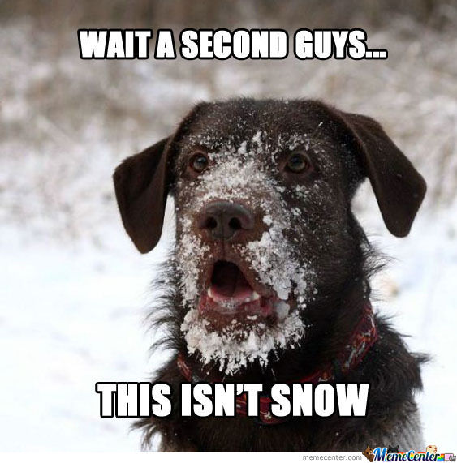
HISTORY
Congelation - Ice
1860 – Cocaine
1884 – 1st medical use
(psychiatry - S. Freud)
1905- 1st synthetic local anesthetic - procain
70th 20th century – next generations of synthetic LA

Slide 27
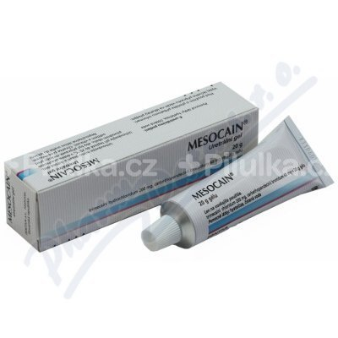
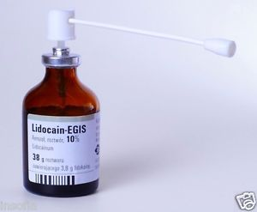
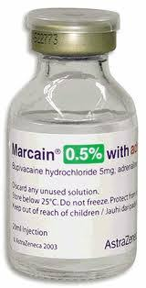
Types
Superficial (surfaces - skin, mucous membrane)
Infiltration
Field blocking
Epidural
Spinal (subarachnoideal)
Intravenous regional
(obsolent, risk of system efects – cardiotoxicity, neurotoxicity…)

Slide 28
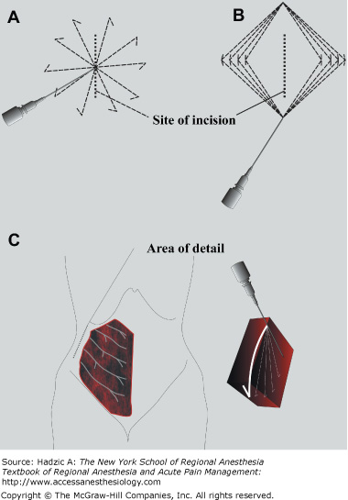
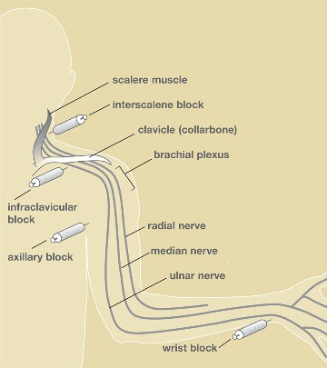
Infiltration vs. Field/nerve block

Slide 29
Infiltration vs. Field/nerve block
INFILTRATON
  Just near of injection/application
  It affects free nerve endings
FIELD/NERVE BLOCK
Application near nerve bundle – effect on nerve endings – area wich is inervated by this nerve

Slide 30
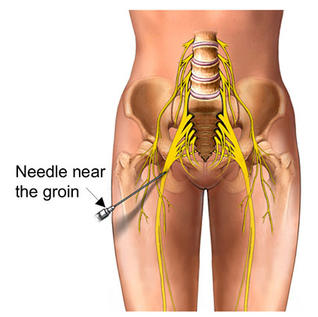
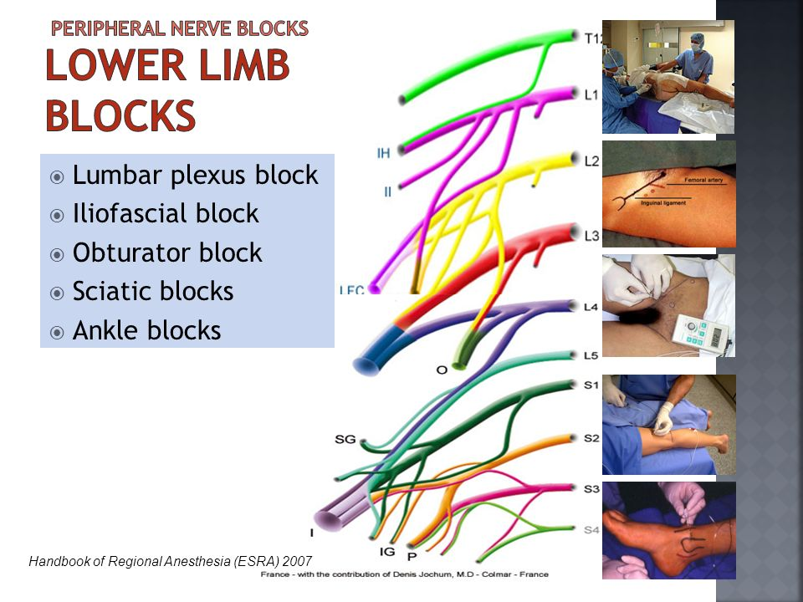
Examples of Blocks

Slide 31
Efect of LA depends on:
Amount of LA used
Type of LA /Mesocain v.s. Marcain…/
Blood supply of tissues
pH of tissues
Additive drug - adrenalin /max. dose 1mg/

Slide 32
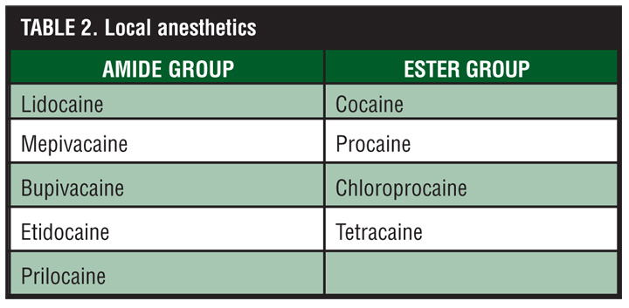

Slide 33
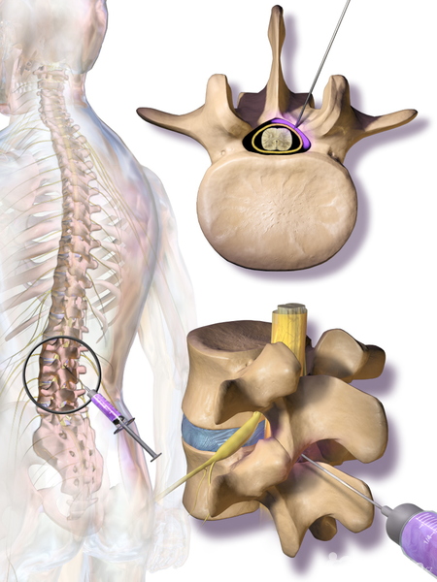
Epidural anesthesia
Cervical, thoracical, lumbar
No effect on motoric
Loss of pain and sense
Block of vegetative nerv system

Slide 34
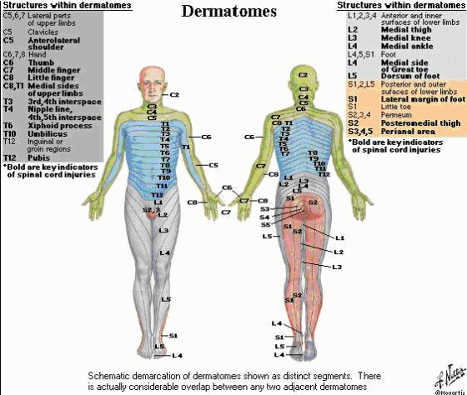
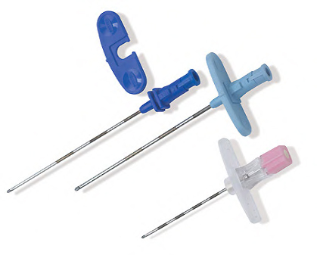
Dermatoms determine the height of the injection

Slide 35
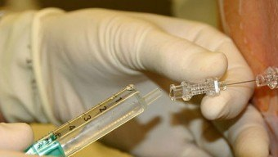
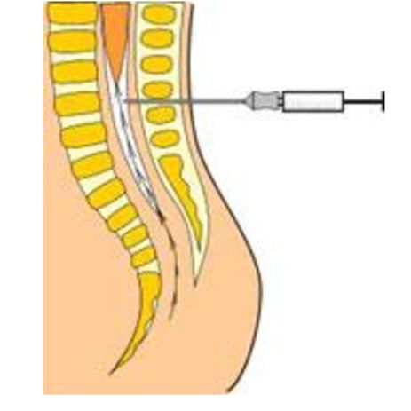
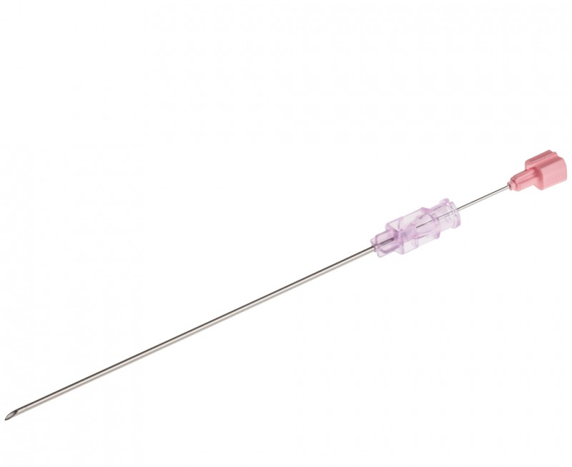
Subarachnoideal anesthesia
Loss of motoric too
Only for lower limbs and pelvis
Risk of total spinal anesthesia (loss of function of breathing muscles)
Risk of injury of the spinal root

Slide 36
Contraindications
Infection in site of aplication
Alergic reaction in anamnesis
Hypokoagulation (Epidural, Subarachnoideal)
Non-compliance of patient
Non-agreement of patient

Slide 37
Risk factors and complications
CNS toxicity:
Paradoxal stimulation, confusion, tremor, cramps, inhibition of breathing center
Cardiovascular toxicity:
Dysrythmia, arytmia, vasodilatation + hypotension
Hypersensitivity/alergic reaction
Bleeding, infection, needle breakage…

Slide 38
TAKE HOME MESSAGE
General anesthesia is not deep slumber
targeted loss of perception of all sensations (touch, pain, heat, cold) - farmacologicaly induced coma (unconsciousness)
I.V., gas, combined
Depth of anesthesia
Mantaining vital signs
Local anesthesia – types, indications
Combinations
Safety rules!

