Slide 1
Medical Terminology for Cancer

Slide 2
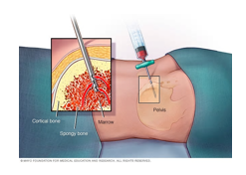
Diagnosis - Biopsy
this is the removal of a small section of the tumour, the sample will be analysed by a histopathologist in order to establish a precise diagnosis. Surgical procedure.
This may be a needle biopsy, where a very fine needle is used to take a tiny sample of the tumour. Occasionally a surgeon may remove the whole tumour prior to diagnosis; a resection biopsy.

Slide 3

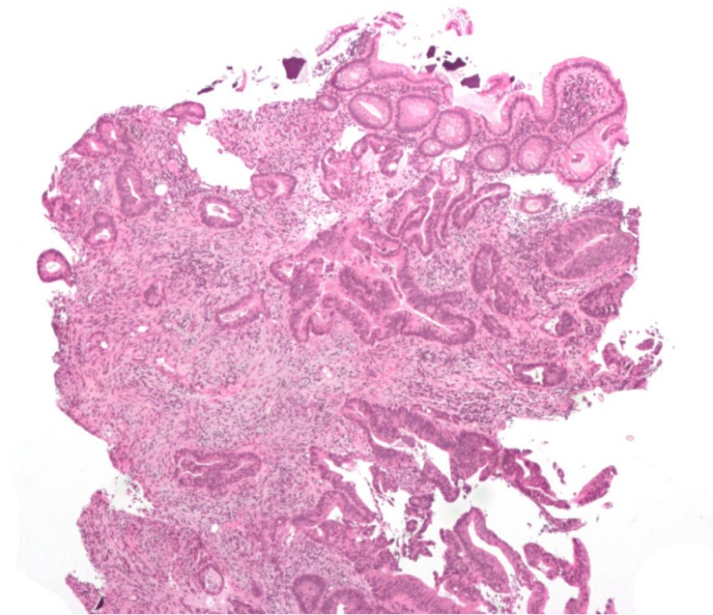
Histopathology
  the study of cells relating to the disease. (Histology is the microscopic study of cells
  and tissues, Pathology is the study of the disease).
  The histopathologist will determine a precise diagnosis by laboratory
  tests and microscopic examination of the cells
Cancer – Invasive adenocarcinoma (the most common type of colorectal cancer). The cancerous cells are seen in the center and at the bottom right of the image (blue). Near normal colon-lining cells are seen at the top right of the image.

Slide 4
Differentiation
is where normal cells go through physical changes in order to form the different specialised tissues of the body. Malignant cells may range from well-differentiated (closely resembling the tissue of origin) or undifferentiated or anaplastic (bearing little similarity to the tissue of origin). In general it is the undifferentiated or anaplastic histologies which are more aggressive

Slide 5
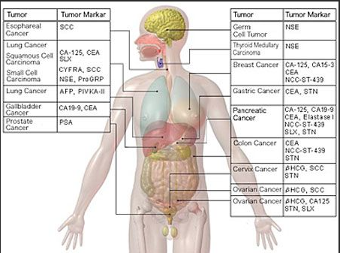
Tumour Markers
A substance in the body that may indicate the presence of cancer.
Markers may be secreted by the tumour itself or produced by the body in response to the cancer.
Tumour markers may aid diagnosis or give an indicator of how treatment is progressing.
These markers are usually specific to certain types of cancer.
For example neuron-specific enolase (NSE) is associated with a number of types of cancers, in particular neuroblastoma. Also alphafetoprotein (AFP) levels are often abnormally high in patients with Germ cell tumours.

Slide 6
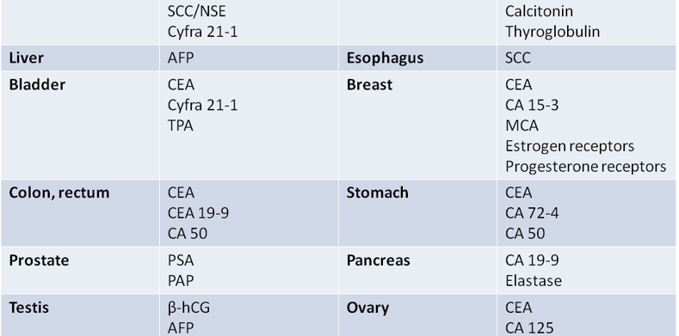

Slide 7
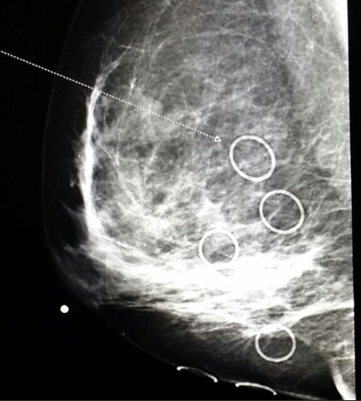
Medical Imaging
X-ray Examination of X-ray films may indicate the site and extent of the tumour and aid in the detection of metastatic spread.
CT Computed tomography (CT or CAT scan) makes a cross-sectional x-ray picture of a "slice" of the body. The machine rotates around the patient taking x-rays from different angles, the images are then processed by a computer.
MRI Magnetic resonance imaging. This is used to determine if the biochemical activity of a tissue responds normally to magnetic forces, tumours may give an abnormal signal.
Ultrasound The use of sound waves to image the underlying structures of the body. Ultrasonic waves are reflected differently depending on the type of tissue they pass through, aiding the detection of abnormal tissues…Endoultrasound
PET(CT, MRI)

Slide 8
Staging and Prognosis
Benign
Not spreading, usually a more mild disease.
Malignant
Cancerous, where the tumour grows uncontrollably and may spread.
In-situ / Invasive
Localised
A tumour restricted to a single site. Circular. Stenotic(bowel obstriction, joundice)
Metastases
Where the tumour has spread to other parts of the body beyond the primary site.
Metastatic sites (secondaries) my be regional or distant from the original tumour.

Slide 9
Staging
Staging is where the disease is categorised as to how far it has spread. The precise staging system used will depend on the type of cancer the patient has. In general low stage patients are those with localised tumours that are easily resectable, whilst high stage patients are those with widespread metastases. The treatment given may largely depend upon which stage the patient is at diagnosis.

Slide 10
Prognosis
is the expected outcome of a disease and it's treatment, this may be influenced by a variety of factors such as stage, age, site etc. depending on the particular type of cancer. For example, in general a patient with localised disease may have a more favourable prognosis compared to a patient with widespread disease which may be less favourable.

Slide 11

Prognosis
Remission
  is where the symptoms of cancer are no longer present.
  There is no longer any evidence of the disease using the available investigations.
Relapse
  This is when the disease reoccurs after a period in remission.
Refractory
  This is where the cancer is resistant to treatment, patient may nevergo into remission,
  possibly with stable or progressive disease.
Restaging
  This is where the patient is staged again after a period of treatment to access the response to therapy.
Follow-up
  When treatment is complete the periodic visits to the physician are needed to monitor the patient
  and ensure there has been no recurrence of the disease.

Slide 12
Treatment
Curative treatment
treatment to destroy the cancer.
Palliative treatment
treatment which relieves the symptoms and pain.

Slide 13
Surgery
  Complete resection (R0)
  this is where all of the tumour has been totally removed during surgery,as opposed to an incomplete resection.
  The surgical specimen may be examined by a pathologist to determine if it is likely to have removed all of the primary tumour.
  If there is any tumour left after surgery this may be macroscopic (visible to the eye) or microscopic,in either case radiotherapy may be needed to kill the remaining tumour cells.
  R1microscopic positive margins
  R2macroscopic positive margins

Slide 14
Radiotherapy
  External radiotherapy - radioactivity from a source outside the body.
  Internal radiotherapy - placing radioactive source within the body in or near to the tumour
  to kill the cancer cells (Brachytherapy).
  Fractions - the radiotherapy dose is divided into a number of smaller doses to reduce the risk of side
  effects. There is normally one fraction per day.
  Hyperfractionated radiotherapy - more than one fraction is given per day.
  Radiotherapy field - the area towards which the radiotherapy was directed.
  Total Body Irradiation (TBI) - radiation to the whole body e.g. to destroy all malignant cells
  prior to bone marrow transplant (BMT).

Slide 15
Chemotherapy
Since the 1960's the development and use of drugs has dramatically improved the prognosis for many types of cancer.
Chemo- means chemicals, for most types of cancer chemotherapy will consist of a number of different drugs, this is known as combination chemotherapy.
Chemotherapy may be given in a variety of ways;
  Intravenously (IV) -into a vein is the most common,
  Intramuscularly (IM) -injection into a muscle,
  Orally -by mouth,
  Subcutaneously (SC) -injection under the skin,
  Intralesionally (IL) -directly into a cancerous area,
  Intrathecally (IT)-into the fluid around the spine,
  Topically -medication will be applied onto the skin. Cytotoxic - cytotoxic drugs kill or damage cells. The normal cells of the body grow and die in a controlled way, but cancer cells keep growing and multiplying. Chemotherapy destroys cancer cells by stopping them from growing or multiplying at one or more points during the life cycle of the cell.
Central line - a thin plastic line into a vein in the chest used for the delivery of chemotherapy e.g. HICKMAN® catheter.
Drug resistance is where tumour cells become resistant to chemotherapy. Some tumour cells will be chemo-sensitive and are killed by anticancer drugs; the cells that remain are likely to be more resistant. Thus by selection it is the most resistant cells survive and divide, they may be resistant to a particular drug, a class of drugs, or all drugs.

Slide 16
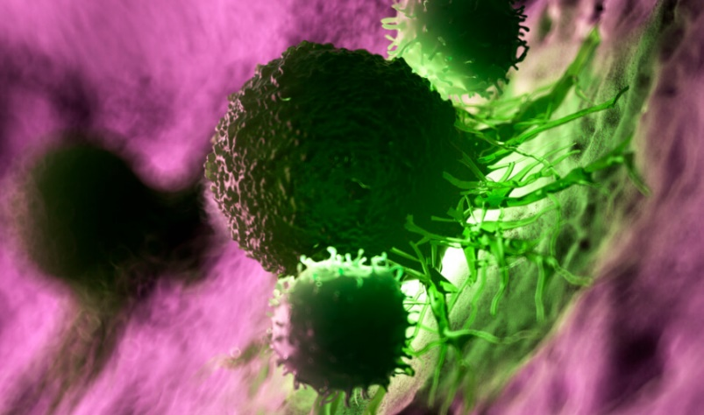
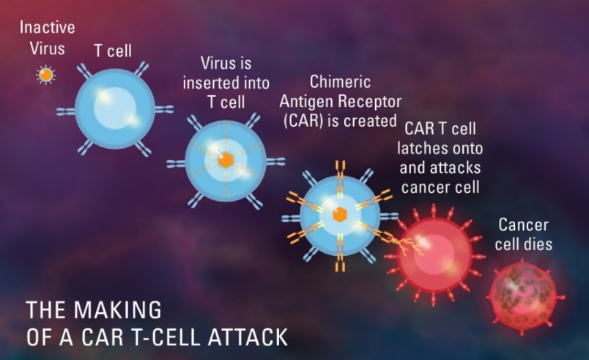
New approaches - Gene therapy / Immunotherapy
  In the future patients might be immunised against their own cancers by injecting them with their
  own tumour cells after they have been genetically modified.
  The gene-modified tumour cells may encourage the patients own immune system to destroy the cancer cells.
  Tumour necrosis factor (TNF) and interleukin-2 (IL-2) are substances associated with the immune
  system which encourage anititumour activity.
An illustration of white blood cells attacking a cancer cell.

Slide 17
Dukes´classification
Dukes' classification, first proposed by Dr Cuthbert E. Dukes in 1932, identifies the stages as:
A - Tumour confined to the intestinal wall
B - Tumour invading through the intestinal wall
C - With lymph node(s) involvement
D - With distant metastasis

Slide 18
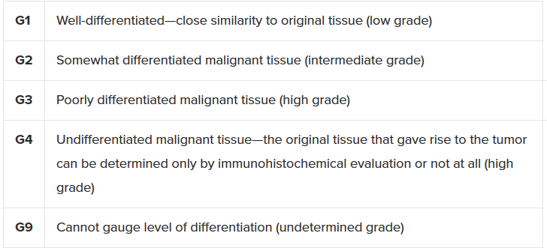
Grading
Grading is based on the histologic assessment of tumor cells according to their state of differentiation. Differentiation in the microscopic appearance of tumor cells determines the grade. Tumor cells are grouped into 4 types based on how they resemble and differ from healthy cells. Well-differentiated tumors (low grade) generally have a better prognosis than poorly differentiated tumors (high grade)
Note: Grading describes the grade of the histologic change of tumor tissue versus the neighboring healthy tissue.

Slide 19
Staging of a tumor
Staging of a tumor can be determined by its size and the extent to which it has spread throughout the body. Tumor staging is performed with different laboratory tests such as radiography, ultrasonography, computed tomography scanning, etc. Solid tumors are usually classified with the TNM system. This system has been administered by the UICC> (Union Internationale Contre le Cancer) since the 1950s, and it is regularly updated.
The letters T, N, and M stand for separate categories: tumor (size and extent of the primary tumor), node (involvement of neighboring lymph nodes), and status of metastases, respectively.

Slide 20
TNM Classification
The most common current staging system is the TNM(for tumors/nodes/metastases) system, though many doctors still use the older Dukes system. The system assigns a number:
T - The degree of invasion of the intestinal wall
  T0 - no evidence of tumor
  Tis- cancer in situ (tumor present, but no invasion)
  T1 - invasion through submucosa into lamina propria (basement membrane invaded)
  T2 - invasion into the muscularis propria (i.e. proper muscle of the bowel wall)
  T3 - invasion through the subserosa
  T4 - invasion of surrounding structures (e.g. bladder) or with tumour cells on the free external surface of the bowel
N - the degree of lymphatics node involvement
  N0 - no lymph nodes involved
  N1 - one to three nodes involved
  N2 - four or more nodes involved
M - the degree of metastasis
  M0 - no metastasis
  M1 - metastasis present

Slide 21
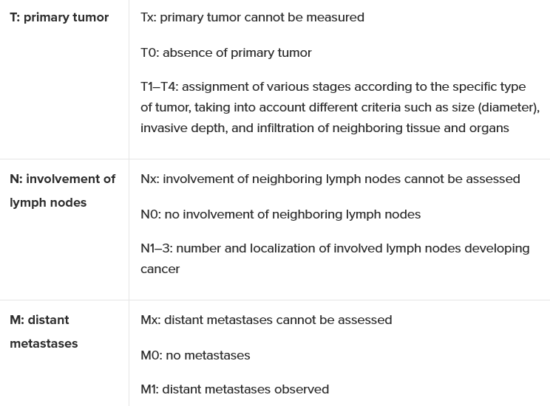
Staging of a tumor
The TNM system is further divided into the following 5 stages
Stage 0 | There is marked growth of abnormal cells, which have not spread to neighboring tissue but have the potential to develop into a tumor (also termed carcinoma in situ)
Stage I, stage II, and stage III | Assignment of various stages occurs according to the specific type of tumor, taking into account different criteria such as size (diameter), invasive depth, and infiltration of neighboring tissue
Stage IV | Metastasis to different organs
:
Note: Staging describes the totality of all indicated examinations that are necessary to determine malignant tumor spread. Observations are described by TNM classification and are assigned to a specific stage.

