Slide 1
Transplantation
Ist Department of Surgery, St. Anne’s University Hospital Brno

Slide 2
Transplantation
A medical procedure in which an organ, part of an organ or tissue is transferred from one place to another or from one body to another
To replace a damaged or missing organ
The aim to restore functions
Graft - tissue that is transplanted without reconstruction of the vascular bed (skin, muscle,…)
Transplant - organ transplantation with concomitant reconstruction of vascular bed
In practice, both terms are used as synonyms

Slide 3
History
1902 Ulmann – kidney transplantation in a dog
1912 Carrel and Guthrie – have developed a transplantation technique based on a perfect vascular stitch
1933 Voronoj – kidney transplantation from deceased to young woman with renal failure due to mercury poisoning (graft did not restore function, recipient died)
1943 Medawar – knowledge of the immunological cause of rejection
1958 Dausset – discovery of histocompatible antigens (HLA)
Introduction of immunosuppressive therapy (whole body irradiation, later medication)
1963 Starzl – has contributed to the development of liver transplants
1963 Hardy – first lung transplantation
1966 Kelly and Lillehei – pancreatic transplantation
1967 Barnard – first successful heart transplant using Shumway technique

Slide 4
Types of transplantation by tissue origin
Autograft (autotransplantation)
  Transplant of tissue to the same person
  There is no risk of graft rejection
    Skin, blood vessels
Allograft (allotransplantation)
  Between two genetically non-identical members of the same species
  There is a risk of graft rejection, immunosuppressants are needed
    Donor
    Recipient
Xenograft (xenotransplantation)
  From one species to another (e.g. porcine heart valve transplant)
Isograft (syngeneic)
  From a donor to a genetically identical recipient (such as an identical twin)
  Do not trigger an immune response
Implantation
  Transplantation of artificial, synthetic tissue

Slide 5
Types of transplants by location
Orthotopic transplantation
  The previous organ is removed and the transplant is placed at that location in the body (e.g. heart into the mediastinum)
Heterotopic transplantation
  The transplant is placed in a different location in the host than it had been in the donor – e.g. kidney transplant is placed in the anterior part of the lower abdomen, in the pelvis

Slide 6
Immunological aspects
MHC (Major Histocompatibility Complex) – the genetic system responsible for recognizing one's own from the alien
In humans, the major histocompatibility system is the HLA complex (Human Leucocyte Antigen) – complex of genes that determine surface antigens
5 HLA complexes – HLA-A, HLA-B, HLA-C, HLA-D, HLA-DR
Consensus in tissue HLA antigens between donor and recipient facilitates graft acceptance and prevents or attenuates post-transplant immune response
Graft from HLA identical sibling recipient tolerates
Graft from HLA unrelated individual is not tolerated
The greater HLA conformity, the longer graft survival
Identification of HLA antigens – tissue typing
  Serological and cellular methods replace DNA typing.
HvG – host versus graft – recipient's immune response against histocompatible antigens of graft

Slide 7
Immunological aspects
GvH – graft versus host – transplantation of immunocompetent cells, graft's T-lymphocytes response against recipient antigens
  Hematopoietic stem cells
  Small intestine, lungs, sometimes liver (contain a lot of lymphatic tissue)
Rejection does not occur:
  Autotransplantation
  Syngeneic transplantation
  Tissue transplants that do not express histocompatible antigens (bones, tendons, cartilage)
  Transplantation to immunologically privileged place – lymphocytes can't get there (e.g. brain, eye, gonades)
Immunosuppressants
  Chemotherapeutics – corticosteroids, cyclosporin A, FK506 (Tacrolimus), Rapamycin, Sanghlifehrin A, Azathioprine, Mycophenolate, mofetil, Cyclophosphamide, Deoxyspergualin, Chlorambucil, Methotrexate, Brequinar, Leflunomid, FTY720, Tautomycetin,
  Monoclonal, polyclonal antibodies – antilymphocytic globulin, antithymocyte globulin, OKT3, CAMPATH, anti-CD25, anti-CD4, anti-CD8, anti-CD2, anti-LFA3
  Total body irradiation

Slide 8
Transplant rejection
Hyperacute
  The existence of preformed antibodies against donor antigens
  Graft destruction within minutes to hours
  Vascular thrombosis and necrosis
  The crossmatch is a protection
Accelerated
  Lower antibody titer, within 5 days after transplantation
Acute
  Most common, within three months and later
  Activation of T-lymphocytes against graft antigens with interstitial inflammation
  Graft function is decreased
  Increase of immunosuppressive therapy
Chronic
  Gradual deterioration of graft function due to vascular changes
  Predominantly humoral factors
  Months to years

Slide 9
Rejection
Deterioration of laboratory parameters (e.g. increas of urea, creatinine)
Decrease in graft function (e.g. diuresis)
Verification by needle biopsy
Decrease in graft function can caused e.g. nephrotoxicity of cyclosporine

Slide 10
Transplantation centers in the Czech Republic
IKEM Prague
  Kidneys, heart, pancreas, liver, small intestine, uterus
UH Motol Prague
  Lungs, kidneys
CKTCH Brno
  Heart, liver, kidneys
UH Olomouc
  Kidneys
UH Ostrava
  Kidneys
UH Hradec Králové
  Kidneys
UH Pilsen
  Kidneys

Slide 11
Conditions for transplantation
1. surgical technique
Revascularization by vascular anastomoses
Connection of organ ducts (ureter, bile duct, pancreatic duct), intestinal anastomoses or respirátory tract
Grafting without damage
Preservation of graft function by intensive care
Complicatons:
  Fistula of ducts
  Graft thrombosis (mostly leads to graft loss)
  Oppression of ureter caused by accumulation of lymph around the transplanted kidney

Slide 12
Conditions for transplantation
2. source of organs
Living donors
  Paired organ (kidneys) or part of organ (liver)
  Close relative (parents, children, siblings)
  Emotionally related (husband and wife)
  Unrelated donor
Deceased donors
  Sudden death, esp. craniotrauma, spont. bleeding, ischemia after resuscitation, after drowning, in some cases meningitis or a primary brain tumor

Slide 13
Warm ischemia
  Time from organ procurement to start of perfusion with perfusion solution
  Start: MAP < 50 mmHg or SpO2 70%
  End: start flushing
  Rapid cell damage
  Most organs tolerate only a few minutes, it should not exceed 30 minutes
  Nearly zero warm ischemia can be achieved in donors with a beating heart
Cold ischemia
  Start: start flushing
  End: restoration of blood flow
  It should not exceed 36 to 48 hours
  Tolerance time (kidneys up to 36 hours), (heart, liver, pancreas, lungs 6-12 hours)
Graft half-life: was defined as the time taken for 1/2 of the grafts functioning at 1 year to fail
Organ Transplant Act

Slide 14
Clinical determination of brain death
Brain death
  is the complete loss of brain function (including involuntary activity necessary to sustain life). It differs from persistent vegetative state, ordinary coma, condition known as locked-in syndrome
Exclusion of factors affecting consciousness
  E.g. hypothermia, hypoxia, intoxication, effect of drugs, hypoglycemia
Neurological examination
The assessment is carried out by two physicians with specialized competence

Slide 15
Clinical determination of brain death
Examination of brainstem reflexes
  Pupillary light reflex
  Corneal reflex
  Oculocephalic reflex
  Glowing reflex
  Cough reflex
  Oculovestibular reflex
  Apnea test

Slide 16
Apnea test
To confirm breathing center malfunction
Disconnecting the patient from ALV
CO2 is accumulated, which physiologically stimulates the respiratory center
If damaged, the patient is unable to ventilate spontaneously
In COPD patients, it may not be valid, elevated CO2 may not be a sufficient incentive to activate the center

Slide 17
Clinical determination of brain death
Paraclinic examinations
  CT angiography – partially preserved circulation may occur in decompressive craniotomies, ventricular drainage and small children
  Evoked potential test
  Transcranail Doppler ultrasound
  Digital subtraction angiography
  Cerebral perfusion scintigraphy
  Electroencephalography

Slide 18
Another donor examination
Virology + Serology: TPHA, HBsAg, anti - HBc total, antibodies against HIV 1 a 2, anti CMV (IgM a IgA), EBV.
Biochemical profile: Na, K, Cl, Gly, urea, creatinine, osmolality, AST, ALT, ALP, GGT, Bilirubin, Albumin, CB, AMS, CK, CKMB, Trop-T, Myoglobin, CRP.
Blood count, coagulation, blood type, Rh factor
Astrup
Electrocardiography
ECHO
Coronarography
X-ray
Abdominal ultrasound
Examinations are indicated in cooperation with the transplant coordinator

Slide 19
Absolute contraindications to transplantation
Bacterial sepsis (except milder forms)
AIDS
Tuberculosis
HBV
HCV
Malignancy (except isolated brain, skin, in situ cervix carcinoma)
Long-term hemodialysis
Patient disagreement with transplantation
Impossibility to identify the patient
Noncompliance of recipient

Slide 20
Donor care
Rule 100
Blood pressure 100/80 mmHg
Diuresis 100ml/h (according to the patient's weight)
Normothermia
Hb >100g/l
Normoglycemia
Saturation 99%
Fluid resuscitation
Maintaining ions and acid-base balance
Venous access: CVC, NG tube, PUC, arterial catheter
To inform survivors

Slide 21
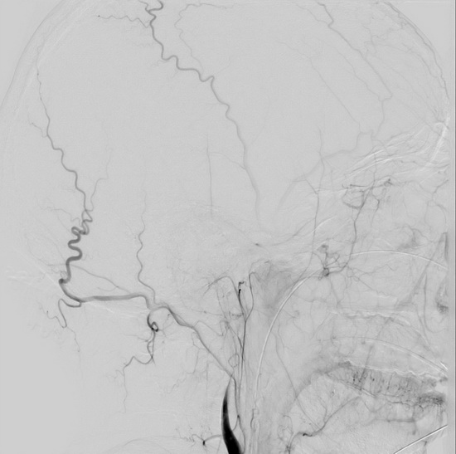
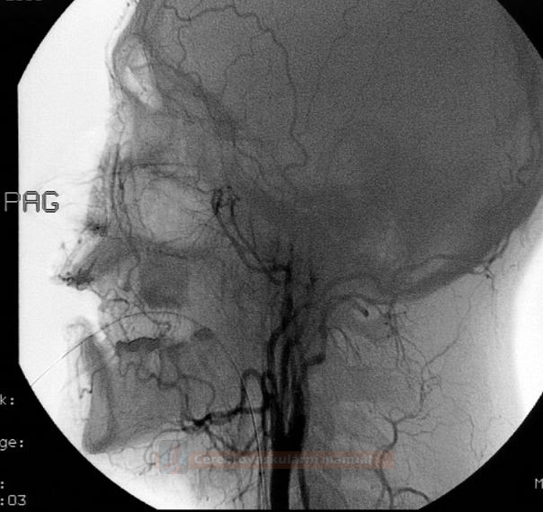
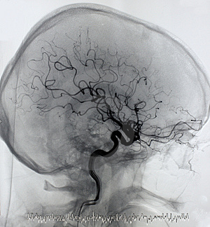
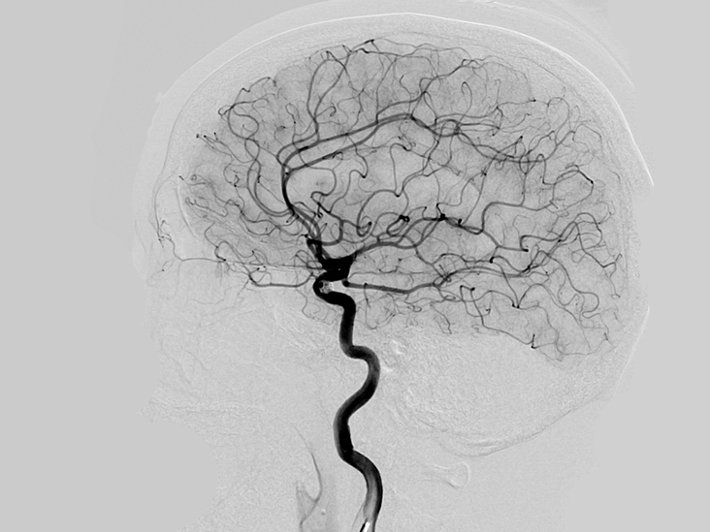
Physiological angiography

Slide 22
Liver transplantation
The first successful liver transplantation in 1967 (USA)
The first liver transplantation in the Czech republic in 1983 in St. Anne’s University Hospital Brno led by prof. Kořístka
In the Czech Republic two centers - IKEM Prague and CKTCH Brno
Most common indications: biliary cirrhosis, alcoholic, chronic active hepatitis, sclerosing cholangoitis, congenital atresia of the biliary tract, Wilson‘s disease, alpha-1-antitrypsin deficiency, Budd-Chiari syndrome and hemochromatosis
Controversial in primary malignancies due to frequent relapses
Orthotopically
Often only one lobe or segment in children
Technically demanding – liver artery, portal vein, inferior vena cava, bile ducts
Economic demands - the need for a number of blood derivative transfers – portal hypertensis, coagulation disorders
Need 10-15 per million inhabitants per year
85 candidates were on the waiting list in 3.5.2019
58 liver transplants were performed in CKTCH, 158 in IKEM in 2018

Slide 23
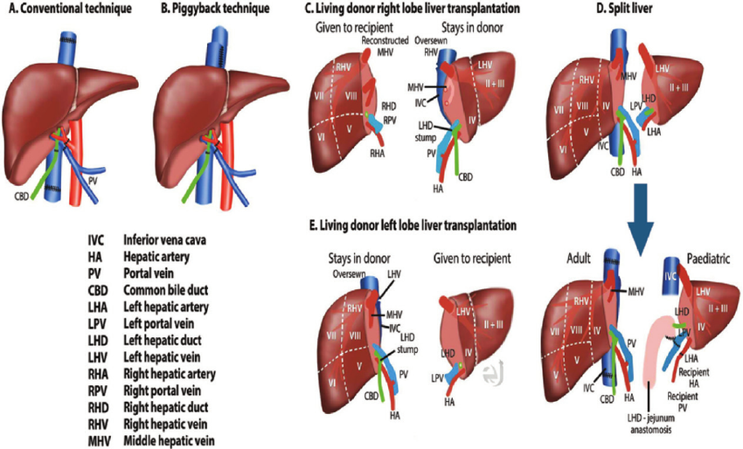
https://www.researchgate.net/figure/Available-surgical-techniques-for-liver-transplantation-A-Illustration-shows-the_fig1_270964176

Slide 24
Heart transplantation
The first successful heart transplantation was performed by Christiaan Neethling Barnard in 1967
In the Czech Republic two centers - IKEM Prague and CKTCH Brno
Most commonly indicated in idiopathic dilated cardiomyopathy or ischemic disease (with a prognosis of survival less than 1 year), unmanageable arrhythmias
Usually orthotopically (heterotopically supports the heart function of the recipient)
Remaining posterior atrial wall with orifices of venae cavae and pulmonary veins, left atrial anastomosis, septum, right atrium, aorta and pulmonary artery
Need about 15 per million inhabitants
76 candidates were on the waiting list in 3.5.2019
Number of transplants in 2018: 39 IKEM, 35 CKTCH

Slide 25
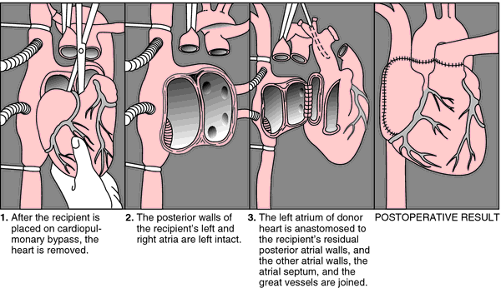
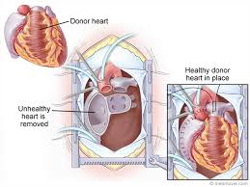
https://medical-dictionary.thefreedictionary.com/orthotopic+transplantation
https://medmovie.com/library_id/3255/topic/ahaw_0093a/

Slide 26
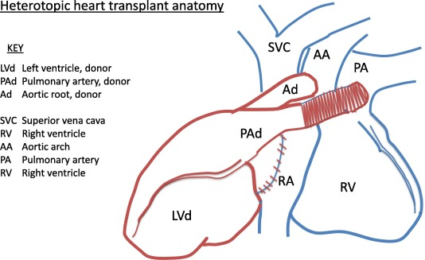
https://www.sciencedirect.com/science/article/pii/S0959289X17304211

Slide 27
Kidney transplantation
First kidney transplant between identical twins in Paris and Boston in 1958
Fastest development due to the possibility of hemodialysis during graft failure
Indication - 4th stage of chronic renal insufficiency
  Glomerulopathy, chronic tubular disease, diabetic nephropathy, polycystosis
Heterotopic transplantation to the iliac fossa - blood vessels on the iliac artery and vein, ureter on the bladder
Mostly one kidney, rarely transplant of both
The original kidney is left unless it is a source of infection, hypertension or polycystosis
Living donor transplants have significantly better results, ideally before hemodialysis
The kidney usually works immediately after transplantation, sometimes later (days, weeks), in 1/10 never

Slide 28
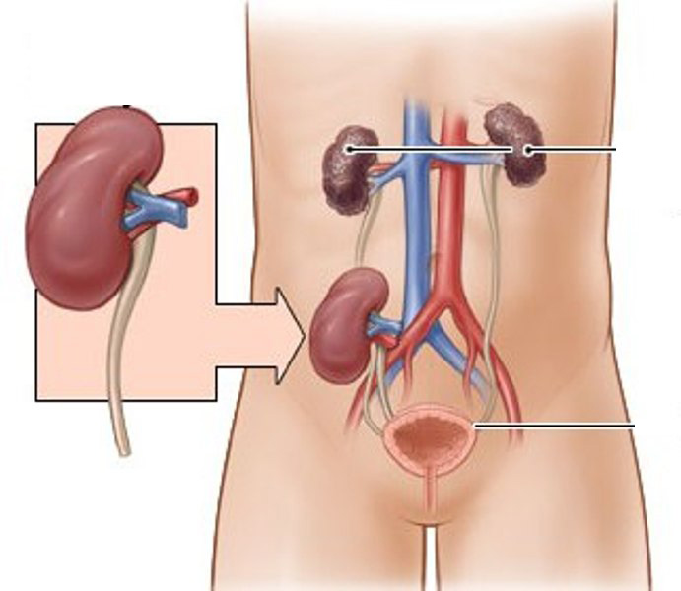
Kidney transplantation

Slide 29
Lung transplantation
In the Czech Republic since 1997, FN Motol
Before transplantation mostly dependence on oxygen therapy
Indications: idiopathic pulmonary fibrosis, exogenous allergic alveolitis, histiocytosis X, sarcoidosis, pulmonary emphysema, COPD, cystic fibrosis, pulmonary hypertension
One side, both sides, complexed with the heart, lobar is not performed in the Czech Republic
Use of extracorporeal circulation
Complications: pulmonary edema, pneumonia, arrhythmia, rejection
In the Czech Republic 30-50 per year

Slide 30
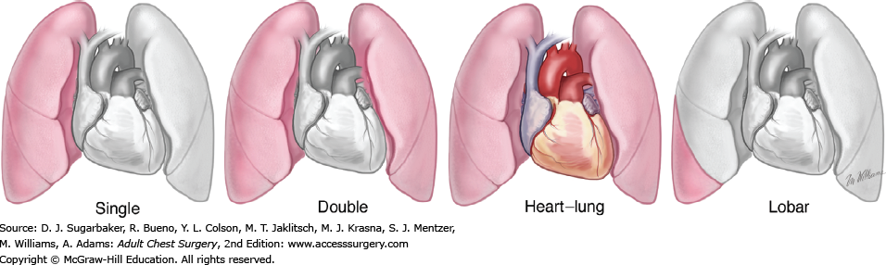
Lung transplantation
https://accesssurgery.mhmedical.com/content.aspx?sectionid=72434315&bookid=1317
https://www.mayoclinic.org/tests-procedures/lung-transplant/about/pac-20384754

Slide 31
Pancreas transplant
IKEM in the Czech Republic
Mostly in patients who have had or are waiting for a kidney transplant. Isolated pancreatic transplantation when the risks of poorly controllable diabetes outweigh the risks of long-term immunosuppression.
A successful pancreas transplant will eliminate the need for insulin injections, reduce or eliminate dietary and activity restrictions due to diabetes, and decrease or eliminate the risk of severe low blood sugar reactions
Artery is anastomosed to right external iliac artery
Terminal diabetic nephropathy, type I diabetes mellitus, seldom type II
Extraperitoneal, intraperitoneal
The need to resolve exocrine secretion – most often the graft duodenum is connected to the jejunal loop, the connection to the bladder is associated with greater complications, polymer obliteration of the outlet, ligation
Complications: metabolic, urological, hematological, gastrointestinal, surgical

Slide 32
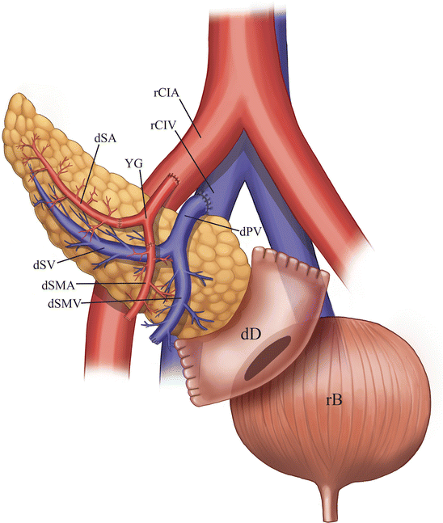
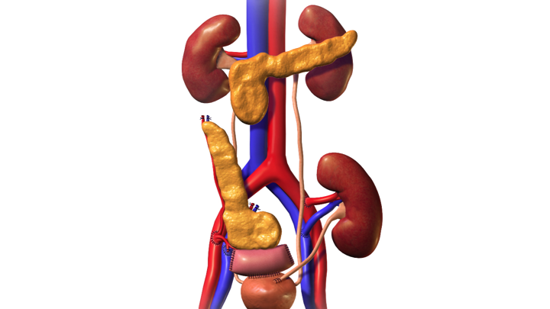
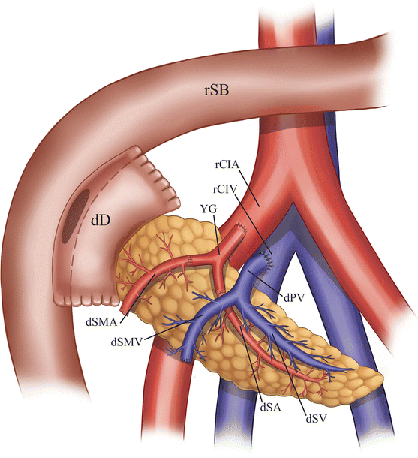
Pancreas transplant

Slide 33
Pancreatic islet cell transplant
IEQ/kg – islet equivalent– one IEQ is considered equivalent to a pancreatic islet with a diameter of 150 μm
The Edmonton protocol - involves isolating islets from a cadaveric donor pancreas using a mixture of enzymes called Liberase
Each recipient receives islets from one to as many as three donors
Islet cells taken from a deceased donor's pancreas are injected into a portal vein that takes blood to the liver
More than one injection of transplanted islet cells may be needed
Patients with diabetic nephropathy and obese are contraindicated

Slide 34
Dermal transplantation
Auto-, allo-, xenotransplantation
By thickness
  Split – thickness – including the epidermis and part of the dermis.
    It can be processed through a skin mesher which makes apertures onto the graft, allowing it to expand up to nine times its size.
    The donor site heals by re-epithelialisation from the dermis and surrounding skin and requires dressings.
  Full – thickness – consists of the epidermis and the entire thickness of the dermis.
    The donor site is either sutured closed directly or covered by a split-thickness skin graft.
  Composite graft – is a small graft containing skin and underlying cartilage or other tissue
Scalpel, Wattson knife, airdermatom, electrodermatome
Meshing
Extensive wounding or trauma, burns, areas of extensive skin loss due to infection, specific surgeries that may require skin grafts for healing to occur

Slide 35
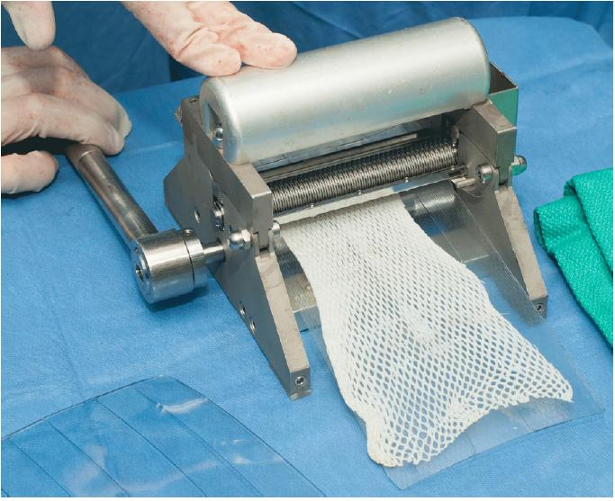
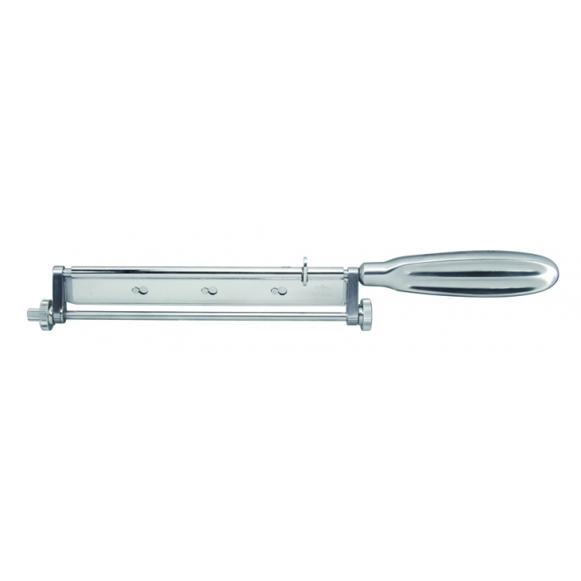
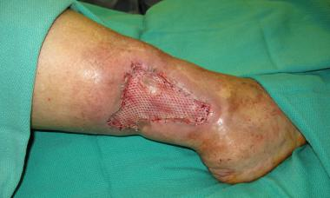
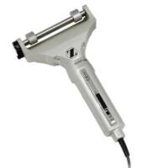
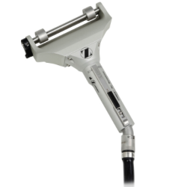
Dermal transplantation

Slide 36
Corneal transplantation
First in 1905 in Olomouc
Perforating keratoplasty – corneal transplantation in full thickness
Lamellar keratoplasty – removal of only the damaged or diseased epithelium and stroma, leaving the endothelium intact, in cases where only the more superficial layers are damaged
Indications
  Optical – transparency restore
  Tectonic – preservation of the integrity of the bulb when the cornea is thinning with imminent perforation
  Therapeutic – severe inflammations
  Cosmetic – blind eyes with leukoma
Immunosuppressive treatment is usually discontinued after removal of stitches between 11-13. month
Donor-recipient compatibility is not required

Slide 37
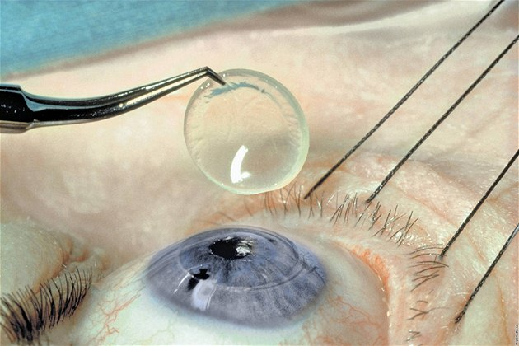
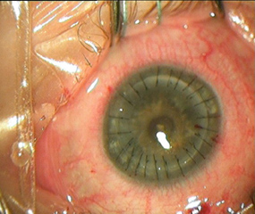
Corneal transplantation

Slide 38
Stem cell transplant
Collecting stem cells:
  Stem cells from the bone marrow - most often taken from the pelvic bones
  Stem cells from the peripheral blood – rowth factors, such as G-CSF or plerixafor, may be given for a few days to stimulate stem cells to grow faster and move into the blood from the bone marrow. Machine separates and collects stem cells from the blood.
  Stem cells from the umbilical cord
Stem cells are given through a central venous catheter and they settle in the bone marrow and begin to multiply and mature
Autologous, Allogeneic, Syngeneic
Indications: acute myeloid leukemia, acute lymphocytic leukemia, non-Hodgkin‘s lymphoma, malignant lymphogranuloma, myelodysplastic syndrome, myelofibrosis, chronic lymphocytic leukemia, chronic myeloid leukemia, severe aplastic anemia, myeloma, congenital haematopoietic disorders
Graft vs. host disease
More than 350 centers in Europe are performing over 18,000 transplantations a year

Slide 39
Small intestine transplantation
Four indications:
  a loss of two of the six major routes of venous access
  multiple episodes of catheter-associated life-threatening sepsis
  fluid and electrolyte abnormalities in the face of maximal medical therapy
  parenteral nutrition associated liver disease
Intestinal failure is usually the result of one of the following:
  short bowel syndrome
  chronic intestinal pseudo-obstruction
  intra-abdominal non-metastasizing tumors
The most common causes for intestinal failure in the adult: ischemia, Crohn‘s disease, trauma, motility disorder, tumor, volvulus
The most common causes for intestinal failure in the pediatric: necrotizing enterocolitis, gastroschisis, omphalocele, intestinal atresia, volvulus, intestinal pseudo-obstruction, microvillus inclusion disease, intractable diarrhea of infancy, autoimmune enteritis, intestinal polyposis, Hirschprung disease
Complete parenteral nutrition – complications limit permanent use – hepatic impairment, steatosis, fibrosis, cirrhosis, liver failure, catheter sepsis
Multivisceral transplantation: intestine, liver, stomach, duodenum, pancreas

Slide 40
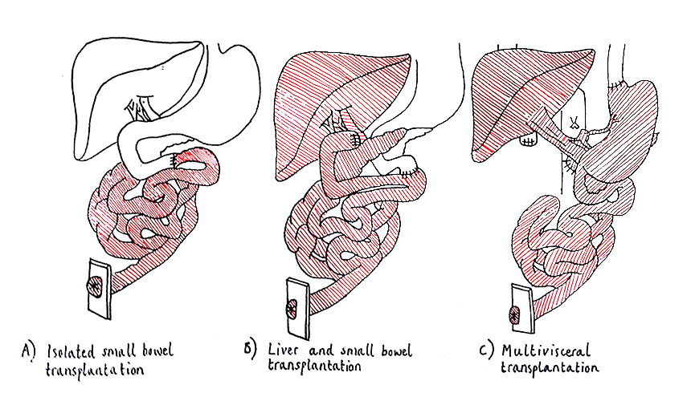
Small intestine transplantation

Slide 41
Others
Uterus
Face
Bones and tendons
Heart valves
Blood vessels
Penis
Hand

