Slide 1
Examination techniques in ophthalmology
V. Matušková

Slide 2
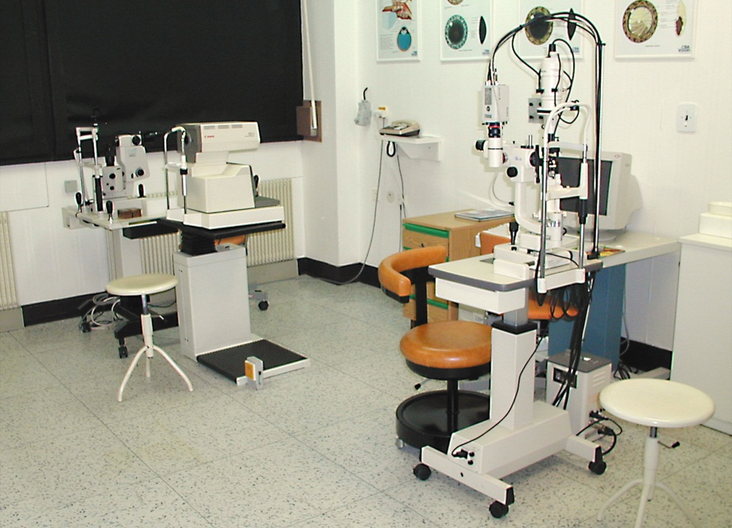
Basic examination techniques
Visual acuity (natural, best corrected)
Measurement of intraocular pressure
Slit lamp examination
Fundus examination

Slide 3
Visual acuity
Visual acuity (natural, best corrected)
Distance vision
Near vision
Charts
Snellen
Landolt ring
Pictures
ETDRS
Jaeger

Slide 4
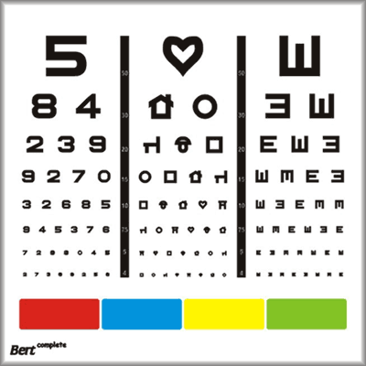
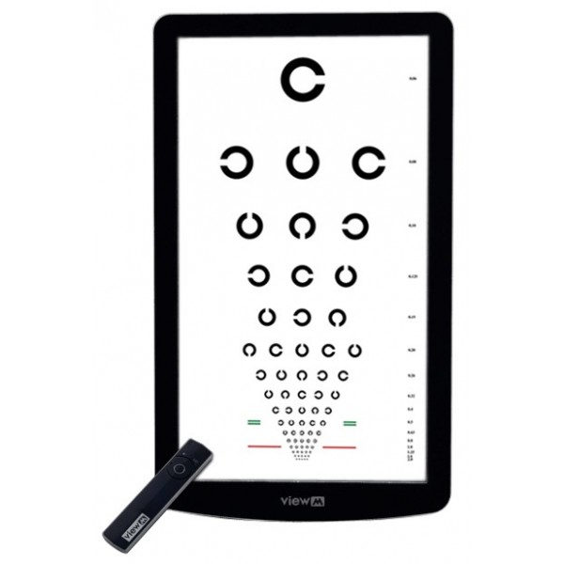
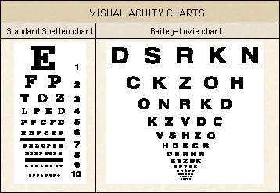
Charts

Slide 5
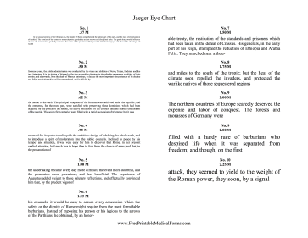
Near vision
Jaeger chart
VODS: s +2,5 Dsf J.No. 1

Slide 6
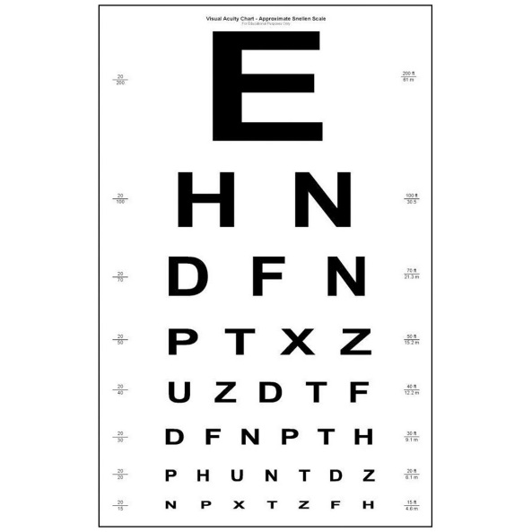
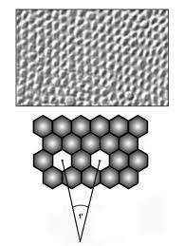
Visual Acuity
5/50 (metres, feet 20/200)
0,1
Minimum separabile – minimum angle of resolution

Slide 7
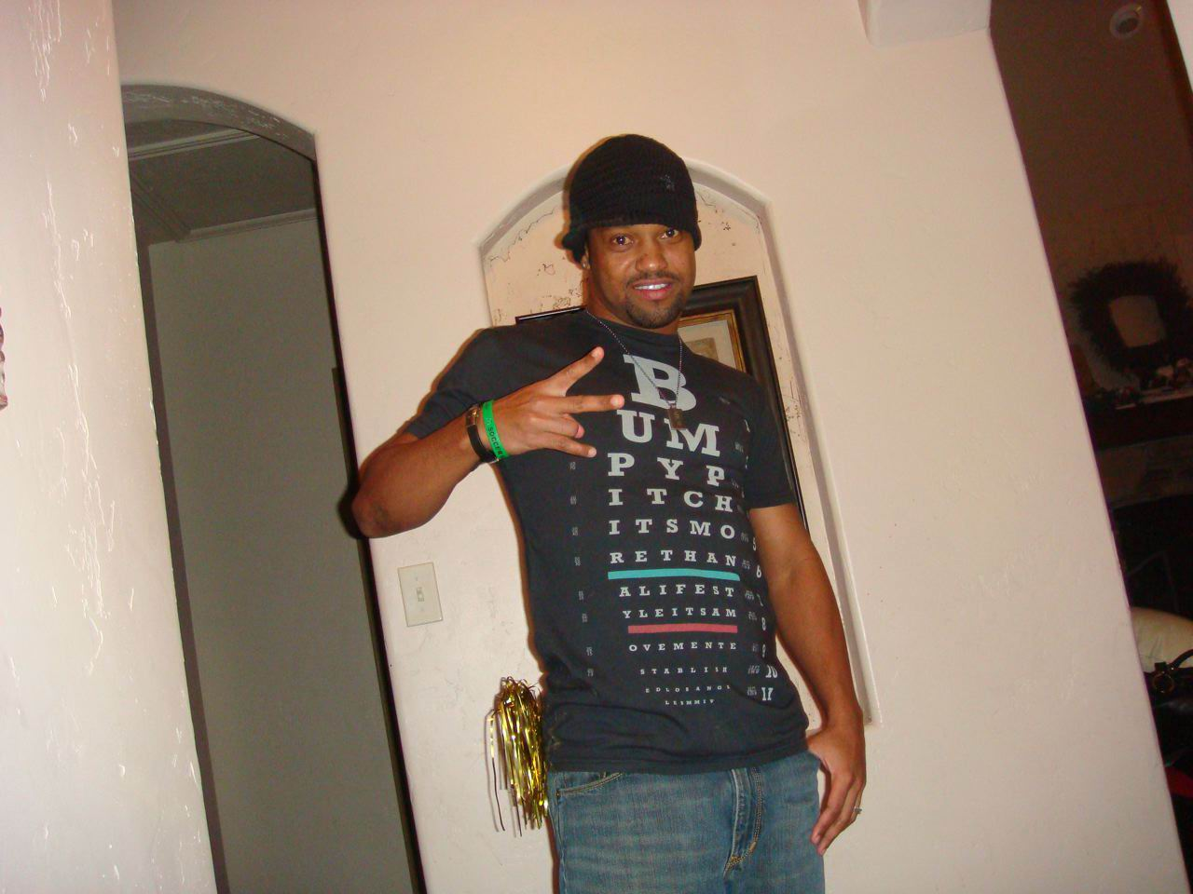
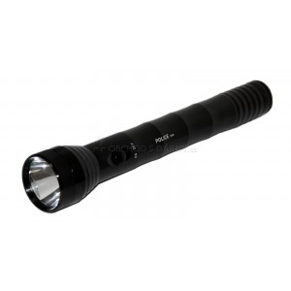
Visual acuity
Counting finger (metres )
Hand movement
Light perception
Amaurosis
Practical blindness

Slide 8
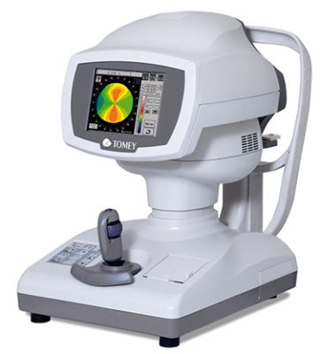
Refraction
Refractive error is an optical abnormality in which the shape of the eye fails to bring light into sharp focus on the retina, resulting in blurred or distorted vision.
In optometry, a "refraction" procedure is the measurement of refractive error
Autorefractor

Slide 9
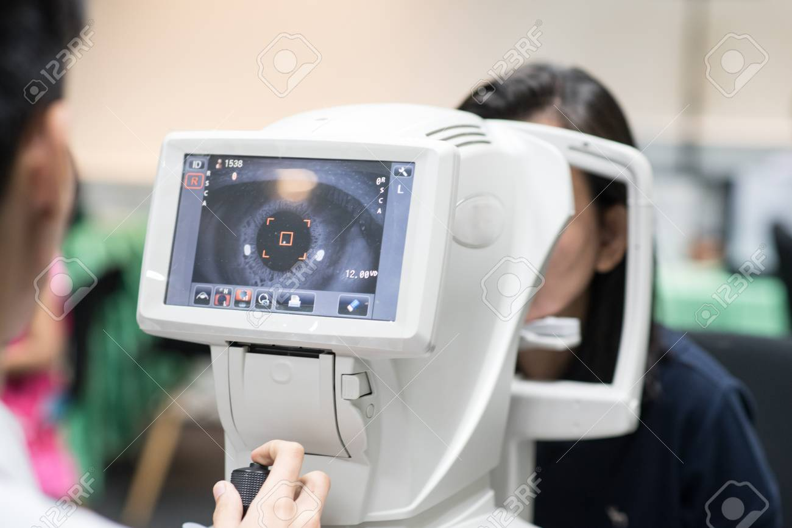
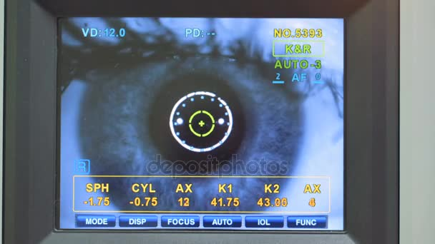
Autorefractor

Slide 10
Visual acuity
VOD: 5/50, s – 2,0 Dsf a -1,0 Dcyl ax 90 5/5
VOS: 5/30, s – 2,5 Dsf a -1,5 Dcyl ax 100 5/7,5,
VOD: visus oculi dextri
VOS: visus oculi sinistri
Dsf: dioptry sferic
Dcyl: dioptry cylindric
Ax: axis

Slide 11
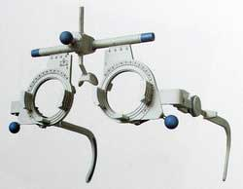
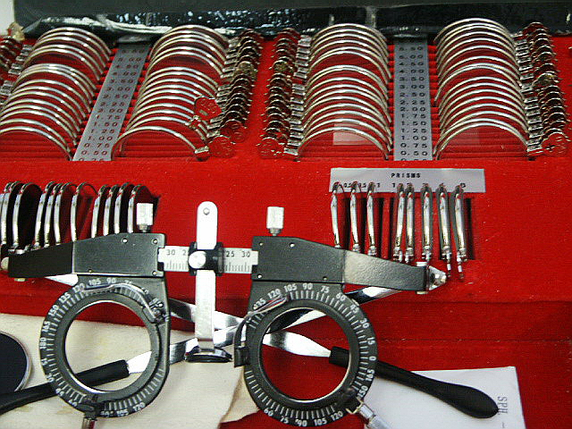
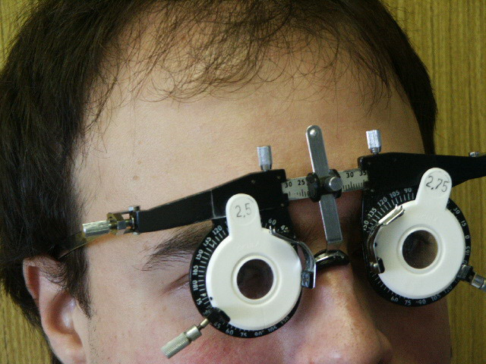
Visual acuity
Frame
Lenses
Axis

Slide 12
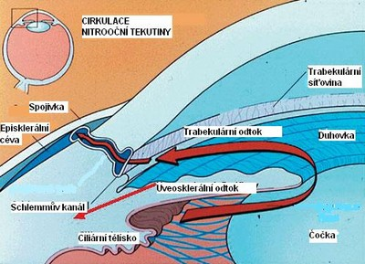
Tonometry
Contact techniques
Schiötz tonometry
Goldmann applanation tonometry
Non contact techniques
Jet air (air puff)

Slide 13
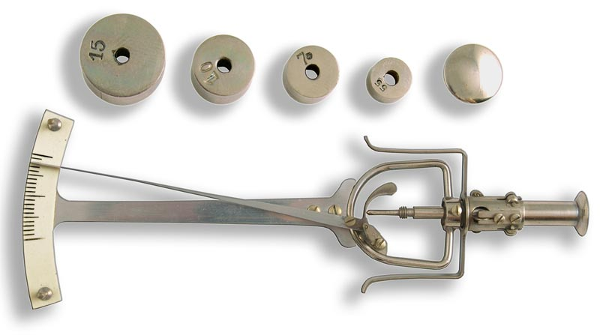
Schiötz tonometry
7/7,5
Topical anestesia

Slide 14
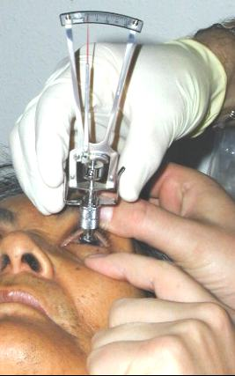
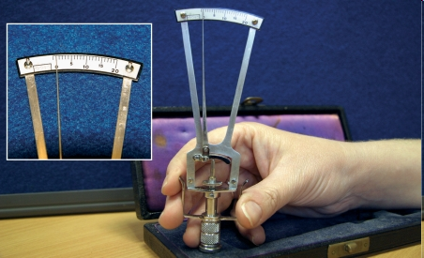
Schiötz tonometry

Slide 15

Goldmann tonometry
The normal range is 10-21 mmHg
Topical anestesia, fluorescein
Force required to flatten the cornae

Slide 16
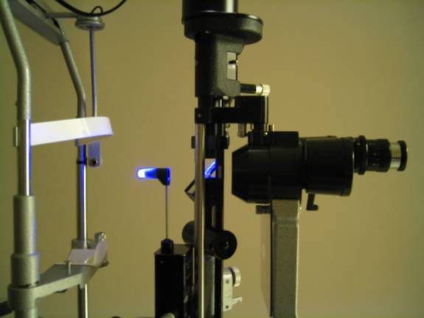
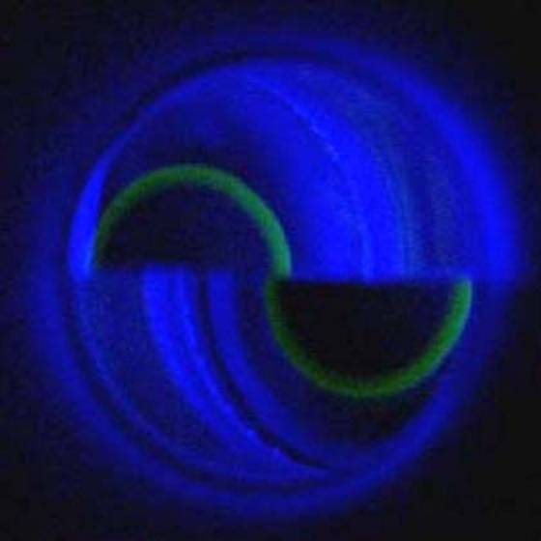
Goldmann tonometry

Slide 17
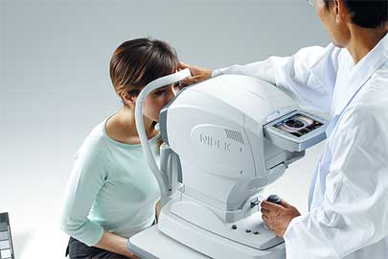
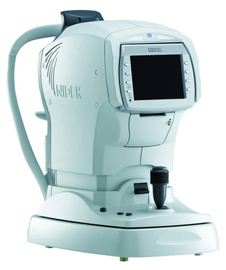
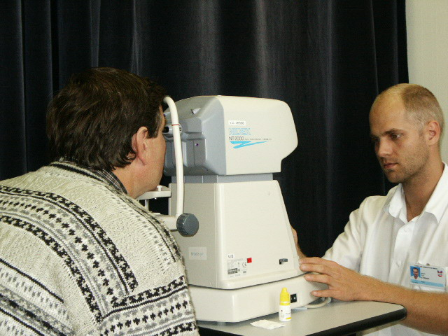
Non contact tonometry

Slide 18
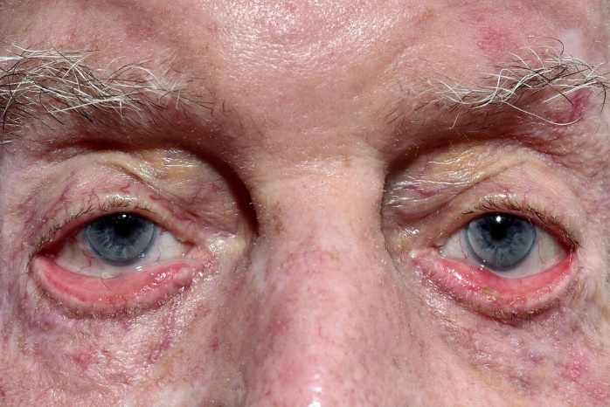
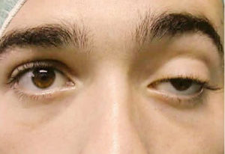
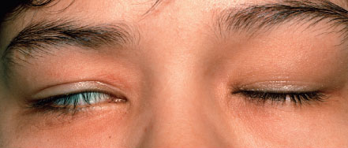
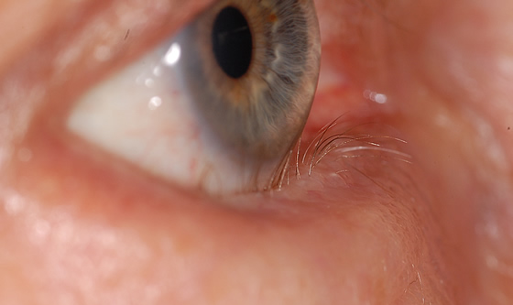
Examination of anterior segment
Aspection
Ectropium
Ptosis
Lagophtalmus
Entropium

Slide 19
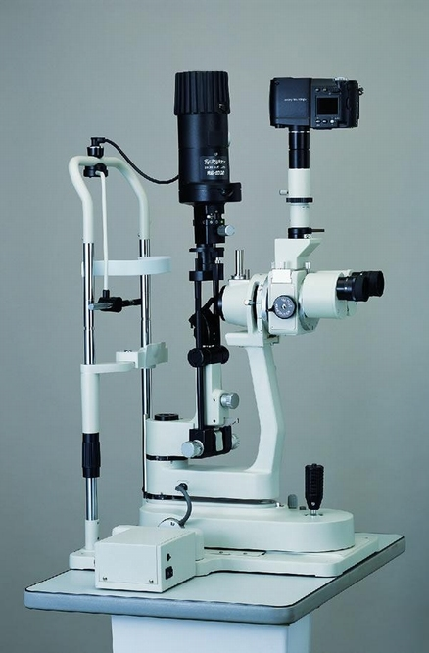
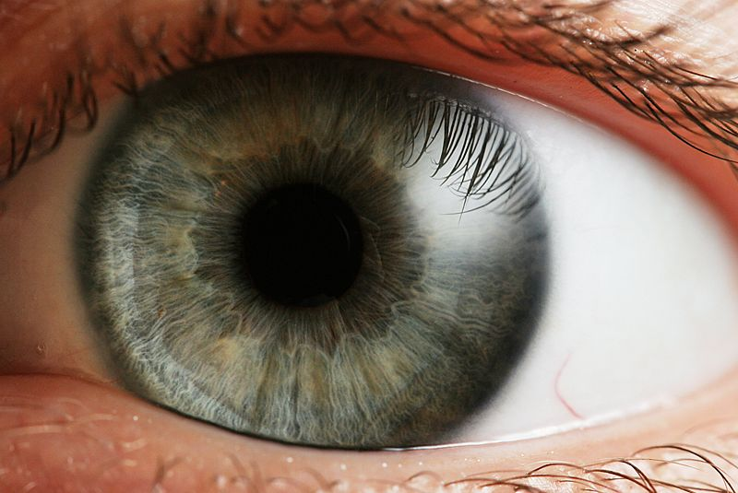
Slit lamp biomicroscopy
table mounted microscope with a special adjustable illumination source attached

Slide 20
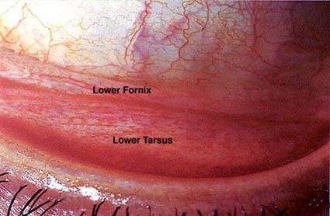
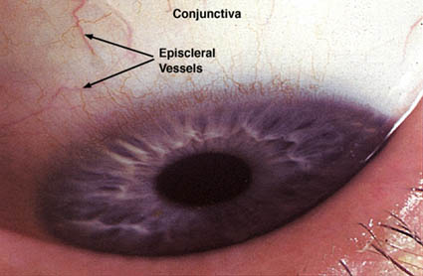
Slit lamp biomicroscopy

Slide 21
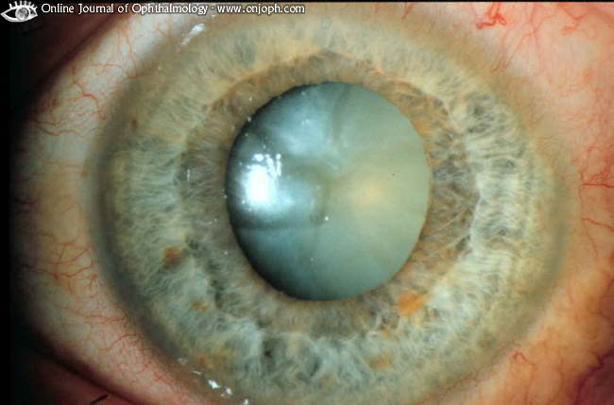
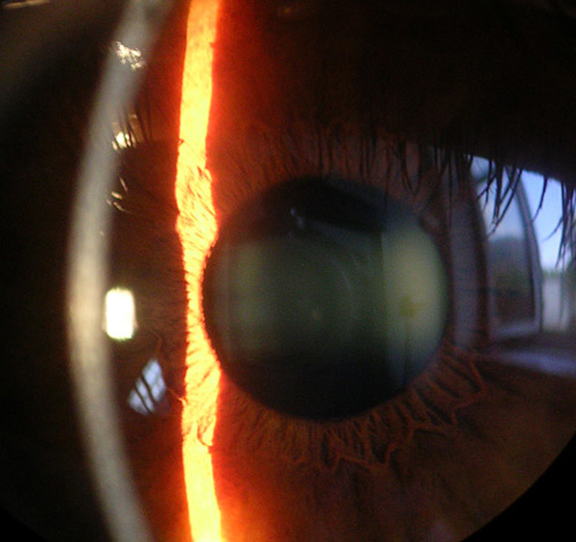
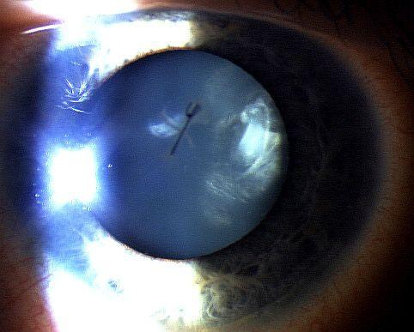
Slit lamp biomicroscopy
,

Slide 22
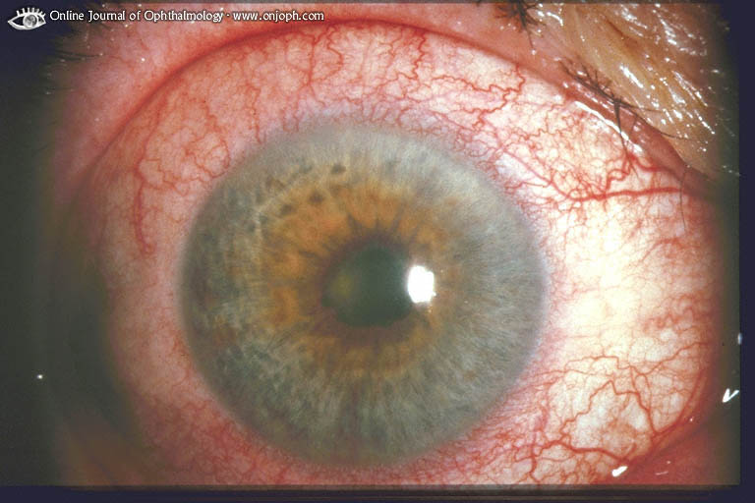
Synechiae posterior

Slide 23
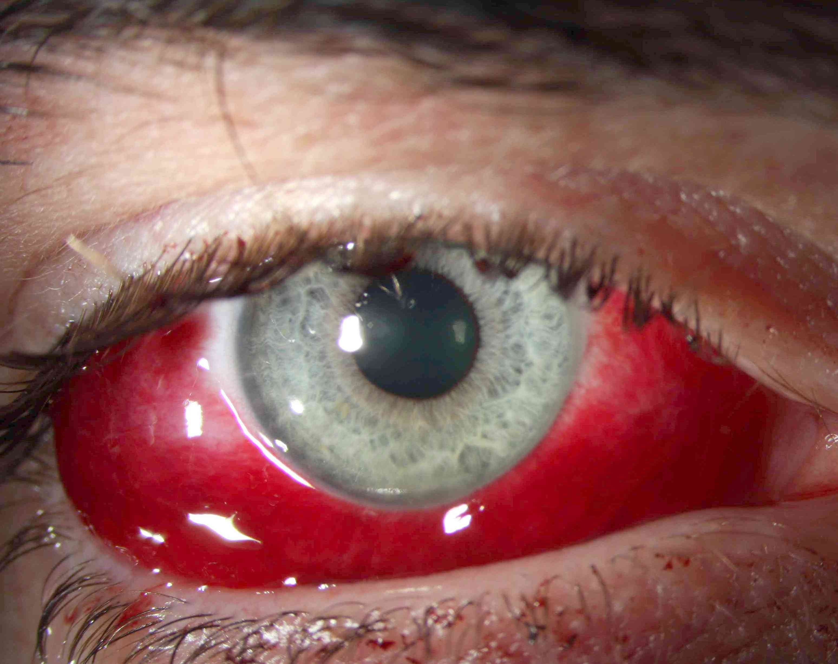
Sunconjunctival haemorrhage

Slide 24
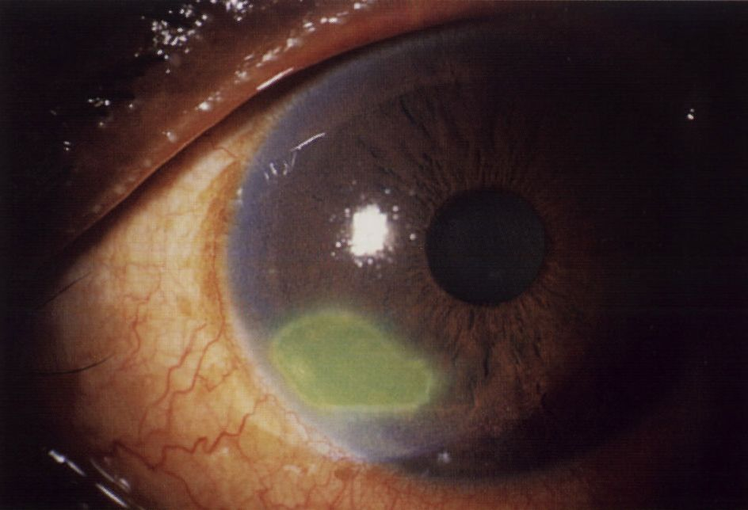
Corneal abrasion

Slide 25
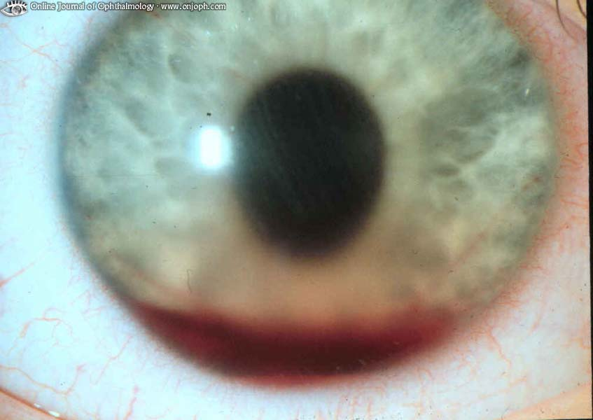
Hyphema

Slide 26
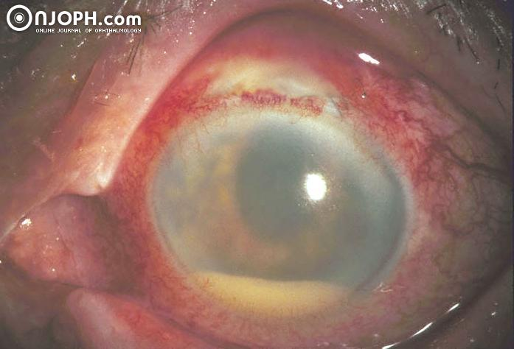
Hypopyon

Slide 27
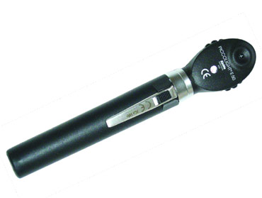
Examination of fundus
Ophthalmoscopy - direct (no steropsis, worse for periphery)
- indirect
Slit lamp biomicrocsopy
(high power convex lens, the image is vertically inverted
and laterally reversed)
Mydriasis is neccesary !

Slide 28
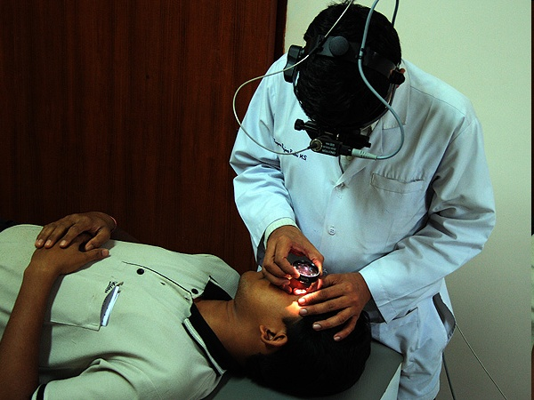
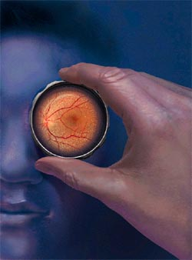
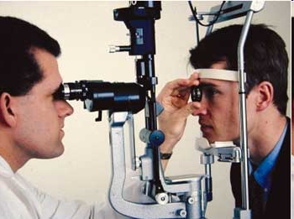

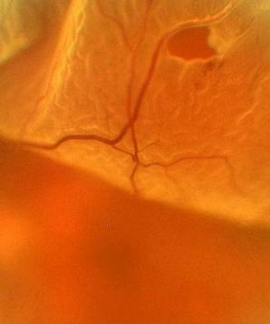
Notes:
28

Slide 29
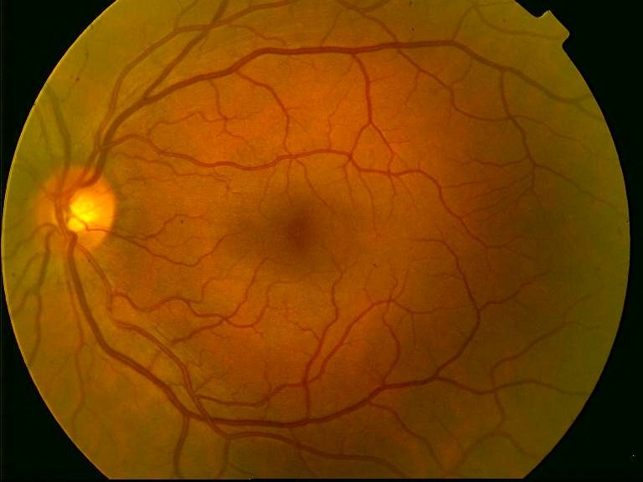
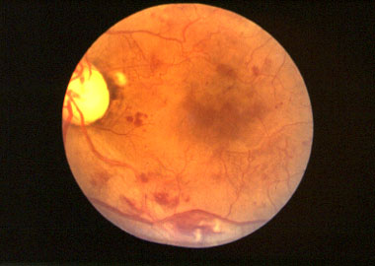
Ocular fundus

Slide 30
Special examination techniques

Slide 31
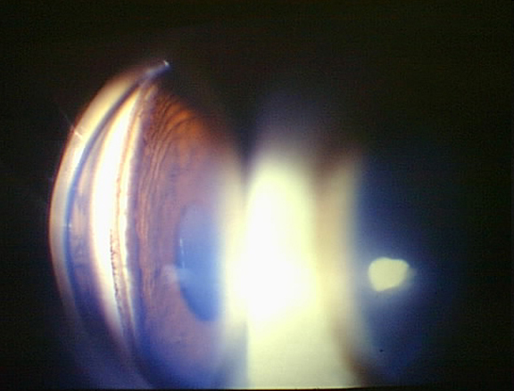
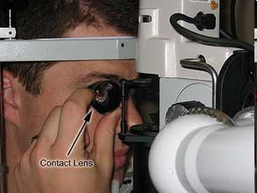
Gonioscopy
Gonio lens ( mirrors)
Angle structures
Fundus examination
Notes:
31

Slide 32
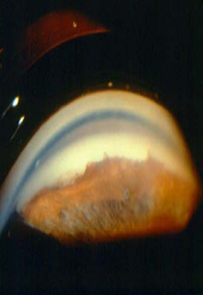

Notes:
32

Slide 33




Slide 34




Optical coherence tomography

Slide 35


Fluorescein angiography

Slide 36
Electrophysical tests
ERG (electroretinography)
diagnosis of functional defects of retina
Record of an action potential produced by the retina when it is stimulated by light
VEP (visual evoked potential)
-diagnosis of functional defects of visual pathways
Record of electrical activity of the visual cortex created by stimulation of the retina

Slide 37


Electrophysical tests

Slide 38

Electrophysical tests

Slide 39



Ultrasound

Slide 40


Ultrasound
Non transparent optical media
UBM- high frequency ultrasound – imaging of anterior segment

Slide 41


Ultrasound
A scan ( biometry)
B scan

Slide 42




Ultrasound

Slide 43


Color vision – HUE test

Slide 44




Hertl exoftalmometry

Slide 45

Děkuji za pozornost!

