Slide 1
Pathophysiology of reproduction – sterility, infertility

Slide 2
Lecture Outline
The Basics
  Gametogenesis
  Gender determination
Female Reproductive Pathophysiology
  Ovarian Cycle
  Uterine Cycle
  Hormonal control and changes
  Disorders
Male Reproductive Pathophysiology
  Infertility

Slide 3
The Basics
Gametogenesis
Gametes are produced during Meiosis I & II
  Meiosis function
    Production of 4 haploid (n) gametes from each diploid oögonium (2n) or spermatogonium (2n)
    Differences between ♂ (male) and ♀ (female) gamete development
      ♂
        continuous development & production of sperm from onset of puberty until….?
        stem cells are retained
        Sperm are motile and contain very little cytoplasm
      ♀
        the entire complement of dictyate primary oocytes are formed during development with 10-20 continuing development during each ovarian cycle
        Oocytes are surrounded by follicular cells – forms ovarian follicle
        stem cells are exhausted
        oocytes are among the largest cells and are non-motile

Slide 4
The Basics
Gametogenesis
Sperm Production
  During development germ cells are produced
    Remain quiescent until puberty
      Actions of hormones from pituitary, sertoli cells and Leydig cells
    At puberty some spermatogonia will
      Undergo mitosis continuously
      Enter into meiosis
        This ensures a continuous supply of spermatogonia

Slide 5
The Basics
Gametogenesis
Process of sperm production involves three stages
  Spermatocytogenesis
    produces secondary spermatocytes from spermatogoium
  Spermatidogenesis
    stage where meiosis I & II occur
    results in spermatid formation
  Spermiogenesis
    final stage of sperm development
    spermatid becomes a motile spermatozoa during spermiation

Slide 6
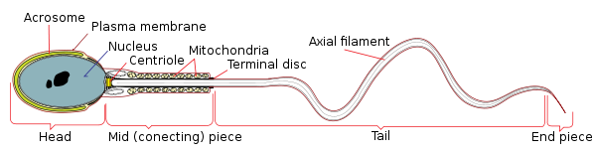
The Basics
Gametogenesis
Spermiation
  The spermatozoa that are formed are initially unable to move.
  The flagella must become motile
    Not used however until ejaculated
    Prior movement through the male reproductive tract is via peristalsis
End result!

Slide 7
The Basics
Gametogenesis
Oogenesis
  Results in formation of secondary oocyte which is released during ovulation
    If no fertilization occurs, meiosis II will not occur.
  Stages of oogenesis
    Oocytogenesis
      Forms oögonia
      During fetal development starting at week 10 and completing around birth
      Results in formation of primary oocytes (~1/2 million)
    Ootidogenesis
      Results in the formation of secondary oocytes
      These are dictyate in prophase I
    Formation of ovum (if fertilization occurs)

Slide 8
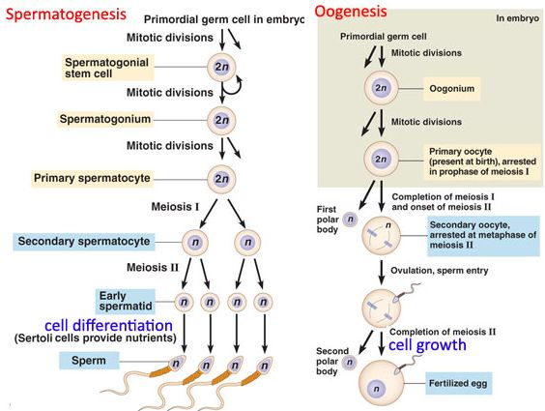
The
Basics
Gametogenesis

Slide 9
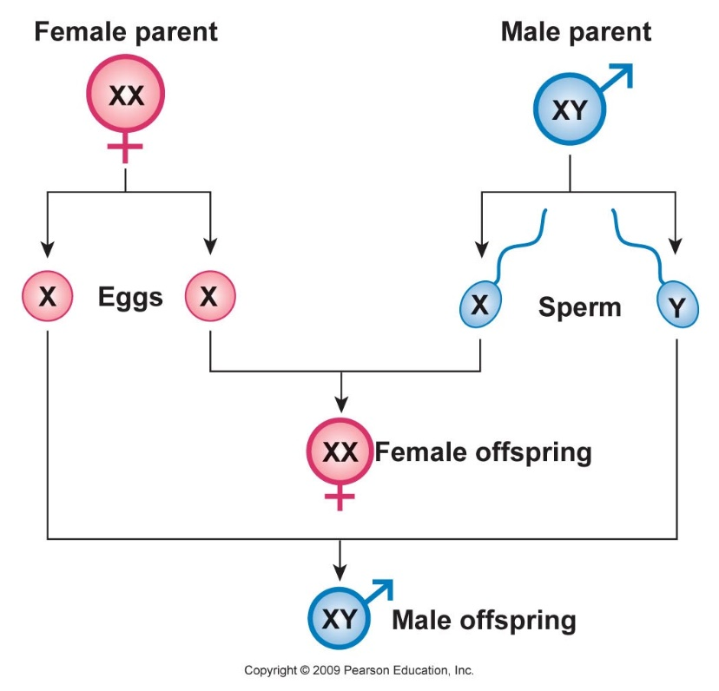
The Basics
Gender Determination
Chromosomes determine gender
  23 donated by egg (n)
  23 donated by sperm (n)
Syngamy
  The fusion of gametes to form a zygote
  Consists of
    plasmogamy
      union of cell membranes and cytosol
    Karyogamy
      union of genetic material
      Autosomes: 44 or 22 pair
      Sex chromosomes: 2 or 1 pair
        XX chromosomes = female
        XY chromosomes = male
What happens if karyogamy of sex chromosomes is different?

Slide 10
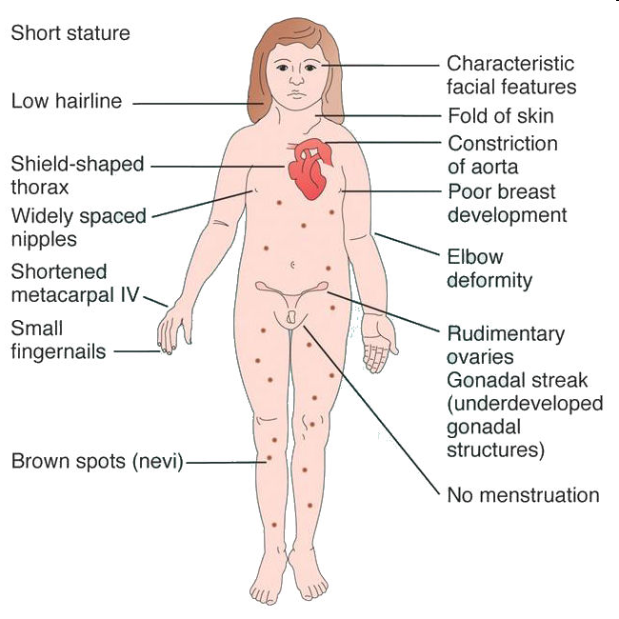
The Basics
Gender Determination
Non-disjunction during meiosis I or II
  Monosomy or polyploidy
    XO (no Y chromosome, or second X)
    Turner’s syndrome
      Phonotypical female
What about YO monosomy?

Slide 11
The Basics
Gender Determination
Non-disjunction during meiosis I or II
  Polyploidy
    The incomplete separation of homologues during meiosis results in a zygote with too many chromosomes
    Regarding the sex chromosomes, it may be
      XXY (47 chromosomes total)
        Klinefelter syndrome: Male sex organs; unusually small testes, sterile. Breast enlargement and other feminine body characteristics. Normal intelligence.
      XYY
        Jacob’s syndrome: Individuals are somewhat taller than average and often have below normal intelligence. At one time (~1970s), it was thought that these men were likely to be criminally aggressive, but this hypothesis has been disproven over time.
        XXYY – male and very rare (48 chromosomes)
      XXX (Trisomy X)
        Individuals are female normal, undistinguishable except for by karyotype.

Slide 12
The Basics
Gender Determination
The embryo exhibits gender bipotential
  Around week seven of fetal development the SRY (Sex-determining Region of Y chromosome) gene becomes activated
  The SRY directs the bipotential gonads
    The absence of this on the X chromosome causes the gonads to develop into ovaries
      Ovaries then produce further gender biased hormones
    The presence of this gene and its products causes the gonads to descend and develop into testes
      Testes then produce further gender biased hormones
      Translocation of the gene to X chromosome results in an XX individual (genotype) but with XY characteristics (phenotype)

Slide 13
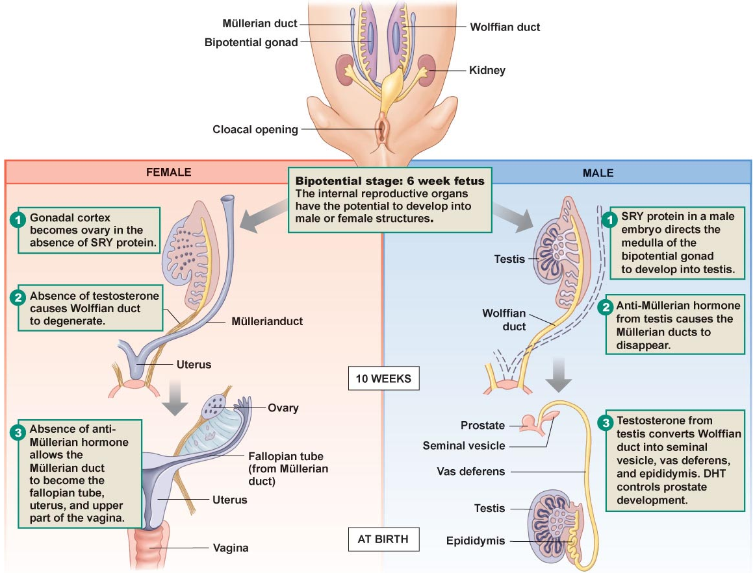
The Basics
Gender Determination
Effects of SRY on sex organ development

Slide 14
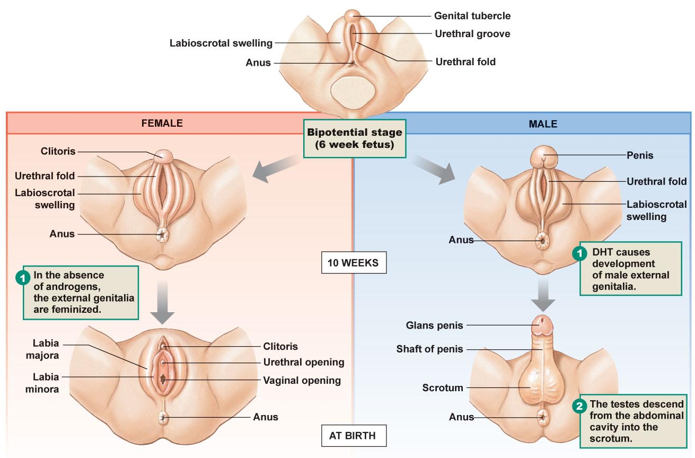
The Basics
Gender Determination
Indirect effects of SRY on male and female genital development

Slide 15
Lecture Outline
The Basics
  Gametogenesis
  Gender determination
The Pituitary-Gonad Axis
Female Reproductive Physiology
  Ovarian Cycle
  Uterine Cycle
  Hormonal control and changes
Male Reproductive Physiology

Slide 16
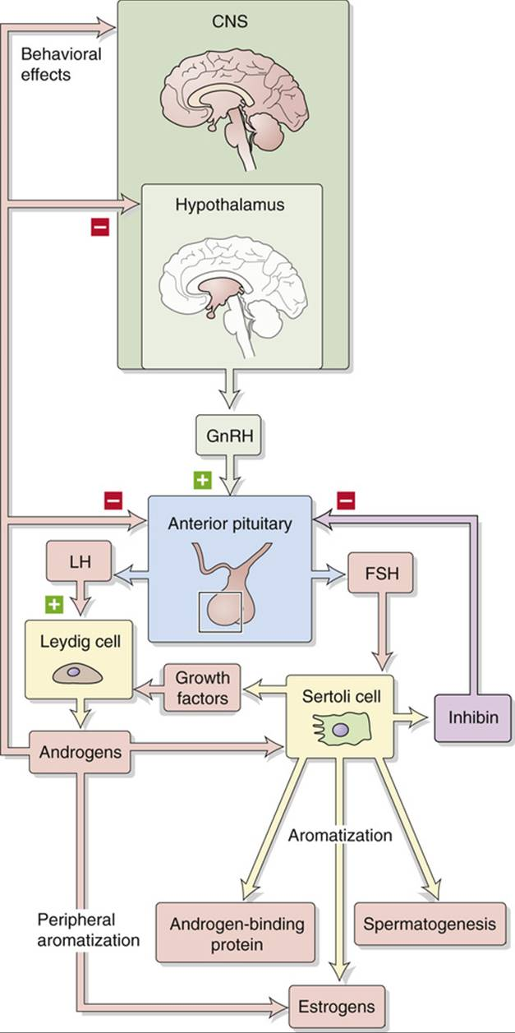
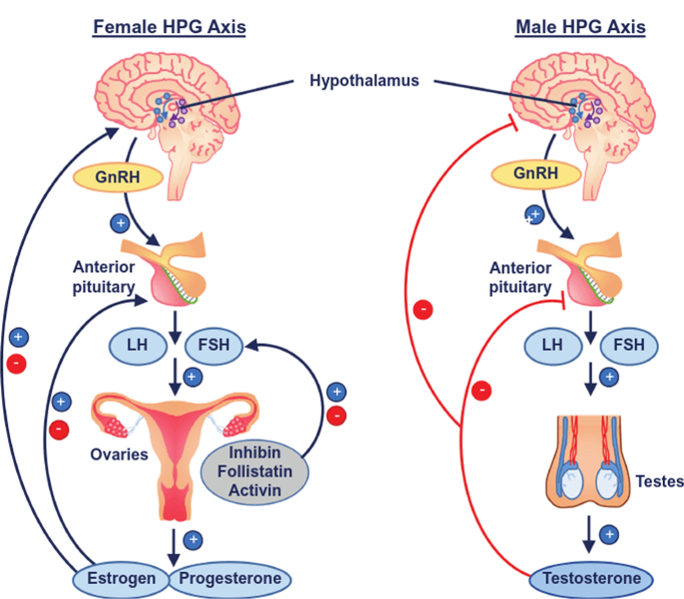
The Pituitary-Gonad Axis

Slide 17
Lecture Outline
The Basics
  Gametogenesis
  Gender determination
The Pituitary-Gonad Axis
Female Reproductive Physiology
  Ovarian Cycle
  Uterine Cycle
  Hormonal controls & changes
Male Reproductive Physiology

Slide 18
Female Reproductive Physiology
Basics
The hypothalamus-pituitary-gonad axis controls the required physiologic changes that occur both in the ovaries and in the uterus of the menstrual cycle.
The Menstrual Cycle
  Duration
    Approximately 28 days (ranges 24 – 35 days)
    Starts with the removal of the endometrium & release of FSH by the anterior pituitary
  The ovarian cycle
    Development of ovarian follicle
    Production of hormones
    Release of ovum during ovulation
  The uterine cycle
    Removal of endometrium from prior uterine cycle
    Preparation for implantation of embryo under the influence of ovarian hormones

Slide 19
Female Reproductive Physiology
The Cycles
Three Phases of the Ovarian Cycle
  Follicular phase
  Ovulation phase
  Luteal phase
Three Phases of the Uterine Cycle
  Menses
  Proliferative Phase
  Secretory Phase
These ovarian and uterine phases are intimately linked together by the production and release of hormones

Slide 20
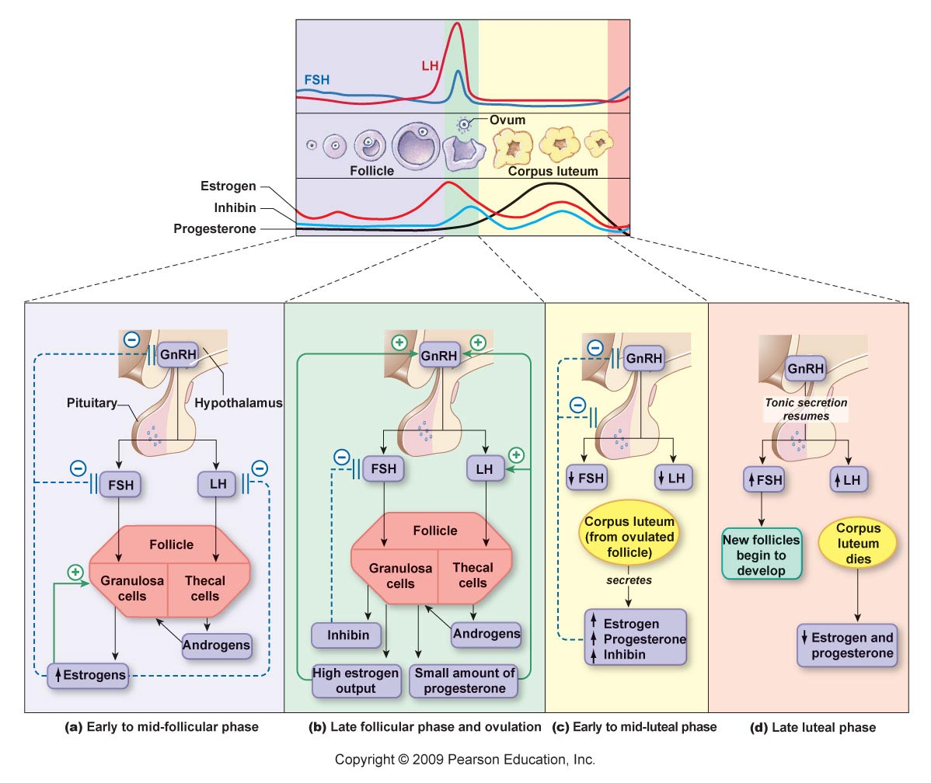
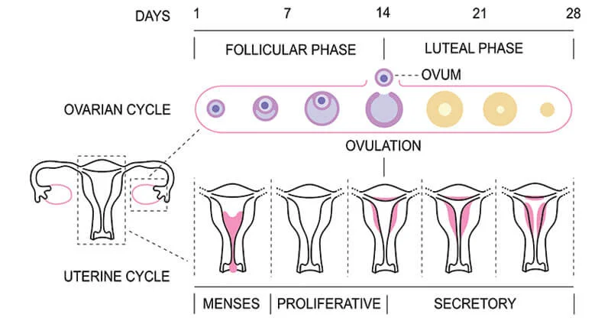
Female Reproductive Physiology
The Cycles
Hormonal control of the ovarian cycle

Slide 21
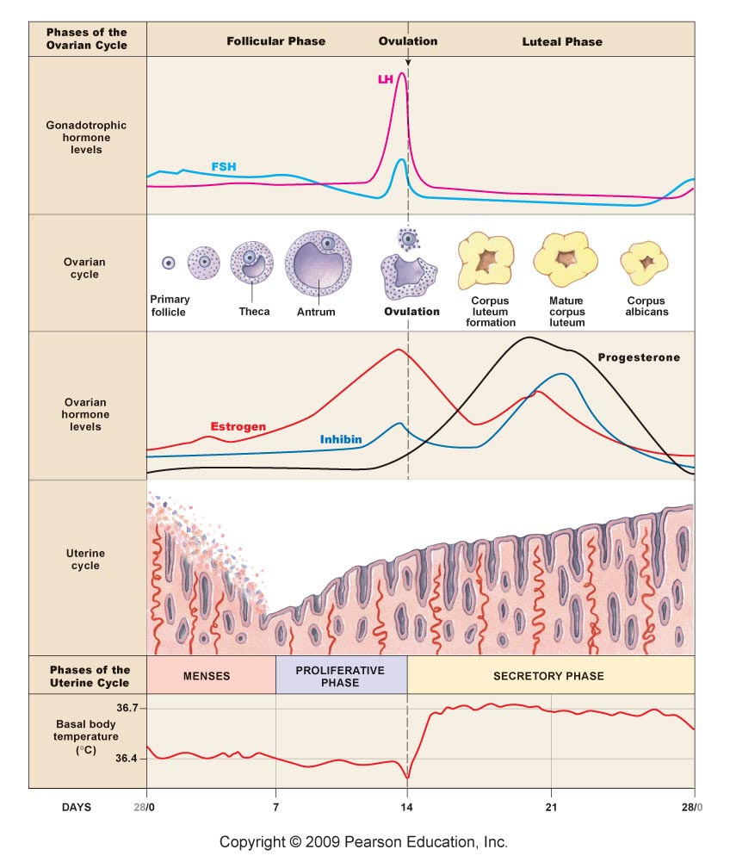
Female Reproductive Physiology
The Cycles
Hormonal control of the uterine cycle

Slide 22
Female Reproductive Physiology
All together

Slide 23
Female Reproductive Physiology
Fertilization Effects
What happens if fertilization occurs?
  Uterine endometrium is maintained by
    First the release of progesterone from the corpus lutem,
    then the release of hCG (human chorionic gonadotropin) which maintains the corpus luteum until the 7th week,
    From 7th week on, the placenta produces progesterone which continues to maintain the endometrium & the corpus luteum degenerates
      Placenta also produces estrogen and progesterone which at high levels blocks GnRH
        Estrogen is also involved in breast development
        Progesterone is also involved in uterine maintenance and relaxation (prevents premature contractions)
    Placenta also produces hPL (human placental lactogen)
      Implicated in breast development and milk production
        Though determined not the only factor as lack of hPL has no ill effects
      More important is the role hPL plays in fetal nutrition by altering maternal glucose and fatty acid metabolism

Slide 24
Female Reproductive Physiology
Fertilization Effects
What changes occur to allow parturition?
  Increasing levels of corticotropin-releasing hormone (CRH) from the placenta a few weeks prior to delivery
    Early deliveries have been linked to early elevated levels of CRH
    During delivery
      progesterone levels drop off
      Oxytocin levels rise
        Oxytocin receptors on the uterus are upregulated during gestation
      Inhibin levels increase
        Relax the cervix and ligaments of the pelvis
        Allows for increased stretch of the cervix which triggers additional oxytocin which triggers stronger uterine contractions which increase stretch of the cervix which triggers oxytocin which triggers stronger uterine contractions which increases stretch of the cervix which increases oxytocin release which increases uterine contractions which increases stretch on cervix which….

Slide 25
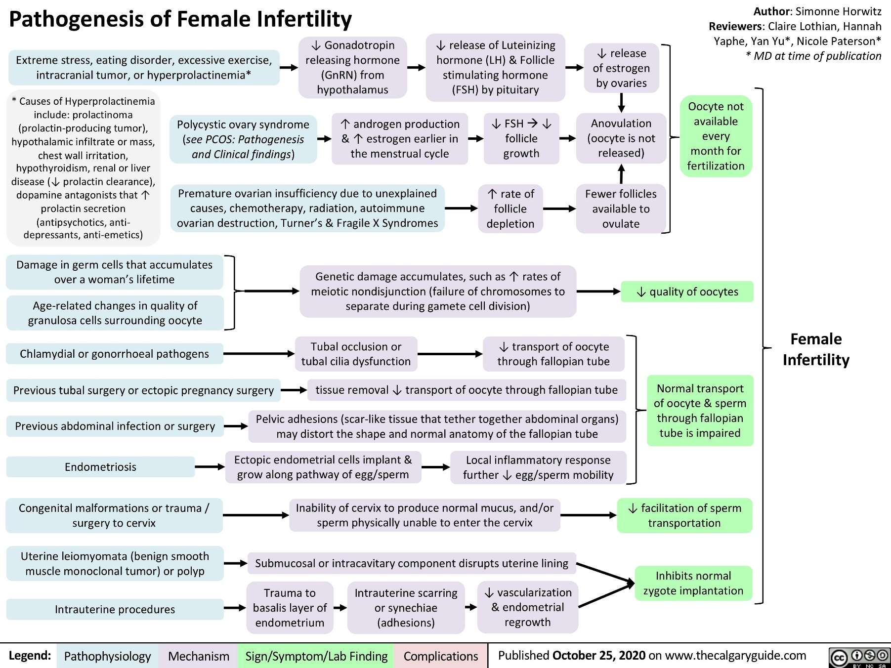
Pathophysiology of female reproduction

Slide 26
Infertility definition
Infertility is defined as the inability of couples to have a baby after one year of regular unprotected intercourse, affecting 10–15 percent of couples. According to the latest WHO statistics, about 50–80 million people worldwide suffer from infertility. Large-scale studies have shown that about half of all cases of infertility occur due to female factors, 20 to 30 percent male factors, and 20 to 30 percent due to common causes of both gender. Recent meta-analysis studies by researchers show that male’s factors are present in 20–70 percent of infertility cases.

Slide 27
PATHOLOGICAL PROCESSES, THEIR IMPLICATIONS, AND THERAPEUTIC OPTIONS
A. Folliculogenesis
1. Genetic
Premature ovarian insufficiency (POI) occurs in ∼1% of women and is defined as the cessation of menstrual cycles under 40 years of age in the presence of an elevated serum FSH measured on two separate occasions. The causes may be genetic, environmental, infective (subsequent to mumps infection), associated with autoimmune conditions, metabolic [due to biochemical damage in the presence of galactossaemia], and subsequent to cancer therapy or surgery; however, in the majority of cases no cause is determined.

Slide 28
Turner syndrome
Possibly the most common genetic cause of POI is Turner syndrome characterized by the loss of all, or part of an X chromosome, occurring in ∼1 in 3,000 female births. Approximately half due to X chromosome monosomy and the majority of the remainder due to mosaicism. This is a condition with several phenotypic features characterized by short stature, cardiac and renal abnormalities, hypothyroidism, webbed-neck, and otological and ophthalmological abnormalities are all common in childhood.
The ovarian insufficiency commonly found in this condition relates to disruption of the BMP15 gene locus located at Xp11.2, within a critical region related to ovarian failure.
Spontaneous puberty occurs in approximately one quarter of girls, more commonly in mosaics; however, premature ovarian failure is universal.

Slide 29
B. Ovulation
1. Hypogonadotrophic hypogonadism
Insufficient ovarian stimulation with gonadotrophins LH and FSH results in the condition of hypogonadotrophic hypogonadism (HH), either due to insufficient hypothalamic GnRH stimulation of the pituitary or due to insufficient secretion due to pituitary compromise. After exclusion of excessive exercise, extreme stress, or an eating disorder, and after ensuring pituitary function, other than secretion of LH and FSH, is normal, and pituitary imaging is normal the condition is considered idiopathic HH (IHH). The most common cause of GnRH insufficiency is the failure of migration of the GnRH secretory neurons to the forebrain which may also result in olfactory disorder (Kallman's syndrome); in the absence of olfactory, the condition is described as normosmic IHH.

Slide 30
2. Hyperprolactinemia
Other central causes of HH can be caused by systemic disease, medication (such as opioids and psychotropic medication), hypothalamic or pituitary compression, or infiltration; however, the most common cause is probably hyperprolactinemia. Hyperprolactinemia may be caused by physiological states such as pregnancy, breastfeeding, stress, exercise, and some medications as well as patients with chronic hypothyroidism. Kidney disease may predispose a patient to hyperprolactinemia due to reduced clearance and altered prolactin metabolism. As prolactin secretion is suppressed by hypothalamic dopamine secretion, interruption or compression of the pituitary stalk by a non-prolactin-secreting pituitary tumor will lead to hyperprolactinemia.

Slide 31
3. Polycystic ovary syndrome
The polycystic ovary syndrome (PCOS) is a collection of signs and symptoms related to ovarian dysfunction, found within a phenotypically heterogeneous group of women. It is classically described by the Rotterdam criteria as a syndrome consisting of two of three criteria related to infrequent or absent ovulation, a morphological description of the ovaries by ultrasound assessment, and hyperandrogenism. Other groups suggest that the excessive androgen secretion is the most significant underlying pathology as this is believed to lead to ovarian dysfunction and the longerterm metabolic consequences these women experience, and they consequently adopt a more stringent definition of PCOS.

Slide 32
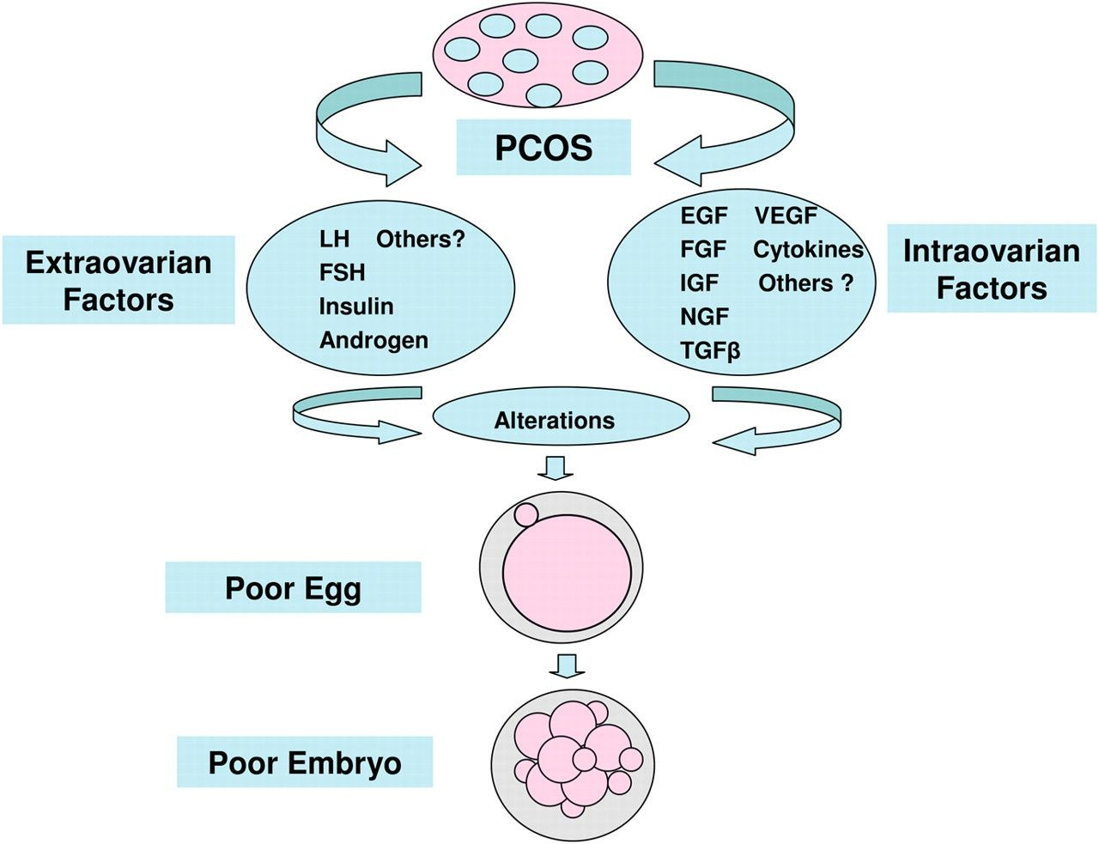
PCOS
It is believed that oocyte developmental competence and the embryos resulting from fertilization are altered in women with PCOS, compared with women without PCOS. There are multiple serum and follicular factors that are reportedly altered in women with PCOS that may be responsible for this poor embryonic development and reduced implantation) although it is not clear whether this is associated with an increase in the rate of embryo aneuploidy. Not only is the systemic and follicular environment different in PCOS, the gene expression profile of oocytes derived from women with PCOS are distinctly different.
These genes relate to signal transduction, transcription, RNA and DNA processing, and the regulation of the cell cycle.
Of particular importance in the acquisition of oocyte developmental competence is GDF-9 expression, which is reduced in the oocytes of women with PCOS.

Slide 33
Ovarian hyperstimulation syndrome
OHSS is triggered by the systemic release of inflammatory cytokines, particularly VEGF which leads to endothelial cell damage and increased vascular permeability and the rapid development of ascites, and potentially pleural and pericardial effusion. OHSS is a significant cause of morbidity and in Australia and New Zealand is reported to complicate 0.6% of IVF cycles. Adjuvant therapies that have been demonstrated to significantly reduce the incidence are the use of an GnRH antagonist for pituitary downregulation, particularly with the use of an GnRH agonist trigger, the VEGF receptor blocker cabergoline, and by combing the ovarian stimulation with metformin administration. Other strategies include using low doses of gonadotrophin drugs for stimulation or omitting completely, cancelling the IVF cycle prior to oocyte retrieval, omitting the gonadotrophin drugs for a few days–“coasting” and not proceeding to an embryo transfer (so-called “freeze-all” approach). A further innovation is to use a different stimulation approach called in vitro maturation of oocytes (IVM) where no final trigger for oocyte maturation is administered prior to oocyte retrieval and oocyte maturation is performed in the laboratory with some centers reporting similar pregnancy rates as their standard IVF approach without the risk of OHSS. The evidence for some of the therapeutic interventions employed for women with OHSS is not robust and hence for the prevention of OHSS clinicians are advised to follow guidelines provided by consensus statements after systematic review of the literature.

Slide 34
C. Fallopian Tube Function
1. Disorders of ciliary action
2. Inflammatory disorders: endometriosis and infection
3. Other gynecological conditions

Slide 35
D. Implantation
1. Systemic
It is generally believed that severe systemic illness, such as sepsis or severe renal disease, will prevent embryonic implantation, although infection is an unusual cause of early pregnancy failure. A comprehensive list of all systemic conditions that have been demonstrated to have a significant negative influence on embryonic implantation is difficult to compile; however, conditions such as unstable diabetes, subclinical hypothyroidism, periodontal disease, and uncontrolled celiac disease have been demonstrated to reduce rates of conception, and it is believed that low serum vitamin D and active autoimmune conditions are also associated with a reduced chance of conception, and strategies to control these conditions may improve conception chances. Due to their high prevalence and ease of correction of the abnormality, celiac disease and subclinical hypothyroidism are discussed further.

Slide 36
2. Celiac disease
In a population of women experiencing unexplained infertility or recurrent miscarriage, celiac disease is five times more prevalent than in the general population. A meta-analysis of patients with celiac disease found that the risk of miscarriage is 40% greater with increased risks in the pregnancy for growth restriction and premature delivery, and the effect is tempered if a gluten-free diet is observed.

Slide 37
3. Subclinical hypothyroidism
Overt thyroid disorder must be appropriately managed prior to conception; however, more subtle perturbations in thyroid function are also associated with reproductive disorder. Approximately 1 in 25 women have subclinical hypothyroidism, and thyroid antibodies are present in up to one in eight of women. The presence of thyroid antibodies in a woman with normal thyroid function is believed to be associated with difficulty conceiving, recurrent implantation failure of embryos, and early pregnancy loss, potentially due to an unrecognized thyroid hormone deficiency or due to a potential autoimmune cause. Treatment of subclinical hypothyroidism is believed to potentially improve embryo development and is recommended for women prior to conception; however, whether to treat a woman prior to conception, who is euthyroid in the presence of thyroid antibodies, is contentious.

Slide 38
4. Thrombophilia
It has been unclear whether an inherited thrombophilia leading to microthrombi within the decidua are associated with implantation failure of the embryo as the intervillous spaces are not developed until 10 wk of gestation. Although it is tempting to speculate that perturbations in the clotting system may influence implantation and early embryonic development, for example, factor XII gene expression is increased in endometrial stromal cells during in vitro decidualization, this is believed to lead to an activation of the kallikrein-kininogen-kinin system during the implantation of human embryos.

Slide 39
5. Natural killer cells
There has been substantial interest in the assessment of blood and uterine natural killer cell populations in women with poor embryo implantation. Evidence would appear to suggest that women with unexplained implantation failure may have an abnormal population of natural killer (NK) cells in the blood and in the endometrium in the mid-luteal phase of the menstrual cycle, although strategies to improve the systemic and endometrial environment to facilitate conception have not been proven.

Slide 40
6. Endometrial and myometrial (endometriosis, leiomyomas, hydrosalpines, PCOS, obesity, endometrial polyps)
As evidenced by IVF success rates, embryonic implantation potential is decreased in the presence of endometriosis, leiomyomas, dilated fallopian tubes (hydrosalpines), and PCOS and have been linked to reduced endometrial expression of HOXA10 and HOXA11. In addition, women with endometriosis have reduced expressions of endometrial integrin α_{v}β₃ and LIF, hypermethylation leading to silencing of the HOXA10 gene and endometrial progesterone resistance leading to a reduction in the chance of conception which may potentially be improved by surgical intervention or by use of prolonged downregulation with a GnRH analog prior to the initiation of an IVF cycle. Similarly to integrin α_{v}β₃ expression normalizing with surgical intervention in the presence of endometriosis, the surgical removal of hydrosalpinges (salpingectomy) will restore the expression of integrin α_{v}β₃ and LIF improving conception.

Slide 41
7. Embryonic
With the advent of genetic testing of blastomeres from embryos of women undergoing IVF treatment, it has become evident that a significant cause of embryos failing to implant is due to chromosomal rearrangements developing within the embryo as described above. With the ability to perform a low-resolution genome-wide survey of either single blastomeres from a three-day-old embryo or by the study of several cells from the trophectoderm of a five- or six-day-old blastocyst, it has become evident that in addition to the common occurrence of aneuploidy within the embryo, usually arising during meiosis, the embryo is predisposed to segmental chromosomal imbalances which arise during programmed DNA breakage and repair by homologous recombination during prophase I of meiosis. These rearrangements may lead to a failure to develop and implant, but also lead to phenotypic variability and hence ultimately genome evolution [for a detailed description of the origin of chromosomal rearrangement, see Voet et al.]. Hence, in IVF programs the majority of apparently morphologically normal embryos fail to implant as aneuploidy is such a frequent occurrence, occurring more frequently in an older woman, and a woman with a history of failed embryonic implantation.

Slide 42
F. Early Pregnancy Failure
The causes of early pregnancy failure overlap with the causes of embryo implantation failure and hence are not reiterated here. The discussion is limited to a description of possible associations of genetic variations which may influence implantation and predispose to early pregnancy loss.

Slide 43
1. Genetic polymorphisms
Genetic polymorphisms associated with recurrent early pregnancy loss suggest that genes regulating oxidative stress may be involved . Single nucleotide polymorphisms of genes associated with oxygen free radical metabolism, ABCB1, COMT, GPX4, and OGG1, have been reported to lead to a doubling of the risk of recurrent miscarriage. In addition, polymorphism of genes that regulate the complement cascade, such as membrane cofactor protein and C4 binding protein, have a putative role in recurrent early pregnancy loss. HLA-G, part of the major histocompatibility complex class I group, has been linked to the success of IVF and is believed to have an immune modulatory role, and potentially lower expression of HLA-G is associated with reduction in embryo implantation and early pregnancy failure.

Slide 44
IV. LIFESTYLE INFLUENCES INFLUENCING OVULATION, FALLOPIAN TUBE FUNCTION, IMPLANTATION, AND MISCARRIAGE
A. Delayed Childbearing
1. Ovulatory frequency
2. Oocyte quality
Aneuploidy
oocyte mitochondrial function
embryo metabolism
epigenetic alterations.
3. Fallopian tube function
B. Dietary Restriction and Over-exercise
C. Stress
D. Obesity
E. Cigarette Smoking

Slide 45
Stress
Due to central neuronal corticotrophin releasing hormone (CRH) projection to GnRH cells and CRH-induced β-endorphin inhibition of GnRH secretion, stress may exert a modulating effect on subsequent pituitary LH and FSH pulsatility, which may be overcome by modified behavior restoring ovulation. Higher daily reported stress levels in a cohort of normal healthy women were associated with a reduction in serum estradiol, LH, and luteal phase progesterone concentrations as well as a predisposition to anovulation. Furthermore, while it is known that an elevated serum cortisol concentration is related to FHA, women with FHA who resume ovulation have serum cortisol concentrations similar to eumenorrheic women, suggesting that by reducing stress levels by therapeutic interventions normal ovulation may return . The Nurses' Health Study demonstrated that working longer hours (over 40 h/wk) and also lifting heavy loads were associated with increased time to conceive, suggesting a relation to tiredness or stress may impact upon conception.

Slide 46
Lecture Outline
The Basics
  Gametogenesis
  Gender determination
The Pituitary-Gonad Axis
Female Reproductive Physiology
  Ovarian Cycle
  Uterine Cycle
  Hormonal control and changes
Male Reproductive Physiology

Slide 47
Male Reproductive Physiology
Basic Functions
Function
  Produce, maintain & transport viable spermatozoa
    Testes
    Epididymis
    Ductus deferens
    Accessory glands
      Prostate
      Seminal vesicles
      Bulbourethral glands
  Hormone production that
    develops secondary sexual characteristics
    Involved in feedback mechanisms relating to spermatogenesis

Slide 48
Male Reproductive Physiology
Testes
Site of Sperm production
  Divided into lobules, each with seminiferous tubules.
  Seminiferous tubule functions to
    Maintain environment for spermatogonia by the basal lamina and the Sertoli cells
      Sertoli cells separate the lumen from the basal lamina and create a blood-testis barrier
      Creates three compartments
        Lumen – low glucose, high K⁺
        & steroid hormones
        Basal compartment – the baso-
        lateral side of the sertoli cells &
        containing the developing
        spermatogonia
        Interstitial fluid space – below the
        basal lamina and contains the Leydig
        cells
    Produce hormones/paracrines
      From Sertoli cells
      From Leydig cells

Slide 49
Male Reproductive Physiology
Testis
Sertoli cells
  Produce hormones & paracrines involved with control of hypothalamus-pituitary-gonad axis and the testes directly
    Anti-Müllerian Hormone (AMH)
      Secreted during embryogenesis
      Prevents development of the Müllerian ducts
    Inhibin & activin
      Regulate FSH release from anterior pituitary
        inhibin decreases FSH release
        activin increases LH function & increases FSH release
    Androgen Binding Protein (ABP)
      Binds to testosterone and DHT, reduces the loses due to diffusion resulting in an increase in testicular testosterone levels
    Estradiols & Aromatase
      Support spermatogenesis

Slide 50
Male Reproductive Physiology
Testis
Sertoli cells, cont…
    GDNF (glial derived neurotrophic factor) & ERM transcription factor
      Maintenance of the stem cell line
Leydig cells
  Produce androgens
    testosterone, androstenedione and dehydroepiandrosterone (DHEA)
      Increase spermatogenesis
      Influence secondary sexual characteristics
  Stimulated to produce androgens by luteinizing hormone (LH)
    FSH increases the response to LH by Leydig cells

Slide 51
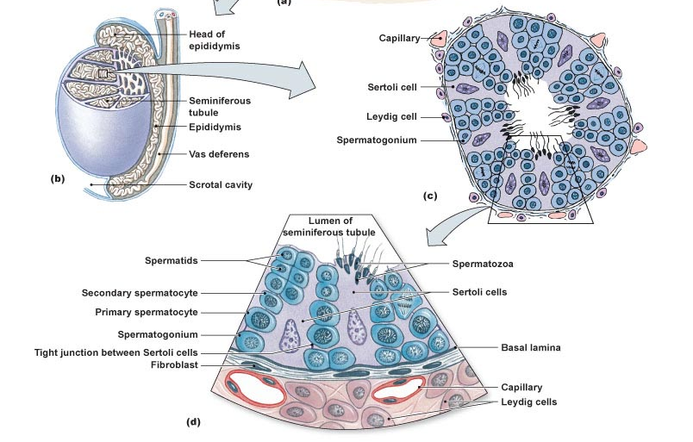
Male Reproductive Phsyiology
Testes

Slide 52
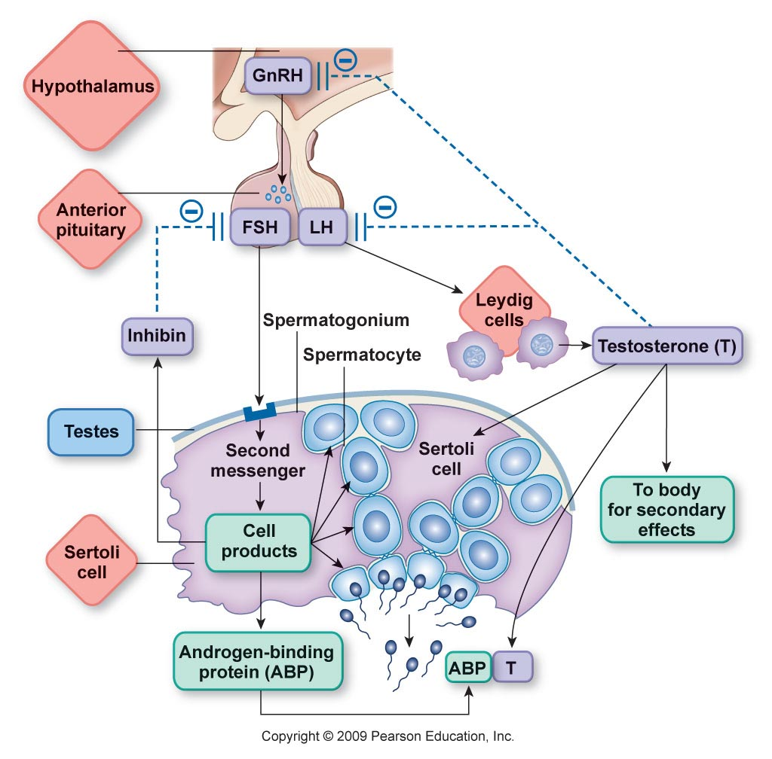
Male Reproductive Physiology
Testes
Spermatogenesis Hormonal Control Flow Chart

Slide 53

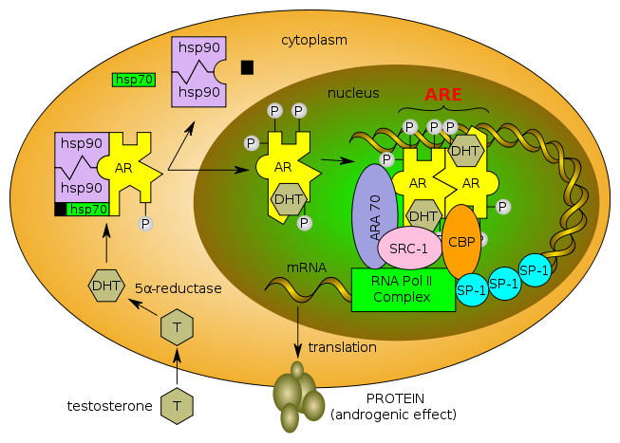

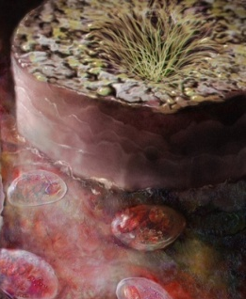

1. ANDROGENS
What does testosterone do ?
A. It or its DHT metabolite bind to Androgen Receptors [AR]
Like all other steroid hormones they act on;
1. Cytosolic GENOMIC Action mediates cell growth & differentation in AR responsive tissues; reproductive, those of 2^{ndry} male sex characters, muscles …
Binding & Activation
Nuclear translocation
Dimerization on SRE
Gene Transcription
mRNA Translation
New Protein Formation
PROTEIN
TESTOSTERONE

Slide 54
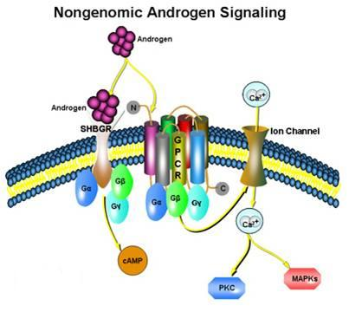
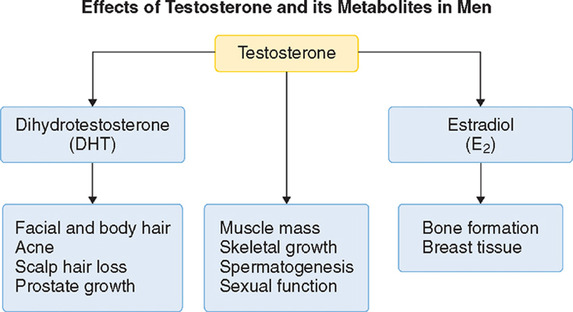
1. ANDROGENS
2. Membranous 
NON-GENOMIC Action  mediates rapid responses  on some brain, CVS, T cells functions
Like all other steroid receptors
B. It aromatize to estradiol and binds to Estrogen Receptors [ER]
Estradiol rather than testosterone; 1.Responsible for feedback inhibition on hypothalamus (specially –ve LH secretion)
2. Induce maturation of cartilage
 leading to closure of
epiphyses & conclusion
of growth.
3. Some CVS protective actions
AR
ER
AR
CNS; -ve loop
CVS; protection
CNS; libido

Slide 55
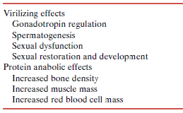
1. ANDROGENS
ACTIONS
ACTIONS DIVIDED INTO
○ Testosterone & Synthetic Androgens
Anabolic Steroids
Not used in infertility

Slide 56
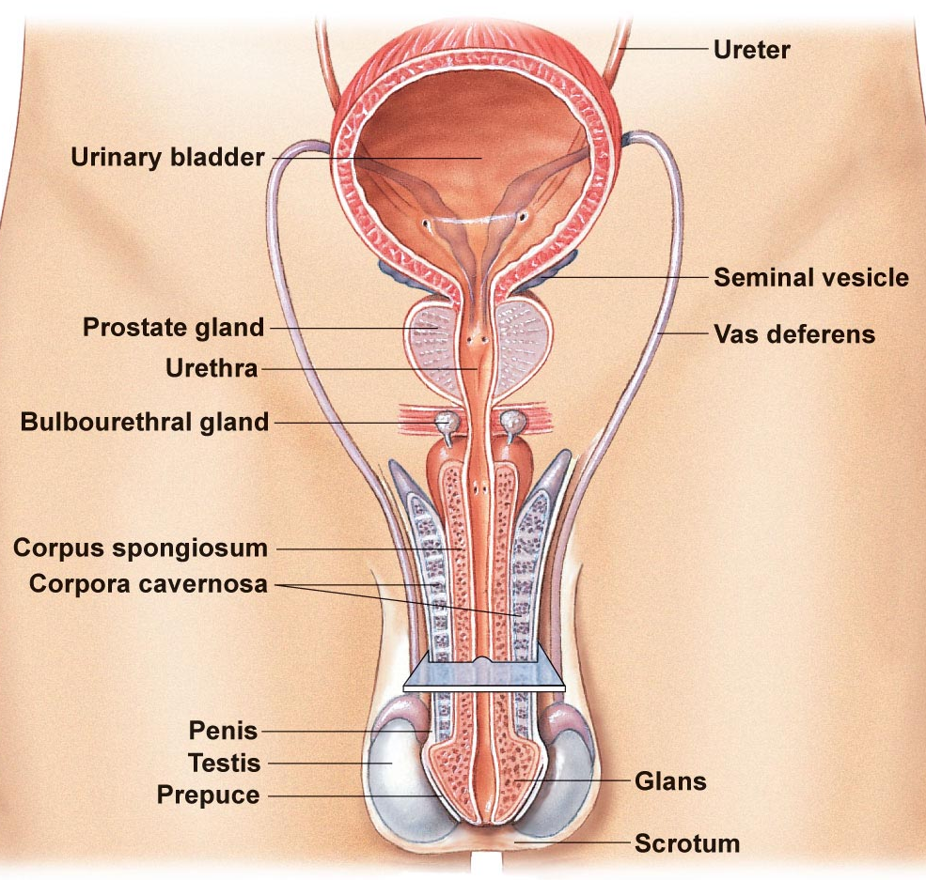
Male Reproductive Physiology
Accessory Gland Function
Job of the accessory glands is to
  Secrete seminal fluid (99% of semen volume)
    Components of seminal fluid
      Mucus
      Water
      Nutrients
      Buffers
      Enzymes
      Prostaglandins
      Zinc?
  Accessory Glands
    Prostate
    Seminal vesicles
    Bulbourethral glands

Slide 57
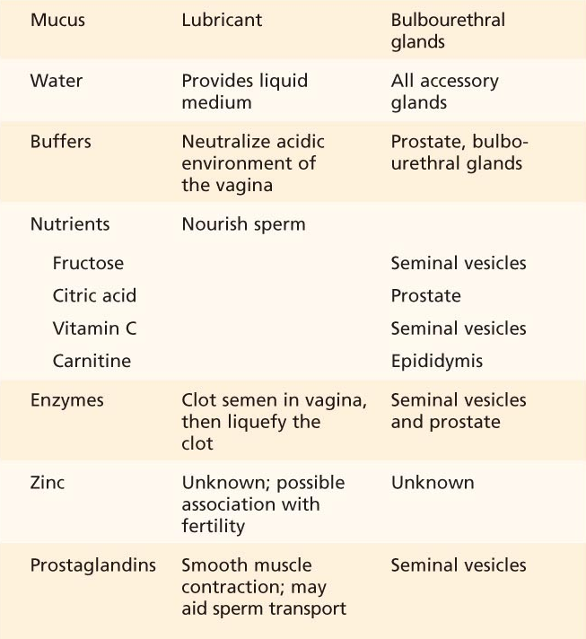
Male Reproductive Physiology
Accessory Gland Function
Seminal Fluid Components, Function and Location (source)
From Table 26-3

Slide 58
Male Reproductive Physiology
The sexual response
Remember
  Function of the reproductive system is to reproduce
  Males contribution is
    Deliver viable sperm into the vagina
    Requires a complex neural reflex – the erection reflex
      Creates changes in vascular condition within the penile arterioles
        Initiated by erotic stimuli (visual, auditory, tactile, cerebral)
        the parasympathetic division of the ANS causes vasodilation of the penile arterioles
        Erectile tissue fills with blood creating an erection

Slide 59
Male Reproductive Physiology
The sexual response
Remember
  Function of the reproductive system is to reproduce
  Males contribution is
    Deliver viable sperm into the vagina
    Requires a complex neural reflexes
      Starts with the erection reflex which creates changes in vascular condition within the penile arterioles
        Initiated by erotic stimuli (visual, auditory, tactile, cerebral)
        the parasympathetic division of the ANS causes vasodilation of the penile arterioles
        Erectile tissue fills with blood creating an erection
      Emission & Ejaculation during climax
        Emission is the movment of sperm from vas deferens into the urethra adding seminal fluid along the way, this is under sympathetic control
        Ejaculation is the expulsion of semen due to strong muscular contractions – this is a spinal reflex

Slide 60
Male Reproductive Pathophysiology
The sexual response
    Emission & Ejaculation during climax
      Emission is the movement of sperm from vas deferens into the urethra adding seminal fluid along the way, this is under sympathetic control
      Ejaculation is the expulsion of semen due to strong muscular contractions – this is a spinal reflex
        Started with the contraction of the bulbospongiosus muscle
Disorders
  Erectile dysfunction (ED)
  Premature ejaculation
  Prolonged ejaculation / anorgasmic

Slide 61
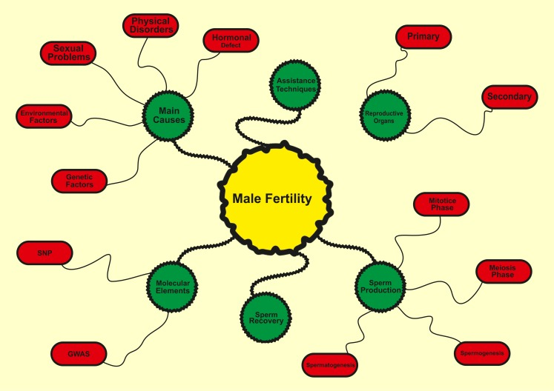
Male infertility

Slide 62
Male infertility - causes
There are multiple causes for male infertility, which can be broadly classified due to their general underlying etiology. These include endocrine disorders (usually due to hypogonadism) at an estimated 2% to 5%, sperm transport disorders (such as vasectomy) at 5%, primary testicular defects (which includes abnormal sperm parameters without any identifiable cause) at 65% to 80% and idiopathic (where an infertile male has normal sperm and semen parameters) at 10% to 20%. These are broad estimates only as accurate statistics are unavailable due to general underreporting, cultural factors, and regional variations. Patients sent to a tertiary referral center are more likely to have their condition reported, while private patients may never have their data collected.
The causes underlying male infertility are numerous and best categorized by effects at one or more of the following levels: pretesticular, testicular, and posttesticular.

Slide 63
Pretesticular causes of male infertility
Hypothalamic Disease
Gonadotropin Deficiency (Kallmann Syndrome)
Kallmann syndrome (1:30,000) is characterized by central hypogonadism, delayed in puberty, and infertility. Other clinical features include anosmia, small testes and occasionally renal agenesis, bimanual synkinesia, cleft lip, and dental agenesis. When anosmia is not present, the condition is termed idiopathic hypogonadotrophic hypogonadism (IHH). The clinical diagnosis of Kallmann syndrome is confirmed by hormonal assessment revealing low testosterone, low LH, low FSH, and normal prolactin levels. Infertility is treatable with gonadotropin (LH and FSH) replacement over 12–18 months, which induces sperm in the ejaculate in 80% of men. The condition is inherited as a familial disorder in one-third of cases and both X-linked and autosomal inheritance patterns have been described.
Isolated Gonadotropin Deficiencies
These deficiencies are rare. As the result of a partial LH deficit, there is enough LH to stimulate intratesticular testosterone production and spermatogenesis but insufficient testosterone to promote virilization. The results are a eunuchoid body habitus, variable virilization, and gynecomastia. These men usually have normal size testes, but sperm concentration is low. Plasma FSH levels are normal, but serum LH and testosterone levels are low normal.
With insufficient FSH production by the pituitary, patients are normally virilized, testicular size is normal, and LH and testosterone levels are normal. FSH levels are uniformly low and do not respond to stimulation with GnRH. Sperm counts range from azoospermia to severely low numbers (oligospermia).

Slide 64
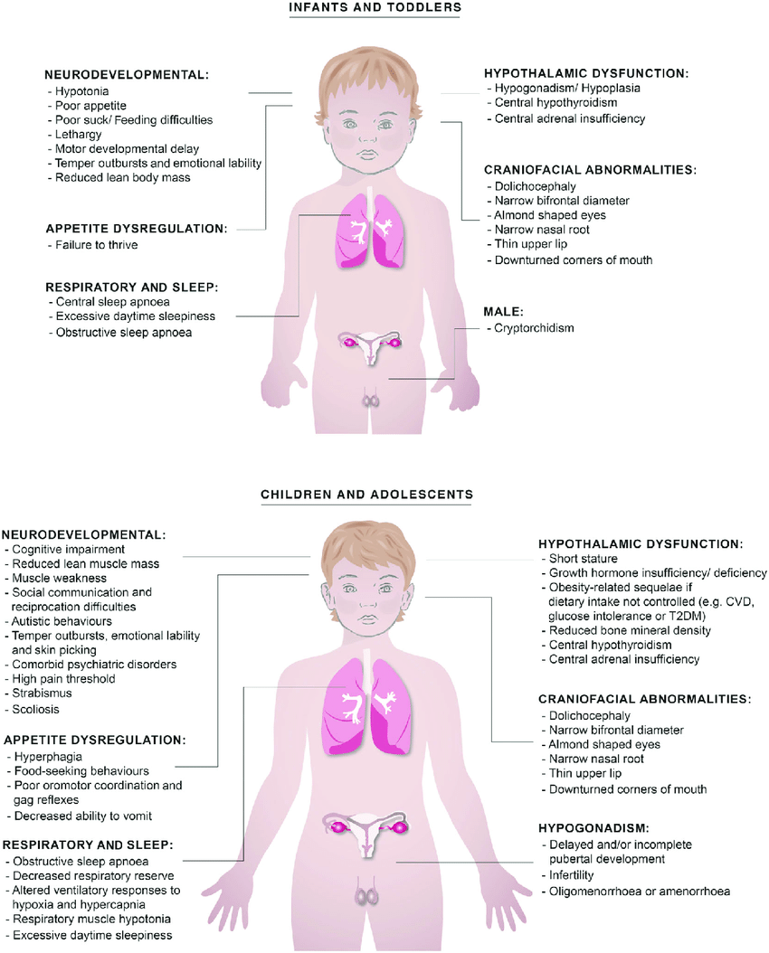
Congenital Hypogonadotrophic Syndromes
Several syndromes may be associated with secondary hypogonadism. Prader–Willi syndrome (1:20,000) is characterized by obesity, mental retardation, small extremities, and hypogonadism and is caused by a deficiency of hypothalamic GnRH. The cause of this condition appears to be a single gene deletion on chromosome 15. Similar to Kallmann syndrome, spermatogenesis can be induced by treatment with FSH and LH. Bardet–Biedl syndrome is an autosomal recessive form of hypogonadotrophic hypogonadism that also results from GnRH deficiency. It is characterized by mental retardation, retinitis pigmentosa, polydactyly, and hypogonadism. The presentation is similar to Kallmann syndrome but includes obesity and may also be treated with gonadotropin administration. Cerebellar ataxia can be associated with hypogonadotrophic hypogonadism. Cerebellar involvement includes abnormalities of speech and gait and these patients can have a eunuchoid appearance with atrophic testes. Hypothalamic–pituitary dysfunction due to pathologic changes in cerebral white matter is thought to underlie infertility.

Slide 65
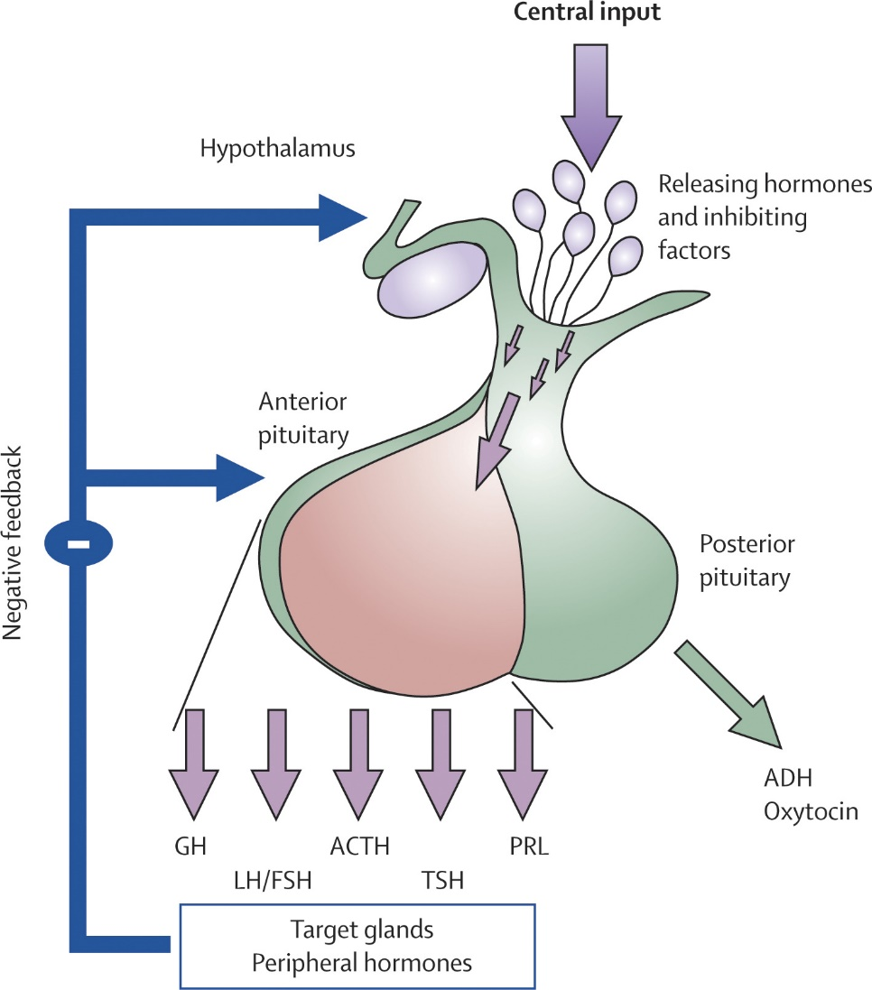
Pituitary Disease
Pituitary Insufficiency
Pituitary insufficiency may result from tumors, infarcts, surgery, radiation, or infiltrative and granulomatous processes. In sickle cell anemia, pituitary and testicular microinfarcts result from sickling of red blood cells potentially leading to both hypogonadism and spermatogenic failure. Men with sickle cell anemia have decreased testosterone and variable LH and FSH levels. Beta-thalassemia occurs primarily in patients of Mediterranean or African origin and is caused by mutations in the beta-globulin that leads to abnormal hemoglobin composition and subsequent red cell lysis. Infertility results from the deposition of hemosiderin in the pituitary gland and testes. Similarly, hemochromatosis results in iron deposition within the liver, testis, and pituitary and is associated with testicular dysfunction in 80% of cases.

Slide 66
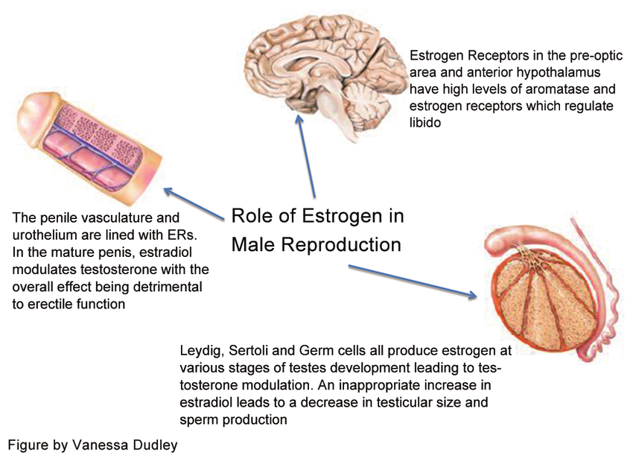
Exogenous or Endogenous Hormones
Estrogens
An excess of sex steroids, either estrogens or androgens, may cause infertility due to an imbalance of the testosterone estrogen ratio, which is normally 10:1. Liver cirrhosis increases endogenous estrogens due to augmented aromatase activity within the diseased liver. Likewise, obesity may be associated with testosterone and estrogen imbalance owing to increased peripheral aromatase activity in adipocytes. Less commonly, adrenocortical tumors, Sertoli cell tumors, and interstitial testis tumors may produce estrogens. Excess estrogens cause spermatogenic failure by decreasing pituitary gonadotropin secretion, thus inducing secondary testis failure.

Slide 67
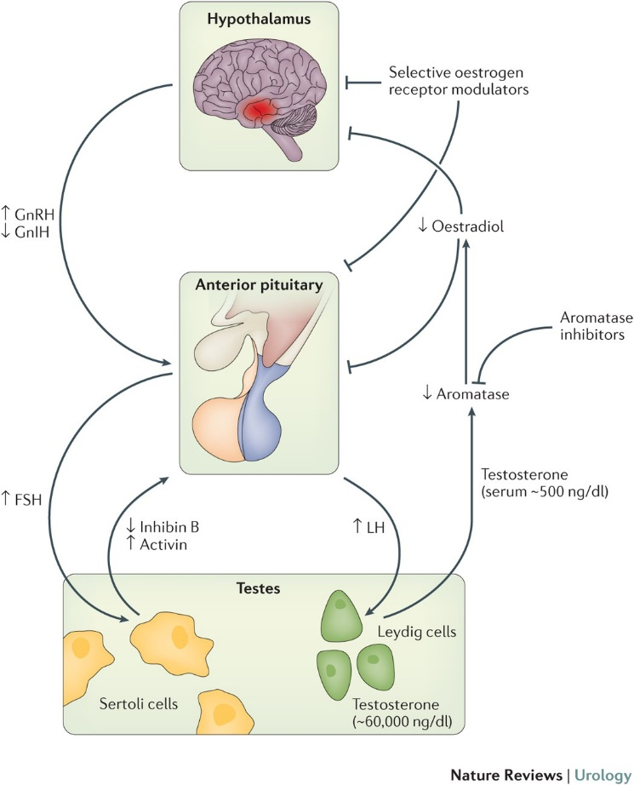
Exogenous or Endogenous Hormones
Androgens
An excess of androgens can suppress pituitary gonadotropin secretion and lead to secondary testis failure. The use of exogenous androgenic steroids (anabolic steroids) by as many as 15% of high school athletes, 30% of college athletes, and 70% of professional athletes may result in temporary sterility due to suppression of the normal HPG axis. Treatment includes immediate discontinuation of steroids and reevaluation of semen quality every 3–6 months until spermatogenesis returns. The most common reason for excess endogenous androgens is congenital adrenal hyperplasia caused by 21-hydroxylase deficiency. The resultant absence of cortisol synthesis and excessive adrenocorticotropic hormone production leads to elevated androgenic steroids by the adrenal cortex. High androgen levels in prepubertal boys result in precocious puberty, with premature development of secondary sex characteristics and abnormal enlargement of the phallus. The testes are characteristically small because of central gonadotropin inhibition by androgens. In young girls, virilization occurs with clitoral enlargement. In cases of classic congenital adrenal hyperplasia that presents in childhood, normal sperm counts and fertility have been reported, even without glucocorticoid treatment. This disorder is one of the few intersex conditions associated with potentially normal fertility. Other sources of endogenous androgens include hormonally active adrenocortical tumors or Leydig cell tumors of the testis.

Slide 68
Male infertility
Male infertility contributes to approximately half of all cases of infertility and affects 7% of the male population. For the majority of these men the cause remains unexplained. Despite a clear role for genetic causes in male infertility, there is a distinct lack of diagnostically relevant genes and at least 40% of all cases are classified as idiopathic

Slide 69
Testicular causes
The Testis
Normal male reproduction requires that the testes have both endocrine (steroid production) and exocrine (sperm maturation and excretion) function. Both of these functions are under the control of the HPG axis. Steroidogenesis occurs in the interstitial compartment, where Leydig cells reside. Spermatogenesis occurs in the seminiferous tubules with the support of Sertoli cells.

Slide 70
Endocrine Testis
Testosterone is metabolized into two primary metabolites in target tissues: (1) dihydrotestosterone (DHT) by the enzyme 5-alpha-reductase and (2) estradiol by the enzyme aromatase. DHT is a more potent androgen than testosterone, and in many tissues, the conversion of testosterone to DHT is required for androgen action. While aromatase is present in many tissues, adipocytes play a significant role in the aromatization of testosterone to estradiol. While the mechanisms are still being elucidated, estradiol appears to have a pivotal role in the regulation of the HPG axis.

Slide 71
Exocrine Testis
FSH acts primarily on Sertoli cells within the seminiferous tubules to induce the production of a number of proteins necessary for spermatogenesis, including androgen-binding protein, transferrin, lactate, ceruloplasmin, clusterin, plasminogen activator, prostaglandins, and several growth factors. Through these actions, seminiferous tubule growth is stimulated during development, and sperm production is initiated during puberty and maintained in adulthood.

Slide 72
Common Genetic Causes
Y Chromosome Microdeletions
Approximately 7% of men with low sperm counts and 13% of men with azoospermia have a structural alteration in the long arm of the Y chromosome (Yq). The testis-determining region genes that control testis differentiation are intact, but there may be gross deletions in other regions that may lead to defective spermatogenesis. The recent explosion in molecular genetics has allowed for sophisticated analysis of the Y chromosome. At present, three gene sites are being investigated as putative AZF (azoospermia factor) candidates: AZFa, b, and c. The most promising site is AZFc, which contains the DAZ gene region. The gene, of which there are at least six copies in this region, appears to encode a ribonucleic acid (RNA)-binding protein that regulate the meiotic pathway during germ cell production. Homologs of the DAZ gene are found in many other animals, including mouse and Drosophila. A quantitative polymerase chain reaction–based assay is used to test blood for these deletions. In the future, sperm DNA may also be tested as part of a semen analysis. Since men with these microdeletions can have sperm in the ejaculate, they are likely to pass them on to offspring if ART is used.

Slide 73
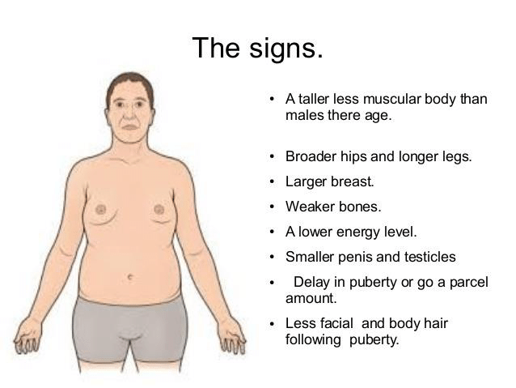
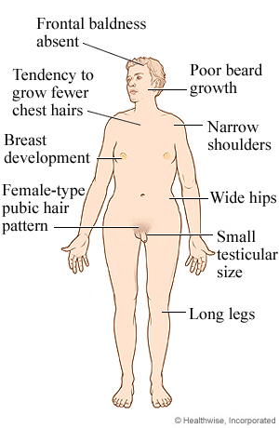
Klinefelter Syndrome
Abnormalities in chromosomal constitution are well-recognized causes of male infertility. In a study of 1263 infertile couples, a 6.2% overall prevalence of chromosomal abnormalities was detected. Among men whose sperm count was <10 million/mL, the prevalence was 11%. In azoospermic men, 21% had significant chromosomal abnormalities. For this reason, cytogenetic analysis (karyotype) of autosomal and sex chromosomal anomalies should be considered in men with severe oligospermia and azoospermia.
Klinefelter syndrome is the most common chromosomal aneuploidy and a common genetic cause of azoospermia, accounting for up to 14% of cases in some series (overall incidence 1:500 males). The classic triad of findings is small, firm testes; gynecomastia; and azoospermia. Some men may present with delayed sexual maturation, increased height, decreased intelligence, varicosities, obesity, diabetes, leukemia, increased likelihood of extragonadal germ cell tumors, and breast cancer (20-fold higher than in normal men).

Slide 74
Klinefelter syndrome
Among men with Klinefelter syndrome, 90% have an extra X chromosome (47,XXY) and 10% are mosaic, with a combination of XXY/XY chromosomes. The testes are usually <2 cm in length and always <3.5 cm; biopsies show sclerosis and hyalinization of the seminiferous tubules with normal numbers of Leydig cells. Hormones usually demonstrate decreased testosterone and frankly elevated LH and FSH levels. Serum estradiol levels may also be elevated. With age, testosterone levels decline, and most men will require androgen replacement therapy both for virilization and for normal sexual function. Paternity with this syndrome is rare but more likely in the mosaic or milder form of the disease. Some men will have limited spermatogenesis, whereby sperm may be retrieved from the testicles and used with ICSI to cause pregnancy.

Slide 75
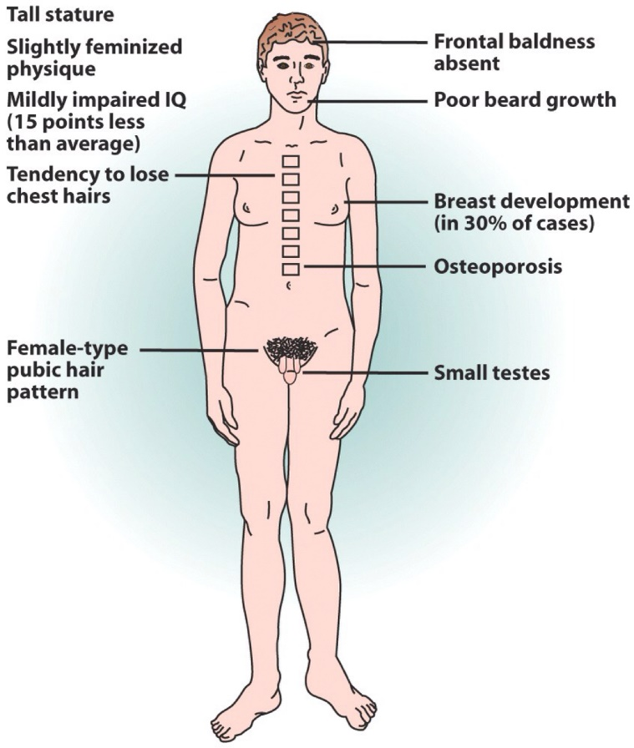
Other Genetic Causes and Syndromes
XX Male Syndrome (De la Chapelle syndrome)
XX male syndrome is a structural and numerical chromosomal condition, a variant of Klinefelter syndrome that presents as gynecomastia at puberty or as azoospermia in adults. Average height is below normal, and hypospadias is common. Male external and internal genitalia are otherwise normal. The prevalence of mental deficiency is not increased. Hormone evaluation shows elevated FSH and LH and low or normal testosterone levels. Testis biopsy reveals absent spermatogenesis with fibrosis and Leydig cell clumping. The most obvious explanation is that sex-determining ratio (SRY), or the testis-determining region, is translocated from the Y to the X chromosome. Thus, testis differentiation is present; however, the genes that control spermatogenesis on the Y chromosome are not similarly translocated, resulting in azoospermia.

Slide 76
Gonadotoxins
Radiation
The effects of radiotherapy on sperm production have been well described. Clifton and Bremner (1983) examined the effects of ionizing irradiation on semen quality and spermatogenesis among a population of healthy prisoners in the 1960s. Before a vasectomy, each of the volunteers was exposed to various levels of radiation and found a distinct dose-dependent, inverse relationship between irradiation and sperm count. Sperm count was significantly reduced at 15 cGy, and azoospermia was temporarily induced at 50 cGy. Persistent azoospermia was induced at 400 cGy, without evidence of recovery for a minimum of 40 weeks. In most subjects, sperm counts rebounded to preirradiation levels with cessation of exposure.

Slide 77
Drugs
Exposure to gonadotropic drugs can result in infertility by various mechanisms. Ketoconazole, spironolactone, and alcohol inhibit testosterone synthesis, whereas cimetidine is an androgen antagonist. Recreational drugs such as marijuana, heroin, and methadone are associated with lower testosterone levels. Certain pesticides, like dibromochloropropane, are likely to have estrogen-like activity. Importantly, the gonadotoxic potential of many pharmaceutical and over-the-counter medications is unknown. Therefore, couples should consider discontinuing and unnecessary medication or supplements prior to their attempt to conceive.

Slide 78
Traumatic injury of testes
Torsion
Ischemic injury to the testis secondary to twisting of the testis on the spermatic cord pedicle is common in prepubertal and early postpubertal boys. When diagnosed and corrected surgically within 6 hours of occurrence, the testis can usually be saved. Torsion may result in inoculation of the immune system with testis antigens that may predispose to later immunological infertility. It recognized that the “normal” contralateral mate of a torsed testis could also exhibit histologic abnormalities. It has not been clearly demonstrated whether this is related to the actual torsion or to an underlying abnormality in testes predisposed to torsion.
Trauma
Trauma to the testis can result in infertility. Because of the unique immunologic status of the testis in the body (ie, it is an immunologically privileged site), trauma to the testis can invoke an abnormal immune response in addition to atrophy resulting from injury. Both may contribute to infertility. Trauma to the testis that results in fracture of the testis tunica albuginea should be surgically explored and repaired to minimize exposure of testis tissue to the body.

Slide 79
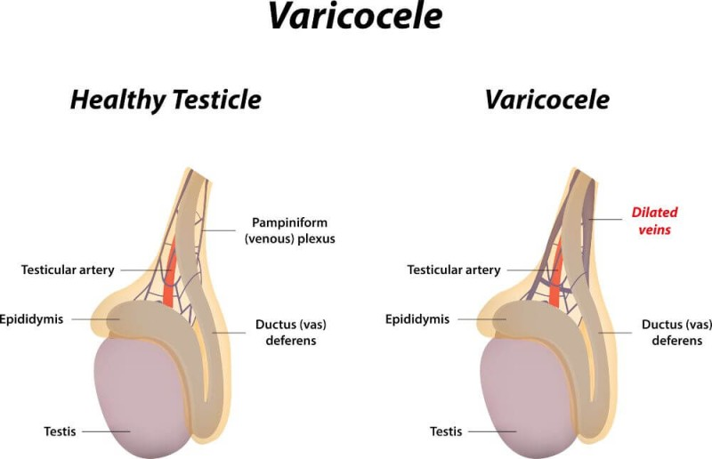
Varicocele
Varicocele is defined as dilated and incompetent veins within the pampiniform plexus of spermatic cord. Varicocele has been described as the most common surgically correctable cause of male subfertility. This is a disease that develops during puberty when both endocrine and exocrine function of the testicle dramatically increases, along with testicular blood flow. Varicocele is only rarely detected in boys <10 years of age. A left-sided varicocele is found in 15% of healthy young men. In contrast, the incidence of a left varicocele in subfertile men approaches 40%. Bilateral varicoceles are uncommon in healthy men (<10%) but are palpated in up to 20% of subfertile men. In general, varicoceles do not spontaneously regress. An accurate physical examination remains the cornerstone of varicocele diagnosis.

Slide 80
Posttesticular causes of male infertility
Congenital Blockages
Cystic Fibrosis
CF is the most common autosomal recessive genetic disorder in the United States with a carrier frequency of 1:20 among Caucasians. The disease is caused by defective chloride ion transport across cell membranes resulting in fluid and electrolyte abnormalities (abnormal chloride–sweat test). CF typically presents with chronic lung obstruction and pulmonary infections, pancreatic insufficiency, and infertility. More than 95% of men with CF also have congenital bilateral absence of the vas deferens (CBAVD). In addition to the vas, parts of the epididymis, seminal vesicles, and ejaculatory ducts may be atrophic or absent, causing obstruction. Although spermatogenesis is quantitatively normal, recent data suggest that sperm from men with CF may lack the normal capacity to fertilize an egg. Furthermore, some carriers of abnormal CF genes may also have functional sperm defects. CBAVD accounts for 1–2% of infertility cases. On physical examination, no palpable vas deferens is observed on one or both sides. As in CF, the rest of the reproductive tract ducts may also be abnormal and unreconstructable. This disease is related to CF. Even though most of these men demonstrate no symptoms of CF, up to 80% of patients will harbor a detectable CF mutation. In addition, 15% of these men will have renal malformations, most commonly unilateral agenesis.

Slide 81
Idiopathic Epididymal Obstruction
Idiopathic epididymal obstruction is a relatively uncommon condition found in otherwise healthy men. There is recent evidence linking this condition to CF in that one-third of men so obstructed may harbor CF gene mutations.
Adult Polycystic Kidney Disease
Adult polycystic kidney disease is an autosomal dominant disorder associated with numerous cysts of the kidney, liver, spleen, pancreas, epididymis, seminal vesicle, and testis. Disease onset usually occurs in the twenties or thirties with symptoms of abdominal pain, hypertension, and renal failure. Infertility with this disease is usually secondary to obstructing cysts in the epididymis or seminal vesicle.

Slide 82
Acquired blockages
Groin and Hernia Surgery
Groin and hernia surgery can result in inguinal vas deferens obstruction in 1% of cases. There has been concern that Marlex mesh used for hernia repairs may add to perivasal inflammation and increase the likelihood of vassal obstruction.
Bacterial Infections
Bacterial infections (E. coli in men age >35 or Chlamydia trachomatis in young men) may involve the epididymis, with scarring and obstruction.

Slide 83
Disorders of Sperm Function or Motility
Immotile Cilia Syndromes
Immotile cilia syndromes are a heterogeneous group of disorders (1:20,000 males) in which sperm motility is reduced or absent. The sperm defects are due to abnormalities in the motor apparatus or axoneme of sperm and other ciliated cells. Normally, nine pairs of microtubules are organized around a central microtubule pair within the sperm tail and are connected by dynein arms (ATPase) that regulate microtubule and therefore sperm tail motion. Various defects in the dynein arms cause deficits in ciliary and sperm activity. Kartagener syndrome is a subset of this disorder (1:40,000 males) that presents with the triad of chronic sinusitis, bronchiectasis, and situs inversus. Most immotile cilia cases are diagnosed in childhood with respiratory and sinus difficulties. Cilia present in the retina and ear may also be defective and lead to retinitis pigmentosa and deafness in Usher's syndrome. Men with immotile cilia characteristically have nonmotile but viable sperm in normal numbers. The diagnosis can only be confirmed with electron microscopy of sperm.

Slide 84
Disorders of Sperm Function or Motility
Immunologic Infertility
Autoimmune infertility has been implicated as a cause of infertility in 10% of infertile couples. The testis is an immunologically privileged site, probably owing to the blood–testis barrier, which consists of Sertoli cell tight junctions and locally downregulated cellular immunity. Autoimmune infertility may result from an abnormal exposure to sperm antigens as the result of vasectomy, testis torsion, or biopsy, which then incites a pathologic immune response. Antibodies may disturb sperm transport or disrupt sperm–egg interaction. Many assays are available to detect ASAs, but assays that detect sperm-bound, and not serum, antibodies are the most clinically relevant.

Slide 85
Infections
Various products of activated leukocytes can exist in infected semen. A correlation exists between leukocytes in semen and the generation of superoxide anions, hydrogen peroxide, and hydroxyl radicals (reactive oxygen species), all of which can damage sperm membranes. Sperm are highly susceptible to the effects of oxidative stress because they possess little cytoplasm and therefore little antioxidant activity. Damage to sperm from oxidative stress has been correlated to loss of function and damaged DNA. Although genital tract infection has been linked to infertility in epidemiologic studies, the correlation between individual organisms and infertility is unclear. Uncontrolled studies suggest that pregnancy rates may improve after treatment, but controlled studies do not confirm these findings.

Slide 86
Disorders of Coitus
Impotence
Sexual dysfunction stemming from low libido or impotence is a frequent cause of infertility. The male hormonal evaluation can detect organic reasons for such problems. Most cases of situational impotence, in which the stress of attempting to conceive results in poor erections, are treated with sexual counseling and oral phosphodiesterase inhibitors.
Hypospadias
Anatomic problems like hypospadias can cause inappropriate placement of the seminal coagulum too distant from the cervix and result in infertility.

Slide 87
The next week plan
Pathophysiology of pregnancy
Pathophysiology of birth
Pathophysiology of early post-partum adaptation

Slide 88


