Slide 1

PHARMACODYNAMICS

Slide 2
Copyright notice
The presentation is copyrighted work created by employees of Masaryk university.
Students are allowed to make copies for learning purposes only.
Any unauthorised reproduction or distribution of the presentation or individual slidesis against the law.

Slide 3
PHARMACOLOGY
Pharmacokinetics (PK)
Deals with the fate of the drug in the body – processes of
Absorption,
Distribution
Metabolism
Excretion …“ADME“
„What the body makes with the drug“
Pharmacodynamics (PD)
deals with the mechanism of action (e.g. receptor sites, molecular level of action..)
„How does it work“

Slide 4
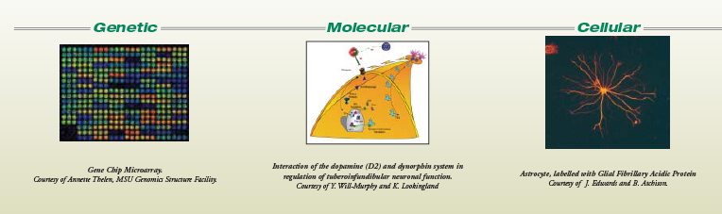
Pharmacodynamics
(how drugs work on the body)
The action of a drug on the body, including receptor interactions, dose-response phenomena, and mechanisms of therapeutic and toxic action
Main targets – cellular, molecular, genetic level…
  Therapeutic effects
  Adverse effects

Slide 5
Mechanism of drug actions
specific
non-specific
Receptor
non-receptor

Slide 6
I. Non-specific drug effects
…through by the general physical-chemical properties of substances - no specific chemical and structural configuration of drugs is needed
- influencing pH
- oxidating and reducing agents
- protein precipitation
- adsorbents / detergents
- chelating agents

Slide 7
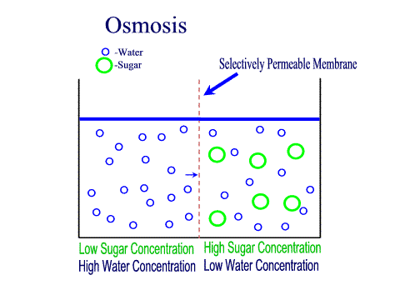
a. based on osmotic properties
e.g. salinic laxatives (magnesium sulphate, lactulosa)
osmotic diuretics (mannitol)

Slide 8
b. influencing acid-base balance
Antacids
  aluminium hydroxide
  magnesium carbonate
  calcium carbonate
  sodium bicarbonate
pH modifiers (blood, urine)
  sodium bicarbonate, ammonium chloride

Slide 9
c. based on oxido – reducing properties
e.g. 3% hydrogen peroxide, boric acid, fenols
chlorhexidine act as antiseptics

Slide 10
d. chelates (chelating agents)
ethylenediaminetetraacetic acid (EDTA) is a chelating agent, it can form bonds with a metal ion
dexrazoxane - a cyclic analog of EDTA administered with anthracyclines to prevent cardiotoxicity → Fe2 + ions

Slide 11
II. Specific drug effects
effect depends on the specific molecules configuration
most drugs act (bind) on receptors
  in or on cells
  form tight bonds with the ligand
….on ion channels or carriers

Slide 12
Specific drug effects
many drugs inhibit enzymes
A very common mode of action of many drugs
  in the patient (ACE inhibitors)
  in microbes (sulfas, penicillins)
  in cancer cells (5-FU, 6-MP)
some drugs bind to:
  proteins (in patient, or microbes)
  DNA (cyclophosphamide)
  microtubules (vincristine)

Slide 13
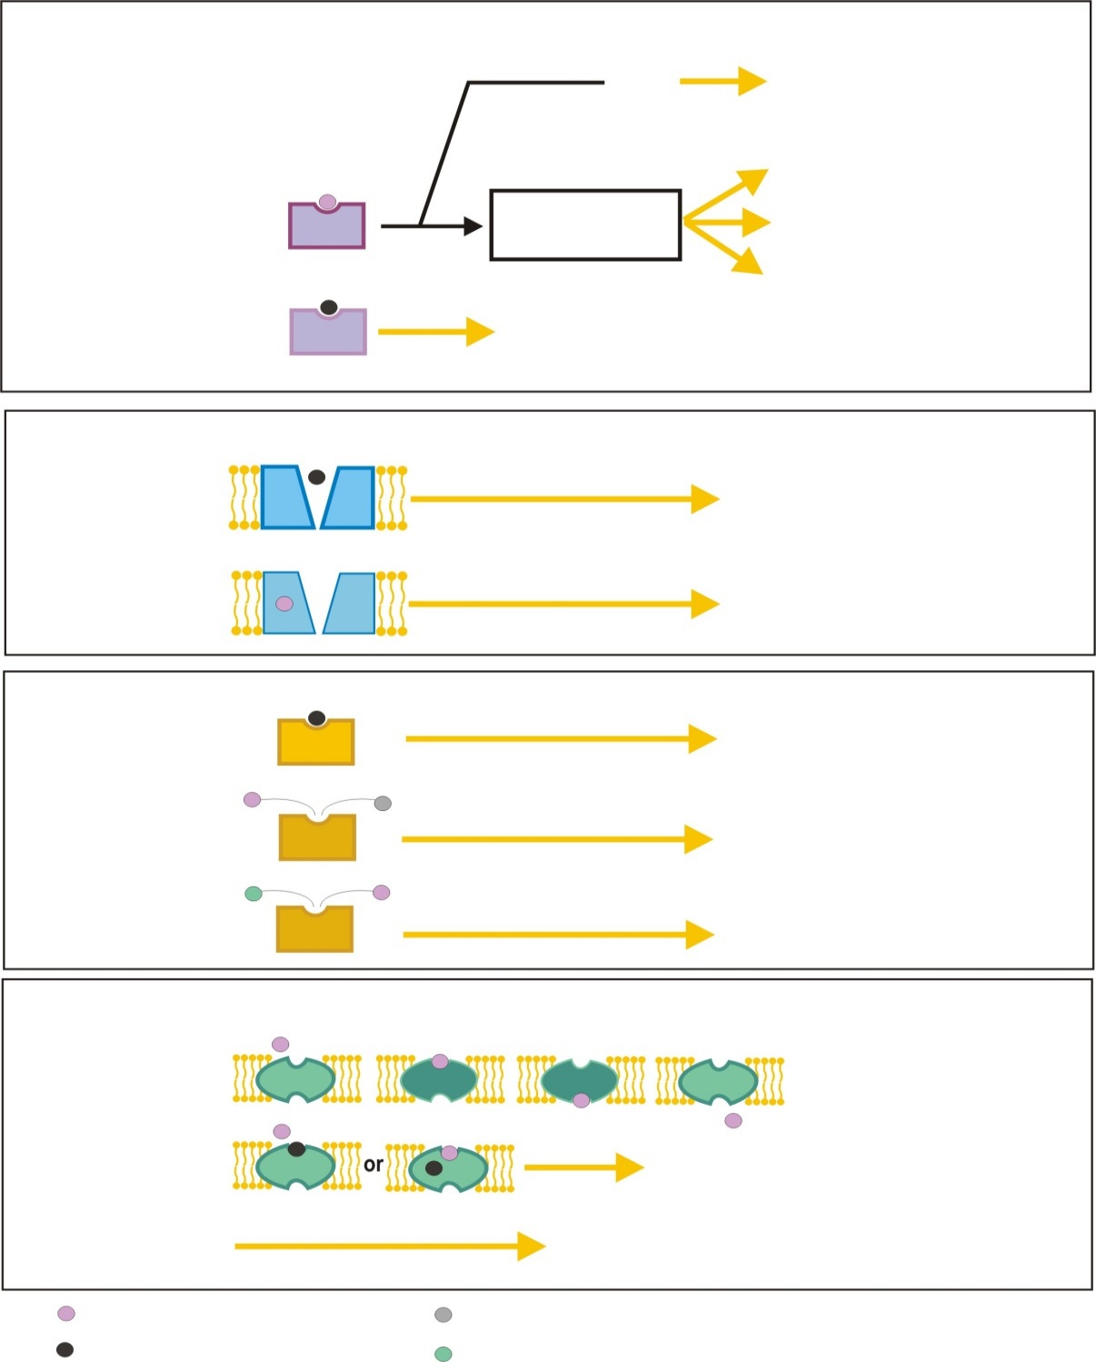
A. RECEPTORS
Ion channels
Open/closed
Direct
Enzymes
Activation/inhibition
Agonist
Signal
Transduction
n channel modulation
DNA transcription
Antagonist
No effect
Endogenous mediator blocked
B. ION CHANNELS
Blockers
Flow is blocked
Modulators
Increasing or decreasing
probability of opening
C. ENZYMES
Inhibitor
Reaction is inhibited
False substrate
Abnormal metabolites
Prodrug
Active substance
D. CARRIERS
normal
transport
Inhibitor
Transport is blocked
Rang and Dale Pharmacology, 2017

Slide 14
A. Receptor – effector system
= complex of processes
extracelullar signal -------------> intracell. signal cascade---------> effector (own effect)
receptor = protein, which interacts ligands
  involved in signal transduction
effector = enzyme, ionic channel etc. change in the activity leads to the effect of drug
ligand (signal molecule) = molecule able to bind to specific receptor
  endogenous - neurotransmitters, hormones
  exogenous - xenobiotics, drugs

Slide 15
Receptor classification
Localization
membrane
cytoplasm
organels
auto/heteroreceptors
Transduction
metabotropic
ion. channels
kinase
DNA regulating
Ligands
  achol
  amines
  AMA
  peptides

Slide 16
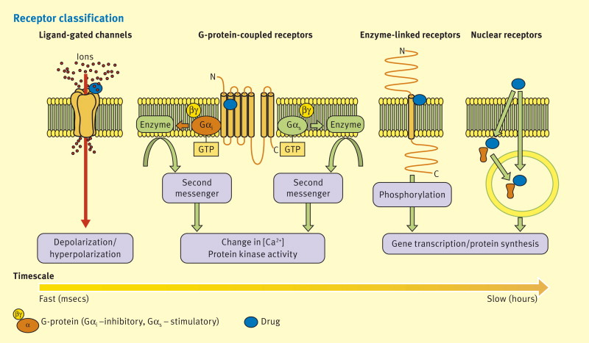

Receptor classification
Lokalizace
membránové
cytoplazmat.
organelové
auto/heteroreceptory
Transdukce
metabotropní
iont. kanály ligandové
kinázové
regulující DNA
Ligandů
  Achol
  Aminy
  AMK
  peptidy

Slide 17
4 main type of receptors
 | Type 1 Receptors connected with ion channels | Type 2 G-protein coupled receptor | Type 3 Receptor tyrosin kinases | Type 4 Intracellular (nuclear) receptors
Place | Membrane | Membrane | Membrane | Intracellular
Efector | Ion channel | Channel or enzyme | Enzyme | Gene transcription
Binding | direct | G-protein | direct | DNA mediated
Examples | Nicotin-cholinergic receptor, GABA receptor | Muscarin-cholinergic adrenoreceptors | Inzulin, growth factor, cytokin receptor | Steroids, thyroid hormon receptors
Structure | Oligomer composed by subunits surrounding center of the channel | Monomer (or dimer) containing 7 transmembrane helical domains. | Single transmembrane helical domain interconencted with extracelular kinase | Monomer structure with separate receptor and DNA binding domain
Rang and Dale Pharmacology, 2012

Slide 18
Receptor – effector system
Affinity
the ability of the ligand to bind to the receptor
Instrinsic activity
ability to evoke an effect after binding to receptor
  !!!the presence of sufficient number of receptor for the induction of pharmacological effect is essential as well as sufficient amounts of receptor ligand!!!

Slide 19
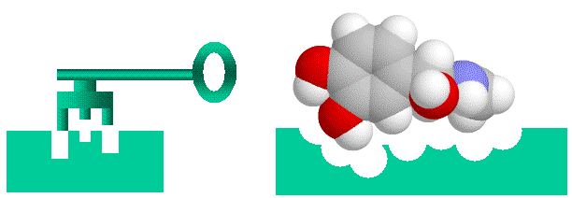
Receptor – effector system

Slide 20
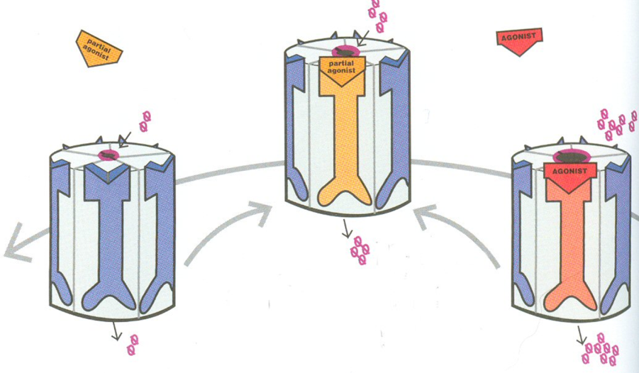
Ligand classification
(intrinsic activity)
AGONISTS
Full agonist Partial agonist
IA = 1 - dualist
- IA in a range from 0‹ to ›1

Slide 21
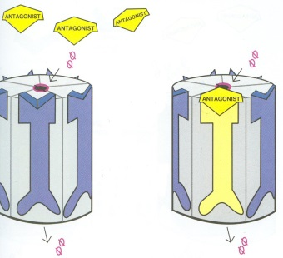
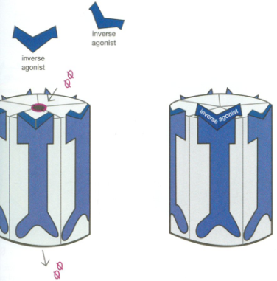
Ligand classification
Antagonists
IA = 0
Blocks agonist binding to receptor
Inverse agonist
IA = -1
Stabilizes the receptor in the constitutive activity

Slide 22
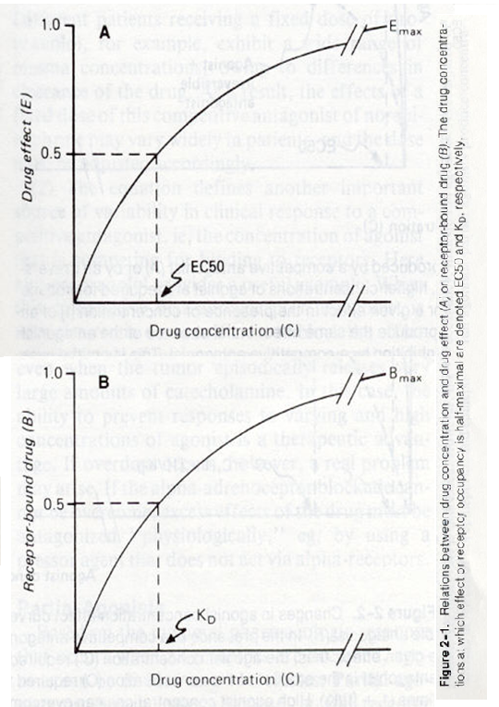
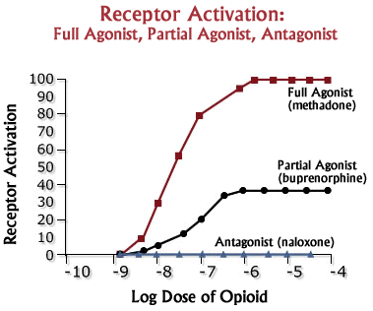
Receptor-effector system
Relation between dose and effect

Slide 23
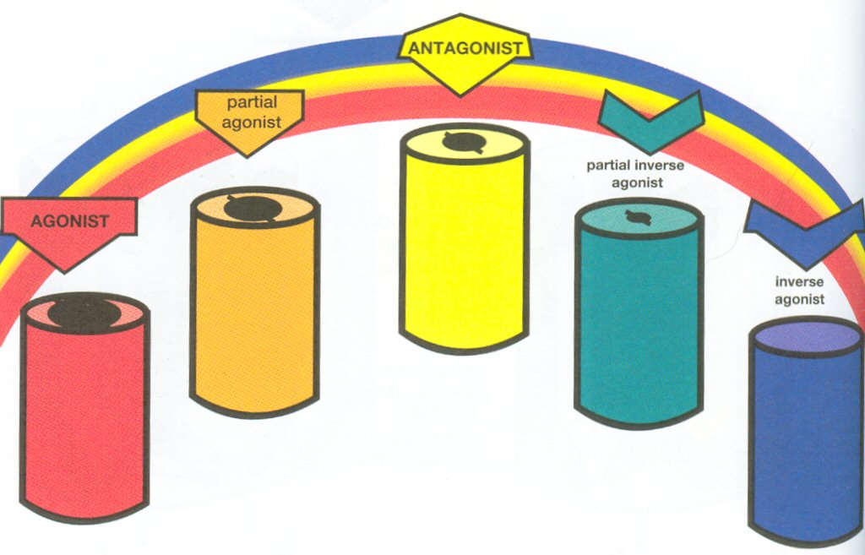
Spectrum of ligands

Slide 24
Antagonism
competitive reversible
non-competitive irreversible
  at the receptor level
  at the function level

Slide 25
Antagonism
Competitive
ligands compete for the same binding site
↑ c of antagonist decreases agonist effect and inversely
the presence of antagonist incerases the amounts of agonist needed to evoke the effect
Non-competitive
allosteric antagonism
irreverzible bounds
↑ c of agonist does not interrupt the effect of antagonist

Slide 26
Regulation of receptor function

Slide 27
Receptor desensitization
Regulation of receptor sensitivity and counts
reducing the sensitivity of the receptors after repeated agonist exposure
Tachyphylaxis – acute drug „tolerance“
  reduced sensitivity to the active substance evolving quickly (minutes) → distortion of the signal cascade
  the reactivity of the organism returns to the original intensity after the elimination of the substance
  Ex. of tachyphylaxis – nitrates administration, ephedrine
Tolerance – reduced sensitivity to the active substance, arising from the repeated administration of the drug (days – weeks) → down-regulation, internalization of the receptors
  to achieve the original effect required increasingly higher doses of drug
  the original reactivity of the organism returns to a certain period of time after discontinuation of the drug
  Ex. of tolerance – opioids administration

Slide 28
Regulation of receptor sensitivity and counts
Hypersensitivity
incerase of receptor sensitivity/counts after chronic anatagonist exposure
Rebound phenomenom
after discontinuation of long-term administered drugs return to its original state or ↑ intensity of the original condition (hypersensitivity of receptors to endogenous ligands → up-regulation)
Example: chronic administration of β blockers

Slide 29
B. Non-receptor mechanism of action
Interaction with „non-receptor“ proteins
1. enzyme inhibition
2. block of ion channels
3. block of transporters
„non-proteins“
binding to cellular components (ATB-ribosomes, hydroxyapatit, tubulin etc.)

Slide 30
1. Enzyme inhibition
Competitive or non-competitive enzyme inhibitors
  reversible
      acetylcholinesteraze– physostigmine
      phosphodiesteraze – methylxantine
  irreversible:
        Cyklooxygenaze – ASA (aspirin)
        MAO-B – selegilin
        aldehyddehydrogenaze– disulfiram

Slide 31
2. Ion channels
Calcium channel blockers (nifedipin, isradipin…)
Potassium channel blockers (flupirtin – selective neuronal potassium channel modulator, oral antidiabetics…)
Natrium channel blockers – local anesthetics

Slide 32
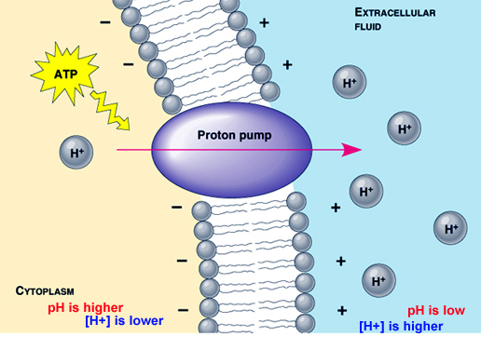
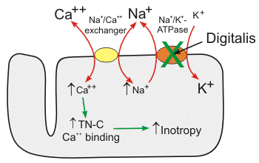
3. “Carriers“
  Proton pump inhibitors (PPIs) – omeprazol
  Na⁺/K⁺ ATPasa inhibitors – digoxin

