Slide 1


General principles of poisoning management. Specific antidotes in poisoning therapy.
General principles of drug addiction
Department of Pharmacology FM MU

Slide 2

Pharmacology vs. Toxicology
  Interconnection of both disciplines
  They study the effects of chemicals on biological systems
  Pharmacology - therapeutically useful effects, drugs
  Toxicology - adverse, harmful (toxic) effects, poisons and toxins
  Paracelsus (1493-1548):
  “All substances are poisonous; there is none which is not a poison. The right dose differentiates a poison and a remedy”

Slide 3
Causes of poisoning
1. drugs - 52%
2. industrial products - 30% (chemicals for cleaning, organic solvents, cosmetics...)
3. plants - 8%
4. pure bulk chemicals -5%
5. funghi - 2%
6. animal poisons (snakebite) -1%
7. others -1%

Slide 4
General principles of acute poisoning treatment
Treatment has to be provided as quickly as possible but always with judgment so that therapeutical procedures do not cause worsening of the patient´s state or even death !!!

Slide 5
General principles of poisoning treatment:
eliminate the substance from organism as quickly as possible
(= decontamination)
antidote (rapid counteraction for poison by means of specific actions);
„a drug, chelating substance, or a chemical that counteracts (neutralizes) the effects of another drug or a poison“
vital functions + symptomatic treatment

Slide 6
1. Elimination of unabsorbed toxic substances from organism
Gastric lavage and administration of emetic, preferably within 1 hour of intoxication (the first treatments should be done prior to transportation to the hospital)
An average patient arrives only after 3 hours

Slide 7
1. Elimination of unabsorbed toxic substances from organism
Induced vomiting
in p.o. poisoning within 4 hours
within 8 hours after anticholinergic agents
within 12 hours of pylorospasm inducing agents (eg, salicylates)
the patient is conscious, without spasms
Syrup of ipeca (emetin)- non-reg., apomorphine (s.c.)
mechanic stimulation of pharynx
Can not evacuate whole stomach content (max 30-50%) !
DO NOT INDUCE VOMITING IF ACIDS OR ALKALI WERE INGESTED

Slide 8
OTHER CONTRAINDICATIONS OF INDUCED VOMITING:
Somnolence and loss of consciousness
Intoxication with foaming agents
Intoxication with hydrocarbons
Attacks of spasms
Alimentary intoxications in small infants

Slide 9
1. Elimination of unabsorbed toxic substances from organism
Adsorbents
With poisons ingested p.o.
Charcoal (adsorbing carbon = Carbo adsorbens) / diosmectit → large active surface
50 – 100 g in 5 – 10% suspension, possibly with stomach tube, then repeatedly 50 g per 4 hours
up to 2.5 g/kg
+: paracetamol, salicylic acid, diazepam, amphetamine
– methyl/ethylalcohol, Li, strong acids and alkali

Slide 10
Toxic substances that are poorly adsorbable by charcoal
acids
alkali
chlorates
chlorids
cyanides
nitrates
ethanol
ethylenglycol
isopropanol
methanol
fluorides
iron
ferrous sulphate
potassium
sodium
detergents

Slide 11
1. Elimination of unabsorbed toxic substances from organism
Gastric lavage
In p.o. intoxications within 4 hours
The patient is conscious, without spasms
when unconscious, ONLY in lying position and intubated
warm water (37°C), saline (preparation: 2 teaspoons of salt per 1 litre water), 300 ml
Sample for toxicological analysis
In the end (the last lavage) add adsorbent (30 g of activated carbon) or a laxative (Na₂SO₄)

Slide 12
1. Elimination of unabsorbed toxic substances from organism - PEG - laxative , GIT dialysis
• PEG - polyethylene glycol in ionic solutions
• 4 liters / 2 hours until the evacuated rectal content is clear

Slide 13
1. Elimination of unabsorbed toxic substances from organism
Increasing the intestinal passage
The patient is conscious, with no spasms
Administration of big doses of strong and quick-acting laxatives
Sodium sulphate (20 – 30 g with a large volume of water)
Mannitol (ca 50g per 1 litre water; 0.5 – 1 litre is administered p.o.)
Castor oil (20 – 30 ml)
CI in poisons soluble in fats!!! (castor oil ↑bile secretion and resorption of fats)

Slide 14
1. Elimination of unabsorbed toxic substances from organism
Total intestinal lavage
Large-volume solution (25 ml/kg)
Through stomach tube, until clean solution flows off
Without resorption, does not cause diarrhoea
It only rinses the intestine
polyethylenglycol + NaSO₄, NaCl

Slide 15
1. Elimination of absorbed toxic substances from organism
Forced osmotic diuresis
Infusion of saccharide solutions (20% mannitol; possible combination with furosemide), physiological solution
Up to several litres / day
CI: brain and lung oedema, heart failure, anuria

Slide 16
1. Elimination of absorbed toxic substances from organism
Forced alkali diuresis
Speeds up elimination of slightly acidic poisons
Alkalinisation of urine and blood (pH 7.5 – 9.0)
NaHCO₃ solutions
I: salicylates, barbiturates, sulphonamides, antipsychotic drugs,...
CI: pulmonary oedema, shock, serious impairment of kidneys

Slide 17
1. Elimination of absorbed toxic substances from organism
Forced acidic diuresis
Speeds up elimination of slightly alkalinic poisons
Acidification of blood and urine
5% Glc solutions with ammonium chloride in i.v. infusion
I: amphetamines, quinine, quinidine, nicotine, morphine,...
CI: serious impairment of kidneys

Slide 18
1. Elimination of absorbed toxic substances from organism
Peritoneal dialysis
Haemodialysis
Haemoperfusion

Slide 19
2. Neutralization of poison through administration of antidote
Antidote – a substance that neutralises the effect of poison
  specific (using antagonistic effects of pharmaceuticals – antidotes that can counteract the effects of poison either partly or completely)
  non-specific (adsorption – activated – medicinal carbon = carbo adsorbens – carbo activatus – carbo medicinalis)
  RATIO OF CARBON : TOXIC SUBSTANCE = 10 : 1
  (usually 50g / 3 – 4h; most often intoxications with medicines, chemicals)
  It is necessary to administer antidote as quickly as possible
  Dosage according to plasmatic level of toxin

Slide 20
Specific Antidotes
https://www.annemergmed.com/article/S0196-0644(17)30657-1/fulltext

Slide 21
3. Symptomatic treatment
Check vital signs
Intubation
Entry into bloodstream
Support of CVS (inotropics, vasopressors)
Therapy of spasms

Slide 22

Toxicological Information Centre
Website of the Toxikologické informační střediskoTIS).
Acute poisoning - what to do?
Dial +420 224 91 92 93 or 224 91 54 02
To receive advice on first aid and what to do next.
Prepare:
precise information on the accident
full name
birth identification number
health insurance company
healthcare professional also their IČP (organization identification number)
In order to facilitate the consultation, the doctors are asked to calculate (provided it can be ascertained) the quantity of medication (active substance) that intoxicated the patient. Also please try to estimate or find out the
body weight of the patient.

Slide 23
Toxicological Information Centre
A 24/7 nationwide telephone medical information service to consult cases of acute human and animal intoxications
For both laypersons and doctors
The goal of the TIS is to decrease the number and severity of intoxications and to favourably effect the course of accidents. The Centre provides information on the chemical composition of commercial products and on the therapy of acute intoxications with these products
It does not deal with:
the influence of chemical compounds on foetus
cancerogeneity
adverse effects of medicinal drugs
impact of chemical compounds on the environment

Slide 24
Intoxication with medicines

Slide 25
Intoxication with medicines
Most often: sedatives, hypnotics, analgesics
Causes of death:
Injury to CNS – psychotropics
Injury to CVS – cardioglycosides antiasthmatic drugs
Liver injury – paracetamol, nimesulide, protease inhibitors,

Slide 26
General principles of drug addiction

Slide 27
Addiction = compulsive drug use despite harmful consequences
is characterized by an inability to stop using a drug (failure to meet work,
social, or family obligations; tolerance and withdrawal).
accompanied by unnatural cravings that prompt the compulsive behaviors.
It is a primary, chronic, neurobiologic disease with genetic, psychosocial and
environmental factors that influence its development and manifestations.
It is characterized by behaviours that include one or more of the following:
loss of control over drug use
continued use despite harm
compulsive use and craving

Slide 28
International Statistical Classification of Diseases and Related Health Problems 10th Revision:
Mental and behavioural disorders due to psychoactive substance use (F10-F19)
F10: Mental and behavioural disorders due to use of alcohol
F11: Mental and behavioural disorders due to use of opioids
F12: Mental and behavioural disorders due to use of cannabinoids
F13: Mental and behavioural disorders due to use of sedatives or hypnotics
F14: Mental and behavioural disorders due to use of cocaine

Slide 29
International Statistical Classification of Diseases and Related Health Problems 10th Revision:
F15: Mental and behavioural disorders due to use of other stimulants, including caffeine
F16: Mental and behavioural disorders due to use of hallucinogens
F17: Mental and behavioural disorders due to use of tobacco
F18: Mental and behavioural disorders due to use of volatile solvents
F19: Mental and behavioural disorders due to multiple drug use and use of other
psychoactive substances

Slide 30
Historic context of drug use
Opium known already in neolithic age (8 000 – 5 000 years B.C.)
Coca and resin from hemp – known thousands years
Drugs were first used for their therapeutic purposes, secondary for they narcotic purposes
Isolation of morphine (1805),
caffeine (1820),
nicotine (1828),
cocaine (1859),
ephedrine (1887)

Slide 31
Summary of frequently abused substances
alcohol
nicotine
cannabinoids (hemp drugs)
opioids
benzodiazepines
„classical“ psychostimulant drugs
MDMA (exctasy)
„new“ synthetic substances
hallucinogens

Slide 32
19th century: beginning of commercial narcotics production
(e.g. morphine since 1828, cocaine 1862, heroine 1898)
Legal consumption of drugs was ended by opium conventions:
1909 Shanghai,
1912 Haag
1925 Geneva
Illegal way: French Connection (France), Cosa Nostra (USA)
After WWII:
Single Convention on Narcotic Drugs of 1961 - an international treaty to prohibit production
and supply of specific (nominally narcotic) drugs and of drugs with similar effects

Slide 33
Council of the Government for Drug Policy Coordination - Annual registr (2012):
CZ – the most frequently abused drugs:
Psychostimulant drugs (particularly methamphetamine, syn. pervitin)
Hemp drugs (particularly tetrahydrocannabinol – THC).

Slide 34
Tolerance x Dependence x Sensitization
Tolerance: a decrease in the effect of a drug as a consequence of repeated exposure
(the effectiveness can decrease with continued use).
Mechanisms of Tolerance:
Pharmacokinetic Tolerance (enzyme induction effect)
It occurs because of a decreased quantity of the substance reaching the site it affects.
This may be caused by an increase in induction of the enzymes required for degradation of the drug e.g. CYP450 enzymes.
This is most commonly seen with substances such as ethanol.
This type of tolerance is most evident with oral ingestion, because other routes of drug administration bypass first-pass metabolism.

Slide 35
Tolerance x Dependence x Sensitization
Pharmacodynamic Tolerance (NT depletion, receptor plasticity)
It occurs when the cellular response to a substance is reduced with repeated use.
This may be caused by a reduced receptor response to receptor agonists (receptor desensitization), a reduction in receptor density (usually associated with receptor agonists), or other mechanisms leading to changes in action potential firing rate.
Dependence: a maladaptive pattern of substance use, leading to clinically significant tolerance, impairment, or distress; an adaptive state associated with a withdrawal syndrome upon cessation of repeated exposure to a stimulus (e.g., drug intake).

Slide 36
Tolerance x Dependence x Sensitization
Dependence develops when the neurons adapt to the repeated drug exposure and only function normally in the presence of the drug.
When the drug is withdrawn, several physiologic reactions occur. These can be mild (caffeine) or even life threatening (alcohol).
This is known as the withdrawal syndrome.

Slide 37
Tolerance x Dependence x Sensitization
Physical dependence x psychological dependence
Physical dependence (physiologic dependence) referrers to the adverse physical symptoms and signs that result from the withdrawal of the drug.
It results from many of the same mechanisms that produce tolerance.
As with tolerance, homeostatic set-points are altered to compensate for the presence of the drug.
If drug use is discontinued, the altered set-points produce effects opposite to those manifested in the presence of the drug.

Slide 38
Tolerance x Dependence x Sensitization
Physical dependence x psychological dependence
Psychological dependence
Psychological dependence is a change in emotional state that occurs after using a substance or engaging in a behaviour over a period of time.
i.e. dependency on specific psychological phenomena provoked by the drug (e.g. euphoria)
This change in emotional state is a result of changes in brain chemicals.
It can cause craving, motivation to seek out the substance or behavior,
irritability, anxiety, or general dissatisfaction when withdrawing from
the substance or activity.

Slide 39

Dependence producing substances
Inverse tolerance (sensitization): the drug
becomes more effective with repeated doses.
Senzitization
(Robinson & Berridge, 1993)
Tolerance
Decreased response to substance
effects. A higher dose is required
to achieve the same effect.
Increased response following repeated drug administration
Substance is usually given
in shorter intervals or
continuously
Intermitent drug administration

Slide 40
Inverse tolerance (sensitization):
There are two hypothesis to explain mechanism of sensitization to psychostimulants:
Intermittent exposure to a drug will cause intermittent dopamine release. This will lead to decreased sensitivity or density of pre-synaptic dopamine autoreceptors.
These receptors are responsible for negative feed back → increased dopamine release → increase stimulatory effects of dopamine.
Important rather for development of sensitization than expression.
2) Long-term intermittent exposure to a drug provokes intermittent release of high amounts of
dopamine → gradual depletion of dopamine in cytoplasm.
This results in increased sensitivity of D₁ postsynaptic receptor (because they are not stimulated by their natural ligand).
Thus, after challenge dose administration (that acts through activation of the same postsynaptic receptors), an augmented behavioural response can be expected.

Slide 41
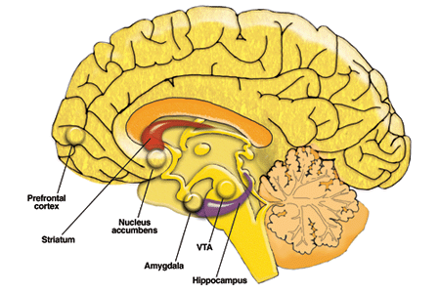
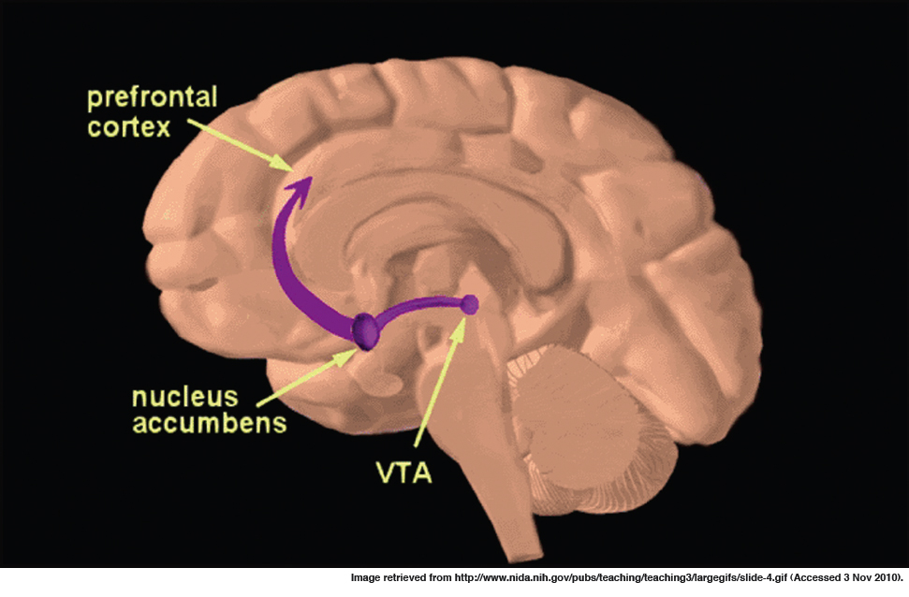
Exposure to alcohol and other drugs (AODs):
Plastic changes associated with AOD use - release of the neurotransmitter dopamine from
cells in ventral tegmental area (VTA) induced by addictive drugs.
The VTA is one of the components of the mesolimbic dopamine system – REWARD PATHWAY.
Neurons whose cell bodies are located in the VTA, extend long axons most prominently to the
nucleus accumbens (NAc) and the prefrontal cortex
Dopamine release in the mesolimbic system is critical for the drive to ingest AODs.

Slide 42
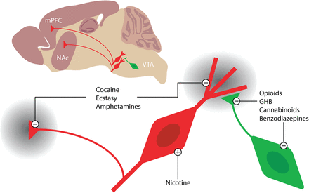
The mesocorticolimbic dopamine system as an initial target of addictive drugs.
The VTA, at the origin of the mesocorticolimbic system, is composed of dopamine projection
neurons that are under inhibitory control of GABA interneurons
The main targets are the NAc and the mPFC.
Addictive drugs cause an increase in mesocorticolimbic dopamine through:
direct activation of dopamine neurons (e.g., nicotine);
2) indirect disinhibition of dopamine neurons (opioids, cannabinoids, benzodiazepines);
3) interference with dopamine reuptake (cocaine, ecstasy, and amphetamines).

