Slide 2
Autonomic nervous system
TAKE HOME MESSAGES

Slide 3
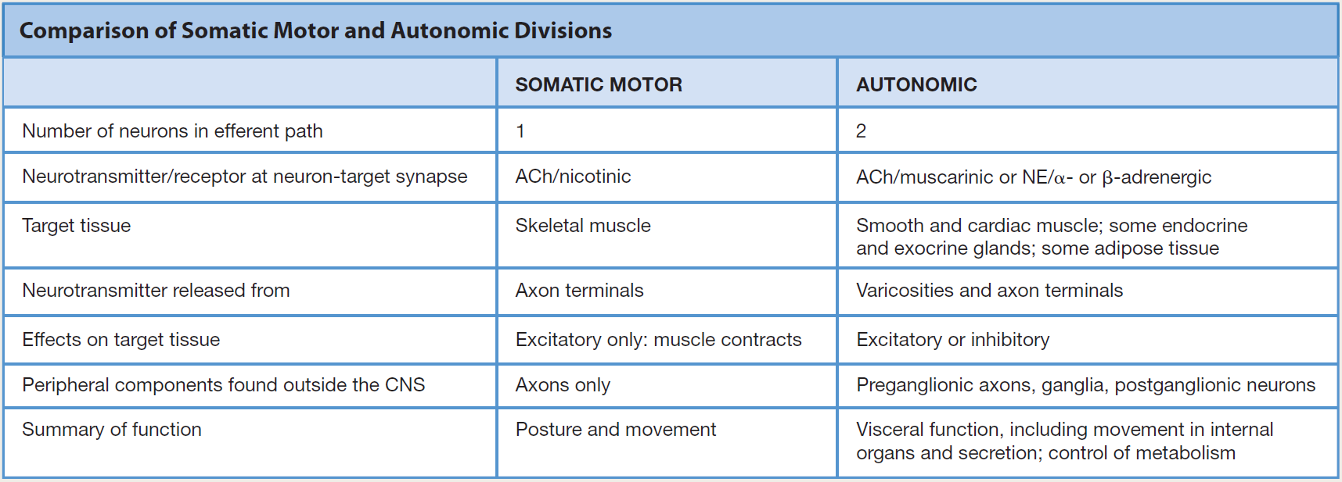
ANS vs. somatic NS

Slide 4
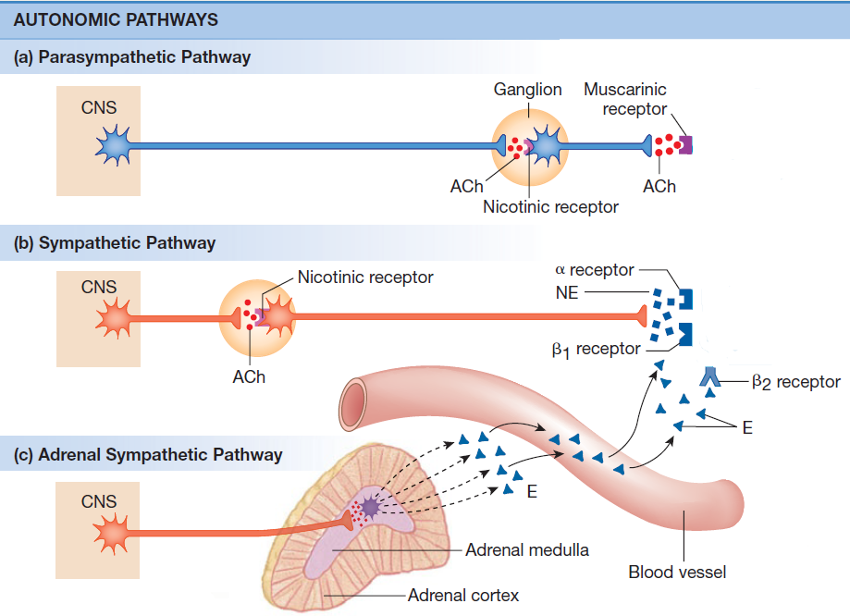
Autonomic nervous system

Slide 5
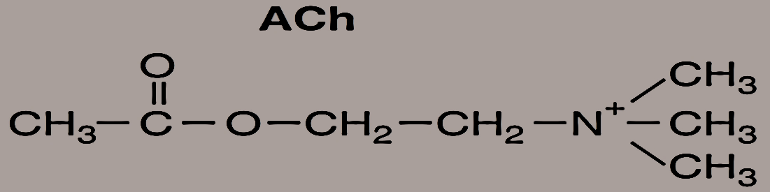
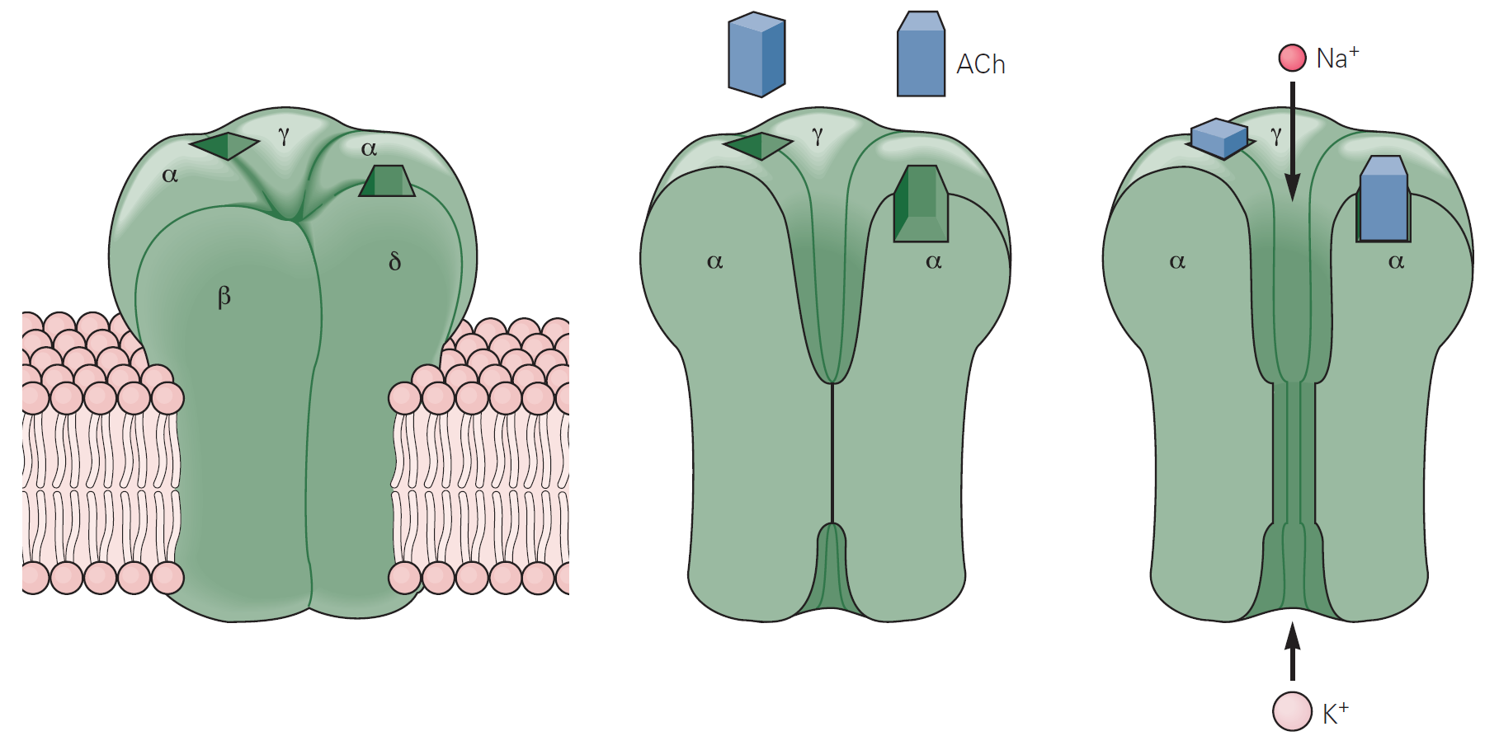
Autonomic nervous system
Preganglionic fibers
SNS, PNS
Nikotinic receptor
  N_{N} type and N_{M} type
  Excitatory receptors

Slide 6
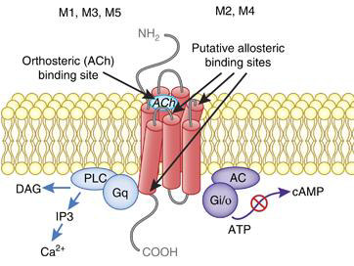
Autonomic nervous system
Postganglionic fibers
PNS
Muscarinic receptor
  G-protein coupled
  Excitatory receptors (M₁, M₃, M₅)
  Inhibitory receptors (M₂, M₄)

Slide 7
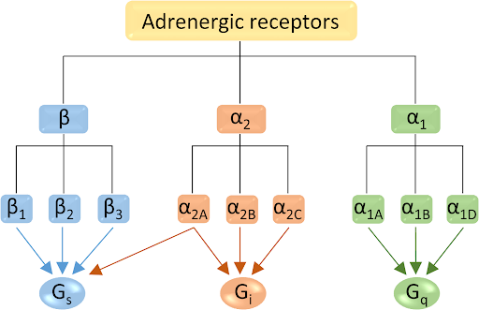
Autonomic nervous system
Postganglionic fibers
SNS
Adrenergic receptor
  G-protein coupled

Slide 8
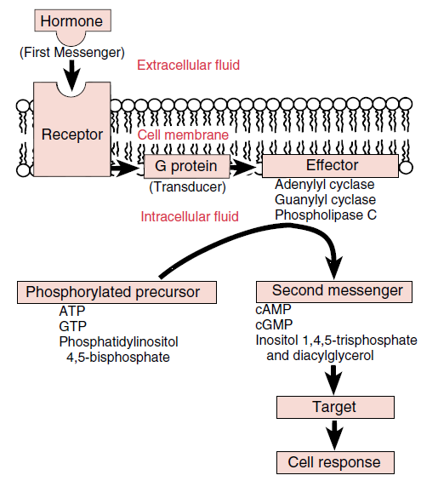
Second messenger systems

Slide 9
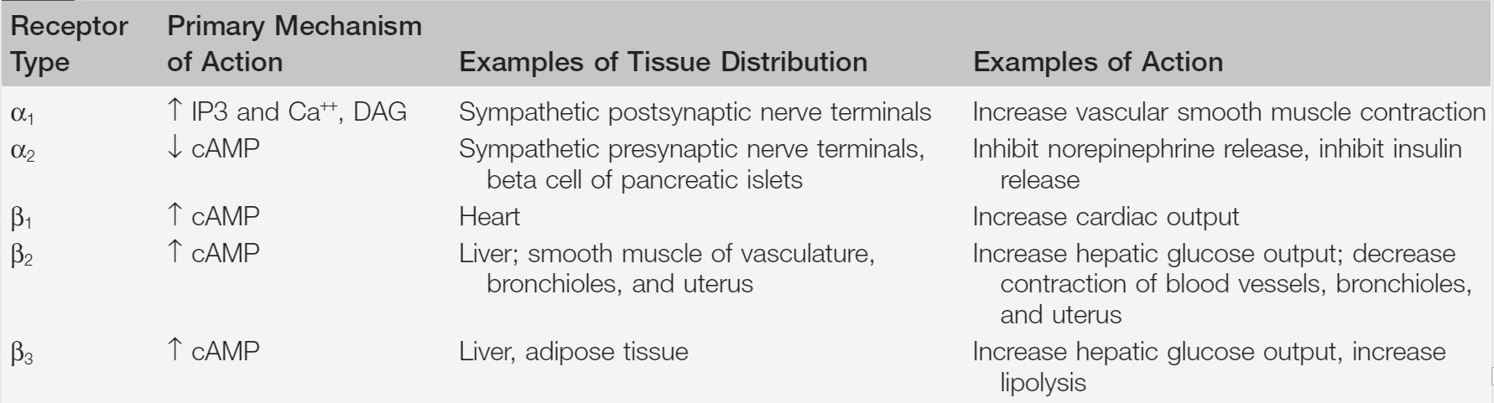
Autonomic nervous system
Adrenergic receptor
G-protein coupled
Type α –Excitatory receptors
Type β – Inhibitory receptors

Slide 10
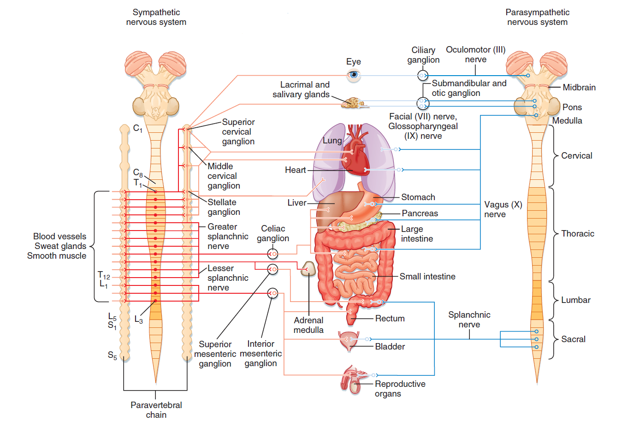
Autonomic nervous system
Ergotropic system
Trophotropic system
FIGHT OR FLIGHT
REST OR DIGEST

Slide 11
ANS innervates
The secretory glands (salivary,sweat, tear, and various mucus-producing glands; smooth muscles, cardiac muscles)
The heart and blood vessels to control blood pressure and flow
The bronchi of the lungs to meet the oxygen demands of the body
ANS regulates:
The digestive and metabolic functions of the liver, GIT, pancreas
The functions of the kidney, urinary bladder, large intestine, rectum
ANS is essential to the sexual responses of the genitals and reproductive organs
Interacts with the body´s immune systém
Mnemonic used:
The sympathetic division tends to Fs: fight, flight, fright,and sex
The parasympathetic division facilitates various non-fourF processes – as digestion, growth, immune response, energy storage
In most cases the activity levels of the 2 ANS divisions are reciprocal- when one is high, the other tends to be low, and vice versa.

Slide 12
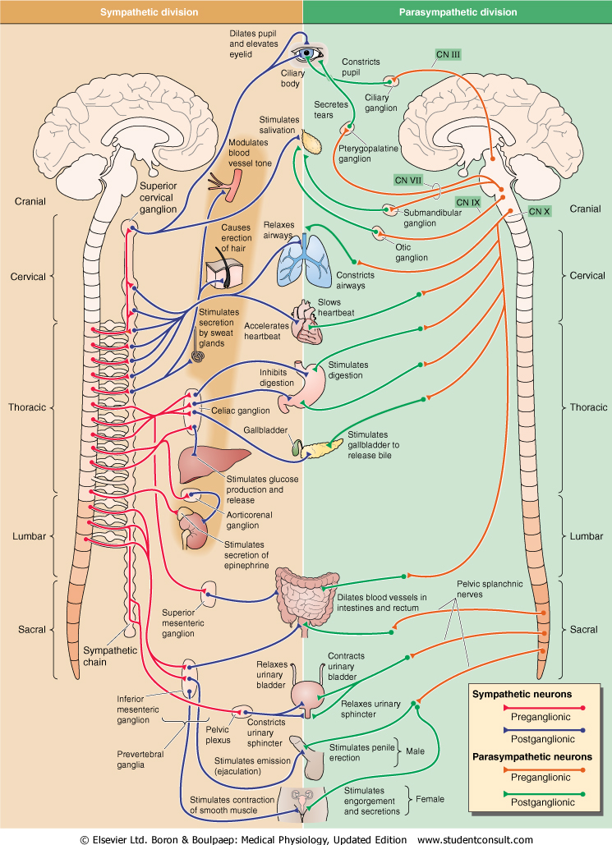
Sympathetic nervous system
Fight or flight response
Energy/store consumption
Preganglionic neuron
– Spinal cord
-Thoraco - lumbar system
Ganglia Paravertebral
Truncus sympathicus
Majority
Prevertebral
-Plexus aorticus
Mostly diffuse effect
Parasympathetic nervous system
Rest and digest response
Energy conservation/en. store production
Preganglionic neuron
– Brain stem and spinal cord
– cranio-sacral system
Ganglia
Close to target organs or intramurally
Mostly local effect

Slide 13
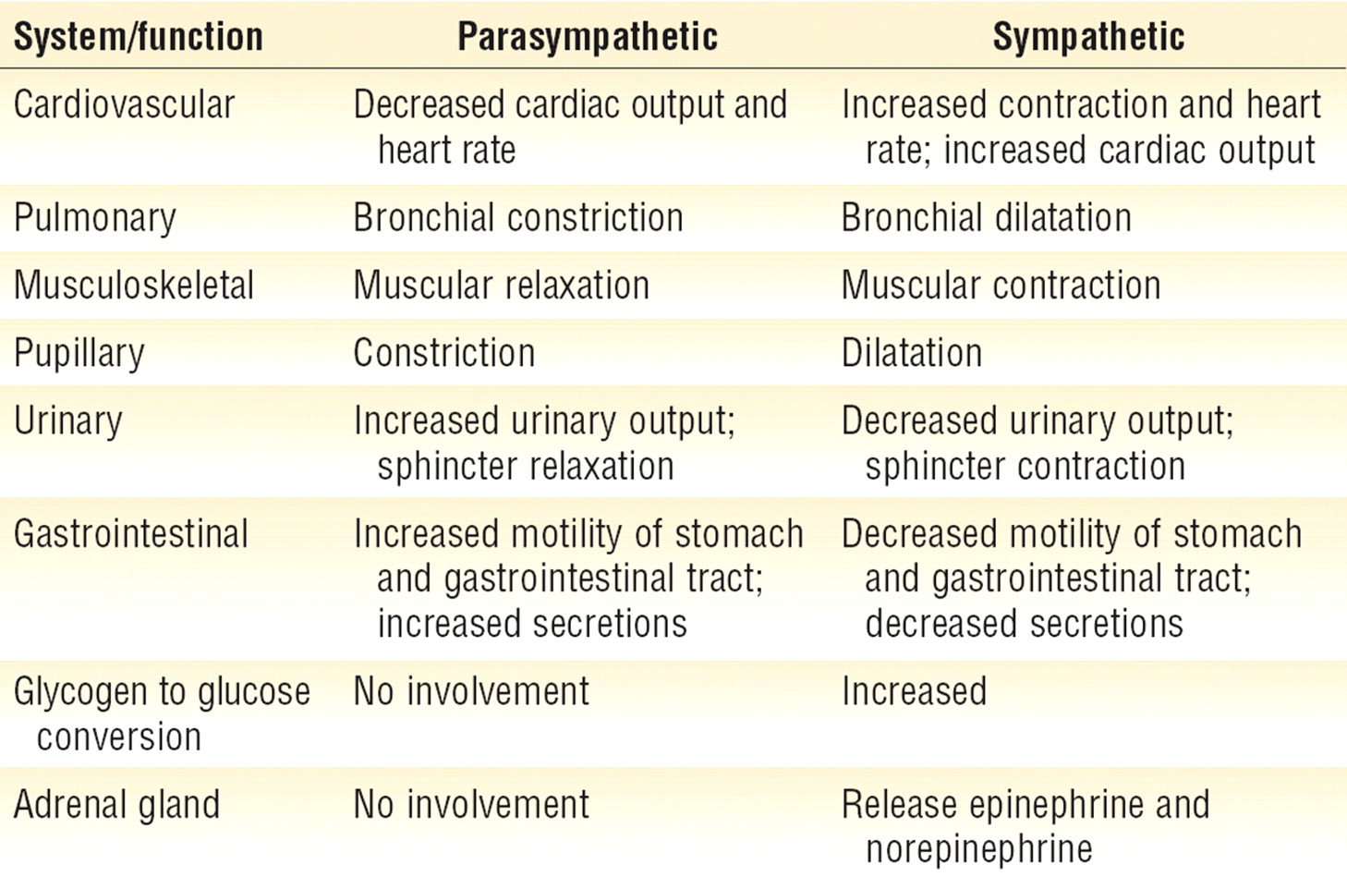
Sympatthetic nervous system
Fight or flight response
Energy/store consumption
Preganglionic neuron
– Spinal cord
-Thoraco - lumbar system
Ganglia Paravertebral
Truncus sympathicus
Majority
Prevertebral
-Plexus aorticus
Mostly diffuse effect
Parasympathetic nervous system
Rest and digest response
Energy conservation/energy store production
Preganglionic neuron
– Brain stem and spinal cord
– cranio-sacral system
Ganglia
Close to target organs or intramurally
Mostly local effect

Slide 14
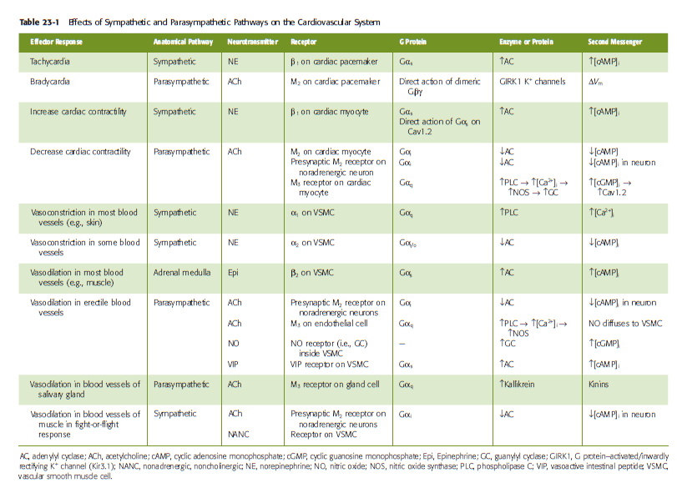
ANS
Boron et al: Medical Physiology, 2017

Slide 15
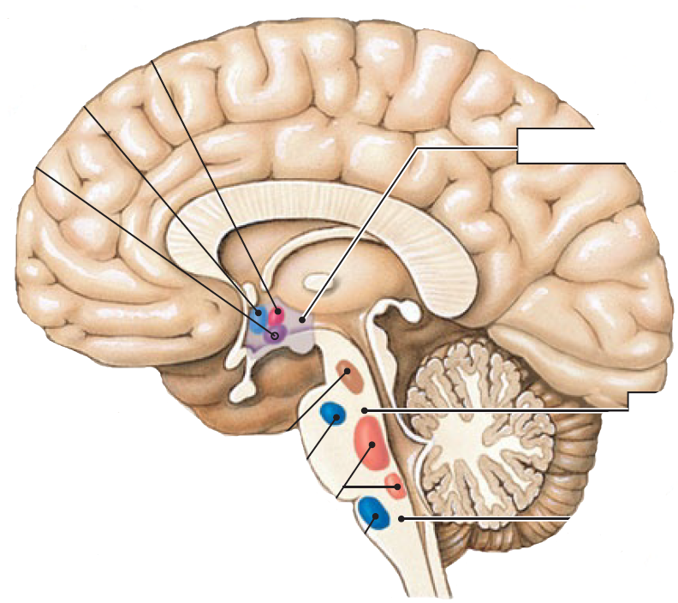
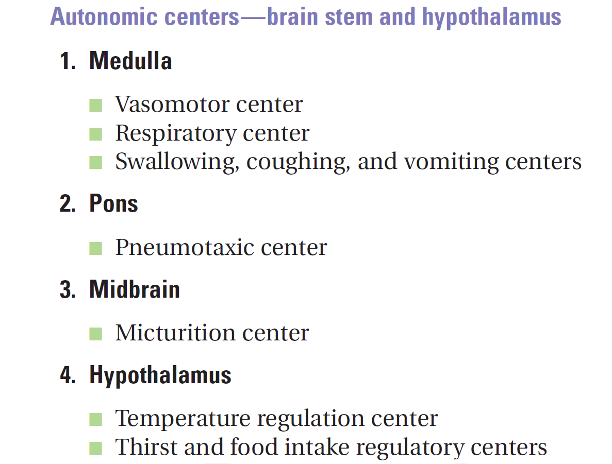

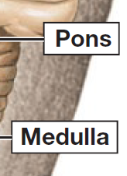
Brain control of ANS
Temperature control
Water balance
Eating
behavior
Urinary bladder
control
Secondary
respiratory center
Respiratory center
Blood pressure
control

Slide 16
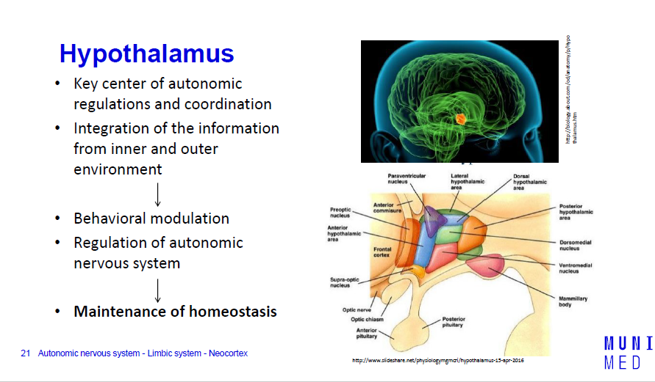

Slide 17
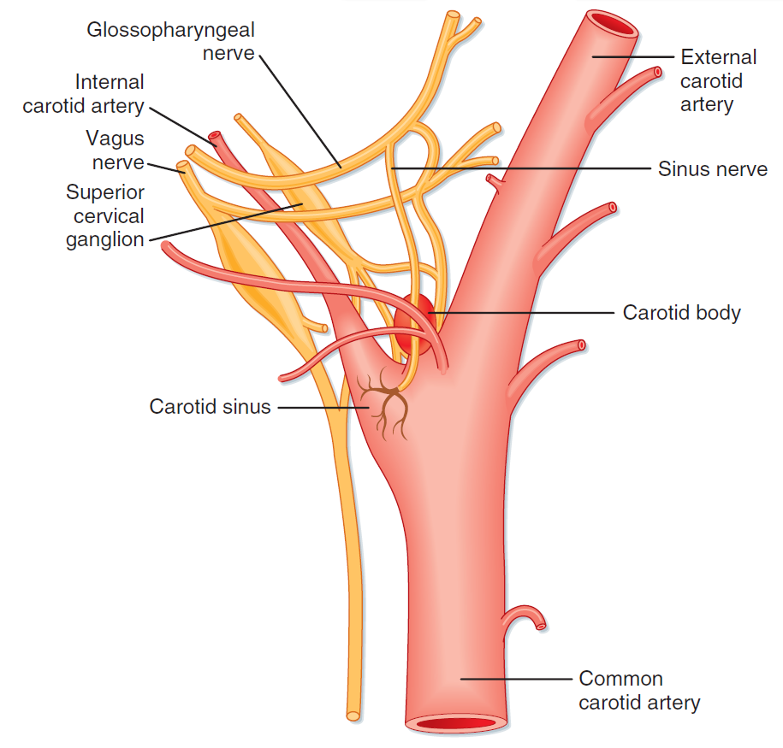
Baroreceptor vs. Chemoreceptor

Slide 18
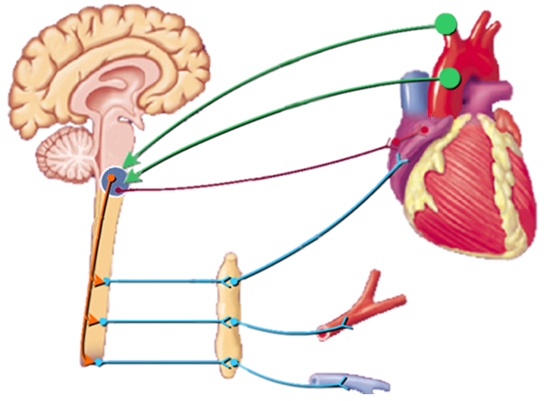
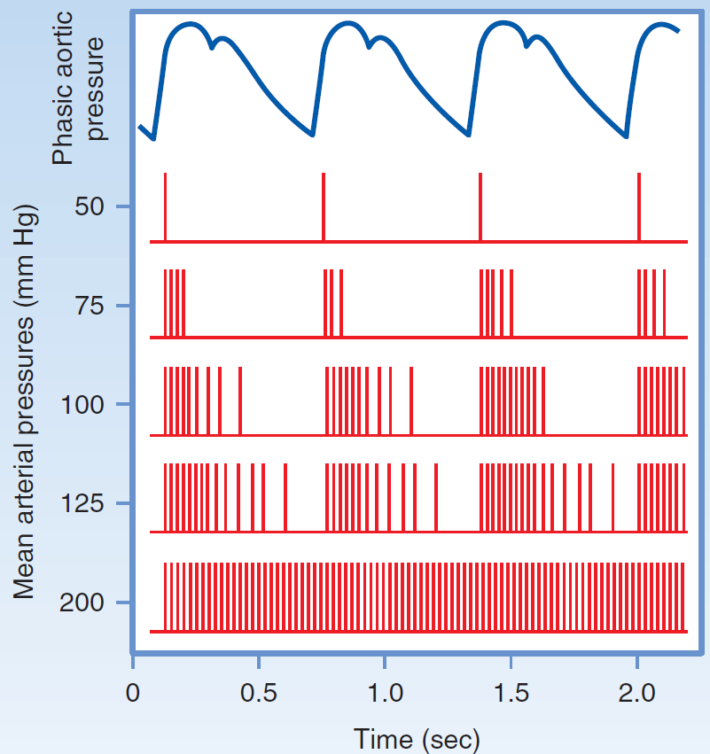
Baroreflex I
HR
Aferent pathway
Parasympathetic pathway
Sympathetic pathway
R
Inotropic
Chronotropic
Dromotropic
Batmotropic
effect
BP=HR x SV x R

Slide 19
Something more…
Oculocardial reflex
  Pressure on the eyebulbes decreases heart rate (activation of the vagus)
  It is used to suppress or stop atrial tachycardia
Low pressure baroreflex
  greater expansion of the left ventricle stimulates baroreceptors –vagus→medulla - inhibition of SNS – vasodilation, bradycardia – decrease of BP
Diving reflex
  Cold water on the face causes respiratory arrest, peripheral vasoconstriction and bradycardia
Coronary chemoreflex (Bezoldov-Hirtov-Jarisch reflex)
  Substances applied to the left coronary artery (veratridine, capsaicin, some contrast agents, substances produced by ischemic tissue) induce apnea and then hyperpnea, hypotension, bradycardia (vagal afferentation)

Slide 20
Testing of autonomic nervous system
Tilt table test
  Neurocardiogene syncopa (cardioinhibitory – vasodepresory- both)
  Cerebral vasoconstriction with syncopa
Pressure of the eyebulbes or sinus caroticus
  Cardioinhibitory-vasodepresory-both answer
  (hypersensitivity of sinus caroticus)
Farmacological tests
  With norepinephrine, isoprenaline, atropine

Slide 21
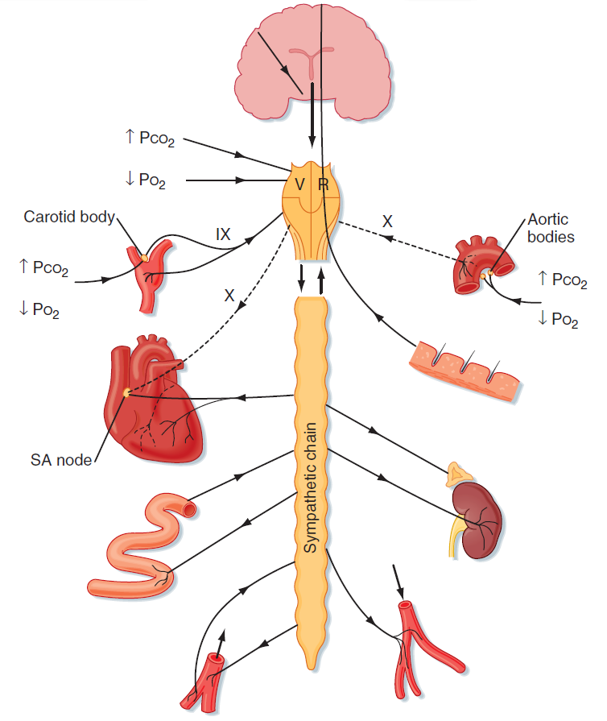
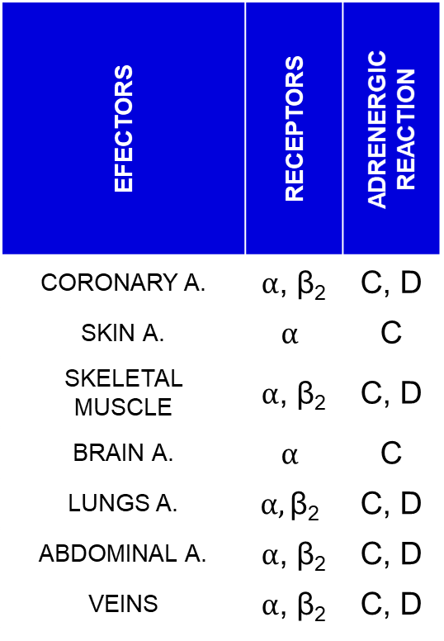
ANS and blood vessels
EFECTORS | RECEPTORS | ADRENERGIC REACTION
CORONARY A. | $α$, β₂ | C, D
SKIN A. | $$α$$ | C
SKELETAL MUSCLE | $α$, β₂ | C, D
BRAIN A. | $$α$$ | C
LUNGS A. | $$α,\text{β}\text{2}$$ | C, D
ABDOMINAL A. | $α$, β₂ | C, D
VEINS | $α$, β₂ | C, D

Slide 22
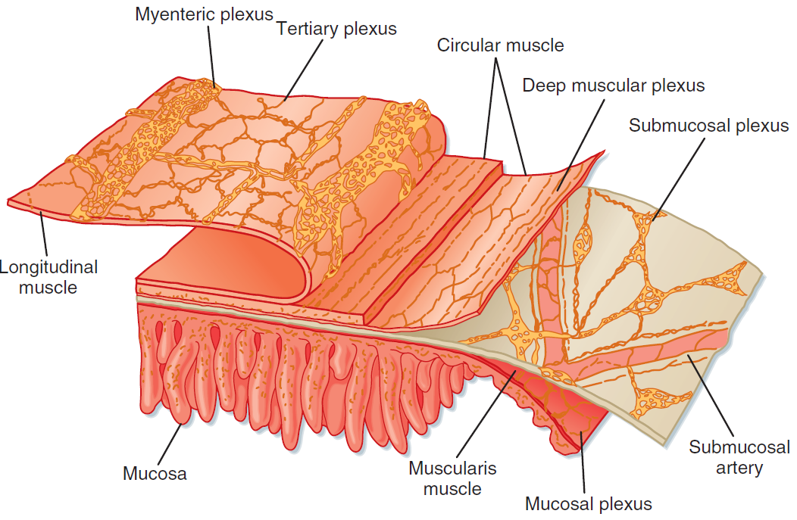
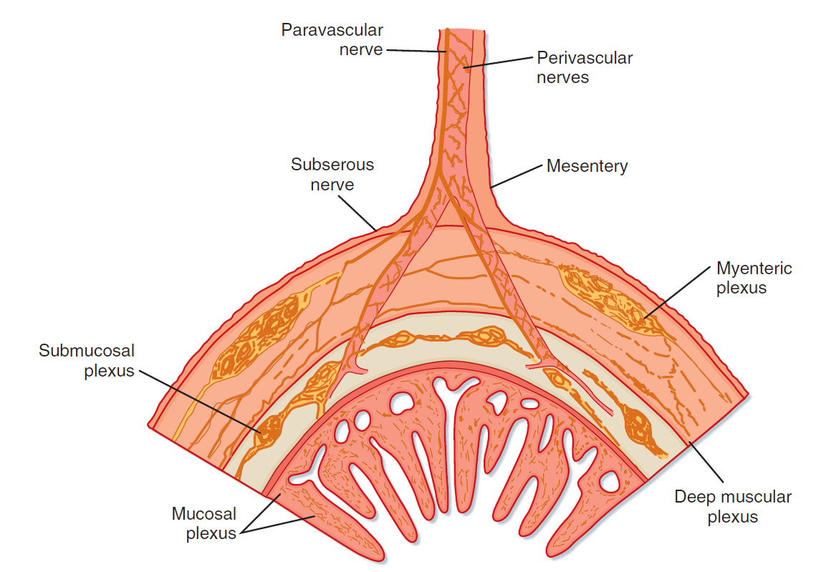
GIT - Enteric Nervous System

Slide 23
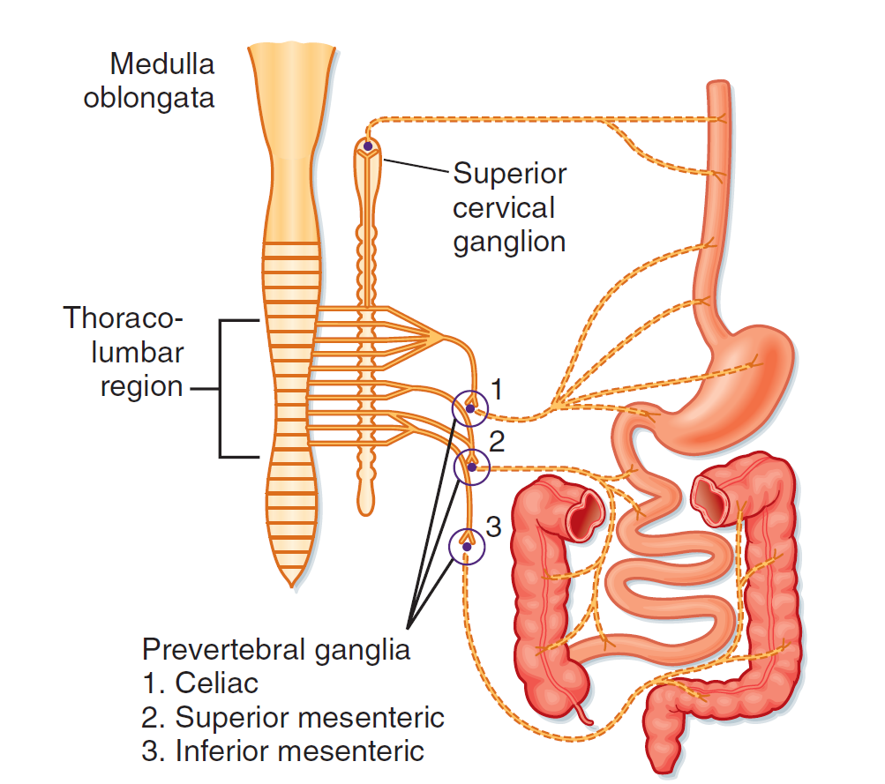
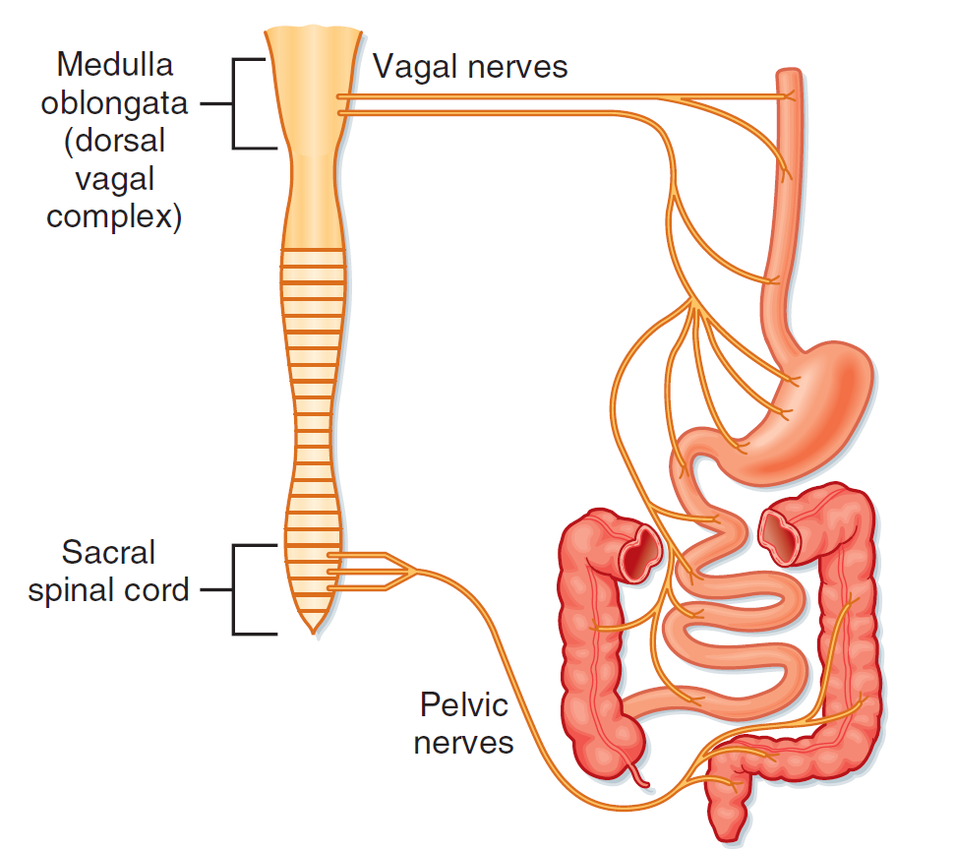
GIT and ANS
SNS
PNS

Slide 24
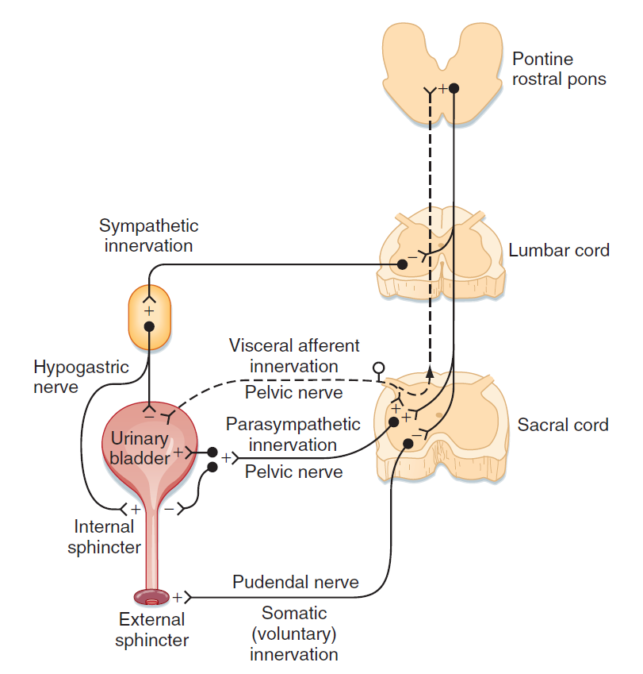
ANS and urinary bladder
SNS
DETRUSOR | RELAXATION
SPHINCTER | CONTRACTION
PSN
DETRUSOR | CONTRACTION
SPHINCTER | RELAXATION

Slide 25
Thank you for your attention

Slide 26
Extra information

Slide 27
Neurogenic bladder
NAME | COMMENTS
Uninhibited bladder | Lesion: above the pontine micturition center Signs: reduced awareness of bladder fullness, incontinence may occur
Upper motor neuron bladder (Detrusor-sphincter dyssynergia) | Lesion: between the pontine micturition center and sacral cord Signs: detrusor is usually spastic, simultaneous detrusor and urinary sphincter contractions increase pressures in the bladder, can lead to vesicoureteral reflux that and renal damage
Mixed type A bladder | Lesion: sacral cord lesion at the detrusor nucleus with sparring of the pudendal nucleus Signs: the detrusor muscle is flaccid, bladder is large, external urinary sphincter is spastic, incontinence uncommon
Mixed type B bladder | Lesion: sacral cord lesion at the pudendal nucleus with sparring of the detrusor nucleus Signs: the bladder is spastic and the external urinary sphincter is flaccid, incontinence is common
Lower motor neuron bladder | Lesion: sacral cord or sacral root while the thoracic sympathetic outflow to the lower urinary tract is preserved Signs: bladder is large and hypotonic, incontinence uncommon

Slide 28
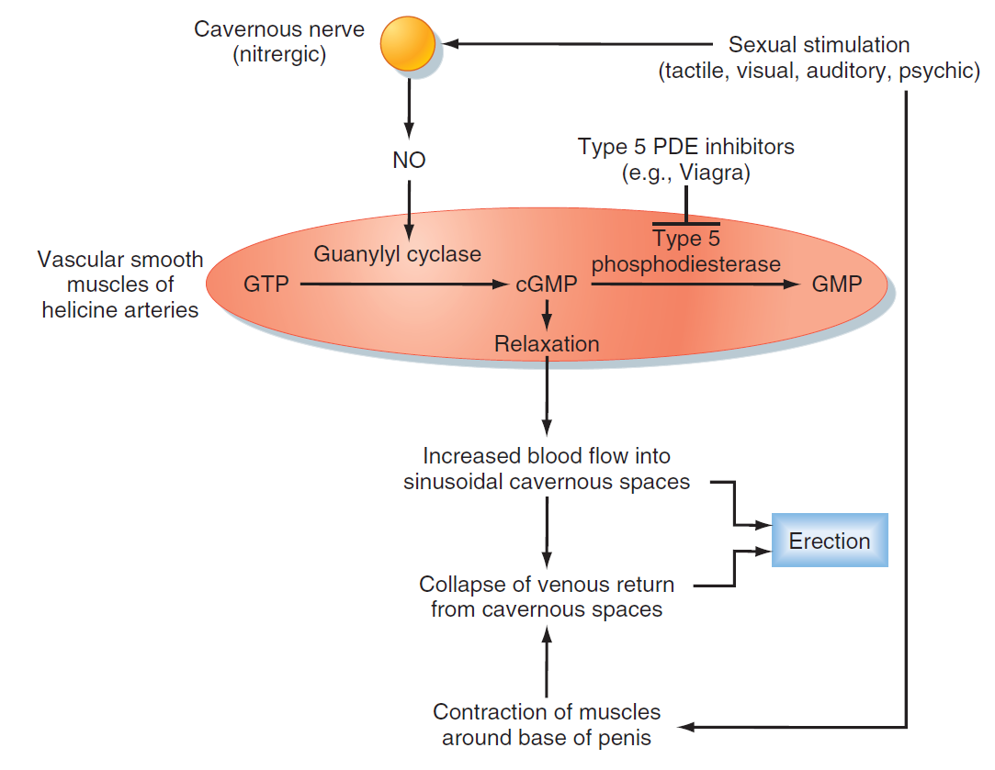
ANS and sexual function

Slide 29
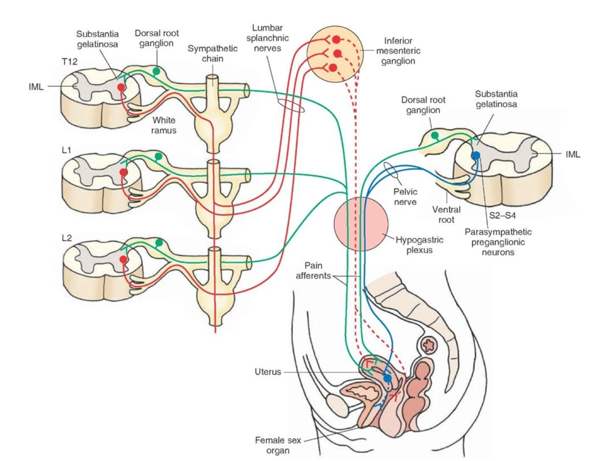
ANS and sexual function

