Slide 1

Pathogenesis of leukemias
František Folber, Jiří Mayer
Dept. of Internal Medicine, Hematology and Oncology
University Hospital Brno and Masaryk University

Slide 2
Outline
Epidemiology
Clinical signs
Key subtypes of leukemias
Model diseases
Elementary principles of pathogenesis
Implications of these facts for diagnostics and therapy
  with time relationships of different discoveries
  and original data from the literature
Including case reports

Slide 3
Cancer incidence In Czechia, 2010-2014
Average number of yearly diagnosed cases
other skin ca (C44)
colon, rectum (C18–C21)
breast, females (C50)
prostate (C61)
lung (C33, C34)
kidney (C64)
melanoma (C43)
urine bladder (C67)
pancreas (C25)
uterus (C54, C55)
stomach (C16)
oral cavity (C00–C14)
non-Hodgkin lymphoma (C82-C85,C96)
acute leukemias and CLL (C91–C95)
ovarium (C56)
thyroid gland (C73)
cervix uteri (C53)
liver (C22)
gallbladder (C23, C24)
brain (C70–C72)
esophagus (C15)
larynx (C32)
multiple myeloma (C90)
testis (C62)
connective tissue (C47, C49)
Hodgkin lymphoma (C81)
Chronic myeloid leukemia (C921)
others
ca in situ (D00–D09)
nonmalignant and uncertain tumors (D10–D36, D37–D48)
Males
Females
Source: National Cancer Registry, ÚZIS ČR

Slide 4
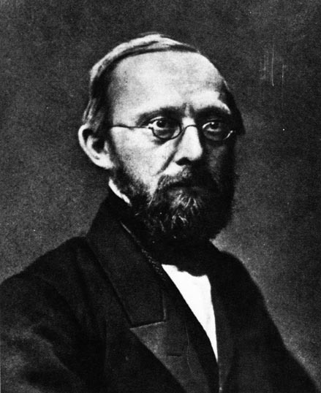
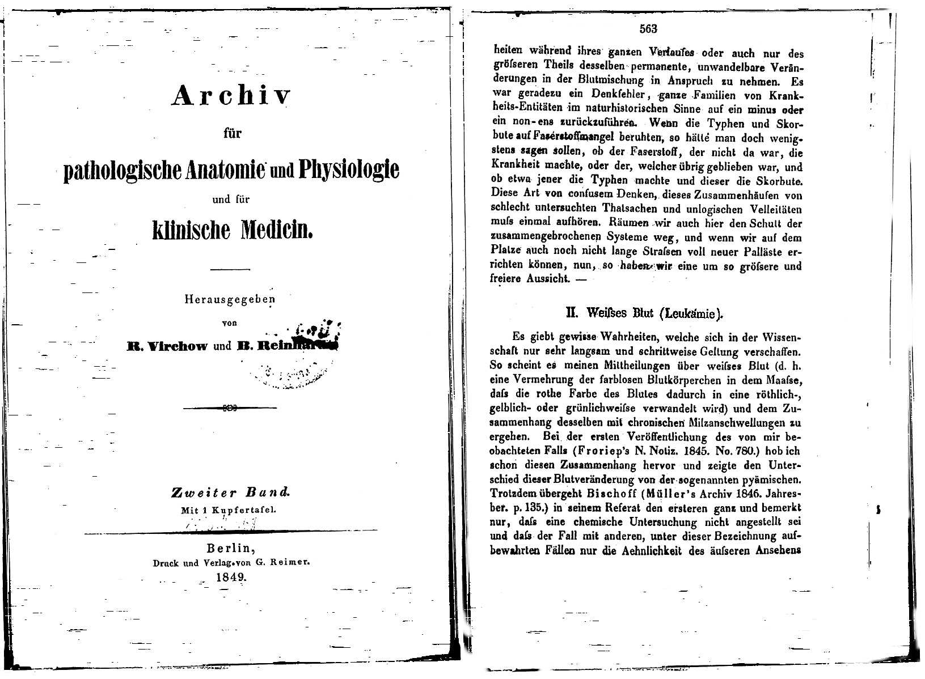
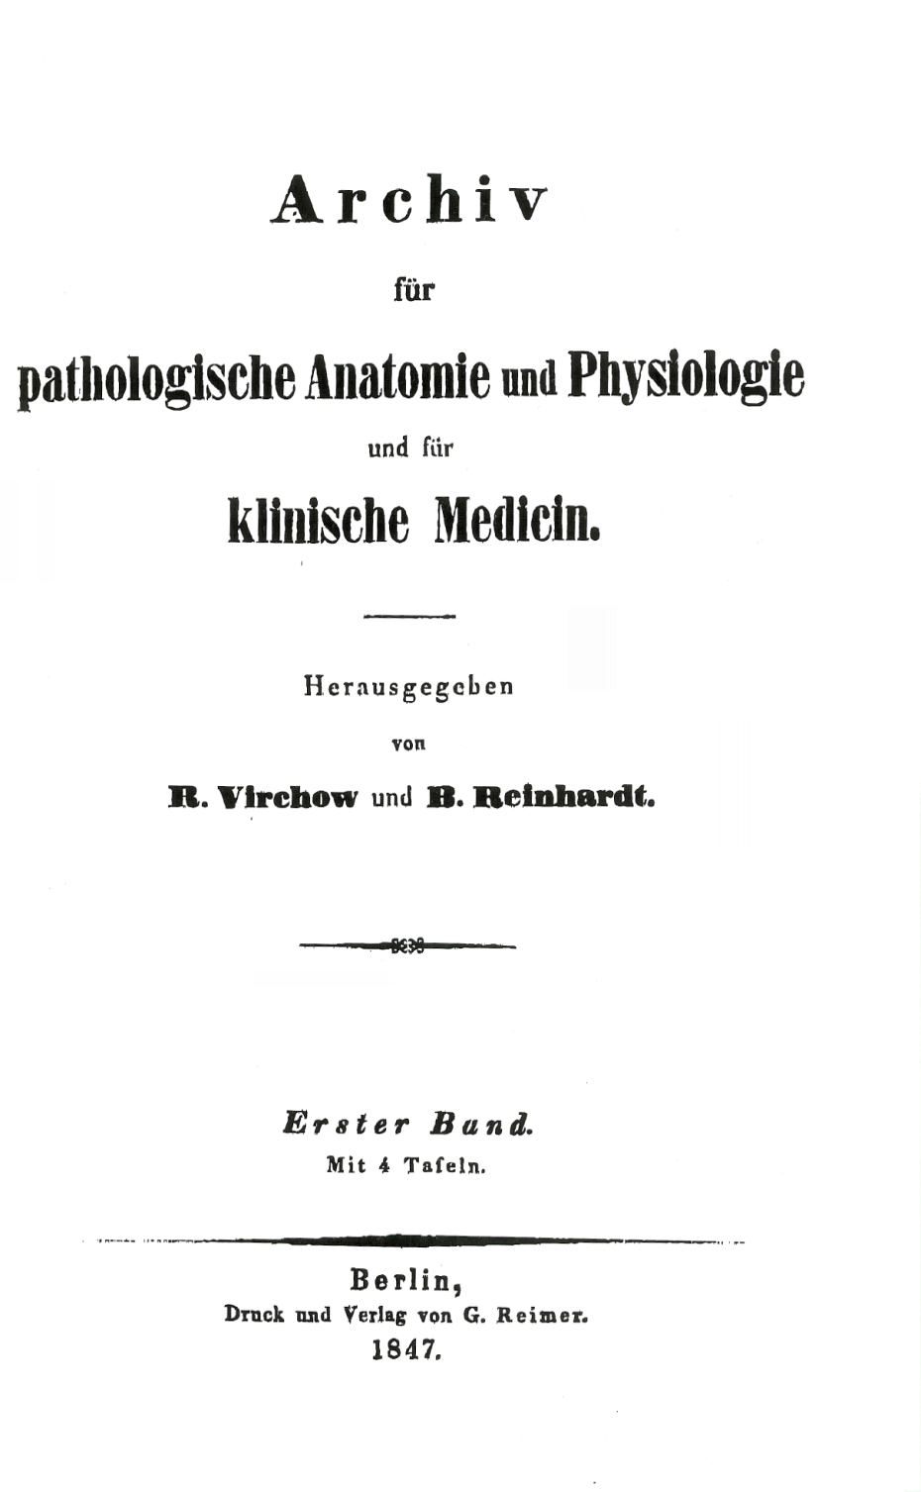

Slide 5
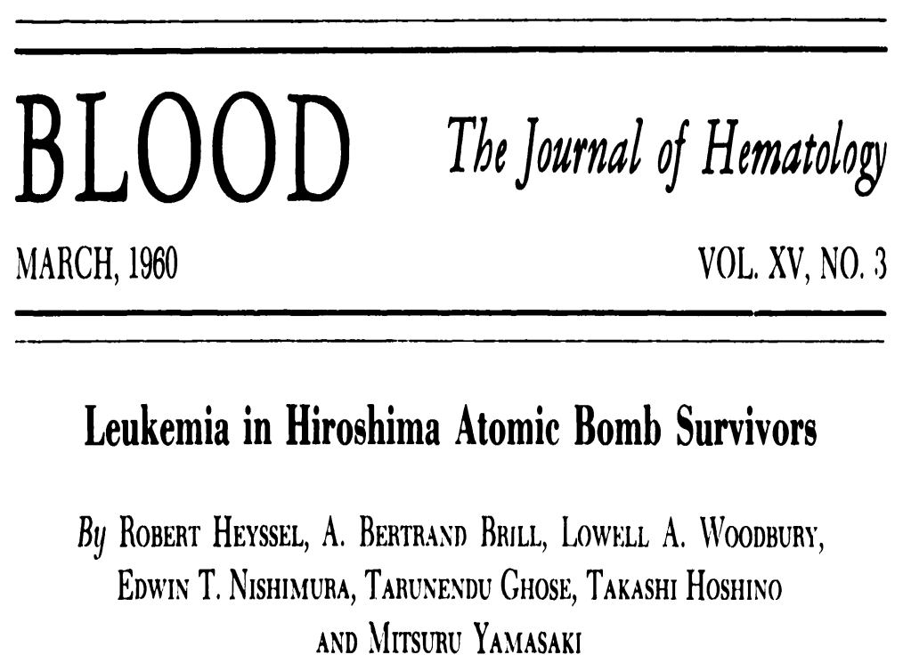

Slide 6
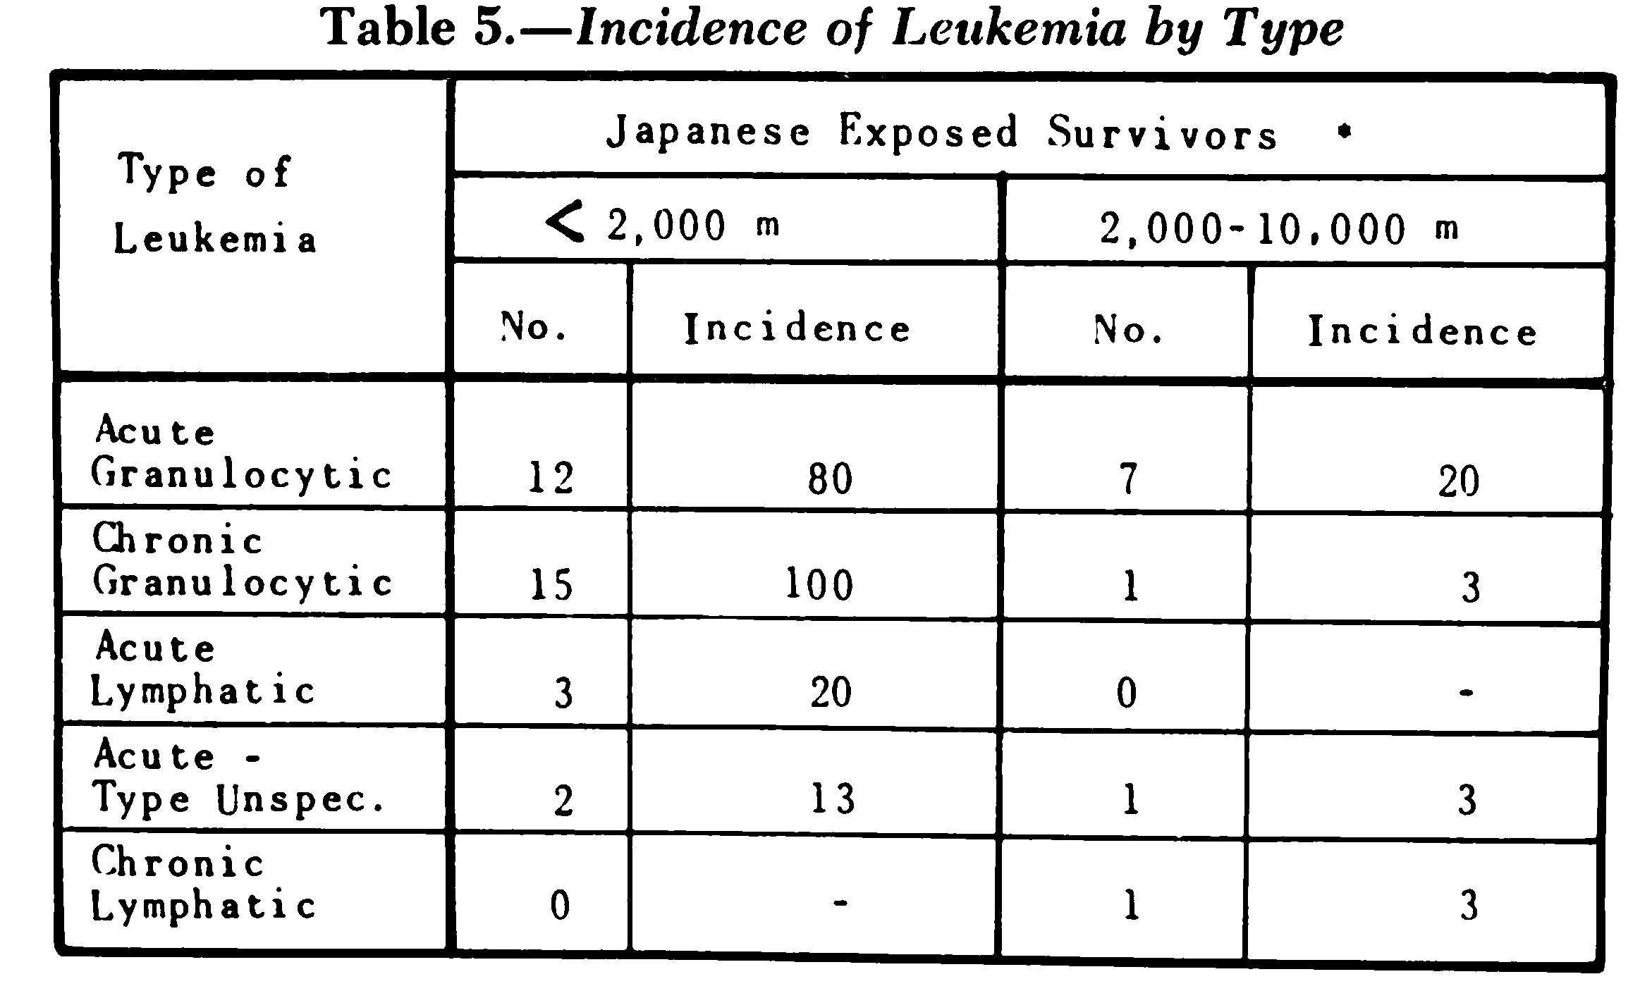

Slide 7
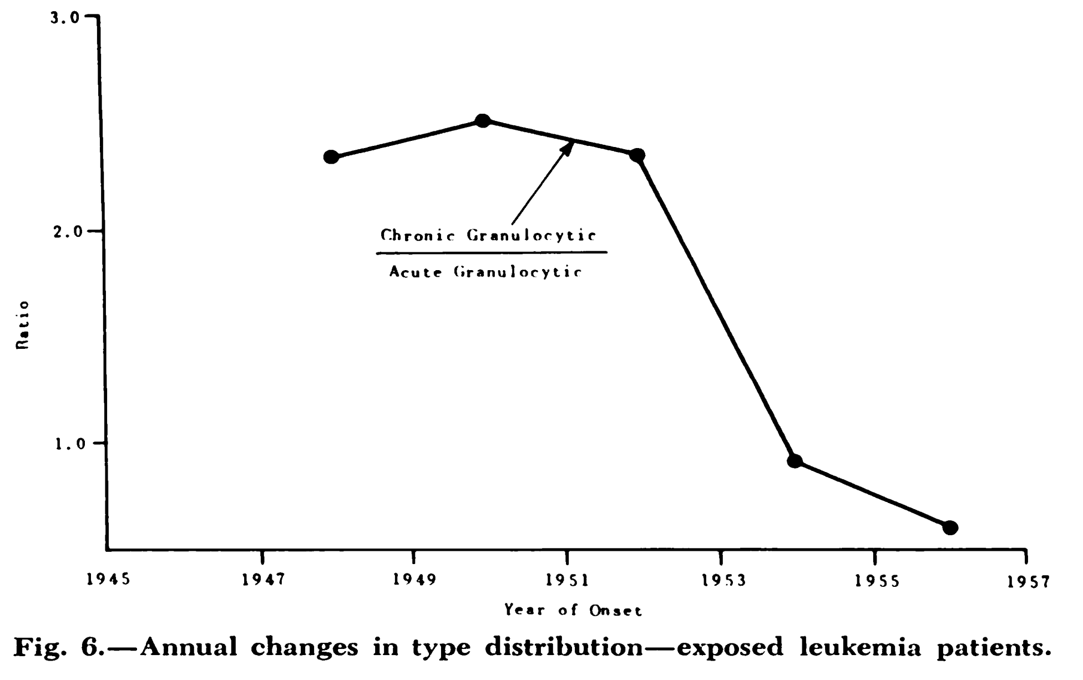

Slide 8
WHO classification, 2022 upgrade
More than 50 types and subtypes
Leukemias – disturbances in the regulation of growth and differentiation of WBC, white blood cells
Key types:
CML, chronic myeloid leukemia
AML, acute myeloid leukemia
  APL, acute promyelocytic leukemia
ALL, acute lymphoblastic leukemia
CLL, chronic lymphocytic leukemia
HCL, hairy cell leukemia

Slide 9
Key clinical signs
Leukocytes
  leukocytosis, hyperviscosity
  leukopenia, neutropenia
  diminished cellular immunity, diminished humoral immunity (CLL)
  infections
Thrombocytes
  thrombocytopenia
  bleeding
  thrombocytosis (CML)
Erythrocytes
  anemia
Organ infiltration
  bone marrow, spleen, liver, lymph nodes, brain, testis, skin, …
  myelosarcoma

Slide 10
1000 leukemia cases
Number of analyzed cases (2004-2009) – 1007 patients
CLL
HCL
CML
ALL
AML
Ráčil et al., Am J Hematol 86, 2011, 800–803

Slide 11
Clinical symptoms
Subjective complaints of patients according to the history at diagnosis
ACUTE LEUKEMIAS
CHRONIC LEUKEMIAS

Slide 12
Objective findings
Objective findings by the first visited physician
ACUTE LEUKEMIAS
CHRONIC LEUKEMIAS
26%
15%

Slide 13
Blood count
Lab exam by the first visited physician
PERFORMED?
ABNORMALITY?

Slide 14
CML
Chronic Myeloid Leukemia
model disease of a single chromosomal abnormality

Slide 15
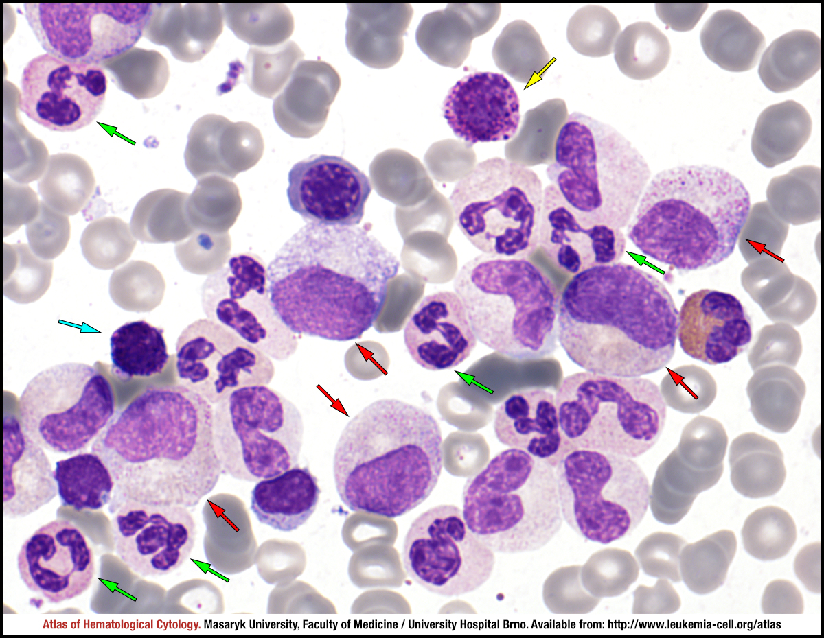

Slide 16

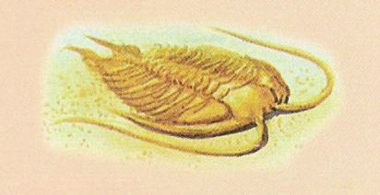
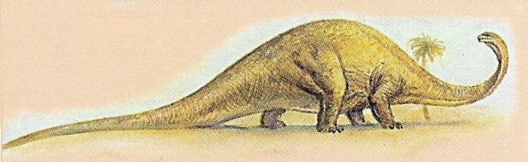
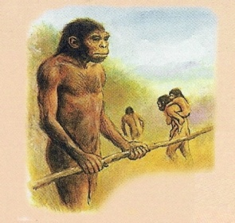

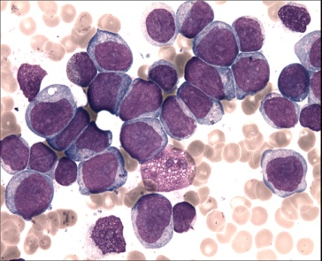
leukemia
(1850)
chemotherapy
(1950)
time
a lot of „nothing“
Ph¹ (1960)
BMT IFN
BCR/ABL PCR
imatinib, dasatinib,
nilotinib
others

Slide 17
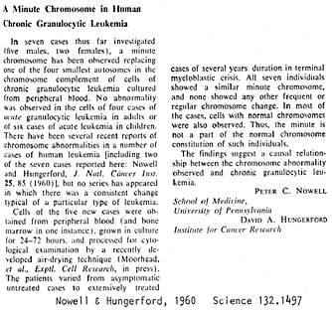
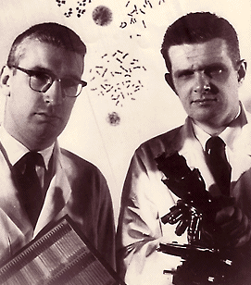
1960
A minute chromosome in human granulocytic leukemia. Science 132, 1960, 1497.
…the findings suggest a causal relationship between the chromosome abnormality observed and chronic granulocytic leukemia…
P.C. Nowell, D.A. Hungerford, University of Pennsylvania in Philadelphia

Slide 18
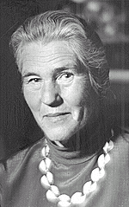
1973: translocation of chromosomal material
Rowley JD: A new consistent chromosomal abnormality in chronic myelogenous leukemia identified by quinacrine fluorescence and Giemsa staining. Nature, 243, 290-293, 1973
…suggesting that there may be a hitherto undetected translocation between the long arm of 22 and the long arm of 9, producing the 9q+ chromosome…

Slide 19
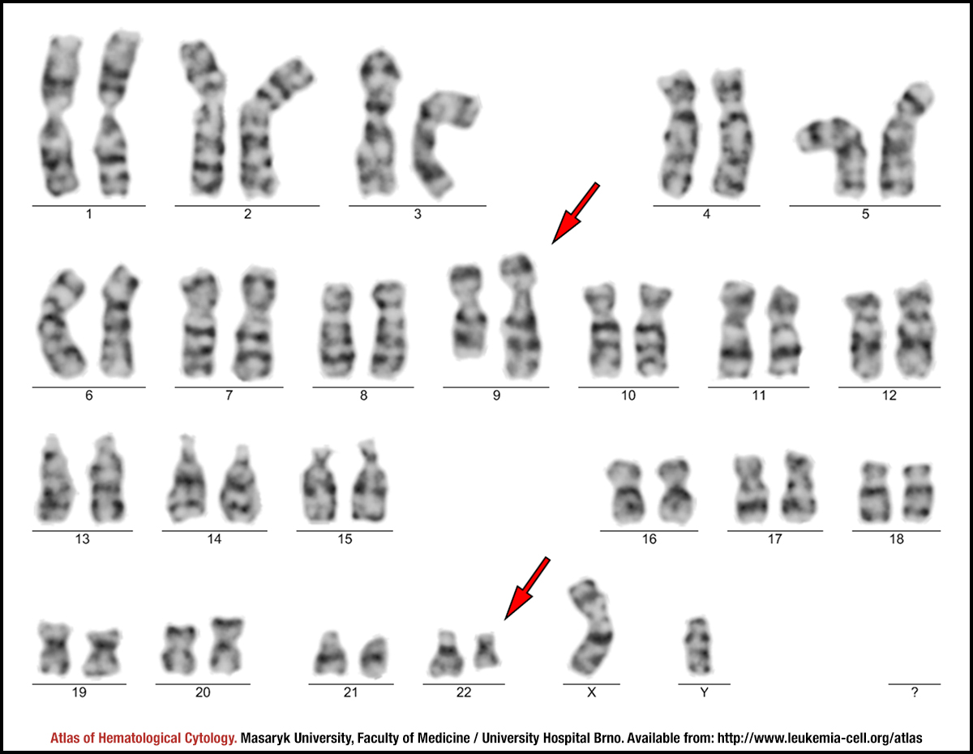

Slide 20
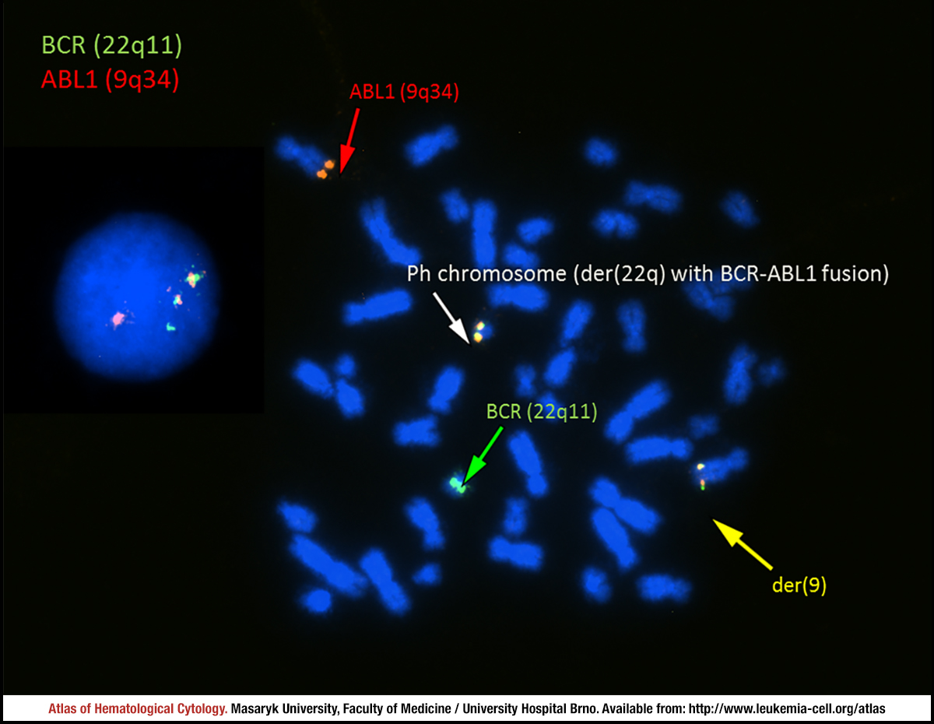

Slide 21
1982: abl localized on chromosome 9
Heisterkamp N et al.: Chromosomal localization of human cellular homologues of two viral oncogenes. Nature 299, 1982, 747-749.
…we now show that the human equivalents of c-fes and c-abl are localized on human chromosomes 15 and 9, respectively. It is of interest that both of these chromosomes are involved in specific rearrangements found in certain forms of human cancer…
ABL gene = the human homologue of the v-abl oncogene of the Abelson murine leukemia virus. Abelson HT, Rabstein LS: Proc Am Assoc Cancer Res 10: 1, 1969

Slide 22
1985: fused protein BCR::ABL
Shtivelman E et al.: Fused transcript of abl and bcr genes in chronic myelogenous leukaemia. Nature 315, 1985, 550-554.
…characterization of an 8-kilobase RNA specific to chronic myelogenous leukaemia shows it to be a fused transcript of the two genes. The fused protein that would be produced is probably involved in the malignant process…

Slide 23
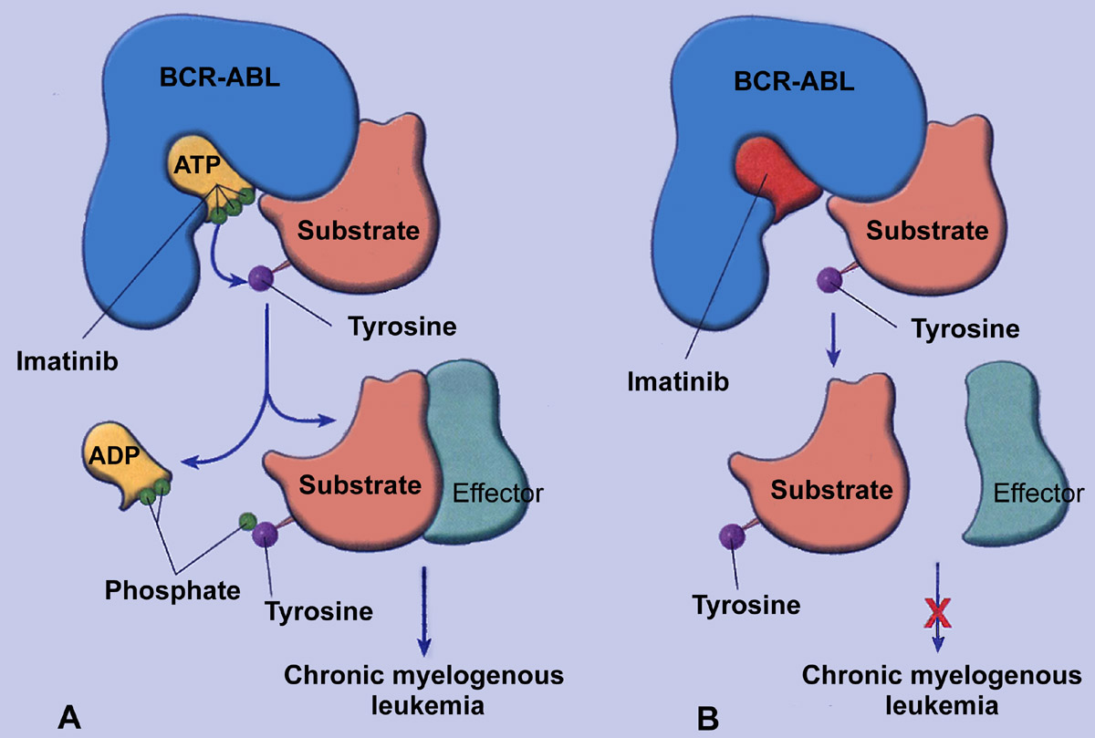
Kinase activity

Slide 24
Epidemiology of CML in Czechia
Prevalence
Number of living persons with the disease per 100 000 inhabitants
Year
Rok
trend of 2005-2014
Source: National Cancer Registry, ÚZIS ČR
Notes:
24

Slide 25
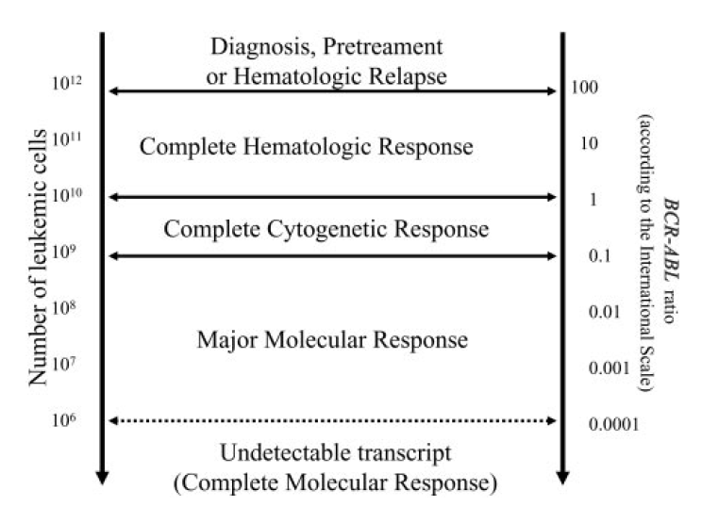
Relationship between the number of malignant cells, therapy response, and BCR-ABL
Baccarani et al.: Blood 108, 2006, 1809-1820

Slide 26
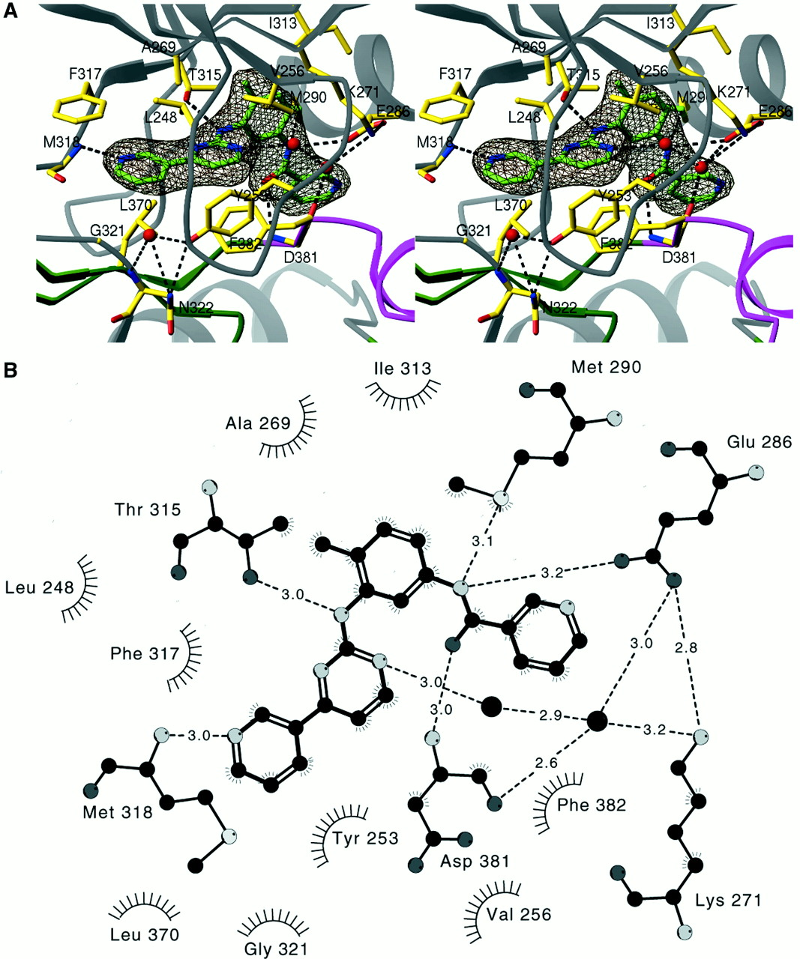
Crystal structure solved, but resistance described
Schindler T et al.: Structural mechanism for STI-571 inhibition of Abelson tyrosine kinase. Science 289, 2000, 1938-1942.
Gorre ME et al.: Clinical resistance to STI-571 cancer therapy caused by BCR-ABL gene mutation or amplification. Science 293, 2001, 876-880.

Slide 27
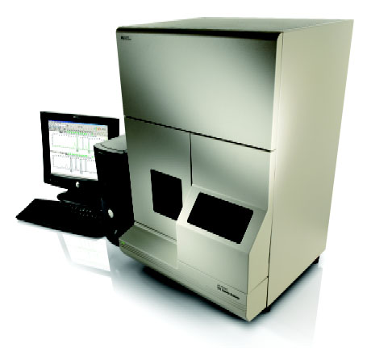
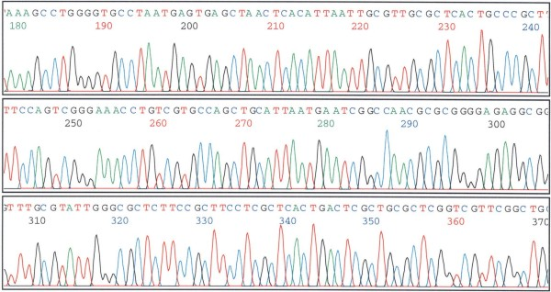

Direct sequencing
BigDye v3.1 Termination kit (Applied Biosystems)
ABI 3100 (Applied Biosystems)
ABL KD 914 bp
(AA 235 – 505)
F-ABL
R-ABL

Slide 28
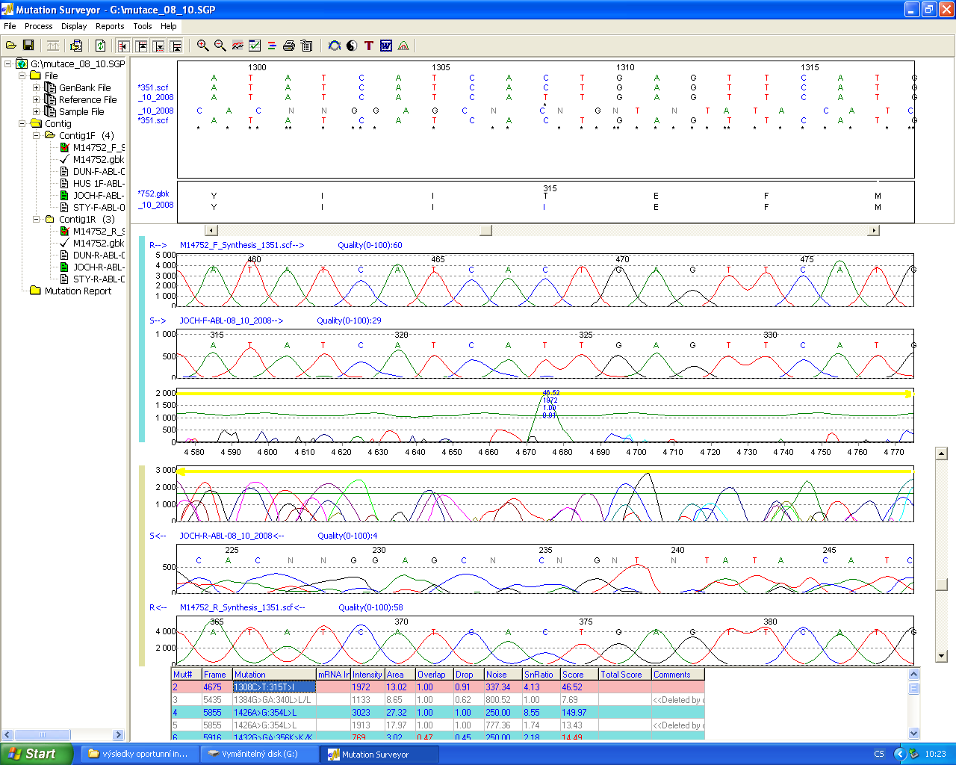
Mutation detection - MutationSurveyor® software (Softgenetics)
Nucleotide change
Amino acid change
T315I
reference sequence (GenBank M14752)
sample sequence

Slide 29
Apperley JF: Lancet Oncol 8, 2007: 1018

Slide 30
CML Case
older man, age 60
history: hypertension, bronchial asthma
drugs: sartan, CaC blocker
occupation: office worker
abusus: no alcohol, smokes 5 c./day
current illnesses:
  no symptoms
  maybe a bit tired
  sent by his GP – leukocytosis 26 found at a routine check-up

Slide 31
CML Case
CBC
  WBC 26 (4-10)
  Hb 143 (135-176)
  plt 207 (150-350)
microscopic WBC differential count
  neutrophils 53% (50-70)
  lymphocytes 23% (20-40)
  eosinophils 2% (0-5)
  basophils 6% (0-1)
  metamyelocytes 5% (0-0)
  myelocytes 6% (0-0)
  blasts 0% (0-0)
immature granulocytes = myeloproliferative disorder suspected

Slide 32
CML Case
bone marrow
  very increased cellularity
  increased granulocyte lineage
  blasts 1% (0.1-3.5)
  promyelocytes 2% (0.5-5)
  myelocytes 28% (5-23)
  metamyelocytes 6% (10-30)
  bands 15% (10-30)
  segments 27% (7-25)
  = myeloproliferative disorder probable
mutations: BCR::ABL found by PCR
cytogenetics: 46,XY,t(9;22) = Philadelphia chromosome
Dg.: chronic myeloid leukemia in chronic phase

Slide 33
CML Case
CML is not an emergency
  except hyperleukocytosis (e.g. priapism)
standard treatment
  tyrosine kinase inhibitors (TKIs)
    1st: imatinib
    2nd: dasatinib, nilotinib, bosutinib
    3rd: ponatinib
  one pill every day, but forever
patient alive in CR

Slide 34
CML - Take home messages
chronic disease
usually found incidentally
Ph chromosome => BCR::ABL fusion gene
TKI = one pill a day
survival better than 95 %
  comparable to normal population

Slide 35
AML
Acute Myeloid Leukemia
model disease of heterogeneous abnormalities
and clonal evolution

Slide 36
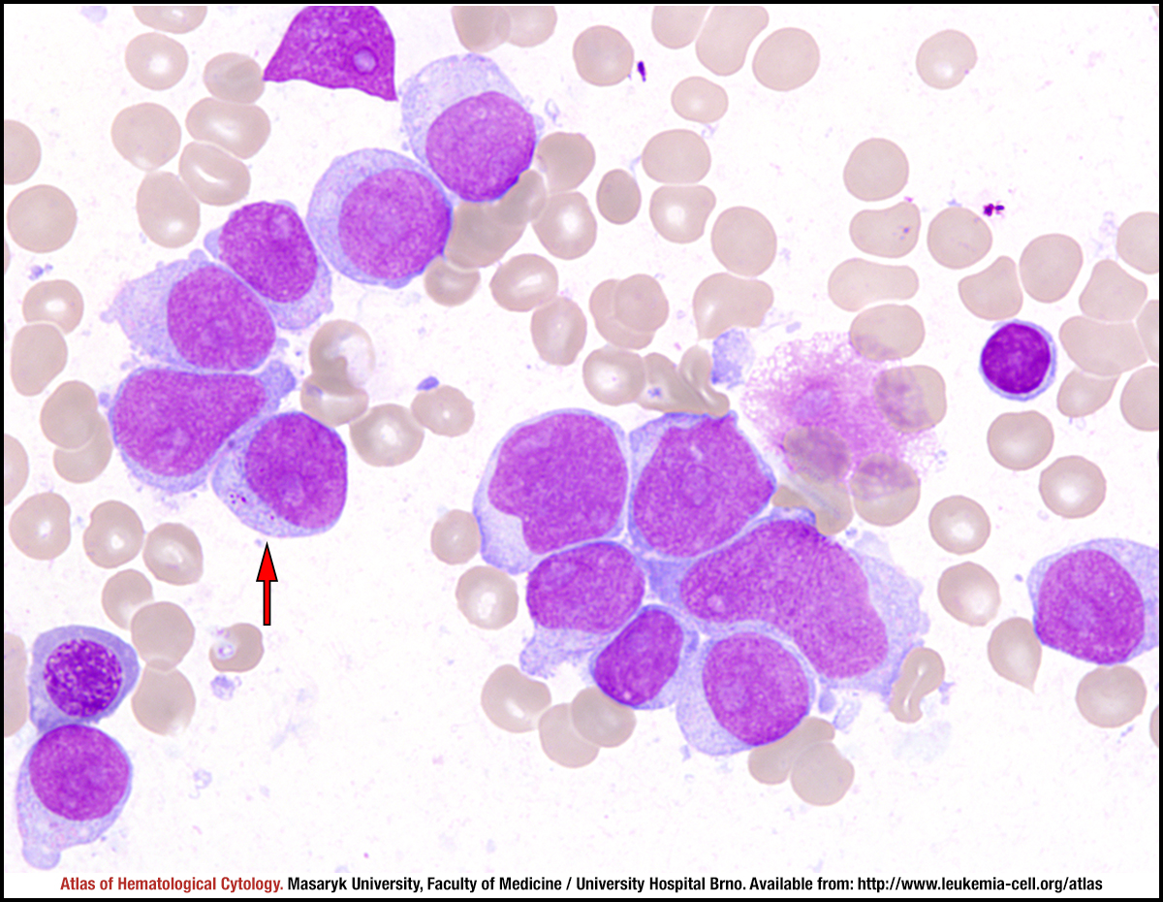

Slide 37
AML: outline
Myeloid pattern of the malignant cells
Variable maturation grade
Amazing genetic heterogeneity significantly influencing the prognosis
Prognostic stratification used in clinical practice for selecting the best therapeutic strategy
New molecular pathogenesis findings lead to the development of new, targeted therapies very recently

Slide 38
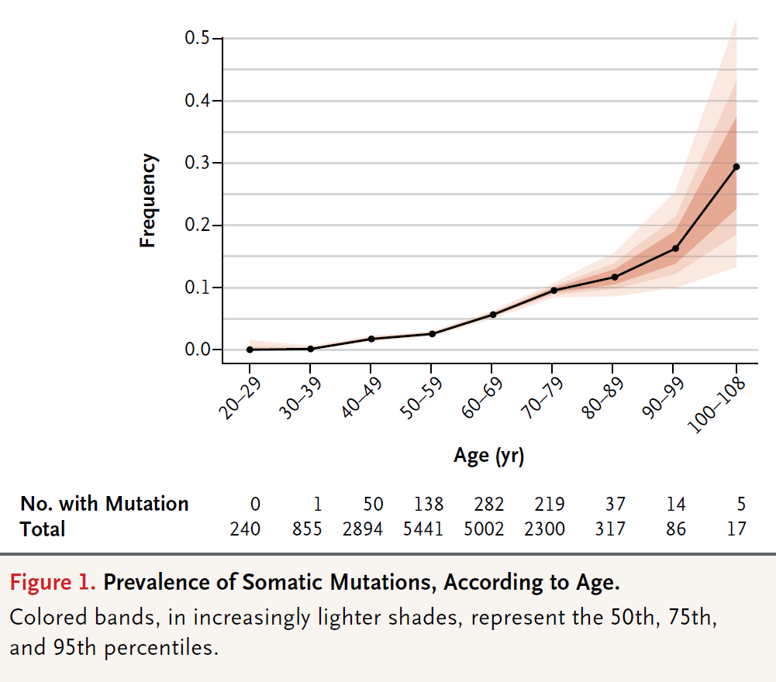
Clonal hematopoiesis
Jaiswal S et al. N Engl J Med 2014;371:2488-2498

Slide 39
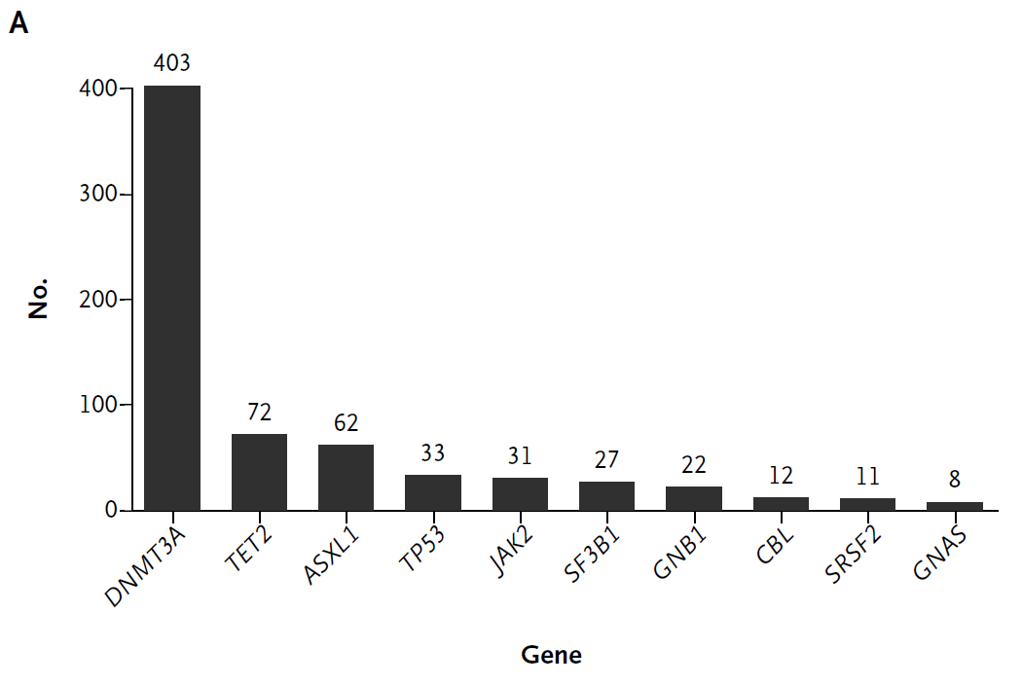
Clonal hematopoiesis
Jaiswal S et al. N Engl J Med 2014;371:2488-2498

Slide 40
DNMT3A
DNA (cytosine-5)-methyltransferase 3A is an enzyme that catalyzes the transfer of methyl groups to specific CpG structures in DNA, a process called DNA methylation. The enzyme is encoded in humans by the DNMT3A gene.
It is responsible for de novo DNA methylation. DNMT3A forms part of the family of DNA methyltransferase enzymes.
While de novo DNA methylation modifies the information passed on by the parent to the progeny, it enables key epigenetic modifications essential for processes such as cellular differentiation and embryonic development, transcriptional regulation, heterochromatin formation, X-inactivation, imprinting and genome stability.

Slide 41
TET2
TET2 tet methylcytosine dioxygenase 2
The protein is a methylcytosine dioxygenase that catalyzes the conversion of methylcytosine to 5-hydroxymethylcytosine.
The encoded protein is involved in myelopoiesis, and defects in this gene have been associated with several myeloproliferative disorders.

Slide 42
ASXL1
The ASXL1 gene provides instructions for making a protein that is involved in a process known as chromatin remodeling.
Through its role in chromatin remodeling, the ASXL1 protein regulates the expression of many genes, including a group of genes known as HOX genes.
The ASXL1 protein may have an additional role in gene regulation by signaling to molecules to add a methyl group (a process called methylation) to an area near a gene called the promoter region, which controls gene activity. When a promoter region is methylated, gene activity is repressed, and when a promoter region is not methylated, the gene is active.

Slide 43
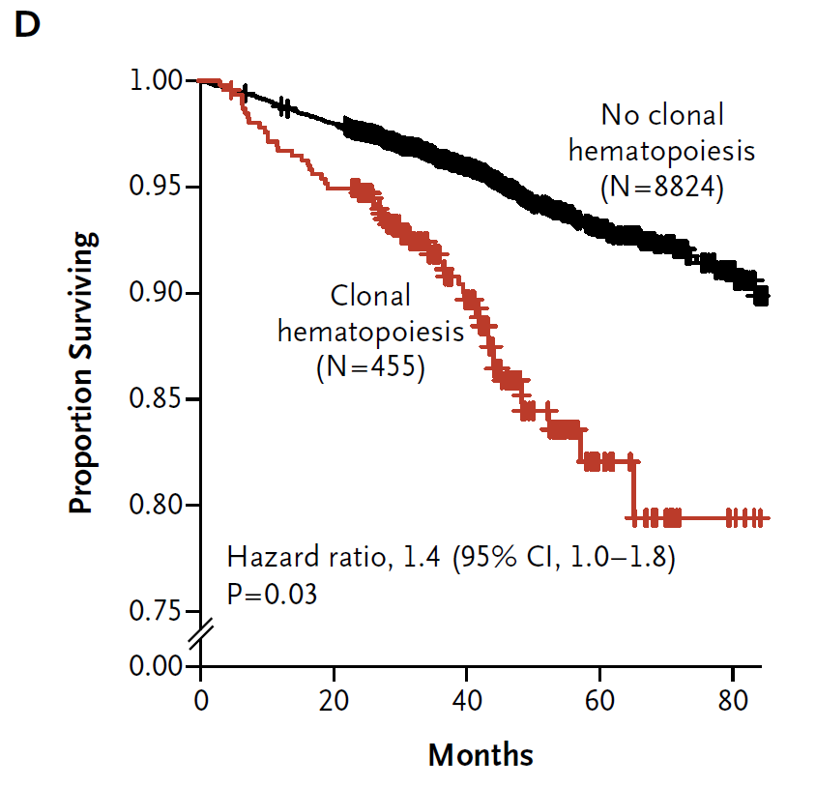
Clonal hematopoiesis: more frequent than hematological malignancies, as well as cardiovascular diseases! Increase in total mortality.
Genovese G et al. N Engl J Med 2014;371:2477-2487

Slide 44
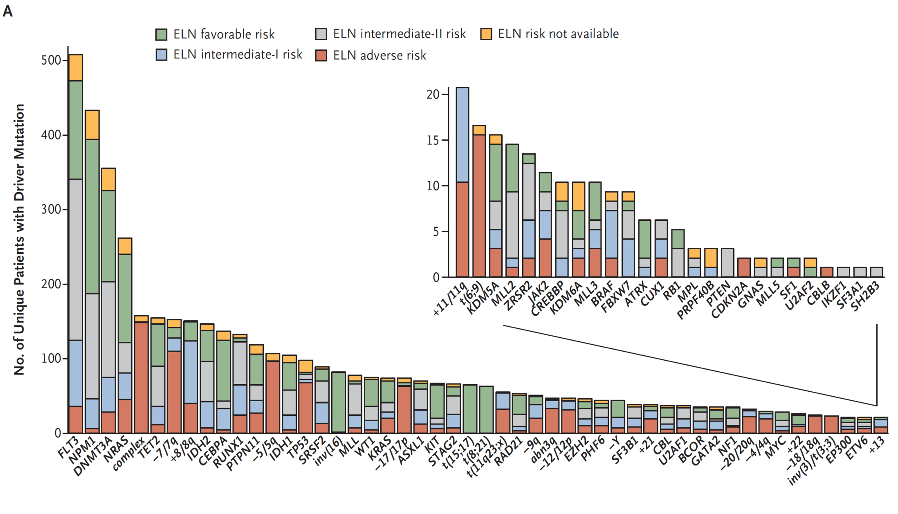
2016, n=1540
Papaemmanuil E et al. N Engl J Med 2016;374:2209-2221

Slide 45
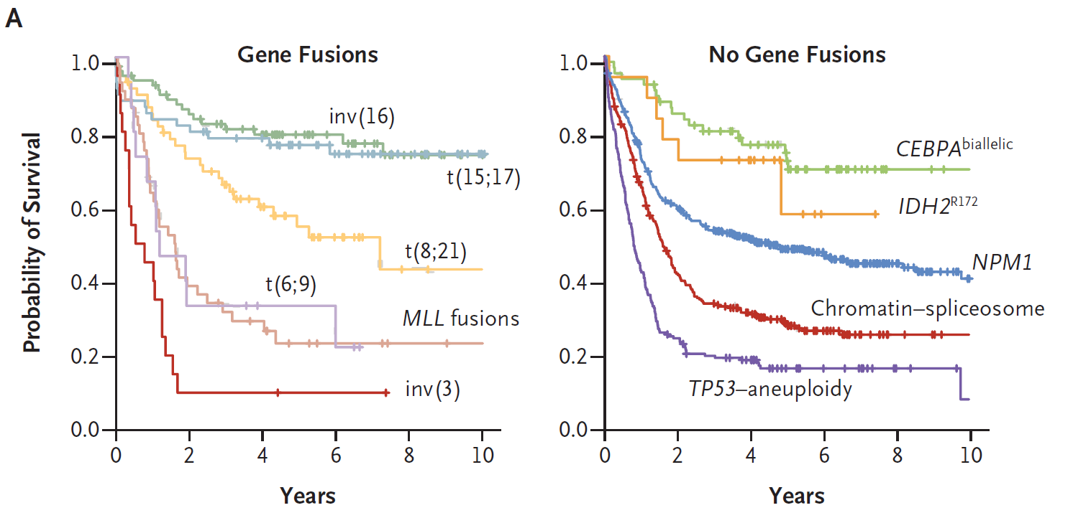
Papaemmanuil E et al. N Engl J Med 2016;374:2209-2221

Slide 46
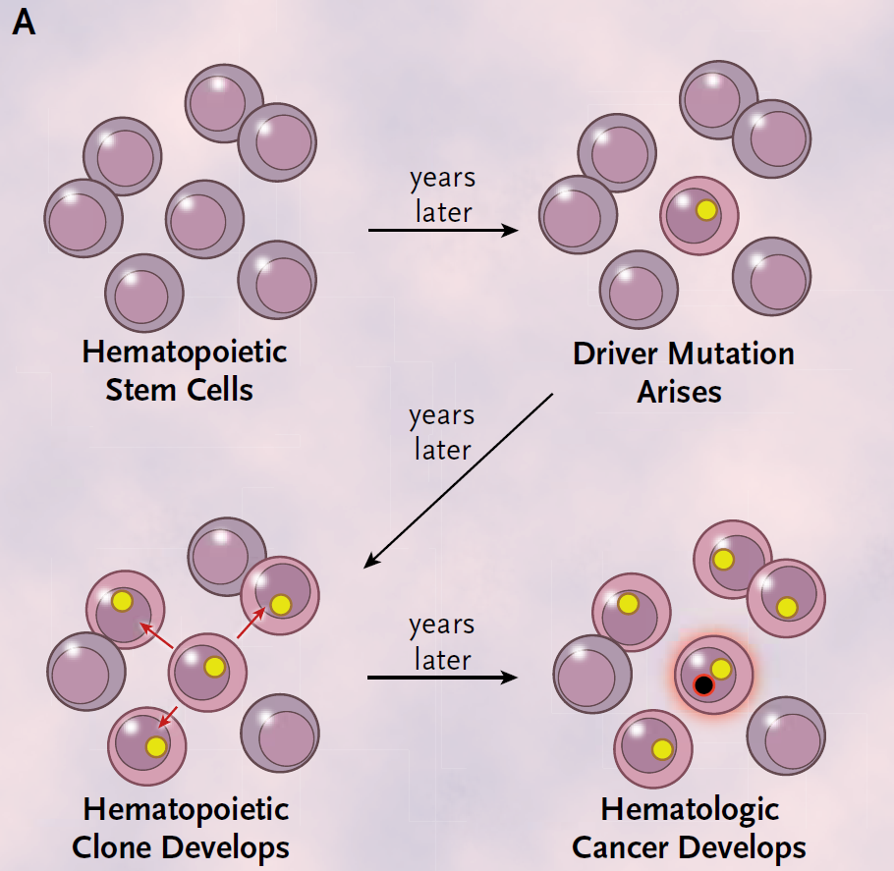
Genovese G et al. N Engl J Med 2014;371:2477-2487

Slide 47
AML Case
young man, age 24
history: none, no drugs taken
occupation: 1st factory worker, 2nd bartender
abusus: alcohol, 10-20 cigarettes/day
current illnesses:
  weight loss 5 kg in last month
  3 weeks fatigue
  2 weeks fever
  gum bleeding – stomatologist: gingivitis, insufficient hygiene
  1,5 weeks cough – GP: bronchitis – started ATB
  1 week ago blurry vision left eye, then both eyes – ophthalmologist: retinal hemorrhage – sent to infectious dep.
  infectious: WBC 320
  hematologist: urgent transfer to our centre

Slide 48
AML Case
CBC
  WBC 321 x10e9/l (normal range 4-10)
  Hb 66 g/l (135-176)
  plt 89 x10e9/l (150-350) after transfusion
microscopic WBC differential count
  neutrophils 0.5% (50-70)
  lymphocytes 1.5% (20-40)
  monocytes 0.0% (2-12)
  blasts 98.0% (0-0) = Dg. acute leukemia
coagulation
  D dimers 14 ug/ml (0-0.5), otherwise normal
biochemistry
  LDH 9.88 ukat/l (2.25-3.75), otherwise normal

Slide 49
AML Case
bone marrow assessment
  increased cellulatity
  low % of normal cells 0-1%
  blasts 93% (0-5)
cytochemistry
  POX (myeloperoxidase) positive
Diagnosis: acute myeloid leukemia
work-up:
  mutations: none found
  cytogenetics: several chromosome abnormalities (complex karyotype)
risk group: very high risk (of relapse)
  hyperleukocytosis + adverse karyotype

Slide 50
AML Case
hyperleukocytosis + leukostasis = hematological emergency
emergency treatment
  leukapheresis
    leuk- = leukocytes
    -apheresis = removal
  supportive measures
treatment
  induction: 1 cycle – complete remission
    Webster: to induce = to cause (something) to happen or exist
  consolidation: 2 cycles
    Webster: to consolidate = to make (something) stronger
  allogeneic stem cell transplantation
died due to transplant related toxicity (infection)

Slide 51
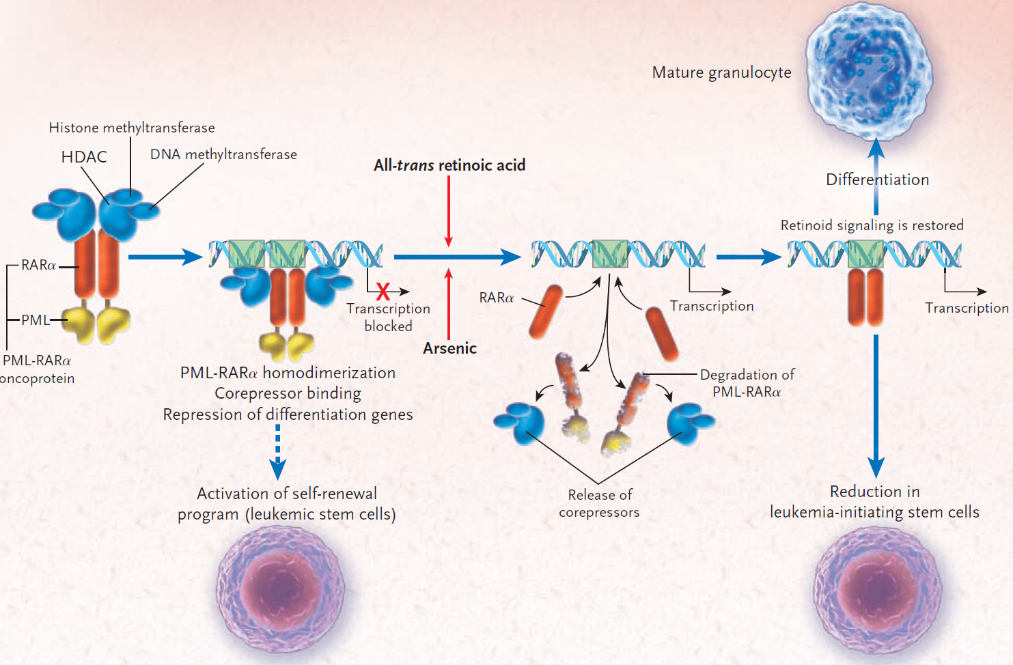
APL
Licht JD N Engl J Med 2009;360:928-930

Slide 52
APL Case
elderly man, age 70
history: non-STEMI, type 2 diabetes, cataract
drugs: ACE-i, BB, ASA, statin, 3 PADs, eye drops
occupation: retired
abusus: non-smoker, alcohol seldom
current illnesses:
  2 weeks shortness of breath
  thought of heart problems
  cardiologist: CBC – pancytopenia
  no other symptoms

Slide 53
APL Case
CBC
  WBC 2.10 (normal range 4-10)
  Hb 74 (135-176)
  plt 24 (150-350)
  = pancytopenia
microscopic WBC differential count
  neutrophils 8% (50-70)
  lymphocytes 41% (20-40)
  monocytes 0.5% (2-12)
  blasts 50% (0-0) = Dg. acute leukemia
coagulation
  D dimers 11.5 (0-0.5), INR 1.35 (0.8-1.2), fbg 1.7 (1.8-4.2) = DIC
biochemistry: normal

Slide 54
APL Case
pancytopenia + DIC = APL suspected = hematological emergency
bone marrow assessment
  increased cellularity
  low % of normal cells
  blasts 26% (0-5)
  promyelocytes 43% (0.1-5) = APL probable
cytochemistry
  POX positive
work-up:
  mutations: PML::RARa detected PCR = Dg. APL
  cytogenetics: 46,XY,t(15;17)
risk group: favorable = very low risk of relapse

Slide 55
APL Case
emergency treatment
  ATRA as soon as possible
    All-Trans Retinoic Acid (vitamin A derivative)
standard treatment
  induction: ATRA + chemo
  consolidation: ATRA + chemo
  maintenance: ATRA alone
  no transplant necessary
option for chemo-free therapy: ATRA + ATO (As₂O₃)
remission

Slide 56
ALL
Acute Lymphoblastic Leukemia
model disease of child malignancies with first and second hit

Slide 57
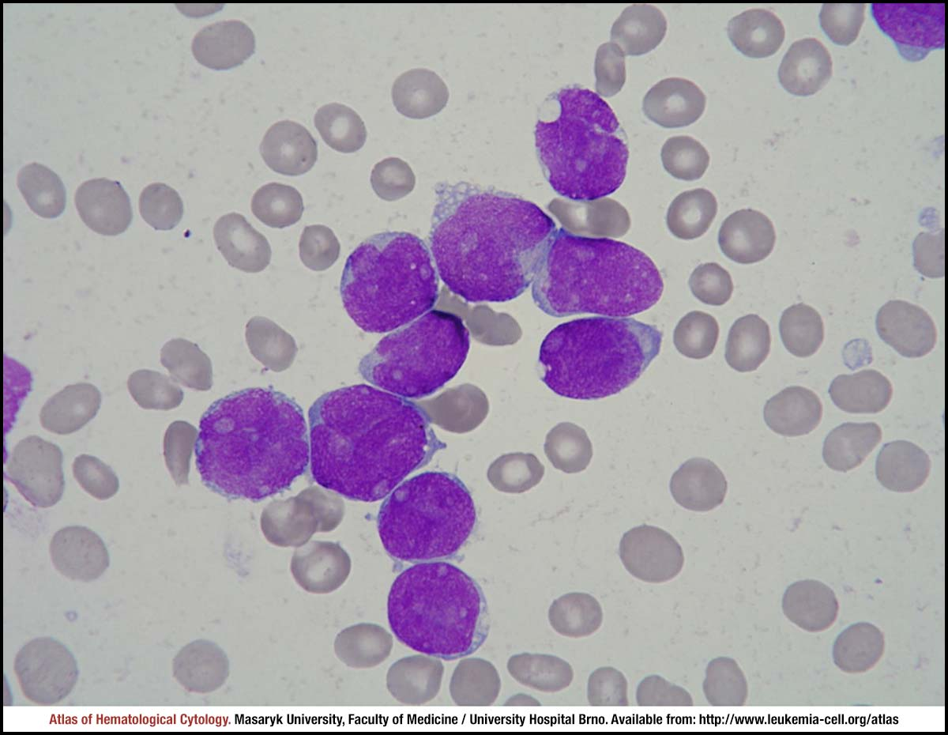

Slide 58
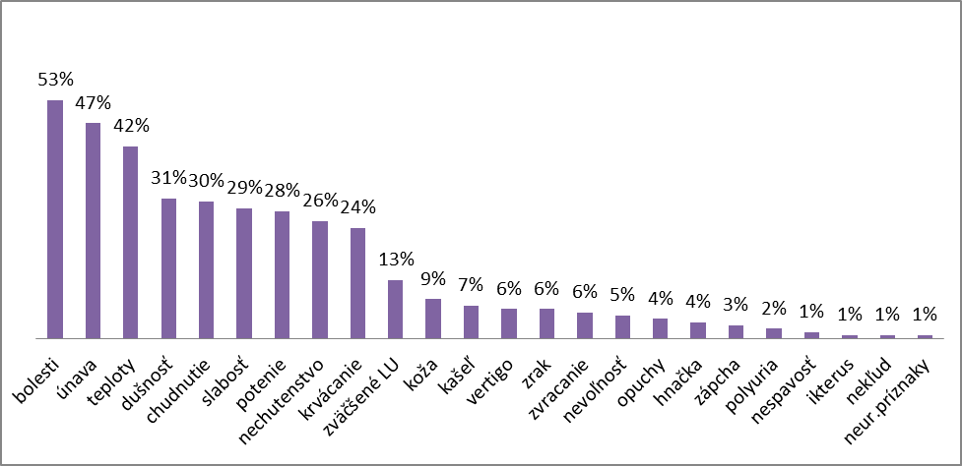
ALL: Clinical symptoms at diagnosis
pain
fatigue
fever
dyspnoe
weight loss
weakness
sweating
anorexia
bleeding
lymph nodes
skin infiltrates
cough
vertigo
vision problems
vomiting
nausea
oedema
diarrhoea
obstipation
polyuria
insomnia
jaundice
restlessness
other

Slide 59
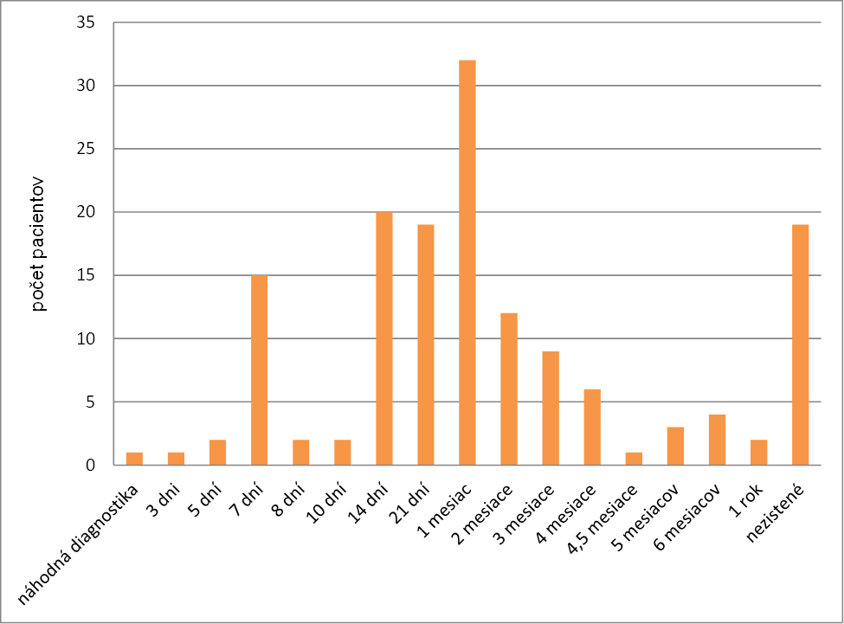
ALL: Time from first symptoms to diagnosis
incidental
3 days
5 days
1 week
2 weeks
3 weeks
1 month
2 months
3 months
6 months
1 year
unknown

Slide 60
Monozygotic twins
ALL
at 3,8 y
at 4,1 y
ALL at 5 y
no ALL
chemotherapy, transplantation
therapy, relapse, death
is living
is living
relapse, death
identical germinal translocation
identical germinal translocation from Guthri cards
hyperdiploidity
IKZF1 deletion
IKZF1 deletion
normal IKZF1
According to: Cazzaniga G et al. Blood 118, 2011, 5559-5564

Slide 61
IKZF1
DNA-binding protein Ikaros also known as Ikaros family zinc finger protein 1 is a protein that in humans is encoded by the IKZF1 gene.
This gene encodes a transcription factor that belongs to the family of zinc-finger DNA-binding proteins associated with chromatin remodeling.
Ikaros displays crucial functions in the hematopoietic system and its loss of function has been linked to the development of lymphoid leukemia.
Ikaros point mutant mice are embryonic lethal due to anemia; they have severe defects in terminal erythrocyte and granulocyte differentiation, and excessive macrophage formation.
The expression of this protein is restricted to the fetal and adult hemo-lymphopoietic system, and it functions as a regulator of lymphocyte differentiation.

Slide 62
ALL Case
young adult man, age 25
history: none, no drugs
occupation: construction worker
abusus: alcohol sometimes, smokes 10/day
current illnesses:
  weight loss 10 kg in last 6 months
  several weeks fatigue
  10 days feeling common cold, cough
  3 days ago fainting – local internal dept.: orthostasis
  yesterday at GP: „bad“ blood count – sent to local internal dept.
  anemia, lymphocytosis, blasts: transferred to our centre

Slide 63
ALL Case
CBC
  WBC 7.49 (4-10)
    automated diff: Lympho 49% (20-40)
  Hb 75 (135-175)
  plt 134 (150-350)
microscopic WBC differential count
  neutrophils 31.5% (47-70)
  lymphocytes 10% (20-45)
  monocytes 0% (2-12)
  blasts 55% (0-0) = Dg. acute leukemia
coagulation: normal
biochemistry: normal

Slide 64
ALL Case
bone marrow
  increased cellularity
  low % of normal cells
  blasts 60% (0-5)
cytochemistry
  POX negative
flowcytometry (immunophenotyping)
  CD10-19+20-22+34+38+c79a+cTdT+cIgM-sIgM- = pro-B immunophenotype
  = Dg. Acute B-lymphoblastic leukemia
mutations: none found
cytogenetics: 46,XY = normal karyotype
risk group: high risk

Slide 65
ALL Case
no emergency treatment necessary
standard treatment
  prephase: steroids
  induction: 2 cycles, achieved CR
  consolidation: 1 cycle (now)
allogeneic stem cell transplant
  no sibling donor
  found 10/10 matched unrelated donor
  still alive in CR

Slide 66
Acute leukemias - Take home messages
acute leukemia: 20 or more % of blasts in blood and/or bone marrow
acute = short history, rapid progression: days or weeks
acute myeloid leukemia: POX positive (or negative)
hyperleukocytosis: emergency
acute promyelocytic leukemia: pancytopenia, DIC, emergency
acute lymphoblastic leukemia: POX neg., immunophenotype
survival depends on risk factors

Slide 67
CLL
Chronic Lymphocytic Leukemia
model disease of complex pathogenesis involving
signalling pathways and tumor microenvironment

Slide 68
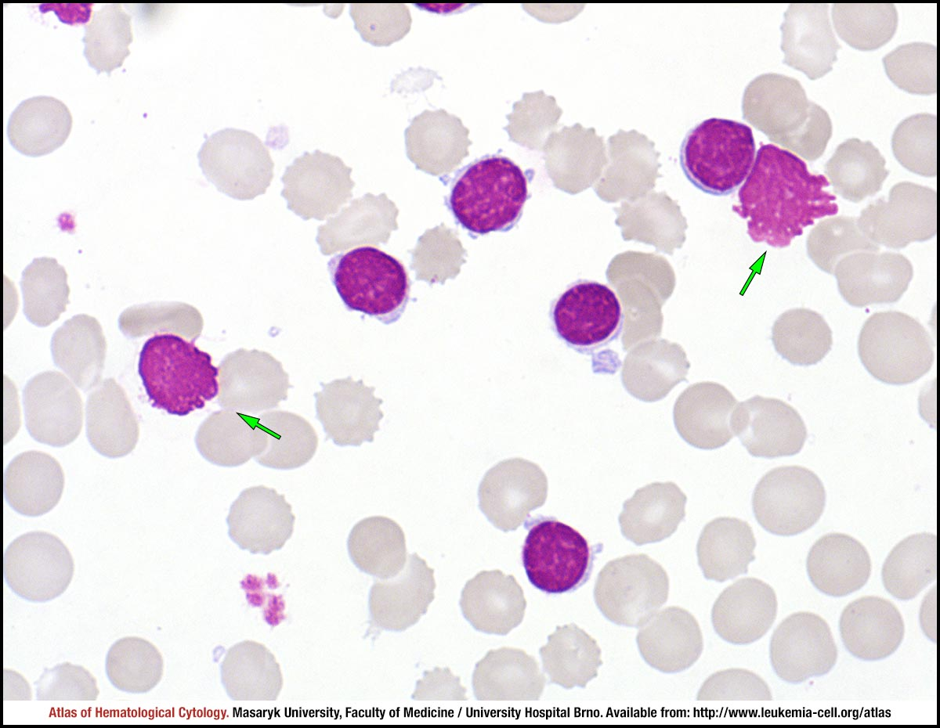

Slide 69
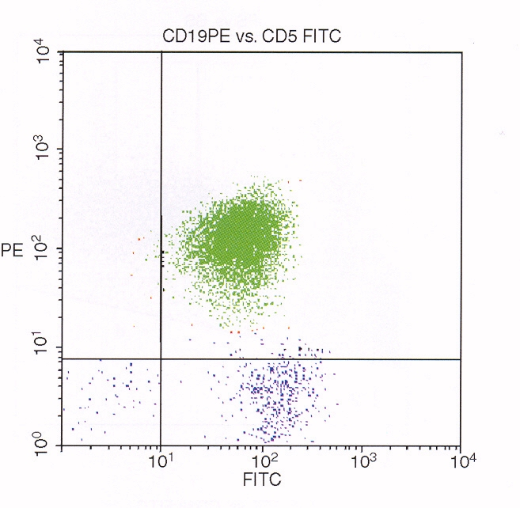
CD19
CD5

Slide 70
CLL - hallmarks
Different behavior than AML, ALL, or CML
Significant proportion of patients never require therapy (smoldering disease)
According to our data, in 60% of patients just observation, watchful waiting
The pathogenesis is extraordinarily complex, not yet fully understood, but big progress in recent years
Not just the malignant cells are involved, also the interactions with microenvironment are crucial (vs AML)
Due to recent progress, new therapies are emerging
However, still incurable (but treatable) disease

Slide 71
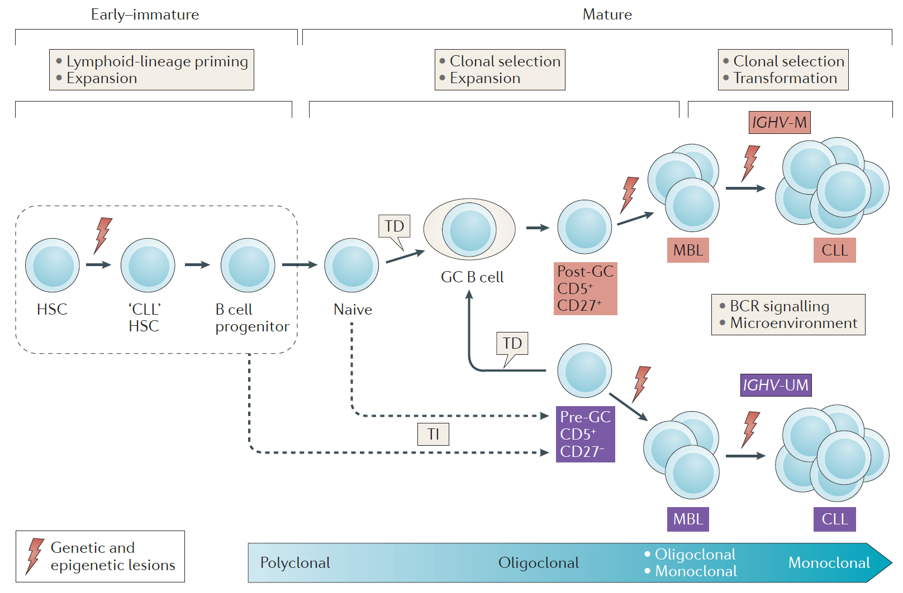

MBL - monoclonal B cell lymphocytosis:
B lymfo < 5x10⁹/L, monoclonal B lympho of CLL phenotype
± 5% in population over 40 y, risk of progression into CLL
Fabbri G, Dalla-Favera R, Nat Rev Cancer 16, 2016, 145-162

Slide 72
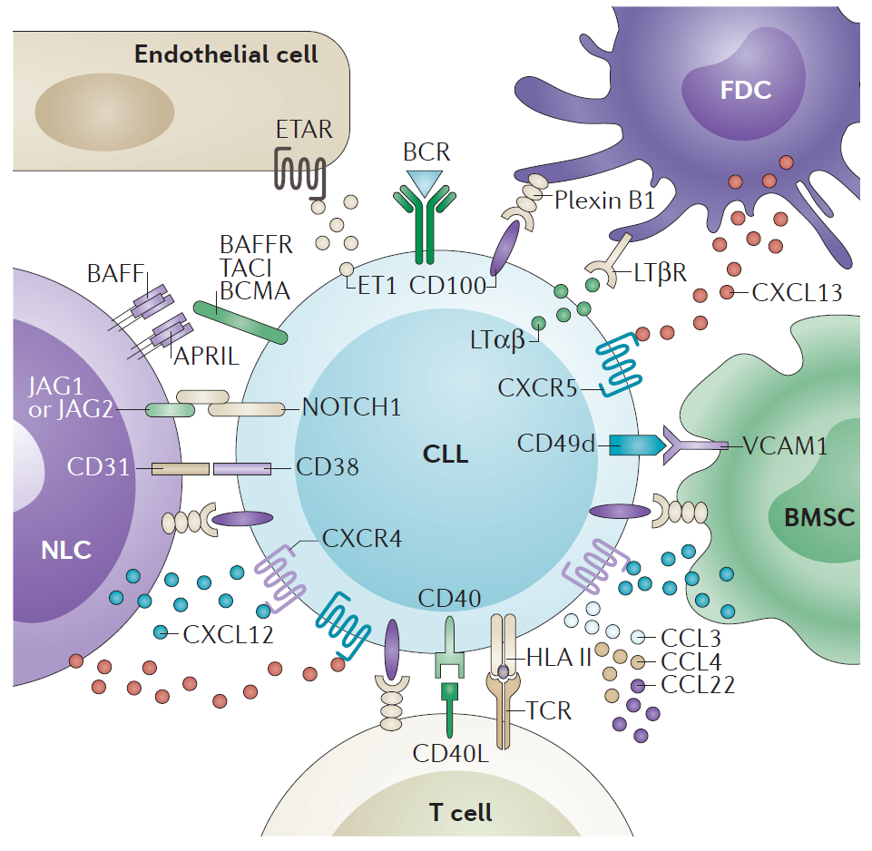
Fabbri G, Dalla-Favera R, Nat Rev Cancer 16, 2016, 145-162

Slide 73
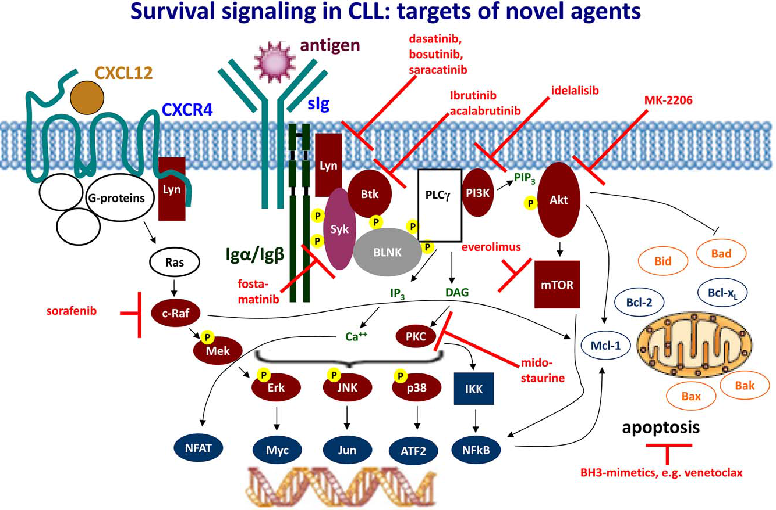
Hallek M, Am J Hematol 92, 2017, 946-965

Slide 74
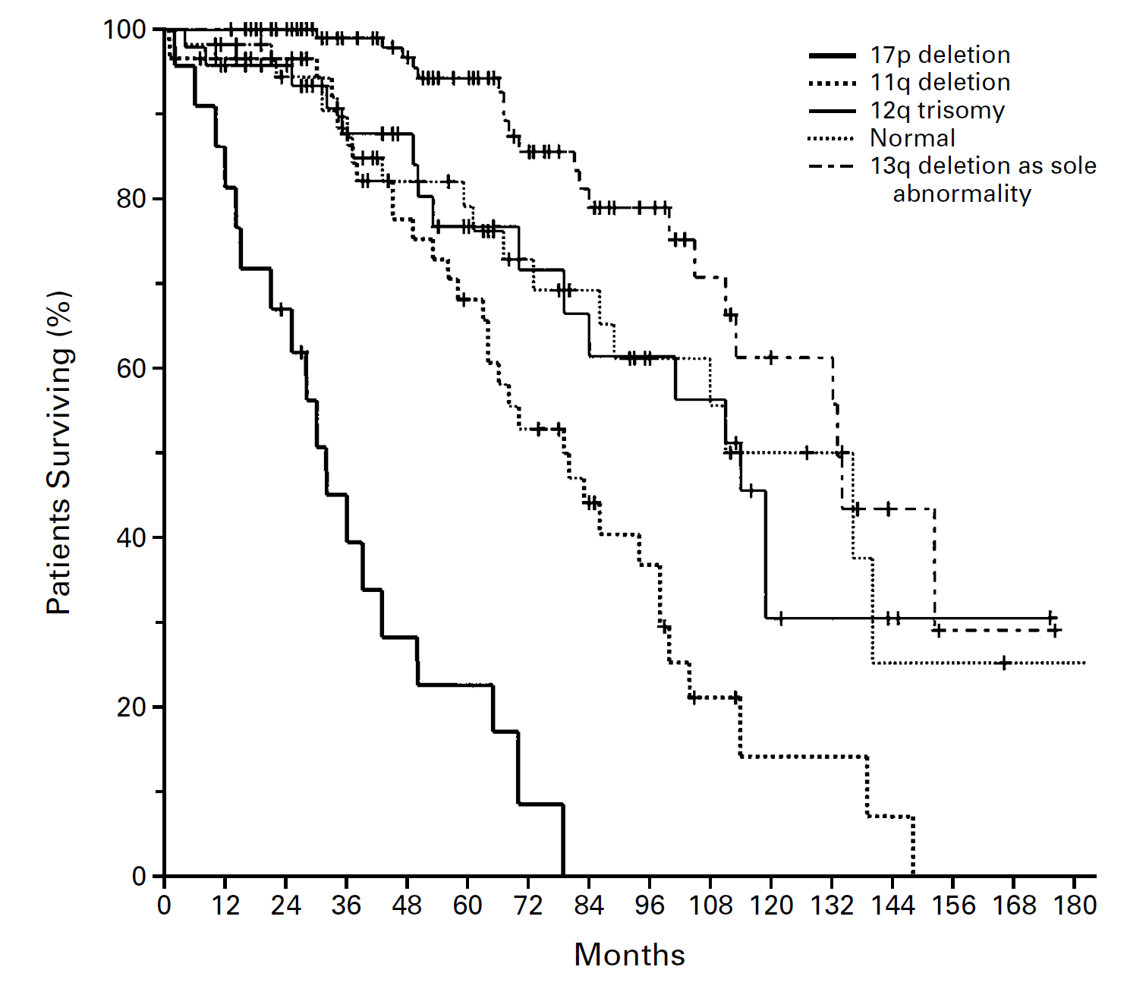
Döhner H et al.: N Engl J Med 2000; 343:1910-1916

Slide 75
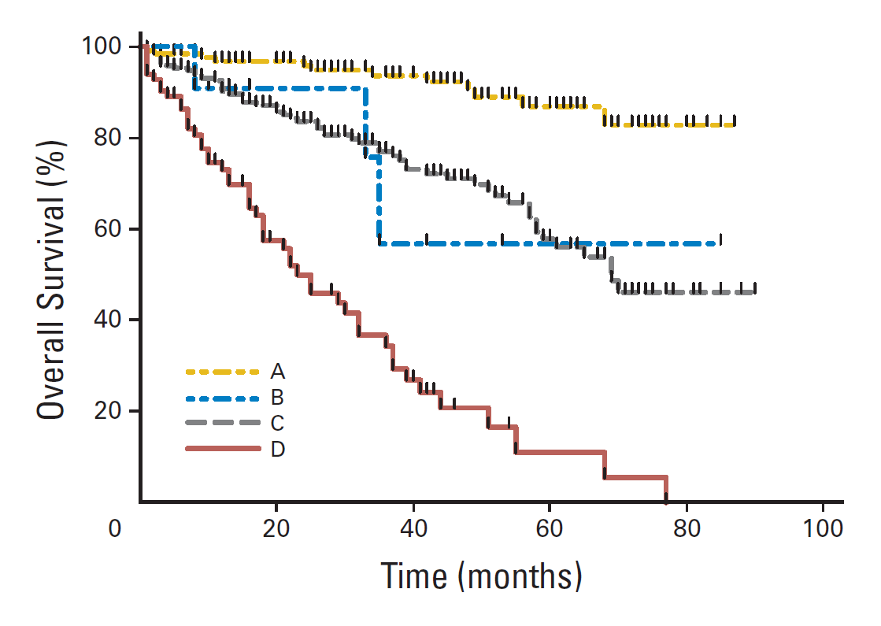
A, wild-type p53 and mutated IgVH
B, p53 defect and mutated IgVH
C, wild-type p53 and unmutated IgVH
D, p53 defect and unmutated IgVH
Trbusek M et al., J Clin Oncol 29, 2011, 2703-2708

Slide 76
CLL Case
elderly man, age 80
history: hypertension, chronic cardiac disease
drugs: ACE-i, BB, ASA, statin
occupation: retired
abusus: alcohol sometimes, non-smoker
current illnesses:
  weight loss 10 kg per last year
  a bit tired
  night sweating
  no other problems
  1 month fever: up to 38 °C
  sent by his GP = fever, lymph nodes and WBC 40

Slide 77
CLL Case
CBC
  WBC 44 (4-10)
  Hb 105 (130-176)
  plt 182 (150-350)
  lymphocytes 93% (20-40)
microscopic WBC differential count
  neutrophils 5% (50-70)
  lymphocytes 94% (20-40)
  monocytes 0% (2-12)
  blasts 0% (0-0)
coagulation and biochemistry: normal
lymphocytosis = lymphoproliferative disorder probable

Slide 78
CLL Case
bone marrow
  increased cellularity
  no blasts
  lymphocytes 53% (5-20)
immunophenotyping
  CD5+10-19+20dim23+200+79a-FMC7- = typical for B-CLL
Dg.: Chronic lymphocytic leukemia
work-up: mutations, cytogenetics
indication for treament
  symptoms: fever, sweating, weight loss
patient is alive, now 2nd relapse

Slide 79
CLL - Take home messages
chronic disease
similar to indolent lymhomas
no symptoms for many months or years
leukocytosis with lymphocytosis
specific immunophenotype (CD5+19+23+)
no treatment when no symptoms nor problems
treatment necessary only in advanced cases
  go go = younger, healthy patients
  slow go = elderly patients
  no go = frail patients with comorbidities
repeated remissions and relapses, incurable

Slide 80
Summary
After more than 150 years, the term leukemia still survives
Leukemias have different clinical behavior, yet with some similar patterns
Where the pathogenesis is relatively simple, just one targeted therapy may show miraculous effect (CML)
Complex genetic changes in other types of leukemia, especially in advanced stages, preclude simple therapeutic strategy
In CLL, disrupting the interactions with tumor microenvironment seems to be very important
Classical non-specific chemotherapy, in combination with monoclonal antibodies, or BMT, still serve as therapeutic option in many cases

Slide 81


The Emperor of All Maladies
$6 (e-book)
$12 (paperback)
500 Kč (print)

