Slide 1
Plethysmography:
Blood flow in the forearm
Physiology II – practice
Spring, weeks 7th-9th

Slide 2
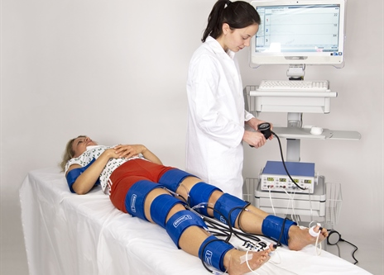
Methods of blood flow measurement – see in practicals
Plethysmography
  Evaluation of the volume changes in the limbs (the higher the blood flow, the faster the volume increase if the blood outflow from the limb is closed)
  Venous occlusive plethysmography uses two cuffs:
    occlusive cuff (OC) is used to close (=occlude) bloodflow through veins
    measuring cuff (MC) is used to detect volume changes
Clinical use:
  Evaluation of endothelial function and dysfunction (within research, so-called FMD = flow-mediated dilation of brachial artery reflects the function of endothelial NO-synthase)
  Evaluation of the ischemic limb disease (U.S., especially in research or in clinical practice using segmental measurement of blood pressure, which informs us about the location of the arterial occlusion)
https://www.perimed-instruments.com/upl/images/377677_464_333_2_0_thumb/segmental-pressures-perimed.jpg

Slide 3
Vascular tone regulation
Various vasoactive compounds are affecting the vessel at one time including both vasodilatory (nitric oxide, adenosine, histamine, low pH = acidosis…) and vasoconstrictive compounds (angiotensin II, adrenaline through α-receptors, vasopressin, serotonin, caffeine…) = whether vasodilation or vasoconstriction occurs, depends on their ratio
Neural regulation
  Vessels are innervated via the sympathetic nervous system:
  α-receptors causing vasoconstriction
  β-receptors causing vasodilation (coronary, muscle and lung circulation)
Myogenic regulation
  Increased vessel wall tension causes vasoconstriction (we can imagine this as a “defence against too big vessel extension if the blood pressure is too high“)
  Myogenic regulation is mediated via stretch-receptors, that are connected to cationic channels (Na⁺, Ca²⁺) = cation influx into the cell leads to depolarization and smooth muscle cells contraction
Metabolic regulation
  Under ischemic conditions, a variety of metabolic degradation products originates (e.g. lactate, ADP, AMP) and pH decreases (acidosis), all of which results in vasodilation (“the aim is to remove the degradation products from circulation“) –this is called reactive hyperemia
  Metabolic regulation is tightly connected with functional hyperemia that occurs during physical exercise (exercise causes the series of contractions and relaxations which affects blood flow in vessels; after every contraction blood flow increases during the relaxation period and this hyperemia lasts even after the exercise is over)

Slide 4
Bloodflow in skeletal muscle
At rest, the nervous regulation of bloodflow in vessels dominates – sympathetic α-adrenergic fibers maintain a constant vascular tone
During physical exercise, blood flow is ensured mainly by metabolic autoregulation ẞ2 receptors in arterioles – binding of adrenaline → vasodilation.
This regulation is especially useful in the initial phase of the exercise.
In a working muscle, blood flow can increase more than 20 times
Isometric muscle contraction can stop blood flow through the muscle
Rhythmic contractions lead to the closure of blood vessels during contraction and filling of blood vessels during relaxation. Thus, they help to pump blood in the tissue in a forward direction
Bloodflow in muscle
Time

Slide 5
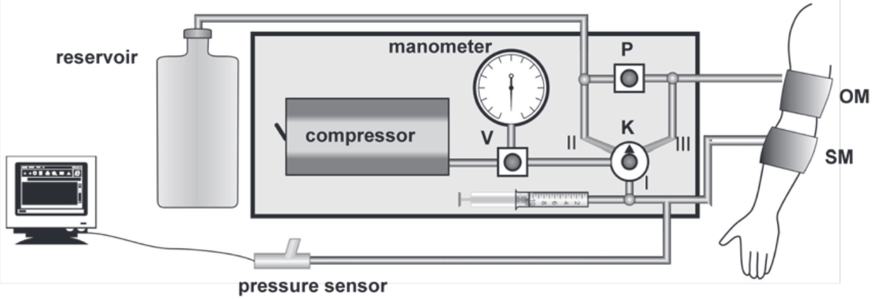
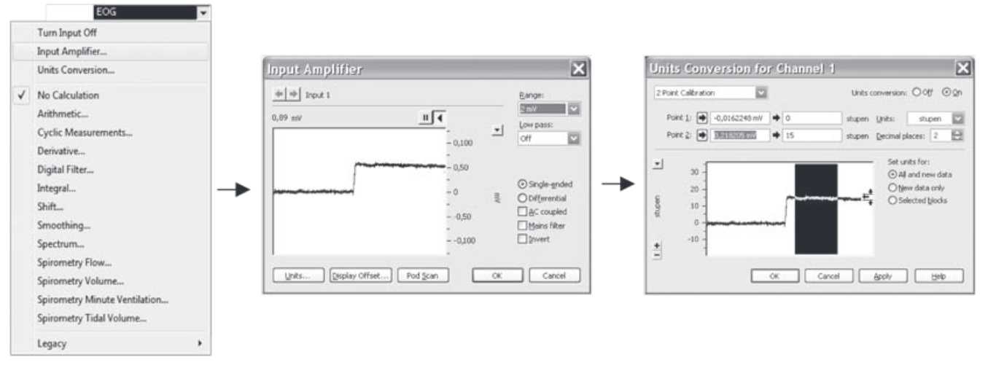
Experimental design in practicals
DON´T FORGET THE CALIBRATION(!)

Slide 6
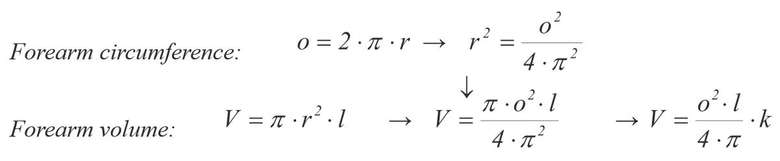
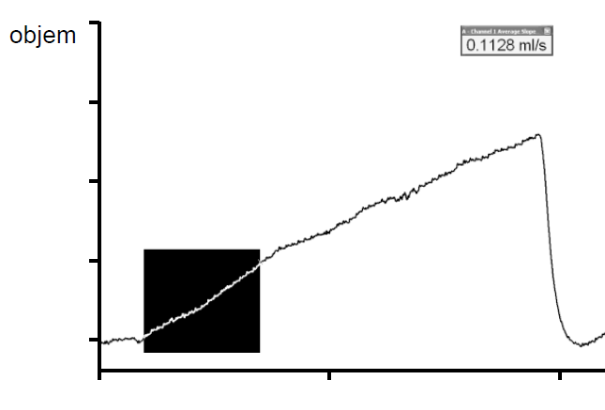
Results
1) Resting flow measurement:
2) Calculation of forearm volume:
Volume
3) Determine flow in ml/min/100 ml of tissue
Mark the increasing part of the curve → computer will automatically determine flow in ml/s
4) Compare with physiological values:
Resting flow in muscles =
2-8ml/min/100 ml of tissue
REPEAT at least 3 times

Slide 7
Results
Blood flow during and after exercise performed with the other hand
  Start exercising with the other hand for 2-3 minutes, during and after the exercise, start recording blood flow in the examined limb (repeatedly)
Work (functional) hyperemia: increased blood flow due to exercise
  After the exercise with the examined hand , start recording blood flow values (repeatedly)A
Reactive hyperemia: increased blood flow due to ischemia
  Induce ischemia of the examined hand as described in the protocol, after the ischemia, start recording blood flow values (repeatedly)
Draw graphs reflecting blood flow changes in the examined limb for each situation
Calculate how many times the blood flow increased compared to resting flow and compare your results with physiological values:
  Functional hyperemia: 10-20 times increase
  Reactive hyperemia: 10 times increase Duration: approx. 140 s

Slide 8
Endothelial function and dysfunction
Endothelial functions:
  Barrier function (endothelium is a part of the hematoencephalic barrier, and glomerular filtration membrane, it participates in the creation of the lymph, etc.)
  Blood clotting and coagulation (thrombocyte adhesion, tissue factor, tPA,…)–Immune and inflammatory reaction (endothelial selectins, VCAM, ICAM…)
  Endocrine functions (e.g. nitric oxide, angiotensin-converting enzyme production, many various receptors for various hormones and signalling molecules)
Endothelial dysfunction
  Endothelial dysfunction is a complex pathological phenomenon characterized by:
    disruption of the vasodilation/vasoconstriction ratio (based mainly on the deficiency of nitric oxide)
    pro-trombogenic state (higher risk of thrombi creation consequently causing vessel wall inflammation)
    transition from quiescent to the proliferative stage (disrupted endothelium produces various growth factors and cytokines leading to endothelial and vascular smooth muscle cells proliferation resulting in the vascular remodelling)
  Endothelial dysfunction represents the initial stage of atherosclerosis which at the end of the day leads to ischemic heart disease (including myocardial infarction), ischemic limb diseases (causing various ulcers and leading to limb amputations) or to brain vessels atherosclerosis (including ischemic strokes)
ENDOTHELIAL DYSFUNCTION
DEVELOPED ATHEROSCLEROTIC PLAQUE (+ ISCHEMIA)

Slide 9
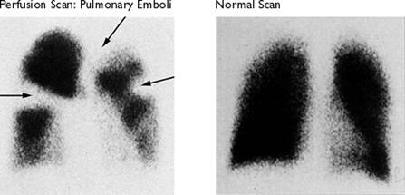
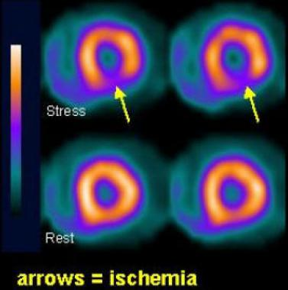
Other methods of blood flow measurement
Radionuclide method
  A patient is injected with radioactive solution (= radiopharmaceutical) with short half-life (= fast elimination from the body = low toxicity)
  The higher the blood flow in the organ, the higher the up-take of the radiopharmaceutical and the higher the radiation (emitted by the radiopharmaceutical) detected on the special detector
Clinical use:
  Lung scintigraphy
    Used in the diagnostics of the pulmonary embolism (clinical condition when embolus blocks part of the pulmonary circulation and the area ahead of this obstruction shows no blood flow and is ischemic)
  Myocardial scintigraphy (Cardiac-SPECT)
    Used in the diagnostics of ischemic heart disease if the ECG and laboratory results are unclear
    After administration, the radiopharmaceutical is distributed over the myocardium and areas with low radiopharmaceuticals concentration correspond to the badly-perfused areas („hibernating myocardium“, locations after coronary artery stenosis) or to areas after myocardial infarction (the myocardial scar is less perfused compared to healthy myocardium)
Normal lung Arrows = flow defect = embolism
Normal heart Arrows = flow defect = ischemia
Obrázek 1: http://web.carteret.edu/keoughp/LFreshwater/CPAP/V-Q%20Relationships/VQClassNotes_files/image006.jpg
Obrázek 2: http://img.medscapestatic.com/pi/meds/ckb/39/26839tn.jpg

Slide 10

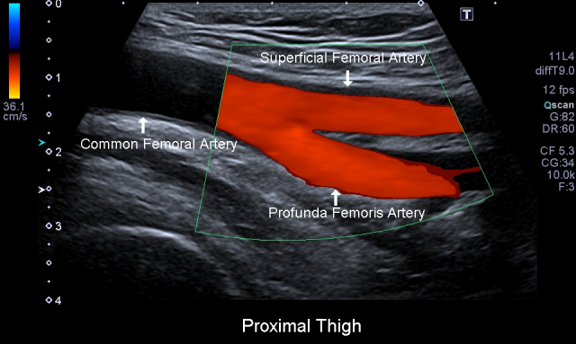
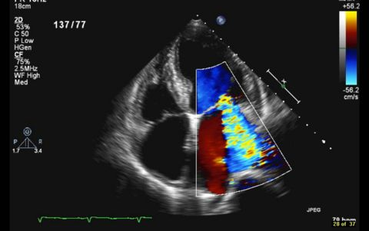
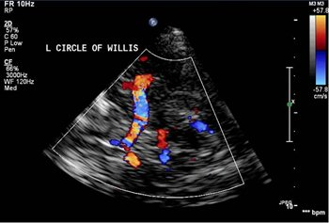
Other methods of blood flow measurement
Doppler measurement
  Based on the Doppler effect (changes in the frequency and wavelength of the emitted and received signal based on the mutual movement of the transmission device and receiver)
Clinical use:
  Vessel ultrasound of extremities (thrombosis, ischemia and blood flow assessment in limbs)
  Echocardiography (blood flow over valves, valve diseases – stenosis, regurgitations…)
  Transcranial Doppler (blood flow in the brain circulation)
Obrázek tepen DKK: http://pacificvascular.com/wp-content/uploads/2014/02/PAEvaluations2.png
Obrázek echokardioagrafie: https://web.stanford.edu/group/ccm_echocardio/wikiupload/thumb/f/f9/A4C_MR_moderate.jpg/480px-A4C_MR_moderate.jpg
Obrázek TCD: http://www.swedish.org/~/media/Images/Swedish/I/Image3CircleofWillis.JPG

