Slide 1
Measurement of pulse wave velocity
Physiology II – practice
Spring, weeks 4–6

Slide 2
Definition of pulse wave
The pulse wave arises during the heart revolution when the blood is expelled from the left ventricle into the circulation during the systolic phase. The arterial system copes with this rapidly expelled volume via its compliance, i.e. the arterial wall‘s ability to distend and increase volume with increasing transmural pressure. A pulse wave is essentially a pressure wave.
The power of systole passes in the form of a pressure wave through the entire arterial system at great speed, incomparably greater than the actual speed of oxygenated blood flow.
The pulse wave propagation rate (PWV) is measurable, around 4 m/s in the aorta.
Beware, the actual speed of blood flow is significantly lower, it is around 80-100 cm/s in the aorta

Slide 3
Pulse wave curve
Heart
Backward wave
Periphery
Forward wave
Pulse wave in the aorta (central pulse wave)
Pulse wave in periphery
The pulse wave is composed of two components: forward travelling wave and backward travelling wave. The forward wave travels from the heart to the periphery. The backward wave is rebounded from bifurcations of arteries in the periphery. It travels to the heart, interferes with the forward wave and both together form the shape of the pulse wave curve.
The amplitude of the pulse wave increases in the periphery due to increased pulse wave velocity.The shape of the curve depends on the place where it is measured, it differs in the central and peripheral parts of the vascular system.

Slide 4
Pulse wave velocity (PWV)
The speed of the central pulse wave is 6-8 m/s
The central pulse wave consists of an anacrotic phase, a catacrotic phase and a dicrotic notch. The anacrotic phase is represented by a sharp rise in the curve (ascending limb). The catacrotic phase is represented by a descending curve after the onset of the maximum (descending limb). The dicrotic notch (incisura) interrupts the catacrotic phase and represents the closure of the aortic valve (followed by a small upward dicrotic wave, already belonging to diastole).
The biggest dicrotic notch is at a young age, with increasing age the incisura gradually disappears.
Dicrotic notch
Anacrotic phase
Catacrotic phase
The peripheral pulse wave velocity is 10-20 m/s (depending on the site of measurement) The peripheral pulse wave consists of three waves – a wave generated by the blood flow and two reflected waves, one from the area of the hands and the other from the lower part of the body.
The shape of the peripheral wave depends on the site of measurement. The smallest wave will be in the radial artery (the most common site of measurement), and the highest wave will be in a. dorsalis pedis. Another possible site is the brachial or femoral artery.

Slide 5
Factors affecting the pulse wave velocity
Modifiable
  Smoking
  Obesity
  Physical activity
Diseases
  Diabetes mellitus
  Hypertension
  Dyslipidemia
Non-modifiable
  Age
  Sex
  Genetics

Slide 6
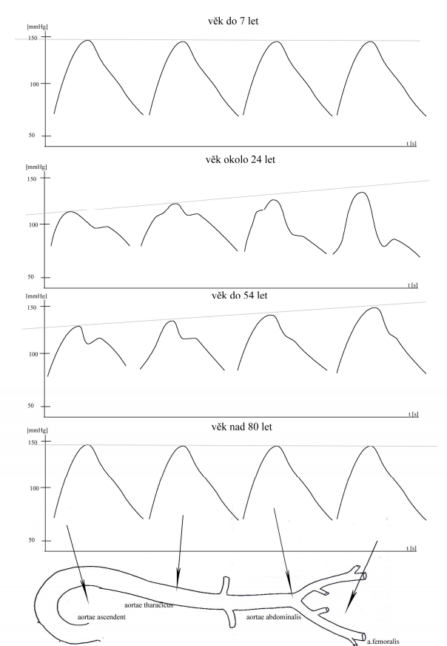
Changes of pulse wave in elderly people
Higher age leads to the increased speed and disappearance of typical features of the pulse wave
Arterial rigidity:
  The arterial stiffness increases the pulse wave velocity and causes a rapid return of the pressure wave.
Changes in tunica media:
  Hyperplasia
  Elastic fibres lose their arrangement and show signs of weakening, splitting, fraying and fragmentation.
  Replacement of the elastin component with collagen, which is much less elastic
Increase in blood pressure:
  With increasing age, there is a progressive increase in systolic blood pressure, accompanied by the disappearance of the diastolic pressure wave.

Slide 7
Changes of pulse wave in children
Increased PVW and disappearance of typical characteristics of the pulse wave‘s shape due to:
1. The smaller length of the arterial system
  A short system decreases the return time of the backward wave and the pulse wave is relatively very slow. The final wave resulting from summation loses its apex of the first systole and post-systolic minimum
2. Longer ejection time
  Relatively long ejection time from the left ventricle and higher heart rate lead to changes in the summation of pulse waves

Slide 8
Pulse wave changes due to the age
Young person: High arterial compliance → lower pulse wave velocity → backward wave meets forward wave during the beginning of diastole → lower pulse amplitude
total wave
forward wave
backward wave
Elder person: Decreased arterial compliance → increased pulse wave velocity → backward wave meets forward wave during the end of systole → increased pulse amplitude

Slide 9
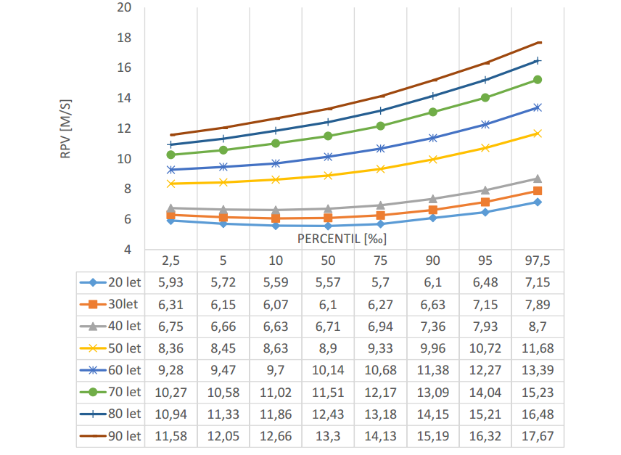
Values of PWV
PWV reference intervals for the carotid-femoral index. On the Y-axis, there are values of pulse wave velocity typical for individual years. On the X-axis, there is the percentile representation. The measured values higher than the reference value of the 90th percentile in the corresponding age category are an indicator of cardiovascular pathology. In the table below the graph, there are values of the pulse wave velocity.

Slide 10
Measurement methods of PWV
Direct methods
  Catheterisation
Indirect methods
  Ultrasonography
  Sphygmography
  Bioimpedance analysis

Slide 11
Sphygmography
Carotid-femoral PWV is a golden standard method in the measurement of pulse waves from pulse on a. carotis, a. femoralis and continuous ECG.
Well-reproducible method (differences between two measurements are < 5 %)
Arterial segment is analysed as complexly
In clinical practice, it is important to take into consideration the actual blood pressure. Arterial compliance is a function of blood pressure and arterial hypertension increases the rigidity of the arterial wall.
Aortal PWV is the most important parameter because it reflects the dampening function of the central arterial system.
A
B
T1
T2
A
B
d
PWV= d/ (T2-T1)
The transit time is an interval between the R oscillation and the beginning of the ascending part of the curves. Another component is the distance between the two measured sites. The speed is then calculated from the ratio of these two quantities in meters per second.

