Slide 1
Arterial stiffness.

Slide 2
Oral exam questions
Arterial elasticity – significance
Arterial pulse, pulse wave

Slide 3
Mr. Folkow - 19th century – added physical characteristics to individual sections of the vascular system (aorta – compliance;
arterioles – resistance; veins – capacity)
Basic relationship: blood pressure is a function of SV and PO
Compliance: ∆V / ∆P

Slide 4
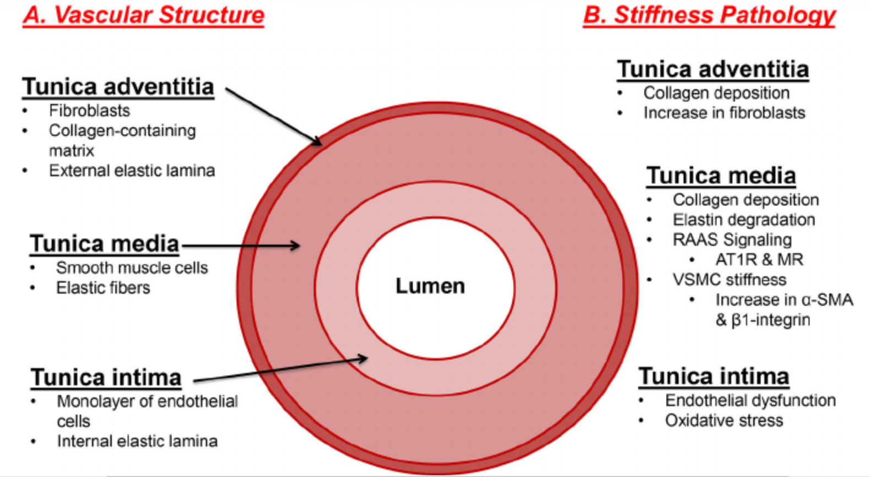
Factors of arterial stiffness changes
!
Elastin degradation
Collagen deposition
Endothelial dysfunction

Slide 5
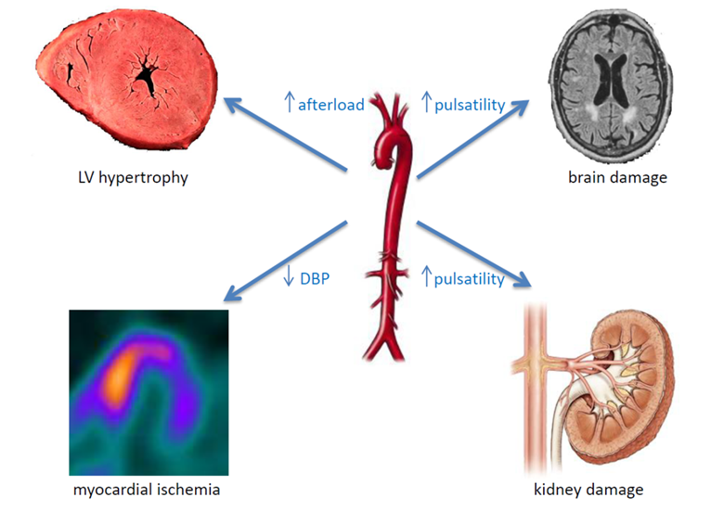
Complications of the higher arterial stiffness

Slide 6
Pulse wave
P[mmHg]
Forward systolic wave
t [s]
Reflected wave

Slide 7
Reflected wave increases = augments blood pressure in the aorta
Physiologically: in young people, the reflected wave mainly affects the diastolic pressure, which increases – and thus contributes to better filling of the coronary circulation and better nutrition of the endocardium

Slide 8
Pulse wave
P[mmHg]
P[mmHg]
SBP/P₁
P₂
DBP
t [s]
t [s]
Forward systolic wave
PP=SBP – DBP
mBP=DBP+1/3PP
AP=P₂ – P₁
Reflected wave
SBP – systolic blood pressure, DBP – diastolic blood pressure, P₁ – pressure at peak of systolic flow, P₂ – pressure of the reflected wave, PP – pulse pressure, mBP – mean blood pressure, AP – augmented pressure

Slide 9
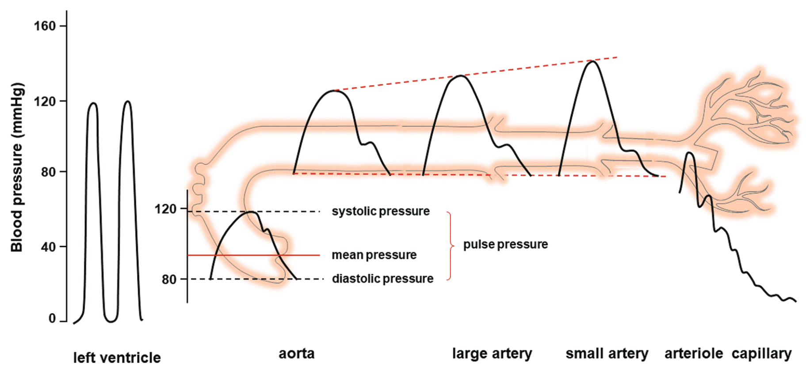
Pulse wave at different vascular segments

Slide 10
If we connect the network of arteries with all its bifurcations and vascular beds, then
… as this primary wave travels along the arteries it will generate reflected waves from each bifurcation and from the peripheral vascular beds.
… all these small reflected waves return to the heart, summing to create a reflected wave as shown, starting even before the end of systole
Pressure in the aortic root is the sum of the outgoing and reflected wave (the green wave)
Note: importantly how the reflected wave boosts the coronary artery perfusion pressure - the aortic root pressure - during diastole when over 95% of perfusion of the sub-endocardium takes place
If the aorta was an long open-ended tube providing a simple resistance to flow (i.e., there was no wave reflection), then:
The pressure wave in the aortic root would show a single peak for each contraction.

Slide 11
In older people, the arteries are stiffer and peripheral resistance is higher, the reflected wave reaches the aorta earlier, still at the time of systole and is absent in diastole – therefore they have high systolic pressure and low diastolic pressure – isolated systolic hypertension

Slide 12
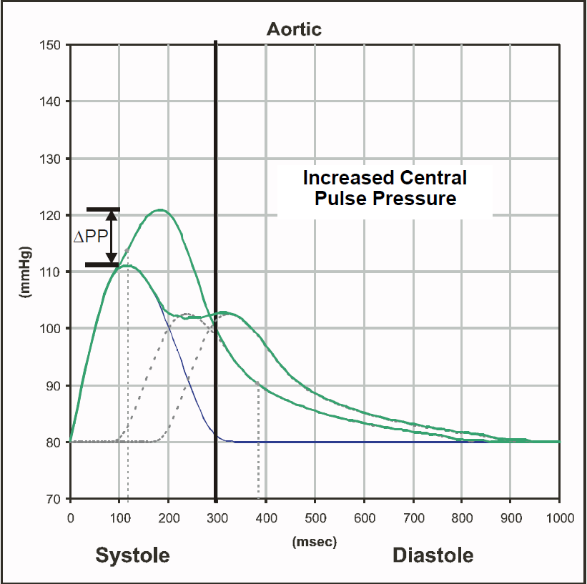
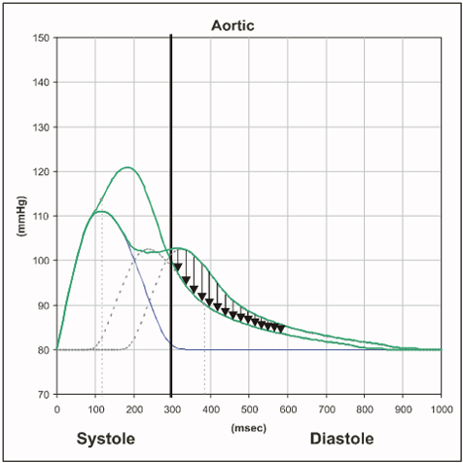
Second, there is an increase in left ventricular load (LV load).
Increase in LV load accelerates increase in LV mass and increases LV hypertrophy
The area under the pressure-time curve during systole is by definition LV load.
This increase in LV Load (late systolic “afterload”) is shown by the black arrowed region
Third, the pressure that is perfusing the coronary arteries during the critical diastole period is reduced, increasing the risk of myocardial ischemias.
CONCLUSION: Increasing arterial stiffness independ-ently increases the risk of all three major cardiovascular outcomes.
First, the central systolic pressure and central pulse pressure is increased.
An increase in the central pulse pressure that stresses cerebral blood vessels increases stroke risk
NOTE: this change in central systolic pressure can occur without any changes occurring in peripheral systolic pressure.
If the patient arteries get stiffer….
then pulse wave velocity increases, and reflected wave arrives back at the heart sooner.
Now there is a very different aortic root pressure waveform (green wave).
As a result of this, there are three important clinical implications.

Slide 13
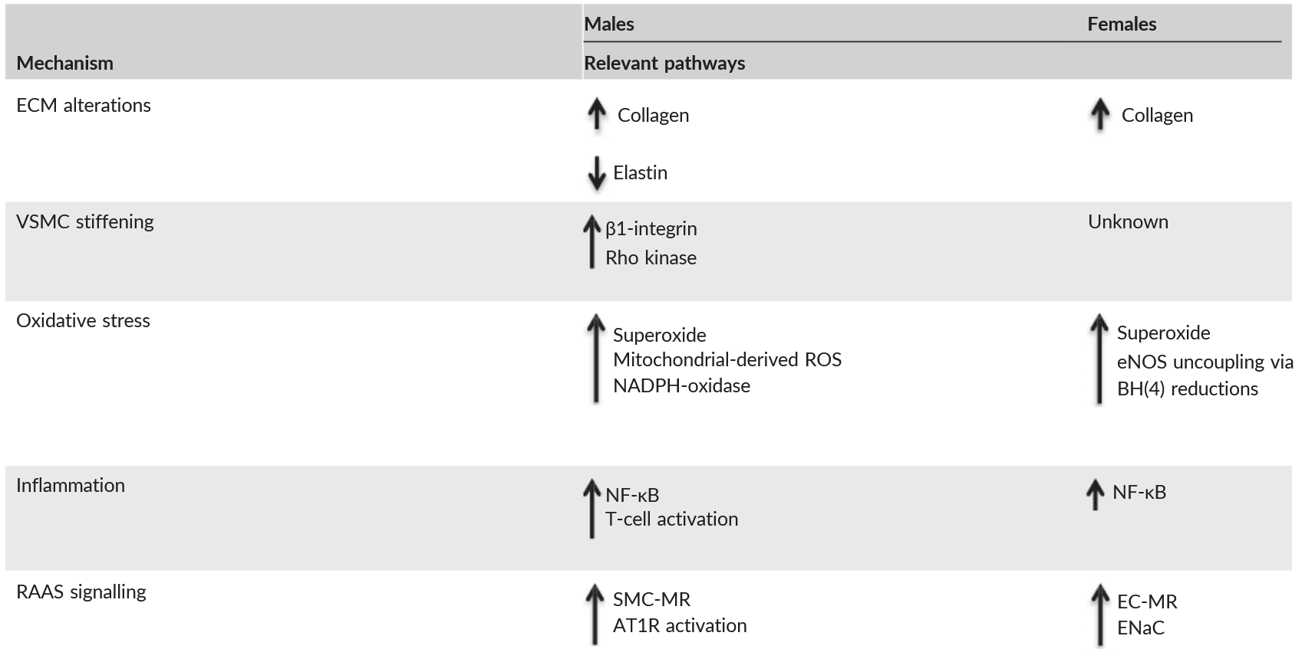
Sex differences in mechanisms of arterial stiffness
ECM - extracellular matrix; VSMC - vascular smooth muscle cell; eNOS - endothelial NOS; NADPH - NAD phosphate oxidase; BH(4) - tetrahydrobiopterin; SMC‐MR - smooth muscle cell mineralocorticoid receptor; AT1R - angiotensin II type 1 receptor; EC‐MR - endothelial cell mineralocorticoid receptor; ENaC - epithelial sodium channel.

Slide 14
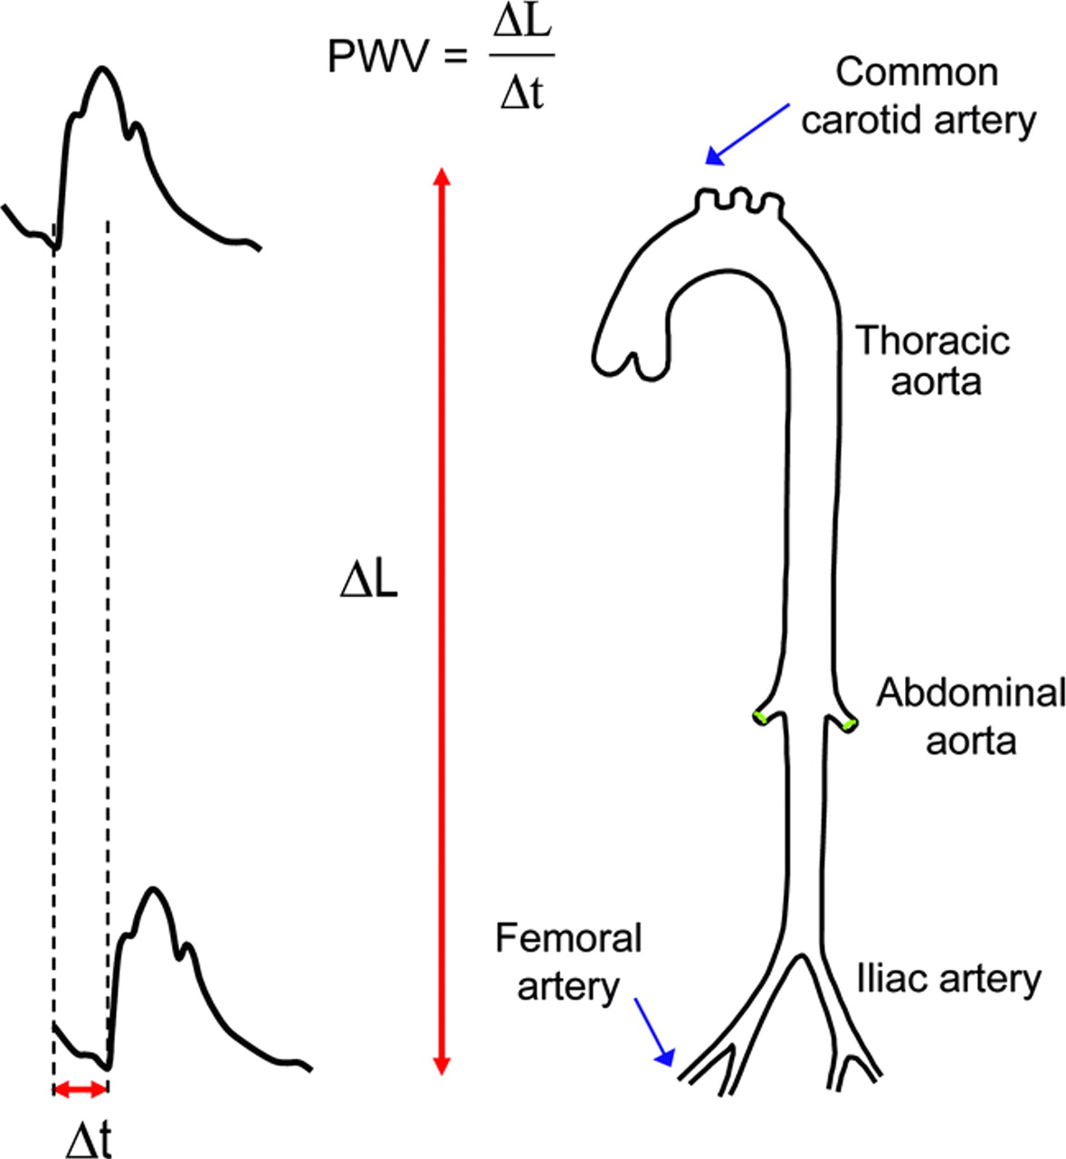
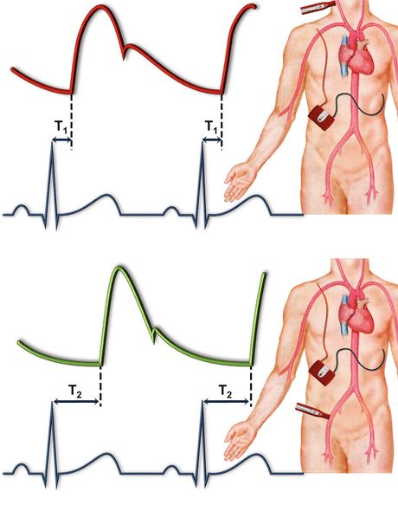
PWV measurement – Sphygmography in practicals
A highly compliant aorta has a relatively low PWV (< 6 m/s)

Slide 15
Use in clinical practice
Non-invasive investigation of arterial stiffness is gradually moving from the position of experiments to clinical practice
Started thanks to new recommendations of the European Hypertensive Society in Milan in 2007 – pulse wave velocity testing was included among the main diagnostic methods and in the process of determining the risk of cardiovascular disease + evaluation of the effect of treatment of essential hypertension

Slide 16
Arterial stiffness expresses damage to their walls by risk factors over a long period of time (years), while blood pressure values fluctuate physiologically and may not reflect the degree of damage to the vascular wall
Using techniques for measuring the pulse wave velocity, it is possible to calculate the central aortic pressure, which is a stronger prognostic parameter than the pressure measured on the brachial artery and more accurately expresses the load on the heart

Slide 17
Changes in arterial stiffness are clinically imperceptible
Methods are a modern trend for determining the risk of cardiovascular disease –
  risk of developing hypertension
  risk of sudden cardiac death

Slide 18
Device Sphygmocor – company: AtCor Medical, Australia

Slide 19
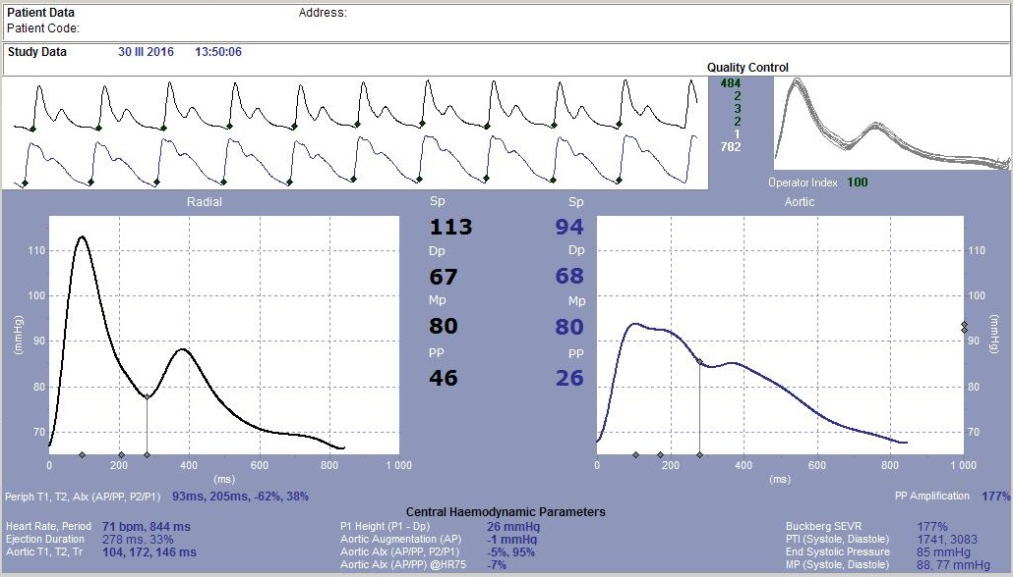

Slide 20
Device VaSera, company: Fukuda Denshi, Japan

Slide 21
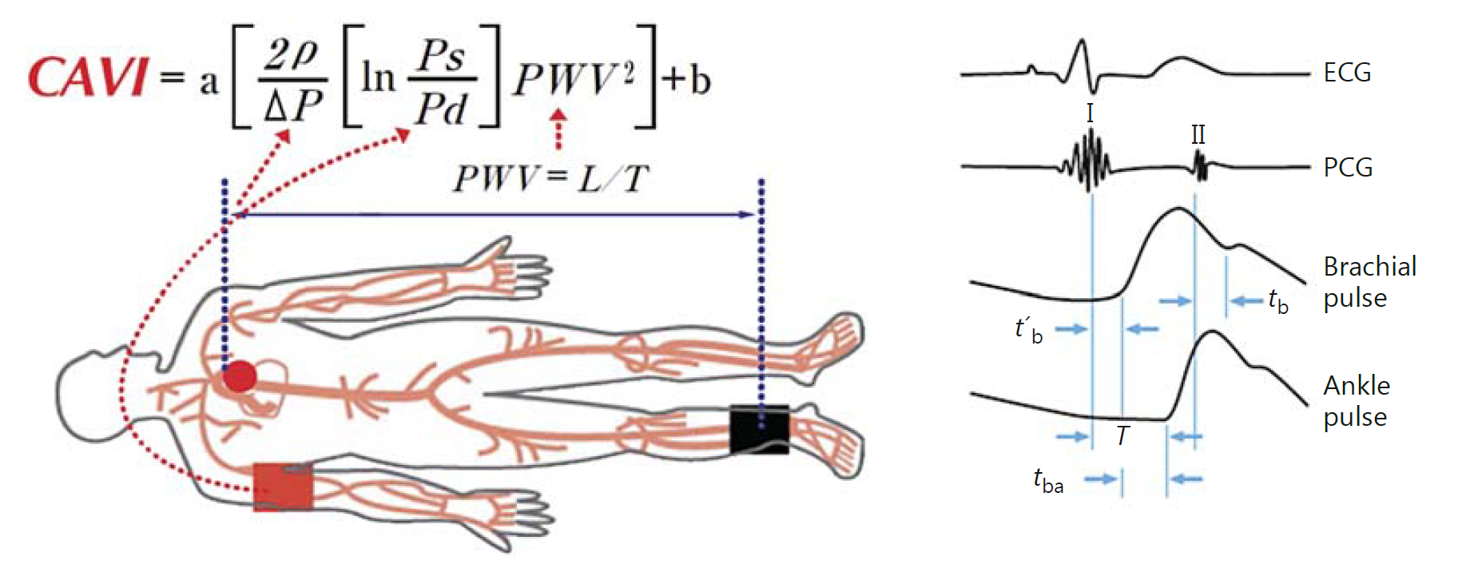
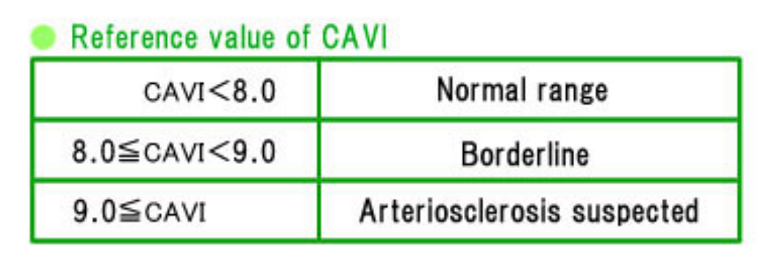
Cardio-ankle vascular index – CAVI - measurement

Slide 22
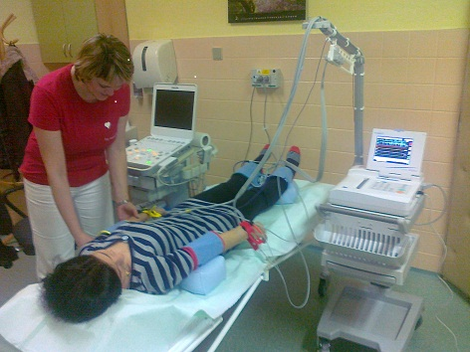
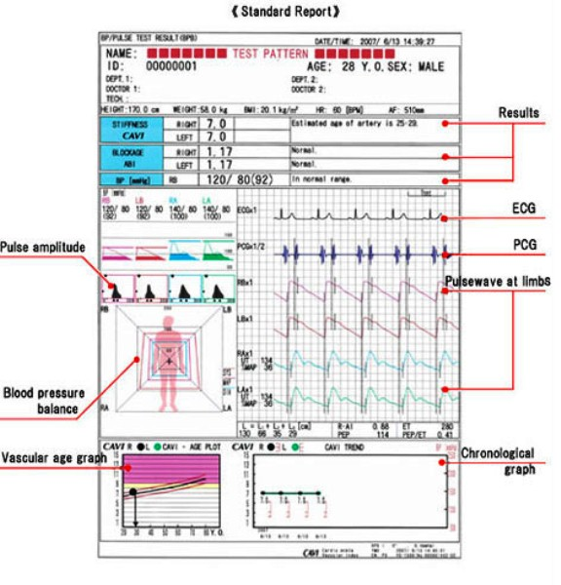
CAVI measurement

Slide 23

Thank you for your attention
Find a mistakes)))))

Slide 25
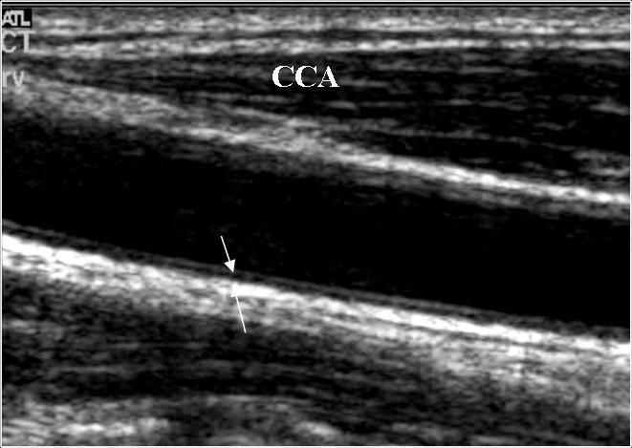
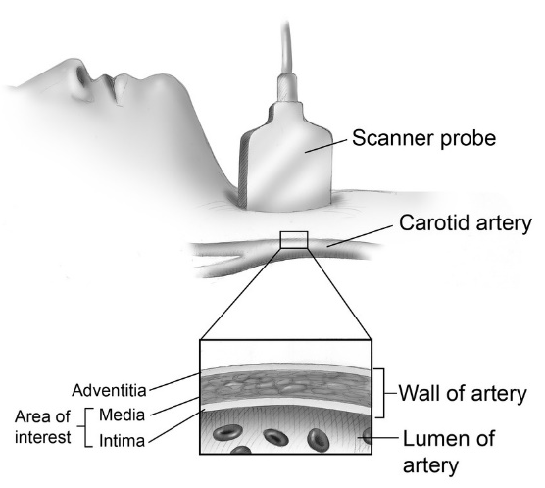
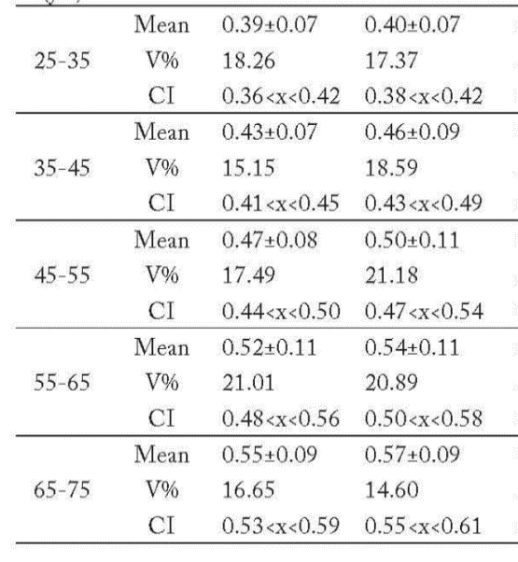
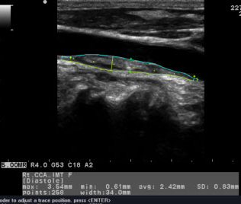
Ultrasound measurement
age
IMT_{R} (mm)
IMT_{L} (mm)

Slide 26
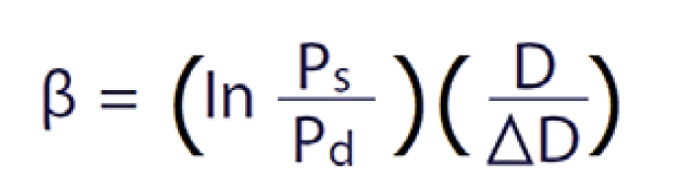

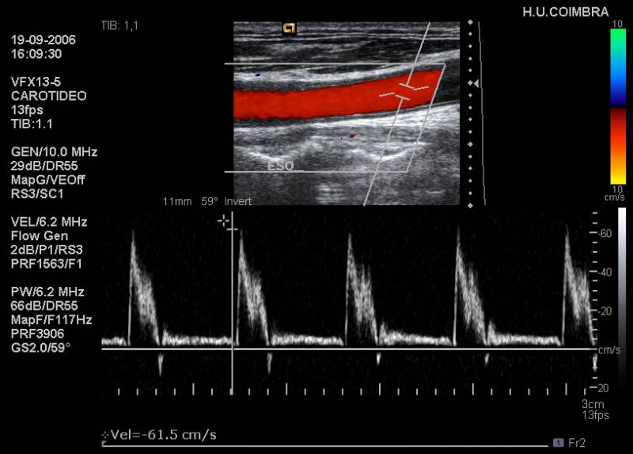
Ultrasound measurement (β – index).

