Slide 1
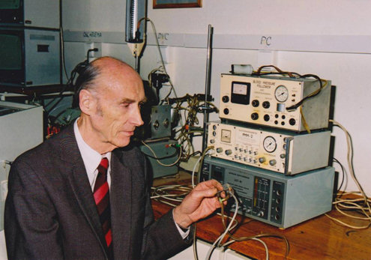
Photoplethysmographic blood presure measurement
Peňáz´s method,
volume-clamp method

Slide 2
Principle of continual blood pressure measurement
pressure
cuff
Control system:
Correction of the pressure in the finger cuff according to the arterial lumen changes.
Aim: maintaining of constant arterial lumen through pressure changes in the cuff.
Control system
Constant finger volume
Arterial lumen (finger volume)
application of control system
Pressure in the cuff
Before application of control system

Slide 3
150/90
127/92
SBP
DBP

Slide 4
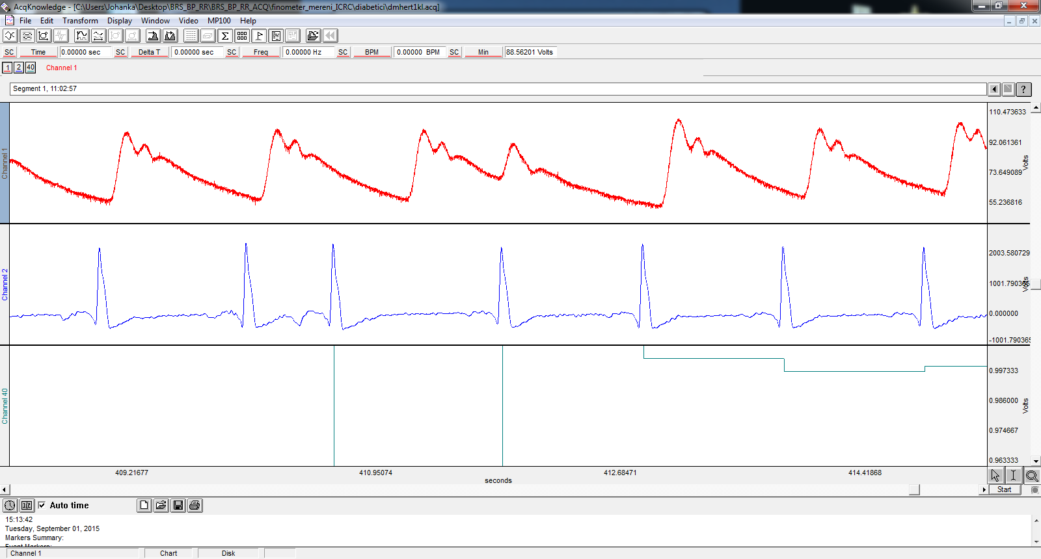
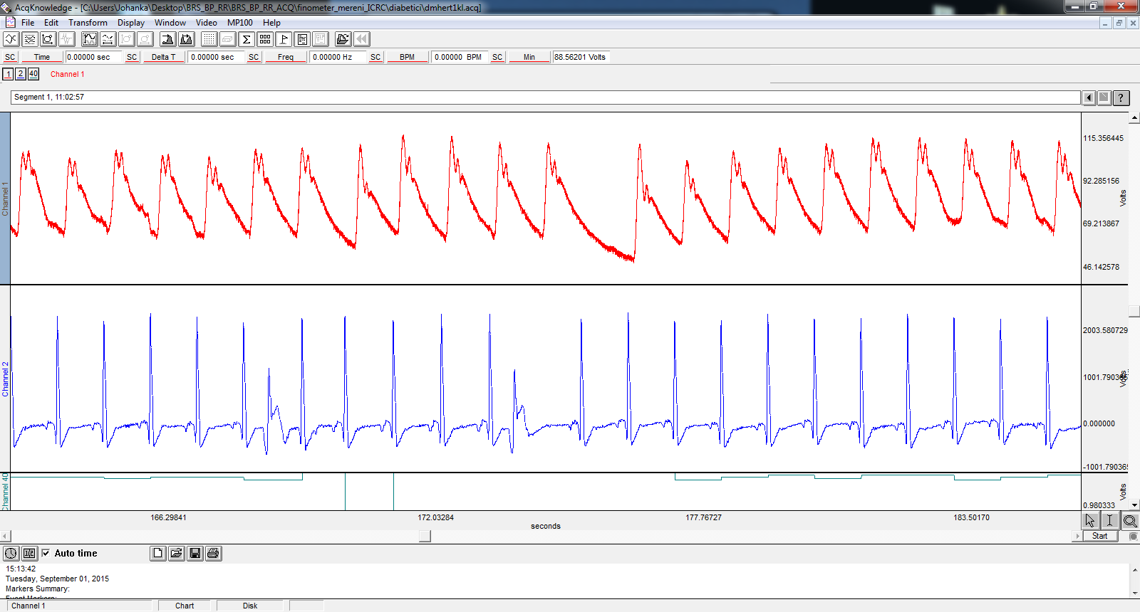
Extrasystoles
supraventricular
ventricular

Slide 5
Orthostatic hypotension

Slide 6
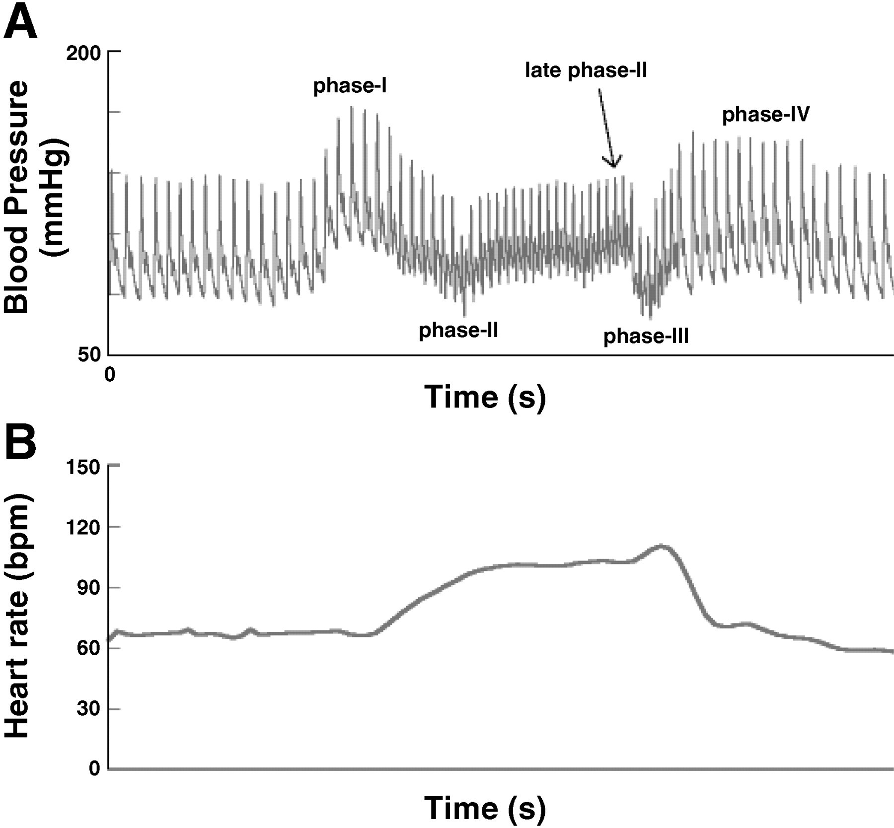
Valsalva manoeuvre

Slide 7
See videos: oscilometric method of BP measurement https://www.youtube.com/watch?v=Y-NvovSaWTc&t=113s
BP changes during smoking https://www.youtube.com/watch?v=J5vPJPfNH3k&t=1s

Slide 8
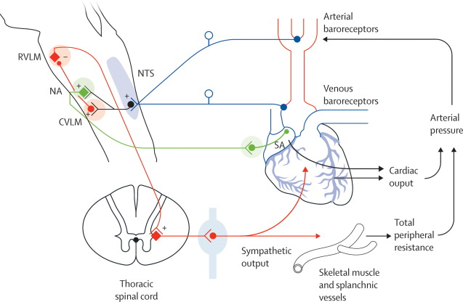
Baroreflex
Fast regulation of arterial blood pressure by changes of heart rate and peripheral vascular resistance

Slide 9
Baroreflex
peripheral (vascular, sympathetic) branch of baroreflexu
resistance arteries
signal: peripheral resistance
CNS: vasomotor centre
arteries
signal: blood pressure
CNS: kardiomotor centre
heart
signal: heart rate
Cardiac (parasympathetic) branch

Slide 10
Baroreflex sensitivity, BRS
Evaluation of cardiac baroreflex function through SBP and heart rate (cardiac cycle) changes
R
ECG
RR interval
SBP
BRS: change of cardiac cycle caused by SBP change by 1 mmHg [ms/mmHg]
Blood pressure
DBP
BRS:
slope
BRSf:
slope
RR
HR
SBP
SBP

Slide 11
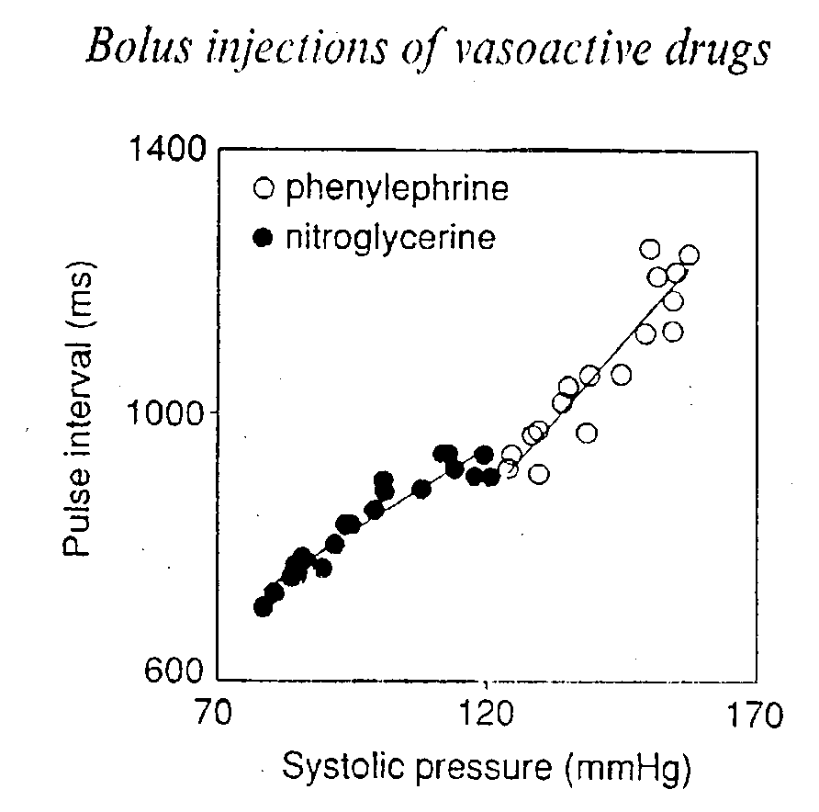
Evaluation of BRS
Standard(oxford) method:
- Application of phenylephrine (vasoconstrictor)
normal BRS
decreased BRS
RR
RR
STK
STK

Slide 12


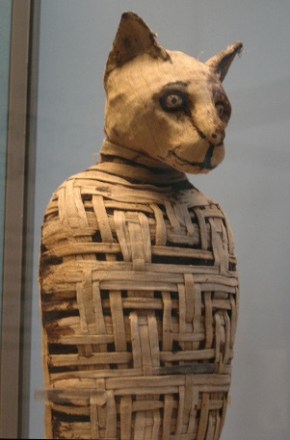
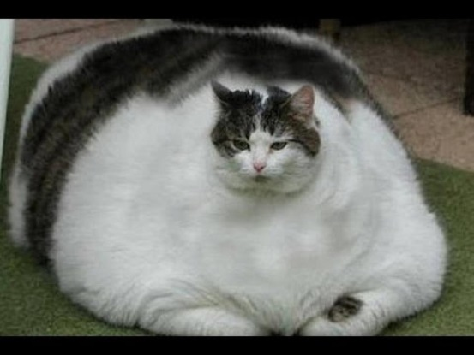



Decreased BRS
Physiologically
  psychic stress – increased sympathetic activity
  Physical exercise – increased sympathetic activity
  In old age
Pathologically
  hypertension – decreased baroreceptor sensitivity (atherosclerosis, increased arterial stiffness)
  diabetes – neuropathy of autonomic nervous system
  Chronic depression (neurogenic)
  Heart insufficiency/failure – heart do not response
  Transplanted heart - denervation
  Myocardial infarction – heart do not response

Slide 13
Signal: time series
Beat to beat (for example 5 minutes)
RR interval: 805, 820, 815, 817, 822, 816,….. ms
Hear rate: 70, 73, 68, 65, 67, 71,….. bpm
Systolic blood pressure: 115, 117, 120, 116, 121, 119,….. mmHg
900
RR
[ms]
800
700
SBP
[mmHg]
130
120
110
20
40
60
80
100
120 s
R
ECG
RR interval
SBP
Blood pressure
DBP

Slide 14
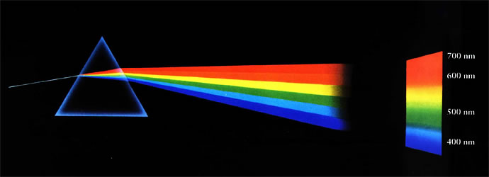
Frequency domain methods – spectral analysis
Time series
Signal in time domain
Spectrum
Signal in frequency domain
Signal is decomposed in individual frequencies
amplitude
amplitude
0
10
20
30
40
50
0
0.1
0.2
0.3
0.4
0.5
time (s)
frequency (Hz)

Slide 15

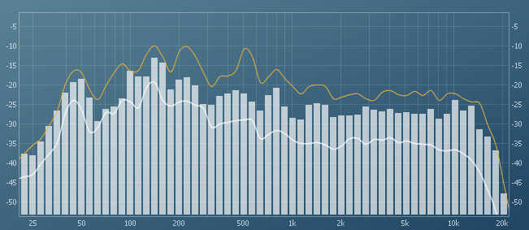
Frequency domain methods – spectral analysis
Time series
Signal in time domain
Spectrum
Signal in frequency domain
Signal is decomposed in individual frequencies
amplitude
amplitude
0
10
20
30
40
50
0
0.1
0.2
0.3
0.4
0.5
time (s)
frequency (Hz)

Slide 16
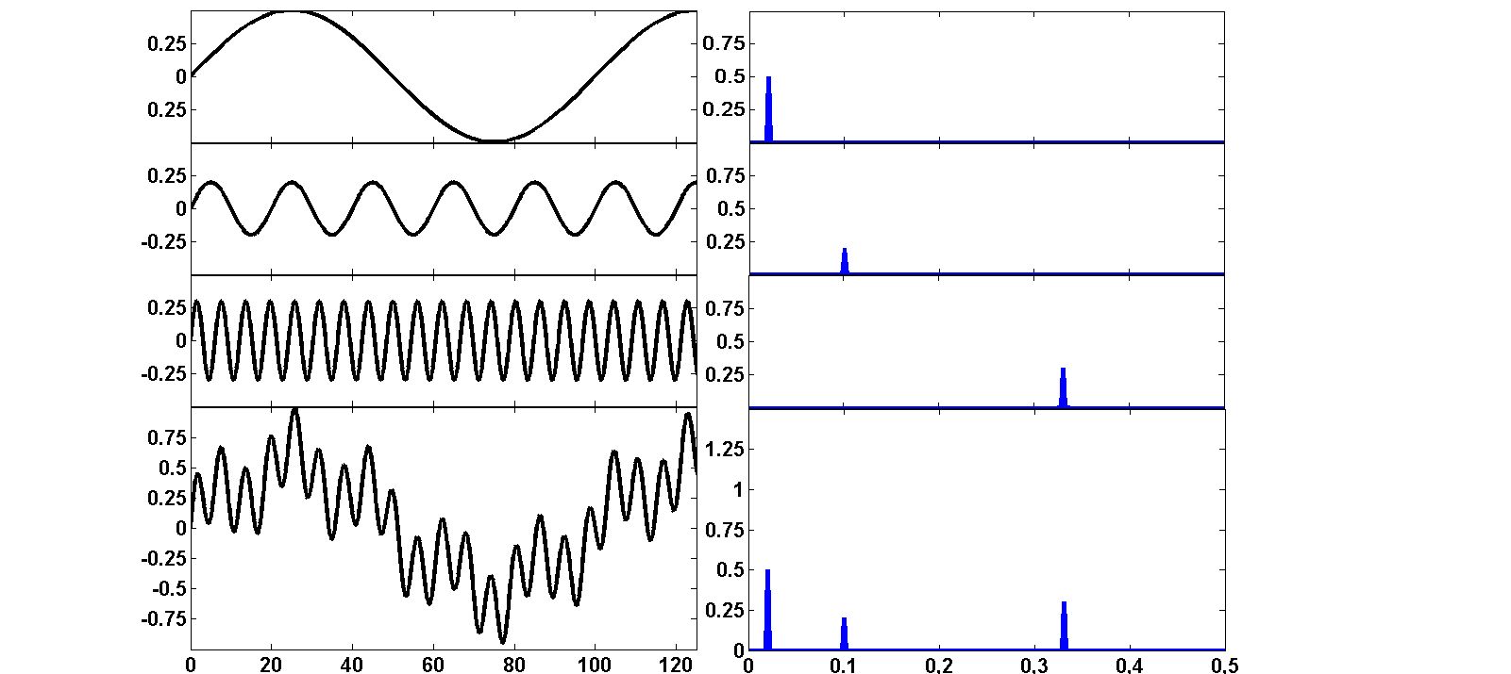
How the spectrum is formed?
Spectrum
Frequency domain
Time domain
period T
amplitude a
frequency f = 1/T
T=50 s
0.5
a=0.5
f = 1/50 = 0.02 Hz
+
T=10 s
+
amplitude
a=0.2
0.2
+
T=3 s
f = 1/10 = 0.1 Hz
+
0.3
=
a=0.3
=
f = 1/3 = 0.33 Hz
0.5
f = 0,1 Hz
0.3
f = 0,02 Hz
f = 0,33 Hz
0.2
time (s)
0.02
0.1
0.33
frequency (Hz)

Slide 17
Physiological significance – frequency bands
Slow hormonal changes, RAS, changes of vascular tonus
0,2
Variability source:
Variability source: respiration
Heart rate
Spectrum HR (n.u.)
0,0
baroreflex
Respiratory sinus arrhythmia
0
Respiratory frequency
0,12
baroreflex
Intrathoracal pressure changes influencing blood pressure
0,08
Spectrum SBP (n.u.)
Systolic blood pressure
0,04
0
0
0.1
0.2
0.3
0.4
0.5
band:
Very low frequency (VLF)
Low frequency (LF)
High frequency (HF)

Slide 18
parasympathetic activity
Sympathetic activity
Time lag < 1 s
0,2
Time lag > 6 s
Slow oscillations
Fast oscillations
Heart rate
Spectrum HR (n.u.)
0,0
baroreflex
Respiratory sinus arrhythmia
0
0,12
baroreflex
Intrathoracic pressure changes influencing blood pressure
0,08
Spectrum SBP (n.u.)
Systolic blood pressure
0,04
0
0
0.1
0.2
0.3
0.4
0.5
band:
Very low frequency (VLF)
Low frequency (LF)
High frequency (HF)

Slide 19
parasympathetic activity
Sympathetic activity
Time lag < 1 s
0,2
Time lag > 6 s
Slow oscillations
fast oscillations
CNS (n. vagus)
Heart rate
Spectrum HR (n.u.)
0,0
0
???
baroreflex
Mechanical transfer
0,12
Changes of TPR
(sympathetic nerves)
Thoracic pressure changes
0,08
Spectrum SBP (n.u.)
Systolic blood pressure
0,04
0
0
0.1
0.2
0.3
0.4
0.5
band:
Very low frequency (VLF)
Low frequency (LF)
High frequency (HF)

Slide 20
Blood pressure signal (270 s)
Sitting, paced breathing
Blood pressure (mmHg)
respiration
Standing, paced breathing
Krevní tlak (mmHg)
Meyer waves (10 s rhythm)
time (s)

Slide 21
sequentions of SBP, DBP and inter-beat intervals
Sitting, paced breathing
BP (mmHg)
IBI (ms)
Standing, paced breathing
BP (mmHg)
IBI (ms)
time (s)

Slide 22
Spectra of SBP and IBI
0,1 Hz
Sympathetic activity
Respiratory frequency
vagal activity
SBP
Sitting, paced breathing
IBI
↓symp. act., ↑vagal act.
Standing, paced breathing
SBP
IBI
↑ symp. act., ↓vagal act.
frequency (Hz)

Slide 23
Coherence a BRS
coherence: synchronization between signals (correlation on particular frequency)
0,1 Hz
baroreflex
Respiratory frequency
BRS (ms/mmHg)
Sitting, paced breathing
coherence
BRS
(ms/mmHg)
Standing, paced breathing
coherence
frequency (Hz)

