Slide 1
Pathophysiology of endocrine system II–homeostasis, principles of regulation and its disorders) -stress reaction and stress as a pathophysiological phenomenon
Julie Dobrovolná
Department of Pathological Physiology MED MUNI

Slide 2
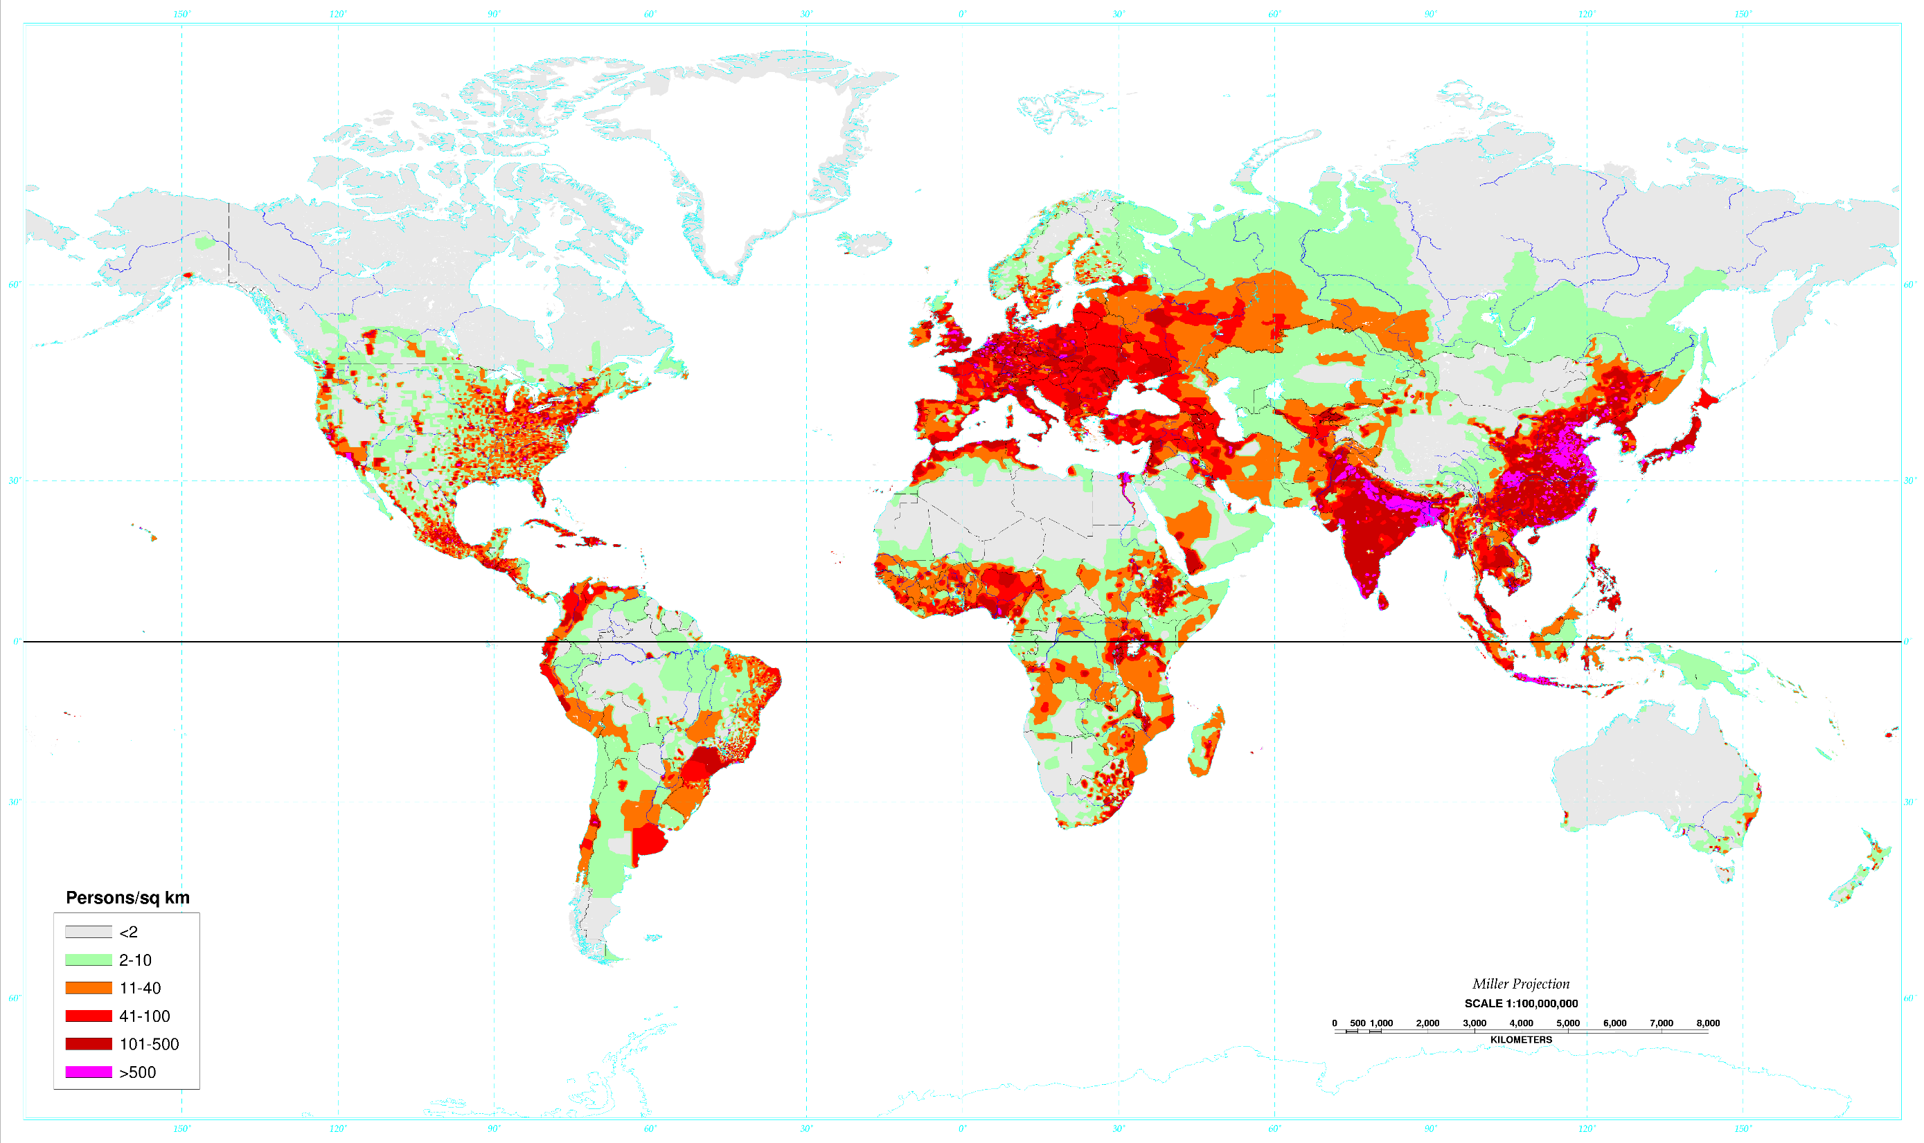
Notes:
The Santa Ana Volcano in El Salvador is a large “cinder cone” volcano that sits at 2,381 metres above sea level. The innermost crater contains a small crater lake.

Slide 3

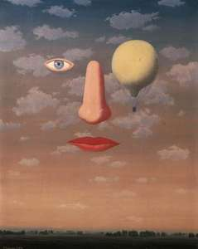

Slide 4

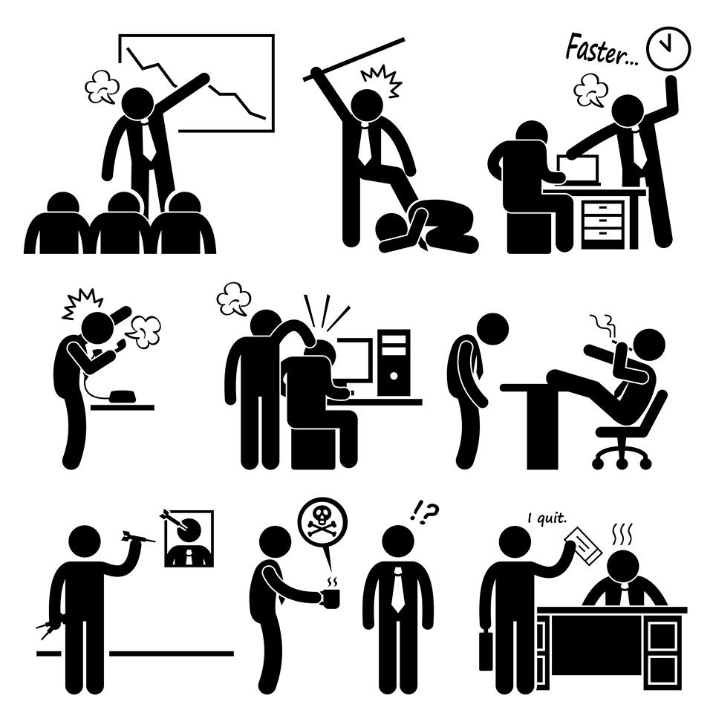
WHAT IS STRESS?

Slide 5


Slide 6
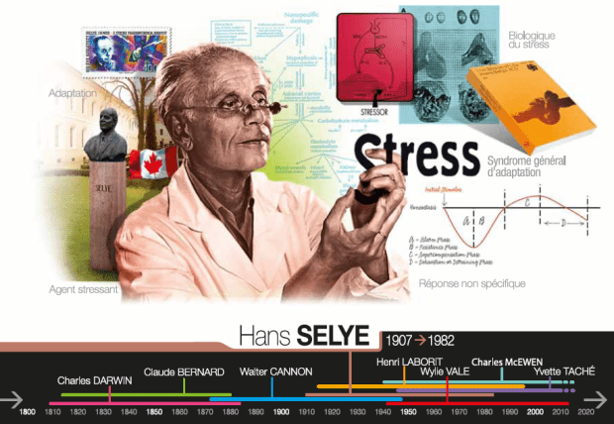
Stress and environment
So what is stress?

Slide 7
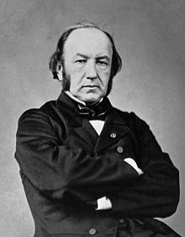
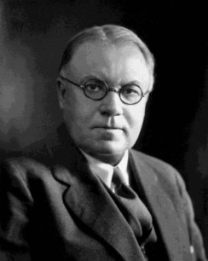
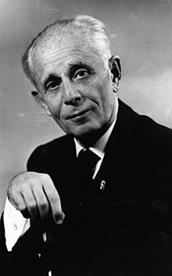
Evolution of the term „stres“
Claude Bernard (1813-1878)
  Leçons sur les phénomènes de la vie communs aux animaux et aux végétaux
  Vnitřní prostředí je udržováno jako stálé
Walter Cannon (1871-1945)
  The Wisdom of the Body
  Homeostáza, stres, autonomní (sympatický) nervový systém
Hans Selye (1907-1982)
  The Physiology and Pathology of Stress; a Treatise Based on the Concepts of the General-Adaptation-Syndrome and the Diseases of Adaptation
  Hypotalamo-hypofyzárně nadledvinková osa (HPA)

Slide 8
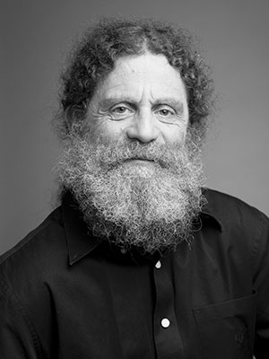
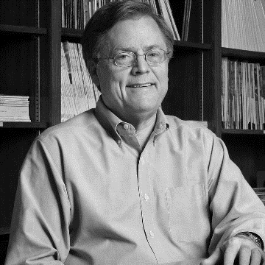

Evolution of the term „stres“
Robert Sapolsky
  Stress, the Aging Brain, and the Mechanisms of Neuron Death
  Why Zebras Don’t Get Ulcers: an Updated guide to Stress, Stress-Related Diseases, and Coping
  Úloha limbického systému (hippocampus) v regulaci HPA
Bruce McEwen & Theresa E. Seaman
  The End of Stress as We Know It
  Allostáza, homeodynamika
Gordon Lithgow a další
  Hormeze, endokrinní regulace délky života u much, hlístů a myší

Slide 9
So what is stress?

Slide 10
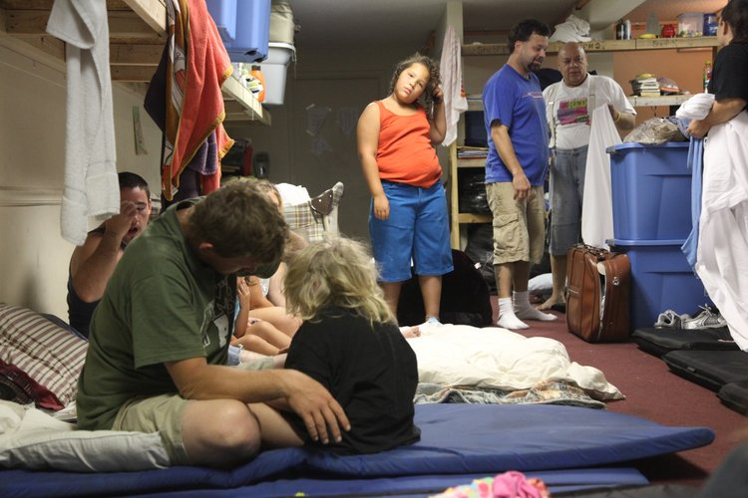

Social aspects of stress
Social factors such as lack of education, a low standard of housing, noise and crowding, homelessness, lack of social support, domestic violence, and economic hardship put individuals under greater stress, contributing to poor health and family problems.

Slide 11

Effects of long-term exposure to poverty in childhood
Evans and Kim (2007)
The aim of the study was to investigate the long-term relationship between poverty or low socioeconomic status, cumulative risk factors and physiological stress.

Slide 12


Effects of long-term exposure to poverty in childhood
Evans and Kim (2007)
Participants were 200 seven-year-olds.
The researchers measured blood pressure and cortisol levels.
Stress regulation was assessed by measurement of the heart’s reactivity to a standard acute stressor, and recovery after exposure to the stressor.
Exposure to risk factors such as substandard housing, and family violence were included to have a measure of cumulative stress factors.

Slide 13
Definition?
The Stress of Life, Hans Selye, 1956:
„… the non-specific response of the body to any demand made upon it, whether it is caused by, or results in, pleaseant, or unpleasant conditions“

Slide 14
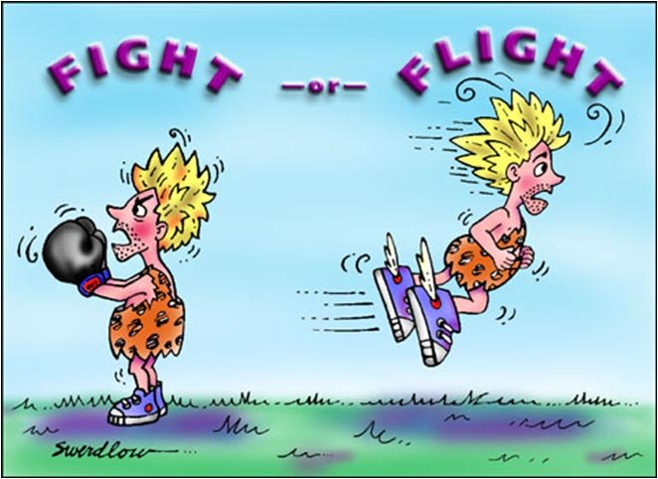
Cannon (1914) The fight or flight theory
The fight or flight response is a physiological stress response evolved to help organisms (i.e. animals and humans) to survive immediate danger.
Activation of the sympathetic nervous system.

Slide 15
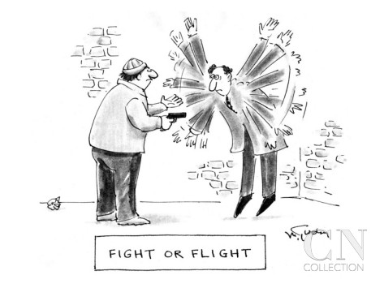
Cannon (1914) The fight or flight theory
The theory proposes that when an organism faces an imminent danger (acute stressor), the body is rapidly aroused and motivated to act via two systems: the sympathetic nervous system and the endocrine system.
These two physiological systems interact to mobilize the organism to fight against or flee the danger.

Slide 16
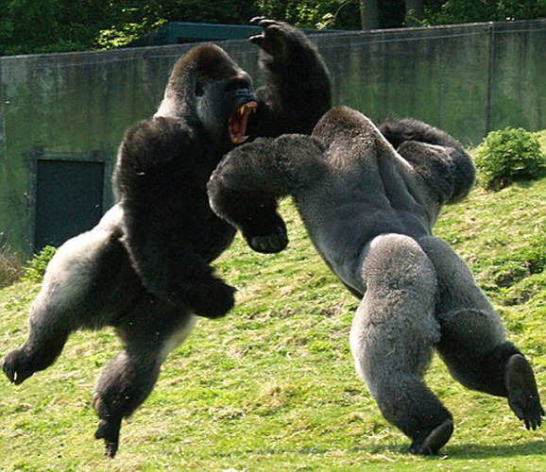

Fight or Flight?
The fight or flight theory is only addressing the physiological aspects of stress.
This could be because Cannon only studied animals. The exclusive focus on physiological aspects of stress is a limitation in relation to humans.
It is now known that cognitive factors can mediate the stress response.

Slide 17
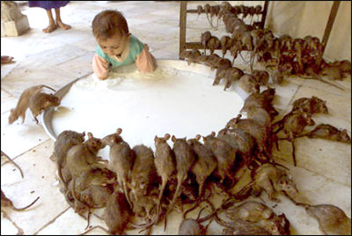
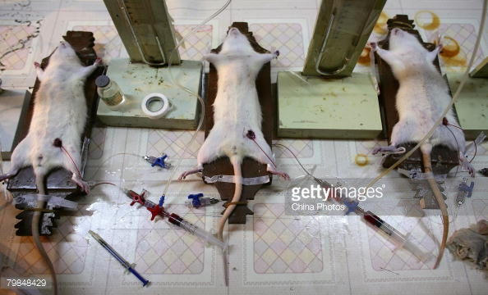
GAS (General Adaptation Syndrome)
Selye (1956)
The theory is based on animal research (rats) and it extends Cannon’s theory.
Selye did experiments where he exposed rats to various stressors (e.g. cold, surgical injury, excessive exercise).

Slide 18

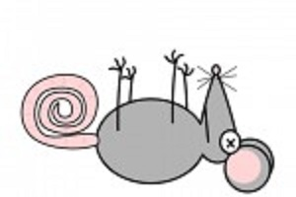
GAS (General Adaptation Syndrome)
Selye (1956)
The animals all showed the same general physiological responses such as enlarged adrenal glands, diminished thymus (important organ in the immune system) and ulcers when they were exposed to stressors.
Some of them died.

Slide 19
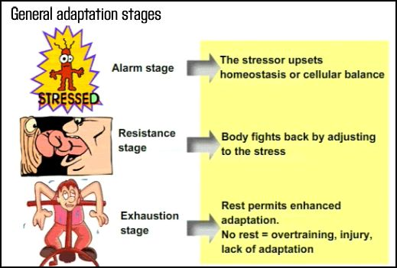
GAS (General Adaptation Syndrome)
Selye (1956)
The three stages of stress
Alarm: Physiological mobilization to respond to the danger. It is the same as the fight or flight response.
Resistance: Attempts to cope with the stress response.
Exhaustion: Occurs when the organism fails to overcome the danger and is incapable of further coping.

Slide 20
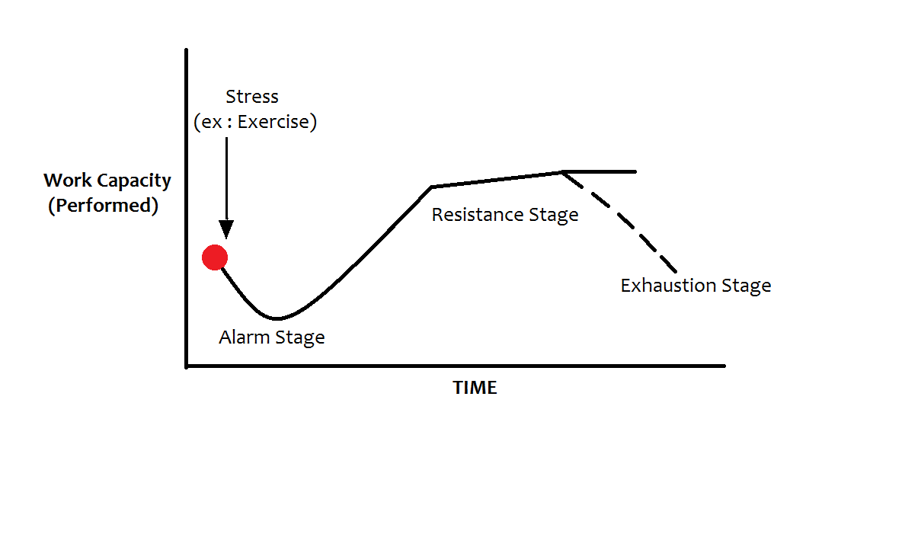
GAS (General Adaptation Syndrome)
Selye (1956)

Slide 21
GAS (General Adaptation Syndrome)
Selye (1956)
Selye concluded that rats (and humans) would respond with the same physiological pattern of physiological changes no matter the stressor.
With prolonged exposure to stress (chronic stress), the physiological system will be damaged and the organism may eventually die.
It may be problematic to generalize such results to humans but research in health psychology has confirmed a link between stress and low immune functioning.

Slide 22

Psychological aspects of stress
Give me a list of things psychologically when you are stressed….

Slide 23
Which organ systems are involved in stress reaction?

Slide 24
Stress and control of adaptation
The role of the adipose tissue

Slide 25
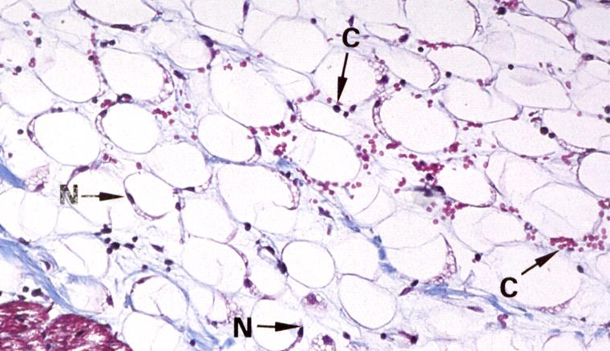
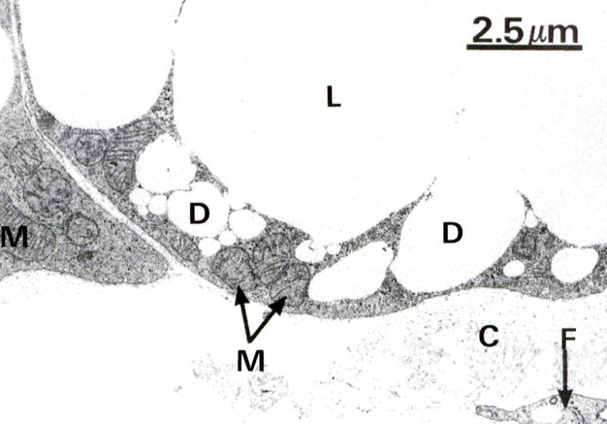
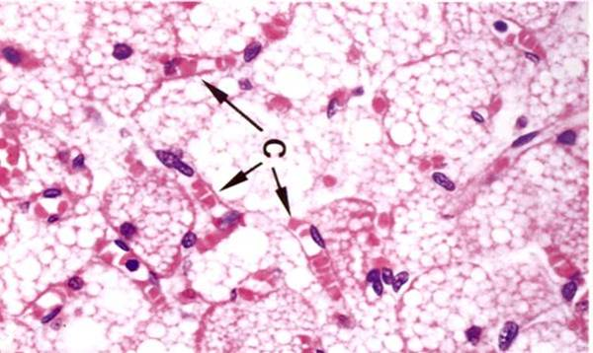
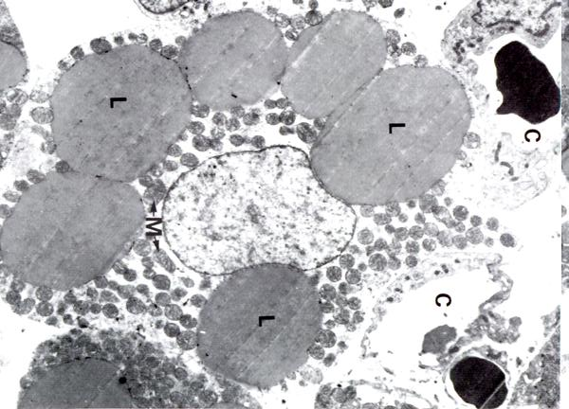
WAT
BAT
For letter symbols, see slide 36

Slide 26

White and brown adipocytes
Brown adipocyte
Multilocular
Storage and mobilization of lipids (++)
Mitochondria (+++)
Beta oxidation (+++)
Respiratory chain (+++)
UCP1 (+++)
PGC-1α (+++)
White adipocyte
Unilocular (→ 200µm)
Storage and mobilization of lipids(+++)
Mitochondria (+)
Beta oxidation (+)
Respiratory chain (+)
UCP1 (0)
PGC-1α (+)
Adopted from prof. D. Langin, Physiopathology of obesity and current theories on the association between an excess of fat mass and insulin resistance
Notes:
U savců nacházíme dva typy tukové tkáně – bílou a hnědou tukovou tkáň. Tyto tkáně se liší funkčním, morfologickým i molekulárním fenotypem. V rámci BAT je energie uvolněna do okolí prostřednictvím odpojení oxidace mastných kyselin od syntézy ATP prostřednictvím uncoupling proteinu 1, který je zásadně důležitý pro regulaci tělesné teploty a je důležitý i pro udržování konstantní tělesné hmotnosti. Hnědá tuková tkáň se stala atraktivním cílem experimentálních farmakologických zásahů za účelem léčby obezity, jelikož nedávno bylo pomocí PET prokázáno, že i u dospělého člověka se udržují okrsky vysoce aktivní BAT, která se mohou navíc zvyšovat následkem stimulace chladem či adrenergní stimulace. U hlodavců i lidí se navíc nachází i přechodný fenotyp – BAT-podobné adipocyty, které se označují také jako béžové. Tyto buňky exprimují UCP-1, typický znak BAT adipocytů, mají multilokulární charakter a jsou indukovatelné prolongovanou beta adrenergní stimulací.

Slide 27
Adipose tissue – there is more than just pure differentiation
Mature adipocytes
Preadipocytes
Mature adipocytes
Endothelia
Hypertrophy and hyperplasia
Angiogenesis
Inflammation
Macrophages
Preadipocytes
Adopted from prof. D. Langin, Physiopathology of obesity and current theories on the association between an excess of fat mass and insulin resistance
Notes:
Z hlediska adaptace je zásadní schopnost tukové tkáně pojímat v určité formě energii a ve vhodných situacích ji uvolňovat. Tato schopnost se ovšem liší i v závislosti na lokalizaci tukové tkáně a nazývá se EXPANDIBILITA. Obecně platí, že podkožní tuková tkáň má tuto schopnost nižší než viscerální (periorgánový) tuk. Navíc dále platí, že existuje velmi silná korelace mezi množstvím viscerálního tuku a množstvím lipidů v játrech. Diskordance zdravotního stavu mezi identickými dvojčasty lze napříkldat částečně vysvětlit odlišým stupněm ukládání lipidů v játrech, které může být ovlivněno např. expozicí polutantům z vnějšího prostředí. WAT se může rozšiřovat dvěma způsoby: zvětšením velikosti buněk (hypertrofie) či jejich počtu (hpyerplazie). Zvětšování WAT v mezenterické oblasti je predominantně hyperplastického charakteru, zatímco tuku v podkožní oblasti spíše hypertrofuje. Co je zodpovědné za tyto rozdíly, není jasné, jak může anatomická lokalizace tuku ovlivnit jeho expandibilitu? Z toho pohledu lze tuk ve viscerální oblasti považovat za unikátní depot se změněným stupněm expandibility a zvýšeným prozánětlivým profilem. Metabolismus glukózy a lipidů navíc ve viscerálním, podkožním a perigonadálním tuku podléhá jiným regulačním mechanismům.

Slide 28
Cellular origin of secreted molecules
Adipocytes → Adipokines
Stromal vascular fraction cells
→ cytokines & chemokines
Monocyte chemoattractant protein 1 (MCP1)
Macrophage inflammatory protein (MIP)
Tumor necrosis α (TNFα)
Interleukins 1β, 6, 8, 10, ….
Chemokines
Resistin
Apelin
…
Leptin
Adiponektin
Serum amyloid
Retinol binding protein 4 (RBP4)
Apelin
FIAF/PGAR
Adopted from prof. D. Langin, Physiopathology of obesity and current theories on the association between an excess of fat mass and insulin resistance

Slide 29
Adipocytes and nerves
IR
β₁- β₂- β₃- AR
α₂-AR
Glucose
VLDL
CL
NH2
ASP
LPL
AC
NH2
GLUT4
CD36
FAT
Gs
Gi
COOH
COOH
IRS
ATP
PDE 3B
GLUT4
PI3-K
cAMP
Glucose- 6-P
5' AMP
PKB
PKA
Pyruvate
Fatty acids
ATGL
ALBP
Glycerol-3-P
Acetyl-CoA
HSL
HSL
P
FFA
DGAT
Perilipins
Triglycerides
FFA
Adopted from prof. D. Langin, Physiopathology of obesity and current theories on the association between an excess of fat mass and insulin resistance
Notes:
Přežití organismu závisí na schopnosti adipocytů přechodně skladovat nadbytečné množství energetických substrátů a schopnosti tyto substráty mobilizovat při poklesu příjmu živin zvnějšku. Substráty jsou ukládány v lipidových kapénkách ve formě triacylglyceridů a jsou uvolňovány procesem zvaným lipolýza ve formě mastných kyselin či glycerolu. V postprandiálním stavu adipocyty vychytávají volné mastné kyseliny uvolněné z VLDL či chylomikronů. Intracelulárně se mastné kyseliny následně esterifikují s glycerolem za vzniku triacylglyceridů. Během prodlouženého lačnění či pohybové aktivity se z triacylclyceridů uvolňují celé acyly působením lipázy, konkrétně adiipocytární triglyceridové lipázy, hormonsenzitvní lipázy a monoglyceridové lipázy. Po svém transportu do lymfy se tyto mastné kyseliny volně nabízejí oxidaci a syntéze ATP. Regulace vychytávání cirkulujících substrátů, biosyntézy triglyceridů i lipolýzy závisí na rovnováze mezi systémovými anabolickými a katabolicmými signály. Zdá se, že z hlediska krátkodobé dostupnosti substrátů hraje zásadní úlohu pankreatický hormon inzulínm. Klíčovou roli inzulínu např. podporuje výrazná lipodystrofie pozorovaná u zvířat s knockoutovanými adipocytárním inzulínovým receptorem.

Slide 30
Stress and metabolic control
Brain vs. adipose tissue

Slide 31
Brain-adipose tissue axis I
NTS/AP
PVN/LHA
OREXIN
ARC
NPY
CRH
AgRP
Spinal cord
NPY/AgRP
α-MSH
POMC
CRH
cortisol
ACTH
TERMOGENEZE
LEPTIN
BAT
WAT
adrenals
Notes:
Under CNS guidance, the gut is in charge of energy intake. Energy homeostasis can be well maintained only when the brain-gut circuit is synchronized. This synchronization is achieved by neuronal and humoral interaction between the brain and gut. In the gastrointestinal tract, nutrient digestion and absorption trigger the secretion of gut satiety signals such as cholecystokinin (CCK), peptide YY (PYY) and glucagon like peptide-1 (GLP-1) for stimulation of vagal sensory nerves to provide feedback to the brain (Berthoud, 2008). Vagal sensory terminals also express receptors for other gut hormones and peptides that are involved in metabolic regulation. The NTS in the hindbrain is one of the major processors of vagal afferent signals, as evidenced by the finding that upper intestinal lipids inhibit hepatic glucose production through a vagal-NTS circuit (Wang et al, 2008). Additionally, gut hormones and nutrients can influence several specific brain regions and neurons via the circulation. These factors reach these regions and neurons via transporters across either the blood-brain barrier (BBB) and/or less BBB-protected circumventricular organs where neurons can sense blood-borne signals more directly (Cottrell and Ferguson, 2004; Gross, 1992). Among these regions, the NTS–area postrema (AP) complex in the hindbrain and the ARC in the forebrain are two of the major targets of gut hormones; insulin, produced in the pancreas, and ghrelin, produced in the stomach, are among the best studied gut hormones acting in these brain areas (Kojima et al., 1999; Obici et al., 2002; Pocai et al., 2005; Tschöp et al., 2000). In response to gut hormones and nutrient signals, these brain areas relay the information to other key regulatory areas, such as the paraventricular nucleus (PVH) of the hypothalamus (to maintain systemic metabolic homeostasis by modulating neuroendocrine and autonomic outputs) and the suprachiasmatic nuclei [SCN; where the central biological clock is located (Yi et al., 2006)] (to synchronize the behavior and physiology of the whole body and balance the sympathetic and parasympathetic autonomic outflow). Defective or weakened signal feedback by the brain in response to satiety and nutrients from the gut could cause over-feeding and dis-inhibition of liver glucose production, and thereby promote metabolic diseases (Berthoud, 2002).

Slide 32
Brain-adipose tissue axis II
ENDOCRINE SIGNAL
WAT - lipolysis
PVN
PVN
EPIPHYSIS
LHA
MCH
CART
DMN
DMN
LHA
smell
BeAT - BROWNING
DYNORPHIN
OREXINS
Sympatikus (T13-L3)
vision
VMN
VMN
ARC
ARC
Sympatikus (T7-L3)
ARC
BAT – BROWNING, TERMOGENESIS
Ganglion stellatum (T1-T6)
MÍCHA
Notes:
The most well-studied metabolic sensing region in the forebrain is the hypothalamus, where a number of nuclei such as the arcuate nucleus (ARC) and ventromedial hypothalamus (VMH) express high levels of receptors that bind adipokines (cell signaling molecules secreted by adipose tissue, such as leptin) and gut hormones. Central leptin resistance, one of the major causes of obesity, is caused by defective leptin sensing in these brain regions (Gautron and Elmquist, 2011). In the hindbrain, the nucleus tractus solitarius (NTS)–dorsal motor nucleus of the vagus (DMV) complex is the best-studied brain area with respect to detection of metabolic feedback, especially from the gastrointestinal system via vagal afferents or the circulation (Berthoud et al., 2006).
Schematic overview of the hypothalamus–adipose axis (based on rat data) involved in food intake regulation and energy expenditure. In short, the arcuate nucleus (Arc) integrates peripheral endocrine signal via blood (such as leptin). Leptin acts on its receptor to modulate the expression and release of Arc appetite-regulating neuropeptides. Then, the Arc drives other hypothalamic areas such as ventromedial (VMN), dorsomedial (DMN) and paraventricular (PVN) nuclei (considered as satiety centres) and the lateral hypothalamic area (LHA; considered as a hunger centre). Coronal section shows the relative position of these nuclei with respect to each other through the hypothalamus. Circuits allowing communications between these neuronal populations are indicated by red arrows. Neuronal signal, especially from the PVN, modulates via the nucleus of the soli

Slide 33
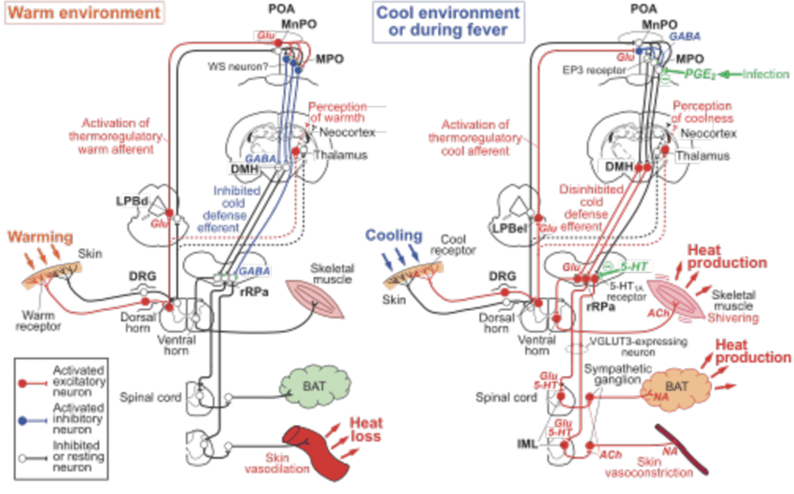
Can stress be calculated? Can temperature be calculated?

Slide 34
Really?
$$∆s_{SEL}=\int_{t_{1}}^{t_{2}}{\left[\frac{{\dot{Q}}_{p}−{\dot{Q}}_{e}}{T_{body}}−\dot{σ}\left(O_{2}\right)M\left(O_{2}\right)+\dot{σ}\left({CO}_{2}\right)M\left(CO_{2}\right)−\dot{σ}\left(H_{2}O\right)M\left(H_{2}O_{in}\right)+\dot{σ}\left(H_{2}O\right)M\left(H_{2}O_{out}\right)−σ\left(O_{2}\right)\dot{M}\left(O_{2}\right)+σ\left({CO}_{2}\right)\dot{M}\left(CO_{2}\right)−σ\left(H_{2}O\right)\dot{M}\left(H_{2}O_{in}\right)+σ\left(H_{2}O\right)\dot{M}\left(H_{2}O_{out}\right)−\frac{4}{3}ηAσ_{SB}T_{air}^{3}+\frac{4}{3}εAσ_{SB}T_{skin}^{3}+\frac{{\dot{Q}}_{cnv}}{T_{skin}}+\frac{{\dot{Q}}_{evp}}{T_{body}}+\frac{{\dot{Q}}_{rad}}{T_{skin}}+\frac{{\dot{Q}}_{cnv_res}}{T_{skin}}+\frac{{\dot{Q}}_{evp_res}}{T_{body}}\right]\frac{1}{m(t)}dt−\int_{t_{1}}^{t_{2}}{σ_{{PROD}_{\left(no stress\right)}}}\left(t\right)dt.}$$
$$Δs_{SEL}(t)=\frac{1}{w}\int_{0}^{t}{\left\{\frac{M(s)}{T_{B}(s)}\right.}\left(1−\frac{{\dot{T}}_{B}(s)}{T_{B}(s)}\right)+εA_{e}σ_{SB}T_{s}(s)^{4}\left(\frac{1}{T_{S}(s)}−\frac{1}{T_{B}(s)}\right)−ηA_{e}σ_{SB}T_{A}(s)^{4}\left(\frac{1}{T_{A}(s)}−\frac{1}{T_{B}(s)}\right)+ \\ +1.87A_{e}\sqrt{\frac{p}{p_{0}}}{\left(T_{S}\left(s\right)−T_{A}(s)\right)}^{\frac{5}{4}}\left(\frac{1}{T_{S}(s)}−\frac{1}{T_{B}(s)}\right)+ \\ +A_{e}λμ\left[611.21\exp\left(\left(18.678−\frac{T_{S}(s)−273.15}{234.5}\right)\frac{T_{S}(s)−273.15}{T_{S}(s)−16.01}\right)−\right. \\ −H_{R}611.21\exp\left.\left(\left(18.678−\frac{T_{S}(s)−273.15}{234.5}\right)\frac{T_{A}(s)−273.15}{T_{A}(s)−16.01}\right)\right]\left(\frac{1}{T_{C}(s)}−\frac{1}{T_{B}(s)}\right)+ \\ +A_{e}M\left(s\right)\left[0.0014\left(T_{RES}(s)−T_{A}(s)\right)+0.0017(58.7−\right. \\ −\frac{1}{133.332}H_{R}611.21\exp\left.\left.\left(\left(18.678−\frac{T_{A}(s)−273.15}{234.5}\right)\frac{T_{A}(s)−273.15}{T_{A}(s)−16.01}\right)\right)\right]\left(\frac{1}{T_{RES}(s)}−\frac{1}{T_{B}(s)}\right)+ \\ +\frac{{\dot{T}}_{B}(s)}{T_{B}(s)^{2}}\int_{0}^{s}{\left(εA_{e}σ_{SB}T_{s}(s)^{4}−ηA_{e}σ_{SB}T_{A}(s)^{4}\right)}dr+ \\ +\left(\frac{{\dot{T}}_{B}(s)}{T_{B}(s)^{2}}−\frac{{\dot{T}}_{S}(s)}{T_{S}(s)^{2}}\right)1.87A_{e}\sqrt{\frac{p}{p_{0}}}\int_{0}^{s}{{\left(T_{S}\left(r\right)−T_{A}(r)\right)}^{\frac{5}{4}}}dr+ \\ +\left(\frac{{\dot{T}}_{B}(s)}{T_{B}(s)^{2}}−\frac{{\dot{T}}_{C}(s)}{T_{C}(s)^{2}}\right)A_{e}λμ\int_{0}^{s∫\left(\left(18.678−\frac{T_{S}(r)−273.15}{234.5}\right)\frac{T_{S}(r)−273.15}{T_{S}(r)−16.01}\right)}{\left[611.21exp[\right.} \\ −H_{R}611.21\exp\left.\left(\left(18.678−\frac{T_{A}(r)−273.15}{234.5}\right)\frac{T_{A}(r)−273.15}{T_{A}(r)−16.01}\right)\right]dr+ \\ +\left(\frac{{\dot{T}}_{B}(s)}{T_{B}(s)^{2}}−\frac{{\dot{T}}_{RES}(s)}{T_{RES}(s)^{2}}\right)A_{e}\int_{0}^{s}{M\left(r\right)}\left[0.0014\left(T_{RES}(r)−T_{A}(r)\right)+0.0017(58.7−\right. \\ −\frac{1}{133.332}H_{R}611.21\exp\left.\left.\left(\left(18.678−\frac{T_{A}(r)−273.15}{234.5}\right)\frac{T_{A}(r)−273.15}{T_{A}(r)−16.01}\right)\right)\right]dr− \\ \left.−σ_{O_{2}}\dot{M}\left(O_{2}\right)\left(s\right)+σ_{CO_{2}}\dot{M}\left(CO_{2}\right)\left(s\right)\right\}ds−σ_{prod,no​stress}t$$
Years of life
S_{prod} [Jkg⁻¹K⁻¹]
Bienertova-Vasku et al.: PLoS One. 2016 Jan 15;11(1):e0146667..
Zlámal et al.: PLoS One. 2018 - in press

Slide 35
Stress and metabolic control
What it all means?
Impaired social environment?
Impaired social context?
Isolated „social animals“?
Loneliness?
Perceived discrimination?
Prenatal modelling?
Absence of contact with the „real“ environment?
…

Slide 36
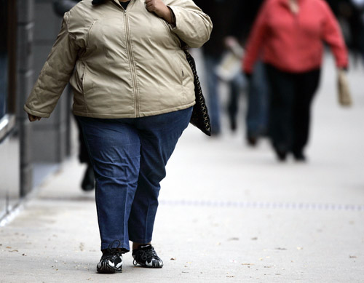
Changing the paradigm of understanding of adipose tissue
Policy
Pollution
Availability of
sportplaces
Society
Exercise
Rodina, SES, zdraví
Place of birth
Social interactions
Geographical
location
Food
Social norms
Social capital
Is it more practical to attempt to change the human or the environment?

Slide 37
Adipose tissue and change of paradigm?
„Obesity is not simply about bodyweight or body image. It is about human vulnerability arising from excess body fat, the origins of which lie in multiple determinants ranging from molecular genetics to market forces.“
Ralston J, Brinsden H, Buse K, Candeias V, Caterson I, Hassell T, Kumanyika S, Nece P, Nishtar S, Patton I, Proietto J, Salas XR, Reddy S, Ryan D, Sharma AM, Swinburn B, Wilding J, Woodward E. Time for a new obesity narrative. Lancet. 2018 Oct 20;392(10156):1384-1386.

Slide 38
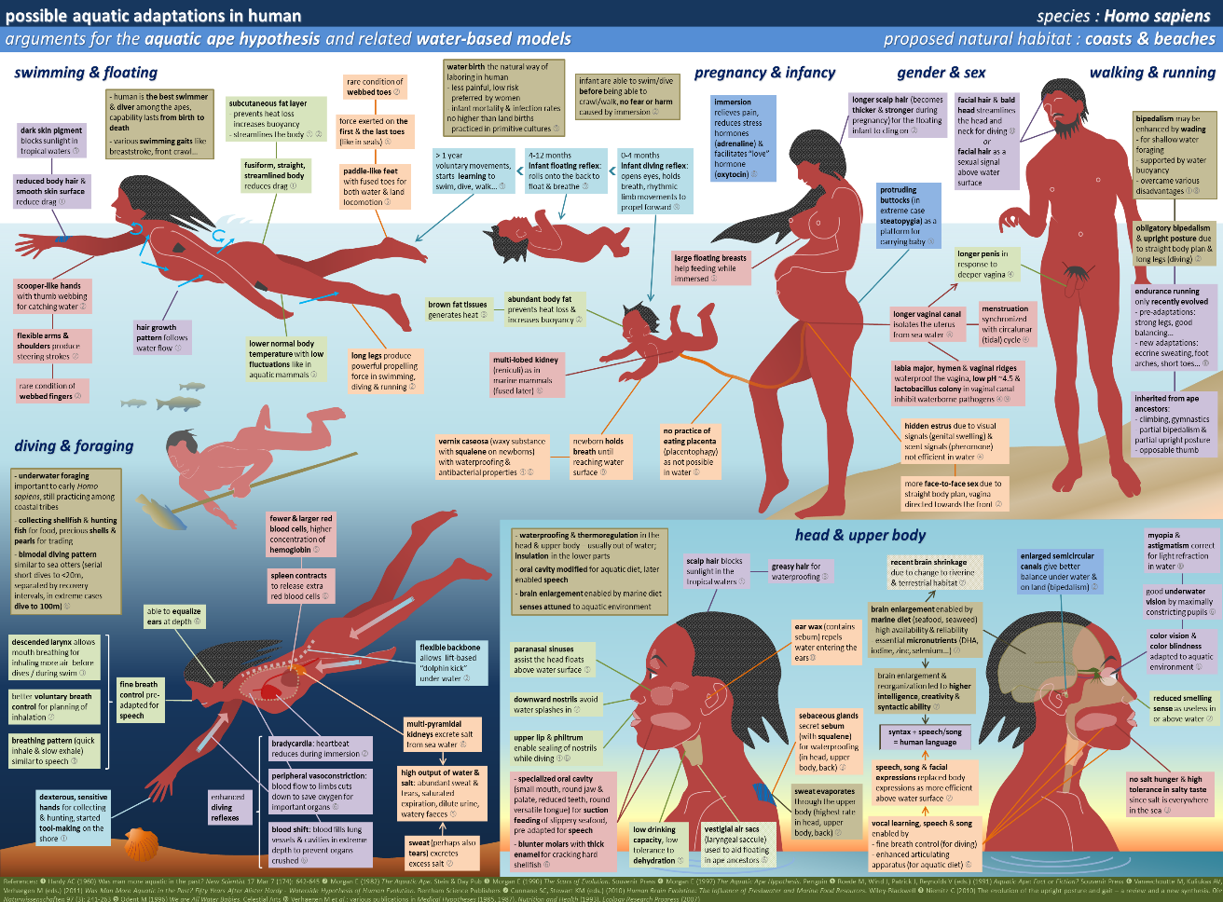
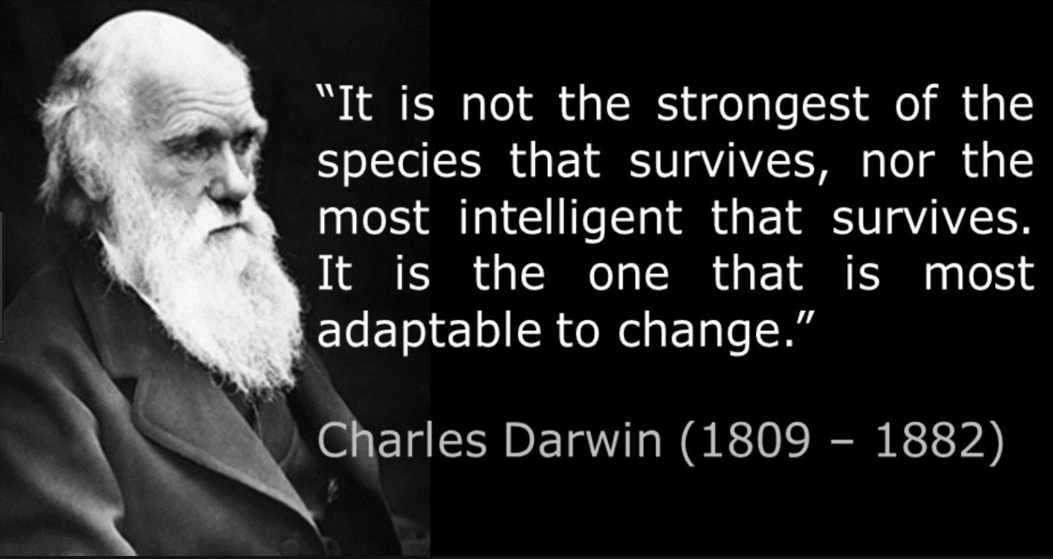
How do we adapt?

Slide 39
Let‘s get back to adaptation!

Slide 40
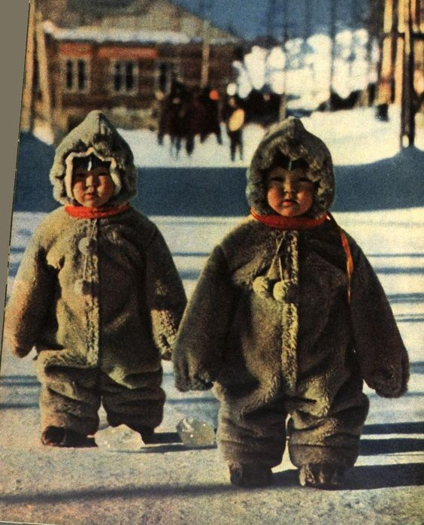

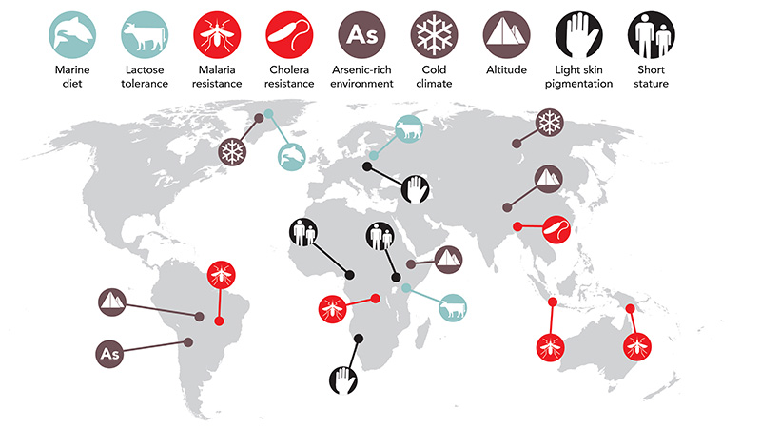


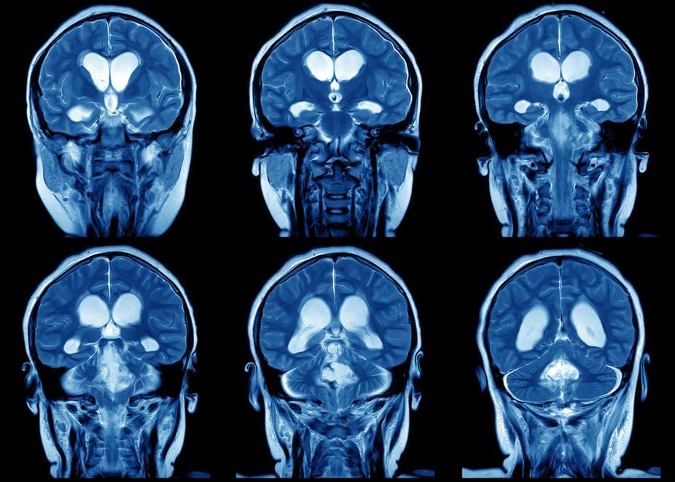

Slide 41
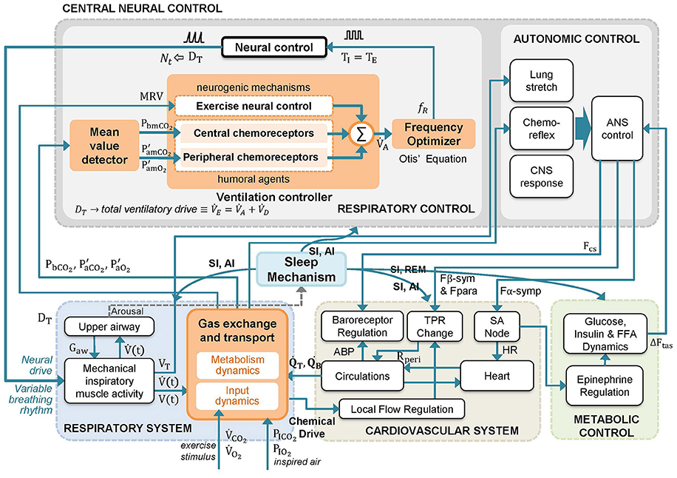

Breathable air?
An Improved Dynamic Model for the Respiratory Response to Exercise
Leidy Y. Serna^{1,2*}, Miguel A. Mañanas^{1,2}, Alher M. Hernández³ and Roberto A. Rabinovich^{4,5}

Slide 42

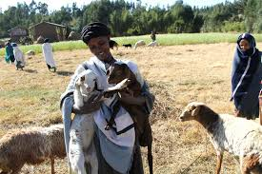

Breathable air
Most of the adaptation during the first 2 weeks to 2 months after arrival to the high altitude area, but in permanently living populations the changes occur prenataly already
Most of the changes go unnoticed
Typical morphology of populations living in the high altitude – the barrel chest
Different mechanism of adaptation (decreased or increased hemoglobin levels, etc.)
Higher hydration
Different distinct populations: Tibetians, Andians, Ethopians.
Notes:
https://breathing.com/blogs/respiratory-chemistry/ethiopian-highlanders

Slide 43

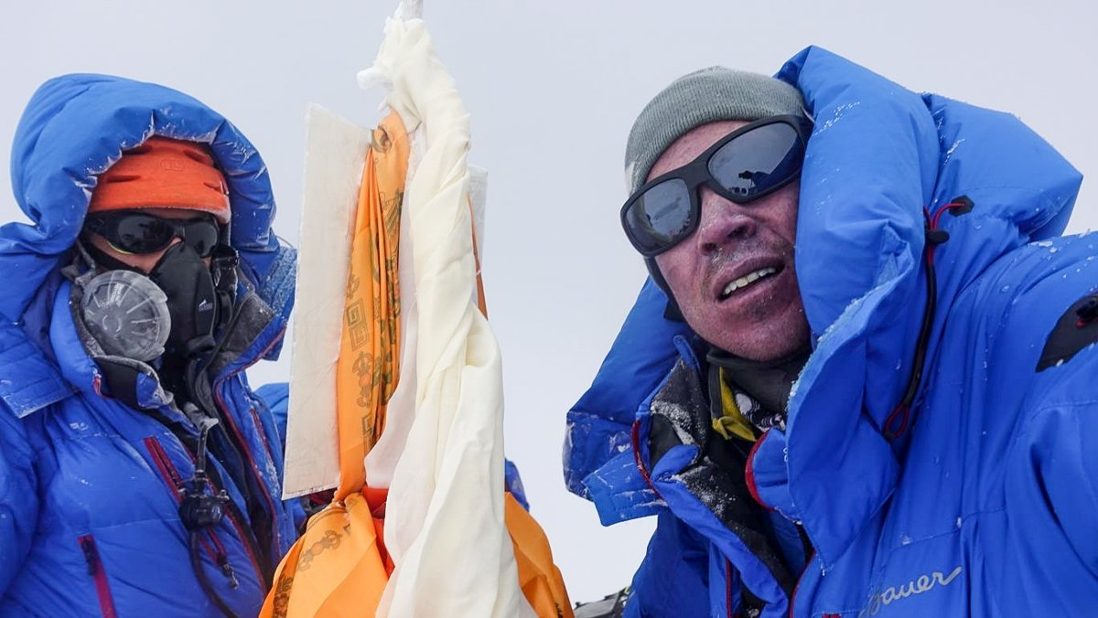
Breathable air: record
Notes:
The current world record for static apnea, or holding your breath in water without moving (often face down, unlike this training session), is 11 minutes and 35 seconds, and was set by Stéphane Mifsud in 2009.

Slide 44
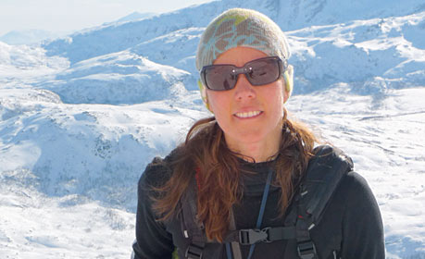
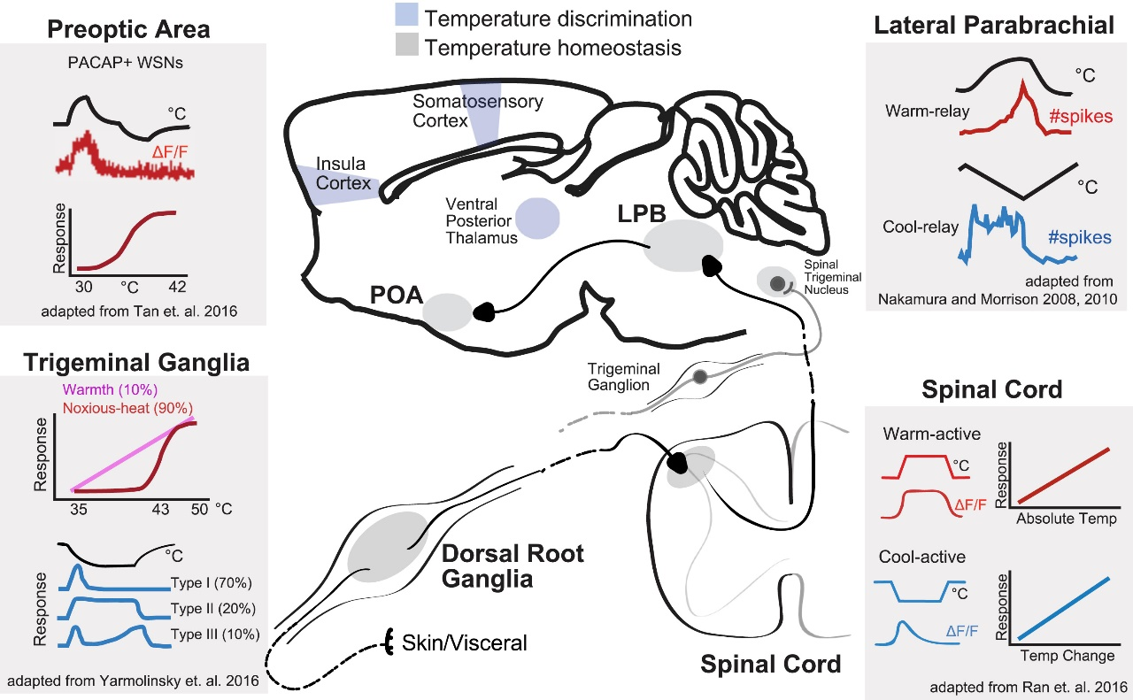
:Shelter: cold and heat - records
Very dry air: 120+ °C (248+ °F) short-term, 70+ °C (158+ °F) long-term (with accesss to water with lower temperature)
Tropical air: 60+ °C (140 °F) short-term, 47 °C (117 °F) long-term
Saturated air: 48 °C (118 °F) short-term, 35 °C (95 °F) long-term
Water: 46° C (115 °F) short-term and 41°C (106 °F) long-term
Regulation of Body Temperature by the Nervous System
Chan LekTan¹Zachary A.Knight¹²³⁴
Notes:
Live Science explains that your body's core temperature should stay in the vicinity of 98.6 degrees Fahrenheit (37 degrees Celsius). Once your body drops to 95 degrees or below, hypothermia takes hold. This impedes the function of vital organs such as the brain and heart. When your core body temperature hits 91 degrees F (33 C), you might suffer amnesia. At 82 degrees F (28 C), you might lose consciousness. At 70 degrees F (21 C), you experience "profound," deadly hypothermia.

Slide 45
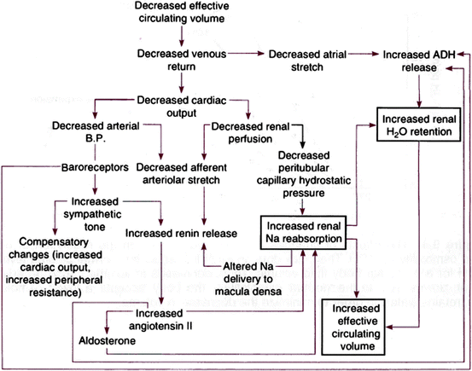

Water?

Slide 46

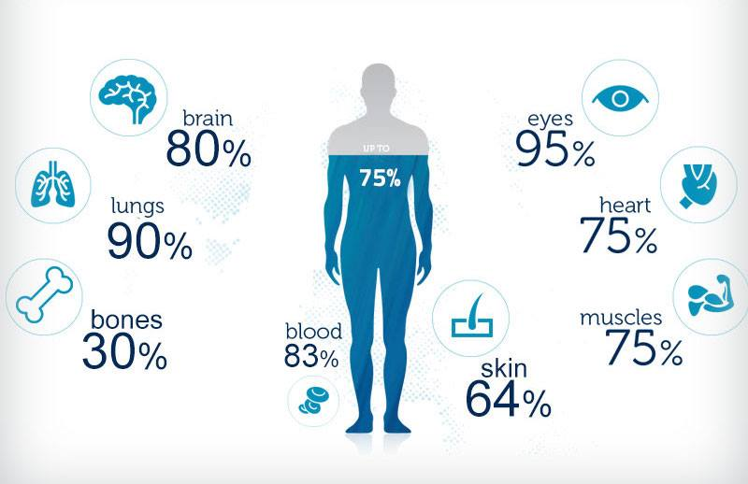
Water: physiological demands: record
Notes:
Andreas Mihavecz, an 18-year-old Austrian man, may have survived the longest without drinking water: Police accidentally left him in a holding cell for 18 days in 1979. It's a fuzzy record, though, since he allegedly licked condensation off the walls of the prison.

Slide 47
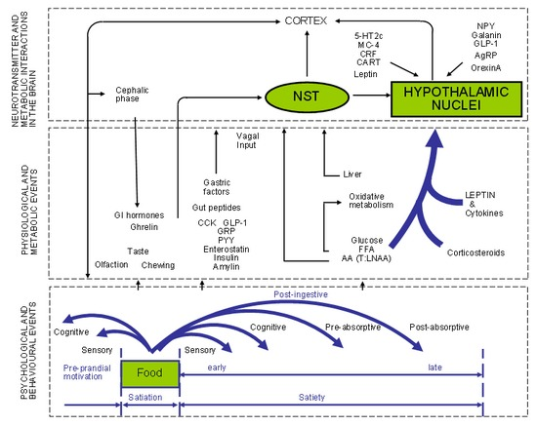

Food intake?

Slide 48
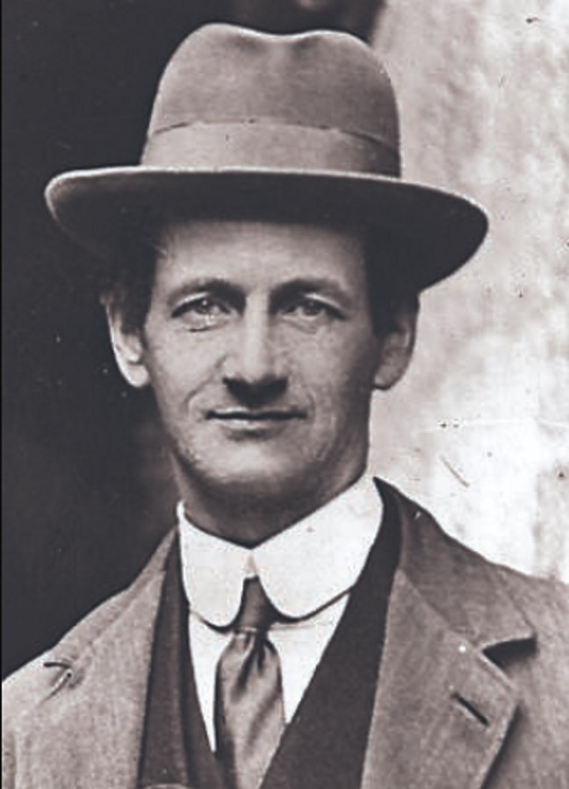
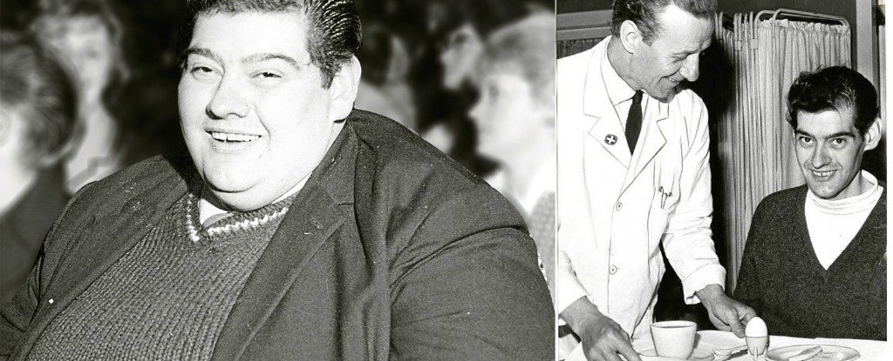
Food: physiological demands, record?
74 vs. 382 days?
Notes:
But the longest-lasting hunger strike in recorded history was undertaken by an Irish political prisoner, , Terence MacSwiney
whose 74-day strike ended with his death in 1920. 382 days Angus Barbieri, 125 kg zhubnul

Slide 49
Stress and the surrounding environment
What do we know?

Slide 50
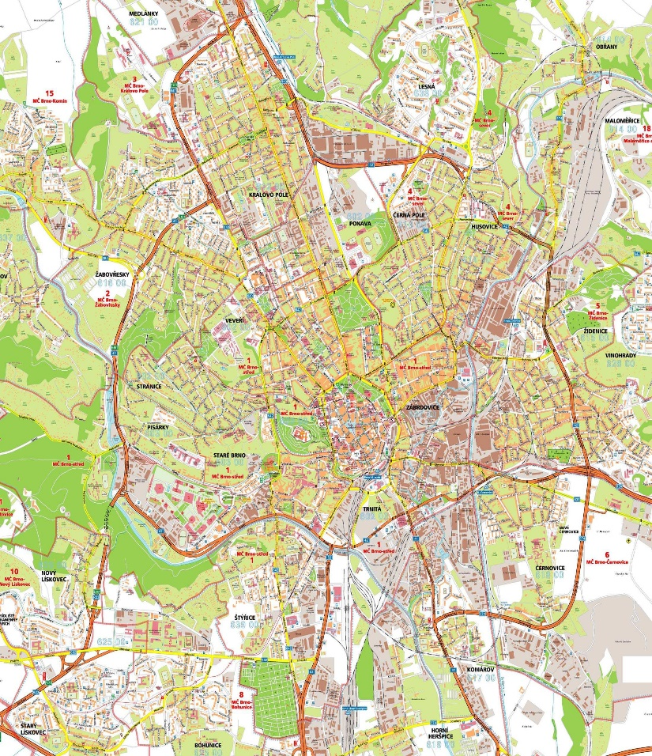
Human wellbeing vs stress
Epictetus: "If you wish your house to be well managed, imitate the Spartan Lycurgus. For as he did not fence his city with¨walls, but fortified the inhabitants by virtue and preserved the city always free; so do you not cast around (your house) a large court and raise high towers, but strengthen the dwellers by good-will and fidelity and friendship, and then nothing harmful will enter it, not even if the whole band of wickedness shall array itself against it.
Also, that city is well fortified which has a wall of men instead of brick.“
There is increasing acknowledgement that design of urban spaces can contribute to the health and well-being of residents. Development of green spaces, design of parks and appropriate proximate infrastructure may promote increased physical activity leading to improved health outcomes within populations (Honold et al., 2015, Nordh et al., 2011, Nordh et al., 2009, Nordh and Østby, 2013).
Notes:
Overall, more people in the world live in urban than in rural setting since 2010. In 2020, 56.2 percent of the world population was urban. Half of these people lived in towns of less than 500,000 inhabitants.

Slide 51
The WHO Expert Committee on Environmental Health in Urban Development
"The health of a city's people is strongly determined by physical, social, economic, political and cultural factors in the urban environment, including the processes of social aggregation, migration, modernisation and industrialisation, and the circumstances of urban living..... [T]he impact of urban processes on health is not just the sum of the effects of the various factors taken individually, since they interact synergistically with each other." (WHO, 1991, pag.11)
Notes:
Are the people in the cities more or less healthy than people living in the urban settings?

Slide 52
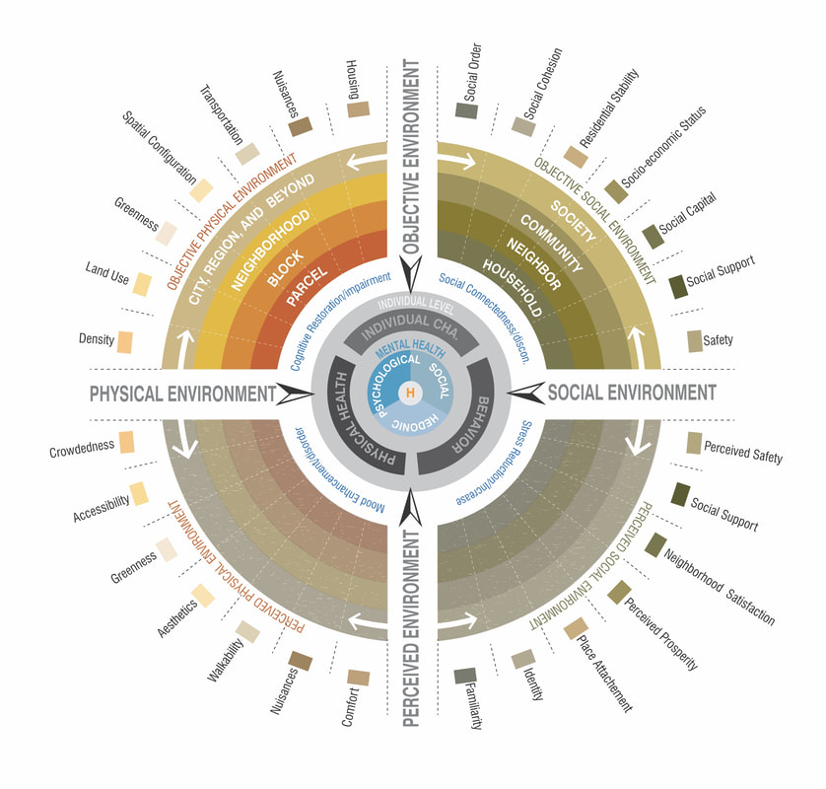
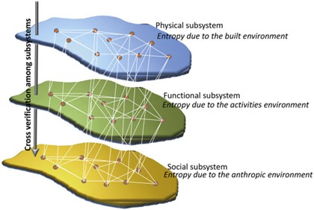
So, what constitutes human wellbeing?
Percentage of Energy-efficient buildings Density of disused buildings, Roads conditions Traffic intensity, Quality of the Local Transport Network Percentage of soft mobility lanes, Density of areas subjected to flooding risk, Density of areas subjected to seismic risk, Density of areas subjected to hydrogeological risk Territorial utilization for agriculture
Population density Presence of metropolitan functions Percentage of Tertiary activities Status of the housing stock, Waste production Building obsolescence Bigger emission sources Building quality Clime characteristics, Density of Illegal buildings Density of Sport and recreational structures Crowding index
Noise pollution
Electromagnetic pollution
Unemployment rate
Multi-ethnic composition of residential population
Safety and care of elder population
Urban form and mental wellbeing: scoping a theoretical framework for action
Amir Hajrasoulih(1), Vicente del Rio(1), James Francis (1) and Jessica Edmondson(2) The Journal of Urban Design and Mental Health
Notes:
Urban air pollution, noise and traffic congestion are the most recognised symptoms of urban environmental stress. Causes of such stresses are clearly related to rapid changes in urban lifestyles and increased urban activities which have occurred in the last decades. Yet, their links with the patterns of urban development are often not fully appreciated. The interrelated nature of urban environmental problems can be best explained by examining, for example, the relationship between air pollution, energy consumption and transportation trends.
Major causes of air pollution in cities are the processes involving the combustion of fossil fuels. These include the production and consumption of energy for domestic and commercial building heating systems, industrial activities and transport. There are important differences in energy patterns among European cities and within cities' inner and outer areas, as illustrated by the examples of London and Berlin (Figure 37.1a, b and c). These are reflected in the levels of emissions of air pollutants and air quality levels. Fuel substitution in domestic heating has reduced dramatically the emissions of sulphur dioxide and particulates per unit of energy consumed in Western European cities. The substitution of natural gas for coal and oil in European cities has also reduced emissions of carbon dioxide per unit of energy. However, the majority of cities still exceed short-term WHO-AQGs (air quality guidelines), and in most Eastern and Southern European cities long-term exposure to particulates and sulphur dioxide is still an important concern. Furthermore, as emissions from stationary sources of urban air pollution from domestic and industrial activities have receded, traffic-generated pollutants such as nitrogen oxides, carbon dioxide, particulates and volatile organic compounds have steadily increased.

Slide 53

The Stress of Life, Hans Selye, 1956:
„… the non-specific response of the body to any demand made upon it, whether it is caused by, or results in, pleaseant, or unpleasant conditions“
Notes:
The relationship between stress and disease is now well established, but was not always recognised. The word ‘stress’ is used in physics to refer to the interaction between a force and the resistance to counter that force, and it was Hans Selye who first incorporated this term into the medical lexicon to describe the “nonspecific response of the body to any demand “. Selye, who is known as the ‘father of stress research’, disavowed the study of specific disease signs and symptoms, unlike others before him, and instead focused on universal patient reactions to illness. His concept of stress impacted scientific and lay communities alike, in fields as diverse as endocrinology, complementary medicine, animal breeding and social psychology.

Slide 54
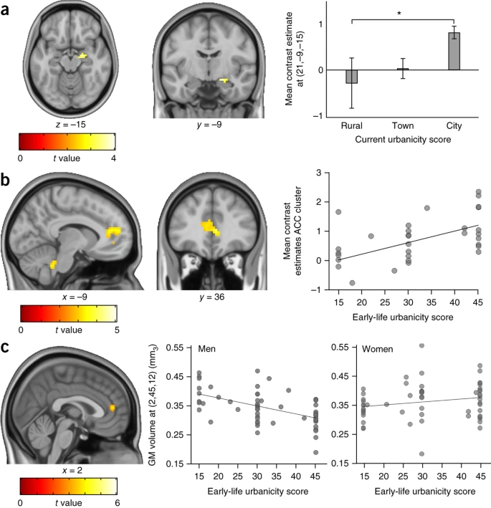
So what is the problem?
How does extent of a given land cover type in a citizens‘ view affect her or his level of emotional arousal, while controlling for walk speed, direction, and distance to automobile roads, and how do changes in direction (turns) explain additional variation in physiological parameters when the other variables are accounted for?
Notes:
a) Amygdala activity during social stress processing is highest in individuals residing in cities, intermediate in those residing in towns and lowest in those residing in rural areas. *P ≤ 0.05; error bars, mean ± s.e.m.(b) Activity in the perigenual anterior cingulate cortex (pACC) during social stress processing correlates positively with urban exposure during upbringing. Images (a,b) adapted from ref. 101 (Nature Publishing Group). (c) Gray matter volume in the pACC correlates negatively with urban exposure during upbringing, specifically in males (image adapted from Haddad, L. et al. Brain structure correlates of urban upbringing, an environmental risk factor for schizophrenia, Schizophr. Bull. 2015, 41, 1, 115–122, by permission of Oxford University Press)¹⁰².

Slide 55

So what is urban stress in terms of human health?
A state of bodily or mental tension developed through city living, or the physical, chemical, or emotional factors that give rise to that tension.
Urban health: an example of a “health in all policies” approach in the context of SDGs implementation Oriana Ramirez-Rubio, Carolyn Daher, Gonzalo Fanjul, Mireia Gascon, Natalie Mueller,
Leire Pajín, Antoni Plasencia, David Rojas-Rueda, Meelan Thondoo & Mark J. Nieuwenhuijsen
Globalization and Health volume 15, Article number: 87 (2019
Notes:
Urban air pollution, noise and traffic congestion are the most recognised symptoms of urban environmental stress. Causes of such stresses are clearly related to rapid changes in urban lifestyles and increased urban activities which have occurred in the last decades. Yet, their links with the patterns of urban development are often not fully appreciated. The interrelated nature of urban environmental problems can be best explained by examining, for example, the relationship between air pollution, energy consumption and transportation trends.
Major causes of air pollution in cities are the processes involving the combustion of fossil fuels. These include the production and consumption of energy for domestic and commercial building heating systems, industrial activities and transport. There are important differences in energy patterns among European cities and within cities' inner and outer areas, as illustrated by the examples of London and Berlin (Figure 37.1a, b and c). These are reflected in the levels of emissions of air pollutants and air quality levels. Fuel substitution in domestic heating has reduced dramatically the emissions of sulphur dioxide and particulates per unit of energy consumed in Western European cities. The substitution of natural gas for coal and oil in European cities has also reduced emissions of carbon dioxide per unit of energy. However, the majority of cities still exceed short-term WHO-AQGs (air quality guidelines), and in most Eastern and Southern European cities long-term exposure to particulates and sulphur dioxide is still an important concern. Furthermore, as emissions from stationary sources of urban air pollution from domestic and industrial activities have receded, traffic-generated pollutants such as nitrogen oxides, carbon dioxide, particulates and volatile organic compounds have steadily increased.

Slide 56
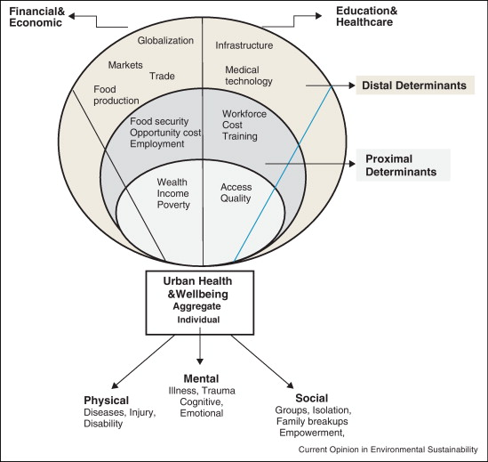

So what are the determinants of urban health?
J. Boydell et al. Br. J. Psychiatry 182, 45–49; 2003
Health and wellbeing in the changing urban environment: complex challenges, scientific responses, and the way forward XuemeiBai IndiraNath AnthonyCapon NordinHasan DovJaron, Current Opinion in Environmental Sustainability Volume 4, Issue 4, October 2012, Pages 465-472
Notes:
In 1965, health authorities in Camberwell, a bustling quarter of London's southward sprawl, began an unusual tally. They started to keep case records for every person in the area who was diagnosed with schizophrenia, depression, bipolar disorder or any other psychiatric condition. Decades later, when psychiatrists looked back across the data, they saw a surprising trend: the incidence of schizophrenia had more or less doubled, from around 11 per 100,000 inhabitants per year in 1965 to 23 per 100,000 in 1997 — a period when there was no such rise in the general population (J. Boydell et al. Br. J. Psychiatry 182, 45–49; 2003 ). The result raised a question in many researchers' minds: could the stress of city life be increasing the risk of schizophrenia and other mental-health disorders?

Slide 57
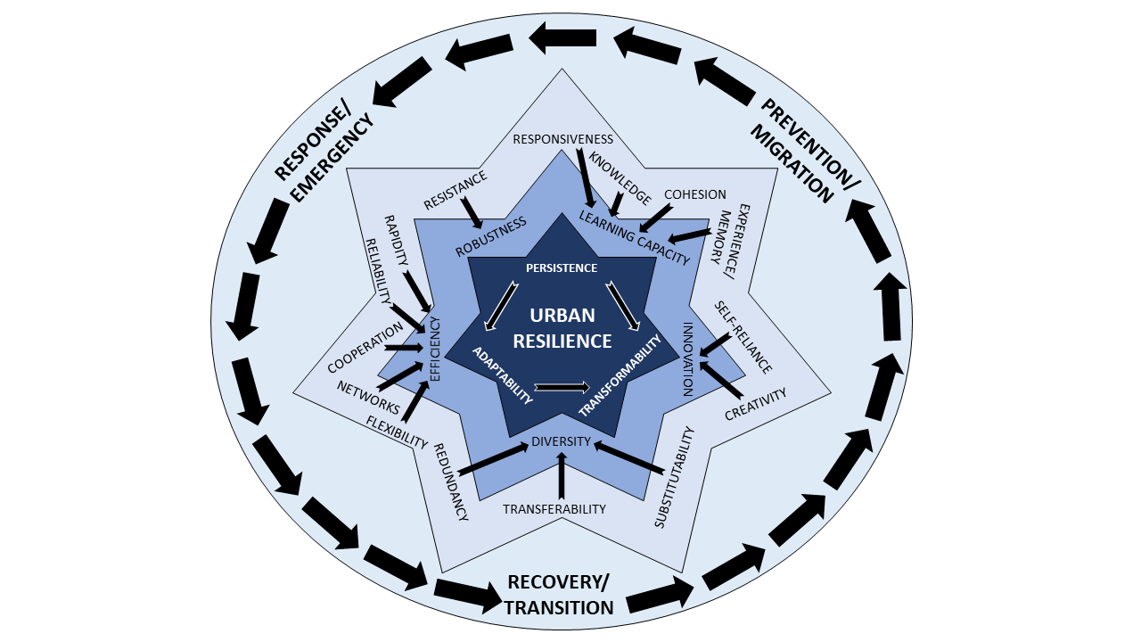
Why is it important?
„Urban resilience has conventionally been defined as the "measurable ability of any urban system, with its inhabitants, to maintain continuity through all shocks and stresses, while positively adapting and transforming towards sustainability".^{[1]} Therefore, a resilient city is one that assesses, plans and acts to prepare for and respond to hazards - natural and human-made, sudden and slow-onset, expected and unexpected. Resilient Cities are better positioned to protect and enhance people's lives, secure development gains, foster an investible environment, and drive positive change.^{[1]} Academic discussion of urban resilience has focused primarily on three distinct threats; climate change, natural disasters, and terrorism.“ – Wikipedia as of 2021
Notes:
Addressing the causes of environmental
maladaptations, instead of treating their symptoms, is necessary if current efforts to improve the urban
environment's quality are to succeed. In cities, people are simultaneously exposed to high concentrations of
environmental pollutants while being confronted with specific visuality of the cityscape and multiple humanto-
human interactions. All of these can be a massive source of stress to the city inhabitants.1 The term
“resilient city” encompasses the complexity of assessing and managing the urban environment subjected to
environmental and internal influences – including the human component.1 The European Environment
Agency (EEA) sees the resilient city as a dynamic urban ecosystem that is “consuming, transforming and
adaptively releasing materials and energy and interacting with other ecosystems, tackling mitigation and
adaptation efforts and addressing quality of life through better and greener urban planning.”2 Clearly, such an
ecosystem is inevitably bound to the wellbeing and stress of its inhabitants.

Slide 58
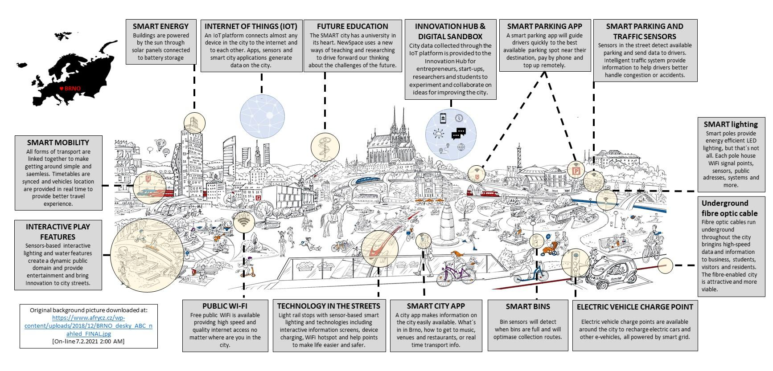
Smart cities – where we want-could be
Masaryk University, RECETOX, Faculty of Sciences
Notes:
When we hear the word “SMART CITIY”, some of us think that it is something very far from our daily life and from our point but I believe that the term “SMART CITY” is broader than just putting “things to the city to measure”.
“SMART CITY” is helping to reduce traffic in a city by monitoring traffic in real time or free parking spaces.
“SMART CITY” is to control and foresee the possible levels of environmental and/or noise pollution of a CITY in order to make more reliable and transparent decisions of the situation.
“SMART CITY” is to prevent industrial accidents and fires by monitoring dangerous agents in the environment.
“SMART CITY” is to control a person’s comfort parameters (temperature, humidity, air quality) in a building so that they feel comfortable in it. Obviously, not everything is great about smart cities. Lack of public awareness and social responsibility, building and maintaining the infrastructure is costly and challenging, demands 24x7 connectivity and power supply, security problems with access to citizens and city data, may lead a way towards social discrimination. Difficult to release the business case for implementation

Slide 59
So what can physiology offer to urbanism?
Deep understanding of pathogenic processes behind common illnesses
Deep insight into methodology of measurement of various urban-stress-related variables
Explanations of pathways between exposure and final health outcome, instead of plain association of exposure with disease
Looking at the city as a platform capable of managing ENVIRONMENTAL DATA (pollution levels, water and waste management), SECURITY (health of buildings, bridges and dams or emergency situations), TRANSPORTATION (lighting on roads, real-time traffic, reduction of travel times and refueling), QUALITY OF LIFE (health, accessibility, sport and leisure) and BUILDINGS (energy consumption and user comfort), should enable major short-term improvements in health of citizens.

Slide 60
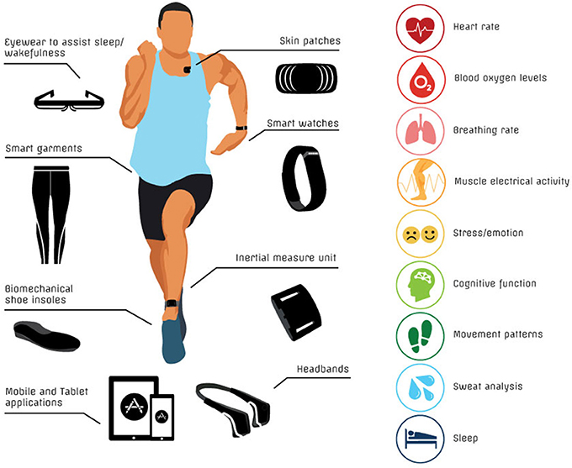
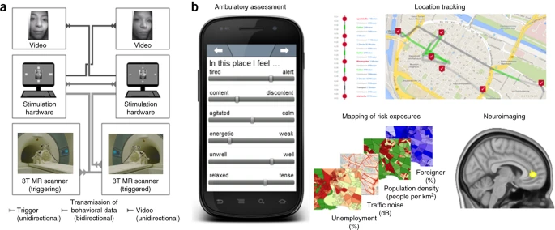
And, how do we measure stress in real world?
A Critical Review of Consumer Wearables, Mobile Applications, and Equipment for Providing Biofeedback, Monitoring Stress, and Sleep in Physically Active Populations. Peake JM, Kerr G, Sullivan JP. Front Physiol. 2018 Jun 28;9:743. doi: 10.3389/fphys.2018.00743.
Masaryk University, RECETOX, Faculty of Sciences
Notes:
a) Hardware environment for functional MRI hyperscanning enabling delay-free data transmission, synchronized data acquisition and live video streaming between scanner sites to study real-time human social interaction. Adapted from ref. 127 (NAS). (b) A multimodal approach for the study of the neural correlates of real-life environmental risk exposures through a combination of neuroimaging with the real-time acquisition of position data, multivariate geographical mapping of natural risk sources and EMA of stress-related psychological variables (MovisensXS platform, Movisens GmbH). Map sources: GeoBasis-DE/BKG, Google (location tracking); OpenStreetMap contributors and City of Mannheim Office of City Planning (traffic noise); Nexiga LOCAL (unemployment percentage, population density and foreigner percentage).

Slide 61
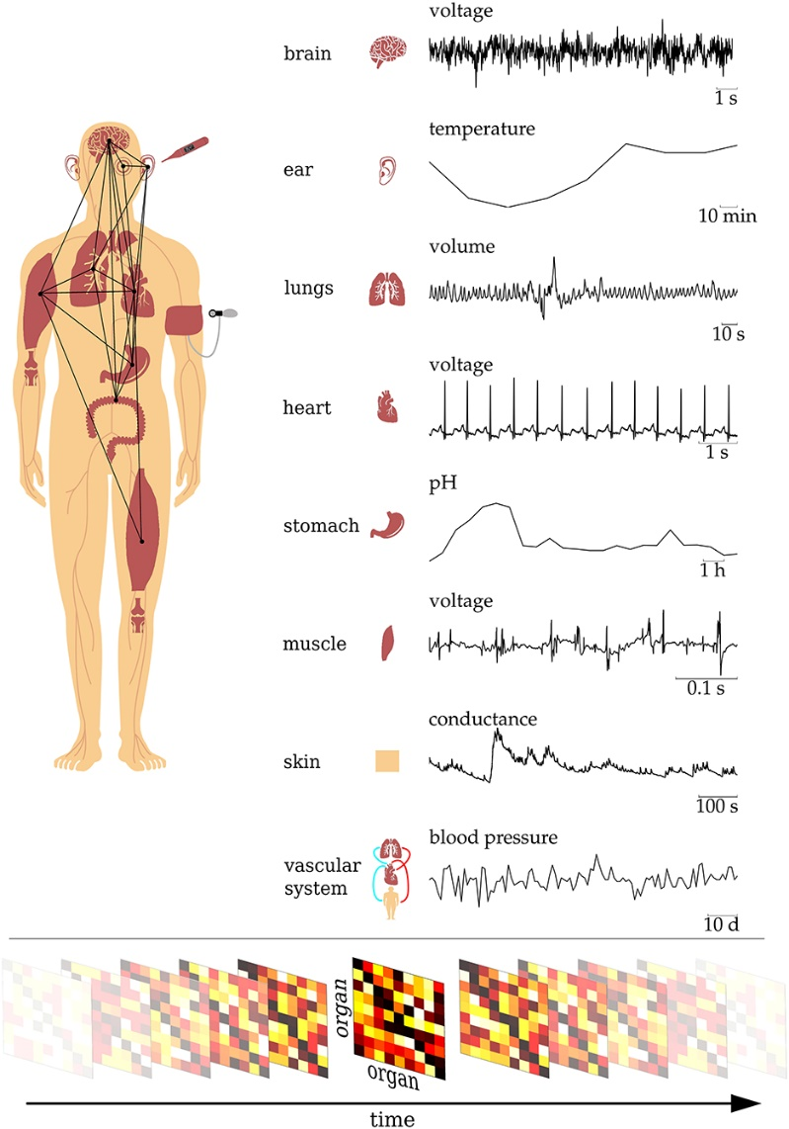
Humans as sensors
• We often do not know exactly the systems' equations of motion;
• We lack knowledge as to how to merge/combine these equations (e.g., due to the issue of time-scale matching);
• We may have insufficient knowledge about relevant structural connections;
• We may not have direct access to interactions between systems (e.g., via probing).
The Human Organism as an Integrated Interaction Network: Recent Conceptual and Methodological Challenges. Lehnertz K, Bröhl T, Rings T. Front Physiol. 2020 Dec 21;11:598694. doi: 10.3389/fphys.2020.598694. eCollection 2020.
Notes:
So what happens if we put all available methodologies on a human simultaneously? Figure 1. Schematic of the human organism as an evolving complex network of dynamical interactions between organ systems. The dynamics of different organs exhibit a broad range of timescales, and physiological observables are typically based on different physical and/or chemical quantities. Time-dependent organ-organ interaction matrices are derived from a time-resolved time-series-analysis-based characterization of interactions from all pairs of observables. These matrices represent a network that evolves in time, with nodes representing organs and edges representing time-varying interactions between them.

Slide 62
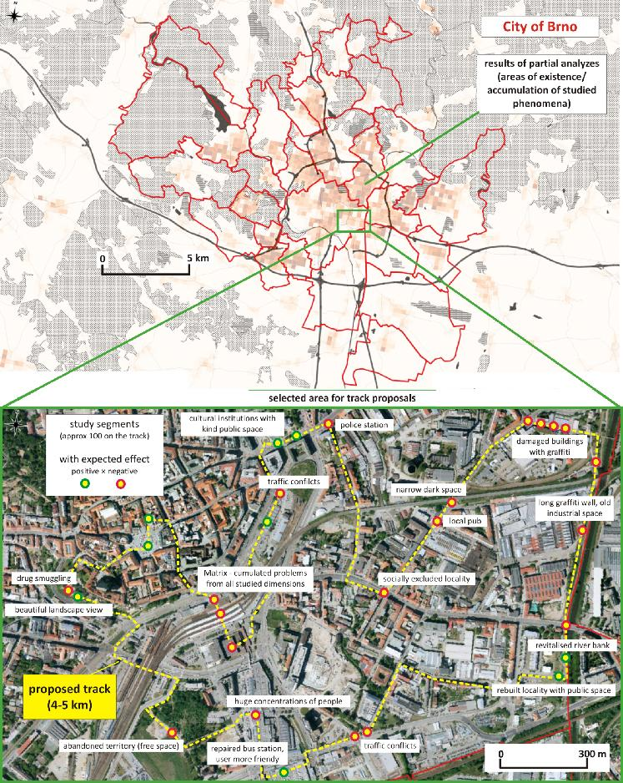

Collective sensing
Space-time analytics of human physiology for urban planning
Garrett C. Millara,*, Ondrej Mitasb, Wilco Boodeb, Lisette Hoekeb, Joost de Kruijfb,
Anna Petrasovaa, Helena Mitasova, Computers, Environment and Urban Systems 85 (2021) 101554
Notes:
The 3D map view (Fig. 6b) from the study by Millara et al. provides an overview of the cyclists' physiological responses within the spatial context, including the effects of buildings. It allows us to display data as a 2D map or zoom-in and explore details in a 3D perspective view. The 3D view facilitates visual assessment of data location accuracy in relation to the buildings and transportation infrastructure, queries all attributes associated with each point, and visually analyzes spatial patterns of attribute values using colored point symbols. The 3D mapping platform thus serves as a valuable feature for exploration, analysis, and interpretation of complex human physiology data across urban landscapes.

Slide 63

What is the point? Change of paradigm?
Formal structures of cities are often inspired by a combination of human geometry and cosmological patterns in both Eastern and Western civilizations, from early representations in mandalas to the Vitruvian Man. Cities have also been understood as a living system, a macroscopic organism, linked through its collective consciousness, communicative structure and relationship to natural resources and cycles. Like the human body or other natural organisms, the city is comprised of multiple parts, organs, cells and functions, each autonomously working with its own requirements. However, we need to learn much more about the interconnectedness to understand better the processes.

Slide 64


“It is our attitude toward events, not events themselves, which we can control. Nothing is by its own nature calamitous -- even death is terrible only if we fear it.”
― Epictetus

Slide 65





Slide 66

Budeme u toho?
Ano!

