Slide 1
Case report III
A fever
Monika Bratova

Slide 2

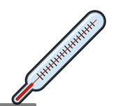
Man, 55-year old, non-smoker, hypertension and GERD in patient´s history, working as a construction manager, living with his wife
Symptoms:
Suffering from fevers around 38°C more then 4 days. He has a chest pain on the left side of thorax, dyspnea and purulent sputum. Without dysuria. He took penicilin antibiotics without any clinical effect.
Hyperstenic habitus, without neurological problems, a regular heart beat, without a heart murmur, breathing - silent breathing above the base and crackles in the middle part of the left lung, abdomen without any resistance, tappotment negative, down extremities without edema

Slide 3
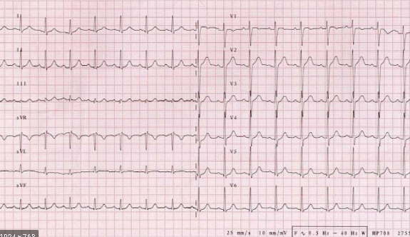
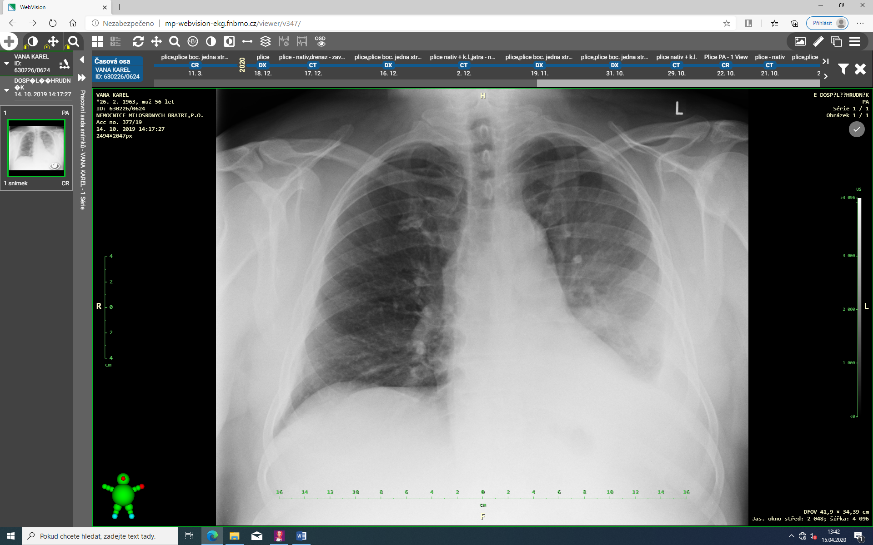
Saturation O2 98%
Which basic examination should be done?
Physiologic ECG
Blood account | Biochemistry
Leucocytes 13,7 | Urea 5,0
Erytrocytes 4,0 | Kreatinine 81
Hemoglobin 125 | Kalium 3,8
Trombocytes 300 | CRP 140

Slide 4
The infiltration of the left lung, maily in the middle and down lobe, left-sided fluidothorax, no enlargement
of the heart

Slide 5
A pneumonia with a pleural effusion:
PLUS – a fever, high inflammatory markers, the X-ray finding, the typical auscultation finding
CONTRA – without effect of antibiotics
Lung cancer:
PLUS – the X-ray finding, persisting despite antibiotics
CONTRA – non-smoker, acute symptoms, without a weigh lost
What is a possible cause of the X-ray finding?
A heart failure:
PLUS – a presence of a fluidothorax, a dyspnoe
CONTRA – without a heart failure in the patient´s history, an unilateral X-ray finding, without an enlargemnet of the heart or edema of down extremities, do not explain a fever
A pyelonephritis:
PLUS – a localization of the pain, a fever, high inflammatory markers
CONTRA – do not explain the X-ray finding, no dysuria, a negative tapottment

Slide 6
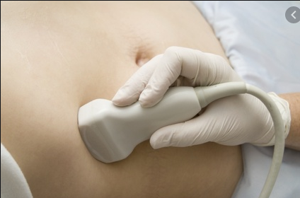
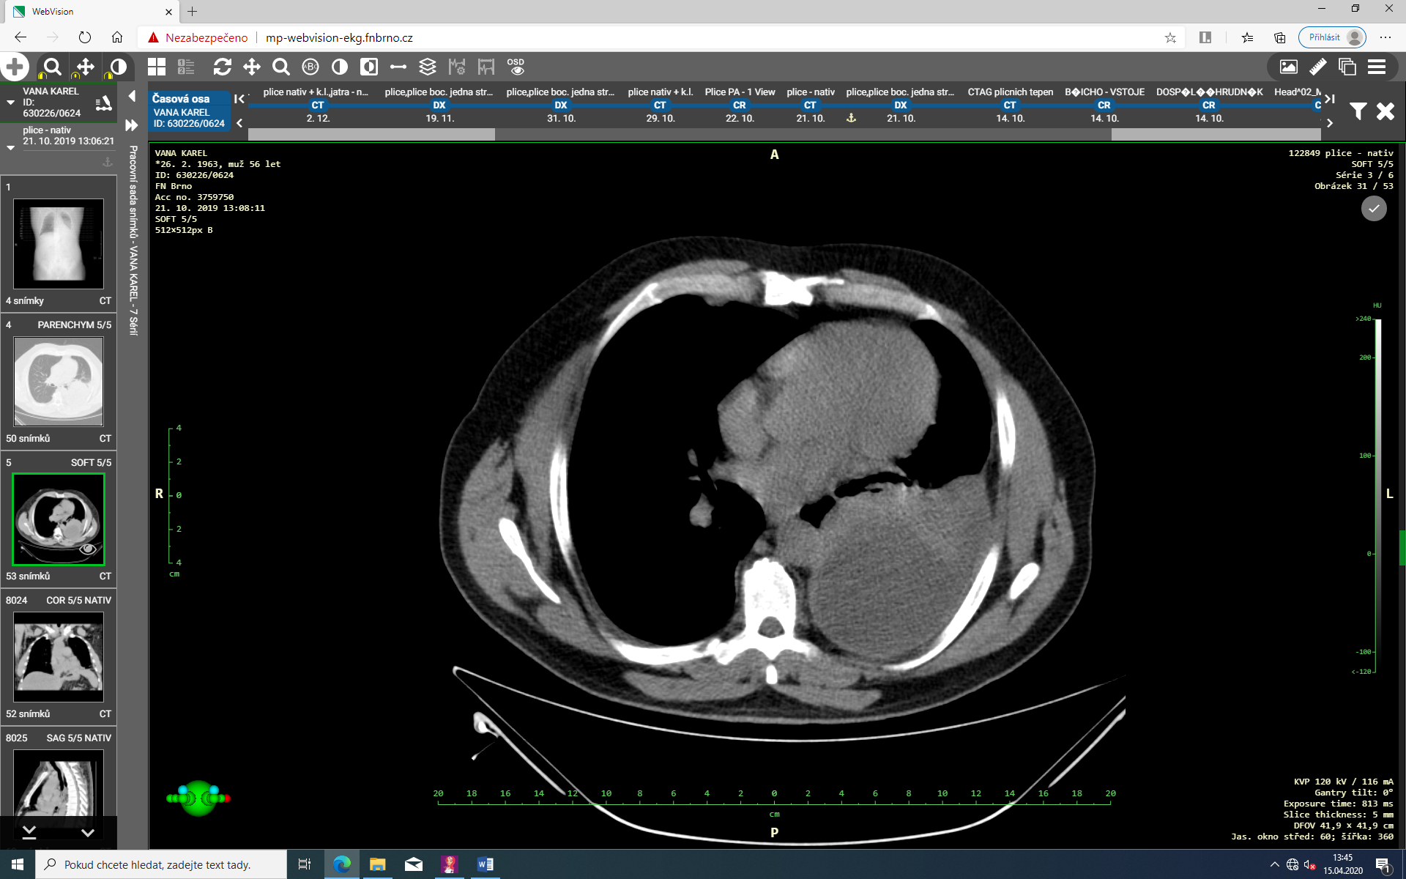
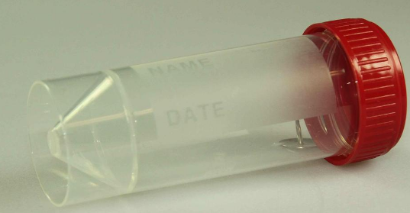
Biochemistry urine examination without evidence of the infection
CT scan: The infiltration of the left lung typical for pneumonia, a massive left-sided fluidothorax, without lymfadenopathy
Which further examination should be done?
An abdomen ultrasonography without pathology
A sputum pozitive from Haemophillus influenzae in the concentration 10⁻⁷

Slide 7
Conclusion
Diagnosis of pneumonia with a pleural effusion
A chest drainage with an evacuation of the empyema was managed, flushed by Betadine
The double combination of antibiotics were administered until 3 weeks
We observed a slow regression of the lung infiltration

