Slide 1
Targeted therapy for the treatment of metastatic lung adenocarcinoma
A case study
Bohdan KADLEC, Jana SKŘIČKOVÁ
Klinika nemocí plic a tuberkulózy LF MU a FN Brno
MUDr. Bohdan Kadlec, Ph.D.
Department of pulmonary diseases and TB LF MU a FN Brno

Slide 2



NSCLC classification is evolving from histological to molecular subtyping of the tumor
Histological subtypes of NSCLC
Adenokarcinoma
Squamous carcinoma
Adenocarcinoma
55%
Squamous
carcinoma
34%
EGFR
ALK
HER2
BRAF
PIK3CA
AKT1
MAP2K1
NRAS
ROS1
RET
EGFR
KRAS
Unknown
EGFRvIII
PIK3CA
EGFR
DDR2
FGFR1 Amp
Unknown
Jiné
11%
EGFR
EGFR mutation shows approximately 10% NSCLC in the "western" population and 30% - 40% of tumors in the Asian population
AKT, protein kinase B; ALK, anaplastic lymphoma kinase; Amp, amplification; BRAF, serine-threonine kinase type B; DDR2, type 2 receptor tyrosine kinase; FGFR, fibroblast growth factor receptor; HER2, type 2 human epidermal growth factor receptor; KRAS, plasma tyrosine kinase; MAP2K1mitogen-activated protein kinase type1; NRAS, plasma tyrosine kinase; PIK3CA, alpha-4,5-diphosphate 3-kinase catalytic subunit; RET, receptor tyrosine kinase; ROS1, receptor tyrosine kinase
Li T, King H-J, Mack DC, et al. J Clin Oncol. 2013;31:1039-1049.
Notes:
Traditional histological subtyping of NSCLC gives way to molecular profile determination
> 50% of adenocarcinomas show the presence of control mutations, some of which can be specifically targeted
EGFR mutations are among the most common and are also the most common targets of specifically targeted therapies
squamous
Reference
Li T, Kung HJ, Mack PC, Gandara DR. Genotyping and genomic profiling of non-small-cell lung cancer: implications for current and future therapies. J Clin Oncol. 2013;31(8):1039-1049.

Slide 3






Resistance due to an acquired mutation is the most common cause of disease progression¹
Metastatic
EGFRm NSCLC
Initial answer
to TKI
The appearance of an acquired mutation, for example
T790M
Progression
during TKI treatment
End of TKI
treatment due to tumor progression
Lung carcinoma cell with EGFR sensitive mutation
Lung cancer cell
with aquired resistant mutation
Most patients with metastatic EGFRm NSCLC progress within 8–14 months during first-line TKI treatment²
1. Diagram adapted from Sacher AG, Jӓnne PA, Oxnard GR. Cancer. 2014;120:2289-2298. 2. Langer CJ. J Clin Oncol. 2013;31:3303-3306.
Notes:
Most patients develop 1.2 after the initial response to TKI treatment
Targeted treatment creates selection pressure on the tumor cell population, thereby enabling the proliferation and growth of other mutated cell types. This results in an increase in the treatment of refractory tumor cells and tumor progression 2
Clinically, progression occurs when a critical amount of refractory cells 3.4 has been reached
References
Sacher AG, Jänne PA, Oxnard GR. Management of acquired resistance to epidermal growth factor receptor kinase inhibitors in patients with advanced non-small cell lung cancer. Cancer. 2014;120(15):2289-2298.
Kosaka T, Yamaki E, Mogi A, Kuwano H. Mechanisms of resistance to EGFR TKIs and development of a new generation of drugs in non-small-cell lung cancer. J Biomed Biotechnol. 2011;2011:165214.
Kwak EL, Sordella R, Bell DW, et al. Irreversible inhibitors of the EGF receptor may circumvent acquired resistance to gefitinib. Proc Natl Acad Sci U S A. 2005;102(21):7665-7670.
Landi L, Cappuzzo F. Irreversible EGFR-TKIs: dreaming perfection. Transl Lung Cancer Res. 2013;2(1):40-49.

Slide 4
EGFR T790M mutations are among the most common causes of acquired resistance to EGFR TKI treatment
Nearly two-thirds of patients with metastatic EGFRm NSCLC who progressed to EGFR TKI treatment had the presence of an acquired EGFR T790M mutation
Frequencies of different mechanisms of acquired resistance.
Yu HA, Arcila ME, Rekhtman N, et al. Clin Cancer Res. 2013;19:2240-2247.
Notes:
524/5000
In a study of 155 patients with EGFRm NSCLC and radiographic progression after initial response or disease stabilization in first-generation EGFR-TKI therapy, the EGFR T790M mutation was the most common cause of acquired TKI resistance, observed in approximately 2/3 of treated patients (95 % CI 55% -70%) 1
Other causes of resistance were, among others, amplification of HER2 and MET1
Rare mechanisms leading to the development of resistance are mutations PIK3CA, BRAF, FGFR, and transformation of tumor cells to small cell type2
References
Yu HA, Arcila MA, Rekhtman N, et al. Analysis of tumor specimens at the time of acquired resistance to EGFR TKI therapy in 155 patients with EGFR-mutant lung cancers. Clin Cancer Res. 2013;19(8):2240-2247.
Gerber D, Gandhi L, Costa DB. Management and Future Directions in Non-Small-Cell Lung Cancer with Known Activating Mutations. ASCO Educational Book. 2014; e353-e365.

Slide 5
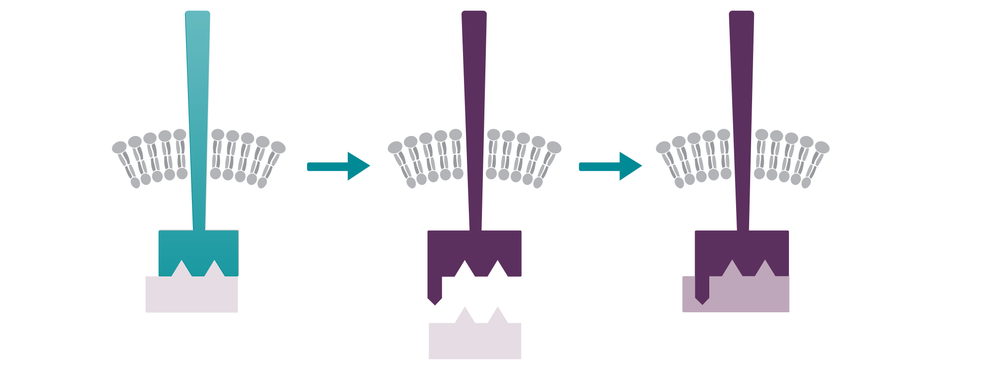
Acquired resistance to EGFR TKI treatment
First line
EGFR TKI
Acquired EGFR mutationT790M
TAGRISSO
EGFRm
EGFR T790M
EGFR T790M
TKI
TAGRISSO
TKI
TAGRISSO inhibits both the EGFR-sensitive mutation and the EGFR T790M mutation responsible for resistance to TKI 1./2. generation
1st and 2nd generation TKI inhibits EGFR signaling
The T790M mutation leads to the development of acquired resistance
SPC Tagrisso.
Notes:
TAGRISSO is an EGFR kinase inhibitor that binds irreversibly to specific mutated forms of EGFR (T790M, L858R, deletion of exon 19) at concentrations approximately 9x lower than those required to bind to wild-type EGFR 1.
In both cell cultures and animal models with implanted tumors, TAGRISSO showed antitumor activity in NSCLC cells carrying specific EGFR mutations (T790M / L858R, L858R, T790M / exon 19 deletion or exon 19 deletion). To a lesser extent, EGFR 1 was also active in cells with WT amplification
TAGRISSO was prepared to have minimal activity against IR or IGFR2
Reference
TAGRISSO [Package insert]. Wilmington, DE: AstraZeneca Pharmaceuticals LP; 2015.
Cross DA, Ashton SE, Ghiorghiu S, et al. AZD9291, an irreversible EGFR TKI, overcomes T790M-mediated resistance to EGFR inhibitors in lung cancer. Cancer Discov. 2014;4(9):1046-1061

Slide 6
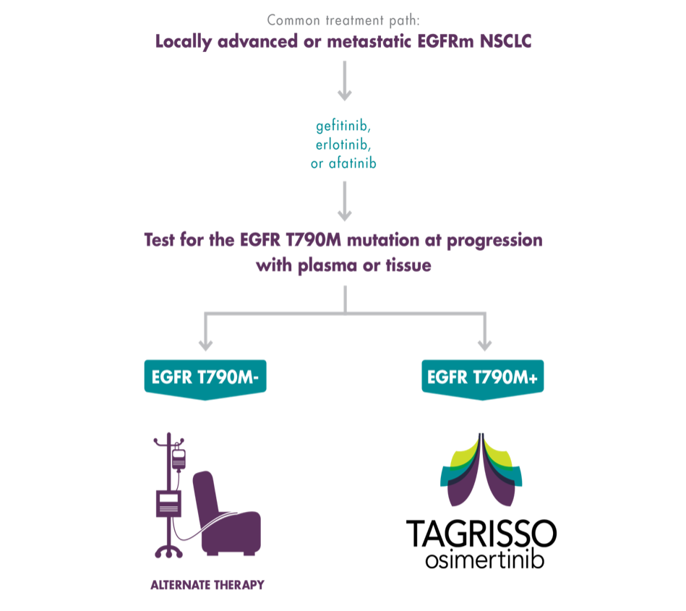
TAGRISSO® (osimertinib): Therapeutic indications
Therapeutic scheme
Localy advanced or metastatic EGFRm NSCLC
Indication
TAGRISSO is indicated for the treatment of adult patients with locally advanced or metastatic non-small cell lung cancer with a proven mutation in the T790M epidermal growth factor receptor (EGFR).
gefitinib
afatinib
erlotinib
EGFR T790M mutation test in case of tumor progression
(blood or tissue)
Alternative treatment

Slide 7


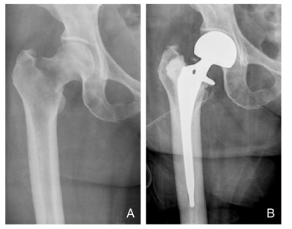
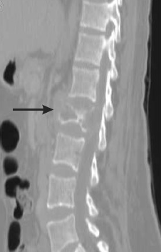
Case study
woman, 46 years old
english teacher
never smoker still healthy
3/2016 dg. adenocarcinoma of the upper lobe of the left lung, wedge. st. IV with malignant pleural effusion and skeletal metastases
EGFR M + deletion in exon 19
symptoms: pain, shortness of breath,
in April 2016 there is a pathological subcapital fracture of the femur on the left, which was resolved by a total endoprosthesis
ECOG - PS 1-2
Notes:
She is a young, still completely healthy woman with a university degree employed as an English teacher, living in a complete family with two minor children, a non-smoker. At the time of diagnosis, this woman was 46 years old. The disease manifested itself in skeletal pain, especially in the upper right femur, and has been examined since February 2016. A general examination revealed an X-ray lesion in the upper lobe of the left lung and a CT examination of the chest including the skeleton confirmed a malignant lesion in the lung parenchyma in segment 3 left subpleurally. size about 17 mm, described as a large soft tissue pathological formation of markedly pinched contours with adhesion to the chest wall, postcontrast it is clearly saturated (Fig. 5 + 6). The CT also showed the destruction of the pedicle and the left side of the L2 vertebra, a small deposit was in the scapula of the hip bone on the left, irregular contours were sacrally bilaterally on the left neck of the hip bone to the left. Skeletal scintigraphy confirmed pathologically increased activity in the head, neck and diaphyseal part of the left femur, in the left scapula of the hip bone and in L2. On bronchoscopic examination, no signs of pathology were found macroscopically, 5 transbronchial biopsies were performed from the bronchial region for segment 3 of the left lung, and tumor cells of low-differentiated non-small cell carcinoma, most likely adenocarcinoma, were captured histologically. In the meantime, we have already consulted the findings on CT whether it would be possible to perform a lung biopsy under CT due to a larger supply of material, including the possibility of genetic testing for EGFR mutation status. This biopsy was performed without complications, although the original material from bronchoscopy, the pathologist sent the tumor material to the Center for Molecular Biology and Gene Therapy (CMBGT) in FDN, but the material was not suitable for mutation analysis, and it was not safe to examine the ALK gene (anaplastic lymphoma kinases), however, biopsy material from transthoracic puncture under CT was already on the way, where primary lung adenocarcinoma was confirmed to be moderately differentiated and EGFR positive mutations were found from this material, again a common type of exon 19 deletion mutation. The progression of cancer with metastatic skeletal involvement was according to the TNM classification determined as T2N0M1b - stage IV, the indication for initiating biologically targeted treatment with afatinib from the end of March 2016 was met at the same time as regular administration of denosumab in the prevention of complications of metastatic skeletal involvement. The patient has a complication at the beginning of treatment in April 2016, namely a pathological subcapital fracture of the femur on the left at the site of metastatic involvement, which was resolved by total endoprosthesis at the orthopedic clinic of the University Hospital at St. Anny. The patient continued treatment with afatinib and denosumab with improvements in control chest CT and anterior anterior skiagrams, first relieving the limb with the crutches for the first months, then fully loading. Her health improved so much during treatment with afatinib and denosumab that she required a return to work, that is, back to school with the pupils, which enabled her to improve her quality of life and satisfaction. The treatment response of partial regression in the lungs lasted until July 2017 (16 months in total), a small thoracic pleural effusion was found in the anterior and lateral skiagram of the chest (Fig. 7), at the same time on regular CT examinations of the chest after 3 months throughout the treatment in addition to effusion, nodules with up to small saturating deposits on the pleura are described, otherwise a stationary image of the regression of a pathological lesion in the upper lobe of the left lung (Fig. 8). Continue on CT without pathological lymphadenopathy of the mediastinum and hils, without fresh lesions on the skeleton, without expansion of the adrenal glands or in the liver parenchyma. This time we were satisfied with probatory pleural puncture and sending the material for cytology and again the required mutational analysis to determine the mutational status of EGFR. Adenocarcinoma tumor cells were confirmed in the collected effusion and retested in CMBGT - in addition to the already present deletion of exon 19, a resistant T790M mutation was detected. Again, we responded quickly with a request for reimbursement for osimertinib for a sick woman who clinically felt the left hemitorax area as more sensitive, painful, and mildly impaired dyspnea. Again, we were not successful with the application for the insurance company, chemotherapy was recommended, which would not be suitable for a woman practicing the profession due to a higher risk of infection, greater fatigue and the need to interrupt this work activity. Again, we gratefully used the osimertinib samples provided by the company, and after use on another chest X-ray, the left-hand finding completely regressed, which was also confirmed on CT in the next month. The current regular use of denosumab for skeletal disorders, which is not clinically worsening, continues. Since August 2017, the patient has been taking Tagrisso with a long-term treatment

Slide 8
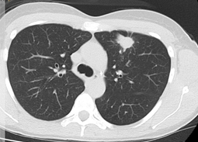
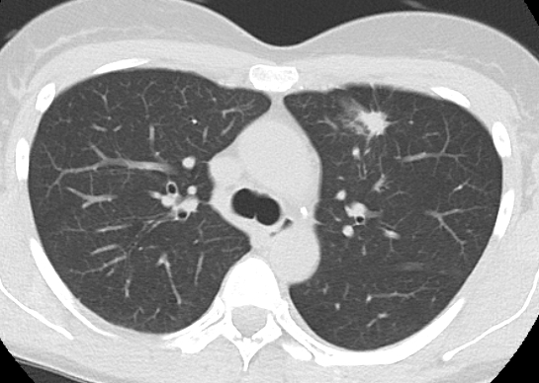
Initiation of afatinib and denosumab treatment
Afatinib 4/2016 – 7/2017 (15 month)

Slide 9
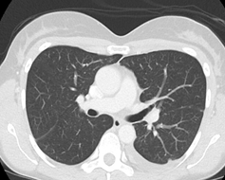
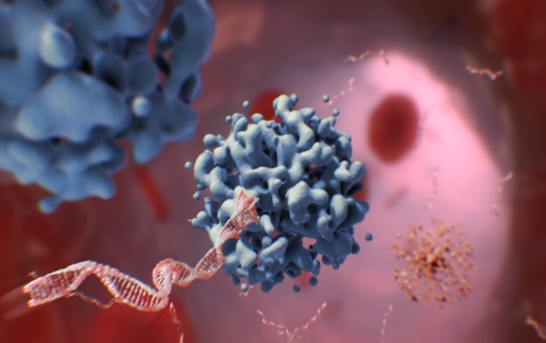
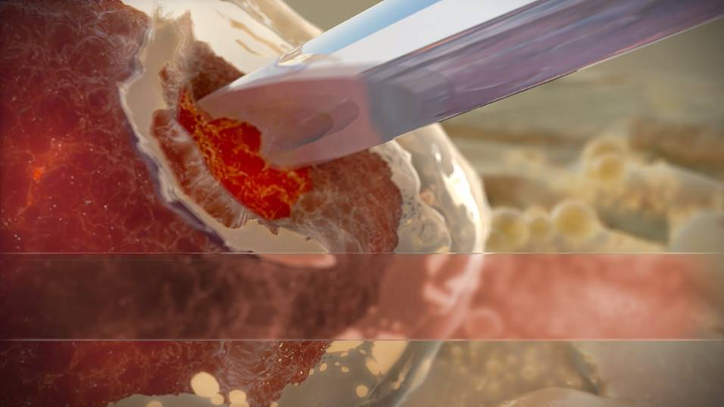
Discovery of a resistant mutation
7/2017 clinical deterioration, pleural pain, left pleural effusion detected
performed a probatory puncture of pleural effusion from which the T790M mutation was proved
ctDNA

Slide 10

Targeted therapy - osimertinib
started at a dose of 80 mg once a day from 8/2017
pleural effusion regressed during treatment
pain and shortness of breath improved

Slide 11
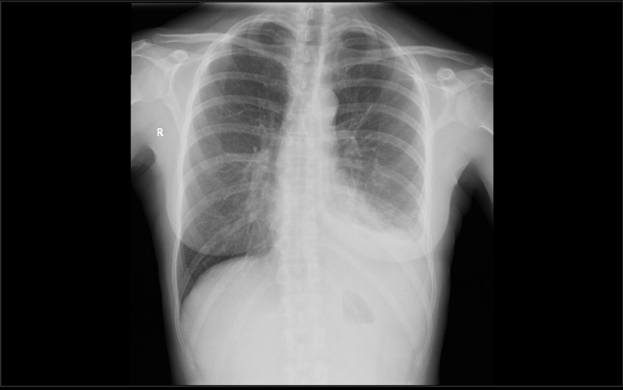
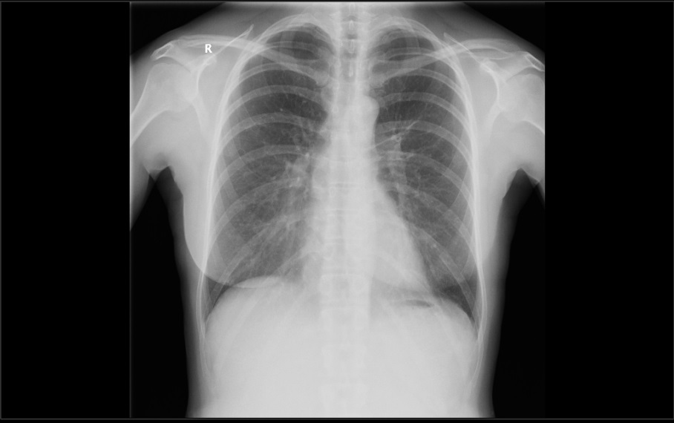
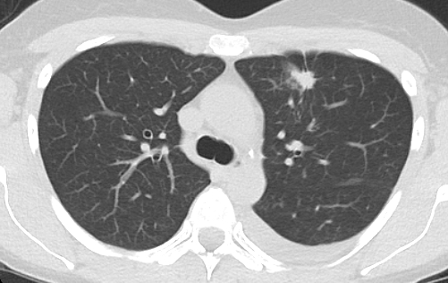
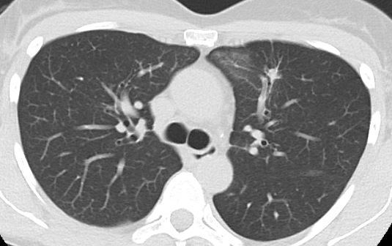
Targeted therapy
Osimertinib 8/2017 – 4/2018
Notes:
Regression of lung tumor, pleural nodularities and effusion.

Slide 12
Conclusion
This case report demonstrates the treatment options of targeted therapy - osimertinib in metastatic lung cancer with the occurrence of the T790M mutation, shows significantly higher survival with comfortable oral administration and significantly lower toxicity compared to conventional chemotherapy treatment.

Slide 13

A case study of a Vietnamese girl
Female, 22 years old, Vietnamese
Anamnestic - in the family without the occurrence of more serious diseases, non-smoking, allergies to grass pollens and mites.
For more than a month, he has difficulty breathing, coughs, wheezes, catches his breath with less exertion, it gets worse overnight, he observes pressure on his chest, he does not give pain.

Slide 14
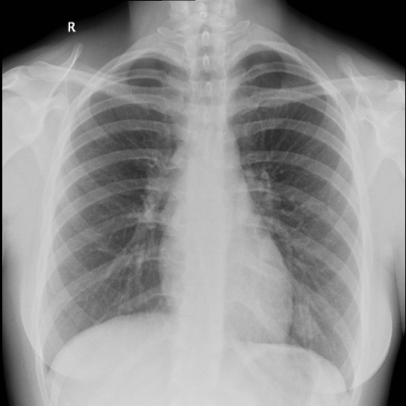
Clinical and imaging examination
Clinically numerous wheezing and wheezing on both sides.
CRP 21, KP without respiratory insufficiency, other laboratory tests in the norm.
Deployed ATB treatment, given bronchodilator infusions including corticoids, bronchodilator therapy and inhaled corticoids
Accepted within a week for non-improving problems

Slide 15
Suggestion for further examination?
A) spirometry and bronchodilation test
B) bronchoscopy
C) CT of the chest
D) PET-CT
E) PET-MR

Slide 16
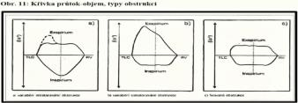
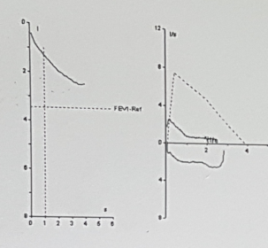
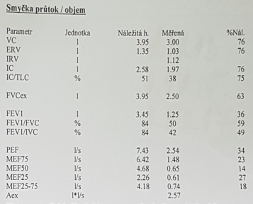
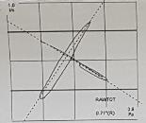
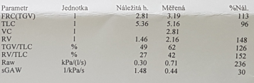
Spirometry

Slide 17
Hospitalization
Laboratory:
Bronchoscopy
IgE 233 (0-90)
hCG less then 2 ( 0 - 5 ) SCCA 0.7 ( 0 - 1.5 )
AFP 1.08 ( 0.74 - 7.29 )
CYFRA 7.99 ( 0 - 3.3 )
NSE 25.5 ( 0 - 16.3 )
the trachea is normal
the main carina is not identifiable, it is taken in a bumpy touch of slightly bleeding infiltration, which spreads to both main bronchi so that they are obturated from 2/3 and a slit remains dorsally, which allows ventilation

Slide 18
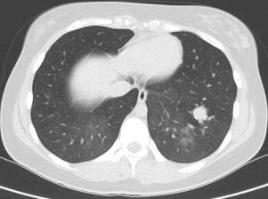
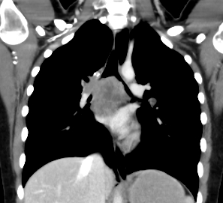
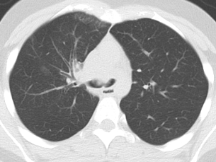
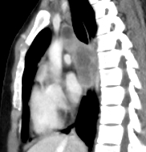
Initial chest CT

Slide 19
Differential diagnostics?
A) Lymfoma
B) Germininal tumor (teratoma)
C) Lung cancer(NSCLC/SCLC)
D) Carcinoid
E) Another primary lung tumor

Slide 20
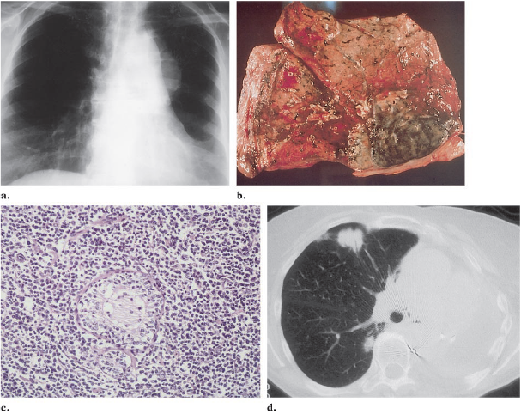
B- lymfoma

Slide 21
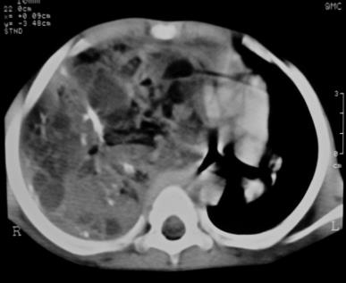
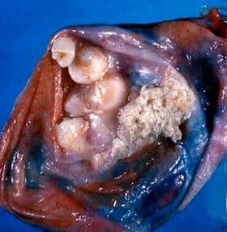
Intrapulmonary teratoma
Rare germ cell tumor.
Causes pain, cough and haemoptysis.
Main treatment is surgical

Slide 22
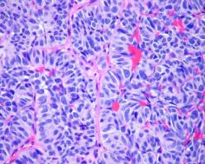
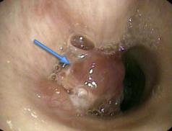
Lung carcinoid
They make up about 1% of lung tumors, incidence 0.5-1.5 / 105.
It belongs to malignant lung tumors.
Typical carcinoids occur more in the younger, atypical in the older.
Central location predominates (> 80%), remaining peripherally, may metastasize to liver, bone, brain, adrenal glands and ovaries

Slide 23
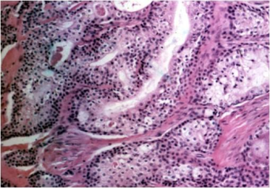
Biopsy
necrotic tumor formed by dominantly merging squamous tumor pins precisely with monocellular keratinization. The tumor sparsely scattered light cells with smaller dark nuclei corresponding to mucinous cells, which are positive for mucus staining.
Immuno: p63 +, CK5 / 6 +, TTF1-, CD5-, CD117-, CK7 +, CK20 fok. +, Chromogranin-, synaptophysin-
Conclusion: mucoepidermoid carcinoma (high grade)

Slide 24
Mukoepidermoid carcinoma
Rare malignant tumor of the salivary glands (<1%), occurs in the small salivary glands of the bronchi.
It occurs in young people and is not associated with smoking.
Symptoms include cough, hemoptysis, bronchitis, wheezing, fever, chest pain and are therefore often diagnosed as asthma, COPD or pneumonia.
Histologically, it is divided into low-grade and high-grade.
Treatment - similar to NSCLC, preferably surgery.
Prognosis: 95% of low-grade patients survive 5 years, high-grade patients survive <10%.

Slide 25
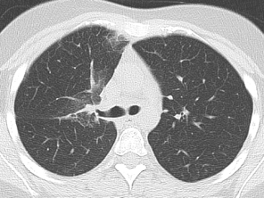
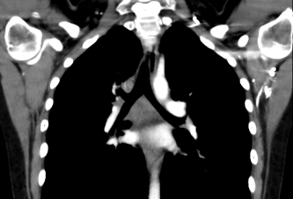
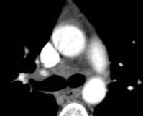
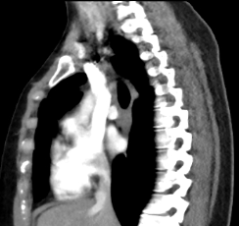
CT regression after chemoradiotherapy

Slide 26
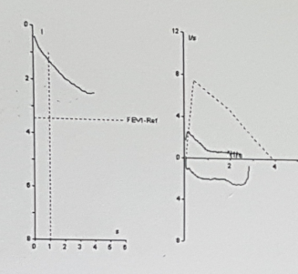
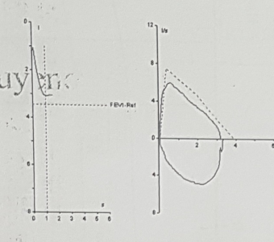
Spirometry before and after treatment
Before
After

Slide 27
Conclusion
This case report shows a case of malignant cancer of the airways, which is clinically reminiscent of an obstructive disease - bronchial asthma. It shows the need to think about this disease and perform examinations to exclude it in the initial differential diagnosis, especially in the case of persistent problems with bronchodilator therapy.

