Slide 1

INTRODUCTION TO THE STUDY OF PHARMACOLOGY

Slide 2
Copyright notice
The presentation is copyrighted work created by employees of Masaryk university.
Students are allowed to make copies for learning purposes only.
Any unauthorised reproduction or distribution of the presentation or individual slidesis against the law.

Slide 3
Pharmacology, definition, aims
„pharmacon“ + „logos“ / „logia“
Scientific discipline dealing with
INTERACTIONS BETWEEN SUBSTANCES.. introduced into the organism from the environment
..AND THE LIVING ORGANISM
on all levels of complexity:
molecular
cellular
organ
organism as a whole

Slide 4
DRUG
„substance or mixture of substances, suppopsed to be administered to the humans or animals for prevention, treatment or diagnosis of diseases or its symptomes or for physiological function adjustment“
Drugs are administered for
Prevention,
Diagnosis,
Treatment of disseases

Slide 5
Pharmacon/um – drug
classical WHO definition:
„Any substance (other than normal body components or substances necessary for normal body functions (food, water, oxygen), that, after administration into the organism evokes a change of a body function“
More precise definition according to Ph.Eur.:
Substances or their mixtures designed to the administration in humans or animals with a purpose of treatment, mitigation, prevention or diagnose of a disease or its symptoms and also to modulation of physiological substances.
  European Pharmacopoea (Ph. Eur. 6th Ed.)
  Pharmacopoea Bohemica 2009 (Ph. B. 2009)

Slide 6
A synthesis of several biomedical sciences….
Biochemistry
Physiology
Pharmacology
Chemistry
Medicine
…but unique in its own right

Slide 7
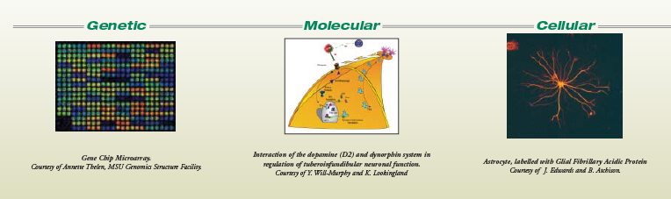
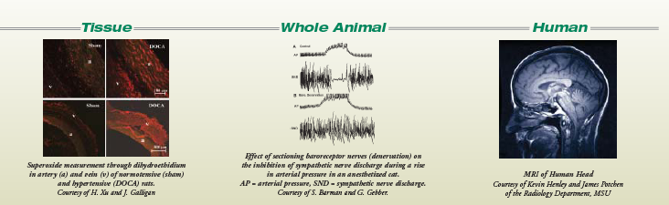
Pharmacologists study science at every level

Slide 8
What Pharmacology is NOT...
Pharmacy
This is a separate profession responsible for the
preparation and dispensation of medication.
Pharmaceutical Science

Slide 9
Basic Pharmacology
General principles
Systems Pharmacology

Slide 10
General principles
Principles which predestinate the interactions of the drug and body
General Pharmacokinetics
General Pharmacodynamics
Two important and interrelated areas:

Slide 11
Pharmacokinetics (PK)
Deals with the fate of the drug in the body – processes of
Absorption,
Distribution
Metabolism
Excretion …“ADME“
„What the body makes with the drug“
Pharmacodynamics (PD)
deals with the mechanism of action (e.g. receptor sites, molecular level of action..)
„How does it work“

Slide 12
Systems Pharmacology
Is focused on individual organ systems and its pharmacotherapy
e.g.
Autonomic drugs
Psychoactive drugs
Drugs used in cardiovascular diseases….

Slide 13
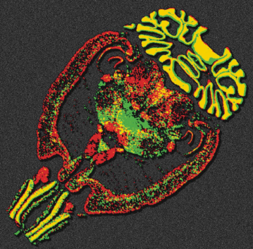

Systems Pharmacology
Neuropharmacology: study of the effect of drugs on
components of the nervous system (brain, spinal cord, nerves)
Example: treatment of Alzheimer‘s disease
Cardiovascular Pharmacology: study of the effects of drugs on heart, vasculature, kidney, nervous and endocrine systems that participate in cardiovascular function.
Example: treatment of high blood pressure (hypertension)

Slide 14
Branches of Pharmacology
Clinical pharmacology
deals with different drugs and their varied clinical usage
interdisciplinary branch, which integrates basic and
experimental Pharmacology with the clinical and
complementary branches
AIM: to study and evaluate the effect of the drug using
objective methods (EBM)
Sub-branches of clinical pharmacology:
Clinical Pharmacokinetics, clin. Pharmacodynamics,
Rational prescribing, Clinical toxicology

Slide 15
Toxicology
the study of the toxic effects of chemicals on living organisms
study of symptoms, mechanisms, treatments and detection of poisoning
experimental (in vitro, in vivo)
clinical - poisoning prophylaxis, diagnosis, treatment
forensic toxicology…

Slide 16
Pharmacogenetics
    deals with the influence of genetic variation on Pharmacokinetics and Pharmacodynamics
    study of the drug response in patients by correlating gene expression or single-nucleotide polymorphisms with a drug's efficacy or toxicity
consequences can be either quantitative or qualitative

Slide 17
Pharmacogenetics
1959 Friedrich Vogel used first time term „pharmacogenetics“
1997 First time used term “Pharmacogenomics“
Pharmacogenetics considers one or at most a few genes of interest, while pharmacogenomics considers the entire genome.

Slide 18
Biochemical and molecular pharmacology
detail study of the mechanism of action at molecular level
Chronopharmacology
Study of the action of the drugs with respect to the biorhythm
(antiasthmatics, glukocorticoids, statins, etc. )

Slide 19
Pharmacoepidemiology
- study of the effect of drugs on populations; questions dealing with the influence of genetics are particularly important
risks and benefits of the therapy using epidemiological methods
Approach of the health specialists (GP, pharmacist)
patient (compliance)
society (drug abuse, marketing, financial resources…)

Slide 20
Pharmacoeconomy
- rationalize the use of sources in health care
- Compares the costs of therapeutic approaches by the pharmacoeconomical analyses
The goal is not „to decrease total money spent in health care“ , but to use the sources effectively

Slide 21
Pharmacovigilance
Pharmacological science relating to the detection, assessment, understanding and prevention of adverse effects
collecting, monitoring, researching and evaluating information from healthcare providers and patients on the adverse effects of medication
Drug safety monitoring
AIM: to minimize the risk of adverse effects

Slide 22
Biological experiment
Experimental pharmacology
in vitro – isolated structures or organs,
cell cultures, microorganisms
- regulatory factors we have to satisfy:
☺ ethical (replacement, refinement, reduction)
☺ small amounts of drugs
☺ use of human cells
☹ elimination of systhemic reaction of the whole body

Slide 23
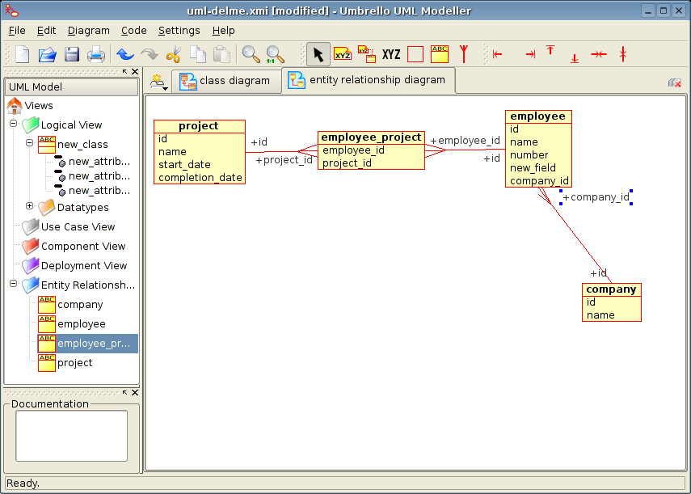
Biological experiment
in silico – use of IT, especially computer modelling (f-kinetics), databases

Slide 24
Biological experiment
in vivo – whole animal
- systhemic effects
- we record toxicity, possible adverse and alergic effects
- impact on memory and other cognitive faculties, learning abilities, depression

Slide 25
Experimental animal
Experimental animal (is born, breed and maintained for experimental purposes)
Defined genetic features:
- randombred – natural breeding - heterozygots
- inbred – breeding of brosthers and sisters, approx. 20 generations homozygots
diabetic mice, hypercholesterolemic mice, hypertonic mice…

Slide 26
Experimental animal
Defined microbial settlement:
- SPF – have 4-5 saprofyte patogens
- Gnotobiotic animals – are born by hysterectomy, pathogens free
- Conventional breeding – not defined settlement

Slide 27
Experimental animal
Mammals
RODENTS: mouse, hamster, rat, guinea-pig
NON-RODENTS (e.g. Lagomorpha): rabbit

Slide 28
Experimental animal
Mammals
carnivores: dog, cat, ferret
Mammals
monkeys: macaque (Macacus sp.), green monkey (Erythrocebus sp.)
Birds
common quail, hen, duck
Amphibians
Xenopus sp.
Fish
guppy (Poecilia reticulata), carp, trout
Crustaceans
Cladocera, Cyclops strenuus

Slide 29
Laws
EU
1986 Council of Europe – rules of protection for vertebrates used for experimental purposes in Europe
Principle 3R: replacement
reduction
refinement

Slide 30
Laws
Czech Republic
Law no. 149/2004 „na ochranu zvířat proti týrání“ – about animal protection against cruelty
Notice no. 207/2004 „o ochraně, chovu a využití pokusných zvířat“ - about protection, breeding and use of laboratory animals
Authorities encharged of animal protection:
Ministry of agriculture, Comission for animal protection, veterinary authorities, ethical comitties

Slide 31
Drug names
Chemical name
according to the IUPAC nomenclature rules
e.g.: N-acetyl-para aminophenol
Generic name (non-proprietary)
INN (International Non-proprietary Name)
not registered, supposed to be used internationally
has to be printed on the packing of the drug (under the registered trade name)
for the universal terminological identification of the medicines
formed from the chemical name (shortness) accordingly with the rules (WHO)
each drug has its own CAS No (Chemical Abstracts Sevice Number)
e.g. paracetamol

Slide 32
Drug names
Trade name (proprietary)
registered, patent-protected ®
has to be acompanied with the INN
e.g. Panadol, Coldrex, Paralen
Officinal name
latin name in Pharmacopoeia (e.g. Paracetamolum)
usually very similar to INN
has to be prescribed on Rx formulary in case of individually prescribed medicines
established name for a drug substance is usually found in the originating country's Pharmacopeia
Paracetamolum
…

Slide 33
Some drug-family names
-olol betareceptor antagonists
-caine local anaestethics
-tidine histamine receptor antagonists
-dipine calcium channel blockers of dihydropyridine type
-statin inhibitors of HMG CoA transferase

Slide 34
DOSE
A specified quantity of a therapeutic agent, prescribed to be taken at one time or at stated intervals.
If administered in the body, desintegrates, solutes, and distribute across the barriers in the body compartments. Than it is measured like „concentration“

Slide 35
DOSE
DOSIS SINGULA - single dose
DOSIS PRO DIE - daily dose
- for 24 h !!
DOSIS CHRONICA
- (adjusted) dose in the chronic treatment (long-term)
on Rx !

Slide 36
DOSE
DOSIS CURATIVA
- total dose of the drug needed for whole period of treatment

Slide 37
DOSE (from effect point of view)
Sub-threshold - cause no observed biological effect
Threshold - minimally effective dose; dose, after which can be observed any effect
Therapeutic dose - produces mostly beneficial effects;
►MAXIMAL
- does not produce harmfull effects
►►DOSIS MAXIMA SINGULA
►►DOSIS MAXIMA PRO DIE
TOXIC – mostly harmfull effects (RISK>BENEFIT)
LETHAL – cause death

Slide 38
ORIGIN OF DRUGS
Modification of the chemical structure of the already known drug
Searching for natural substances
Investigation (screening) of already known chemical compounds
Targeted synthesis of substances with a structure designed by computer modeling

Slide 39

Origin of drugs – synthesis/isolation
Medicinal Plants (cardiac glycosides)
Animal tissues (heparin)
Microorganisms (penicillin)
Human cells (autologue vaccines)
Biotechnology (insulin, MAb)

Slide 40
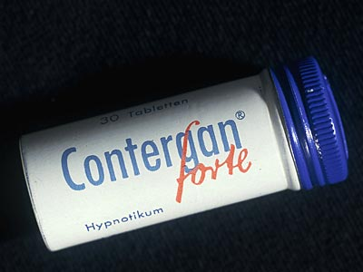
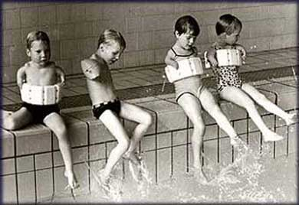
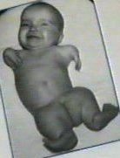
Thalidomide crisis
Thalidomide - Contergan © 1950 - 1960
hypnosedative used by pregnant women
It gave birth to 12,000 children with disabilities

Slide 42
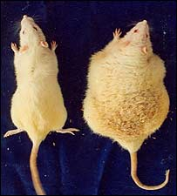
PRECLINICAL TRIALS :
Evaluation of effect in vitro
Evaluation of effect + toxicity in animal models (2 animal species at least)
In situ
Influencing organ systems that can not be studied in isolation (KVS , DS , GIT)
Living animals
overall effects ( convulsions , sedation , anesthesia, temperature)
affecting cognitive function (learning, attention, memory )
influence on the specialized function (immune system)
.

Slide 43
Preclinical Trials:
Evaluation of acute and short term toxicity in animals. It Involves :
  -Lethal dose determination
  -Effect of dose at normal level for short/Long term
Assess how the drug is absorbed/distributed/metabolized and excreted in animals.

Slide 44
Phase 1 CLINICAL TRIALS :
All CTs has to be approved by SUKL
(State institute for drug control)/EMA
Drug given to 10-100 healthy volunteers
  Duration could vary from 1 month to 1 year.
Following is studied here :
  Drug absorption/Metabolism in human.
  Effect on organs and tissues
  Side affect of different dosages.
  Proceed to next Stage

Slide 45
Phase 2 CLINICAL TRIALS :
1 st administration to the patient
randomized clinical trial tested the drug x = standard therapy x placebo
  Often called „Blinding“ – blinding also in multicentric manner
It monitors the effect of the disease, dose , pharmacokinetics in patients
Informed consent , with no financial reward

Slide 46
Phase 2 CLINICAL TRIALS :
Drug given to 100 - 300 patients - volunteers
Duration could vary from 1 year to 2 years
  Cost could vary from $10 - $100 million.
  Following is studied :
    Drug effectiveness in treating the disease.
    acute side effects in patients
    Less than 1/3rd of New Chemical Entities (NCE) enter phase 2

Slide 47
Phase 3 CLINICAL TRIALS :
Phase 3 - Extended trial
Patients 100-1000
Comparison of the therapeutic efficacy and safety to standard therapy
In the Czech Republic a year to 300 proposals involving 30,000 patients
Coordinates the SUKL/EMA/FDA
Approval for new substances to launch the market issued by the State Institute for Drug Control (SUKL)/EMA (European Medicines Agency)

Slide 48
Phase 3 CLINICAL TRIALS :
FDA consulted before beginning phase 3
  Drug given to 1000-3000 patient volunteers
  Duration could vary from 3 years to 4 years.
  Cost could vary from $10 - $500 million
Following is studied here :
  Safety of Drug [ Benefits v/s risk analysis ] –
  Long term side effects in patients
Proceed to next Stage - registration

Slide 49
Market Launch/Phase 4 :
4th phase - post-registration
post-marketing evaluation
verification of effects in broad clinical practice
An average of 5 years
Data on the incidence of adverse effects, interactions , differences in the age groups etc.
Comparison with standard therapy
The possibility of drug withrawal

Slide 50
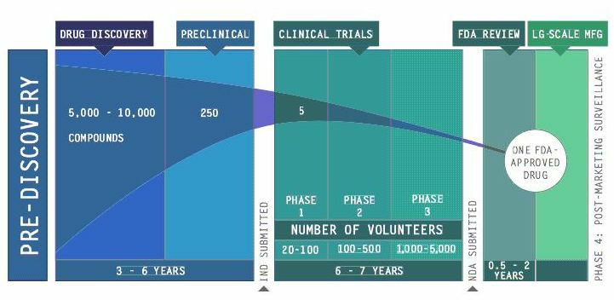
Market Launch/Phase 4 :
Additional post marketing testing of patients to
  Support the use of the approved indication
  Finding new therapeutic opportunities
  Extending use of the drug to different classes of patients like children

Slide 51
Examples of drug withdrawals
rofecoxib (HVLP Vioxx)
CVS AE, - AMI
clobutinol (HVLP Silomat)
Heart dysrhytmias
rosiglitazon
CVS risk

Slide 52
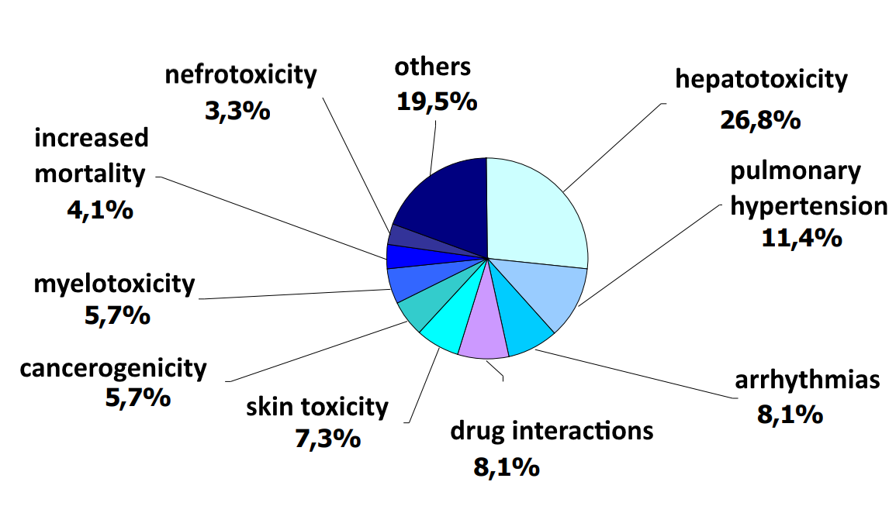
Reasons for drug withdrawal

