Slide 1

Drug delivery approaches.
Ondřej Zendulka

Slide 2
Structure of the lecture
Classification of administration routes
Factors related to administration route selection
Characteristic of administration routes
Innovative administration routes

Slide 3
Administration/effect of drug
Systemic
drug is absorbed to systemic circulation
possible influence on whole body
higher risk of AE
effect depends on dose, bioavailability and DDF
Local
drug absorption is limited
effect aimed on target tissue/organ
low risk of AE
effect depends upon final concentration

Slide 4
Classification of administration routes
local
type of effect
systemic
enteral
peroral, rectal, gastric
parenteral
epicutaneous, vaginal, intraocular,
intraarticular, intrathecal…
parenteral
transdermal, transnasal, i.v., i.m., s.c., i.a., inhalations, i.o….
enteral
peroral, rectal, gastric

Slide 5
Classification of administration routes
with regard to the disruption of natural protective barriers
Non-invasive
vaginal, (intrauterine?)
sublingval
epicutaneous
oral
intranasal
inhalational
rectal
…
Invasive
intravenous
intraartrerial
intraoseal
intramuscular
subcutaneous
intradermal
implants
…

Slide 6
Classification of administration routes
with respect to administration schedule
Intermitent use
repeated use
plasma level fluctuation
all administration routes
local and systemic use
Continuous use
constant speed of drug administration = constant plasma level of drug
intravenous
intramuscular
subcutaneous/implants
intravaginal/intrauterine
intrathecal
transdermal

Slide 7
Physical-chemical properties of drug
lipophilicity/hydrophilicity, solubility
chemical structure/size of molecule
pH/pKa
availability of pharmaceutical form

Slide 8
Therapeutic indication + severity of disease
the same drug administered differentialy with respect to diagnosis
local administration prefered
acute situations – fast onset of effect required
Benefit:risk ratio
the more severe, the „more risky“ administration

Slide 9
Comorbidities
can block distinct administration routes
can influence drugs efficacy
Comedication
risk of drug-drug interactions

Slide 10
Administration routes - local effect
intraurethral, intravesical, intracavernal
dental, gingival
endotracheopulmonal

Slide 11
Administration routes - local effect
intraaural
intraamniotic
intracoronar, intraarterial

Slide 12
Ocular/conjunctival administration
usually eye drops and ointments
local effect
risk of systemic AE
specific quality requirements - sterility
Intraocular administration
intravitreal implants and injections in macular degeneration

Slide 13
Intrathecal/intracerebral/intracerebroventricular administration
to the subarachnoideal space
/brain/ brain ventricles

Slide 14
Intraarticular administration
analgesics/antiphlogistics
hyaluronic acid
for local effect

Slide 15
Administration routes for local and systemic effect
vaginal, intrauterinne
dermal/transdermal
intranasal/transnasal
inhalational
rectal
oral/transbucal, sublingual
peroral

Slide 16
Vaginal, endocervical, intrauterinal
1. local effect
minimum of AE
specific adjuvants ↓ pH
antibiotics, antimycotics, antiparasitics
2. systemic effect
vaginal rings intrauterine devices
controlled drug release
contraceptives

Slide 17
Epicutaneous/transdermal administration
Local effect
ointments, creams, solutions, patches
minimal AE
dermatology
Systemic effect
transdermal administration
mainly patches
continuous release
local+systemic AE
high compliance
easy discontinuation

Slide 18
Intranasal/transnasal administration
drops, sprays, ointments
local effect - antiseptics, ATB
- antihistamines, decongestants
- antiphlogistics
systemic effect - analgesics, antivirotics
- hormones (ADH, gonadotropin, insulin)

Slide 19
Inhalation
gases, aerosols
systemic effect – general anesthetics
local effect – antiasthmatics
fast onset of effect
minimal presystemic elimination
administration from spray cans or other instruments (turbohaler, dischaler, nebuliser)

Slide 20
Rectal administration
suppositories, capsules, tablets, foams, tampones
alternative for peroral administration in case of nausea/vomitting or unconciousness
variable drug absorption

Slide 21
Oral/sublingual/buccal administration
fast onset of systemic effect
oinly for small and lipophilic molecules
sprays, tablets, dispergable films
analgesics – fentanyl, buprenorfin
hypnotics – zolpidem
vasodilators – nitroglycerine
antiemetics – ondansetrone
homeopatics, alergens, cannabis….

Slide 22
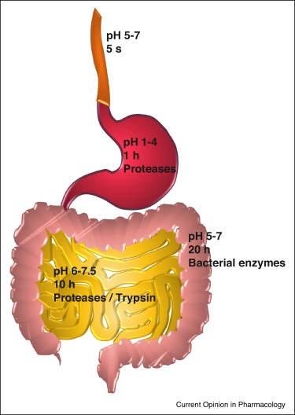
Peroral administration
Salvador et al. 2017
1. for local effect
minimal AE
risk of interaction with coadministered drugs
antacids, laxatives, antibiotics
2. for systemic effect
drug absorbed from different parts of GIT
    can be influenced by DDF
„slow“ effect onset
the effect depends on patients „compliance“

Slide 23
Administration routes for mainly systemic effect
intravenous/intraosseous
intramuscular
subcutaneous injections and implants

Slide 24
Injections
intravenous, (intraarterial)
injection/infusion
100% bioavailability, „immediate“ effect
true solutions + emulsions
intramuscular
max. volume 5 ml
to m. glu. maximus
absorption: solution> emulsion> suspension
subcutaneous
to 2 ml
variable absorption with regard to adipose tissue

Slide 25
Injections
intradermal
minimal volume
diagnostic purposes
intraosseal
alternative to i.v.
injection/infusion
Eg. Atropine onset of the effect
i.v. 30-90 s; s.c. 15-30 min; i.m. 30-45 min

Slide 26
Implants
degradable/nondegradable
usually s.c. or intraocular
systemic/local effect
continuous/pulsatile release = continuous/repeated drug administration
increased patient‘s compliance
complicated discontinuation

Slide 27
Innovations in drug administration
new posssibilities of administration routes are probably depleted => modification of DDF
the goals are:
  1. increase of drug safety/decrease of drug toxicity
  2. increase the efficacy of administered dose
  3. increase the patient‘s compliance

Slide 28
More about innovations in drug administrations:
Current Opinion in Pharmacology, Vol. 36, 2017

