Slide 1
(XIV.) Ergometry

Slide 2
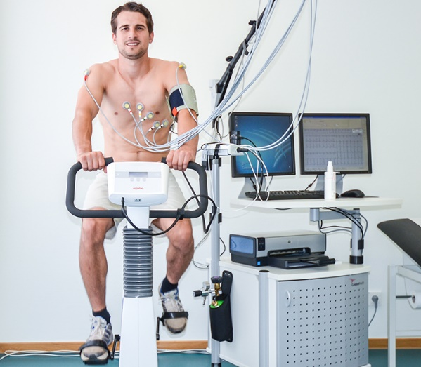
Ergometry (stress testing, exercise testing)
Work load examination – measurement of ECG and other parameters depending on the increasing degree of work load on the ergometer
In addition to ECG, the following can be recorded:
O2 consumption, CO2 output, blood pressure, blood samples (mainly lactate)
Types of ergometers
  Bicycle ergometer – load mainly on the lower half of the body
  Rowing machine – upper body load
  Rump ergometer – exercise bike for hands, para/quadriplegia
  Master´s step
  Treadmill
Can be used in:
  Sports Medicine
  Rehabilitation medicine
  Cardiology

Slide 3
Ergometry deals with evaluation of performance (work, power).
Its name comes from two Greek words: „ergon“´= work, „metron“ = measure.
The test is a part of complex examinations evaluating responses and adaptation of organism to exercise. It is used to diagnose, to decide about the treatment and/or evaluation of its effectiveness. In the sport medicine, it is used mainly for evaluation of fitness.

Slide 4
Basic protocol types :
Single stage test
Intermittent incremental steps
Continuous incremental step
„ramp“ protocol

Slide 5
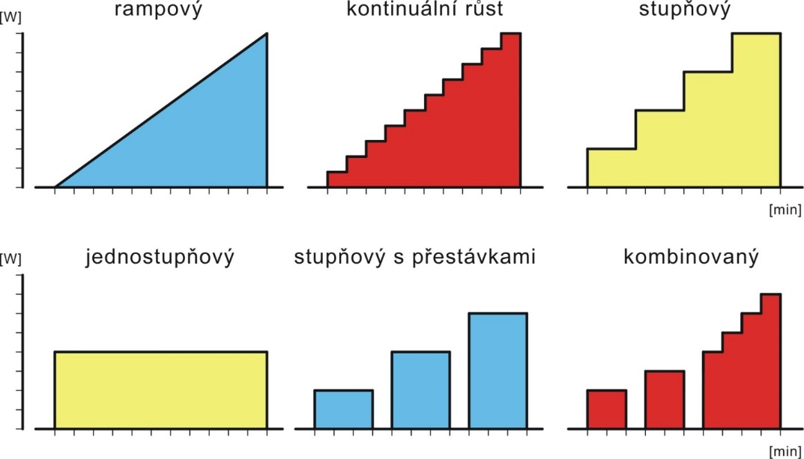
Basic types of protocols for exercise testing
Ramp
Continuous increase
gradual
Single stage step
Intermitent incremental test
combination both

Slide 6
Basic types of protocols for exercise testing
Ramp
Continuous increase
gradual
Single stage step
Intermitent incremental test
combination both

Slide 7
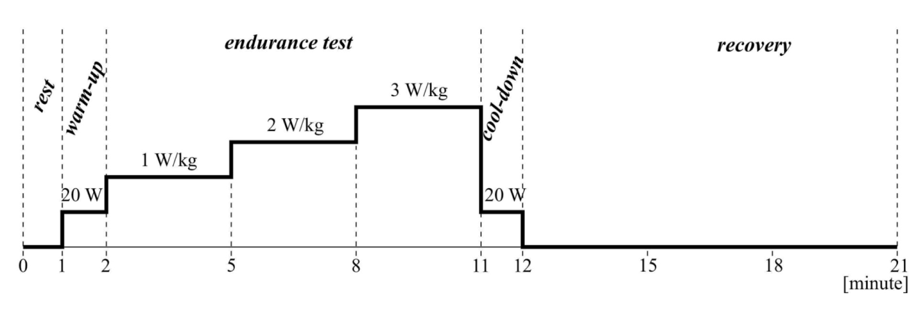
Examination phases:
recording of resting values
exposure of examined person to graduated physical work
workload of low intensity supporting catabolites removal (lactic acid), helping heart rate recovery, reducing vertigo and collapses (due to after-work hypotension)
application of low workload in order to increas tissue perfusion and improve joints mobility
follow-up after exercise

Slide 8
Heart rate change:
Up to 180 beats/min heart rate increases LINEARLY
(if workload increases continually)
200
180
160
Heart rate [beat/ min]
W₁₇₀ : Index describing work capacity at heart rate of 170 beats/min.
140
untrained individual
120
trained individual
100
90
W₁₇₀
W₁₇₀
Work load [W] or [W/kg]
trained
untrained

Slide 9
Heart rate change:
W₁₇₀ : Index describing work capacity at heart rate of 170 beats/min
Population norms (Heller, 2005)
A G E | Men |  | Women
 | [W] | [W/kg] | [W] | [W/kg]
18 | 178 | 2,7 | 103 | 1,8
20 | 185 | 2,7 | 106 | 1,8
22 | 190 | 2,7 | 107 | 1,8
25 | 193 | 2,7 | 109 | 1,8
30 | 194 | 2,6 | 112 | 1,8
35 | 195 | 2,6 | 115 | 1,8
40 | 195 | 2,5 | 118 | 1,8
45 | 195 | 2,4 | 121 | 1,8

