Slide 1
ECG – Electrocardiography
Physiology II – practice
Spring, weeks 4-6

Slide 2
Electrocardiography
Definition: recording of the cardiac electrical activity from the surface of the body
(Recording of electrical heart activity can also be obtained from the esophageal leads or the heart surface itself, but these methods are called differently)
Key words:
  heart conduction system
  tools for ECG recording
  limb and chest leads
  unipolar and bipolar leads
  heart vector, the electrical axis of the heart

Slide 3
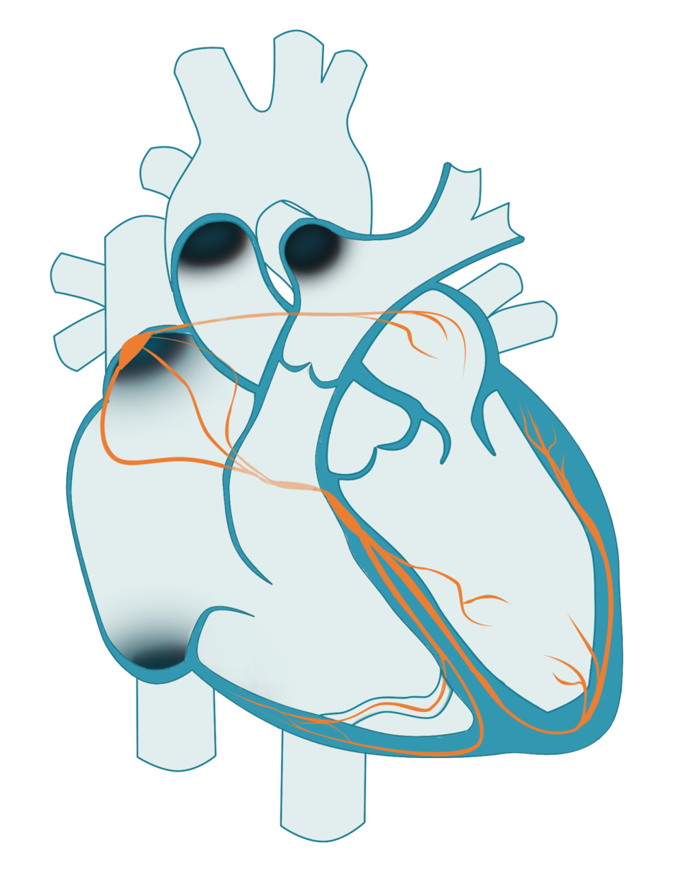
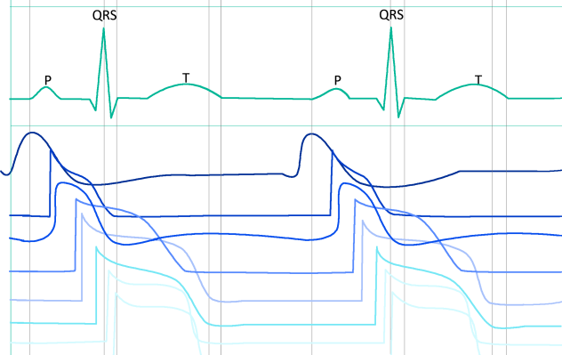
Cardiac conduction system
Sinoatrial node (SA)
Internodal tracts
SA node
Atrial myocyte
Atrioventricular node (AV)
AV node
His bundle
Tawara branches
His bundle
Purkinje fibers
Ventricular myocyte
Tawara (bundle) branches
Purkinje fibers

Slide 4
Cardiac conduction system
Function: AP formation and preferential conduction
Atria are separated from ventricles by a non-conductive fibrous septum - the only way is through the AV node
  Sinoatrial node (SA) – natural frequency 100 bpm (mostly under parasympathetic damping effect), conduction velocity 0.05 m/s
  Internodal tracts – conduction velocity 0.8 – 1 m/s
  Atrioventricular node – a single conductive connection between atria and ventricles, natural frequency 40 – 55 bpm, conduction velocity only 0.05 m/s (nodal delay)
  His bundle – conduction velocity 1–1.5 m/s
  Tawara (bundle) branches – conduction velocity 1–1.5 m/s
  Purkinje fibers – conduction velocity 3–3.5 m/s
Sinus rhythm – AP is formed in the SA node
Junction rhythm – AP is formed in the AV node or His bundle
Tertiary (ventricular) rhythm – AP is formed in bundle branches or Purkinje fiber
Ventricular myocardial activation – from inside to outside, synchronized, determined by the onset of a stimulus
Repolarization of ventricular myocardium – in the opposite direction, less sharp, repolarization isles
Note: natural frequency is the frequency of AP formation unaffected by neural and hormonal control
natural frequencies of 20 - 40 bpm, they have slow spontaneous depolarization

Slide 5
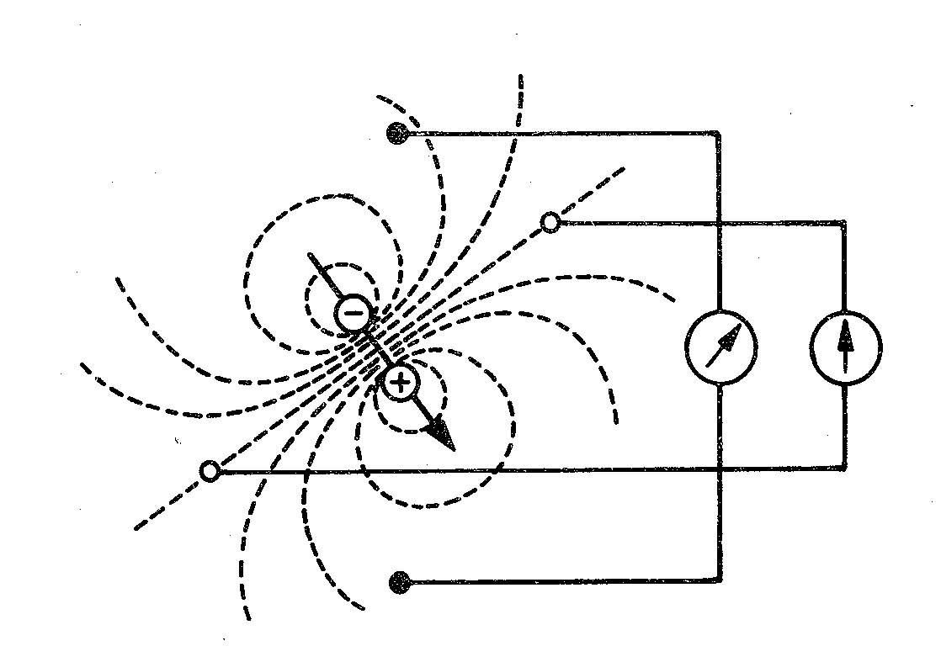
Electric dipole
electrode
Electrode: records electrical potential (Φ)
Electrical lead: a connection between two electrodes
  It records the voltage between the electrodes
  Voltage: difference of el. potentials
  (V= Φ1- Φ2)
Φ2
lead
Φ1

Slide 6
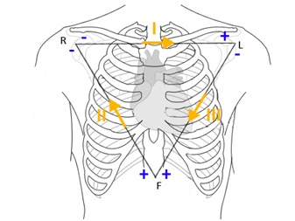
Einthoven’s triangle
(standard, limb, bipolar leads)
Bipolar leads: both electrodes are active (variable electrical potential)
Electrode colors:
R: red, L: yellow, F: green
I
R
L
II
III
F

Slide 7
Goldberger leads
(augmented, limb unipolar leads)
Unipolar leads: one electrode is active (variable electric potential) and the other is inactive (constant electric potential, usually 0 mV)
The active electrode is always positive
R
L
avR
aVL
aVF
F

Slide 8
Wilson‘s central terminal (W)
It is formed by the connection of limb electrodes through resistors
Electrically represents the center of the heart (it is led out or it is calculated)
Inactive electrode (constant potential)
+
+
-
Central terminal
-
Real central terminal
+

Slide 9
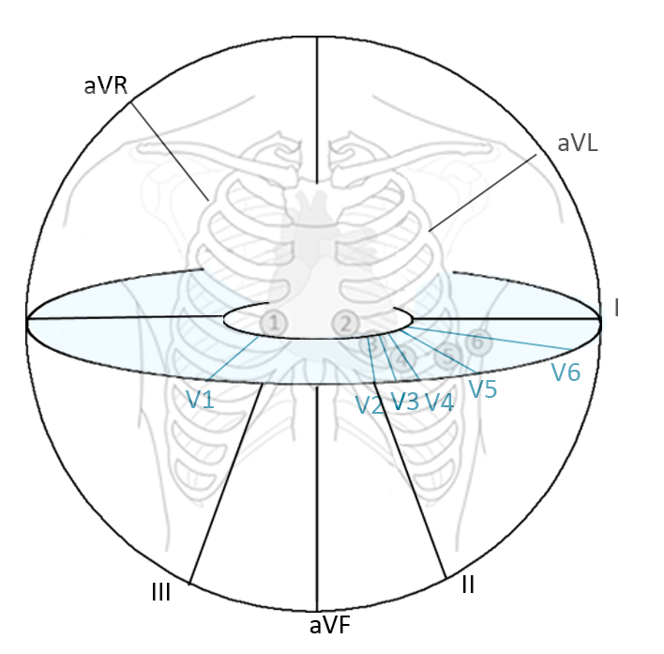
Chest leads
A chest lead: a connection between a chest electrode and the central terminal
Unipolar leads: the chest electrode is active (positive) and the central terminal is inactive (potential = 0 mV)
chest electrode
1
2
3
5
6
4

Slide 10
Leads according to Cabrera
–
I
–
–
R
+
L
–
+
-
+
+
+
–
aVR
aVL
–
aVL
-30°
–
+
-
-
III
II
aVF
I
0°
–
–
+
+
+
aVR
F
+
30°
+
+
II
III
aVF
60°
120°
90°

Slide 11
Analysis of ECG
Heart action
Heart rhythm
Heart rate
Waves, segments and intervals
  P wave
  PQ interval
  QRS complex
  ST segment
  T wave
  QT interval
Electrical heart axis
Ventricular depolarization (QRS)
R
Ventricular repolarization
Atrial depolarization
T
P
Lead II
Q
S

Slide 12
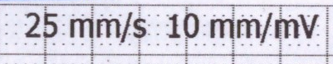
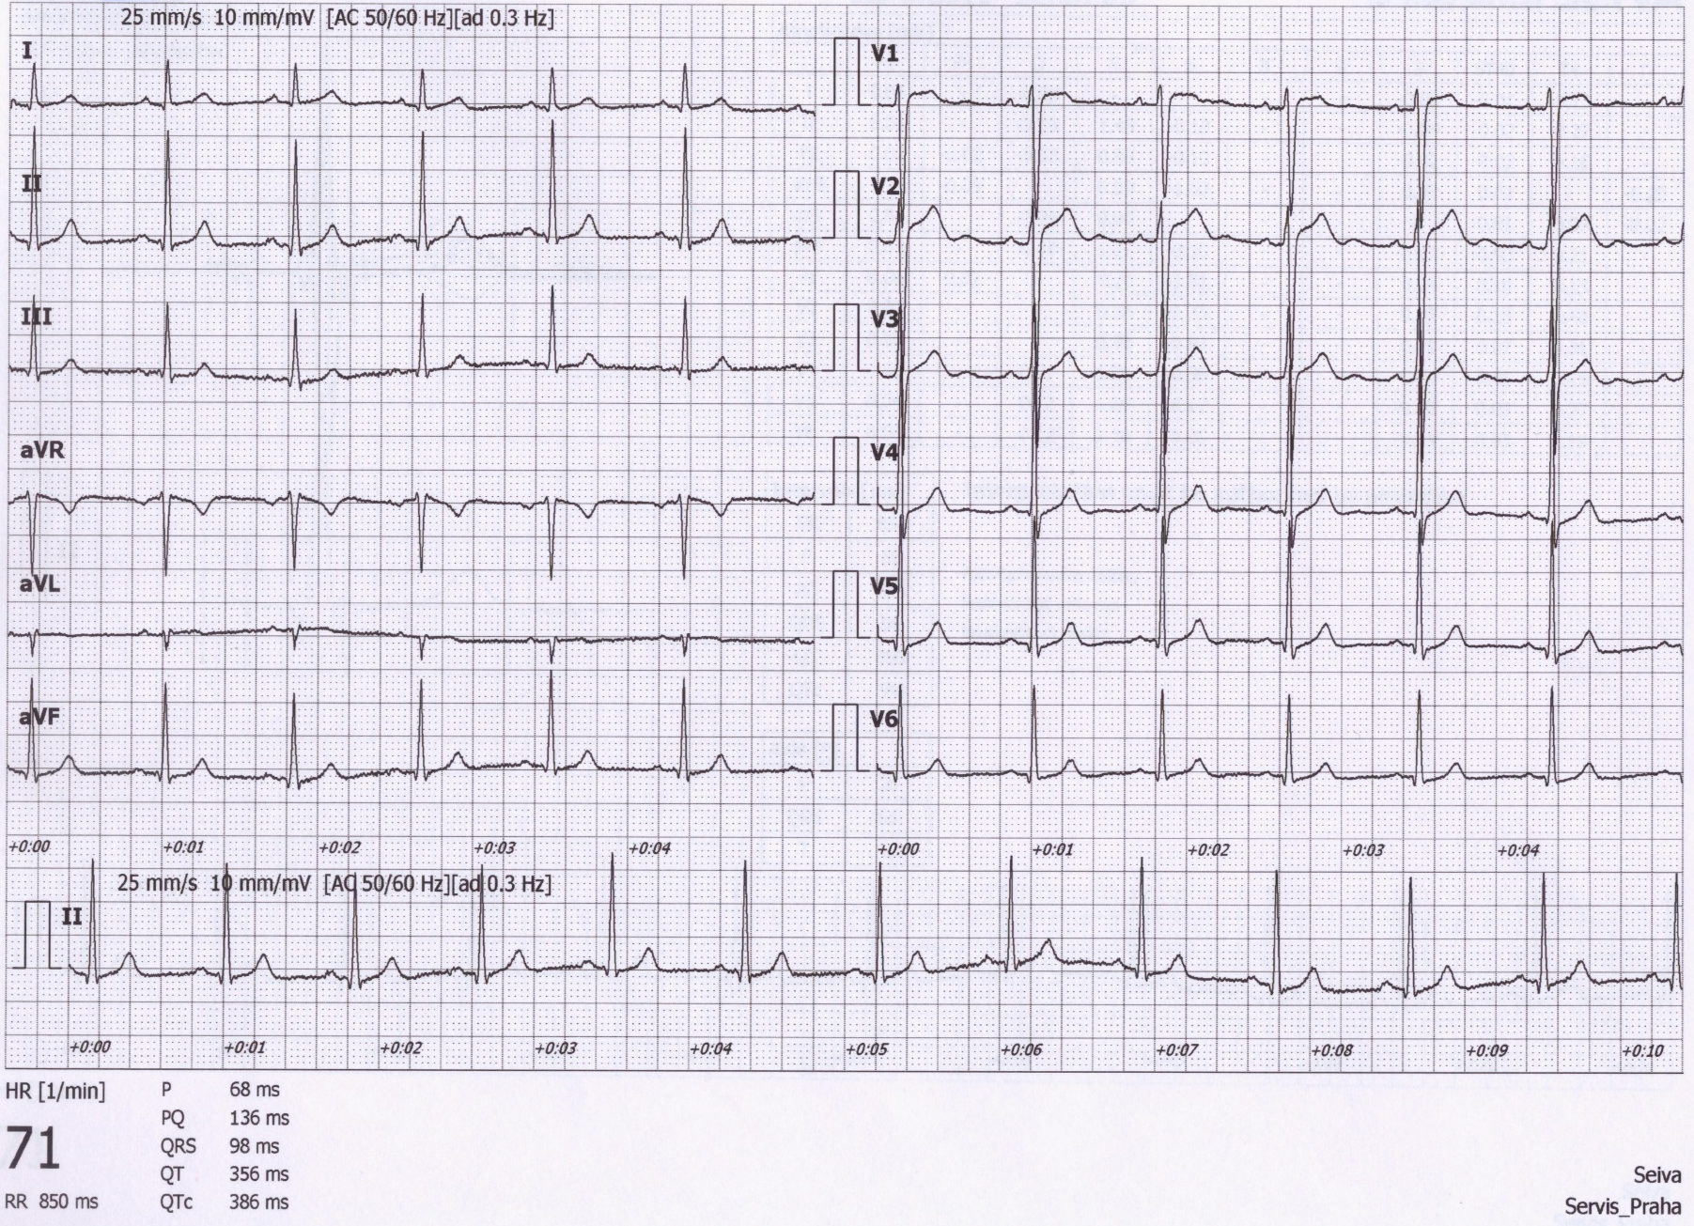
Analysis of ECG
A millimeter grid of paper will help in fast analysis
See the paper speed (here 25 mm/s)
  How many ms is one mm?
  It is good to know how much mV is one mm

Slide 13
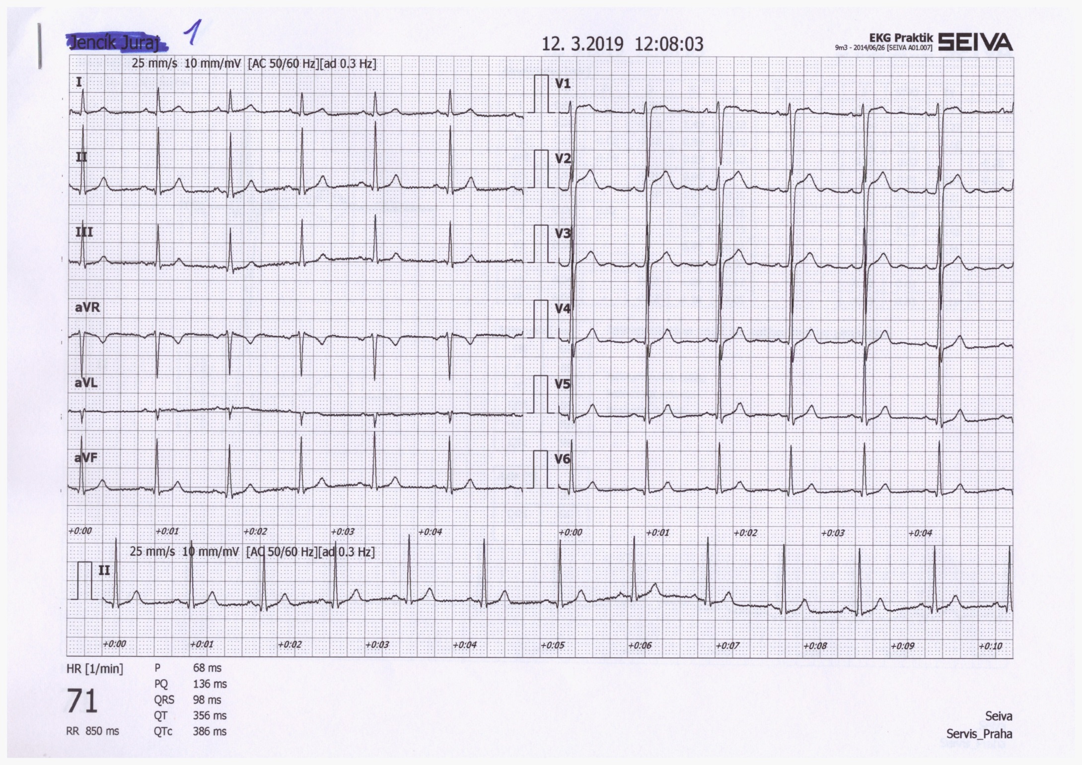
1) Heart action
Regularity of distances between QRS complexes - RR intervals
Calculate difference: RR – mean RR
(you only need to choose the shortest and longest RR in
the record)
Regular action: difference < 0,16 s
Irregular action: difference > 0,16 s
  Usually pathological
  Beware of significant sinus respiratory arrhythmia - it is very physiological. If you are unsure, ask the patient to hold their breath during the recording
Note: if one extrasystole is present, but otherwise the action is regular, it is called regular
RR

Slide 14
2) Heart rhythm
̶Heart rhythm is determined by the source of action potentials that lead to ventricular depolarization
ventricular depolarization is crucial because it determines cardiac output
Sinus rhythm
  AP begins in the SA node
  ECG: P wave (atrial depolarization) precedes QRS complex
Junction rhythm
  AP begins in the AV node or His bundle, and the frequency is usually 40-60 bpm
  P wave does not precede QRS complex, QRS shape is normal (narrow)
  Heart rate is low (40-60 bpm)
  Atrial depolarization can be present in the ECG if the ventricular impulses are transferred to the atria - wave is after QRS and has opposite polarity because it runs in the opposite direction
  Tertial (ventricular) rhythm
  AP begins in other parts of the conduction system, frequency of 30-40 bpm
  QRS has a strange shape (wider) because it spreads in a non-standard direction in the ventricles

Slide 15
2) Heart rhythm
Sinus rhythm – P wave precedes each QRS complex – the impulse begins in the SA node, it is followed by the depolarization of the ventricles
Junctional rhythm – normal P waves do not precede QRS – the impulse begins in the AV node or His bundle, low heart rate, but normal QRS shape (the impulse spreads normally in the ventricle)
Atrial depolarization
or
Tertiary (ventriclular) rhythm – there are no P waves bound to QRS, the impulse begins somewhere in the ventricles – a deformed shape of QRS, very low heart rate, for example, 3rd-degree AV block
Atrial repolarization
P – atrial depolarization
3rd-degree AV block – tertiary rhythm in ventricles, faster rhythm in atria determined by the SA node, but the stimulus is not transferred to the ventricles

Slide 16
3) Heart rate (HR)
A frequency of ventricular contractions (it determines cardiac output); on ECG – a frequency of ventricular depolarizations
HR = 1 / RR bpm (beats per minute)
Physiological values: 60-90 bpm at rest
Tachycardia: > 90 bpm at rest
  It can be sinus rhythm (due to increased sympathetic activity, medication, …)
  Tachyarrhythmias: rhythm is not sinus rhythm
  If higher than 180 bpm, it isnť probably sinus rhythm
Bradycardia: < 60 bpm
  It can be sinus rhythm (increased parasympathetic activity, athlete‘s heart - physiological)
  If HR < 50 bpm, it isnť probably sinus rhythm (but junctional or ventricular rhythm)

Slide 17
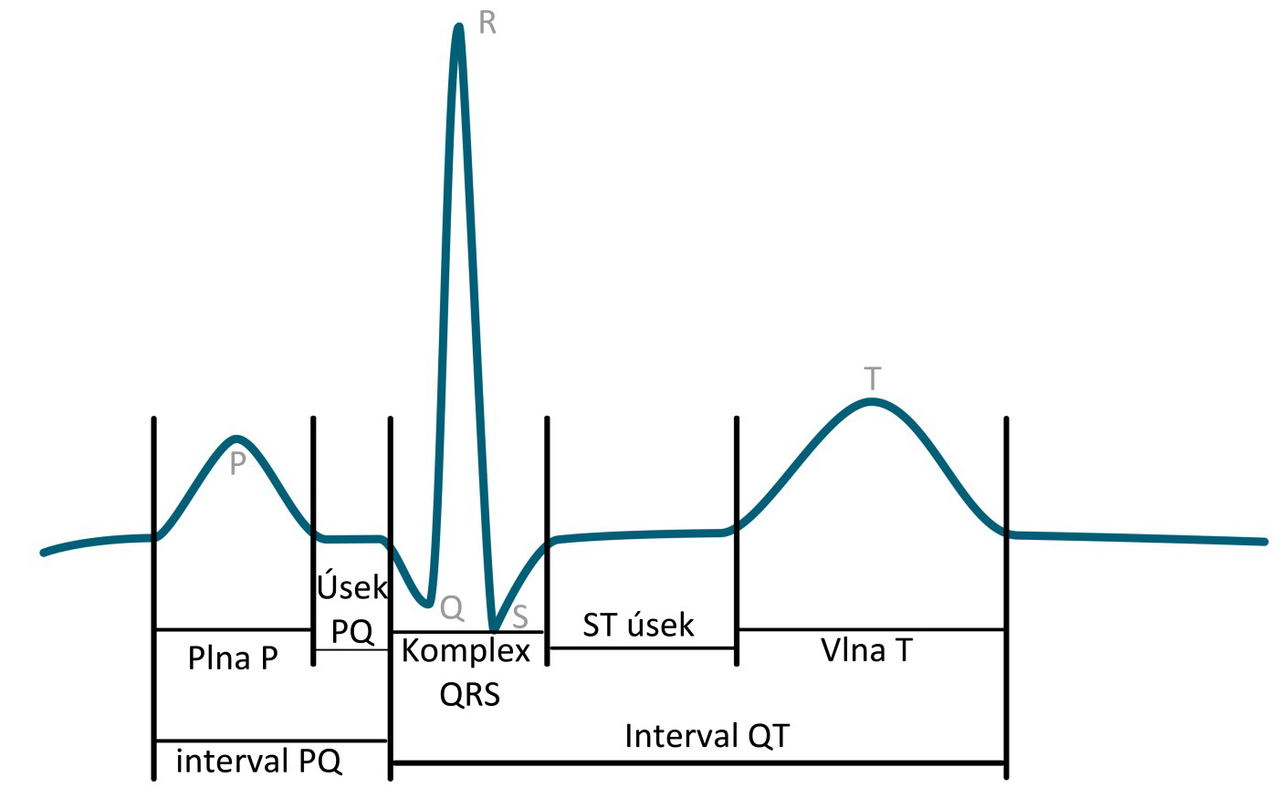
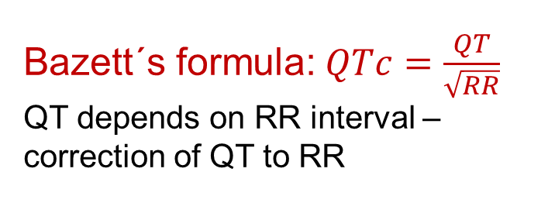
4) Waves, segments, intervals
Name | Norm
P wave | 80 ms
interval PQ (PR) | 120-200 ms
segment PQ (PR) | 50-120 ms
Q | -
complex QRS | 80-100ms
R | -
S | -
segment ST | 80-120 ms
interval QT | < 420ms
wave T | 160 ms
R
T
P
PQ segment
ST segment
Q
S
P wave
QRS complex
T wave
QT interval
Bazett´s formula:$QTc=\frac{QT}{\sqrt{RR}}$
QT depends on RR interval – correction of QT to RR
PQ interval

Slide 18
4) Waves, segments, intervals
name | Place and description | Physiological background | Norm
Wave P | First-round wave (negative or positive) | Atrial depolarization | 80 ms
Interval PQ (PR) | The interval from the beginning of P wave to the beginning of Q (or R, if Q is not present) | The time interval from SA node activation to the Purkinje fibers activation | 120-200 ms
Segment PQ (PR) | From P wave‘s end to the beginning of Q (or R, if Q is not present) | Complete atrial depolarization, the AP transfer from the AV to ventricles | 50-120 ms
Q | First negative deflection | Depolarization of septum and papillar muscles | -
Complex QRS | From the beginning of R to the end of S | Ventricular depolarization | 80-100ms
R | Positive deflection | Main ventricular depolarization | -
S | Negative deflection after positive deflection. |  | -
Segment ST | The interval of isoelectric line between the end of QRS and the beginning of T wave | Complete depolarization of ventricles | 80-120 ms
Interval QT | From the beginning of Q (or R) to the end of T wave | Electrical systole | < 420 ms
Wave T | Second round wave (negative or positive) | Ventricular repolarization | 160 ms

Slide 19
4) Waves
P wave:
Is it present?
Is it positive/negative, one-peak/two-peak, high (>0,25 mV)/normal/low?
QRS:
  Q: first negative deflection
  R: first positive deflection
  S: negative deflection after positive deflection
Small deflection (less than 0,5 mV) – small letter
Strong deflection (5 mm and more) – capital letter
Second positive deflection (‘)
T wave:
Is positive/negative/bipolar?
Does it have the same polarity as the strongest QRS deflection?
  Yes: concordant (ok), No: discordant (pathology)
Bipolar T:
  Preterminal negative (-/+)
  Terminal negative (+/-)
Examples:
RS
Ventricular depolarization - QRS
R
qRs
rSr‘
Ventricular repolarization
Atrial depolarization
T
P
Lead II
Q
S

Slide 20
5) Electrical heart axis
Electrical heart axis: average direction of the electric heart vector during ventricular depolarization (QRS complex)
(can also be determined for atrial depolarization: P, or ventricular repolarization: T, but in practice, we will analyse ventricular depolarization)
El. heart axis
–
–
–
+
+
aVL
-30°
The heart axis is physiologically directed down, left, and back
- refers to the real placement of the heart in the chest.
Here, we solve only the frontal plane (limb leads)
The heart axis direction is influenced by bigger muscle mass. In a healthy heart, mostly the left ventricule, in pathological hypertrophy, the direction of pathological muscle mass prevails
–
+
I
0°
Physiological range:
Middle type 0° – 90°
Left type -30° – 0°
Right type 90° – 120°
Pathological range:
Right deviation: > 120 ° (right ventricular hypertrophy, dextrocardia)
Left deviation: < -30° (left ventricular hypertrophy, pregnancy, obesity)
–
–
aVR
+
30°
+
+
II
vectocardiogram
III
aVF
60°
120°
The axis is also changed if Tawara branches are blocked or after a heart attack, el. activity of part of chambers is missing
90°

Slide 21
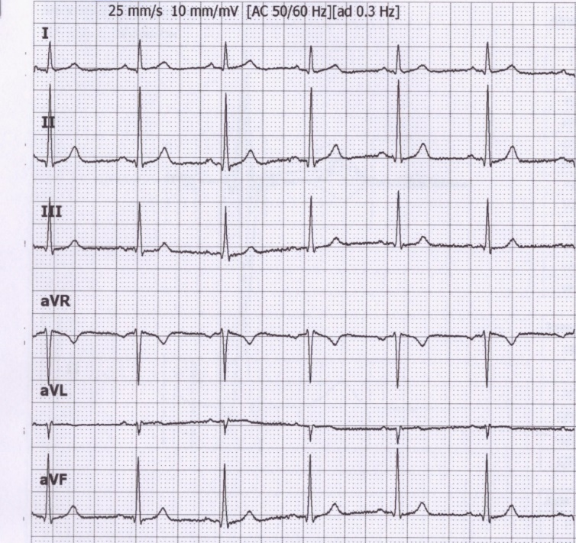
Electrical heart axis – calculation
Because the el. axis is related to ventricular depolarization in the frontal plane, for calculation, use QRS in limb leads: I, II, III.
Calculate the sum of QRS oscillations in leads I, II, III.
When the oscillation goes downward, it is negative. When the oscillation is upward, it is positive. Use a millimeter grid.
  Lead I: Q_{I}=-1; R_{I}=6; S_{I}=0;
  QRS_{I}=5
  Lead II: Q_{II}=-1; R_{II}=17; S_{II}=-1;
  QRS_{II}=15
  Lead IIII: Q_{III}=0; R_{III}=10; S_{III}=-1;
  QRS_{III}=9

Slide 22
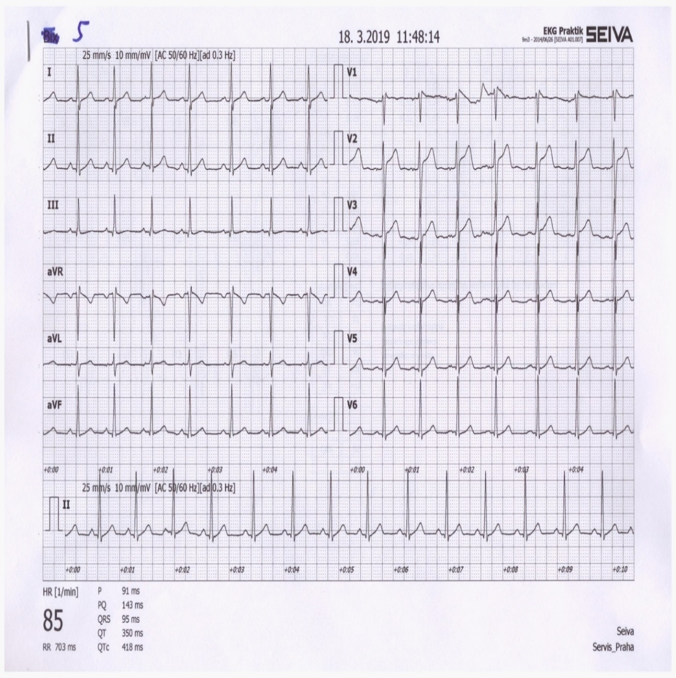
Electrical heart axis – calculation
Draw the Einthoven triangle with Goldberger augmented leads
Mark the angles around the triangle (in the circle)
Lead I:
  0 at lead I is in the center of lead
  QRS_{I} = 5, so from 0, measure 5 mm towards the positive electrode, make a mark (or any other units, a ratio is important)
  If the sum of QRS is negative, you will go towards the negative electrode
  Run a line from the mark perpendicular to the I lead (parallel to the aVF lead)
I
–
0
5
+
-30°
–
–
0°
II
III
0
0
9
30°
15
+
+
120°
60°
90°

Slide 23
Electrical heart axis – calculation
Lead II:
  0 at lead II is again in the center of lead
  QRS _{II} = 15, so from 0, measure 15 mm towards the positive electrode, and make a mark (again, if the sum of QRS is negative, you will go towards the negative electrode)
  Run a line from the mark perpendicular to the II lead (parallel to the aVL lead)
Draw an arrow that starts at the center of the triangle and passes the cross of the drawn lines
I
–
0
5
+
-30°
–
–
0°
II
III
0
0
9
30°
15
+
+
120°
60°
90°

Slide 24
Electrical heart axis – calculation
Lead III:
  The same way, draw the line for QRS _{III} = 9
  Draw an arrow that starts at the center of the triangle and passes the cross of the drawn lines
This arrow shows the direction of the cardiac electrical axis in the frontal plane
Note: logically, even lines from just two leads are sufficient
I
–
0
5
+
-30°
–
–
0°
II
III
0
0
9
30°
The cardiac electrical axis for ventricular depolarization in the frontal plane is 70 °
15
+
+
120°
60°
90°

Slide 25
Leads II and aVR
Note the appearance of the ECG in the lead II and aVR. Both leads look at electrical cardiac activity from a similar angle (deviation only 30 °), but the aVR has the opposite polarity (it looks at the heart upside down compared to II). Therefore, leads II and aVR are similar, only mirror-inverted.
–
–
–
+
+
aVL
-30°
–
+
I
0°
qRs
–
–
aVR
+
30°
+
rSr‘
+
II
III
aVF
60°
aVR usually has negative T and P
120°
90°
Due to its different appearance, QRS has different description in lead aVR and II.

Slide 26
QRS in limb leads and axis
amplitudes of Q, R, and S
Sum of QRS
description of QRS
Q = -1
R = 6
S = 0
QRS = 5
qR
Q = -1
R = 17
S = -1
QRS = 15
qRs
Q = 0
R = 10
S = -1
QRS = 9
Rs
Q = 1
R = -11
S = 0
QRS = -10
rS
Q = 0
R = -3
S = 0
QRS = -3
q
Q = -1
R = 13
S = -1
QRS = 11
qRs

Slide 27
Amplitudes of Q, R, S
Sum of QRS
Electric axis estimation
Find the lead with the largest and smallest sum of QRS (just by eye) - those leads will be perpendicular to each other. The angle of lead with the largest sum of QRS will determine approximately el. heart axis. It is not perfectly accurate, but it is sufficient in practice.
Q = -1
R = 6
S = 0
QRS = 5
–
Q = -1
R = 17
S = -1
–
–
QRS = 15
+
+
aVL
-30°
Q = 0
R = 10
S = -1
QRS = 9
–
+
0°
Q = 1
R = -11
S = 0
I
QRS = -10
–
Q = 0
R = -3
S = 0
–
QRS = -3
aVR
30°
+
+
Q = -1
R = 13
S = -1
El. cardiac axis slightly more than 60 °
III
+
II
QRS = 11
aVF
60°
120°
90°

Slide 28
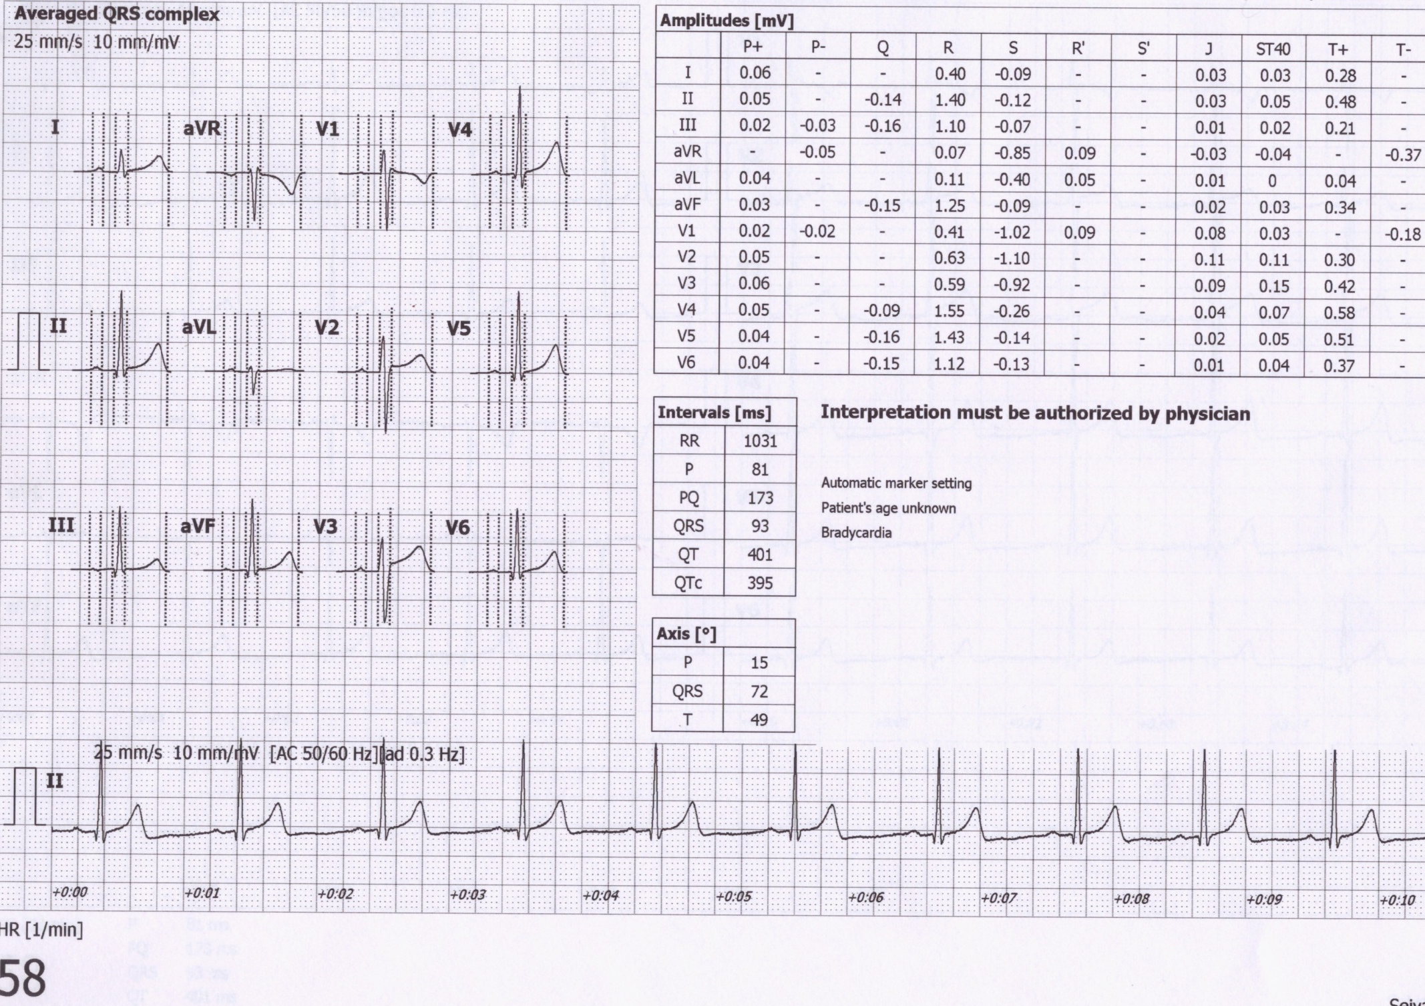
Electric axis calculation by software
Electrical axis for atrial depolarization
72°
Electrical axis for ventricular depolarization
Electrical axis for ventricular repolarization

Slide 29
Diagnostic use of ECG
Arrhythmia: a disorder of heart rhythm, formation or conduction of the excitation

Slide 30
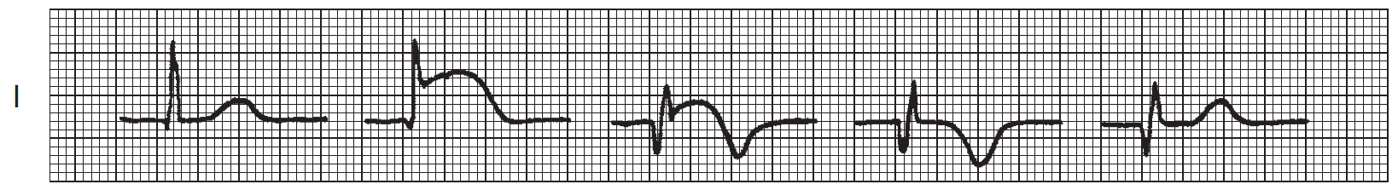
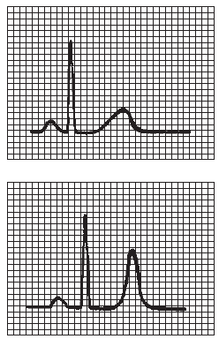
Diagnostic use of ECG
Cardiac ischemia, myocardial infarction
Electrolyte dysbalance - hyperkalemia
normal
ST elevation,
sign of ischemia
Large QRS, hight T
A
B
C
D
E
ischemia
Time

Slide 31
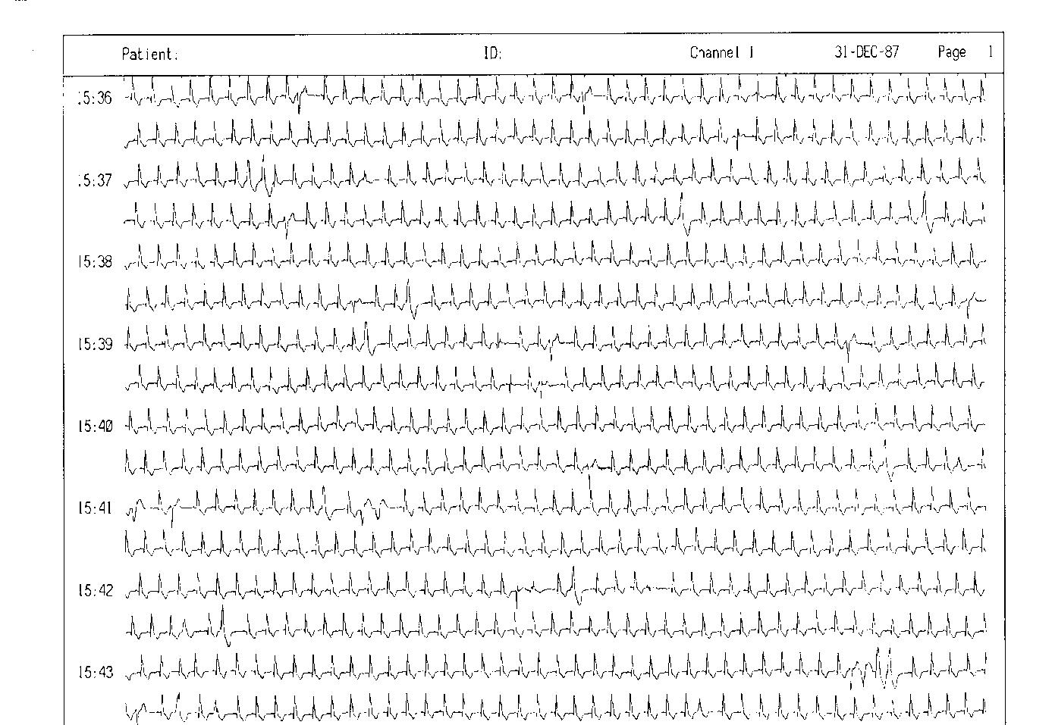
ECG Holter
24-hour monitoring of ECG

Slide 32
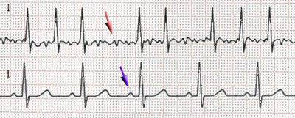
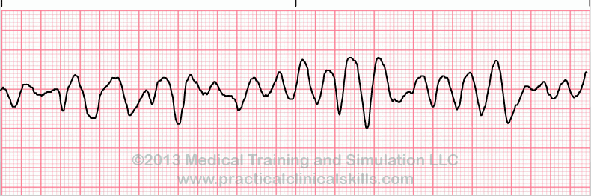
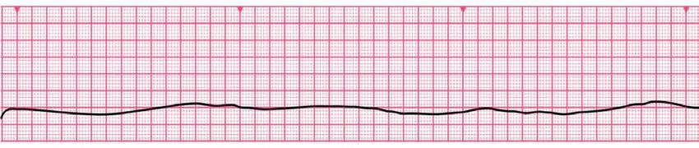
Fibrillation
Fibrillation: unsynchronized cardiomyocyte activity
Atrial – missing P wave, slightly irregular "serrated" isoline, irregular RR (usually), frequency 80 - 180 bpm. QRS is normally shaped. It is not life-threatening. Ventricular refraction time protects ventricles from HR higher than 180 bpm, but it still exhausts the heart. Heart activity is not regulated. Risk of thromboembolia
Fibrillation
Normal ECG
Ventricular – the heart does not function as a pump (cardiac arrest), zero cardiac output, brain damage after 3 - 5 minutes of fibrillation. Without early defibrillation, the cardiomyocytes become exhausted → asystole
Asystole – no electrical activity of cardiomyocytes, non-defibrillable
First aid:→ standard cardio-pulmonary resuscitation (CPR) and adrenalin

Slide 33
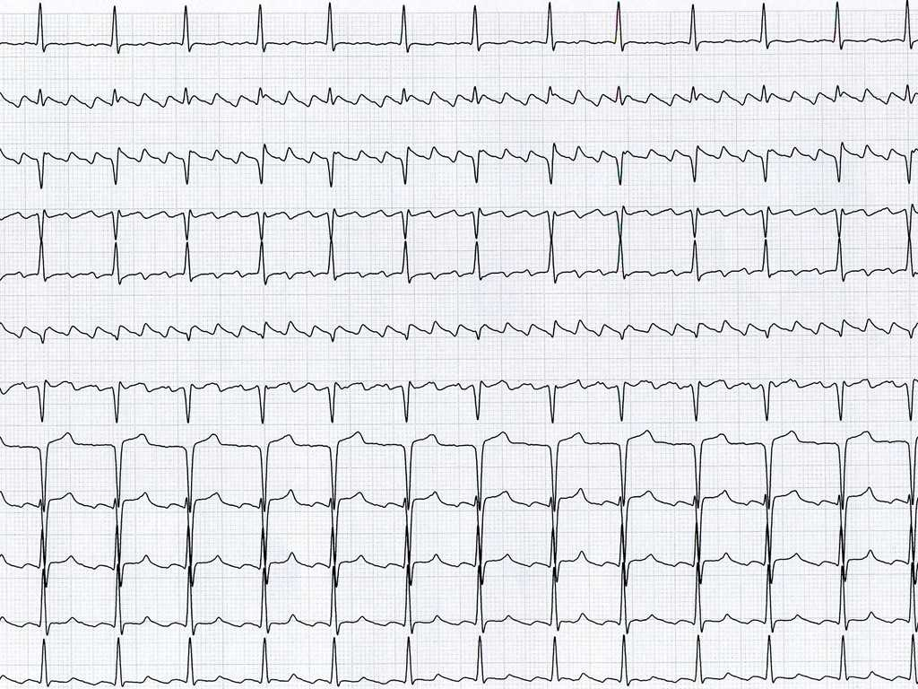
Artial flutter
Regular “teeth“ between the QRS.
Regular RR, tachycardia.
The cause is atrial re-entry.
The regularity is given by the number of "turns" of atrial depolarization per transfer to the chambers (in the picture: 3 turns per 1 transfer to the chambers, i.e. 3:1).
If the flutter does not disappear, it changes into atrial fibrillation
The danger of the deblocked flutter 1:1 (each atrial turn is transferred in ventricles) – exhaustion of ventricles
Risk of thromboembolia

Slide 34
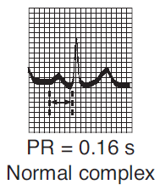
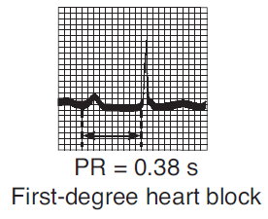
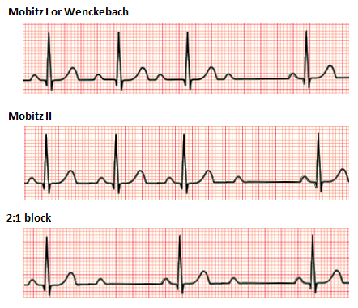
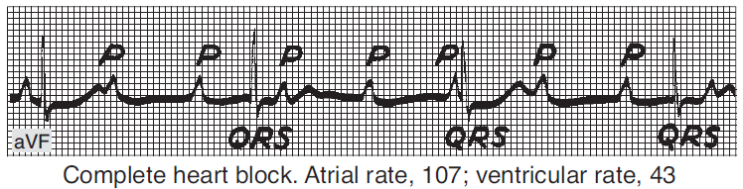
Atrioventricular block (heart block)
AV block: a disorder of the transmission of depolarization from the atria to the ventricles
AV block 1st degree
AV block 2nd degree
Prolongation of the transfer of depolarization from the atrium to the ventricles, prolonged PQ
AV block 3rd degree
Some atrial depolarizations do not transfer: occurrence of P wave, which QRS does not follow
A complete blockage of the transfer of depolarization from the atria to the ventricles, P and QRS are not synchronized.
Pulse rate possibly very low → insufficient cardiac output
https://upload.wikimedia.org/wikipedia/commons/thumb/6/64/Afib_ecg.jpg/400px-Afib_ecg.jpg
http://www.qureshiuniversity.com/Ventricular%20Fibrillation.gif
https://ekg.academy/ekgtracings/313.gif

Slide 35
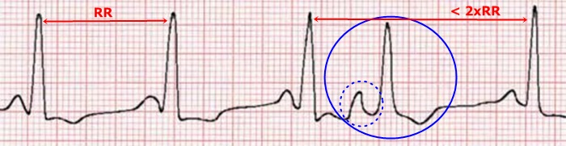
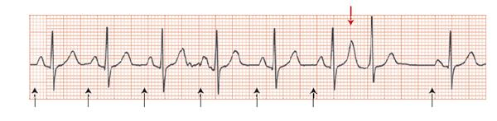
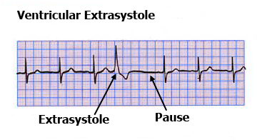
Extrasystoles – ectopic pacemaker
Supraventricular – atrial or AV ectopic pacemaker
Normal shape of QRS (depolarization spreads normally in ventricles)
  P wave does not have a normal shape (it can be negative or covered by QRS)
  There may be a postextrasystolic pause
  (re-propagation of depolarization through
  the atria)
Ventricular
  Large, abnormal shape of QRS
  At a slow heart rate, there is no compensatory pause (extrasystole is interspersed between normal QRS)
  Or there may be a compensating pause if the next depolarization, coming from the SA node, comes at a time when the ventricles are still refractory
Atrial extrasystole
T+P
P
P
P
P
P
P
P
https://www.stefajir.cz/supraventrikularni-extrasystola-ekg
https://www.techmed.sk/predsienova-extrasystola/
https://thoracickey.com/atrial-ectopic-beats/

Slide 36
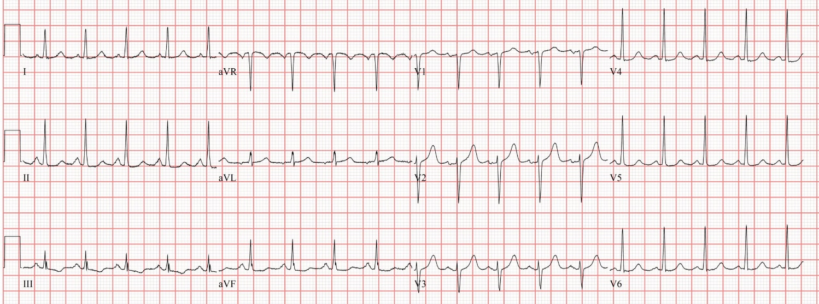
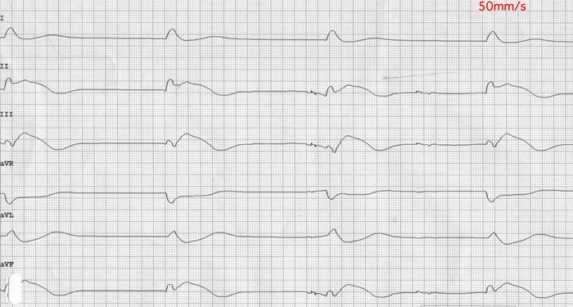
PEA – pulseless electrical activity
PEA refers to cardiac arrest in which the electrocardiogram shows a heart rhythm that should produce a pulse, but it does not. PEA can look almost like normal ECG activity. Pulseless electrical activity is found initially in about 55% of people in cardiac arrest.
Under normal circumstances, electrical activation of muscle cells precedes mechanical contraction of the heart (known as electromechanical coupling). In PEA, there is electrical activity but insufficient cardiac output to generate a pulse and supply blood to the organs.
PEA is classified as a form of cardiac arrest.
non-defibrillable, therapy: Cardio-Pulmonary Resuscitation and adrenalin
Important !: Regular electrical activity on ECG does not mean maintained circulation. Always check for a central arterial pulse.
https://www.researchgate.net/publication/334071817_Impact_of_Transitory_ROSC_Events_on_Neurological_Outcome_in_Patients_with_Out-of-Hospital_Cardiac_Arrest/figures?lo=1, https://www.stefajir.cz/bezpulzova-elektricka-aktivita-ekg, https://medcourse.in/learn/lesson/asystole-and-pulseless-electrical-activity-pea/, https://en.wikipedia.org/wiki/Pulseless_electrical_aktivity,

Slide 37
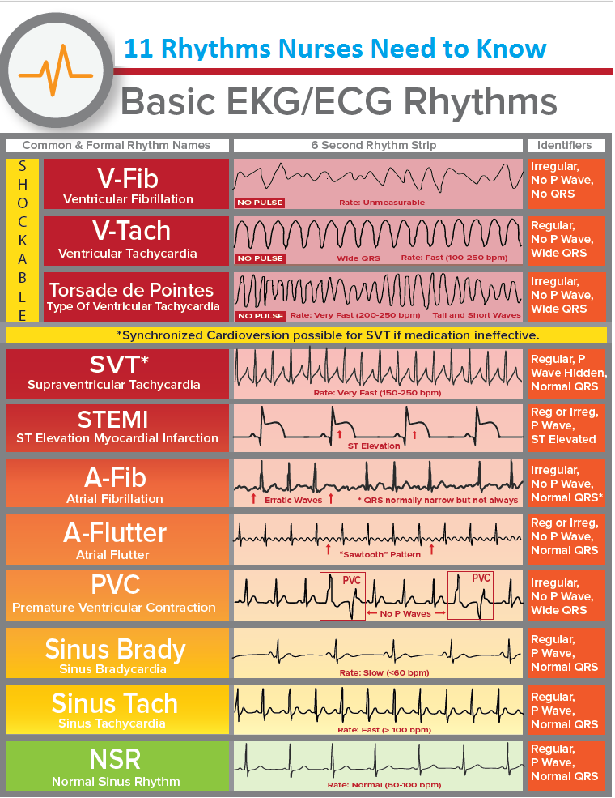
https://www.medicalestudy.com/basic-ecgekg-rhythms-nclex-cheat-sheet/

