Slide 1
Fossa temporalis, fossa infratemporalis, fossa pterygopalatina

Slide 2
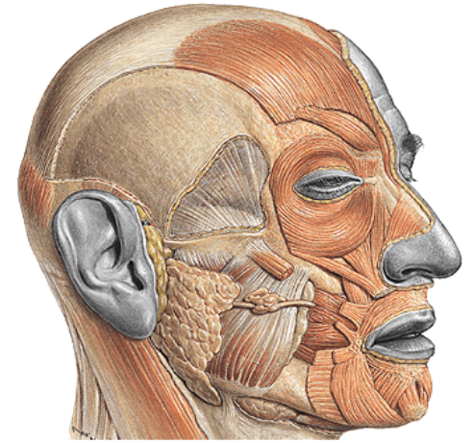
Fossa temporalis
Borders:
linea temporalis sup.,
arcus zygomaticus

Slide 3
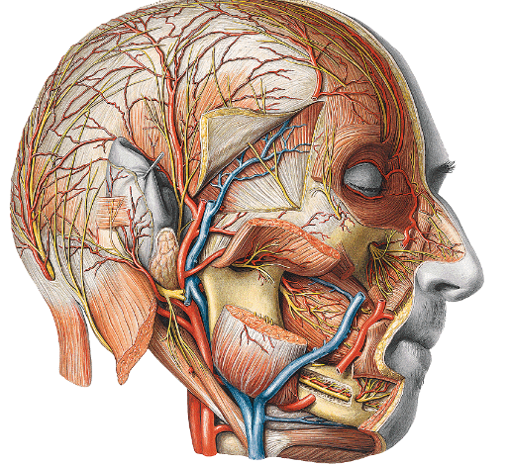
Fossa temporalis - content
skin
M. temporalis
m. temporoparietalis (n.VII.)
n. auricularis magnus
a., v. temporalis spf. (v. retromandibularis)
n. auriculotemporalis
fascia temporalis (two laminae)
a.,v., n. temporalis prof.

Slide 4
Fossa infratemporalis
Borders:
Upper: crista infratemporalis alae majoris osis sphenoidalis
Ventral: facies infratemporalis corporis maxillae
Lateral: ramus mandibulae
Medial: lamina lat. proc. Pterygoidei
Dorsal: missing, styloid septum

Slide 5
Fossa infratemporalis - content
Mm. pterygoidei
A. maxillaris
N. mandibularis
Plexus pterygoideus

Slide 6
Fossa infratemporalis
v.ophthalmica inf. (fissura orbitalis inf.)
n.mandibularis (foramen ovale)
a.meningea media (foramen spinosum)
n.alveolaris inf. (canalis mandibulae)
n.mylohyoideus (sulcus mylohyoideus)

Slide 7
A.maxillaris in fossa infratemporalis
Pars pterygoidea
arteria masseterica
arteriae temporales prof.
rr. pterygoidei
arteria buccalis

Slide 8
Branches of the mandibular nerve in the infratemporal fossa
N. mandibularis
N. buccalis
N. lingualis
N. alveolaris inf.
n. mentalis
R. mylohyoideus
N. auriculotemporalis

Slide 9
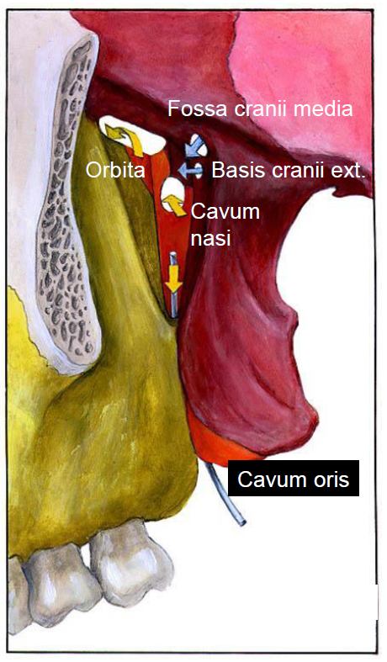
Fossa pterygopalatina
Upper wall
  Facies maxillaris alae majoris ossis sphenoidalis
  Foramen rotundum (fossa cranii media)
  Fissura orbitalis inferior (orbita)
Medial wall
  lamina perpendicularis ossis palatini
  Foramen sphenopalatinum (cavum nasi osseum)
Ventral wall
  tuber maxillae (foramina alveolaria)
Dorsal wall
  Processus pterygoideus ossis sphenoidalis
  canalis pterygoideus (basis cranii externa)
Caudally:
  Canalis palatinus major (cavum oris)

Slide 11
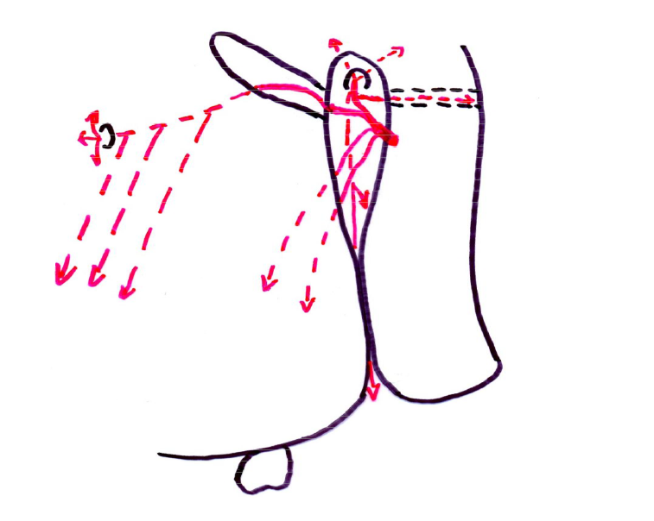
Branches of a. maxillaris – pars pterygopalatina
Pars pterygopalatina
a. infraorbitalis
a. alveolaris sup. post.
a. palatina descendens
a. canalis pterygoidei
a. sphenopalatina

Slide 12
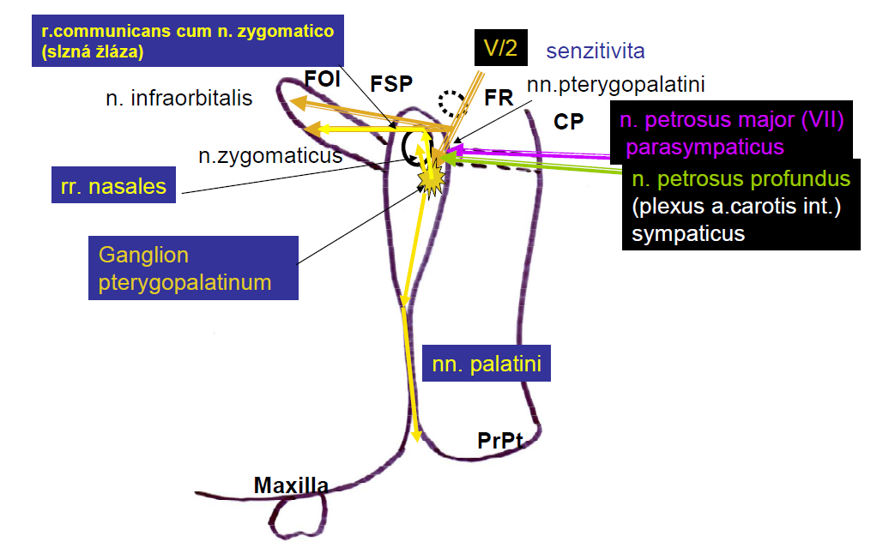
Side view of fossa pterygopalatina (passages of nerves)
(lacrimal gland)

Slide 13
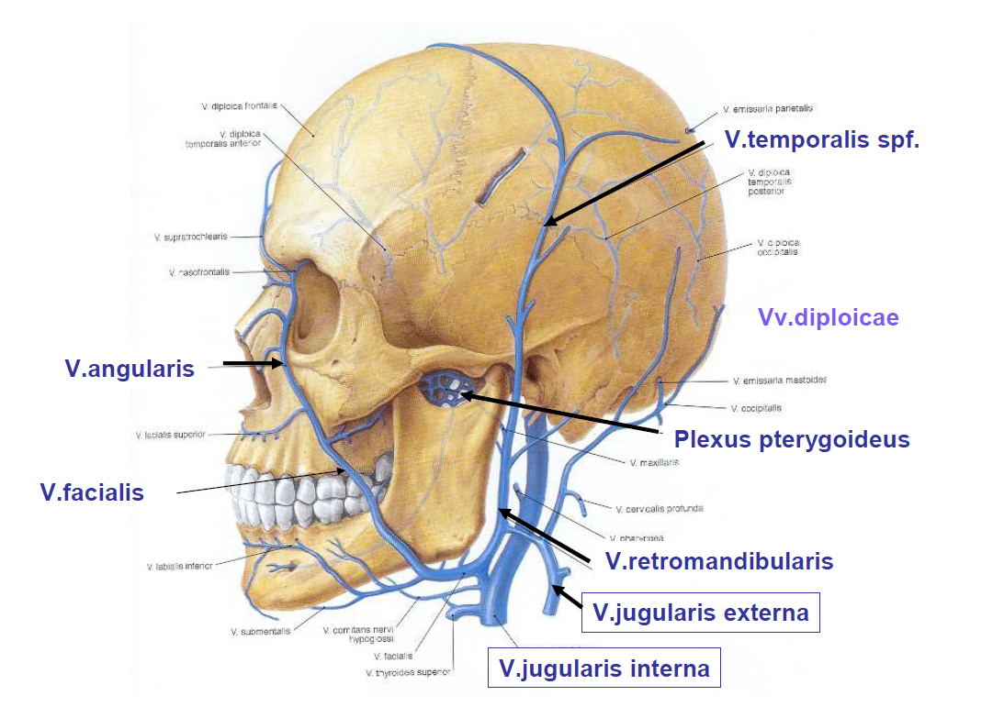

Slide 14
References:
Čihák, R.: Anatomie 1,2,3, Praha, Grada, 2001
Netter, F.: Atlas of HumanAnatomy, 4th ed., Elseviesr, USA, 2006
Naňka, Elišková: Přehled anatomie. Galén, Praha 2009
Seidl et al.: Radiologie pro studium i praxi, Grada publishing, 2013
Mrázková, Doskočil: Klinická anatomie pro stomatology, Alberta, Praha, 1994
Brand, Isselhard: Anatomy of orofacial structures, 8th edition, Elsevier, USA, 2019
Fehrenbach, Herring: Illustrated anatomy of the head and neck, 5th edition, Elsevier, USA, 2017
Moore, Dalley: Clinically oriented anatomy, 5th edition, USA, 2006

