Slide 1
Computer network user
Klimeš Daniel, Šmíd Roman, Krejčí Jan

Slide 2
Organisation of the course
Conditions for credit
Registration in is.muni.cz
Learning this material
Passing the electronic test

Slide 3
Course outline
Network connection
  Connection options, what is needed, comparison
Network services
  HTTP, FTP, DHCP, DNS, E-mail, remote access
Network security
  Passwords and Explorer in general, Firewall, email, spyware, phishing
  Mobile devices
Encryption and electronic signature
Czech E-government (optional)
Electronic health care in the Czech Republic
Notes:
3

Slide 4
Network connection

Slide 5
Data and its volume
How to express information
1 bit (b) - basic information unit 1/0
1 Byte (B) - 8 bits, integer from 0 to 255,
  1 text character (ASCII), e.g. "A" = 65
1 Kb = 1024 bits
1 KB = 1024 Bytes

Slide 6
Computer network
Connecting two or more computers
Network elements are part of the network
  Computer (device) with network card, modem, wifi adapter
  Cabling (metallic, optical)
  Hubs, routers and switches, wifirouters, antennas
  Devices providing network services, network printers...
The quality of a network, or a particular path in a network, can be assessed by
  Network throughput (speeds) - (K/M/G) bits per second (b/s)
  Response speeds (milliseconds) - ping

Slide 7
Connecting local networks
Routers / routers
Switch
Intranet
Internet

Slide 8
Identifying PCs on the network
Network card identification
    Worldwide "unique" MAC address (physical address)
    00-0A-E4-C0-36-81
IP address (similar to an ID number or phone number)
    Globally "unique"
    147.251.147.76
Internet name (similar to a postal address) - URL
    Worldwide unique
    www. iba.muni.cz

Slide 9
IP address
IPv4 x IPv6
IPv4: 32b = 2³² IP address => approx. 4 * 10⁹ address
IPv6: phased in 128b => 3.4 * 10³⁸ addresses
Same computer
transferred to another network
usually has a different IP address!

Slide 10
IP address
Fixed x dynamic IP address
Public x non-public IP address
  Non-public IP is not globally unique - only within the local subnet
  Non-public addresses do not have an associated Internet name
  Dynamic + non-public IP - typical service consumer
  Fixed + public IP - typical service provider
  http://www.ip-adress.com/
  cmd - ipconfig

Slide 11


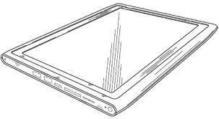
Non-public IP addresses
192.168.*.*
Internet
WIFI-router
Modem
Non-public IP
192.168.1.2
Non-public IP
192.168.1.4
1 public IP
147.251.26.1
+
1 non-public IP
192.168.1.1
Non-public IP
192.168.1.3

Slide 12
Physical connection of the PC to the network
Cable TV
  Modem, metallic network x optical network
Telephone line
  xDSL modem
Mobile connection
  LTE modem or mobile phone
Wireless - WiFi
  Special equipment/card, antenna

Slide 13
Cable TV
In places where cable TV is available
Speed up to 500 Mbps
Metallic x optical connection
  Metallic has significantly worse upload
Special modem
Main providers
  http://www.vodafone.cz
  http://www.netbox.cz
  http://www.selfnet.cz
  http://rychlost.cz/pripojeni-internetu/kabelova-tv/

Slide 14
Telephone line
ADSL ( up to 16 Mbps)
VDSL (up to 100 Mbps)
  Offered within 1.3 km of the exchange
Each type requires a specific modem

Slide 15
WiFi-connection
Outdoor/indoor
Commercial/community networks
Speed up to 54 Mbps
Special affordable equipment
Risk of interference, eavesdropping, unauthorised connection
Access point /Access point/ hot spot
http://www.internetprovsechny.cz/wifi/
https://it.muni.cz/sluzby/wifi
  Eduroam

Slide 16
Mobile connection
GPRS ( up to 128 kbps)
2G - EDGE ( up to 512 kbps)
3G - UMTS/HSDPA (1024 kbps and more)
4G - LTE (80 Mbps or more)
  More coverage than 3G
  Newer smartphones and modems

Slide 17
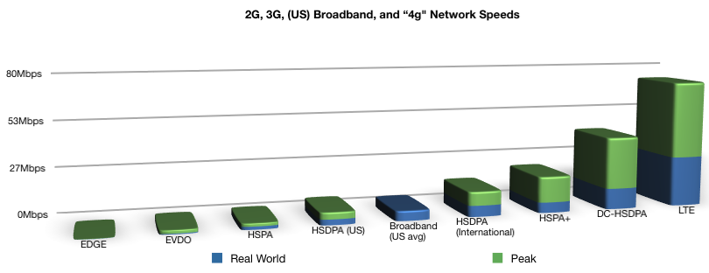
GSM connection speed
Many terms and abbreviations - GPRS, EDGE, UMTS, HSPA, HSPA+, HSDPA, HSUPA, WCDMA, 3G, 4G, LTE....
Source: tasel.wordpress.com

Slide 18
LTE coverage
  Great dynamics
  Provider websites or
  http://lte.ctu.cz/pokryti/
  For all operators
  LTE bands
    LTE-800 = basic for the Czech Republic

Slide 19
Choosing an internet connection
Method of use - fixed PC x notebook
Availability in given locations, coverage
Speed, usually in Mbps
  symmetric x asymmetric (download, upload)
  (e.g.: 20/2 Mbps)
  Actual speed verified in practice
Fair user policy (FUP) - speed limitation after transferring a certain amount of data
Aggregation (e.g.: 1:32) - (ADSL, wireless)
The actual speed between two computers can be measured indicatively using speedmeters
E.g.: http://nastroje.lupa.cz/mereni-rychlosti/, www.dsl.cz

Slide 20
Intercommunication of computers in the network
Client - Server model
Who, who, what he wants
USER
CLIENT
SERVER
Request
Answer
Computer
Program
Computer
Program = SERVICE
For whom, from whom
What client do you use
for the service?

Slide 21
Network services
Notes:
Hello,
welcome to the continuation of the course "Computer Network User". In this video we will talk about "Network Services".

Slide 22
Network services
A network service is a service provided to users over a computer network
The main ones are DHCP, DNS, HTTP, FTP, SSH, POP3, IMAP, SMTP, ...
Typically one server provides multiple services
The server is identified by its IP address (phone number), the service by its number called port
The complete service address is always the server IP address + port number
Each service has a defined standard port, e.g. HTTP has port 80, SSH has port 22, ...
Notes:
A network service is a service provided to users over the Internet, or computer networks in general. These services are provided by computer programs, usually running on a server. As we discussed in the previous topic, a server is some computer on a network that is identified by a unique IP address (in real life, you can think of it as identifying a telephone set by a telephone number). Such a server can of course provide multiple services, so the different services are differentiated within the server by a so-called port - the port is a number identifying the service (this can be thought of as a telephone flap). Each such provided service has a standard port defined so that their use is compatible within the network.
Users can use many services in this way, some are used by the user on purpose, some are used in the background without the user's knowledge. Some of the most well-known are HTTP for web browsing, IMAP for remote mail reading, and so on. In the following slides, we'll take a closer look at some of these.

Slide 23
DNS service (name resolution)
Translating Internet names to IP addresses
Not every IP address has a defined Internet name
The translation is performed by DNS servers that maintain a list of known Internet names and query other DNS servers for unknown names
Internet names cannot be used without the availability of this service, only IP addresses
For example: med.muni.cz => 147.251.128.10
Notes:
The DNS service, or name resolution service in English, is a service we use every day without perhaps realizing it. As we said earlier, each server is identified on the network by its IP address.
However, in order not to have to remember complex IP addresses, but only simple names such as seznam.cz or muni.cz, the DNS service is used for this purpose. This service translates this easy-to-remember name into an IP address.
If this service didn't exist, we would have to remember a plethora of IP addresses, but also the servers would have to own multiple IP addresses if they provided more content. Thanks to the DNS service now, a server can distinguish between these requests by the name of the site and can provide content for multiple websites or services in general. Thus, a server can have multiple Internet names. But it may also not have any.
For example, for the website of the Faculty of Medicine of Masaryk University, just remember MED.MUNI.CZ, thanks to DNS translation we will automatically connect to the IP address 147.251.128.10.

Slide 24
DHCP service (IP address allocation)
Automatically configure your computer's network connection on your local network
The DHCP protocol sets all the parameters necessary to connect the PC to the network, in particular
  IP address of the PC (147.251.140.250)
  Netmask (255.255.255.0)
  Gateway IP address (147.251.147.1)
  DNS server IP address (147.251.26.1)
Computer connections (network cards = MAC addresses) can be enabled/disabled by the network administrator
Notes:
Another service is DHCP. This is a protocol that automatically sets all the necessary network parameters (i.e. IP address, mask, default gateway and DNS server) to a given device the moment it connects to the computer network.
This is a simple and user-friendly way to configure the network on the device, it actually happens automatically and there is no need to remember and configure any settings.
Most of us also use this service without realising it. For example, whenever you connect to home wifi at home, your mobile or laptop is configured automatically, you don't really care, you're connected right away.

Slide 25
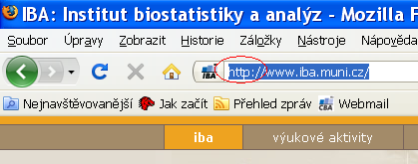

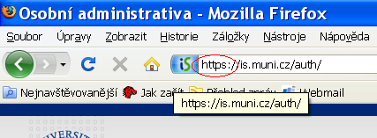

HTTP and HTTPS protocols (web pages)
Web page transfer protocol
HTTP
  transmits data in readable form
  Port 80
HTTPS
  communication between client and server is encrypted
  data is unreadable during transmission
  HTTPS has its own port 443
Nowadays most sites are already HTTPS
  Browsers automatically warn the user when unencrypted HTTP is being used
Unencrypted transmission using HTTP
Encrypted transmission using HTTPS
Notes:
Another, more familiar protocol is the HTTP protocol. This protocol is the basis for the functioning of WWW pages, i.e. web browsing as we know it. This protocol currently exists in two side-by-side variants. Both are based on the older HTTP protocol and its younger counterpart HTTPS, which extended the original protocol by encrypting the transmitted content with a certificate. The original protocol transmitted data in an open form, so in theory anyone who had access to it during transmission could read it at will. However, this was inappropriate for the transmission of confidential information such as passwords or bank details, so the protocol was extended to include the ability to encrypt the transmitted content using a certificate.
Nowadays, the vast majority of websites are already run with the secure HTTPS protocol. The user can recognize this in the browser by the label or the colored icon next to the entered address.

Slide 26


HTTP(S) websites
CLIENT
SERVER
Page request
Reply with the requested page
In case of HTTPS encrypted
Browsers:
Microsoft EDGE
Mozilla Firefox
Google Chrome
Apple Safari
Servers:
IIS
Apache
Ports:
80 (HTTP)
443 (HTTPS)
Notes:
The HTTP protocol is a protocol that uses a client request and server response system. In practice, when browsing web pages, it works by the user entering an address into the browser, sending a request from the client to the server (for example, show me the front page of a search engine list), the server processes the request and sends back to the user the content of the front page of the requested portal as a response. At the client, the browser processes and displays it.
The encrypted version of HTTPS follows a very similar process, but the content is encrypted "as-is" using a certificate.

Slide 27
Cookies - what they are for
Small files stored on your computer
Tied to a specific server
The browser sends them with a request to the server
The server creates/modifies them, sends them to the browser
The server "remembers" you
Privacy Campaign
Risk of connection takeover after you log in to the open WIFI service, if the connection is not encrypted
Notes:
Cookies are an integral part of browsing websites. This refers to a small amount of data that the web server sends to the user's browser to be stored there for later use. Each time you visit the same server again, the browser then sends this data back to the server, which is why some websites may pretend to remember you or your settings. Cookies are commonly used to differentiate between users, store user preferences, collect statistics and so on. Their content is some specific value tied to a particular website.

Slide 28
Cookies - how to remove them
MS Edge
  Settings -> Clear browsing data
Mozilla Firefox
  Options menu -> Privacy -> Remove cookies
Google Chrome
  Settings -> Privacy -> Delete browsing data
Apple Safari
  Settings -> Safari -> Advanced -> Site Data -> Delete all site data
Notes:
As such, cookies make life easier for the user (and therefore for the creators of the website), but it is not always desirable to store such information.Therefore, every web browser contains the option not only to view these cookies, but of course to delete them. Here you can see the procedures for the most commonly used web browsers.

Slide 29
Email services
Mailbox = files primarily located on the mail server
Mail servers communicate with each other - they forward mails
Email programs versus email via web interface
Mail reading services (POP3 and IMAP)
Service for sending mail (SMTP)
Notes:
The penultimate service is email services. Electronic mail, or e-mail, is the most widely used method of electronic communication, and everyone of us encounters it on an almost daily basis.
Email communication works similarly to HTTP, i.e. by passing some data between servers. We'll take a look at how these servers communicate with each other, what services they use to do so, and what options they have for reading their mail in the following slides.

Slide 30
IMAP and POP3 services (receiving mail)
IMAP and POP3 protocols are used to read mail on a mail server using a mail client
IMAP protocol
POP3 protocol
Sends email headers only
The content of the email will be sent upon request
All email folders are on the server
Convenient when reading mail from multiple computers
Sends all new whole emails
Removes them from the server
Sorting emails into folders on the local computer
Suitable for offline reading
Notes:
IMAP and POP3 services are used to read mail on a remote mail server when using a local mail client.
Both of these protocols allow the user to read mail, but each in a different way:
- The POP3 protocol, which is older by the way, was widely used in the days of dial-up or slow Internet connections. This is because it works by automatically downloading new emails from the server to the client and deleting them one by one on the server. The disadvantage is that they then only exist on that computer, so they are not available online from anywhere, but in turn are available on that device even without an internet connection.
- In contrast, IMAP automatically downloads only the headers, the user then chooses which emails he wants to download to his client, but these emails are then only copied, nothing is deleted from the server. The advantage is that the mail can be stored on the client, but it is still available on the server. It can then be read from several different devices, or you can use the web interface and the local client at the same time.

Slide 31

Email via local client
CLIENT
SERVER - local
Outlook, Thunderbird, Mail
POP3, IMAP, SMTP services
Email via web interface
SERVER - foreign
SERVER - foreign
Web browser
HTTP Service
IMAP, POP3, SMTP client
POP3, IMAP, SMTP services
Notes:
As mentioned on the previous slide, mail can be read on the server via the local email client, but also using the web interface. The following slide shows the different paths that the mail travels. Note that in the case of using the web interface, another server enters the schema, providing a web interface for the user, but also acting as a mail client and reading the mail content from another dedicated server.

Slide 32
SMTP service (sending mail)
SMTP is a service for sending email, especially when using email clients
CLIENT
SERVER
User login with name and password
Send to
email
to the server
recipient
Email to send
Answer: accepted/not accepted
Clients:
MS Post 10
MS Outlook
Mozilla Thunderbird
Apple Mail
SMTP service
Notes:
SMTP is a protocol used to send email, especially when using local email clients. This means that the user writes an email in any email client, when the "send" button is pressed, the client connects to the SMTP server of the email provider (i.e. where the client has an email box) using the name and password, the server processes the email and sends a confirmation of receipt to the user's client or returns an error code if the email is not processed.
However, if the email is successfully processed by the server, it is then sent by the server (without the participation of the client) to the recipient's mail server.

Slide 33
Virtual private network (VPN) service
The service simulates the connection of a remote computer to the local network
"Tunnel" to the remote network
The remote computer is assigned a local IP address
The remote PC then becomes "almost" a full-fledged part of the internal network
Used for remote access to work, for example in HO
It is always necessary to install some client software
Nowadays, PCs with Windows, MacOS and Linux are mostly supported, but also mobile devices with Google Android or iOS.
Notes:
A VPN service is used to remotely access a computer network from somewhere outside. The computer is assigned a local network address, and the computer therefore pretends to be part of that network. All you need is some software and access data. Such remote access is then useful, for example, when working from home or when accessing services on an internal computer network.

Slide 34
VPN service for MU students and employees
The MUNI VPN provides staff and students with access to the university network from home, abroad or another university.
To log in, you need to know the User ID + secondary password
This allows students and staff to use services that are only available from the university network, even if they are not currently on the network. By connecting to the VPN, you get a public address from the MU range, for example:
  access to MU's paid information resources: http://ezdroje.muni.cz/prehled/abecedne.php?lang=cs
  Access to paid university licenses: https://it.muni.cz/sluzby/software
  access to services available only from the MU network (e.g. specialised equipment and devices)
For more information visit: http://vpn.muni.cz/ (OpenVPN)
Notes:
In the real world, as employees or students of Masaryk University, you can meet the MUNI VPN. This is used to connect remotely to the university network, but mainly to draw on the university's electronic services, such as software licences, electronic resources and specialised equipment or computing and storage capacity. It is available to every student or employee of the university and to use it, you need to install the OpenVPN program from the VPN.MUNI.CZ website and know your UČO and secondary password.

Slide 35
Network services
Notes:
Hello,
welcome to the continuation of the course "Computer Network User". In this video we will talk about "Network Services".

Slide 36
IT security policies
See file
Network security.pptx

Slide 37
Encryption and electronic signature

Slide 38
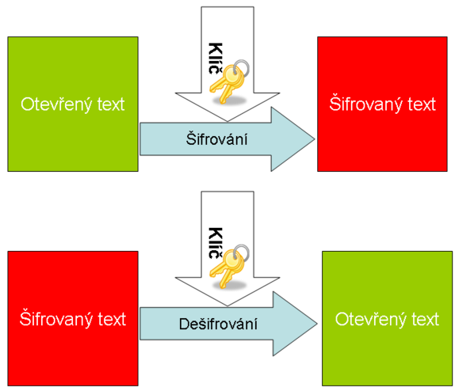
Encryption
Changing the form (encoding) of text and data into a form that is unreadable without knowledge of the decryption key (password)
You can encrypt e.g.
  Documents (7zip, winrar - symmetrically)
  Emails (email client support, recipient public key)
  Network communication (https, sftp, imaps, ssh)
  Disks (truecrypt, realcrypt, bitlocker)
Confidentiality of communications and documents

Slide 39
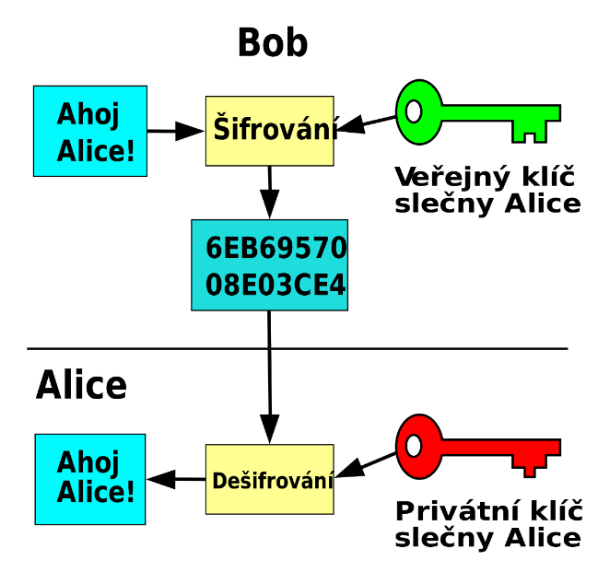
Types of encryption
Symmetric encryption
  Simpler form, a single key is used for encryption and decryption - the password
Asymmetric encryption
  The key has two parts, private and public

Slide 40

Asymmetric encryption
  The key has two parts, private and public
  If someone wants to send me encrypted information, they encrypt it using the public part of the recipient's key.
  The only one who can decrypt this data is the owner of the private part of the key, i.e. me

Slide 41
Electronic signature
Uses elements of asymmetric encryption
If I want to digitally sign some text, I just need to use the private part of the key for signing (done by email client, PDF editor)
Anyone who knows the public part of my key (it is sent automatically with the signed email) can then digitally sign the text
  Read more
  Verify that I am the author/submitter
  To verify that the text has not been tampered with
Signed email/document is not encrypted!!
  You don't have to "calculate" or remember anything, an email client or other application (pdf reader) will do the job
In its basic form, it is not intended for signing archival documents with long-term validity

Slide 42

Calculating hash
ABCD12345
Private key encryption
attached to a document
ABABD111
ABABD111
Electronic signature

Slide 43
The document itself
Signature verification
ABABD111
Public key signature decryption
HASH calculation
ABCD12345
ABCD12345
= ?

Slide 44

Digital certificate
Physical = computer file from the certification authority
    Issued by a certification authority
    Limited certificate validity (usually 1 year)
Contains
  Subject data (user, server)
    Name
    E-mail address
    Other identification data
  Subject public key
The separate component is the corresponding private key
Can be revoked (revoked) if the private key is disclosed
Qualified x commercial certificate

Slide 45
Qualified x commercial certificate
Act No. 297/2016 Coll., the Act on trust services for electronic transactions
Qualified certificate
  Issued by a qualified trust service provider
  https://www.mvcr.cz/clanek/seznam-kvalifikovanych-poskytovatelu-sluzeb-vytvarejicich-duveru-a-poskytovanych-kvalifikovanych-sluzeb-vytvarejicich-duveru.aspx
  Czech Post (PostSignum)
First Certification Authority, a. s.
eIdentity a. s.

Slide 46
Digital certificate - how to get it practically
Issued by so-called certification authorities (e.g. Czech Post)
  Login to the web (or download the off-line) application
  Self-generated and saved key pair with password
  Completing the application
  Visit a branch with an application, verify data
  Inclusion of the public part of the key by the CA in the list of authenticated keys
  Receiving a signed certificate with a public key and identification
Can be easily integrated into used email applications in the form of a certificate = guaranteed digital (electronic) signature
At MU, you can obtain a free personal digital certificate for users at http://pki.cesnet.cz/cs/tcs-personal.html

Slide 47
Electronic signature and eIDAS
electronic signature (FO) - expresses consent
electronic seal (PO)
Qualified Electronic Signature (QES):
  Must be based on a qualified certificate for electronic signature
  It must be created using a qualified (secure) electronic signature creation device (smart card and USB token = QSCD (from: Qualified Signature Creation Device).
a guaranteed electronic signature based on a qualified certificate
  Must be based on a qualified certificate
  A qualified device (certified smart card/token) is not required.
Advanced Electronic Signature (AdES)
  No specific certificate requirements
Recognized electronic signature = common designation for a. and b.

Slide 48
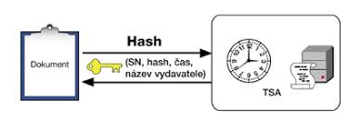
Electronic time stamp
Evidence that the document existed in the relevant form at the time.
Combined with electronic signature
  "Extend" the validity of the e-signature
Limited validity, but longer than e-signature
Simple and qualified stamp

Slide 49
Electronic signatures in practice
Application behaviour
  When programs tell us that a particular signature is valid, we have to find out for ourselves whether it is a recognized signature or a commercial certificate signature.
  Conversely, if they tell us that they can't verify the validity of the signature (i.e. the validity of the signature is unknown), it may just be because the certificate is not in the right place in the trusted certificate store.
  Applications often do not verify certificate revocation
  The email signature does not include the subject line or the sender's address
  The sender's email is not verified to match the email in the certificate

Slide 50
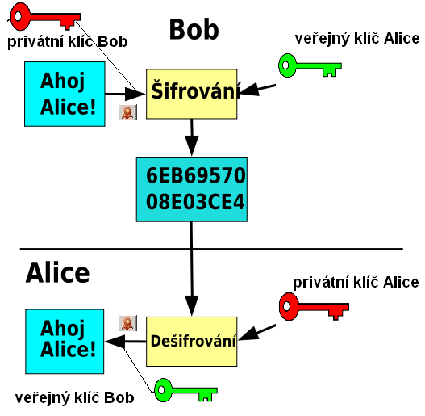

Encrypted email
Bob signs the message to Alice with his private key
The email is encrypted with Alice's public key
Alice decrypts the message with her private key
She'll verify Bob's signature with his public key

Slide 51



Remote Person Authentication
... or how to remotely prove it's me
1) Something unique I know
Means of proving identity
2) I have something unique
Level of assurance
Low
Considerable
High

Slide 52
Security level of proof of electronic identity
Means by level of trust:
  Low - e.g.: login + password
  Substantional - two-factor authentication = SMS confirmation, OTP = One Time Password
  High (chip card, electronic ID card)

Slide 53
Means of proving identity
Passwords
Tokens
Cards
Biometrics
Mobile phones
The issuance of these resources and the actual
authentication of access is handled by
A) Target service provider
B) According to the NIA concept of "Identity provider"
Identity resource provider

Slide 54
Identity resource provider
State
  Electronic ID card from 1 July 2018
  Password + one-time SMS code
Private provider
  Running certification
  Banking Identity

Slide 55
Where electronic signatures can be used
when submitting a statement of income and expenses for self-employed persons
for registration and deregistration for sickness insurance
for VAT returns
in electronic communication with the state administration
electronic communication with regional and municipal authorities
electronic communication with health insurance companies
when applying for social benefits
when applying for EU funding
when signing invoices
as an electronic signature of PDF documents
Source: en.wikipedia.org

Slide 56
Czech E-government
Optional chapter for international students

Slide 57
Czech E-government
Data boxes
Basic registers
Electronic ID card
Citizen Portal

Slide 58
Data boxes
It can be used for the same purpose as an electronic signature in communication with the state administration
Setting up and communicating with the state administration free of charge
Not limited validity as for certificates
Retains documents for 90 days only
Works like a "web email", instead of an email address there is a mailbox code
Communication outside the public authorities is subject to a fee
Set up at the post office, simple form and OP

Slide 59
Basic registers
ROB - population register
  Linked to the population and foreigners register
  Restricted access
ROS - register of persons (business)
RUIAN - Register of Territorial Identification, Addresses and Real Estate
Birth number x AIFO (agenda identifier of a physical person)
  Different citizen identification in different agendas

Slide 60
Electronic ID card
Issued from 1.7. 2018
Contact technology
Allows you to log in to electronic government services
Activation required at the office
Allows you to upload a signing certificate
You need a card reader (laptop or external)
Access codes (PIN)
  BOK, IOK, DOCK, PIN, PUK, QPIN

Slide 61
Citizen Portal
https://obcan.portal.gov.cz
Login via eOP or data box
Gradual rollout of services
Overview of documents
e-Prescription

Slide 62
Electronic health care

Slide 63
National register of health professionals
According to Act 372/2011 Coll.
Medical and non-medical staff
The record is created automatically by the educator after the completion of education
  Basic field, specialization, certification courses
Registration of employees by the employer (health service provider)
Employee = looks up, adds contact details, takes a printout
Provider - obligation to register employed healthcare workers

Slide 64
E-prescription
Central recipe repository
Identification of patients against ROB is ongoing (not necessary)
Around 5 million e-prescriptions per month
Server certificate (for the provider = for the ID)
Recognised electronic signature (doctor)
Login and password of the doctor, pharmacist
https://www.epreskripce.cz/

Slide 65
Clinical data exchange in the Czech Republic
Types of communication
  Between information systems within the facility
  Between health facilities (HF)
    Image data
      PACS, DICOM ,
      ePACS (http://www.epacs.cz/)
      ReDiMed (https://www.medimed.cz/redimed)
    Clinical data
      eMeDOcS , MEDICAL NET (CGM), MISE (STAPRO), E-message
  Between health insurance companies and insurance companies
    K-Benefits
    Health insurance portals (commercial certificates)

Slide 66
International data exchange
Patient summary
ePrescription and eDispensation
https://www.nixzd.cz/

Slide 67
Data structure (1/2)
Laboratory data
  NČLP - National codebook of laboratory items
  Division: system (blood), component (ERY), quantity (number), unit, procedure (FLOWCYT)
Medicines
  SÚKL code - corresponds to the code in the VZP codebook
    7-digit number
    Specific product
    0046224 - Panadol - POR TBL FLM 24X500MG
    http://www.sukl.cz/modules/medication/search.php
  ATC classification
    Active ingredient
    Anatomical-therapeutic-chemical groups
    Hierarchical code layout
    N02BE01 - Paracetamol (N Nervous system)
    L01BC02 - Fluorouracil (L Cytostatics and immunomodulatory drugs)
    www.whocc.no, http://www.sukl.cz/modules/medication/atc_tree.php

Slide 68
Data structure (2/2)
Healthcare payers
  Standard VZP (K Benefits)
  Methodology for the acquisition and transmission of VZP ČR documents
  www.vzp.cz - Providers
  Dialers
    Performance dial
    HVLP - mass-produced medicinal products
    Medical devices
    ICD-10 - International Classification of Diseases version 10

Slide 69
MKN 10
Czech translation of ICD - 10
International Statistical Classification of Diseases and Related Health Problems
Approximately 14 thousand items
Hierarchical code structure
  Xnnnn, Xnn - disease
  A, B - Infectious diseases
  C - malignant tumours
    C50 breast cancer
    C502 breast cancer - upper inner quadrant of the breast
Web: https://mkn10.uzis.cz

Slide 70
Classification in oncology
MKN classification - O
  Currently version 3
  Translation of the International Classification of Diseases (ICD) - O
  Morphological code
    M - 8140/ 3 1
      histology/behavior (grade)
  Topographic code
    C50.2 Upper inner quadrant of the breast
TNM classification
  Extent of cancer
    T - size of the tumour itself (T1 to T4)
    N - involvement of adjacent lymph nodes (N0 - N3)
    M - metastatic involvement (M0/M1)

Slide 71
HL7
Health level 7
Worldwide distribution
Centre in the USA
  www.hl7.org
Branches in individual countries
  www.hl7.cz
"Factory" for communication standards in healthcare
Limited distribution in the Czech Republic

Slide 72
CDA
Clinical document architecture
  HL7 application
  Formalized clinical document (medical reports)
  3 levels of formalisation
    Formalized header + unstructured text
    Header + split text into blocks
    Fully structured machine-processable content
  CDA templates prepared for specific documents
  Applied e.g. in Austria, Poland

Slide 73
SNOMED
Clinical terminology
Managed by the International Health Terminology Standards Development Organisation (IHTSDO)
Not only the terms, but especially the links
Multi-axial arrangement
Basic unit = concept
Basic structure
  Concept (Concept)
  Description
    FSN - Fully Specified Name
    Preferred Term
    Synonyms
  Bonds (Relationship)

Slide 74
SNOMED
Approximately 400 thousand concepts
19 root concepts
  Observable entity (questions)
  Clinical finding (answers)
  Procedure
  Body structure
  Organism
  Substance
  Pharmaceutical products
  Physical force
  Physical object
  ..
Concept name ("semantic tag")
Fracture of foot (disorder)

Slide 75
Test
In IS:
  Student -> select subject UPS -> Answering machines
  Select "UPS test english version" -> "I want to build the first set of questions"
  At the end "Save and evaluate"
Answered by
  20 questions
  60 minutes - Cannot be interrupted
  5 attempts to carry out the evaluation
  For some there are more than one correct answer (each for a point)
  Deduction of points for incorrect answers
  The minimum to qualify is 15 points

