Slide 1
Schemes head, neck

Slide 2
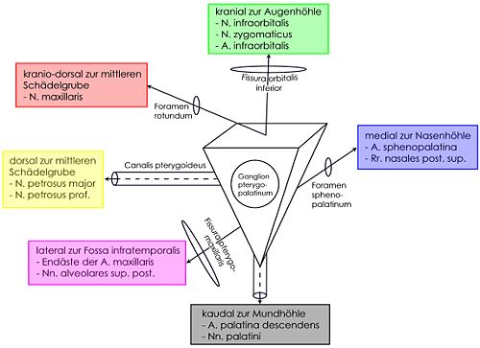
Fossa pterygopalatina
kranio-rostral

Slide 3
Canalis n.facialis
porus acusticus
internus
foramen stylomastoideum

Slide 4
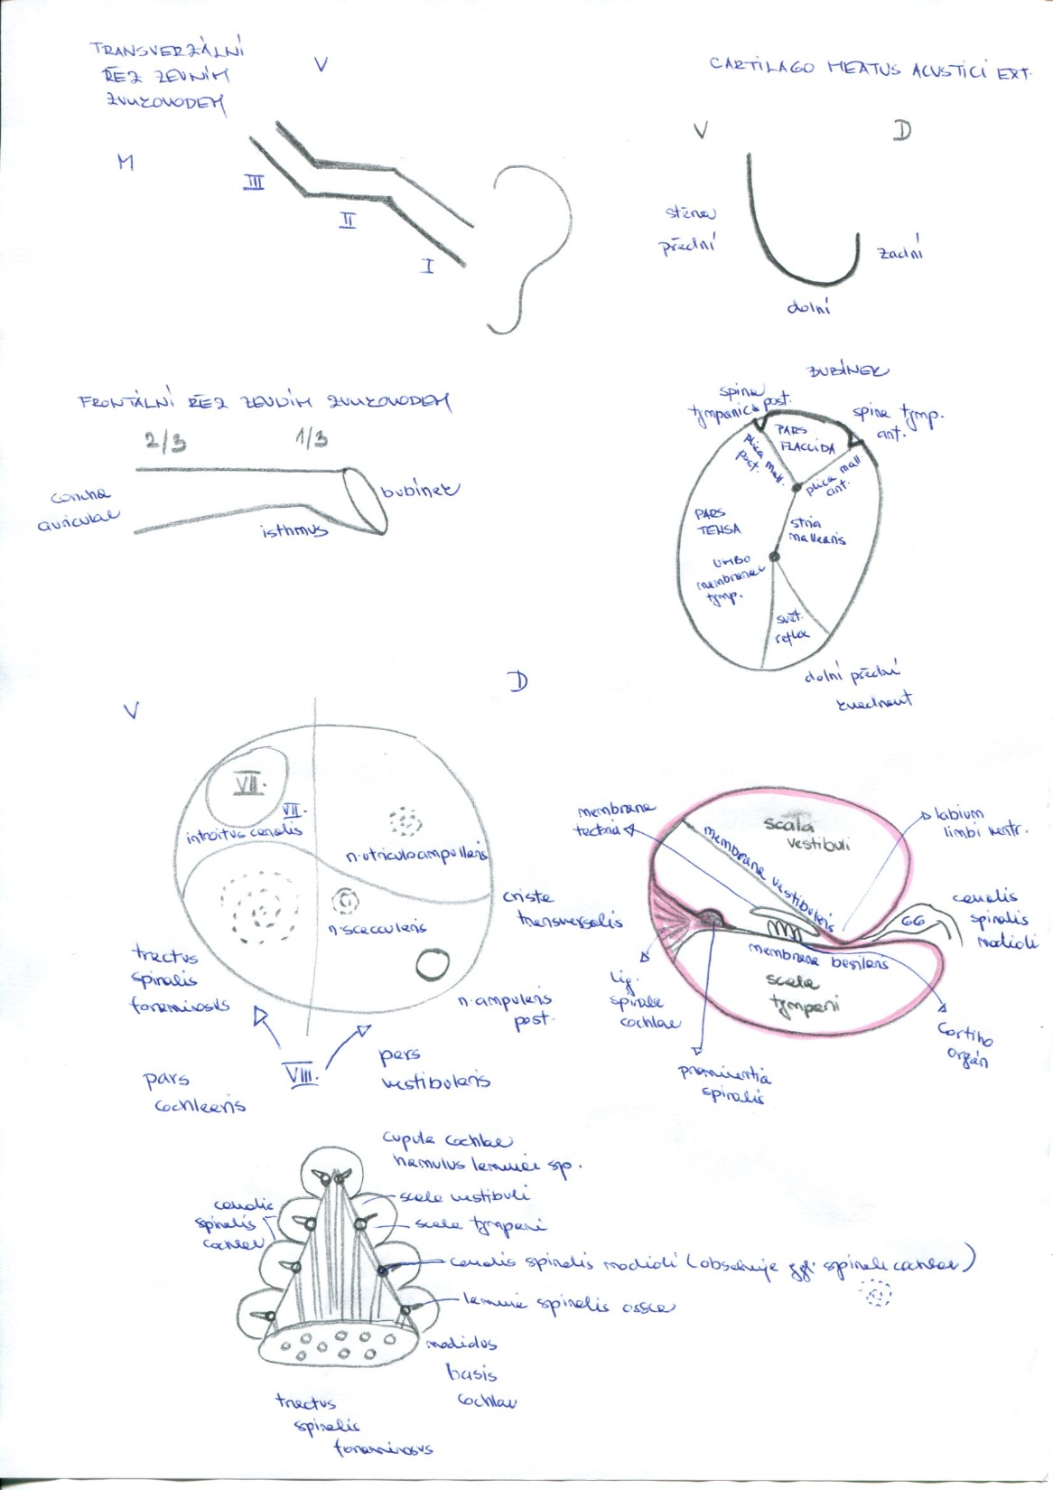
Porus acousticus internus

Slide 5
Os ethmoidale

Slide 6
SEPTUM NASI OSSEUM
lamina perpendicularis
ossis ethmoidalis
vomer

Slide 7
Atlantoaxial connection
Membrana atlantooccipitalis ant.
lig.apicis dentis
Membrana tectoria
lig.transversum atlantis
Membrana atlantooccipitalis post.

Slide 8
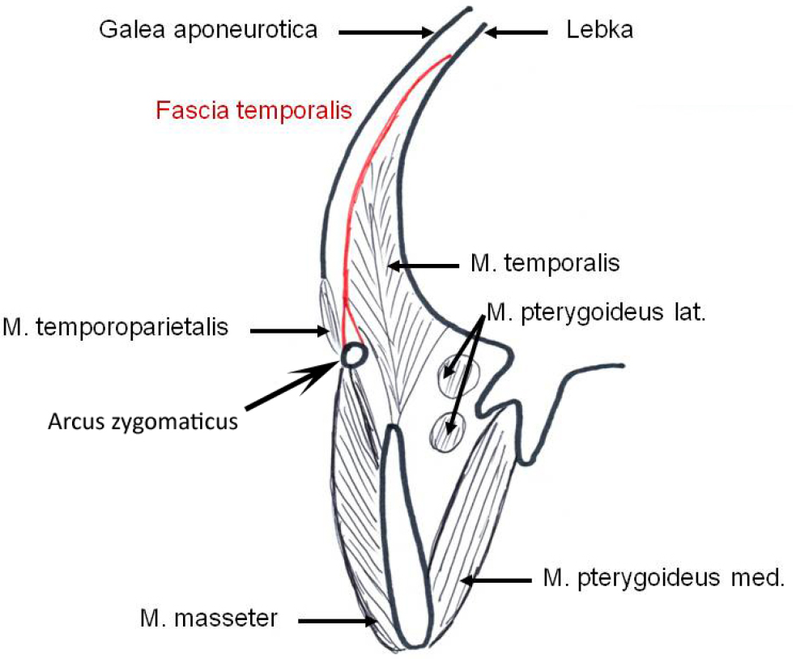
Temporal fossa on the frontal section
skul

Slide 9
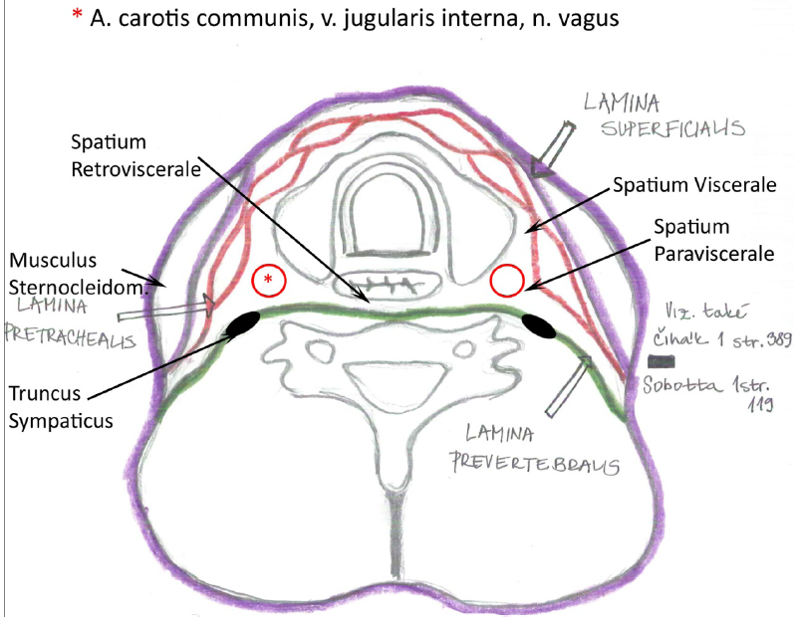
Cervical fascia – transversal section

Slide 10
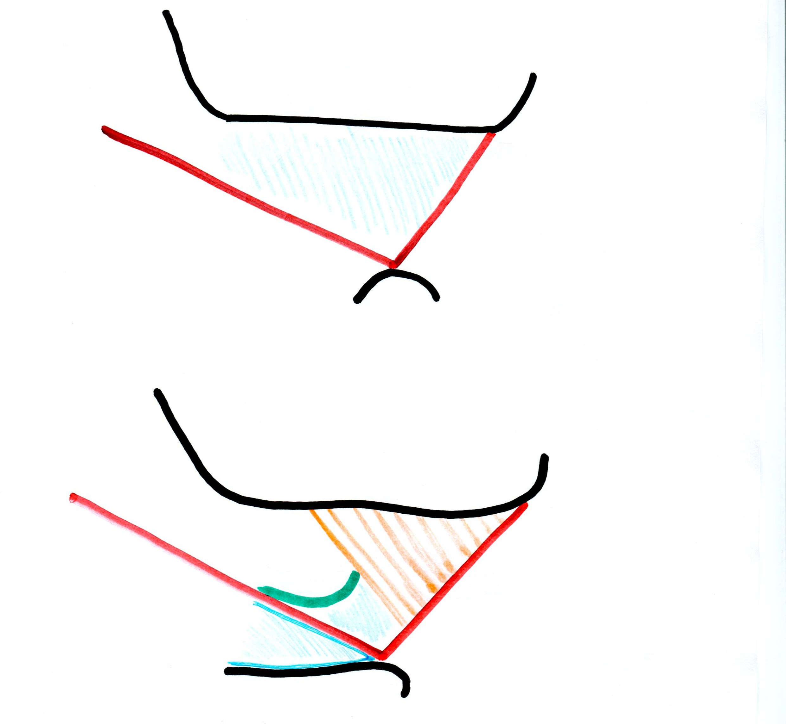
Trigonum submandibulare
mandibula
Venter anterior m.digastrici
Venter posterior m.digastrici
Os hyoideum
m.mylohyoideus
Venter posterior
m.digastrici
mandibula
n.hypoglossus
Venter anterior m.digastrici
Trigonum Pirogovi
Beclard´s angle
Os hyoideum

Slide 11
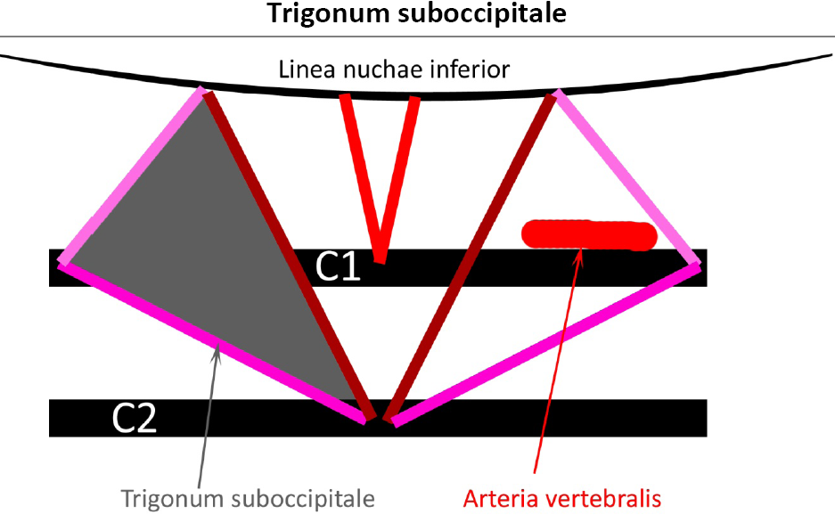

Slide 12
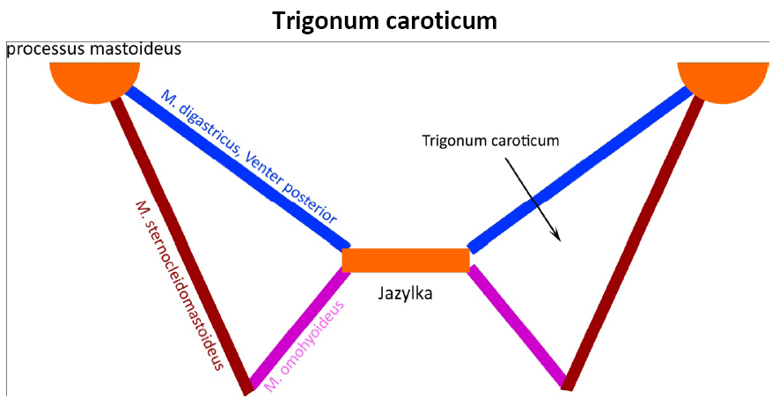
Hyoid bone

Slide 13
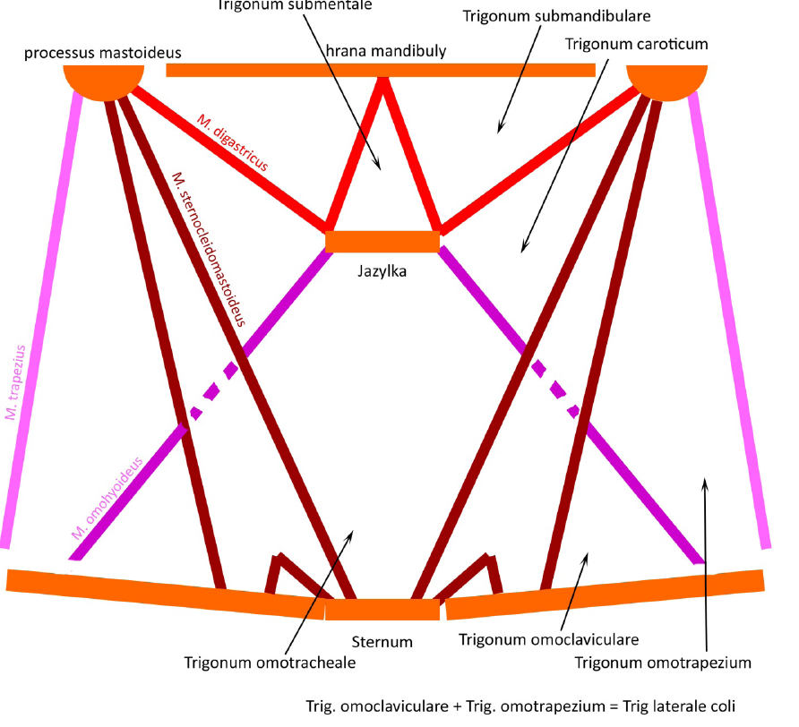
mandible
Hyoid bone

Slide 14
Fissura scalenorum
m. scalenus med.
m. scalenus ant.
Costa I.
Plexus brachialis
a. subclavia
v. subclavia- neprochází fissurou

Slide 15
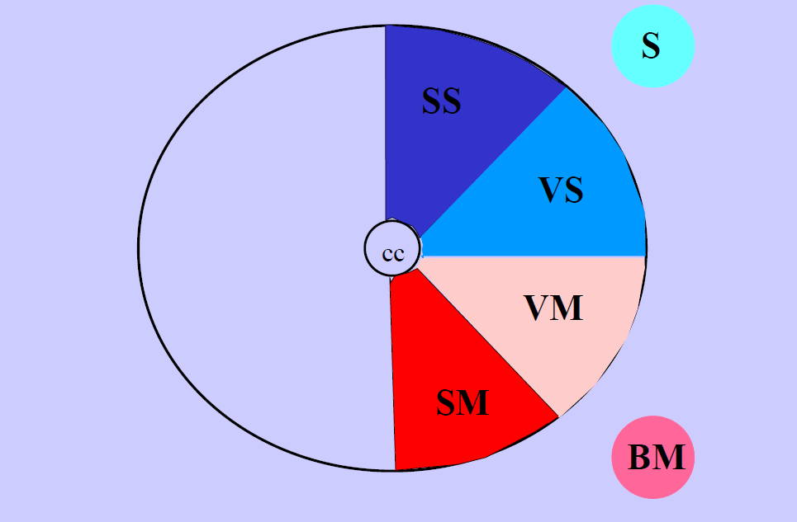
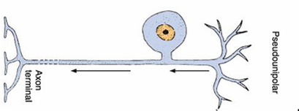
Scheme of the NS
CNS
PNS
sensor
Striated muscle
efector
Functional zones of the grey matter
Pseudounipolar neuron
aferent axon

Slide 16
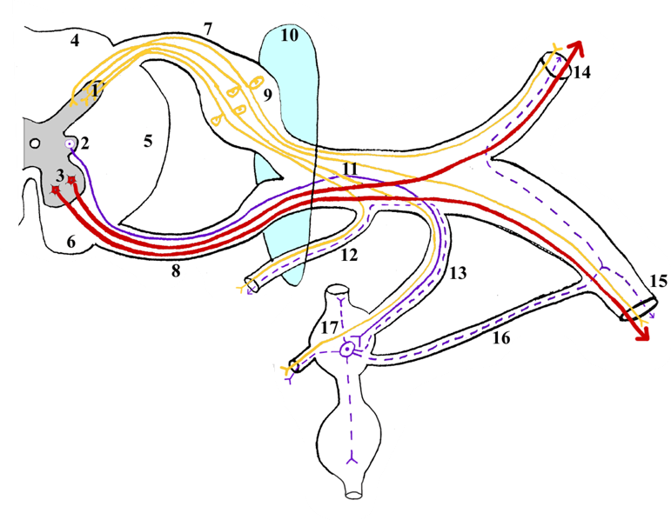
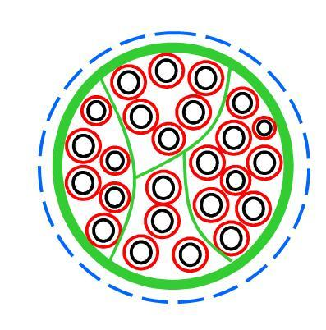
Scheme of the spinal nerve
Structure of the spinal nerve

Slide 17
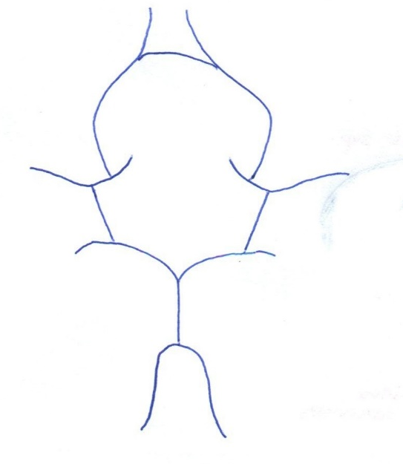
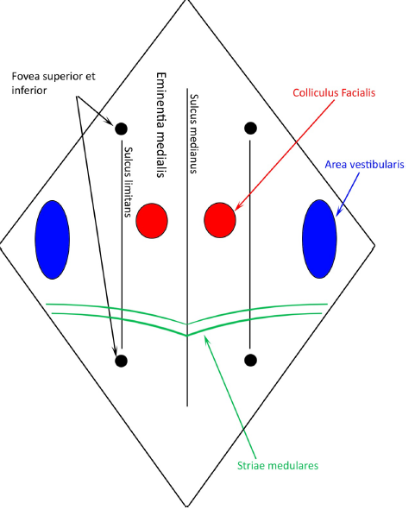
Circulus arteriosus Willisi
Fossa rhomboidea

Slide 18
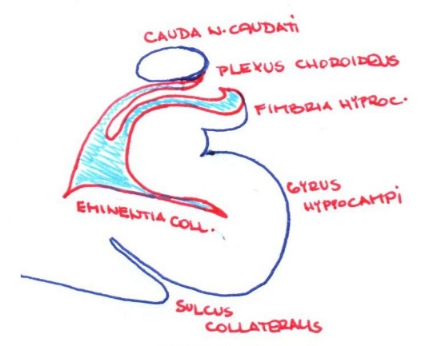

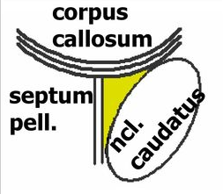

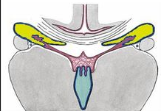
Ventriculus lateralis
Cornu frontale
Cornu temporale
Pars centralis

Slide 19
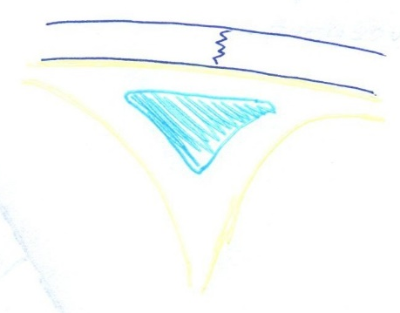

Sinus sagittalis superior
Sinus cavernosus
Dura mater

Slide 20
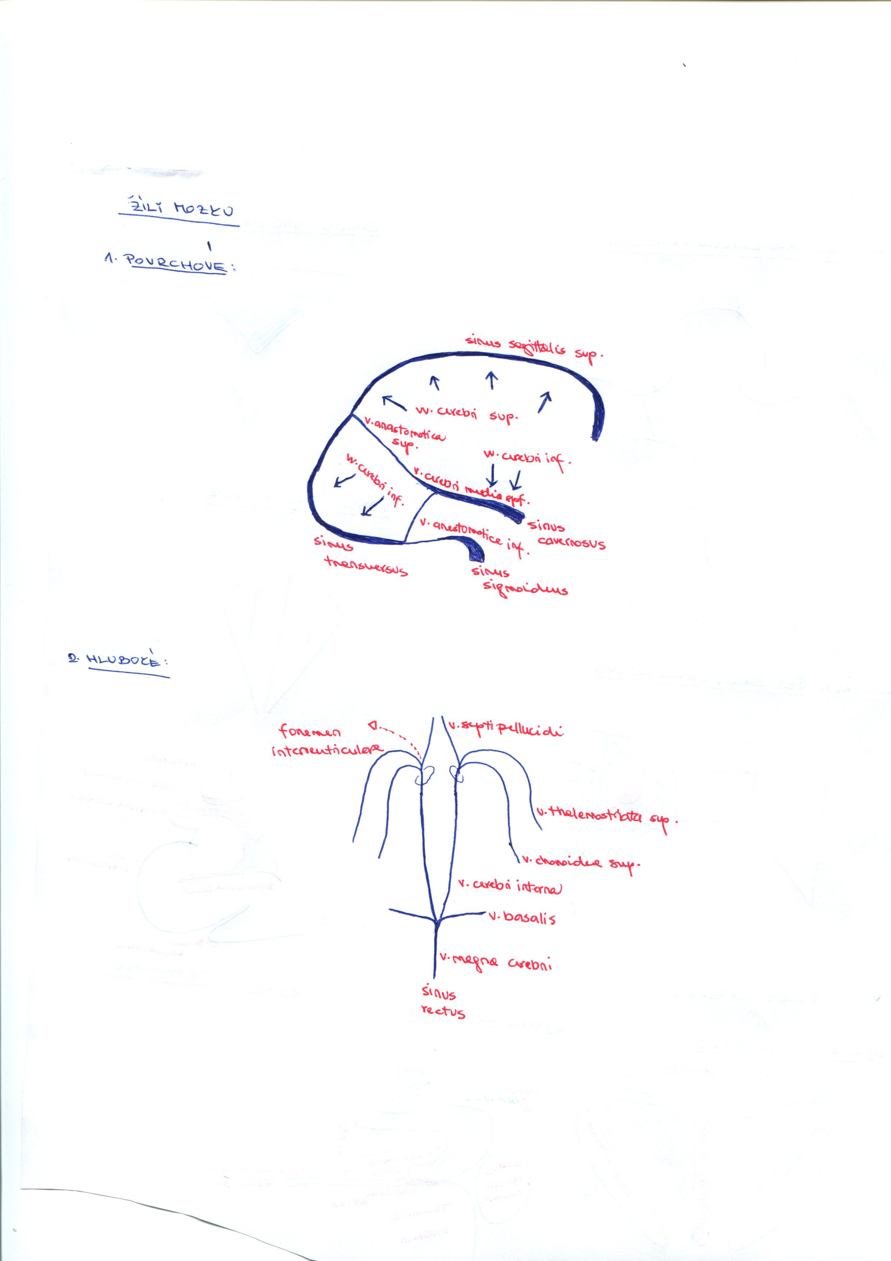
Superficial veins
Deep veins

Slide 21
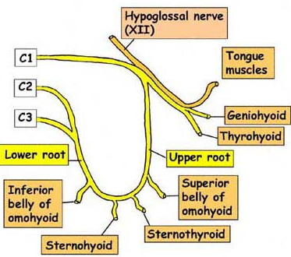
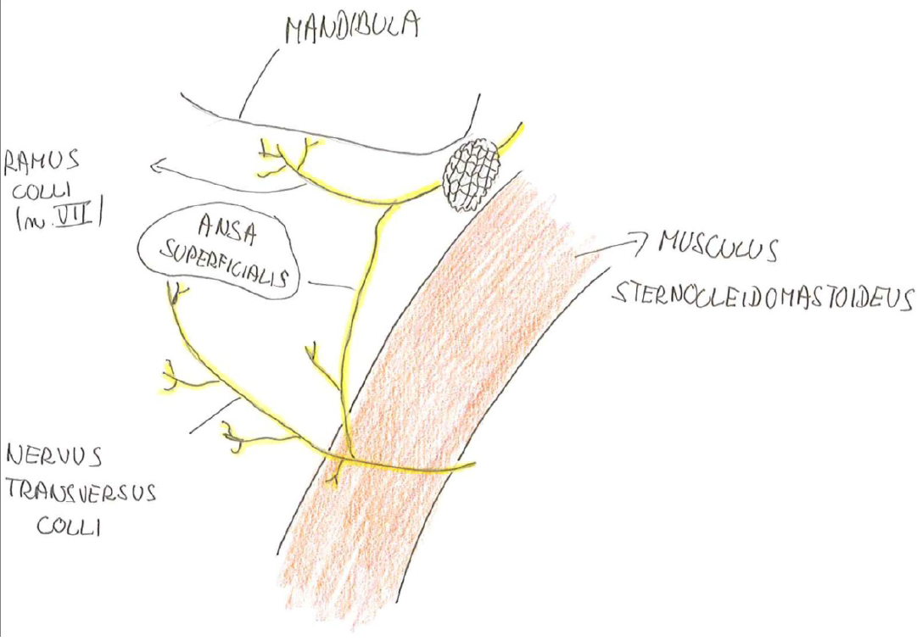
Cervical ansae
Deep ansa
Superficial ansa

Slide 22
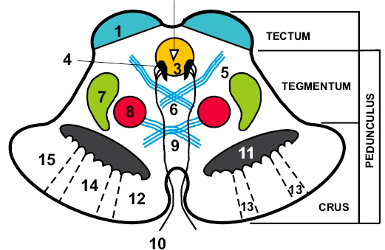
Pedunculus cerebri

Slide 23
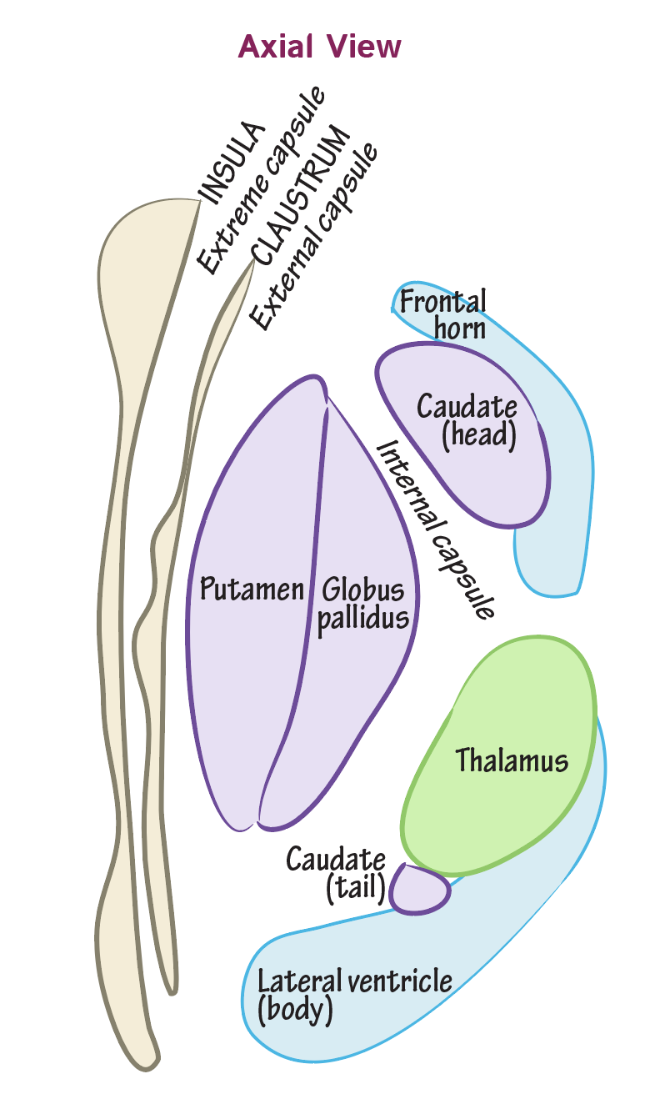
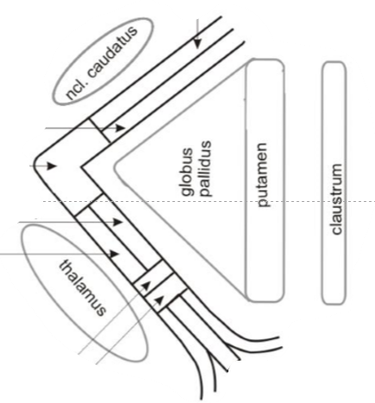
Basal ganglia
Capsula interna

Slide 24
Ductus cochlearis
Membrana tympani

Slide 25
Cochlea

Slide 26
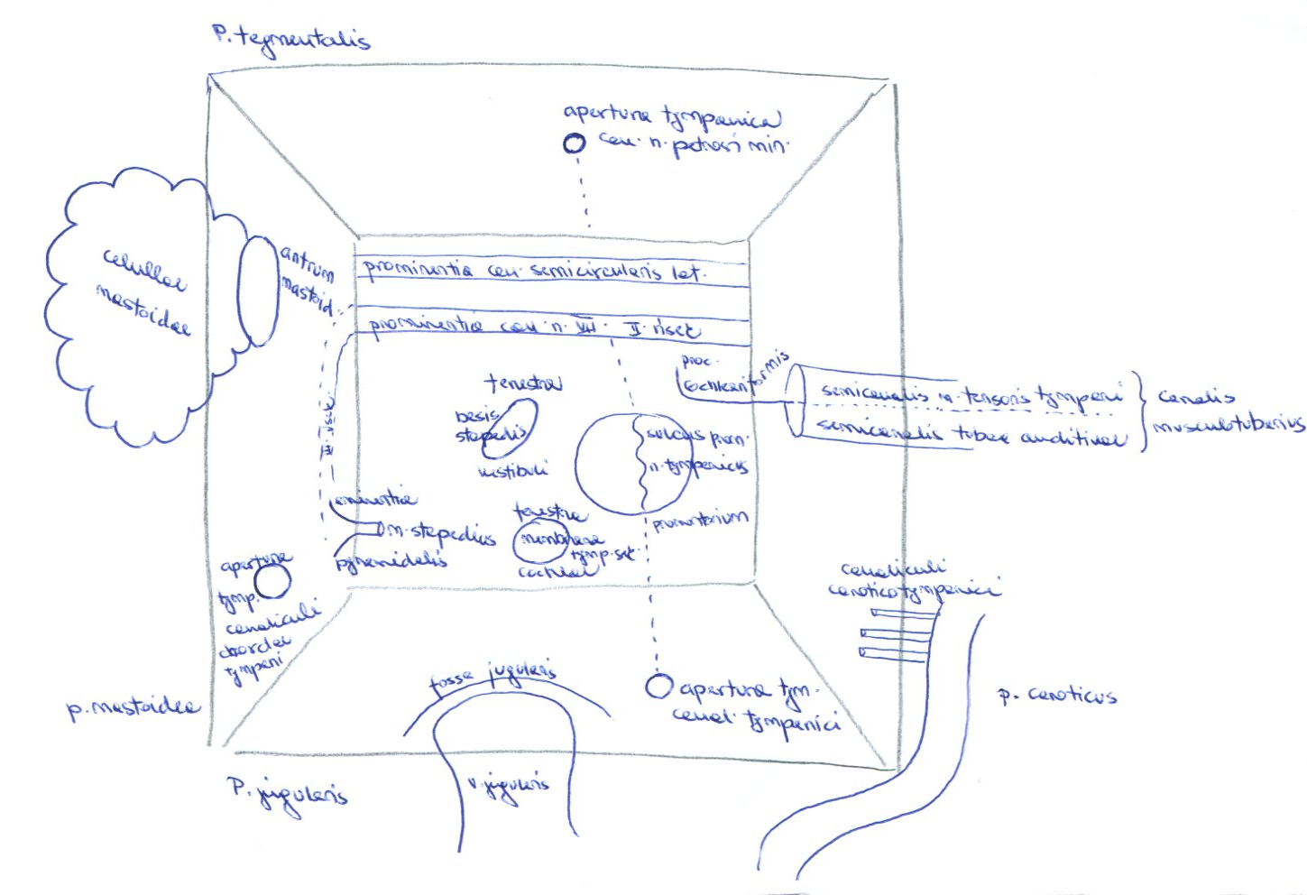
Cavum tympani

Slide 27
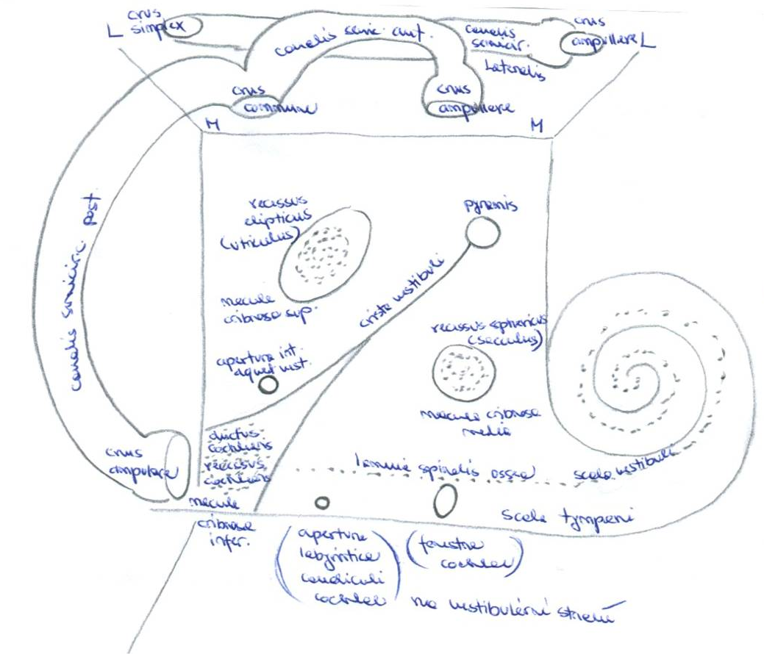
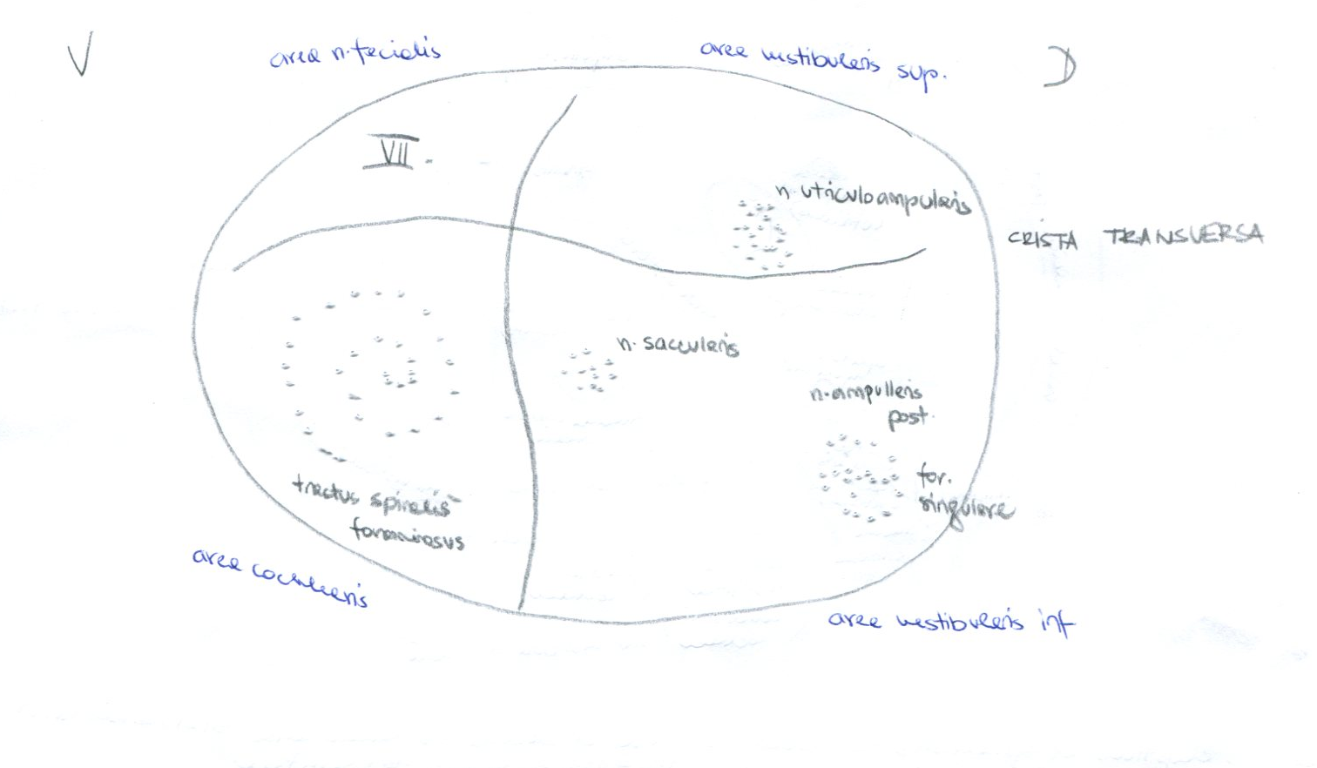
Porus acousticus internus
Vestibulum of the osseous labyrinthus

Slide 28
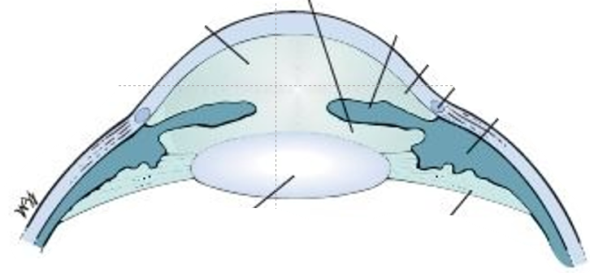
Camerae bulbi

Slide 29
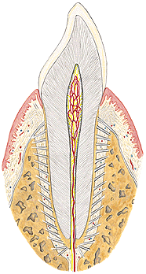
Tooth

