Slide 1
MIKROCIRKULACE

Slide 2
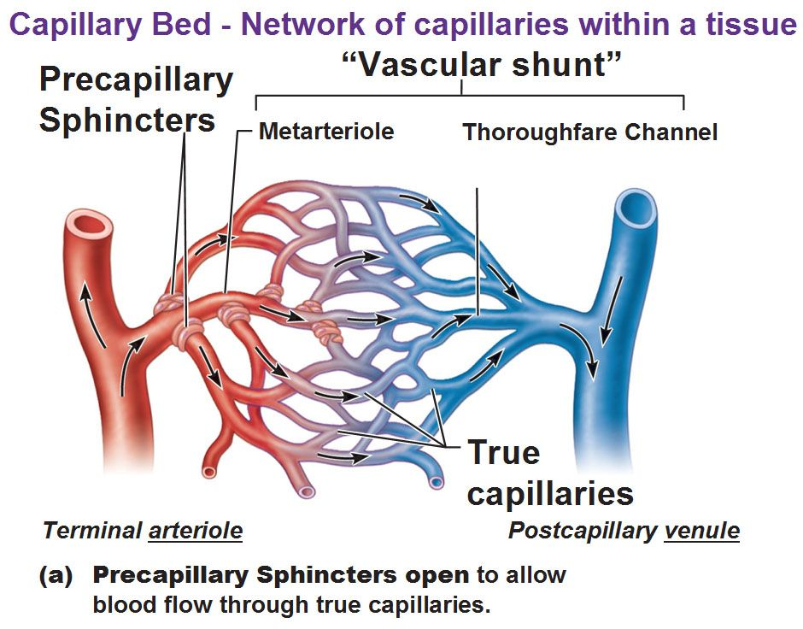
FUNKČNÍ ANATOMIE
Mikrocirkulace označuje oběh krve v nejmenších cévách lidského těla – arteriolách, kapilárách a venulách.
Hlavní funkcí mikrocirkulace je umožnit transport látek (voda, plyny, glukóza, bílkoviny aj.) mezi cévním systémem a tkáněmi.
Notes:
Microcirculation
The most purposeful function of the circulation is microcirculation: It allows transport of nutrients to the tissues and removal of cell excreta. The principal parts of circulatory system where the microcirculation occurs are arterioles, capillaries and venules. The small arterioles control the blood flow to each tissue, and local conditions in the tissues in turn control the diameters of the arterioles. Thus, each tissue, in most instances, controls its own blood flow in relation to its individual needs.
Arterioles are the small-diameter blood vessels (20-50 μm) that extend and branch out from an artery and lead to capillaries. Arterioles have continuous muscular walls (usually only one to two layers of smooth muscle) and are the primary site of vascular resistance.
The terminal parts of arterioles that connect arterioles to the capillary networks are called metarterioles. Metarterioles do not have a true tunica media (muscle layer is not continuous but rather irregularly interrupted). At the point where each true capillary originates from a metarteriole, a smooth muscle fibre usually encircles the capillary. This muscle fibre is called precapillary sphincter. Precapillary sphincters regulate the flow of blood into the capillaries. If most or all of the precapillary sphincters associated with a capillary network contract simultaneously, blood is moved directly from the arterial to the venous system through the metarteriole. In this situation, the metarteriole is acting as a thoroughfare channel, and the entire capillary network is bypassed. Because each metarteriole regulates blood flow into a specific number of capillaries, blood flow through any tissue is finely controlled. Blood delivery to a particular tissue can be quickly increased, decreased, or even temporarily halted in order to respond to the current metabolic activity of the tissues they supply.
Precapillary sphincters are controlled predominately by the concentration O₂ in the tissue. The reduction of O₂ concentration, high levels of CO₂ and associated acidosis cause the sphincter to open. When the tissue no longer needs freshly oxygenated blood and the balance is returned, the sphincter closes to allow other tissues to receive blood.
Capillaries are the smallest blood vessels in the body (diameter 4-9 μm): they convey blood between the arterioles and venules. These microvessels are the site of exchange of many substances with the interstitial space surrounding them. Substances which exit include water (proximal portion), oxygen, and glucose; substances which enter include water (distal portion), carbon dioxide, uric acid, lactic acid, urea and creatinine.
Venules are larger than the arterioles and have a much weaker muscular coat. However, the pressure in the venules is much less than that in the arterioles, so that the venules still can contract considerably despite the weak muscle.
Pozn.:
Průtok krve jednotlivými tkáněmi je regulován tak, aby byl zajištěn „minimální“, avšak funkčně dostatečný průtok pro výživu tkání a odvod odpadních produktů. Kdyby to tak nebylo, musel by být celkový průtok tkáněmi a srdeční výdej několikanásobně větší.
Průtok v jednotlivých kapilárách není kontinuální, ale přerušovaný. Celkový, střední průtok kapilárním řečištěm je pak dán procentem kapilár, které jsou v daném okamžiku otevřené a toto procento se mění v závislosti na metabolickém obratu tkáně.

Slide 3
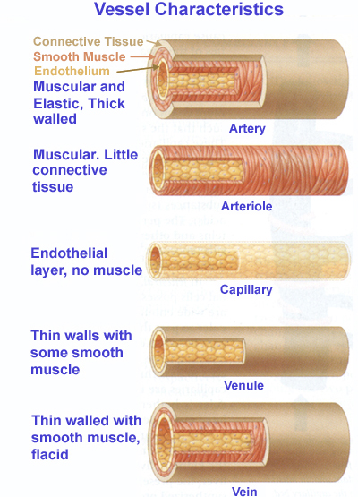
STRUKTŮRA STĚNY CÉV
1
Kapilární stěna je asi 1 μm silná.
2
Celková plocha kapilárních stěn u dospělého člověka přesahuje 500 m².
3
Rychlost krevního toku v kapilárách je 0.2 - 1 mm/s.
4
Tranzitní doba pro průchod krve kapilárou je 1 - 2 s.
Notes:
Structure of vessel wall
The arteries and veins have three layers:
• The inner layer (tunica intima) is the thinnest layer. It is a single layer of flat cells glued by a polysaccharide intercellular matrix, surrounded by a thin layer of subendothelial connective tissue interlaced with a number of circularly arranged elastic bands called the internal elastic lamina. A thin membrane of elastic fibers in the tunica intima run parallel to the vessel.
• The middle layer (tunica media) is the thickest layer in arteries. It consists of circularly arranged elastic fiber, connective tissue, polysaccharide substances, the second and third layer are separated by another thick elastic band called external elastic lamina. The tunica media may (especially in arteries) be rich in vascular smooth muscle, which controls the caliber of the vessel. Veins don't have the external elastic lamina, but only an internal one. The tunica media is thicker in the arteries than in the veins.
• The outer layer (tunica adventitia) is the thickest layer in veins. It is entirely made of connective tissue. It also contains nerves that supply the vessel as well as nutrient capillaries (vasa vasorum) in the larger blood vessels.
Capillaries consist of a single layer of endothelial cells with a supporting subendothelium consisting of a basement membrane and connective tissue. Length of the capillaries is most often between 0.5 and 1 mm. The basic characteristics of the capillaries allowing the efficient exchange of solutes between the capillary and interstitial space are summarised on the slide.
Note: The total length of capillaries in the human body is estimated at 96 000 km!

Slide 4
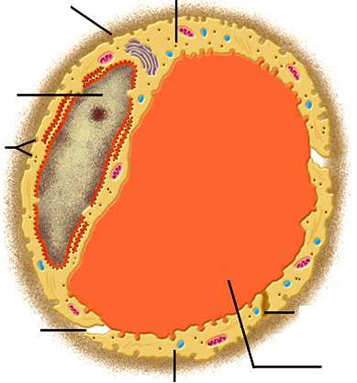
ULTRASTRUKTÚRA KAPILÁRY
Bazální membrána
Endoteliální buňka
Jádro
Vezikuly
5-10 μm
Fenestrace
Mezibuněčné štěrbiny
Lumen
Endoteliální buňka
Notes:
Passageways allowing transport of fluid and solutes through capillary wall
Intercellular clefts. Very small passageways connecting the interior of the capillary with the exterior. Each cleft is interrupted periodically by short ridges of protein attachments that hold the endothelial cells together, but between these ridges fluid can percolate freely through the cleft. The cleft normally has a uniform spacing with a width of about 6 to 7 nanometers.
Because the intercellular clefts are located only at the edges of the endothelial cells, they usually represent no more than 1/1000 of the total surface area of the capillary wall. Nevertheless, the rate of thermal motion of water molecules as well as most water-soluble ions and small solutes is so rapid that all of these diffuse with ease between the interior and exterior of the capillaries through the clefts. Intercellular clefts can be typically found in so called continuous capillaries, e.g. in the brain or skeletal muscle.
Fenestrations. Passageways through endothelial cells allowing the exchange of larger molecules. Fenestrated capillaries are “leakier” than continuous capillaries and can be found e.g. in kidneys where numerous small oval windows called fenestrae penetrate all the way through the middle of the endothelial cells, so that tremendous amounts of small molecular and ionic substances (but not the large molecules of the plasma proteins) can filter through the glomeruli without having to pass through the clefts between the endothelial cells. The fenestrated capillaries are also present in the endocrine glands, intestines or pancreas.
Note: A special type of large pores between endothelial cells can be found is sinusoidal capillaries or discontinuous capillaries. In these capillaries, the pores between the endothelial cells are wide open, so that almost all dissolved substances of the plasma, including the plasma proteins, can pass from the blood into the interstitial space. Such a large pores can be found e.g. in capillaries of the liver or bone marrow.
Plasmalemmal vesicles. The larger molecules such as albumin and other large proteins pass through the endothelial cells by means of plasmalemmal vesicles. These form at one surface of the cell by imbibing small packets of plasma or extracellular fluid. This transport process is called transcytosis.

Slide 5
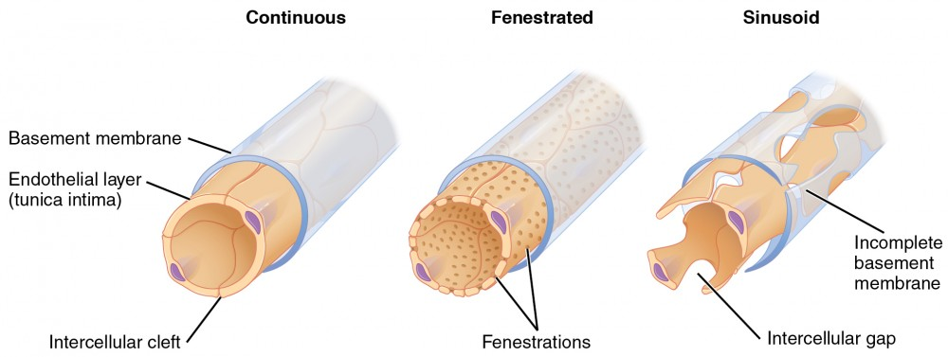
TYPY KAPILÁR
Kapiláry se souvislým endotelem jsou např. v mozku, kůži nebo svalové tkáni a slouží k transportu vody, glukózy, iontů a malých částic (šířka štěrbiny je 6 až 7 nanometrů).
Kapiláry s fenestrovaným endotelem lze nalézt v ledvinách, střevech, pankreatu a žlázách s vnitřní sekrecí a umožnují transport i větších molekul (průměr fenestrací je 70 - 80 nanometrů).
Kapiláry s nespojitým endotelem jsou např. v játrech nebo kostní dřeni. Obsahují široce otevřené póry, takže téměř všechny rozpuštěné látky plazmy včetně plazmatických bílkovin a dokonce i buněk mohou přecházet do intersticiálního prostoru.

Slide 6
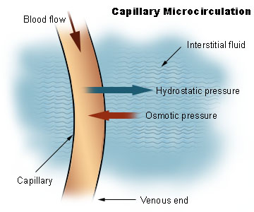
POHYB TEKUTINY PŘES KAPILÁRNÍ STĚNU
Účinek hydrostatického tlaku
filtrace
Účinek onkotického tlaku
resorpce
difuze
K difuzi, filtraci a resorpci plazmatické tekutiny přes kapilární stěnu dochází prostřednictvím mezibuněčných štěrbin, buněčných pórů a fenestrací.
Notes:
Movement of fluid across capillary wall
By far the most important means by which fluid is transferred between the capillary and the interstitial space is diffusion. Diffusion results from thermal motion of the water molecules. As the blood flows along the lumen of the capillary, tremendous numbers of water molecules diffuse forth and back through the capillary wall, providing continual mixing between the plasma and interstitial fluid. However, because the thermal movement of water molecules in both directions is balanced, the total diffusional flux of water across the capillary wall is zero.
The hydrostatic pressure in the capillaries tends to force the fluid through the capillary gaps into the interstitial spaces, causing filtration. Conversely, osmotic pressure induced by the plasma proteins (colloid osmotic pressure) tends to cause fluid movement by osmosis from the interstitial spaces into the capillaries, leading to resorption. This osmotic pressure normally prevents significant loss of fluid volume from the blood into the interstitial spaces. Under physiological conditions, the movement of water molecules due to filtration is higher than the opposite movement caused by resorption resulting in the net flux of water out from the capillary.
To sum up, the diffusion is the principal factor in providing exchange of plasma fluid between the capillaries and tissue cells. However, the diffusional fluxes in both directions are the same. Only about 2% of the plasma passing through the capillary is filtered and absorbed, with filtration being greater than reabsorption.

Slide 7
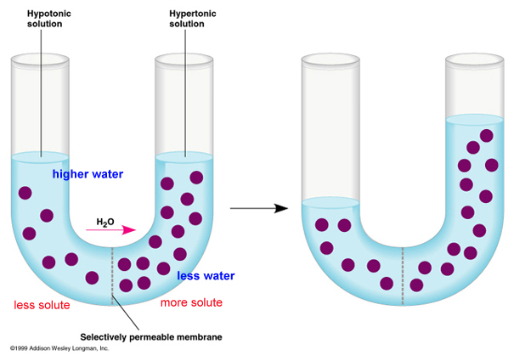
OSMOTICKÝ TLAK
hypotonický roztok
hypertonický roztok
ustálený stav
osmotický (onkotický) tlak
osmotický (onkotický) tlak
Selektivně propustná membrána
hydrost. tlak
Notes:
Osmosis occurs when two solutions containing different concentrations of solute are separated by a selectively permeable membrane. Solvent molecules pass preferentially through the membrane from the low-concentration solution to the solution with higher solute concentration. The transfer of solvent molecules will continue until equilibrium (the same concentration of solute on both sides) is attained.
Osmotic pressure is the minimum pressure which needs to be applied to a hypertonic solution to prevent the flow of the pure solvent across a semipermeable membrane into this solution (yellow arrow). Therefore, in the figure above, the osmotic pressure is equal to the hydrostatic pressure difference (blue arrow) given by the different levels of solution on both sides of the tube.

Slide 8
TLAKOVÝ GRADIENT PODÉL SVALOVÉ KAPILÁRY
arteriola
venula
Rozdíl hydrostatických tlaků:
P_{c}- P_{i} = 36 mmHg
Rozdíl onkotických tlaků:
π _{c}- π _{i} = 25 mmHg
INTERSTICIUM
Rozdíl hydrostatických tlaků: P_{c} - P_{i} = 16 mmHg
Rozdíl onkotických tlaků:
π _{c}- π _{i} = 25 mmHg
P_{c}
P_{c}
π _{c}= 25
37
filtrace
resorpce
17
P_{i} = 1
π_{i} ≈ 0
KÁPILÁRNÍ HYDROSTATICKÝ TLAK P_{c} = 37 až 17 mmHg
INTERSTICIÁLNÍ HYDROSTATICKÝ TLAK P_{i} = 1 mmHg
KAPILÁRNÍ ONKOTICKÝ TLAK π_{c} = 25 mmHg
INTERSTICIÁLNÍ ONKOTICKÝ TLAK π_{i} ≈ 0 mmHg
Notes:
Pressure gradients across the wall of capillary
There are four primary forces that determine whether fluid will move out from the capillary into the interstitial fluid or in the opposite direction. These forces, called “Starling forces” in honour of the physiologist who first demonstrated their importance, are:
1. The capillary pressure (P_{c}), which tends to force fluid outward through the capillary membrane.
2. The interstitial fluid pressure (P_{i}), which tends to force fluid inward through the capillary membrane.
3. The capillary plasma colloid osmotic pressure (π_{c}), which tends to cause osmosis of fluid inward through the capillary membrane.
4. The interstitial fluid colloid osmotic pressure (π_{i}), which tends to cause osmosis of fluid outward through the capillary membrane.
Note that P_{c} decreases from ∼37 mmHg at the arterial end of the capillary to ∼17 mmHg at the venous end of the capillary. It is also worth noting that, in majority of cases, π_{c} is nearly constant (∼25 mmHg) along the capillary and P_{i} as well as π_{i} are very small.

Slide 9
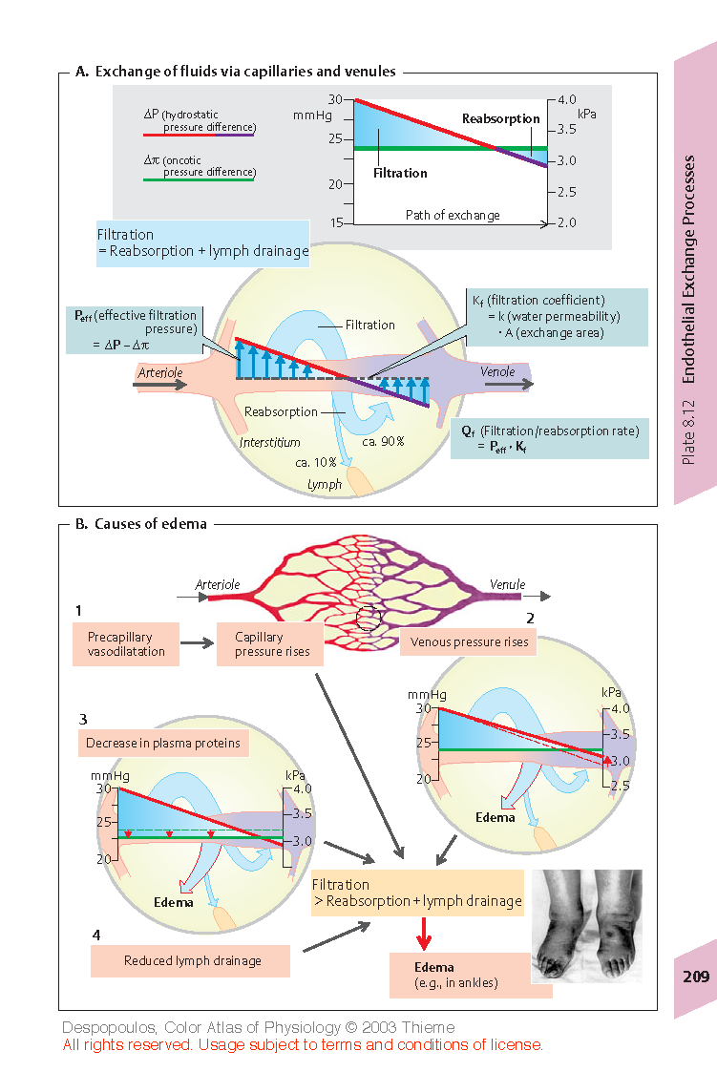
VÝMĚNA TEKUTIN V KAPILÁRÁCH
Rozdíl hydrostatických tlaků
Rozdíl onkotických tlaků
([P_{c} − P_{i}] − σ [π_{c} − π_{i}]) - efektivní (čistý) filtrační tlak
Notes:
Exchange of fluid via capillaries
If the sum of the Starling forces, the effective filtration pressure, is positive, there will be a net fluid filtration across the capillaries. If the sum of the Starling forces is negative, there will be a net fluid absorption from the interstitial spaces into the capillaries. The effective filtration pressure (P_{eff}) at a given point of the capillary can be calculated from the hydrostatic pressure difference (P_{c}-P_{i}) and oncotic pressure difference (π_{c}-π_{i}) across the capillary wall according to the relation:
P_{eff}=(P_{c}-P_{i}) − (π_{c} − π_{i}) .
Normally, about 20 L/day of fluid is filtered (excluding the kidneys) into the interstitium from the body’s exchange vessels. About 18 L/day of this fluid is thought to be reabsorbed by the venous limb of these vessels. The remaining 2 L/day or so make up the lymph flow and thereby return to the bloodstream (through left an right subclavian vein).
Lymphatic System
The lymphatic system represents an accessory route through which fluid can flow from the interstitial spaces into the blood. Most important, the lymphatics can carry proteins and large particulate matter away from the tissue spaces, neither of which can be removed by absorption directly into the blood capillaries. This return of proteins to the blood from the interstitial spaces is an essential function without which we would die within about 24 hours.

Slide 10
STARLINGŮV VZTAH
J_{v} - TOK TEKUTINY PŘES KAPILÁRU
K_{f} - kapilární filtrační koeficient
P_{c} - kapilární hydrostatický tlak
P_{i} - intersticiální hydrostatický tlak
π_{z} - kapilární onkotický tlak
π_{i} - intersticiální onkotický tlak
σ - reflexní koeficient
Notes:
Starling´s equation
In most tissues, the mean P_{eff} along the capillaries is slightly positive under normal conditions, resulting in a net filtration of fluid into the interstitial space. Except for P_{eff}, the rate of fluid filtration in a tissue is also dependent on the number and size of the gaps in each capillary (clefts, fenestrations and pores), on the number of capillaries through which blood is flowing and on the permeability of capillary wall to proteins. These factors are involved in the Starling equation:
J_{v} = K_{f}(P_{c} − P_{i}) − σ(π_{c} − π_{t}),
by means of capillary filtration coefficient (K_{f}) and reflection coefficient for proteins (σ, between 0 and 1). σ is 1 if capillary membrane is not permeable to plasma proteins and decreases with an increase of membrane permeability to these proteins.
Note: In some sources like Text of Medical Physiology (Guiton and Hall) or Atlas of physiology (Silbernagel&Despopoulos) the reflection coefficient is not included in the Starling’s equation. In this case, it is already included in the formulation of both oncotic pressures. In my presentation, I formulated the Starling’s equation according to the textbook of Medical Physiology by Boron, which is the recommended source for the study of General Medicine in our school. Nevertheless, both descriptions are compatible.

Slide 11
PŘÍČINY ZVÝŠENÉHO OBJEMU INTERSTICIÁLNÍ TEKUTINY A OTOKŮ
1
2
3
Increased capillary permeability
4
Reduced lymph draiage
Notes:
In most tissues, under normal conditions, the amount of the fluid that enters the interstitial space by filtration is the same as the amount of the fluid that returns back to the capillaries by reabsorption plus amount of the fluid that is removed from the interstitial space by lymphatic vessels. If the volume of filtered fluid is higher than the amount of the fluid returned to the blood (by both the reabsorption and lymphatic drainage) the fluid accumulates in the interstitial space and edema occurs.
Causes of edema:
1) Increased capillary pressure (↑P_{c}) due to precapillary vasodilation or increased venous pressure caused, for example, by venous thrombosis or cardiac insufficiency (cardiac edema).
2) Decreased concentration of plasma proteins, especially albumin, leading to a drop in π_{c} due, for example, to loss of proteins (proteinuria), decreased hepatic protein synthesis (e.g., in liver cirrhosis), or to increased breakdown of plasma proteins to meet energy requirements (hunger edema).
3) Increased capillary permeability for proteins (σ↓) due, for example, to infection or anaphylaxis (histamine etc.).
4) Decreased lymph drainage due, e.g., to lymph tract compression (tumors), severance (surgery), obliteration (radiation therapy) or obstruction (bilharziosis).
Note: Increased hydrostatic pressure promotes formation of edema in lower regions of the body (e.g., in the ankles).

Slide 12
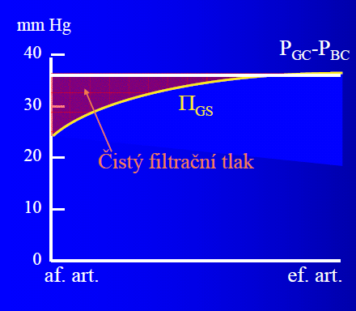
SPECIÁLNÍ PŘÍPADY
Glomerularní mikrocirkulace
Glomerulární hydrostatický tlak (P_{GC}) je ∼45 mmHg a tlak v Bowmanově pouzdře (P_{BC}) ∼10 mmHg. Efektivní filtrační tlak (P_{eff}) na arteriálním konci kapilár je ∼10 mmHg (červená plocha). Plazmatická koncentrace proteinů a glomerulární onkotický tlak (Π_{GS}) však kvůli vysoké filtrační frakci podél kapiláry narůstají z 25 na 35 mmHg, čímž P_{eff} klesá až k nulové hodnotě (nulová filtrace).
Efektivní filtrační tlak (P_{eff}) P_{eff} = P_{GC} - P_{BC} - Π_{GS}
P_{GC} – glomerulární kapilární tlak
P_{BC} – tlak v Bowmanově pouzdře
Pulmonální mikrocirkulace
Rozdíly hydrostatických a osmotických tlaků v plicních kapilárách jsou za fyziologických podmínek malé (∼10 mmHg) a přibližně stejné. Tím je zajištěna rovnováha mezi filtrací a reabsorpcí. Zvýšená filtrace do intersticia je pak vyrovnána zvýšeným odtokem intersticiální tekutiny do plicních lymfatických cév.
Notes:
The pressure gradients across the wall of capillary are substantially different especially in the kidneys and lungs. Look at the figure and text on the slide to understand the related differences in glomerular and pulmonary microcirculation.
Difference of hydrostatic pressures in lungs is ∼ 10.5 mmHg (Silbernagl p. 208, Boron p. 684). Difference of oncotic pressures in lungs is ∼ 13 mmHg (Ward, Základy fyziologie p. 55). At the pulmonary capillary level, the balance between hydrostatic pressure and oncotic pressure results in a small net movement of fluid out of the vessel and into the interstitial space (Berne p. 487). Reflection coefficient (mostly about 0.9) must be therefore equal or slightly lower then 0.8 in lungs!

Slide 13
TRANSPORT ROZPUŠŤENÝCH LÁTEK PŘES KAPILÁRNÍ STĚNU
DIFUZE – existuje-li pro danou látku rozdíl koncentrací mezi plazmou a intersticiem, probíhá její difuze. Látky rozpustné v tucích (O₂ ,CO₂) prochází kapilární stěnou přímo, avšak látky nerozpustné v tucích (ionty, močovina, glukóza) prochází kapilární stěnu skrze mezibuněčné štěrbiny, buněčné póry a fenestrace.
SOLVENT DRAG – během průchodu plazmatické tekutiny stěnou kapiláry jsou strhávány i rozpuštěné částice.
Notes:
Although dissolved particles are dragged through capillary walls along with filtered and reabsorbed water (solvent drag), diffusion plays a much greater role in the exchange of solutes. Net diffusion of a substance occurs if its plasma and interstitial concentrations are different.

Slide 14
!!! NEZAPOMENOUT !!!
Čtyři síly známé jako Starlingovy síly určují průtok tekutiny přes kapilární membránu.
P_{c}= Kapilární tlak → Vytlačuje tekutinu z kapiláry do intersticia.
P_{i} = Intersticiální tlak → Vytlačuje tekutinu z intersticia do kapiláry.
π_{c} = Kapilární onkotický tlak → Způsobuje osmózu tekutiny z intersticia do kapiláry.
π_{i} = Intersticiální onkotický tlak → Způsobuje osmózu tekutiny z kapiláry do intersticia.
Efektivní filtrační tlak = ((P_{c}-P_{i}) – (π_{c}- π _{i}))
Difuze je hlavní mechanizmus zodpovědný za transport rozpuštěných látek mezi kapilárou a cílovými buňkami.

Slide 15
PŘÍČINY VZNIKU OTOKŮ:
Kapilární tlak -P_{c} (zvýšený krevní tlak, srdeční selhání)
Plazmatické bílkoviny (nefrotický syndrom, cirhóza jater)
Kapilární permeabilita - K_{f} (infekce, záněty, poranění)
Odtok lymfy - (blokáda lymfatických cév)

