Slide 1


Case report – pancreatic cancer
T.Rohan
Department of Radiology and Nuclear Medicine University Hospital Brno and Faculty of Medicine Masaryk University

Slide 2
Male, 56 years old
Emergency department
Pain of the epigastrium after meal 5 weeks ago, than it stopped. One week ago wandering pain off the whole abdomen. Visited general practitioner, who recommended him to visit hospital. Today - severe pain of the epigastrium, newly developer lubar pain and pain of the left hypogastrium.
Clinical findings: peritoneal sigs not present, liveer and spleen not palpable, tapottment negative, peristaltis audible
Anamnesis: diabetes mellitus 1st type, former smoker
X-ray and ultrasound of the abdomen were indicated

Slide 3
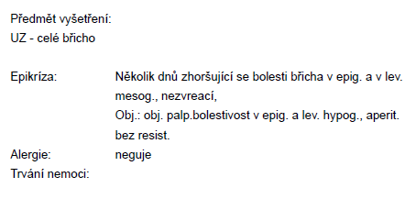
Abdominal ultrasound – request
Results of blood tests were not available at the time of ultrasound examination.

Slide 4
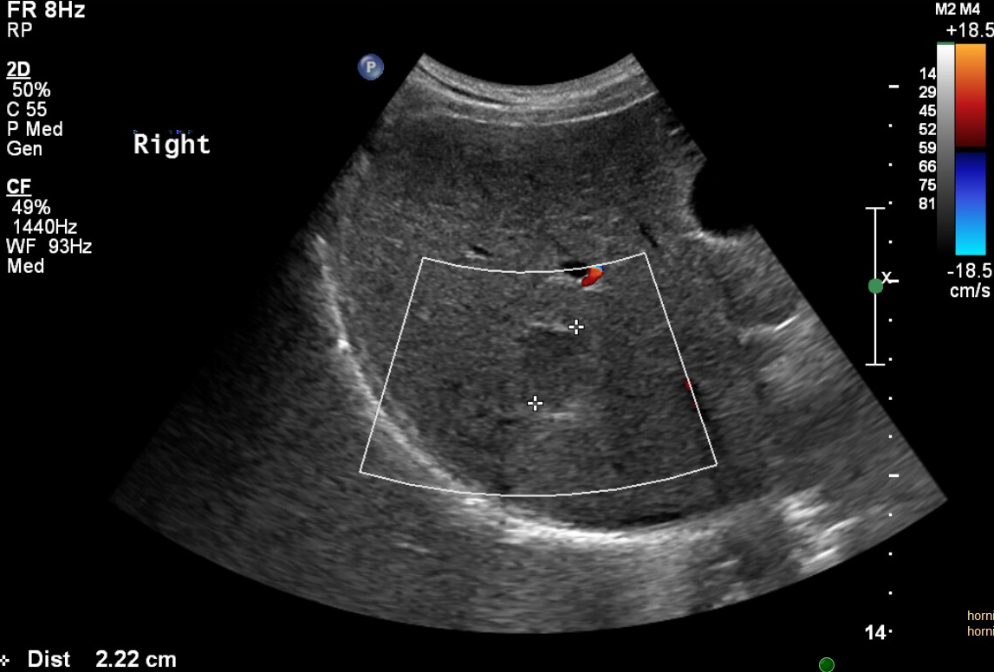
Abdominal ultrasound – summary
2 hypo-isoechoic liver tumors (image) – on the ground of weight loss (patient asked during ultrasound examination) metastasis was considered, but benign etiology is also possible. Because of emergency examination contrast agent was not administered and therefore the etiology could not be specified. Pancreas was not visible due to artefacts (gas) from bowels.

Slide 5
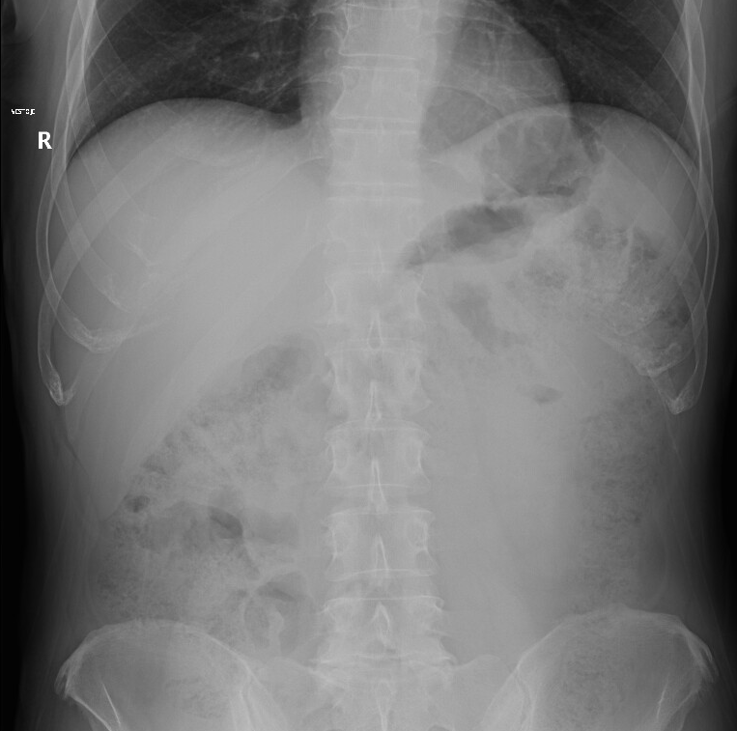
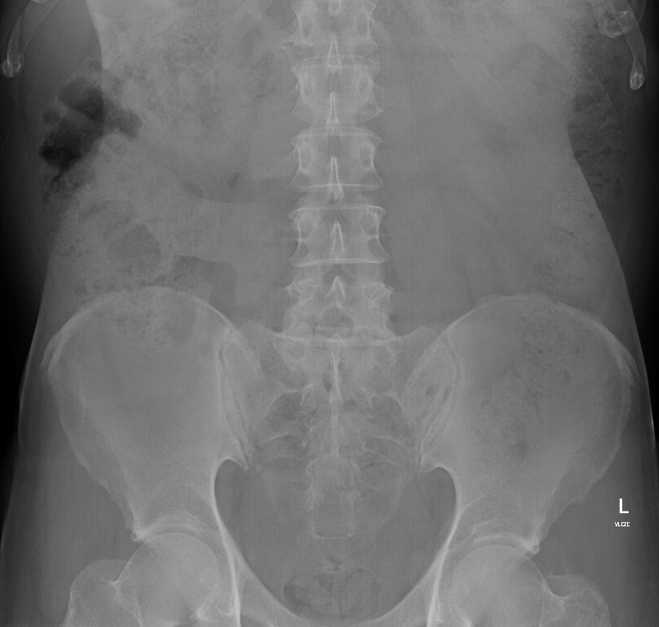
Abdominal X-ray - summary
No signs of pneumoperitoneum or bowel obstruction.
UPRIGHT – no pneumoperitoneum
SUPINE – no dilation of bowel loops

Slide 6
Blood test
Bi-celk. 5.7 umol/l, ALT 0.36 ukat/l, AST 0.31 ukat/l, GGT 0.76 ukat/l, ALP 1.21 ukat/l, AMS 0.63 ukat/l,
Glukóza 13.3 mmol/l, CRP less than 1.0,
Urea 3.3 mmol/l, Kreat. 70 umol/l
Clical signs + X-ray + Ultrasound of the abdomen + blood test does not indicate acute abdomen.

Slide 7
Evaluation of weight loss and liver tumor
Oncomarkers (elevation of CA19-9 4238 kU/l – suspected tumor of pancreatobiliary origin)
Deterioration of blood tests during following 10 days: Bi-celk. 94.1 umol/l, ALT 11.33 ukat/l, AST 8.59 ukat/l, GGT 27.25 ukat/l, ALP 8.26 ukat/l
CT focused on pankreas and liver tumors was indicated.

Slide 8
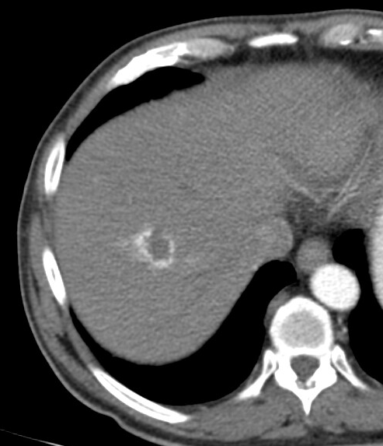
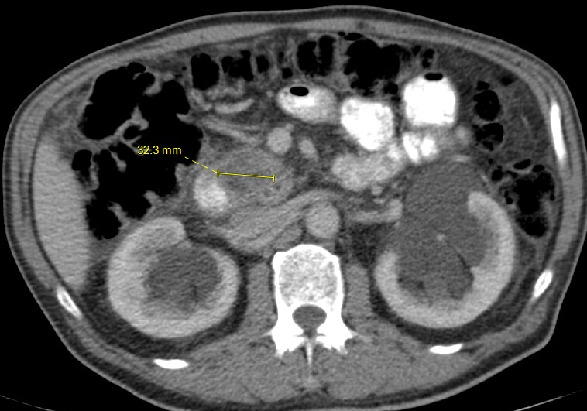
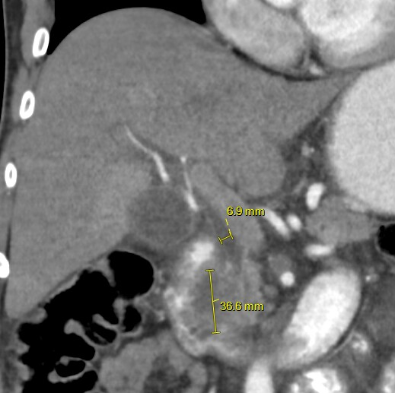
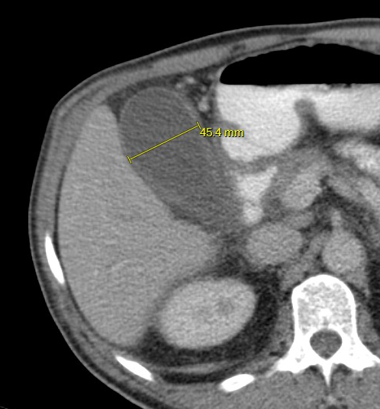
CT of the abdomen - summary
Tumor of pancreatic head infiltrating the duodenum, in close contact with inferior vena cava. Regional lymfadenopathy.
Two liver tumors characterised like hemangiomas.
Abdominal CT in arterial phase – tumor with granular enhancement on the periphery – typical of hemangioma
Abdominal CT in arterial CT (right) and portal phase (left) – hypodense tumor of pancreatic head bulging into the duodenum (in duodenum is positive perorally administered contrast). Portal vein (asterixis) and superior mesenteric artery (circle) without signs of infiltration. Borderline width of ductus hepatocholedochus (width 7 mm, normally up to 7 mm).Regional lymfadenopathy (triangle). Bilateral parapelvic cysts of the kidneys.
Abdominal CT in portal phase – voluminous gall bladder is one of thee typical signs of pancreatic head tumor. Width of gallbladder is normally up to 4 cm (in the image is 4,5 cm).
CT with intravenous contrast is suitable method for diagnosis and staging of pancreatic cancer.
Intravenous contrast is necessary for characterisation of liver tumors on CT.

Slide 9
Follow-up
Presentation on tumor board.
Tumor board recommends surgical revision, becasue there were no signs of distant metastasis and infiltration of portal vein and superior mesenteric artery on CT.
But during surgery the tumor was found to be curatively unresectable, sample for histopathology was taken (low grade adenocarcinoma) and paliative bypass surgery was performed (Roux en Y with choledochojejunal anastomosis, gastroenteroanastomosis and enteroenteroanastomosis).
Paliative chemotherapy was indicated.

Slide 10
Summary
Pancreas is not always visible on ultrasound (visibility is limited in obese patiens and due to gas in stomach and transverse colon).
If pancreatic tumor is suspected, CT with intravenous contrast is indicated.
CT is suitable method for staging of pancreatic cancer.
Intravenous contrast is necessary for characterisation of liver tumors on CT.

