Slide 1
Ankle – Brachial index (ABI).

Slide 2
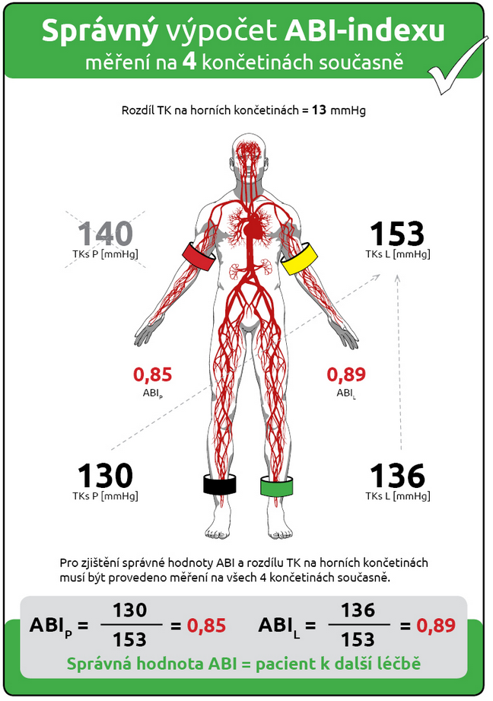
Ankle – Brachial Index
The Ankle – Brachial Index (ABI) is a non-invasive diagnostic method providing information about the ratio of arterial pressures in the upper and lower extremities.
Under physiological conditions in the lying position, blood pressure in the upper and lower limbs has the same value.
ABI is a quick and easy way to detect peripheral artery disease (Peripheral artery disease = PAD).
PAD is a common circulatory problem in which narrowing of the arteries reduces blood flow to the extremities, usually the legs. It is commonly caused by atherosclerosis.
The ABI index is determined separately for each lower limb.
  the normal value of the ABI index is 1.00 – 1.29
  the cut-off value of the ABI index is 0.91 – 0.99
  the clearly pathological ABI value (indicative of the presence of PAD) is below 0.9
$$ABI=\frac{Systolic pressure in the lower limb }{Higher systolic pressure from both upper extremities }$$

Slide 3
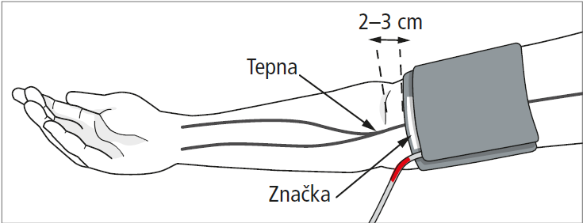
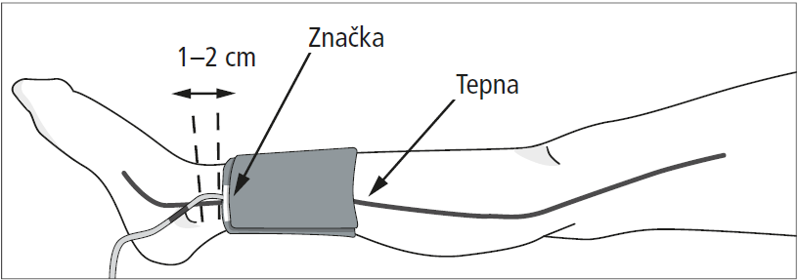
Preparation of ABI measurements
Measurements must be taken with the patient in a supine position in order to obtain comparable pressure conditions for the upper and lower extremities.
The legs must not be crossed.
Before starting the measurement, the patient must lie still for about 5 minutes.
Put on the individual cuffs according to their colour coding on the air connection hoses: red – right arm above the elbow, yellow – left arm above the elbow, green – left leg above the ankle, black – right leg above the ankle.
Attach the upper arm cuffs so that the lower edge of the cuff is about 2-3 cm above the elbow socket. The cuff must be positioned so that the marking (white stripe) is located above the brachial artery.
Brachial artery
white stripe
Fit the ankle cuff so that the bottom edge of the cuff is about 1-2 cm above the ankle. Place the cuff so that the white stripe is located on the posterior tibial artery.
white stripe
a. tibialis posterior

