Slide 1
Systolic time intervals
Apex beat
Heart sounds
Physiology – practice
Spring, weeks 7th-9th

Slide 2
Apex beat, heart sounds
Examination of external manifestations of cardiac activity using the senses:
Inspection
  Configuration of the anterior chest - chest shape, postoperative scars and visible pulsations in this area
Palpation
  Apex beat, heaves (systolic lifting of the sternum and left parasternal region), thrills (palpable vibration - murmur)
Percussion
  Very approximate determination of heart size
Auscultation

Slide 3
Apex beat
The area where the heart apex is in the contact with the chest wall (1-2 cm medially from the midclavicular line in the 4th or 5th intercostal space
Localization of the maximal apex beat – palpation, inspection
Examined mostly in the supine or half-sitting position
A change in position of the maximal apex beat to the left + visible apex beat – signs of hypertrophy and dilatation of the left ventricle

Slide 4
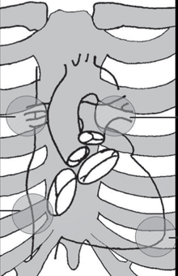
Heart sounds – auscultation
Right Left
Ear
Stethoscope
  Bell
  Diaphragm
Microphone – phonocardiography
Aortic valve
Pulmonary valve
Tricuspidal valve
Mitral valve
Heart valves auscultation points

Slide 5
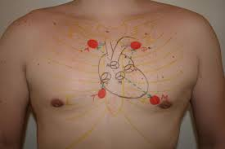
Heart sounds – auscultation points
Aortic valve:
  2nd intercostal space at the right sternal edge
Pulmonary valve:
  2nd intercostal space at the left sternal edge
Mitral valve:
  5th intercostal space in the midclavicular line = a site of apex beat
Tricuspidal valve:
  5th intercostal space at the lower right sternal edge

Slide 6
Heart sounds – phonocardiogram
1st sound: mitral and tricuspis valve closure
2nd sound: aortic and pulmonary valve closure
  Systolic pause: between 1st and 2nd heart sound
  Diastolic pause: between 2nd and 1st heart sound
3rd sound: at the beginning of diastole, rarely heard mainly in young and athletes, in people older than 30 y. almost always a sign of pathology – dilated left ventricle
4th sound: atrial systole, very rarely in children, in adlts always pathological – hypertrophic left ventricle
QRS
P
T
ECG
I
II
IV
III
phonocardiogram
0
0.4
0.8 s

Slide 7
First heart sound (S₁)
As a result of the filling of the ventricle with blood flowing from the atrium, the pressure in the ventricle increases to above the pressure in the atrium, which leads to the closure of the cusp valves (mitral and tricuspid) and simultaneous oscillation of the valvular apparatus
Low-frequency sound, almost only from the mitral valve
Can be heard about 50 ms after the beginning of the QRS complex, duration of around 100 ms
Is best heard above the apex in the left supine position
CLINICALLY IMPORTANT: assessment of the loudness of the sound, in particular the finding of a clear increase or attenuation, or split of the first sound

Slide 8
Second heart sound (S₂)
Rapid vibrations of the aortic and pulmonary valves, associated with their closure
A high-frequency sound that has two components – pulmonary and aortic, pulmonary one delays behind the aortic one, especially during deep inhalation
Is best heard above the apex in the left supine position
CLINICALLY IMPORTANT: assessment of the loudness of the sound, in particular the finding of a clear increase or attenuation, or fixed split of the second sound

Slide 9
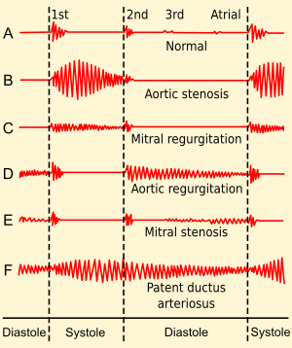
Murmurs
Heart murmurs are produced as a result of turbulent flow of blood strong enough to produce audible noise. They arise mainly in places where the heart cavity or vessels are either narrowed or have an uneven surface.

Slide 10
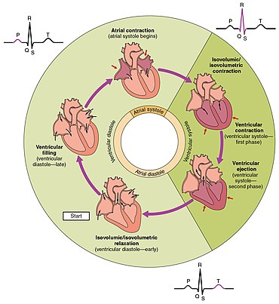
Cardiac cycle
Isovolumic contraction (IVC):
  Contraction of ventricular myocardium leads to an increase in intraventricular pressure, AV valves close around 50 ms after the beginning of QRS, it produces 1st sound
Ejection (E):
  Intraventricular pressure overcomes diastolic pressure in big arteries, semilunar valves open, and blood flows to the arteries
Isovolumic relaxation (IVR):
  Semilunar valves close, rapid decrease in intraventricular pressure even below pressure values in atria, AV valves open
Inflow (I):
  Rapid inflow phase, slow inflow phase (ventricular diastole), atrial systole

Slide 11
Cardiac cycle phases: PV (Wiggers) diagram
Systole = IVC + E
P [mmHg]
IVC = 0.06 s
E = 0.21 s
SBP
120
E
Diastole = IVR + I
IVR = 0.07 s
I = 0.49 s
100
DBP
80
IVR
IVC
I
10
0
50
120
V [ml]
ESV
EDV

Slide 12
Polygraphy
Simultaneous recording of several physiological parameters using various non-invasive or invasive methods
Phonocardiography – a graphical recording of heart sounds
Electrocardiography – recording of cardiac electrical activity
Sphygmography – a graphical record of the arterial pulse
!notice: Pulse recorded on a. carotis is shifted in time in relation to aortal pulse!

Slide 13
Polygraphy
IVC
E
IVR
I
IVC
E
IVR
R
R
P
T
P
T
ECG
Q
S
Q
S
Phonocardiograpy
S₁
S₂
S₁
S₂
SBP
SBP
Sphygmography
aorta
DBP
DBP

Slide 14
Polygraphy
QRS
P
T
ECG
EML
EML – electromechanical latency
IVC – isovolumic contraction
LVET – left ventricular ejection time
PEP – pre-ejection period (EML+IVC)
S₁
S₂
S₃
S₄
phonocardiogram
diastole
systole
diastole
SBP
IVC
PEP
Dicrotic notch
The sphygmogram (SpG) corresponds to the shape of the blood pressure curve, but with sphygmography, it is not possible to measure blood pressure values.
Pressure in aorta
DBP
LVET
sphygmogram
0
0.4
0.8 s

Slide 15
QRS – ventricular depolarization
T – ventricular repolarization
P – atrial depolarization
ECG
2nd sound – aortic and pulmonary valves closure
1st sound – atrioventricular valves closure
Phonocardiogram
Blood pressure (mmHg)
Dicrotic notch – aortic and pulmonary valves closure
115
Systolic BP
Systolic BP
100
BP in aorta
Diastolic BP in aorta
80
AV valves closure
BP in left ventricle
Atrial contraction
5
BP in left atrium
Diastolic BP in ventricle
0
0.4
0.8 s
I – inflow
IVC – isovolumic contraction
E – ejection
IVR – isovolumic relaxation
Diastole
Systole
Diastole
Inflow
IVC
Ejection
IVR
Inflow

Slide 16
Polygraphy – in practicals
QRS
P
T
ECG
The pressure wave in the carotid artery is time-shifted compared to the wave in the aorta
EML
I
II
phonocardiogram
diastole
mech. systole
diastole
SpG in aorta
Sphygmogram in carotid
LVET
electromechanical systole
0
0.4
0.8 s

Slide 17
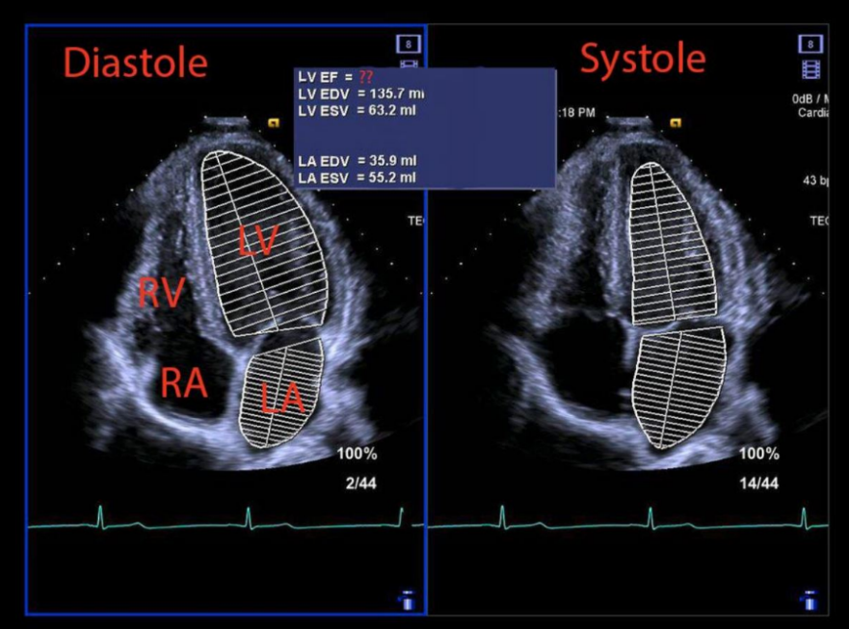
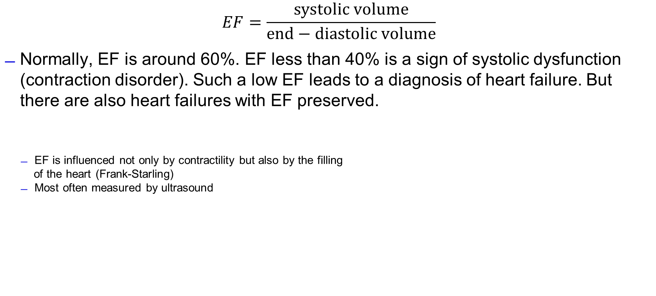
Cardiac contractility indexes – ejection fraction (EF)
$$EF=\frac{systolic volume}{end−diastolic volume}$$
Normally, EF is around 60%. EF less than 40% is a sign of systolic dysfunction (contraction disorder). Such a low EF leads to a diagnosis of heart failure. But there are also heart failures with EF preserved.
  EF is influenced not only by contractility but also by the filling
  of the heart (Frank-Starling)
  Most often measured by ultrasound
https://www.kardio-cz.cz/data/upload/doporucene_postupy/2016/Doporucene_postupy_pro_diagnostiku_a_lecbu_akutniho_a_chronickeho_srdecniho_selhani_2016.pdf
https://www.chegg.com/homework-help/questions-and-answers/4-look-screen-echocardiography-heart-ultrasound--look-calculated-volumes-heart-chambers-ca-q45835869

Slide 18



Cardiac contractility indexes
Relationship between end-diastolic BP (EDBP) and end-diastolic volume (EDV) at rest and during physical exercise
  Systolic dysfunction – increase in EDV and EDBP during exercise compared to at rest
  Diastolic dysfunction (relaxation disorder) – EDBP increases in exercise, EDV does not change
Contractility indexes derived from systolic ejection:
$$Emax 1$$
$$Emax=\frac{dP}{dV}$$
$$Emax 2$$
Sagawa-Suga index
B1
B2
A: normal P-V diagram
B: P-V diagram for artificially increased afterload
1: healthy heart
2: failing heart
A

Slide 19
Cardiac contractility indexes – ∆ P/∆ t
Contractility indexes derived from isovolumic systolic phase:
  In clinical practice, we determine the fastest velocity of increase in pressure during IVC (just before opening of semilunar valves – at the end of IVC)
  In practicals, we determine a mean velocity of increase in pressure during IVC:
$$\frac{∆P}{∆t}=\frac{pressure difference between the end and the start of IVC }{time duration of IVC}=\frac{DBP − 8 }{IVC }$$
∆ P/∆ t
IVC
(8 mmHg corresponds approximately to the pressure at the end of the diastole, also approximately to the pressure in the left atrium)
115
∆t
100
BP in aorta
A slowed increase in ventricular pressure during IVC is a sign of impaired cardiac contractility
DBP: 80
∆P
BP in left ventricle
EDBP: 8
0
0.4
0.8 s

Slide 20
Cardiac contractility indexes – LVET and PEP
The ratio of LVET to PEP – shortening of LVET and prolongation of PEP is a sign of decreased cardiac contractility.
  The heart spends most of its energy on reaching the opening pressure, and there is no energy left for blood ejection
IVC
LVET
failing heart
IVC
LVET
healthy heart
115
100
BP in aorta
failing heart
80
BP in left ventricle
8
0
0.4
0.8 s

