Slide 1
Measurement of basal metabolic expenditure
Compiling daily diet
Evaluation of nutritional state
Physiology II – practice
Spring, weeks 1–3

Slide 2
Measurement of basal metabolic expenditure using indirect calorimetry and calculation

Slide 3
Metabolism
All chemical and energy transformations in the body
In relation to food: energy and chemical transformations after food intake (includes processing, digestion, absorption and distribution to cells)
A living organism oxidizes nutrients to produce H₂O, CO₂ and energy needed for life processes
  Catabolism: a complex, gradual process of decomposing substances into simpler compounds, with the release of energy. Energy is released as heat or as chemical energy (stored in macroergic compounds, e.g. ATP)
  Anabolism: process of formation of more complex substances from simpler ones, with a consumption of energy

Slide 4
Calorimetry
Calorimetry – a measurement of heat released in the studied system during a certain process (chemical, physical, biological)
  Heat = energy, unit joule (J)
Assessment of animal metabolism: based on the assumption that all metabolic processes are accompanied by heat production
  Food metabolism is almost equivalent to direct food oxygenation (burning)
Direct calorimetry – measurement of direct heat with a calorimeter
  Heat caused by food burning with a sufficient supply of oxygen
  Heat emitted by the metabolising animal with a sufficient supply of oxygen

Slide 5
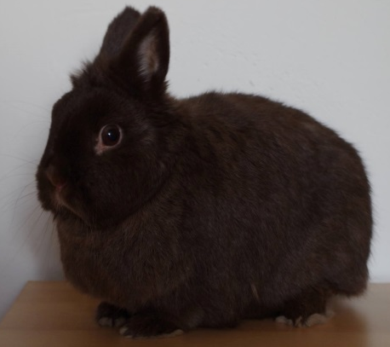
Direct calorimetry
Technically more difficult
If used in animals, then only in small ones
Isothermal calorimeter
  The temperature does not change during the experiment. The generated heat is removed, and it causes, for example, a phase transformation of a matter (ice into water)
Air income
Air outcome
water
thermoisolation

Slide 6
Heat of combustion
Total energy released as heat when a 1 g of substrate undergoes complete combustion with oxygen – energy of a 1 g of substrate
  Physical heat of combustion – energy created via burning the substrate
  Physiological heat of combustion – energy created via substrate oxidation by a living organism
Carbohydrates and fats: physiological = physical heat of combustion
Proteins: physical > physiological heat of combustion
  The burning of proteins produces nitrogen oxides. Proteins metabolism produces urea which contains a part of the chemical energy
Combustion heat of nutrients:
  Carbohydrates = 17.1 kJ/g
  Fats = 38.9 kJ/g
  Physical combustion heat of proteins = 23 kJ/g
  Physiological combustion heat of proteins = 17.1 kJ/g

Slide 7
Indirect calorimetry
Principle: O₂ consumption, CO₂ output and waste of nitrogen metabolites are related to energy consumption
  Possibility to measure it in the open or closed system
  In practicals – Krogh spirometer (equipped with soda lime – ensures absorption of CO₂)
Caloric (energy) equivalent of oxygen (EE) – energy related to litre of oxygen
  The amount of energy that is released when consuming 1 liter of oxygen
  Universal constant for calculating energy expenditure in a mixed diet
  EE = 20.19 kJ / litre O₂
EE of nutrients:
  Glucose 21.4 kJ / litre O₂
  Proteins 18.8 kJ / litre O₂
  Lipids 19.6 kJ / litre O₂

Slide 8
Respiratory quotient (RQ)
Ratio: CO₂ produced / O₂ consumed
Provides information about the processed substrate
  Saccharides : RQ = 1 – the same ratio of C and O as in water and CO₂
  Lipids: RQ = 0.7 – contain less oxygen
  Proteins: RQ = 0.8 - 0.9 - more complicated because urine must be taken into account
  Mixed food: RQ = 0.85
  Glucogenesis: RQ ≈ 0.4
  Lipolysis: RQ ≈ 0.7
  Lipogenesis: RQ ≈ 2.75
  Fasting, starvation: RQ <0.85 – lipolysis, gluconeogenesis
Other factors affecting RQ
  Hyperventilation RQ > 1 – CO₂ is exhaled
  During exercise or metabolic acidosis RQ > 1
  Hypoventilation or metabolic alkalosis: RQ < 0.7
  Particular organs – brain RQ = 0.97-0.99 (glucose consumption), stomach RQ < 1

Slide 9
Nitrogen balance
The ratio between the nitrogen ingested in the diet (proteins, amino acids) and the excreted nitrogen (mainly in the urine)
  Indicator of protein and amino acid decomposition or new tissue formation (protein incorporation)
Negative nitrogen balance
  Nitrogen is more excreted than consumed
  Sign of protein and amino acid degradation
  Starvation, forced long-term immobility, lack of some essential amino acids, tissue breakdown (extensive injuries, burns, tumor breakdown, postoperative conditions)
Positive nitrogen balance
  Nitrogen is more absorbed than excreted
  Growth, pregnancy, reconvalescence

Slide 10
Basal metabolism
The amount of energy necessary to maintain basic vital functions
Basal energy expenditure (BEE): energy expenditure of the organism under defined – basal conditions:
  Thermoneutral environment
  Physical and mental peace (in the morning before getting out of a bed)
  Protein-free diet 12-18 hours before measurement
BEE varies depending on many factors
  Muscle tissue increases BEE
  Repeated weight loss reduces BEE
The obtained value is only an estimation of the actual energy associated with basal metabolism
  Resting energy expenditure – measurement of expenditure in clinical conditions, when it is not possible to exactly meet all basal conditions – slightly higher than BEE

Slide 11
Measurement of O₂ consumption in practicals
Inspirium
(the respirometer reservoir is descending)
volume (L)
Total O2 consumed during resting
Oxygen from the respirometer is metabolized, CO₂ is captured by soda lime → O₂ consumption is measured as the loss of O₂ in the respirometer
Expirium
(the respirometer reservoir is rising up)
The slope of the volume decrease in spirometer v_{n} (L/s)
= consumtion of O₂ per time
The total amount of oxygen consumed after the exercise
A curve describing a volume changes in Krogh respirometer while breathing
while lying at rest
after exercise
time (s)

Slide 12
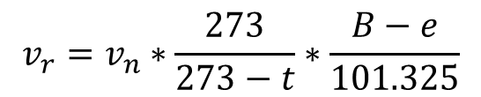
Actual energy expenditure (AEE)
Expenditure measured under current conditions
In practicals: AEE
  While resting (≠ resting energy expenditure!) – lying down
  While standing
  After exercise – walking on the steps for 5 min
Determine
  v_{n} – consumption of O₂ (L/s)
  v_{r} – value corrected to 0°C a 101,325 kP (L/s)
    t: temperature °C, B: barometric pressure kPa (1 mmHg = 0.133 kPa), pressure of water vapour kPa (in the table)
Calculate AEE (error of the calculation is aprox. 8%)
  AEE (kJ/s) = 20.19 * v_{r}
  AEE (kJ/day) = 20.19 * v_{r} * 86400
$$v_{r}=v_{n}∗\frac{273}{273−t}∗\frac{B−e}{101.325}$$

Slide 13
Calculation of energy expenditure via equation
Basal energy expenditure (BEE) – Harris-Benedict equation
  Man (kcal/day)
  Woman (kcal/day)
  m: weight (kg), h: height (cm), r: age (years)
BEE (kJ/day) = BEE (kcal/day) * 4.184
AEE (kJ/day) = BEE * AF * TF * IF
  Basal energy expenditure (BEE, kJ/day)
  Activity factor (AF) – in practicals: healthy (AF = woman 1.55; man 1.6)
  Temperature factor (TF) – normal (TF = 1)
  Injury factor (IF) – no injury (IF = 1)
  Increased temperature and damage increases AEE
The BEE and AEE calculation is just an estimation of a real value. The equation was based on statistical evaluation but two people with the same parameters will never have the same AEE, only similar. For example, the equation does not take into account the composition of body mass, the proportion of muscle
and fat, and the individual metabolism.
$$BEE=66+13.7∗m+5∗h−6.8∗r$$
$$BEE=655+9.6∗m+1.7∗h −4.7∗r$$

Slide 14
Conclusion
Compare the calculated BEE and the measured AEE while lying down and after exercise
Expected results:
BEE < AEE resting < AEE after exercise
Explain observed results
It might happen :
BEE ≥ AEE resting
Explain

Slide 15
Compiling daily diet
Principles of proper nutrition

Slide 16
Principles of proper nutrition
Energy intake and expenditure should be in balance
Try to maintain adequate body weight (according to BMI and waist circumference)
Eat at least 3 times a day at regular intervals (every 3-4 hours) – the number of meals depends on the total energy intake
Exercise regularly – at least 30 minutes of mild physical activity at least 5 times a week (or 30 minutes of intermediate physical activity 3-4 times a week)

Slide 17
Principles of proper nutrition
The diet should be varied – it should include:
  All the necessary nutrients (proteins, fats, sugars) of the right composition, energy value and ratio
  Vitamins
  Minerals in the optimal amount
  Water
  Fibre
To limit
  Alcohol <30 g/day
  Limit your intake of canned food and semi-finished products, fried foods and sausages (probably important factors causing diabetes mellitus type II)
  NaCl <5 g/day
  Cholesterol <300 mg/day
  Other factors – optimal dining culture
  and don't smoke!

Slide 18
Daily diet
For assessment of food intake:
  Determination of caloric intake, diet composition, distribution of food during the day
For therapeutic intervention:
  Daily diet plan according to the individual needs and the principles of proper nutrition, adjusting the diet regarding diseases, health status, allergies, activity, weight adjustment
The table should contain
  Food
  Meal time
  Amount in g
  Energy value of food in kJ
  Ingredients – proteins, fats, sugars
  Vitamins, minerals
  Resulting values of all parameters and recommended daily doses
  Ideally calculated daily energy expenditure for an approximate comparison with income
  Specific dynamic effect of nutrients

Slide 19
Nutrients
Recommendation: 10% proteins, 26% lipids, 64% carbohydrates
(alcohol is also a source of energy, but not recommended)
Protein – RDA adults: 0.8–1.2 g/kg, children: 1.2-1.5 g/kg
  Must contain all the essential amino acids in the correct ratio suitable for the synthesis of new proteins – intake replaces 20-30 g of proteins that are daily degraded
  Animal proteins have a balanced ratio of amino acids, plant proteins often lack some amino acids – a plant diet is more difficult to compile
  Function: structural, signalling (hormones, receptors), as a source of energy only exceptionally (during starvation).
Saccharides – RDA adults: 4-6 g/kg
  The fastest energy source (17.1 kJ/g), mainly of plant origin.
  Usable carbohydrates – 64% of energy intake (simple saccharides should be <10%)
  Unusable carbohydrates – indigestible, part of fibre (mainly cellulose), RDA 25-35 g/day – GIT motility support

Slide 20
Nutrients
Fats: RDA adults 1g/kg
  The largest source of energy (38.9 kJ/g) – mainly storage functions
  Other functions – fat-soluble vitamins, building, thermoregulation (brown adipose tissue, isolation), mechanical protection of organs and bones
  Optimal ratio of fats in the diet: 10% saturated fatty acids (FA), 10-12% monounsaturated FA, 8-10% polyunsaturated FA
  Cis-configuration FA – vegetable and most animal fats.
  Trans-configuration – dairy products, beef and mutton, industrially hardened fats (margarine) – increase in LDL-cholesterol concentration
  Cholesterol (animal products only) – a structural component of brain tissue, cell membranes, steroid hormone precursor, vit. D, bile acids - 4% of total cholesterol circulates in the blood.
  75% of cholesterol is produced in the liver, 25% is obtained from food
  Specific dynamic effect of nutrients (SDE): the energy needed for nutrient processing, about 10% of the energy from consumed mixed foods (proteins have a higher SDE than glucose)

Slide 21
Metabolic syndrome (MS)
MS is a cluster of 3 or more of the following conditions together
  Obesity: waist circumference >102 cm in men, >88 cm in women
  Dyslipidemia: TAG >1.7 mmol/L
  HDL <1 mmol/L in men, <1.3 mmol/L in women
  Hypertension: BP >130/85 mmHg or treatment
  Hyperglycaemia: fasting glycaemia >5.6 mmol/L ← insulin resistance, diabetes II. type (DM II)
  Czech Republic: 32% men, 24% women, mainly in the elderly population
  Genetic predisposition (mainly insulin resistance) and poor lifestyle (higher energy intake, lack of exercise)
  Significant pro-inflammatory, procoagulatory and proatherogenic state, the risk for cardiovascular diseases is higher than the risk caused by the simple sum of the risks of its individual risk factors – all factors mutually support each other
  Consequences: reduced quality of life and life expectancy: DM II with complications, cardiovascular and cerebrovascular thrombotic events (heart attack, stroke, embolism)
  It is a complex disease of the whole organism

Slide 22
Diabetes mellitus (DM)
It includes a heterogeneous group of chronic metabolic diseases, the basic manifestation is hyperglycemia.
It is caused by a lack of insulin, its lack of effect (sometimes referred to as relative deficiency) or a combination of both.
Impairment of glucose transport from the blood to the cell through the cell membrane → hyperglycaemia and glucose deficiency intracellularly
  DM I – starts in childhood, autoimmune destruction of pancreatic beta-cells – insulin substitution required, absolute insulin deficiency
  DM II – in adulthood, insulin resistance (insensitivity) of target tissues (insulin resistance), relative insulin deficiency
DM complicates treatment, increases the risk and worsens the other diseases, worsens healing. As a result, DM is a disease also of the cardiovascular system

Slide 23

Protocol: prepare before your lesson!
Write the weight, height, age and gender of the person for whom you will compile the menu
Calculate his/her daily energy expenditure
Compile the daily diet on www.myfitnesspal.com
Print the menu, write down BEE and AEE calculated based on weight, height, age and gender and daily activities. Copy BEE and AEE in the protocol (not printed automatically)
Write in the protocol:
  Sum of received energy, nutrients, minerals and vitamins
  Specific dynamic effect of nutrients (SDE)
  Recommended values of all monitored parameters
  Compare energy intake and expenditure, received and recommended daily doses of nutrients, minerals and vitamins. Evaluate whether the subject's diet is correct,
  describe the mistakes and suggest improvements
AEE + SDE
Energy intake
(BEE + daily activity)

Slide 24
Evaluation of nutritional status

Slide 25
Obesity
Obesity – excessive storage of energy reserves in the form of fat. Energy intake is for various reasons higher than expenditure.
  CZ adults: 35% overweight, 17% obese – more in men
  children 6-12 years: 10% overweight and 10% obese; 13-17 years together 11%
Obesity is caused by a combination of factors – rarely just one factor
  A combination of higher energy intake, lack of exercise
  Hereditary influences – genetic (usually only predisposition, purely genetic cause is rare)
  Psychological influences – distress, depression
  Prenatal influences (mother's behaviour during pregnancy, diabetes, obesity – prenatal programming), delivery, early childhood, learned eating habits
  Endocrine diseases – hypothyroidism, Cushing disease
  It can be the result of other illnesses or injuries
  Consequence of treatment – some antidepressants
  Low socioeconomic status, lack of nutritional education
  The problem from the healthcare professional's point of view: more demanding
  patient handling, a complication in the treatment of other diseases

Slide 26
Malnutrition
Malnutrition is a disease caused by insufficient intake of nutrients, inability to absorb nutrients in diseases of the digestive tract, excessive catabolism of nutrients (septic shock), serious diseases (oncological), nauzea,…
Even the obese patients can be malnourished – despite their high energy intake, some nutrients may be lacking
  In western countries, the cause is not a lack of food, but rather a poor diet, eating disorders, diseases causing impaired absorption and processing of nutrients

Slide 27
Adipose and muscle tissue
Lipolytic hormones (and increasing glycaemia):
Adrenalin, Noradrenalin, Somatotropin, Glucagon, ACTH, Prolactin, Glucocorticoids
Body mass: active (muscles) and passive (fat)
  Slow weight gain with increasing age is physiological (insulin sensitivity decreases, slower metabolism). Being overweight in old age (from about 65 years) is not harmful if it is the result of slow weight gain (about 0.25 kg/year).
Types of adipose tissue
  White subcutaneous – not harmful (within physiological values)
  White abdominal – "beer belly" (between the abdominal organs) – strongly hormonally and metabolically active, production of pro-inflammatory factors, high cardiovascular risks – greater incidence in men
  White organ adipose tissue – protection/storage in some organs – around the kidneys, around the heart, pancreas, in the liver – useful (within physiol. values) – mobilization faster than subcutaneous (during weight loss)
  Brown adipose tissue – thermogenic – mainly in young children, rarely present in some adults between the shoulder blades and on the neck (useful, overweight prevention)
    Beige adipose tissue – white containing a lot of mitochondria – a consequence of physical activity.
    Newly discovered pink adipose tissue – can differentiate into other cells, the mammary gland

Slide 28

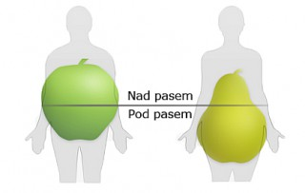
Adipose and muscle tissue – gender difference
Men have a larger portion of muscles, it is easier to increase muscle tissue (testosterone), which is a greater energy consumer – easier weight loss
The same BMI in men and women has different risks – the similar risk of developing diabetes in women is usually at a much higher BMI than in men
Different stages of weight gain – women during pregnancy and after menopause, men during lifestyle change (starting a family, divorce, change of job)
Android type of fat storage (apple)
  Accumulation of fat in the abdomen, subcutaneous tissue and
  between organs
  More harmful (higher cardiovascular risks)
  Gynoid type of fat storage (pear)
  Storage in the thighs and buttocks – the function is storage
  Energy for pregnancy and breastfeeding (lower cardiovascular risk)
Android
Gynoid
Above waist
Below waist

Slide 29
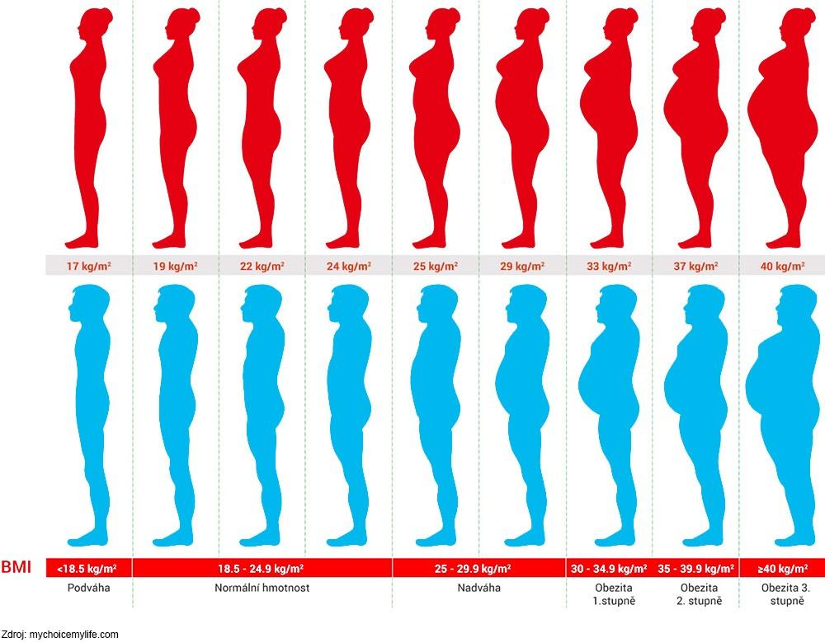
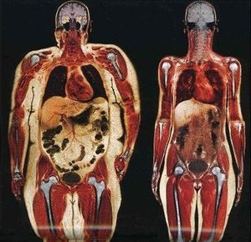
Adipose and muscle tissue
Underweight
Normal weight
Overweight
Obesity
1st gr.
Obesity
2nd gr.
Obesity
3rd gr.

Slide 30
A relatio between compounds of MS
Dyslipidemia – overweight – hyperglycemia – hypertension
  High LDL → atherosclerosis
Overweight and DM II
  Insulinoresistance
DM II and hypertension
  Hyperglycemia + hyperinsulinemia + dyslipidemia → endothelial dysfunction → higher vascular resistance → hypertension
  Insulin resistance (and hyperglycemia) ↔ sympathetic activity → hypertension
  Hyperglycemia → autonomic neuropathy → blood pressure regulation disorder
  Dyslipidemia – atherogenic process – hypertension
  Atherosclerosis – thrombembolic complications

Slide 31
Healthy life style
Principles of behavior that support our body in maintaining health for as long as possible
Generally: a healthy diet, sufficient exercise, sufficient sleep, a healthy environment (no smog, no smoking), stress management, well-being, etc. (just everything you, as a student or health care professional, have no chance to accomplish)
Slim people without sufficient exercise have worse cardiovascular prognosis than overweight people who exercise (unfit-unfat / fit-fat)
Regular physical activity
  Helps weight loss
  Improves parameters of DM and metabolic syndrome
  Positive effect on the psychical health (important in the therapy of depression)
  Muscle strength (such as a handgrip test) is an important indicator of a patient's ability to recover
  Reduces postprandial inflammation in adipose tissue (immune response that occurs after a meal)

Slide 32
Evaluation of nutritional state
Indices based on anthropometric indicators
Measurement of body fat with a caliper
Measurement of fat in the body by bioimpedance method
Measurement of muscle mass

Slide 33
Indices based on anthropometric indicators
Degree of obesity according to the Broca index
  Based on the calculation of the ideal weight and the percentage of the ideal weight
  Some physiological parameters are estimated based on the ideal weight – for example, the initial setting of tidal volume in mechanical ventilation
Ideal weight:
For men:
  Height (cm) – 100
  Or (height in m)² – 23
For women:
  Height (cm) – 100 – 10%
  Or (height in m)² – 21.5
Index = actual weight/ideal weight x 100
Degree of obesity | % of ideal weight
Mild | 115 – 129
Medium | 130 – 149
Heavy | 150 – 199
Morbid | > 200

Slide 34
Indices based on anthropometric indicators
BMI (body mass index) = weight (kg)/height (m)²
^{For adults}
BMI – various tables for men / women, adults / teens / children
 | man | woman
Underweight | < 20 | < 19
Norm | 20 – 24.9 | 19 – 23.9
Overweight | 25 – 29.9 | 24 – 28.9
Obesity | 30 – 39.9 | 29 – 38.9
Serious obesity | > 40 | > 39

Slide 35
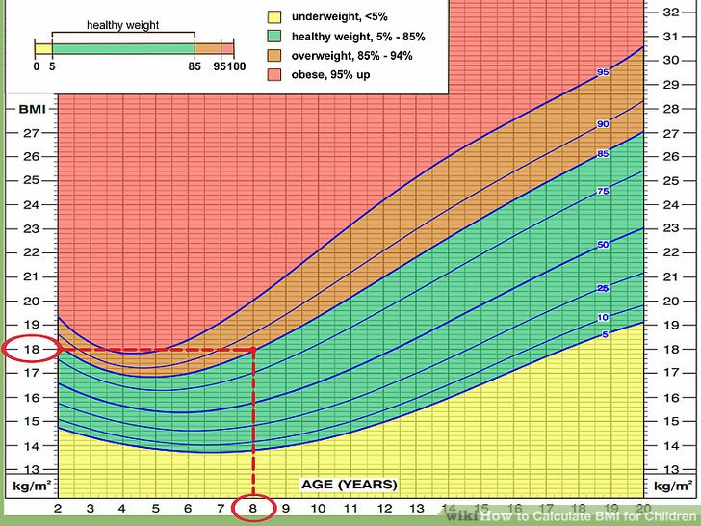
Indices based on anthropometric indicators
Advantages: simple calculation
Disadvantages
  BMI does not take into account the constitution of body mass. A man with great musculature can be in the overweight area of a table without having a nutrition problem
  Broca index uses a linear relationship between height and weight – the index is approximate
  BMI – a quadratic relationship between height and weight – better than Broca, but it is still necessary to use different tables for adults, adolescents and children – BMI 17 is normal at 15 years, but in adulthood it means underweight
  Rohrer‘s index (100 * weight (g) / height (cm)³).
  Weight is determined by volume (the cube of the dimension), so this index is the best.
  More consistent in age. More suitable for children and teenagers.

Slide 36
Waistline, waist/hip ratio
Very simple but effective predictive parameters for nutrition evaluation
Waist/hip ratio
  Men < 1
  Women < 0.8
Waistline in cm
Category | Men | Women
Recommended | ≤ 94 | ≤ 80
Necessary to reduce weight | 95 – 102 | 81 – 90
Weight loss requires medical assistance | > 102 | > 90

Slide 37
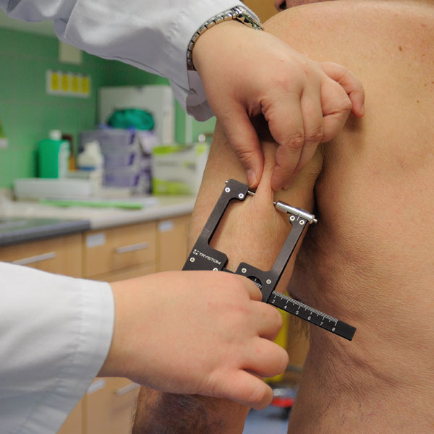
Measurement of body fat with a caliper
The subcutaneous fat layer is measured
It reflects the energy balance of the organism
It does not cover possible differences in the distribution of subcutaneous and visceral fat
The most common place of measurement: the triceps skinfold (other places: above the shoulder blade, the abdomen, the spina iliaca, the thigh, the lower leg)
The triceps skinfold
 | Normal (mm) | Mild to moderate deficit (mm) | Significant deficit (mm)
Women | > 16.5 | 10 – 15 | < 10
Men | > 12.5 | 7.5 – 11 | < 7.5

Slide 38
Bioimpedance method
Measurement of fat portion in the body
Different body tissues have different impedance for very small electric currents (muscle conductivity versus adipose tissue)
The method is based on bioelectrical impedance analysis; the bioelectric impedance (resistance) of the adipose tissue is measured
The ratio of adipose tissue to other tissues is calculated
It depends on the amount of fluid in non-fat tissues – on the hydration of the organism (reason for fluctuations in values during the day if the standard conditions of individual measurements are not observed)
The device can evaluate the % of fat, water and bone tissue

Slide 39
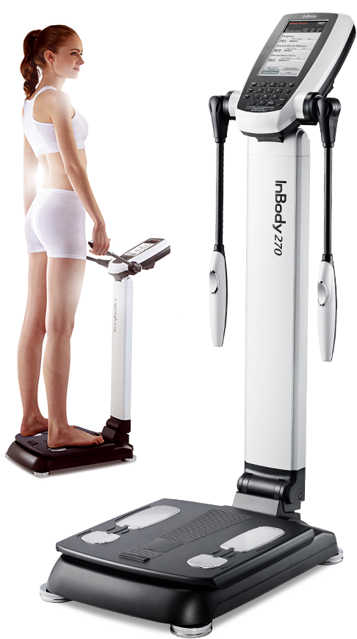
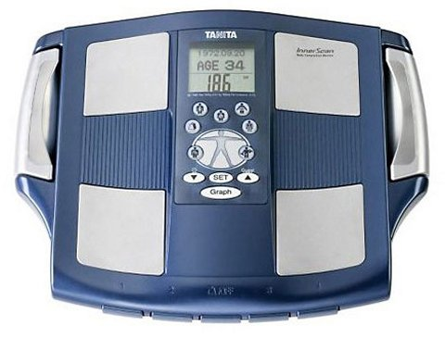
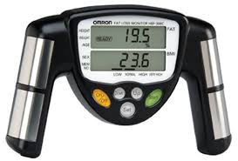
Bioimpedance method
Measurement of fat portion in the body
The handpiece measures the upper half of the body, the scale measures the lower half
Whole body measuring devices are now used

Slide 40
Measurement of muscle mass
Muscle tissue is an important parameter of nutritional status
Arm muscle circumference (OSP) – in cm
Corected area of arm muscle (kPSP) – in cm
  Men
  Women
$$OSP \left(cm\right)=arm circumference−π∙the triceps skinfold$$
$$kPSP= \frac{{\left(arm circumference−π∙the triceps skinfold\right)}^{2}}{4∙π}−10$$
$$kPSP= \frac{{\left(arm circumference−π∙the triceps skinfold\right)}^{2}}{4∙π}−6.5$$
Muscle loss | No loss (cm) | Medium (cm) | Heavy (cm)
Women | > 23.2 | 14.1 – 23.1 | < 14
Men | > 25.3 | 15.1 – 25.2 | < 15
Deficit | No deficit | Mild | Medium | Heavy
Women | > 36.3 | 29.1 – 36.2 | 25.5 – 29.0 | < 25.4
Men | > 40.9 | 32.8 – 40.8 | 28.7 – 32.7 | < 28.6

Slide 41
Conclusion
Evaluation of the nutritional state is an important indicator in all areas of medicine
Both malnutrition and obesity may be detrimental to the human organism
The process of evaluation of nutritional state starts with simple formulas and continues with sophisticated measuring instruments
The results help to set the diet correctly (rational, reducing, high-energy, etc.)

