Slide 1
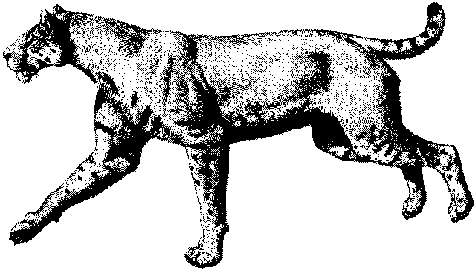
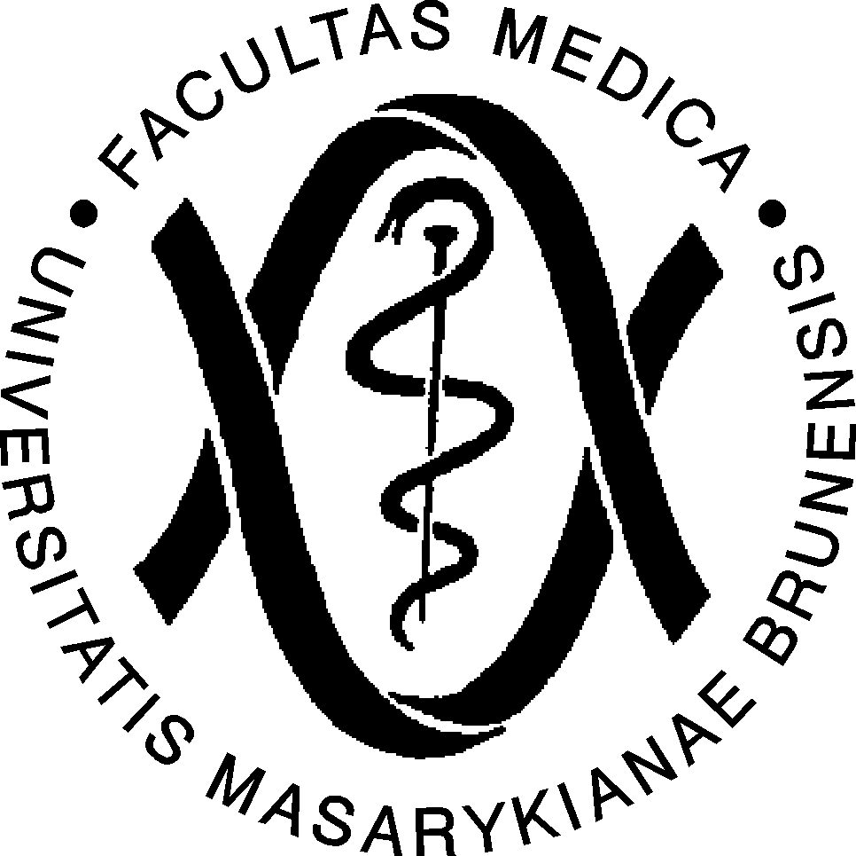

Evolutionary physiology of hard tissues and comparative physiology of adaptations
Miriam Nývltová Fišáková
Department of Physiology

Slide 2
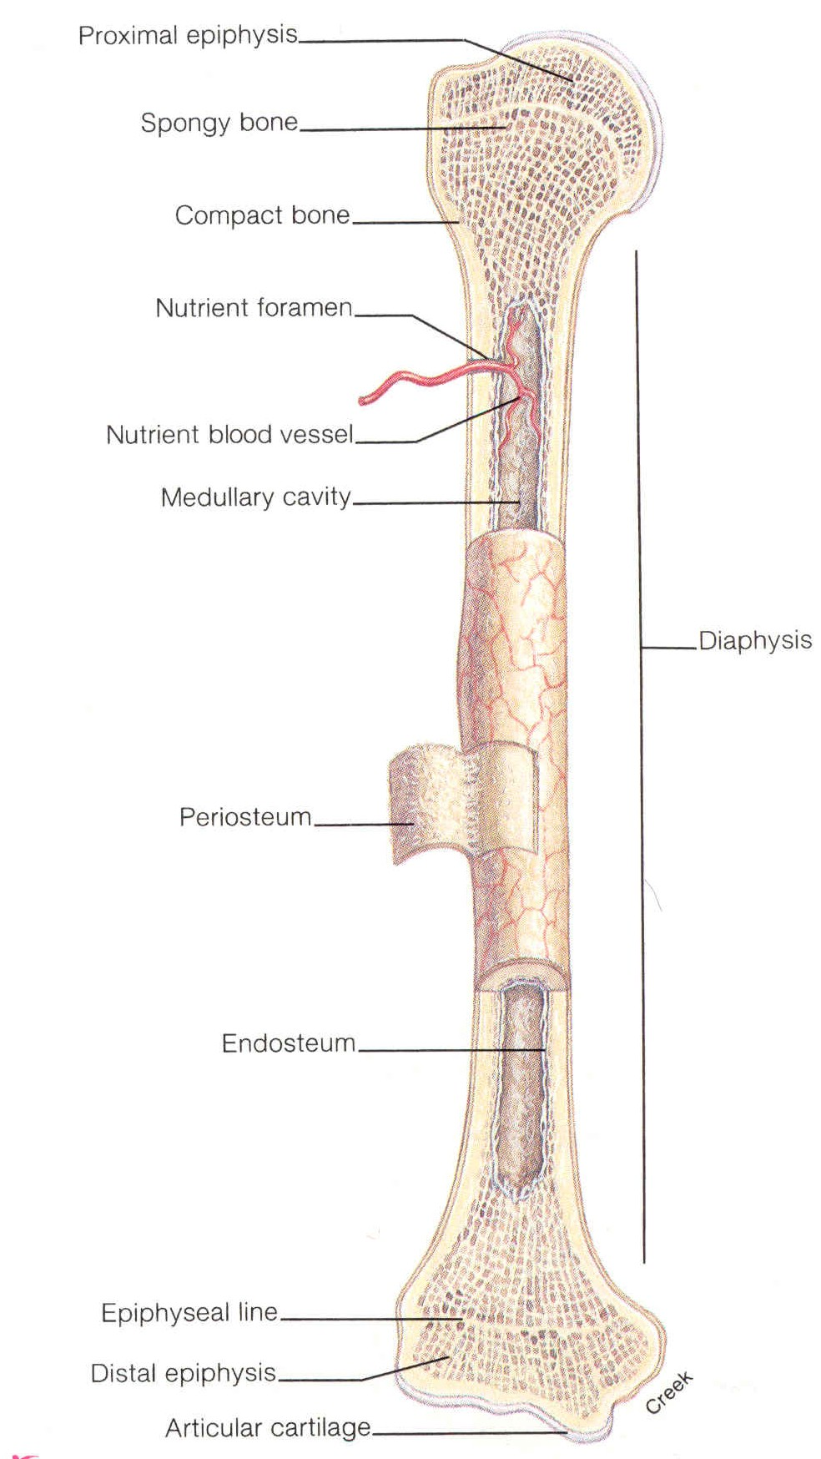
Bone (os) is among the binder and the type of tissue.
It is composed of minerals (50-70%), to a lesser extent of organic substances (20-40%), -10% is water and about 3% lipids.

Slide 3
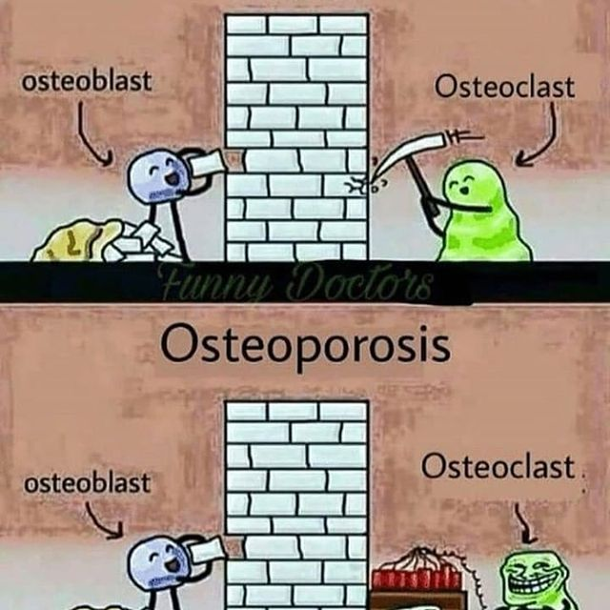
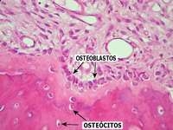
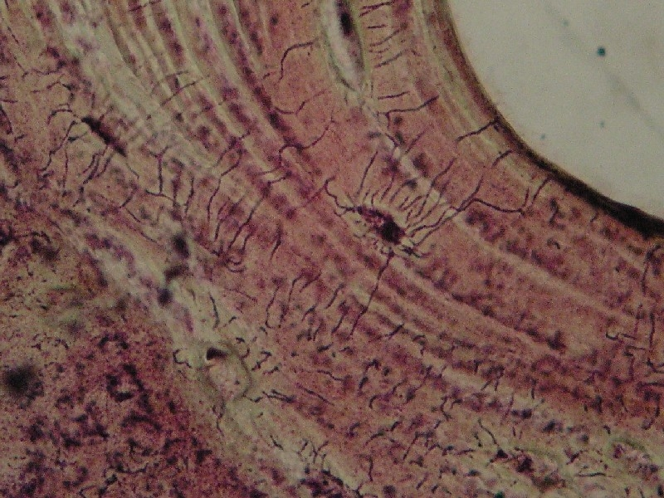
Bone cells
Osteoprogenitor cells
Osteoblasts
Osteocytes
Osteoclasts

Slide 4
the skeleton of an adult and other mammals is on average 80% compact bone and 20% trabecular. However, this ratio is different in different parts of the skeleton, which is due to the biomechanics of the part of the skeleton and due to evolution in vertebrates. For example, in vertebrae, the ratio is 25:75, in the femoral head 50:50, and in the vertebral shaft 95: 5,
the spine and the head of the femur and humerus dampen shocks arising during movement and, thanks to the beam, they spring and in the case of the spine it does not compress. On the contrary, the vertebrae and tibia have a strong compact or carry the weight of the whole body,
compact bone is less metabolically active than trabecular bone. Its porosity is less than 5%, which is related to the ratio of active and inactive osteons,
compact has outer periosteal and inner endostal surface, on periosteal surface bone formation predominates over resorption, on ondostal surface bone reconstruction is more intense,
On the surface of compact bone is the periosteum (periosteum) is formed by fibrous ligament, contains blood vessels, receptors, nerve fibers, osteoblasts, osteoclasts and is close to the external environment of coarse bundles of collagen fibers, so-called Sharpey fibers, which extend into the bones. The same fibers anchor the roots of the teeth in the alveolus.

Slide 5
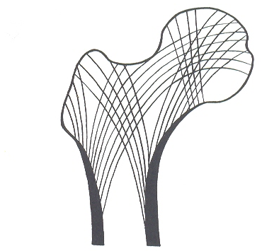
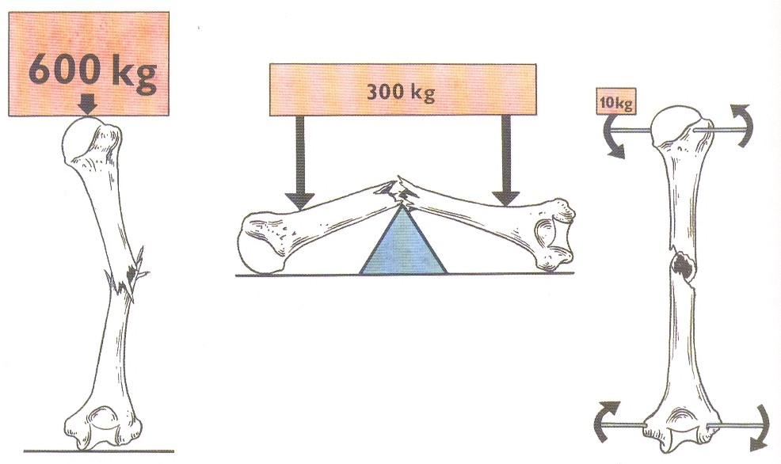
Bone matrix
makes up 90% of the total bone mass. It is composed of inorganic and organic components. The inorganic component represents 99% of calcium reserves, 85% of phosphorus and 40-60% of magnesium and sodium occurs in the form of hydroxyapatite Ca₁₀ (OH) ₂ (PO4) ₆, provides bone strength, stiffness and resistance to pressure
the organic component is a product of osteoblasts, it consists of proteins as well as glycoproteins, growth factors and proteoglycans
of the proteins, 85-90% are type I. collagen, 10-15% are non-collagen proteins present

Slide 6
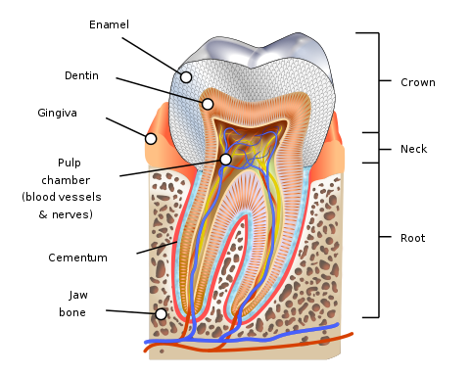
Teeth (dentes)
Three mineralized tissues are involved in tooth structure:
enamel that covers the crown
dentin, which forms the main mass of the tooth
3) cement that covers the neck and root of the tooth
The following formations are recognized on the tooth:
crown (corona dentis)
neck (collum dentis)
root (radix dentis)
Inside the tooth is the pulp (pulpa dentis), which is a soft tissue containing blood vessels and nerves. The tooth is fixed in the alveolus by a system of fibers called periodontin.

Slide 7
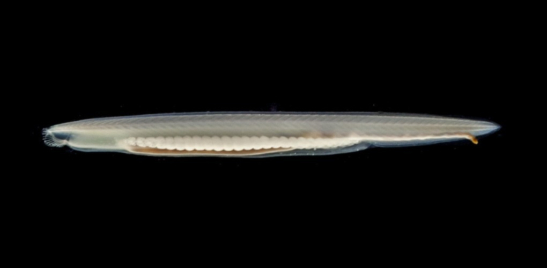
Evolution of bones
The first reinforcement of vertebrates - dorsal string (spina dorsalis)

Slide 8
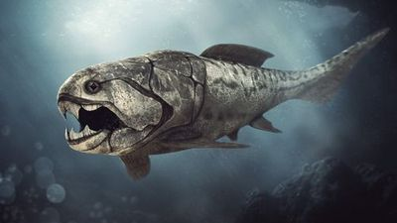
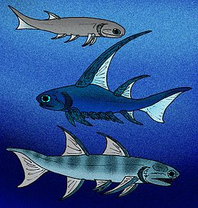
Bone ossification (growth) is two:
direct (desmogenic), i.e. the bone is formed. From the ligament of osteoblast activities. This ossification is evolutionarily the oldest and was already present in fish-like vertebrates, where it formed head shields. These fish had a dorsal string (spina dorsalis) as reinforcement. Suitable for this arrangement for calm sea depths.
indirect (chondrogenic), where bone is formed from cartilage from ossification centers. This type of ossification is evolutionarily younger and originated for the first time in bony fish, which developed in the fresh waters of the Silurian and passed into the sea secondary. This type of bone originated as a reaction to the dynamic environment of fresh water, allowing better maneuvering in wild water

Slide 9
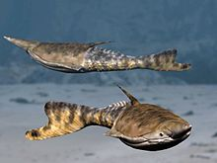
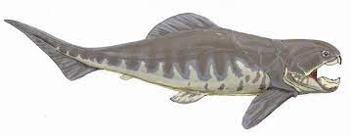
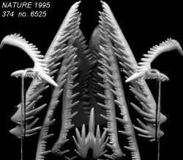
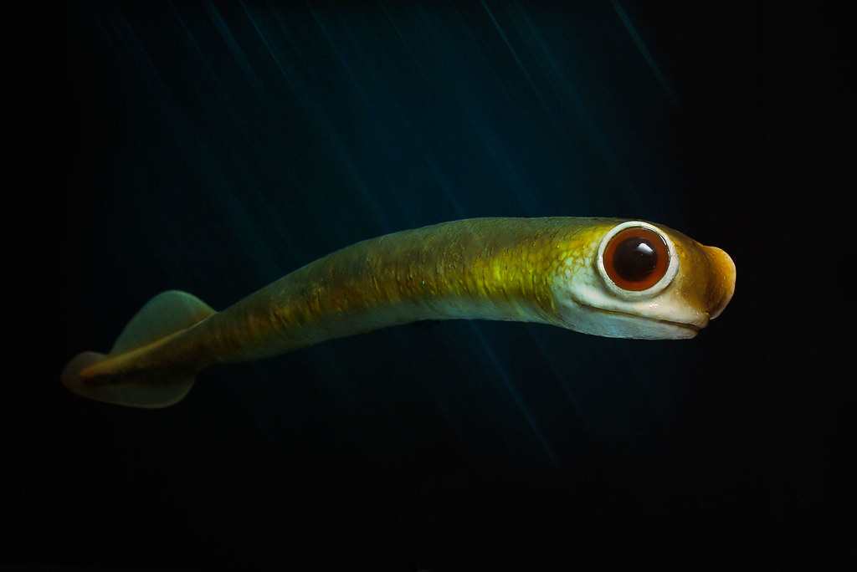
Evolution of teeth
Ostracodermi
Ectoderm
Origin of teeth can be seen in evolution of odontogenic
capacity in neural crest-derived mesenchyme
Placodermi-Duncleosteus
Endoderm
Conodonta-reconstruction
Conodonta-teeth

Slide 10
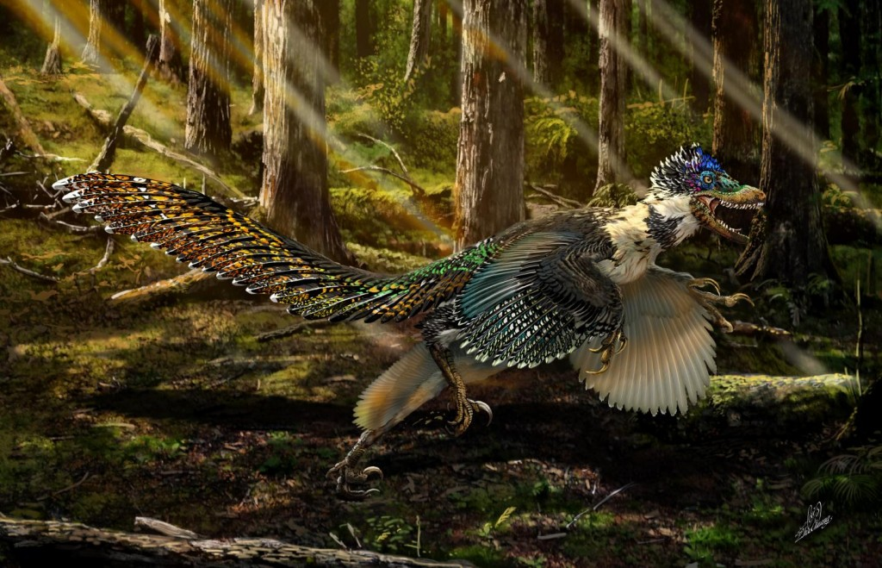
Evolutionary physiology of adaptations

Slide 11
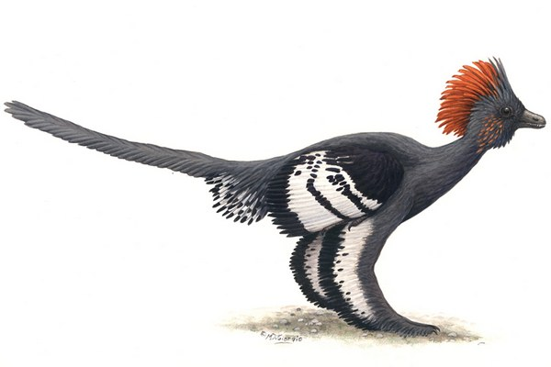
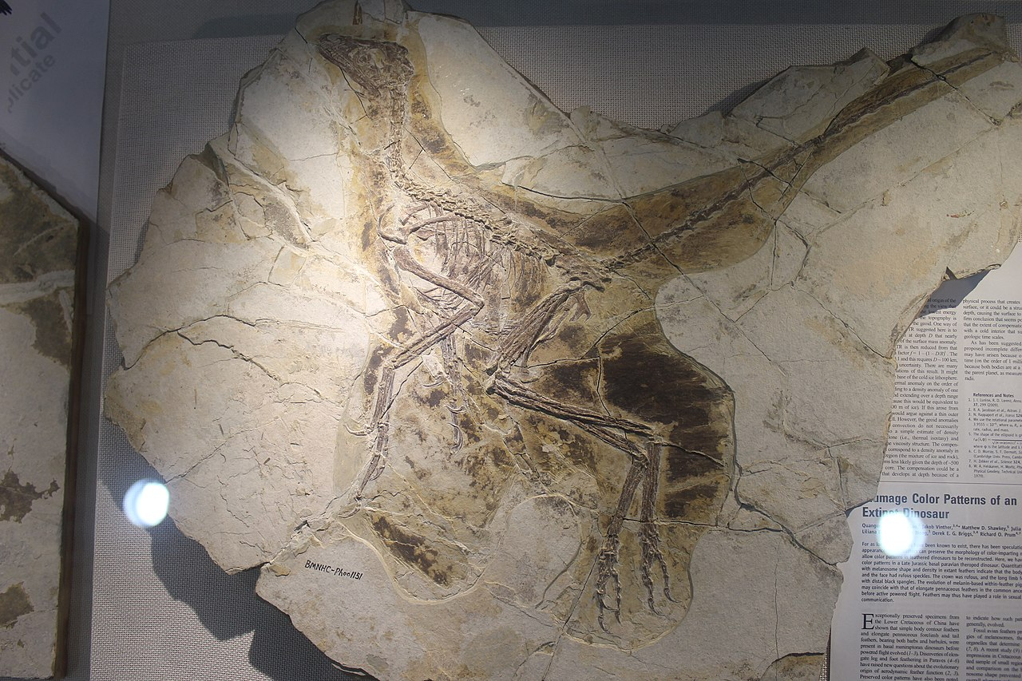
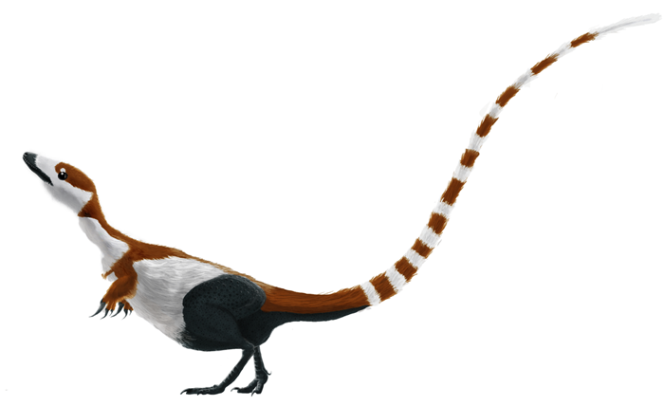
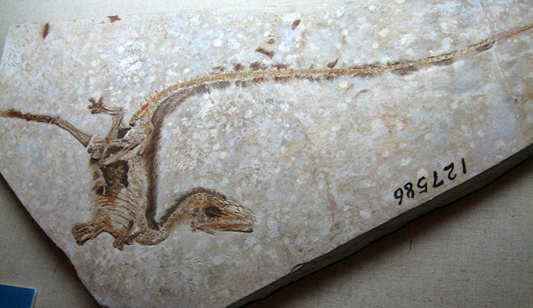
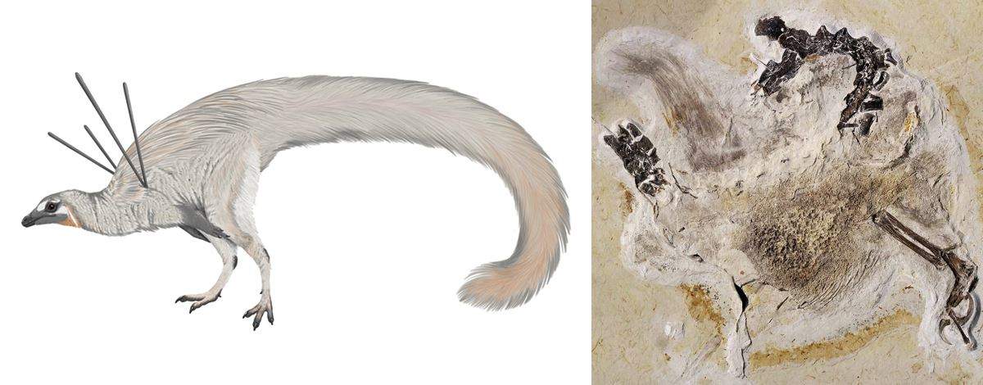
Birds, the successors of the dinosaurs, evolved from these lines
Anchiornis
Thanks to plumage and warm-bloodedness, dinosaurs inhabited all ecosystems, including the polar regions, although there were no polar caps during the Cretaceous period, but seasons changed, including snowfall
Sinosauropteryx
Sinosauropteryx
Based on findings from sites in China, we know that dinosaurs had feather coverings. We also know color based on decay products. Feathers show that these species were warm-blooded
Ubirajara jubatus

Slide 12
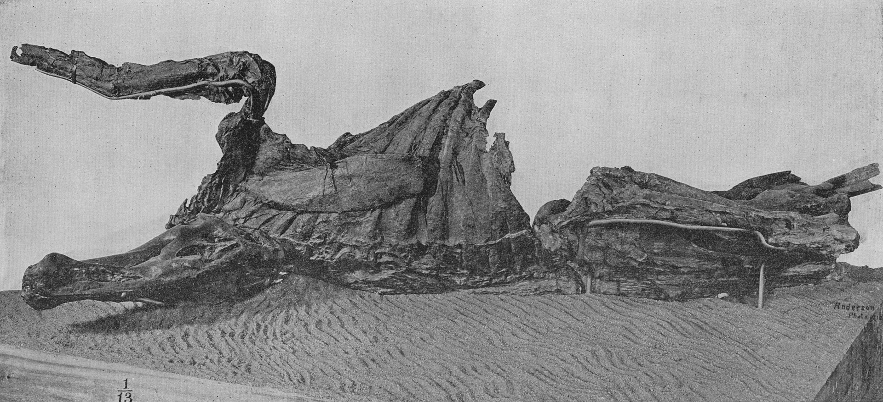
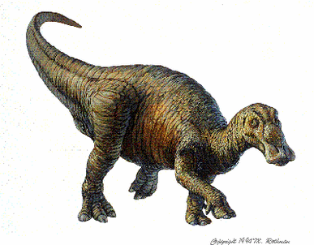
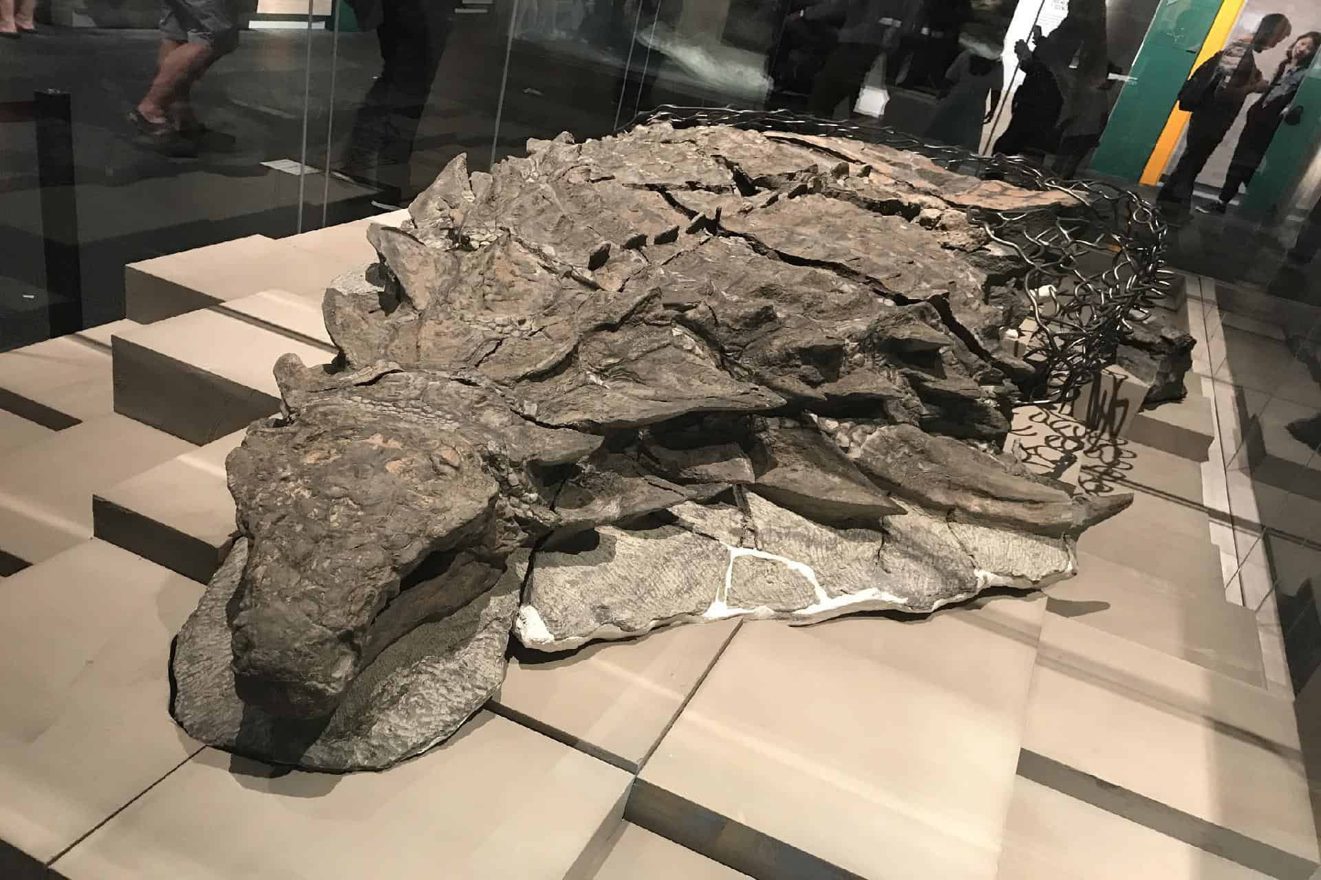
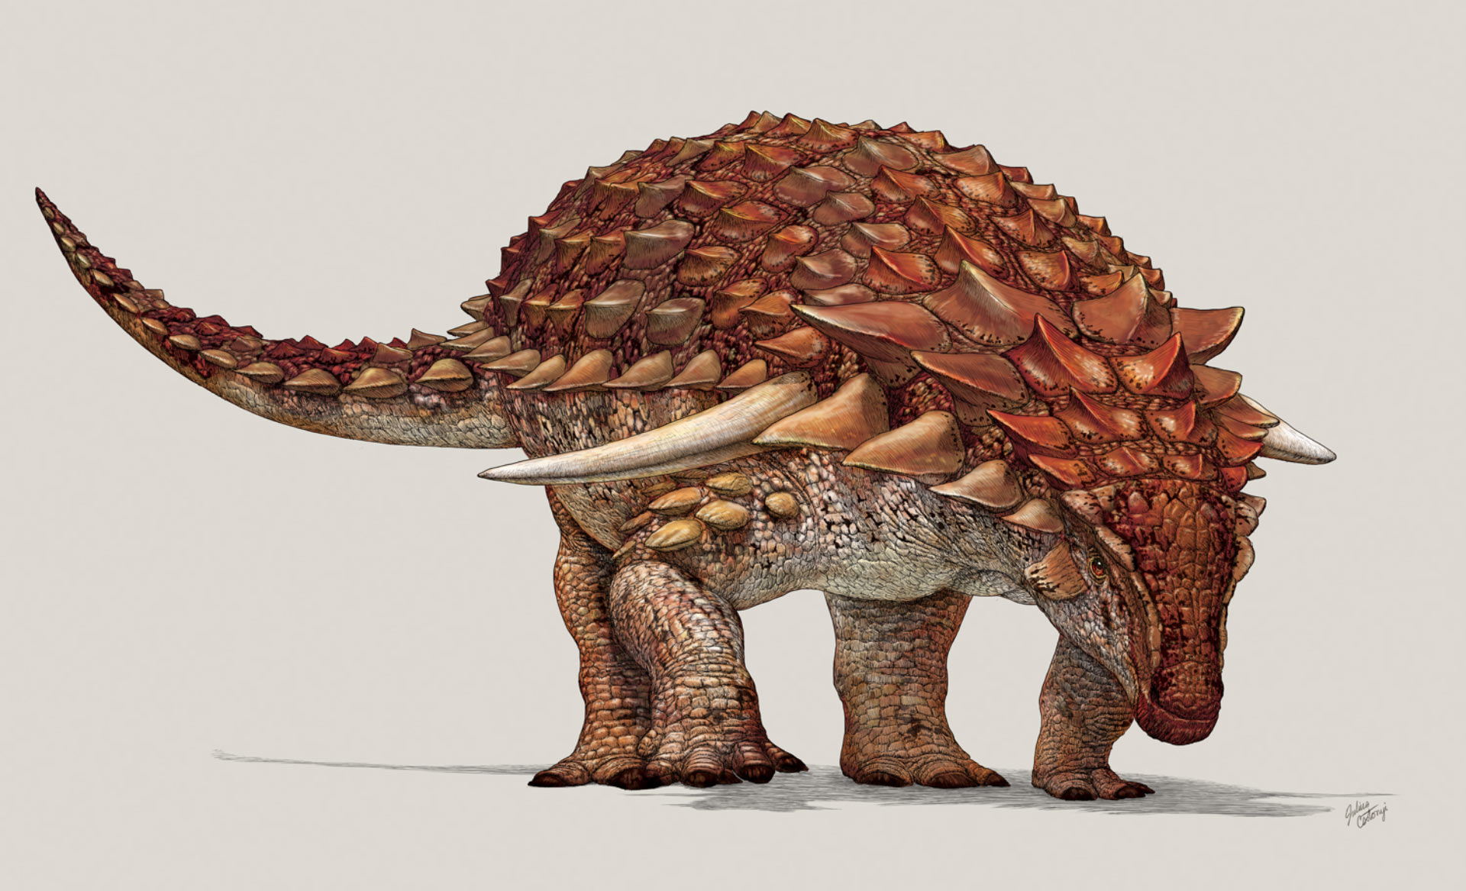
Trachodon
We also know the skin of dinosaurs from mummies
There were featherless dinosaurs with scaly skin, we know these dinosaurs from mummies. These dinosaurs were among the largest, so they maintained the temperature thanks to their size. However, the young of these species were warm-blooded in order to quickly grow to adult size in order not to become victims of predators
Within one species existing physiological adaptations according to conditions
Nodosaurus

Slide 13
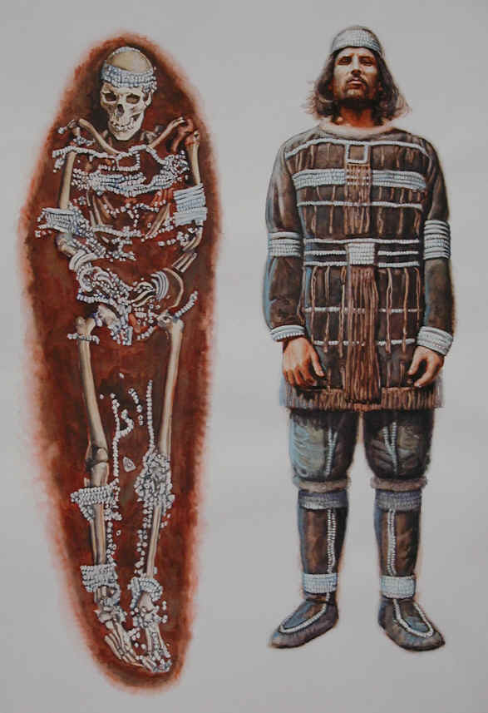
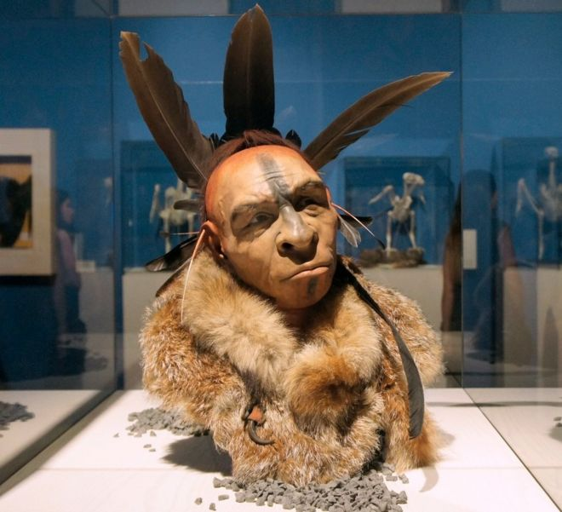
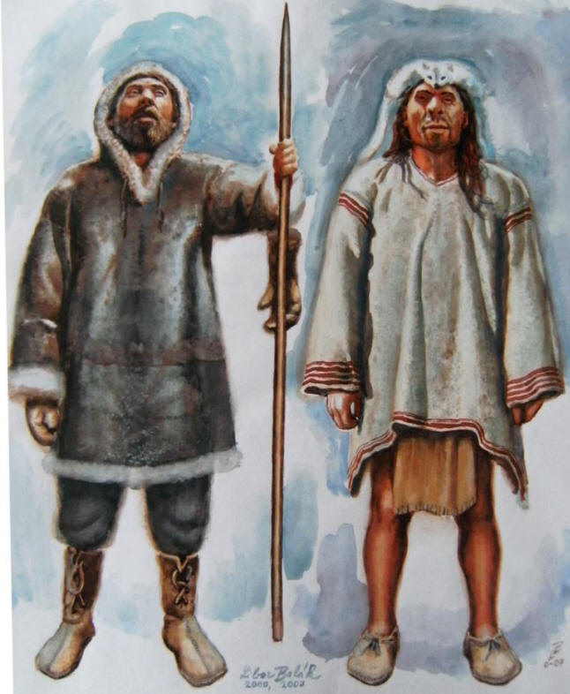
Evolutionary physiology of adaptations
Homo neanderthalensis -Krapina
Homo sapiens - Sungir
Neanderthal man was very well adapted to the cold climate of Europe. Modern man first acclimatized before coming to Europe. why did he win.
The Neanderthal had a larger brain capacity, made very precise stone tools, decorated himself, took care of his loved ones and the infirm, buried his dead. So why did it become extinct?

Slide 14
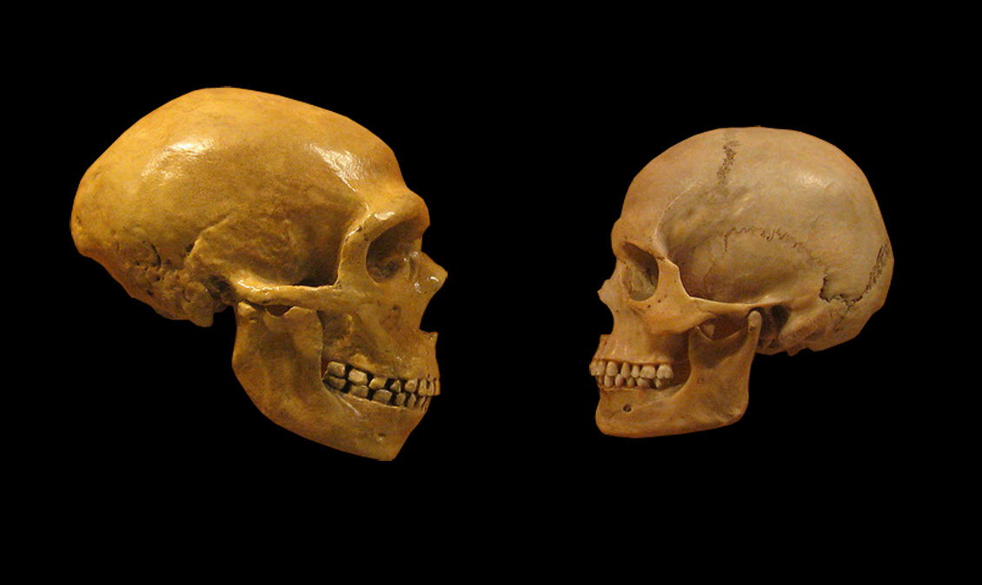
Metabolism of calcium

Slide 15
Metabolism of calcium
So why did it become extinct?
the reason is calcium metabolism. The Neanderthals only had access to food once in a while, they were not always successful in hunting, and they had to store large stocks of bones
modern human began to behave like a superorganism, he began to domesticate and exploit animals. They lived in houses, e.g. in the Sungir locality. They had enough calcium in their diet

Slide 16
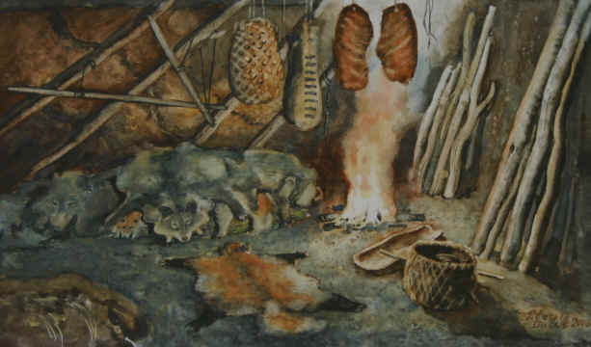
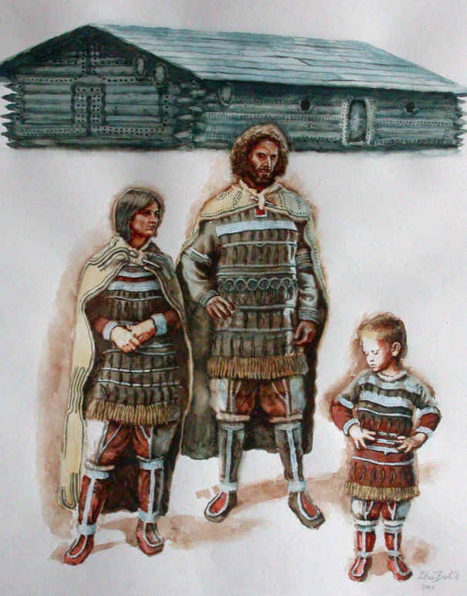
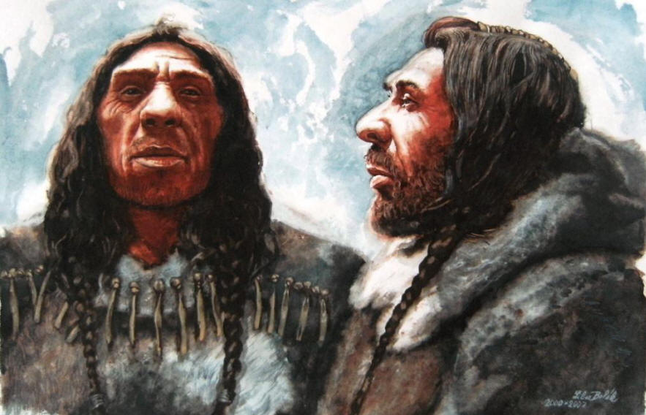
Neanderthal dwelling in Lazaret cave
Homo neandertalensis
Homo sapiens-Sungir

Slide 17
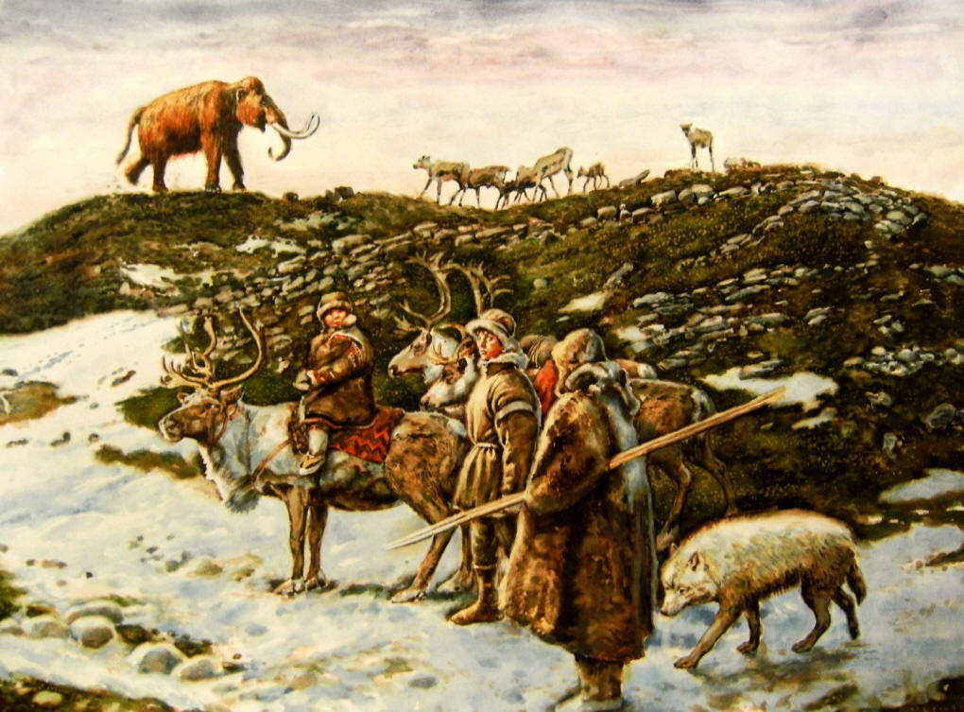
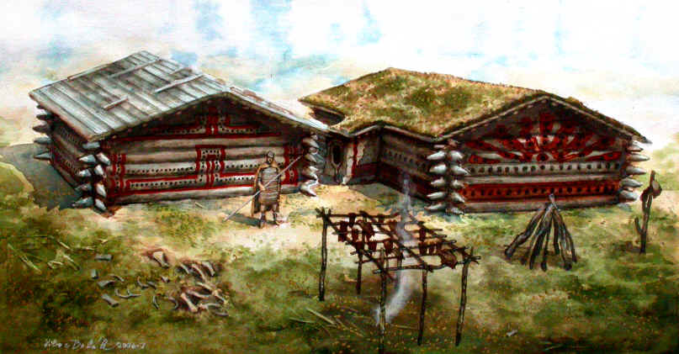
Modern human in the Paleolithic (Old Stone Age), in the period of about 34 thousand years BP, already domesticated animals such as dogs and reindeer. The dog made it possible to watch over herds of reindeer, and the reindeer mostly provided him with everything he needed, the rest was obtained by collecting and occasionally hunting mammoths, hares and other kinds of animals. This herding way of life allowed them to live a more settled way of life, groups of people grew and could raise more children and thus displaced the Neanderthals in a relatively short time. We interbred with the Neanderthals and we carry many genes in our own genome that help us survive (resistance to infections, light skin, etc.). With the growing population, there was also the construction of large log houses, which were previously considered to be a Neolithic invention (the period of the first farmers), but at the Sungir site, evidence of such long log houses was also found in the Paleolithic (25,000 years BP). All this resulted in thinning bones and so-called autodomestication, because we no longer needed strong bones to store calcium

Slide 18
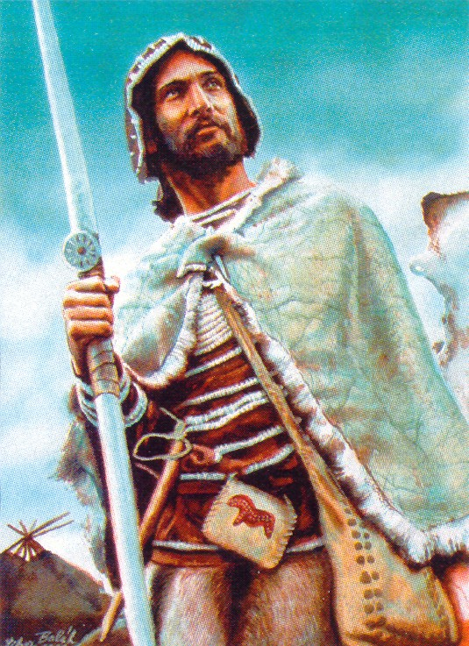
Thank you
for
attention!

