Slide 1

Differential diagnosis of back pain

Slide 2
Čtvrtek SIMU Ortopedie a rehabilitace CZ+ENG VLOR7X1c aVLOR7X1
- dvě skupiny po 10 (+- 4) studenti
dva lektoři: Ortopedie FN Brno a FNUSA
HARMONOGRAM
07:30 - 08:45 teorie - artroskopie obecně/entezopatie/bursitity+ klinické vyšetření
08:45 - 09:00 pauza
09:00 - 10:00 praxe na simulátoru + case reports
10:00 - 10:15 pauza
10:15 - 11:30 teorie - páteř + klinické vyšetření
11:30 - 11:45 pauza
11:45 - 12:30 praxe na simulátoru + case reports
FNUSA lektor
FN Brno lektor

Slide 3
Summary
Definition
Etiology and Epidemiology
Risk factors
Differential diagnosis
Examination
Red flags/Yellow flags
Literature

Slide 4
Definition
Back pain is defined by a triad of symptoms:
pain
muscle tension
stiffness tied to a topographically defined area of the body.
the pain may radiate to the extremities

Slide 5
According to time
Acute pain (0 - 6 weeks)
  It can be a transient pain (hours - 2 days) that subsides spontaneously, usually without medical intervention. More often it lasts for days to weeks, it can progress together with neurological symptomatology. It can appear repeatedly.
Subacute pain (6-12 weeks)
Chronic pain (continuous or recurrent pain for more than 12 w.)

Slide 6
Acording to location
Neck and arm pain
trauma
cervical spondylosis
metastatic disease / infection
cervical radiculopathy
cervical myelopathy
ankylosing spondylitis
Thoracic back and rib pain
trauma
metastatic disease / infection
thoracic disc herniation
osteoporotic comression fracture
trauma
Low back pain
muscles strain
disc herniation / discogenic pain
degenerative spondylolithesis
spinal stenosis
lumbar radiculopathy
abdominal aortic aneurism
Sacroiliac pain
SI infection
ankylosing spondylitis
Sacral pain
coccydynia
sacral insufficiency fracture

Slide 7
CONSTRUCTING A DIFFERENTIAL DIAGNOSIS
Most low back pain is caused by conditions that are troublesome but not progressive or life-threatening.
Serious back pain (pain due to a systemic or visceral disease or pain with significant neurologic symptoms or signs)
Nonspecific back pain related to the musculoskeletal structures of the back, called mechanical back pain.

Slide 8
According to etiology 1/3
1. Back pain due to disorders of the musculoskeletal structures
  Nonspecific (mechanical) back pain: no definite relationship between anatomic abnormalities seen on imaging and symptoms
  Specific musculoskeletal back pain: clear relationship between anatomic abnormalities and symptoms
    Lumbar radiculopathy due to herniated disk, osteophyte, facet hypertrophy, or neuroforaminal narrowing
    Degeneration…..Spinal stenosis, spondylolisthesis…..
    Cauda equina syndrome

Slide 9
According to etiology 2/3
2. Back pain due to visceral disease (serious, requires specific and rapid diagnosis and treatment)
  Retroperitoneal
    Aortic aneurysm
    Retroperitoneal adenopathy or mass
  Pelvic
    Prostatitis
    Endometriosis
    Pelvic inflammatory disease
  Renal
    Nephrolithiasis
    Pyelonephritis
    Perinephric abscess
  GI
    Pancreatitis
    Cholecystitis
    Penetrating ulcer

Slide 10
According to etiology 3/3
3. Back pain due to systemic disease affecting the spine
  Serious and emergent (requires specific and often rapid treatment)
    Neoplasia
      (1) Multiple myeloma, metastatic carcinoma, lymphoma, leukemia
      (2) Spinal cord tumors, primary vertebral tumors
    Infection
      (1) Osteomyelitis
      (2) Septic diskitis
      (3) Paraspinal abscess
      (4) Epidural abscess
  Serious but nonemergent (requires specific treatment but not urgently)
    Osteoporotic compression fracture
    Inflammatory arthritis
      (1) Ankylosing spondylitis
      (2) Psoriatic arthritis
      (3) Reactive arthritis
      (4) Inflammatory bowel disease–associated arthritis

Slide 11
Epidemiology
Prevalence 60 – 85%
Aging population, obesity, sedentary lifestyle

Slide 12



Epidemiology
Notes:
90% lidí za život, ½ z nich opakovaně během jednoho roku , někde 8/10 a 65% třeba Austrálie, ale čísla jsou pro industrilizovaný svět +- stejný

Slide 13
Classification of low back pain (Waddell 1987)
Specific low back pain
  the cause is an identifiable progressive pathology with possible involvement of nervous structures (15%):
  intervertebral disc herniation
  spondylolisthes
  spinal stenosis
  segmental instability
  fractures, tumors, inflammations
Non-specific low back pain
  pain without an identifiable specific anatomical or neurophysiological disorder (85%)

Slide 14
Diagnostic triad (Waddell 1998,Barsa,Häckel 2004,Vrba 2008)
I. Simple back pain
  Obvykle muskuloskeletální původ, postižení LS oblasti
  nejčastěji mezi 20- 55 lety, dobrá prognoza konzervativní léčby
  90% se uzdraví do 6 týdnů
II. Root (neurogenic) pain
  typical lateralization with projection to DK with paresthesias
  loss of sensitivity and nerves (motor skills, reflex changes) due to neurological symptomatology. Prognosis of conservative treatment worse (50% recover within 6 weeks)
III. Pain caused by a serious disease of the spine - “red flags“
  Tumors, inflammations, fractures-deformities, serious neurological diseases.
  Risk factors: age under 20 and over 55, spinal injury, pain in the thoracic spine and abdomen without obvious causes, pain at rest, permanent and independent of movement

Slide 15
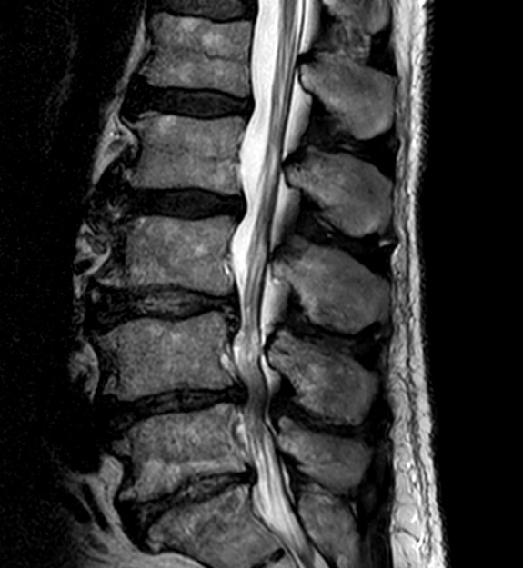
Mechanical causes
Spinal stenosis
Spondylosis
Spondylolysis, spondylolisthesis
Herniated disc
Scoliosis
Trauma

Slide 16
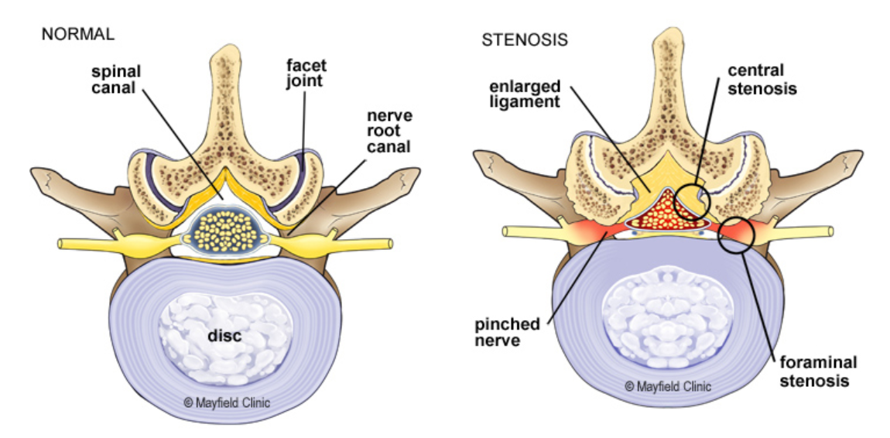

Slide 17
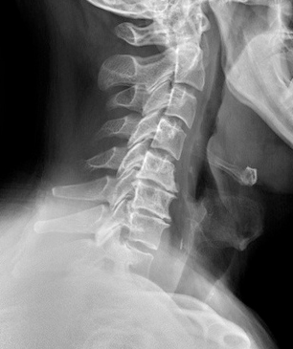
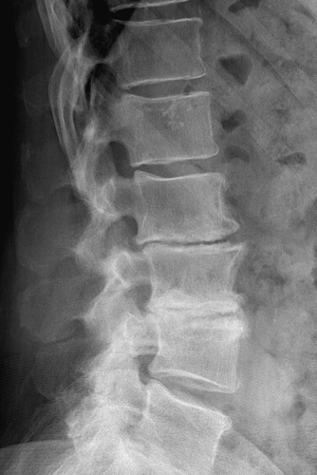
Mechanical causes
Spinal stenosis
Spondylosis
Spondylolysis, spondylolisthesis
Herniated disc
Scoliosis
Trauma

Slide 18
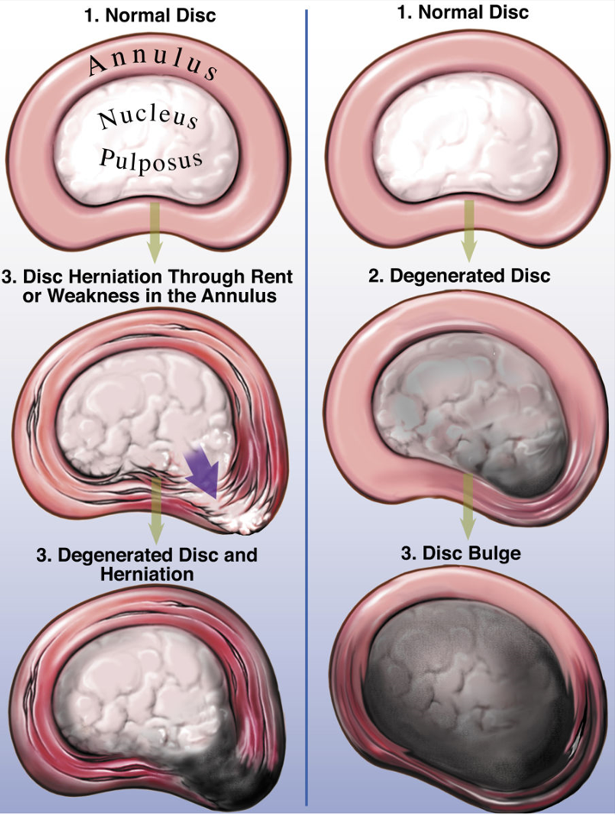

Slide 19
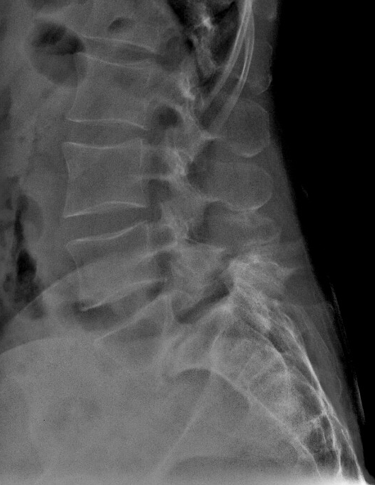
Mechanical causes
Spinal stenosis
Spondylosis
Spondylolysis, spondylolisthesis
Herniated disc
Scoliosis
Trauma

Slide 20
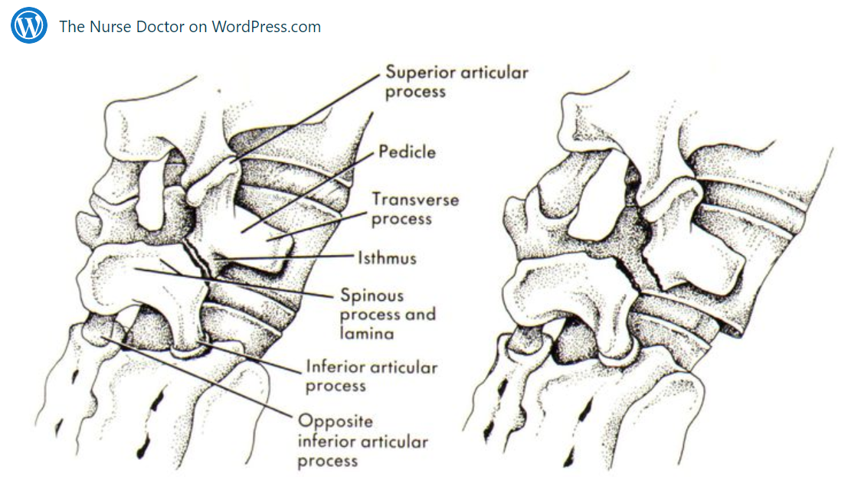
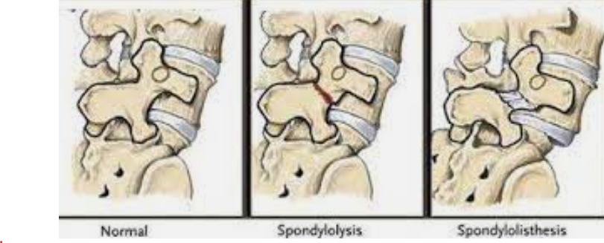

Slide 21
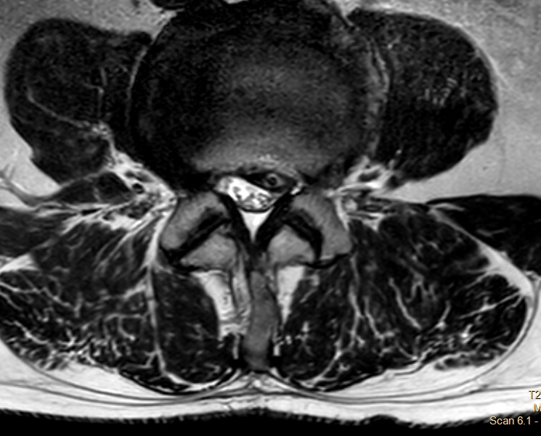
Mechanical causes
Spinal stenosis
Spondylosis
Spondylolysis, spondylolisthesis
Herniated disc
Scoliosis
Trauma

Slide 22
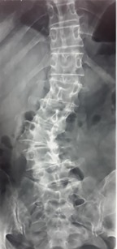
Mechanical causes
Spinal stenosis
Spondylosis
Spondylolysis, spondylolisthesis
Herniated disc
Scoliosis
Trauma

Slide 23
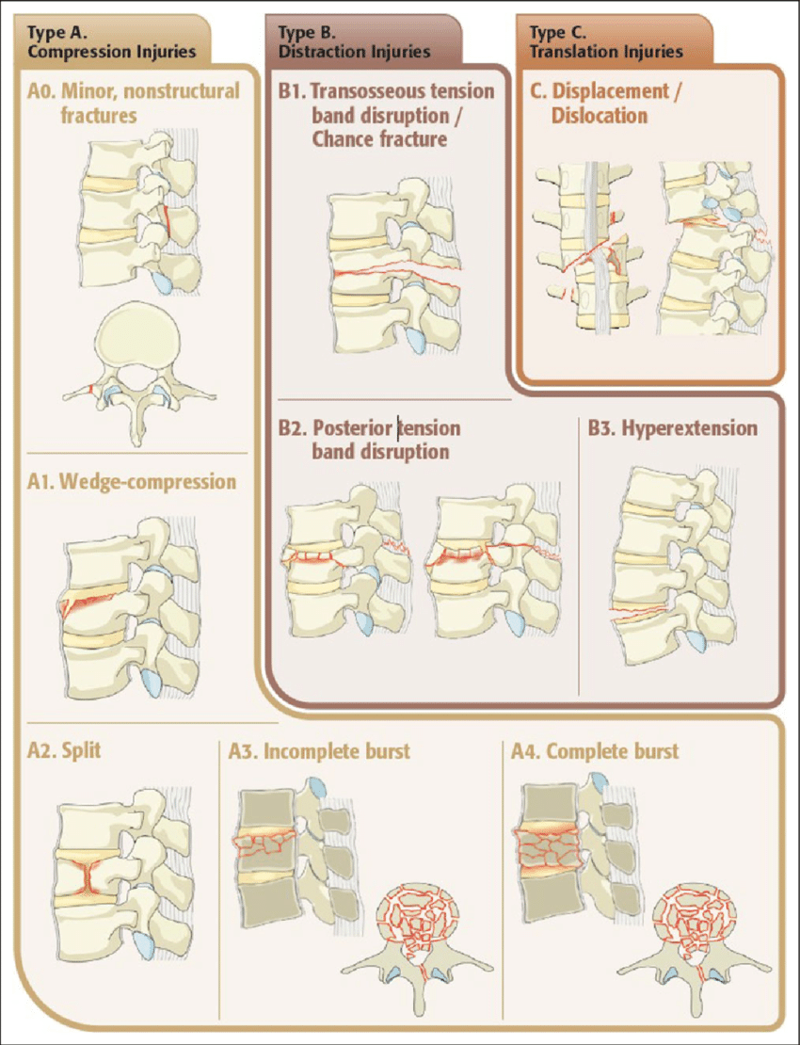
Mechanical causes
Spinal stenosis
Spondylosis
Spondylolysis, spondylolisthesis
Herniated disc
Scoliosis
Trauma

Slide 24
Mechanical causes
Other degenerative changes:
  Facet joints, lateral recess, foramina
  Osteophytes
  Synovial cysts
  Lipomatosis
  Discogenic pain and endplate changes
  oPLL

Slide 27
Spine tumors
Primary (3%)
Benign (25%)
- Osteoid osteoma
- Osteoblastoma
- Aneurysmal bone cyst
- Osteochondroma
- Neurofibroma
- Giant cell tumor
- Eosinophilic granuloma
- Hemangioma
Malignant (75%)
- Osteosarcoma
- chondrosarcoma
- Ewings sarcoma
- chordoma
- fibrosarcoma
Secondary (97%)
- Lungs
- Breast
- Prostate
- Thyroid gland
- Kidneys
- GIT
Zdroj.: 1.Ciftdemir M, Kaya M, Selcuk E, Yalniz E. Tumors of the spine. World J Orthop. 2016;7(2):109-116. Published 2016 Feb 18. doi:10.5312/wjo.v7.i2.109, 2.DREGHORN, C. R., NEWMAN, R. J., HARDY, G. J., & DICKSON, R. A. (1990). Primary Tumors of the Axial Skeleton. Spine, 15(2), 137–140. doi:10.1097/00007632-199002000-00018
27 /33

Slide 28
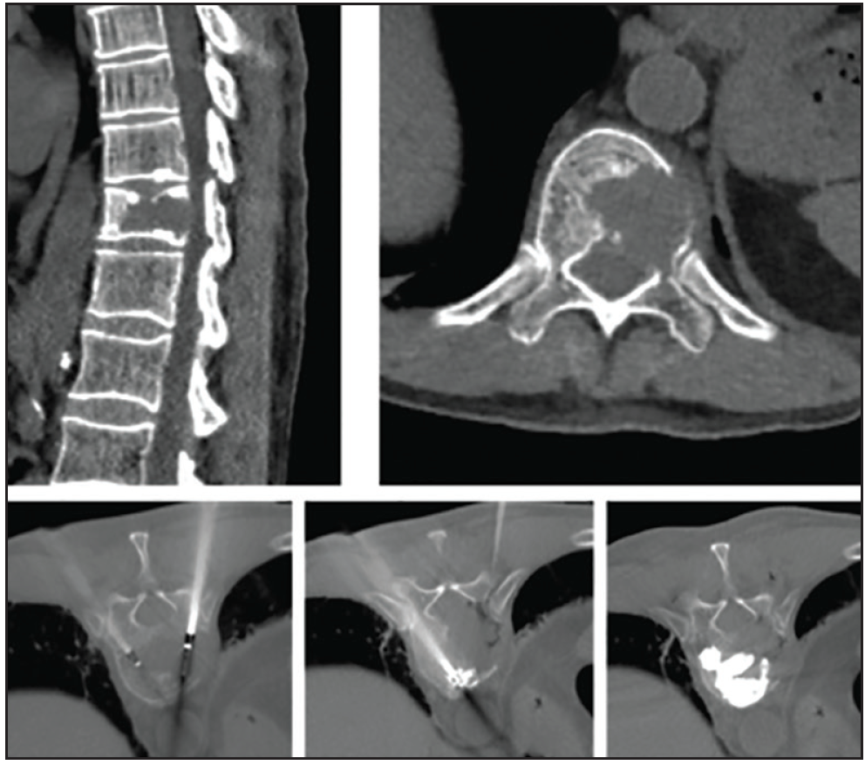
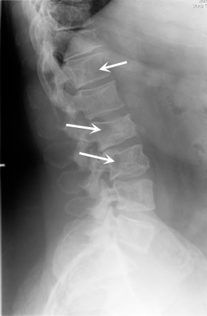
Malignant tumors
Chondrosarcoma
Osteogenic sarcoma
Ewing's sarcoma
Chordoma
Multiple myeloma
Lymphoma
Metastases - breast, lung, prostate, thyroid, kidney

Slide 29
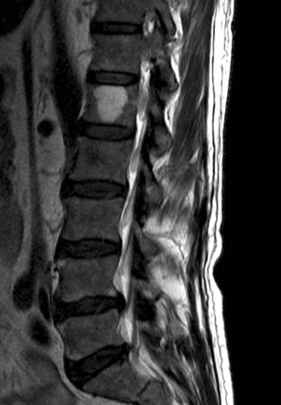
Benign tumors
Osteochondroma
Osteoid osteoma and osteoblastoma
Giant cell tumor
Aneurysmal bone cyst
Hemangioma
Eosinophilic granuloma

Slide 30
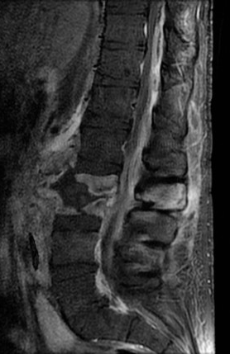
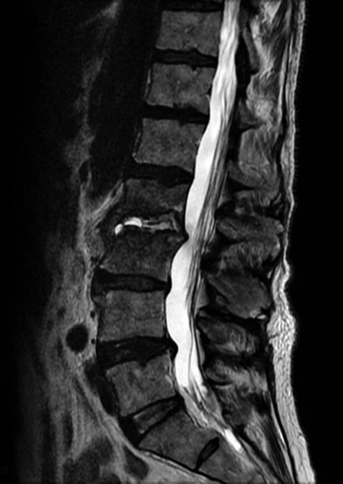
Infection
Osteomyelitis
Epidural abscess
Discitis
Granulomatous infection
TBC

Slide 31
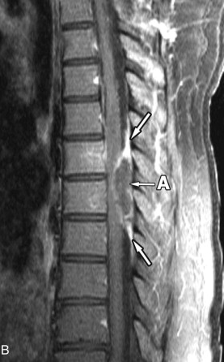
Infection
Osteomyelitis
Epidural abscess
Discitis
Granulomatous infection
TBC

Slide 32
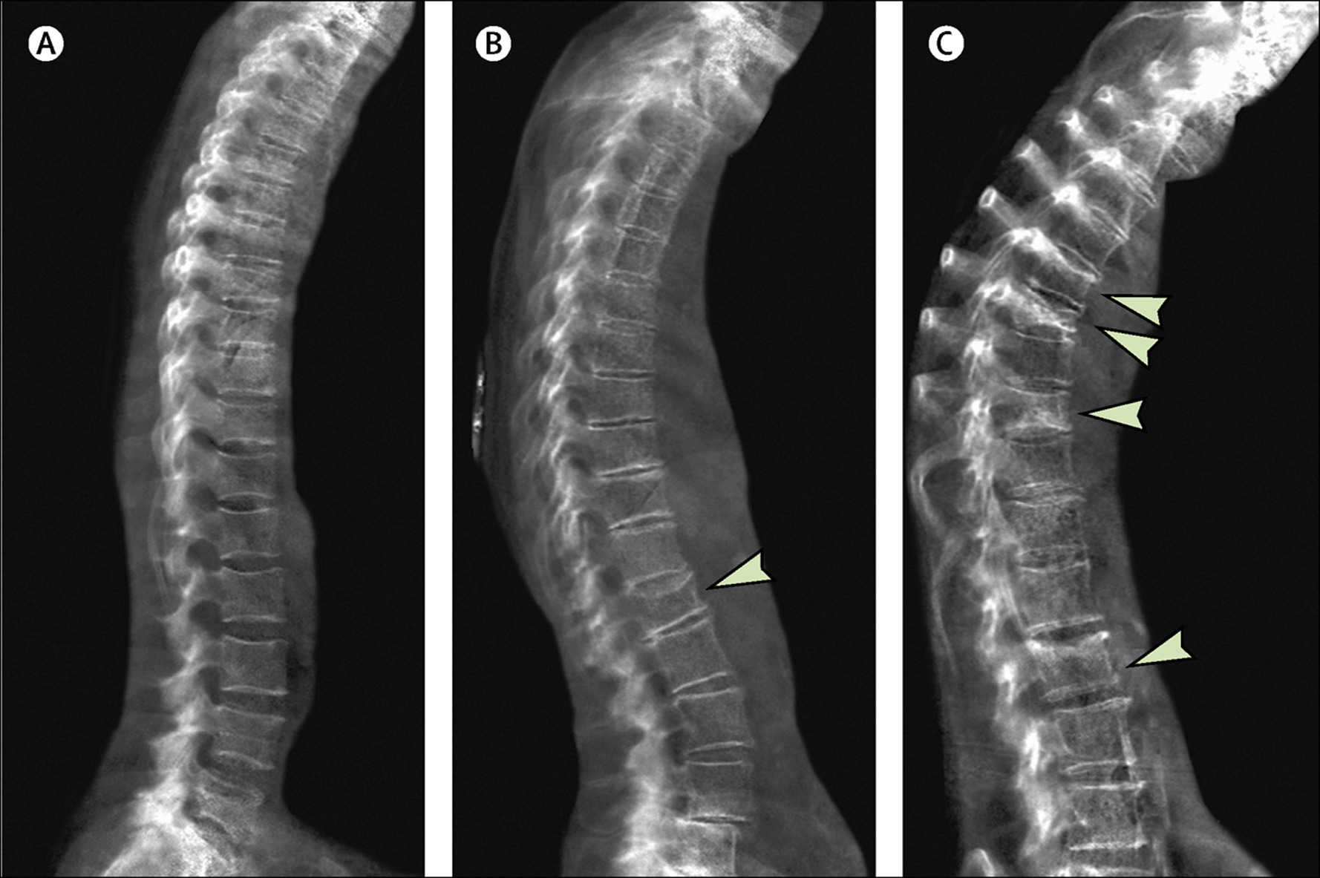
Osteoporosis
senilní
postmenopauzální
farmakologicky induk.
Compston JE, McClung MR, Leslie WD. Osteoporosis. Lancet. 2019 Jan 26;393(10169):364-376. doi: 10.1016/S0140-6736(18)32112-3. PMID: 30696576.

Slide 33
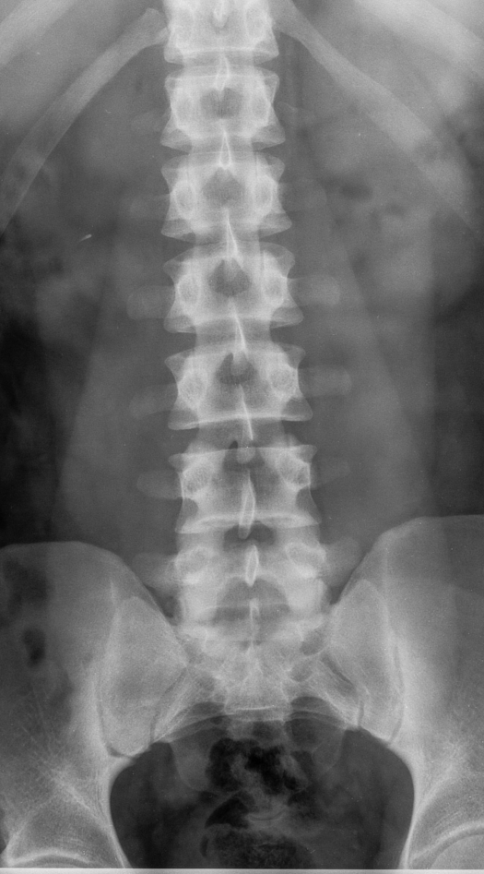
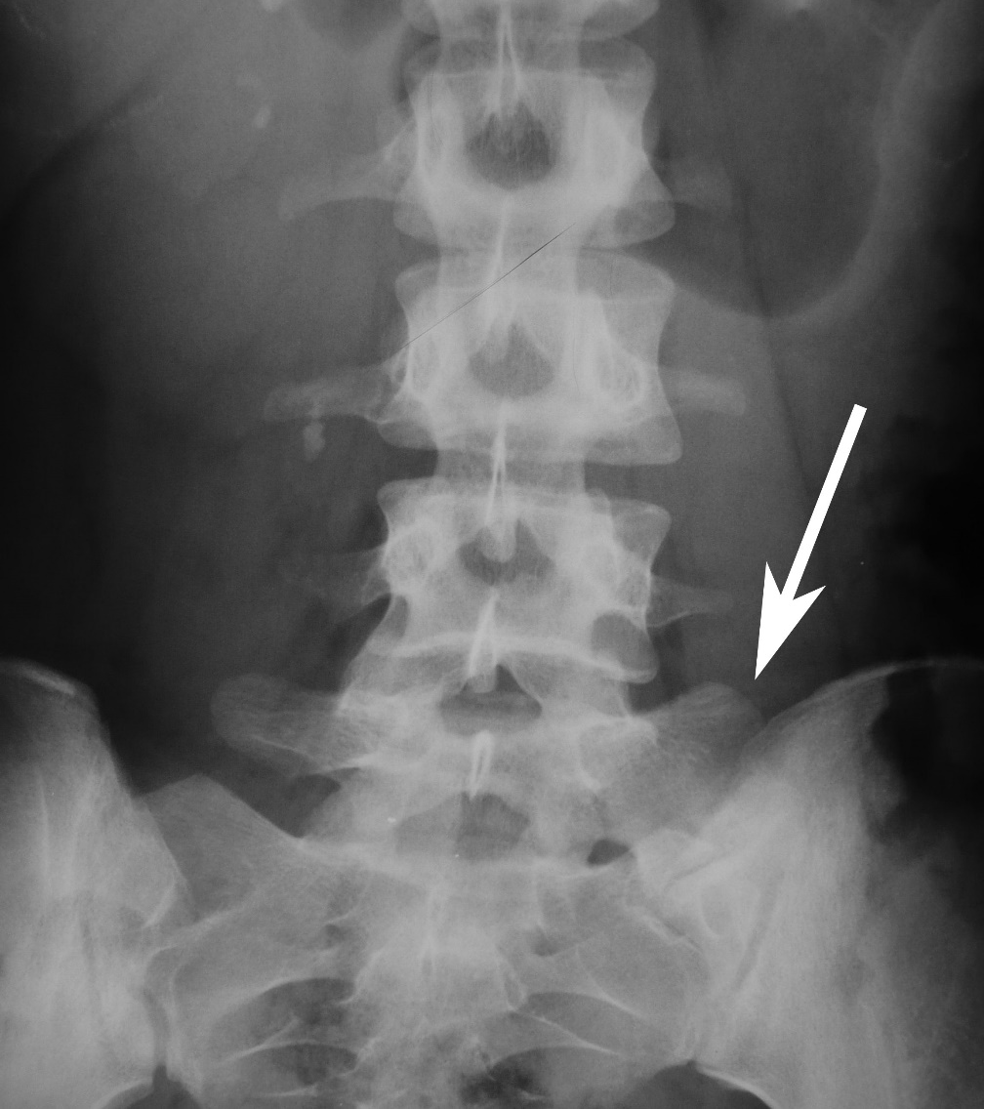
Congenital and other degenerative changes
1
2
3
4
5
6
Sacralization, lumbarization
Bertolotti's syndroma
Lumbar hyperlordosis with vertical sacrum
Baastrup phenomenon

Slide 34
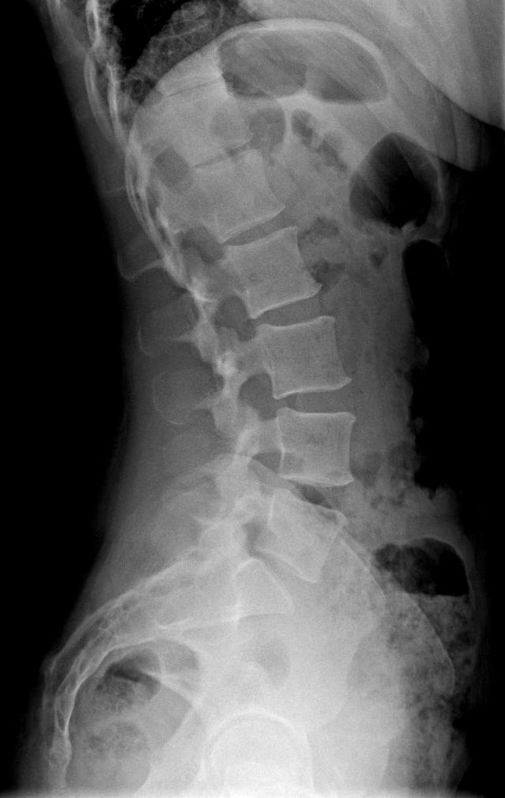
Congenital and other degenerative changes
Sacralization, lumbarization
Lumbar hyperlordosis with horizontal sacrum
Baastrup phenomenon

Slide 35
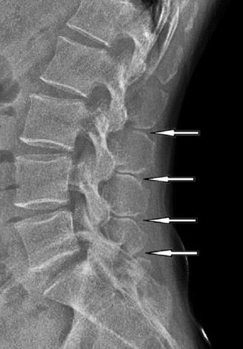
Congenital and other degenerative changes
Sacralization, lumbarization
Lumbar hyperlordosis with vertical sacrum
Baastrup phenomen

Slide 36
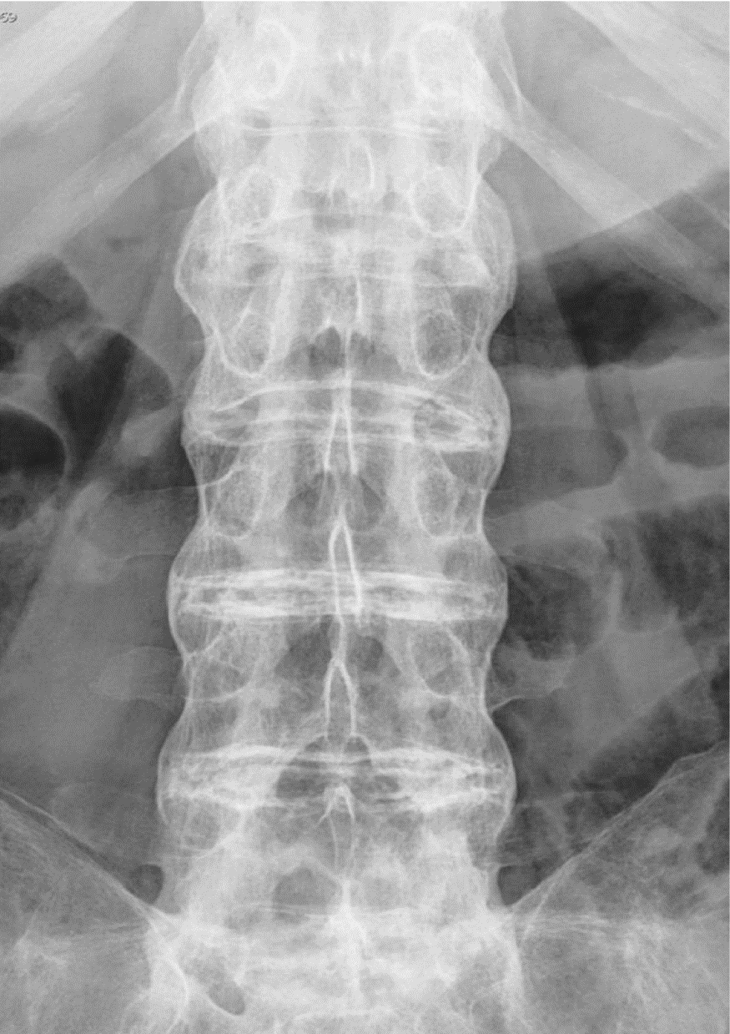
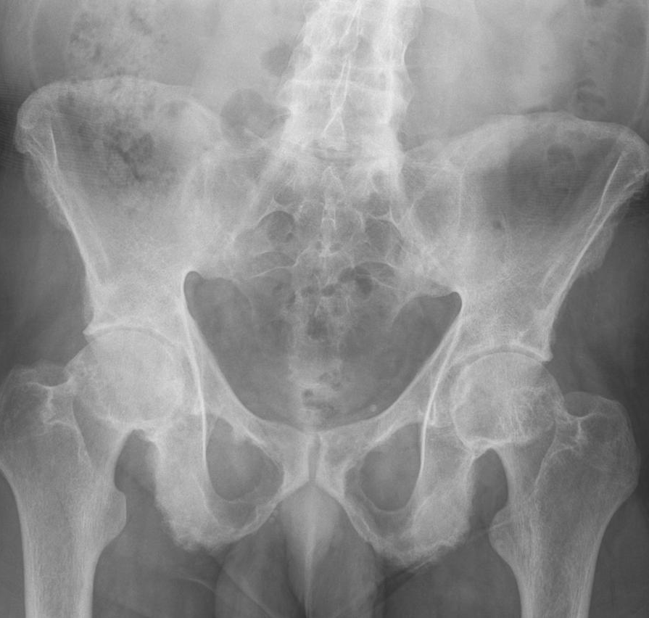
Spondyloarthropathy
Ankylosing spondylitis – HLA - B27+
Rheumatoid arthritis

Slide 37
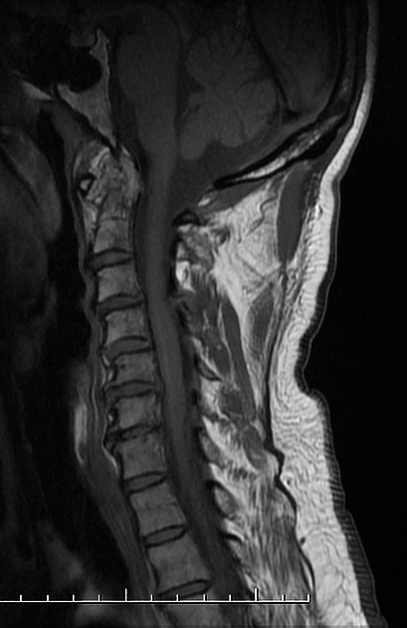
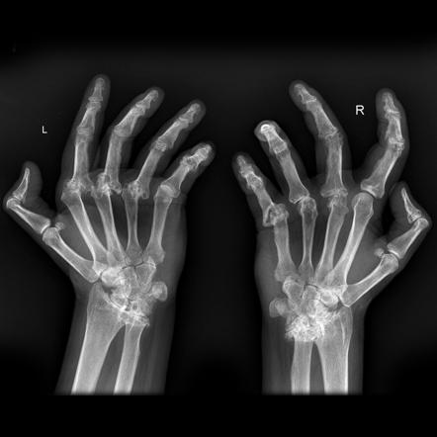
Spondyloarthropathy
Ankylosing spondylitis – HLA - B27
Rheumatoid arthritis

Slide 38
EXAMINATION
Anamnestic data– RA, OA, FA, AA, PSA
Perfect clinical examination and documentation
XR – standardized images
CT – acute trauma
MRI - the gold standard for soft tissue
Other imaging modalities after MDT
Consultation of expertise in the case of therapeutic doubts

Slide 39
Red flags
infection x tumor x trauma x cauda equina syndrome
New onset back pain age <20, 50+
Night pain
Saddle anaestesia, bladder bowel distrubance
Fever, loosening weight
Anamnesis of cancer, steroid use

Slide 40
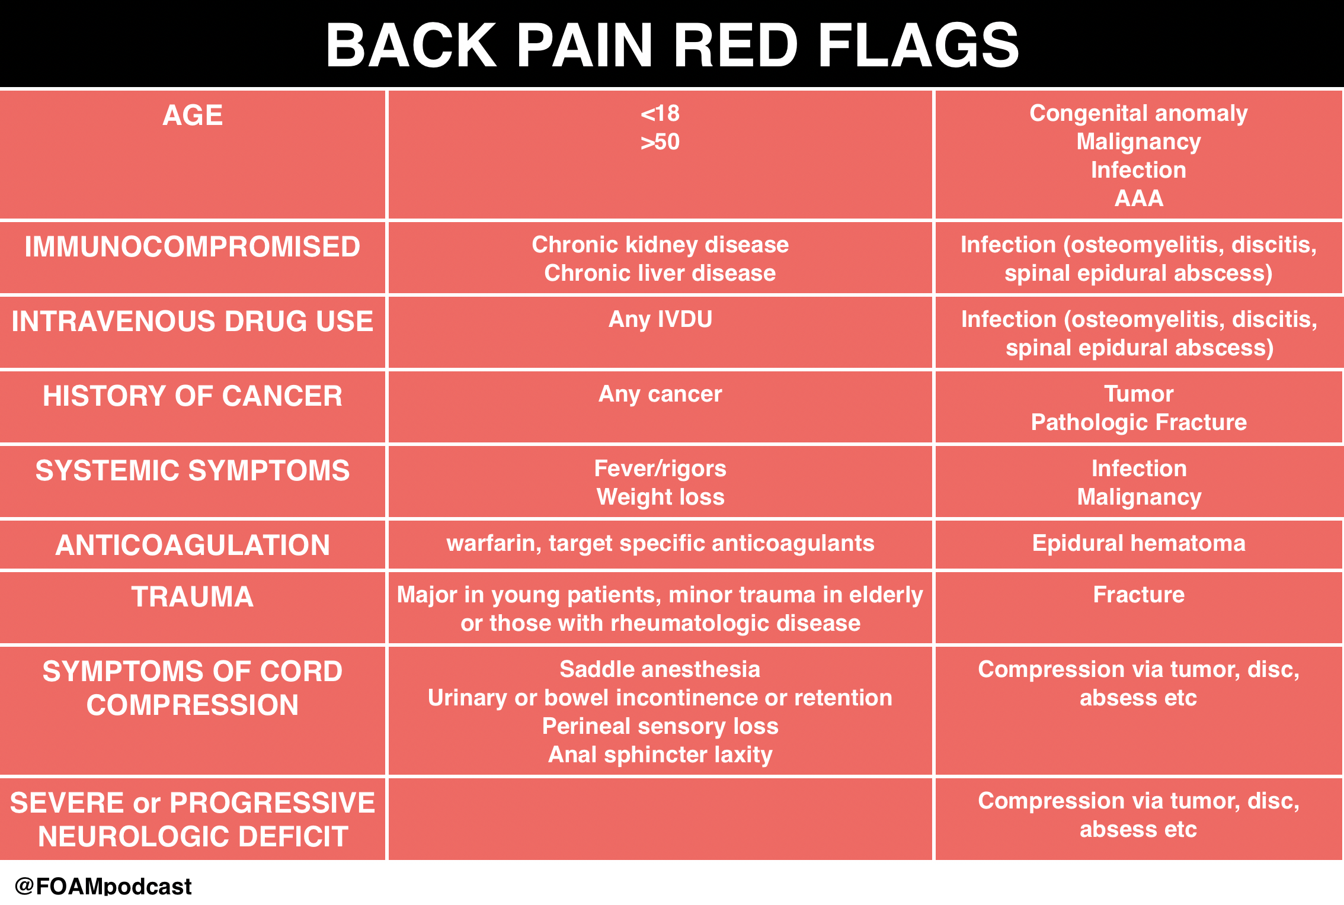

Slide 42
Red flags – TUNA FISH
Trauma
Unexplained Weight Loss
Neurologic Symptoms
Age over 50
Fever
IVDU (IntraVenous Drug User)
Steroid Use
History of Cancer

Slide 43
Yellow flags
"yellow/warning/flags"
psychosocial risk factors
e.g. wrong attitudes and superstitions of the patient about back pain
unsuccessful diagnostic and treatment results
behavioral, emotional, family and work problems
catastrophizing and depression
passive coping with pain (passive expectation of pain, limitation or exclusion of physical and social activity)
increase in muscle tension (muscle imbalance)
signs of protective behavior (taking comfortable positions, limping, overuse of support aids, etc.)

Slide 44
Literatura
Benzel, E. C., & Steinmetz, M. P. (2017). Benzel's spine surgery: Techniques, complication avoidance, and management (Fourth edition.). Philadelphia, PA: Elsevier.
COST B13: European guidelines for the management of low back pain. Eur Spine J 15, s125– s127 (2006). https://doi.org/10.1007/s00586-006-1066-z
DUNGL, Pavel. Ortopedie. Praha: Grada, 2005. ISBN 80-247-0550-8.

