Slide 1
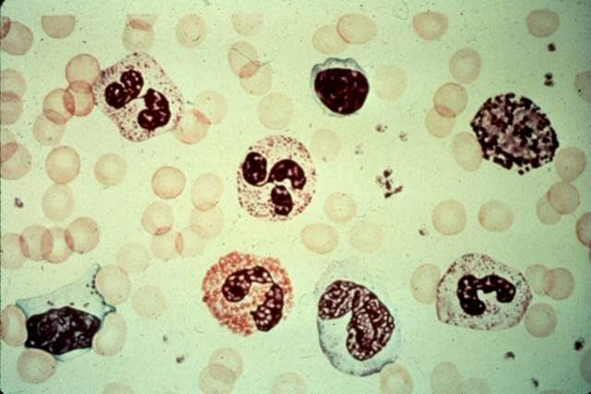
Hematology: Anemias
Stanislav Matoušek

Slide 2
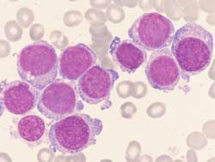
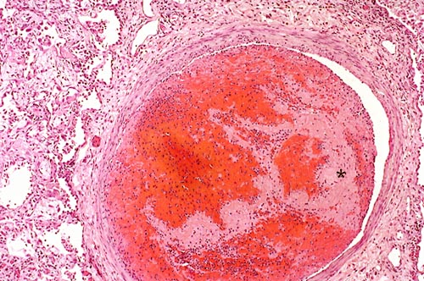
HEMATOLOGY
.
Leukemia etc.
(oncology – lympho-
and myeloproliferative
disorders)
E.g. chronic myeloid
leukemia
Anemias and -penias
(not having enough elements)
thrombocytopenia
Disorders of blood clotting
Primary hemostasis
Secondary hemostasis
Bleeding disorders/ thrombo-embolism

Slide 3
Clinical symptoms of hematologic disease
Anemia
→ signs of hypoxia – tiredness, weakness, dyspnea
→ signs of low levels of hemoglobin - paleness
→ cardiovascular symptoms – palpitation
Polycytemia → hyperviscose blood → risk of thrombosis
Bleeding, spontaneous bleeding, unceasing bleeding
Thrombosis → embolism – local symptoms of swelling or ischemia – DVT -, pulmonary embolism
Frequent infections

Slide 4
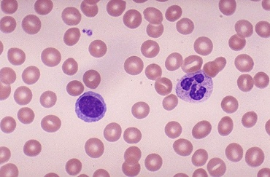
Anemia
Hb
M: < 135 g/L
F: < 120 g/L
Hct
M: < 40 %
F: < 37 %
Ery
M: < 4,3 * 10¹² /L
F: < 3,9 * 10¹² /L
Principal criterion: Hb< 120 g/L in w or < 135 in m

Slide 5
Pathophysiology of anemia symptoms
low hemoglobin concentration paleness
Deficient oxygen delivery into tissues
Tissue hypoxia sympaticus
activated
weakness,dyspnea
palpitations hyperkinetic circulation

Slide 6
Causes of hypoxia
Altitude hypoxia – lack of O₂ in the inspired air = low pO₂
Respiratory insufficiency– hypoxic hypoxia
Lack of hemoglobin – transport hypoxia = anemia
Circulatory disturbance – circulatory hypoxia
Impaired oxidation in mitochondria – histotoxic hypoxia

Slide 7
Laboratory tests:
Principal:
Complete (full) blood count (CBC or FBC)
Complementary:
Tests of iron metabolism
Erythropoietin levels
Detecting antibodies against RBC – Coombs test = antiglobuline test AGT
Osmotic fragility test
Historically: Ham’s test (resistance in acidic environment)
Blood film/smear microscopic examination
Bone marrow cytology/ aspiration (Sternal puncture)

Slide 8
Anemias classified by RBC morfology (CBC)
by MCV
microcytic - e.g. iron deficiency
normocytic - e.g. acute bleeding
macrocytic (megaloblastic) - pernicious
by MCHC (color)
hypochromic – lack of iron
normochromic

Slide 9
Stem cells, growth factors
BONE MARROW
erythropoietin:
Cellular division, maturation:
DNA synthesis: vitamin B₁₂, folic acid
Hemoglobin synthesis: globin, porphyrine, Fe
Other factors
PRODUCTION
hemolysis
PERIPHERAL BLOOD
Erythrocytes
LOSSES
hemoglobin, RBC count,
hematocrit
MCV, MCH, MCHC
shape etc.
bleeding

Slide 10
Anemias by their etiology/patho
decreased production
Stem cell failure or failure to differentiate
disorder in DNA synthesis
Disorder in hemoglobin synthesis
Lack of erytropoetin / renal failure
Complete loss of erythropoiesis – decrease of RBC count 10% / wk
increased destruction - hemolysis
Defect of erythrocytes
Causes outside of RBC
increased loss - bleeding
misdistribution and loss (hyperslenism, pooling in spleen)

Slide 11
Reticulocyte count
Daily replenishment rate
0.5 – 1.5% of total RBC count
Mature during the 1st day in peripheral blood
Criterion of bone marrow activity –
Key test in distinguishing anemias
Reticulocytosis
Reaction of the BM to a blood loss (hemolytic anemias, severe bleeding)
Response to a correct anemia therapy (e.g. defic. B12 or Fe)
Reticulocytopenia
Defective erythropoiesis

Slide 12
Blood loss anemia
Acute blood loss
shortly after massive blood loss Hb normal due to vasoconstriction
normochromic - normocytic
Chronic blood loss
results in iron deficiency
Excessive hemolysis (RBC destruction)

Slide 13
Excessive hemolysis (RBC destruction)
reticulocytosis, LDH is increased, unconjugated bilirubin accumulates
Extrinsic RBC defect (normocytic-normochromic RBC )
Immunologic abnormalities (AIHA, PNH)
Mechanical injury (trauma, infection)
Intrinsic RBC defect
Membrane alterations
congenital (spherocytosis, elliptocytosis)
Aquired (hypophosphatemia)
Metabolic disorders (G6PD deficiency)
Hemoglobinopaties (Sicle cell disease, Thalassemia)
Notes:
G6PD deficienc over 100 mutant forms identified. X-linked, drug senzitive variety most common (drugs which produce peroxide)
AIHA - autoimmune hemolytic anemia

Slide 14
Mechanisms of extravascular and intravascular hemolysis
paroxysmal nocturnal hemoglobinuria (PNH) and autoimmune hemolytic anemia (AIHA)
INTRAVASCULAR
EXTRAVASCULAR

Slide 15
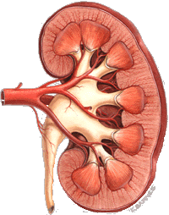
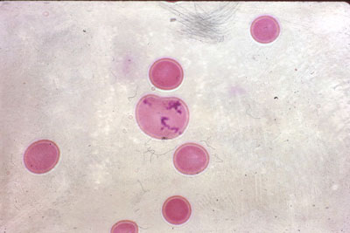
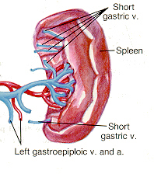
SYMPTOMS OF HEMOLYSIS
intravascular
loss of red blood cells
loose Hb
hemoglobinemia,
hemoglobinuria
hemosiderinuria
anemia
BM activation
damage to the kidneys
reticulocytosis
extravascular
increased prodution of bilirubin jaundice (icterus)
splenomegaly

Slide 16
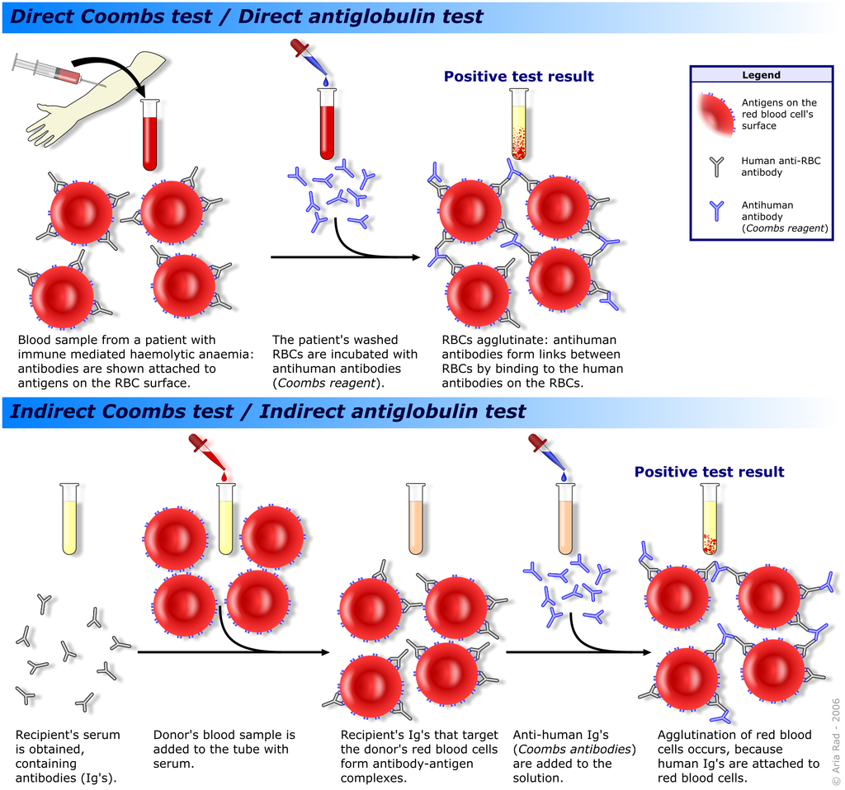
TESTS FOR HEMOLYSIS

Slide 17
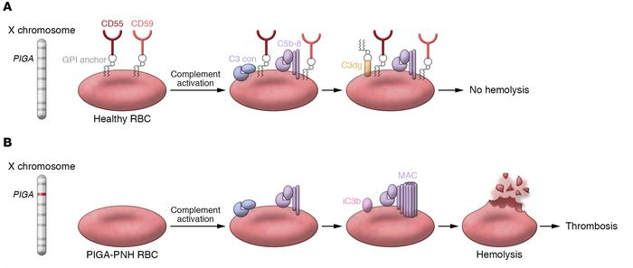
Paroxysmal nocturnal hemoglobinuria
life-threatening disease of the blood characterized by destruction of red blood cells by the complement system
The main proteins that protect blood cells from destruction are decay-accelerating factor (DAF/CD55), which disrupts formation of C3-convertase, and protectin (CD59/MIRL/MAC-IP), which binds the membrane attack complex and prevents C9 from binding to the cell.
Complement decay-accelerating factor
phosphatidylinositol glycan A (PIGA)

Slide 18
Paroxysmal nocturnal hemoglobinuria

Slide 19
Paroxysmal nocturnal hemoglobinuria

Slide 20
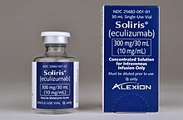
PNH treatment
Eculizumab is humanized therapeutical antibody that binds C5 complement and prevents its cleavage by C3b. It is used to treat paroxysmal nocturnal hemoglobinuria (PNH), atypical hemolytic uremic syndrome (aHUS), and neuromyelitis optica.
Eculizumab
C3b
C5
C5a
C5b
C3
PC
C3b
Pegcetacoplan
PC
Pegcetacoplan binds to complement protein C3 and its activation fragment C3b
regulating the cleavage of C3 and the generation of downstream effectors of complement activation

Slide 21
Direct antiglobulin (Coombs’) test (DAT)
Detection of antibodies to erythrocyte surface antigens
AIHA
Antiglobulin serum is added to washed RBC from the patient ------ agglutination indicates presence of immunoglobulins or complement components bound to RBC

Slide 22
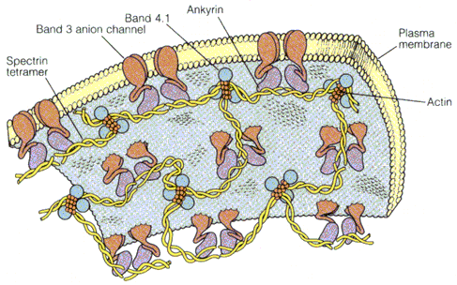
TESTS FOR HEMOLYSIS
Test of osmotic resistence
RBC survive only in isotonic surrounding but have some toleration to its changes
RBC in some hemolytic states have decreased tolerance
Special tests
membrane properties (electrophoresis of proteins)
properties of hemoglobin
genetic tests

Slide 23
Deficient erythropoiesis
Iron deficiency
microcytic-anisocytosis, ↓ reticulocytes
Vitamin B₁₂ or Folate deficiency
macrocytes-anisocytosis
BM failure - chronic diseases, aplastic anemia, myelodysplasia, leukemia
normochromatosis-normocytosis
BM hypoplasia
Notes:
Iron deficiency: Include = anemia of chronic blood loss; Hypochromic-microcytic anemia; Hypochromic anemia of pregnancy, infancy, and childhood) BLOOD LOSS leadind cause; DEFECT IN FE UTILIZATION – hemoglobinopaties, sideroblstic and myelodysplastic anemia HIGH RDW --- ringed sideroblasts in BM SIDEROBLASTIC ANEMIA associated with myelodysplastic sy.
Vitamin B12: RISK OF GASTRIC CANCER --- GI X-ray advised
REQUIRES INTRINSIC FACTOR from gastric mucosa to absorb in the intestine
Folate PROLONGD COOKING DESTROYS FOLATE, Peaple who eat marginal diet = TEA-and –TOASTERS, CHRONIC ALCOHOLICS Defective DNA synthesis ---- RNA synthesis continue ---- increased cytoplasmatic volume and maturation ---- increased intramedullar cell death = inefective erythropoiesis
Chronic disease: JZ6]Kidney, endocrine – thyroid, pituitary, or protein depletion

Slide 24
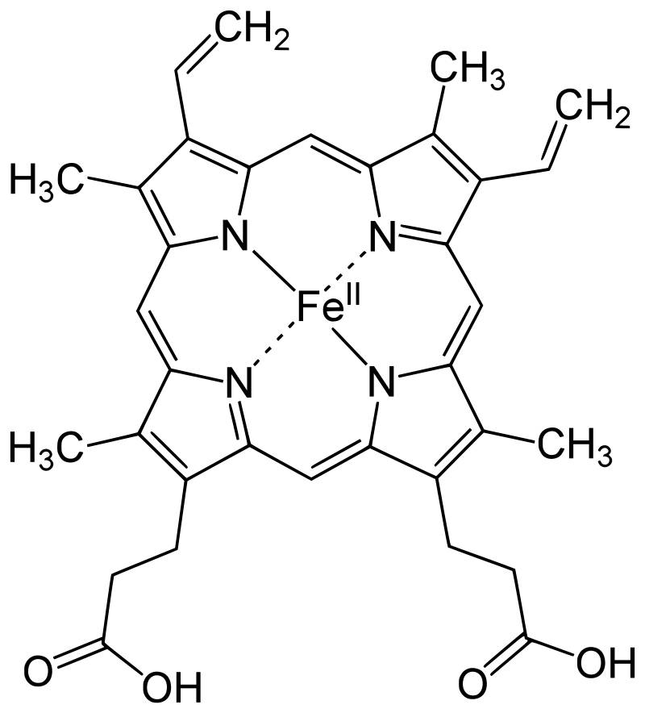
Iron metabolism
Iron is an essential bioelement for most forms of life, from bacteria to mammals due to its ability to mediate electron transfer.
Fe²⁺ (ferrous state)
Fe³⁺ (ferric state)
Structure of Heme b
Because of its toxicity, free soluble iron is kept in low concentration in the body

Slide 25
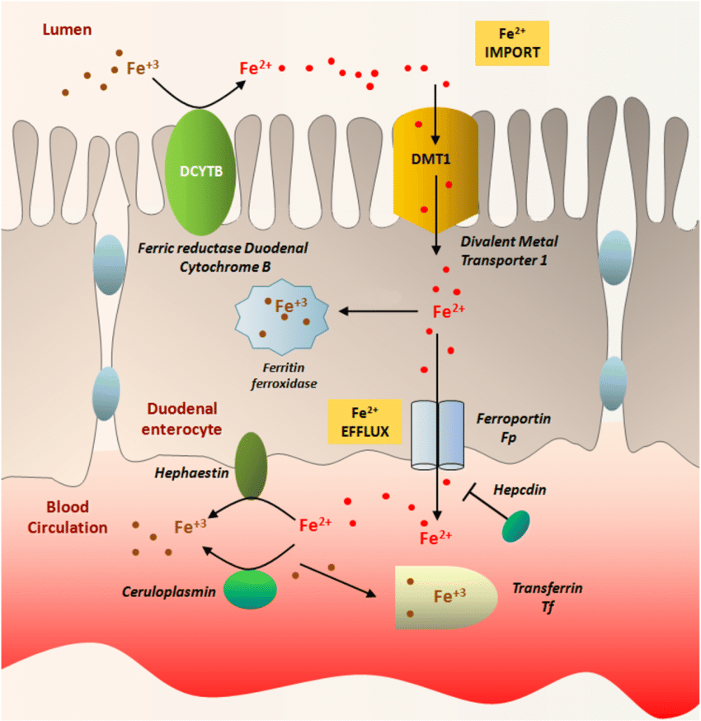
Iron transport
absorption of dietary iron is relatively low (5-35%)
absorption from diet is enhanced in the presence of vitamin C and diminished by excess calcium, zinc, or manganese
HCP1
heme carrier protein 1
enterocytes synthesize more Dcytb, DMT1 and ferroportin in response to iron deficiency
* there is no physiologic regulatory mechanism for excreting iron

Slide 26
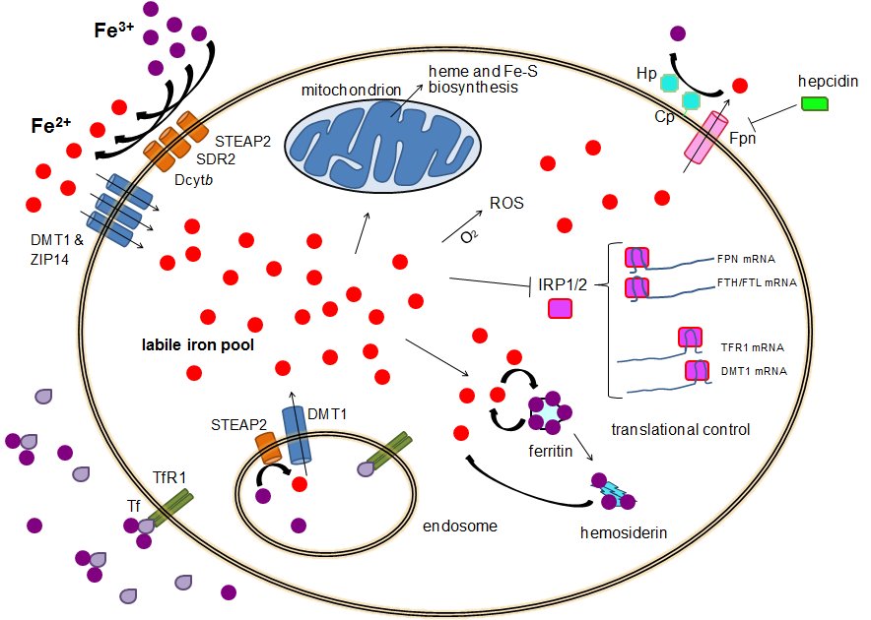
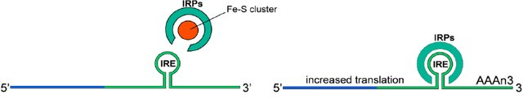
Cellular iron homeostasis
Alternatively,divalent iron can enter the cell directly via DMT1, ZIP14
Hepcidin causes the internalization of ferroportin, decreasing iron export.
iron exporter
ferroportin Fpn
~0.001 mM
iron-responsive element-binding proteins, also known as IRE-BP, IRBP, IRP and IFR
Cellular uptake primarily through receptor-mediated endocytosis via transferrin receptor TFR1, TRF2 and GAPDH

Slide 27
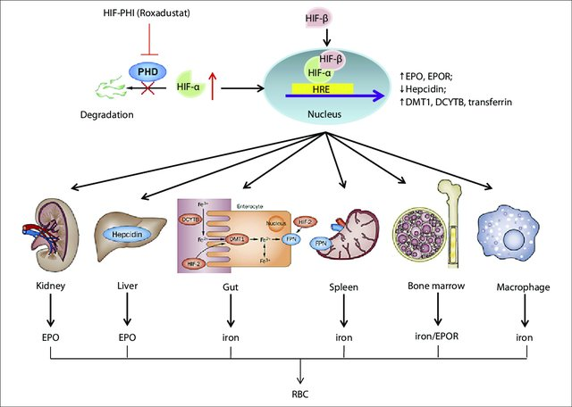

Slide 28
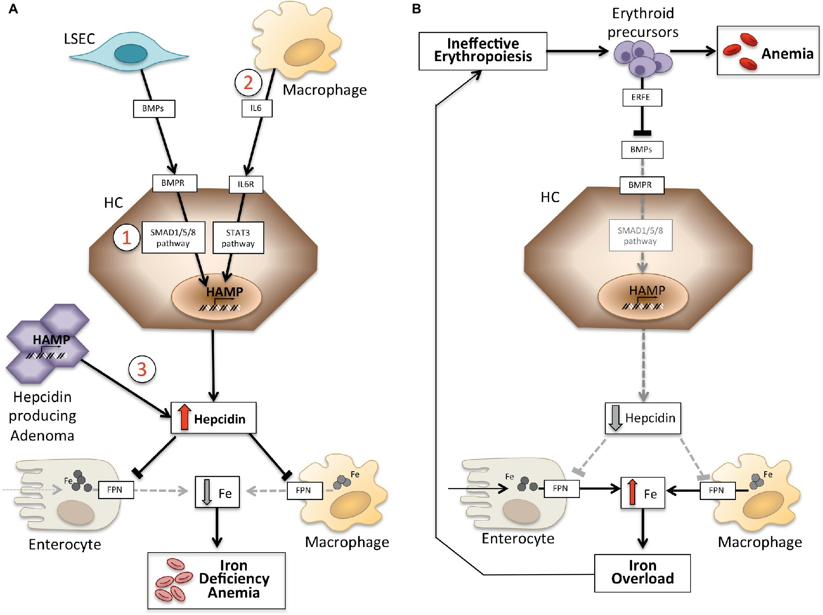
HEPCIDIN
Erythroferrone is a protein hormone encoded in humans by the ERFE gene. Erythroferrone is produced by erythroblasts

Slide 29
Tests for iron
iron concentration in serum (age , sex)
TIBC (total iron binding capacity for Fe)
transferrin saturation (N 20-55 %)
serum ferritin
serum (solubile) transferrin receptor (sTfR)

Slide 30
Tests of iron metabolism
Serum iron ( SI)
F: 600-1400 μg/L, 11-25μmol/L; M: 750-1500 μg/L, 13-27μmol/L
Low in Fe deficiency and chronic disease
High in hemolytic syndromes and iron overload
Total iron binding capacity (TIBC)
2500 – 4500 μg/L , 45-82 μmol/L
High in Fe deficiency
Low in chronic disease
Serum ferritin (30-300 ng/mL)
Fe storage glycoprotein
Closely correlates with total body Fe stores
<12 ng/mL Fe deficiency
Elevated in Fe overload, liver injury, tumors (Acute phase protein)

Slide 31
Tests for iron metabolism
Serum transferin receptor
Increase in increased erythropoiesis and early Fe deficiency
RBC ferritin
storage status over the previous 3 month (Fe deficiency/overload)
unaffected by liver function or acute illness
Free RBC porphyrin
increased when heme synthesis altered

Slide 32
Manifest
anemia
Latent iron deficiency
erythropoiesis
serum iron
transferin satur.
transferin
Prelatent no stores
serum ferritin
TIBC ~ transferin
iron in BM

Slide 33
Microcytic Hypochromic Anemia (MCV<83; MCHC<31)
Iron deficiency |  | Responsive to iron therapy
Chronic inflammation |  | Unresponsive to iron therapy
Thalassemia major |  | Reticulocytosis and indirect bilirubinemia
Thalassemia minor |  | Elevation of fetal hemoglobin, target cells, and poikilocytosis
Lead poisoning | Basophilic stippling of RBCs
Sideroblastic | Ring sideroblasts in marrow
Hemoglobi-nopaties | Hemoglobin electrophoresis

Slide 34
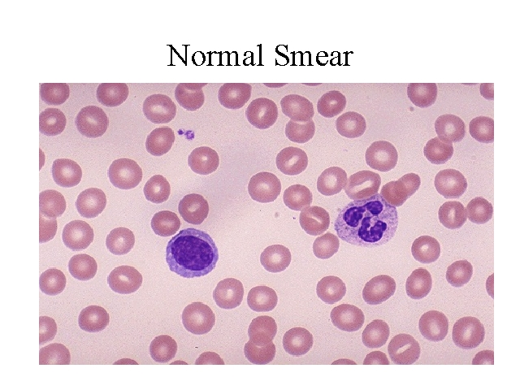

Slide 35
Microcytic Hypochromic Anemia (MCV<83; MCHC<31)
 | Serum Iron | Total Iron-Binding Capacity (TIBC) | Bone Marrow Iron | Comment
Lead poisoning |  |  |  | Basophilic stippling of RBCs
Sideroblastic |  |  |  | Ring sideroblasts in marrow
Hemoglobinopaties |  |  |  | Hemoglobin electrophoresis
N
N
++
N
++++
N
N
++

Slide 36
Microcytic Hypochromic Anemia (MCV<83; MCHC<31)
 | Serum Iron | Total Iron-Binding Capacity (TIBC) | Bone Marrow Iron |  | Comment
Iron deficiency |  |  |  |  | Responsive to iron therapy
Chronic inflammation |  |  |  |  | Unresponsive to iron therapy
Thalassemia major |  |  |  |  | Reticulocytosis and indirect bilirubinemia
Thalassemia minor |  |  |  |  | Elevation of A of fetal hemoglobin, target cells, and poikilocytosis
0
++
N
++++
N
N
++

Slide 37
Macrocytic Anemia (MCV, >95)
Megaloblastic bone marrow | Deficiency of vitamin B-12
 | Deficiency of folic acid
 | Drugs affecting DNA synthesis
 | Inherited disorders of DNA synthesis
Nonmegaloblastic bone marrow | Liver disease
 | Hypothyroidism and hypopituitarism
 | Accelerated erythropoiesis (reticulocytes)
 | Hypoplastic and aplastic anemia
 | Infiltrated bone marrow

Slide 38
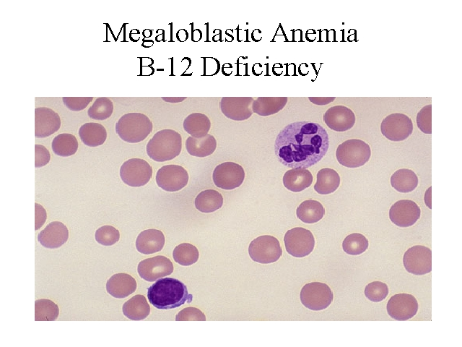

Slide 39
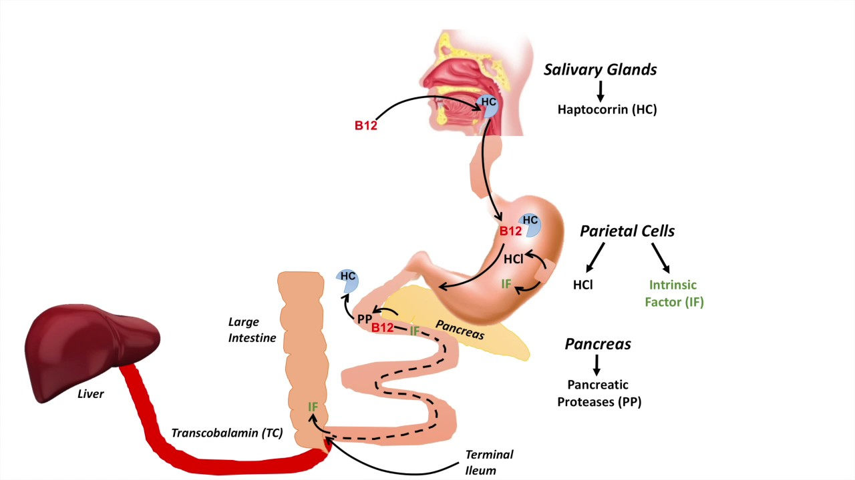
Absorption of vit. B12

Slide 40
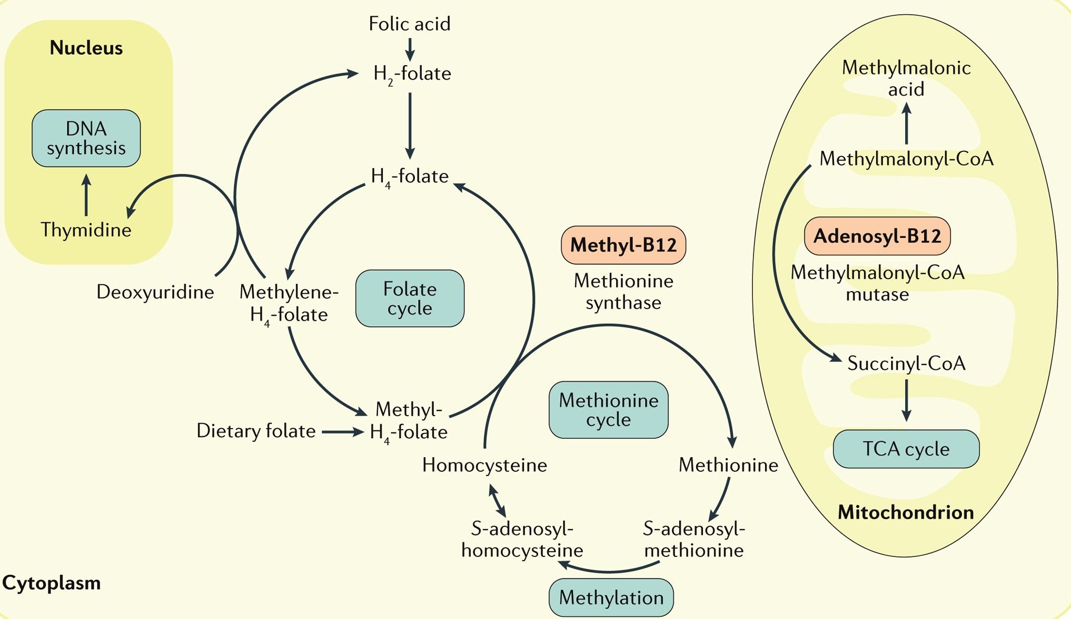
The role of vit. B12 and folate

Slide 41
Lack of vit. B12 - causes
Not enough ingestion – strict vegans if they do not take care
Autoimmune inflammation of gastric mucosa (atrophic gastritis) leading to deficiency in intrinsic factor
Diseases of terminal ileum (celiac disease, Crohn disease)

Slide 42
Blood smear
Morphology of blood elements
Anisocytosis = variation in size
Poikilocytosis = variation in shape (schistocytes=RBC fragments; ovalocytes; spherocytes)

Slide 43
Various Forms of RBCs
Spherocyte | Loss of central pallor, stains more densely, often microcytic. Hereditary spherocytosis and certain acquired hemolytic anemias.
Target cell | Hypochromic with central "target" of hemoglobin. Liver disease, thalassemia, hemoglobin D, postsplenectomy.
Elliptocyte | Oval to cigar shaped. Hereditary elliptocytosis, certain anemias (particularly vitamin B-12 and folate deficiency).
Schistocyte | Fragmented helmet- or triangular-shaped RBCs. Microangiopathic anemia, artificial heart values, uremia, malignant hypertension.
Stomatocyte | Slitlike area of central pallor in erythrocyte. Liver disease, acute alcoholism, malignancies, hereditary stomatocytosis, and artifact.
Sickle cell | Elongated cell with pointed ends. Hemoglobin S and certain types of hemoglobin C and l.

Slide 44
Sicle Cell Disease
Hemoglobin (Hb) S arises from a mutation coding of valine instead of glutamine in position 6 of the hemoglobin beta chain.
The resulting hemoglobin has the physical properties of forming polymers under deoxy conditionsUnder deoxy conditions.
Hb S forms a gel-like substance containing hemoglobin crystals called tactoids.
Notes:
Hemoglobin (Hb) S arises from a mutation substituting thymine for adenine in the sixth codon of the beta-chain gene GAG to GTG. This causes coding of valine instead of glutamine in position 6 of the hemoglobin beta chain. The resulting hemoglobin has the physical properties of forming polymers under deoxy conditions. It also exhibits changes in solubility and molecular stability. These properties are responsible for the profound clinical expressions of the sickling syndromes.
Under deoxy conditions, Hb S undergoes marked decrease in solubility, increased viscosity, and polymer formation at concentrations exceeding 30 g/dL. It forms a gel-like substance containing hemoglobin crystals called tactoids. The gel-like form of hemoglobin is in equilibrium with its liquid soluble form. A number of factors influence this equilibrium, including the following:
Oxygen tension
Polymer formation occurs only in the deoxy state.
If oxygen is present, the liquid state prevails.
Concentration of Hb S
The normal cellular hemoglobin concentration is 30 g/dL.
Gelation of Hb S occurs at concentrations greater than 20.8 g/dL.
The presence of other hemoglobins
Hemoglobin A and hemoglobin F have an inhibitory effect on gelation.
These and other hemoglobin interactions affect the severity of clinical syndromes.
SS hemoglobin produces a more severe disease than SC, SD, SO Arab, and SA hemoglobin.

