Slide 1
Blood pressure
Preclinical practice
13. 5. 2024

Slide 2
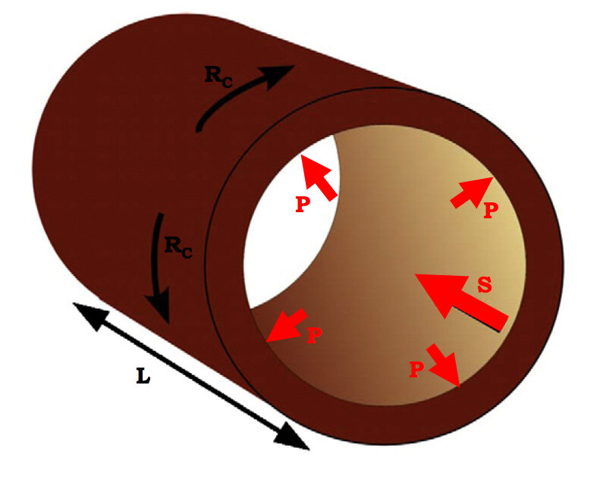
Blood pressure
Blood pressure (BP): pressure of blood on the vessel wall
(arterial BP – part of the energy of systole converted into lateral pressure on the vascular wall)

Slide 3
Arterial blood pressure curve
Pulse wave
  arises when the blood is expelled from the left ventricle into the circulation during the systolic phase
Mean arterial pressure (MAP): mean value of blood pressure in the inter-beat interval (IBI) – integral of the BP curve; area above MAP = area below MAP
aproximation: MAP = DBP + 1/3 PP (PP = SBP – DBP)
Definition:
SBP (systolic BP)
maximum of BP in the inter-beat interval
DBP (diastolic BP)
minimum of BP in the inter-beat interval
SBP
Dicrotic notch
PP
pulse pressure
MAP
DBP
Inter-beat interval

Slide 4
Pulse wave velocity (PWV)
The pulse wave propagation rate (PWV) is measurable, around 4 m/s in the aorta.
  Beware, the actual speed of blood flow is significantly lower, it is around 80-100 cm/s in the aorta
The peripheral pulse wave velocity is 10-20 m/s (depending on the site of measurement)
Measureable by inderect method: Sphygmography with ECG
A
B
T1
T2
A
B
d
PWV= d/ (T2-T1)

Slide 5
Blood pressure
a function of cardiac output (CO) and total peripheral resistance
  SBP is determined mainly by CO
  DBP is determined mainly by TPR
Blood pressure = Cardiac output (CO) * Total peripheral resistence (TPR)
CO = Heart rate (HR) * Stroke volume (SV)

Slide 6
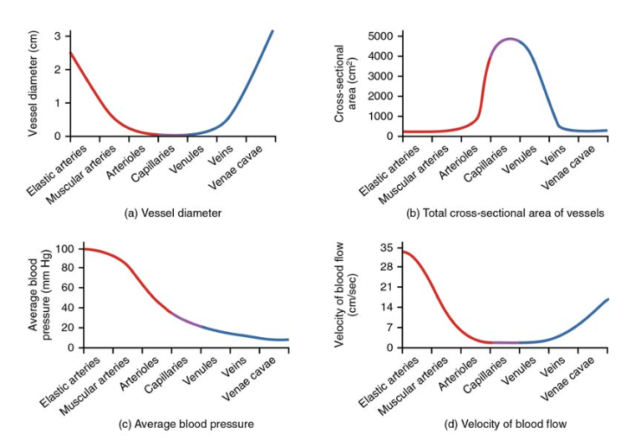
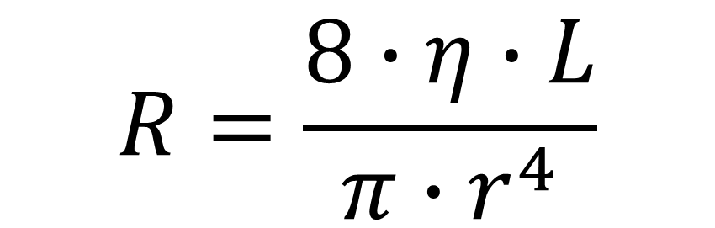
Total peripheral resistence
consist of resistence from all vessels
the narrower tube (↓ diameter) → the ↑ pressure needs to be exerted to maintain the flow
determined by the Hagen-Poiseuille law for tube resistance
$$R=\frac{8∙η∙L}{π∙r^{4}}$$

Slide 7
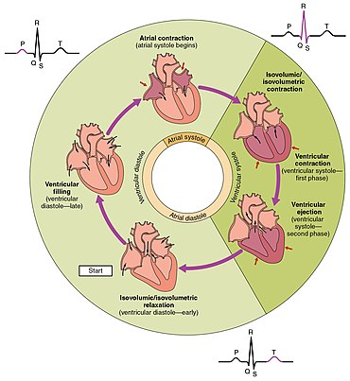
Cardiac cycle
Isovolumic contraction (IVC):
  Contraction of ventricular myocardium leads to an increase in intraventricular pressure
Ejection (E):
  Intraventricular pressure overcomes diastolic pressure in big arteries, semilunar valves open, and blood flows to the arteries
Isovolumic relaxation (IVR):
  Semilunar valves close, rapid decrease in intraventricular pressure even below pressure values in atria, AV valves open
Inflow (I):
  Inflow phase (ventricular diastole), atrial systole

Slide 8
P-V diagram (Left ventricle)
Systole = IVC + E
P [mmHg]
IVC = 0.06 s
E = 0.21 s
SBP
E
Diastole = IVR + I
120
IVR = 0.07 s
I = 0.49 s
100
DBP
80
IVR
IVC
I
10
50
120
V [ml]
ESV
EDV
Notes:
Normal RV systolic pressure is 20–30 mmHg and normal diastolic pressure is 3–7 mmHg (Table 2).
LV – 130-9

Slide 9
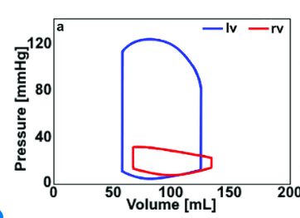
P-V diagram
Notes:
Normal RV systolic pressure is 20–30 mmHg and normal diastolic pressure is 3–7 mmHg (Table 2).
LV – 130-9

Slide 10
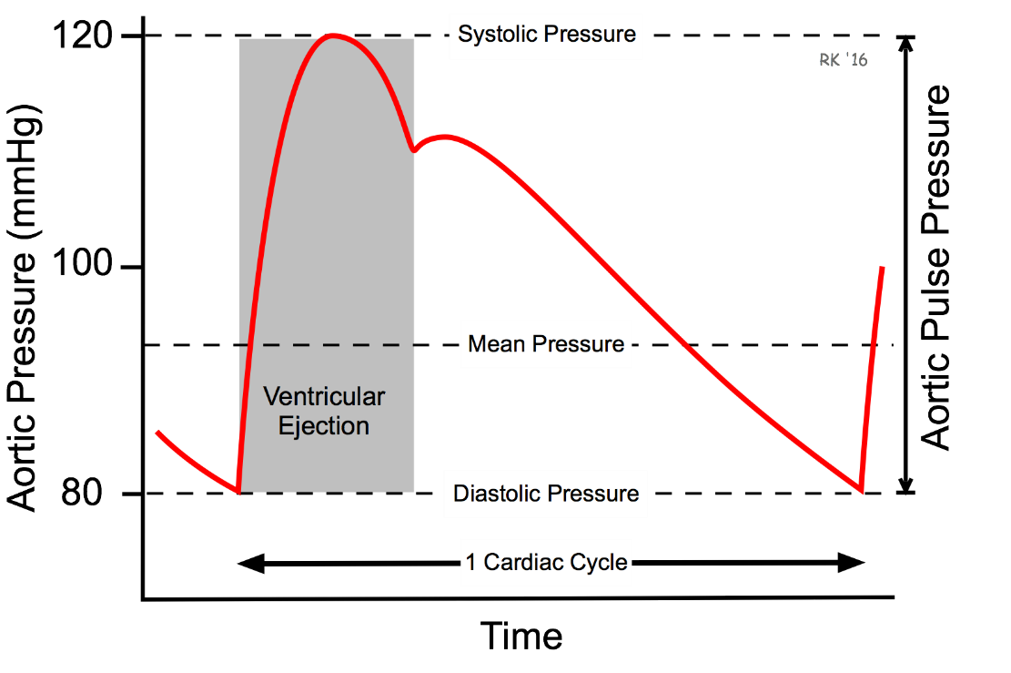
Arterial blood pressure
stable blood flow thanks to aortic compliance
  the aorta expands and holds the ejected blood volume (change of kinetic energy into elastic) and during diastole, it contracts and moves the blood further into the bloodstream (change of elastic energy to kinetic)
Notes:
Normal RV systolic pressure is 20–30 mmHg and normal diastolic pressure is 3–7 mmHg (Table 2).
LV – 130-9

Slide 11
Blood pressure in veins
low pressure system
peripherial pressure in veins is usually between 8 and 10 mmHg
central vein pressure is aproximately 0–6 mmHg
Notes:
Normal RV systolic pressure is 20–30 mmHg and normal diastolic pressure is 3–7 mmHg (Table 2).
LV – 130-9

Slide 12
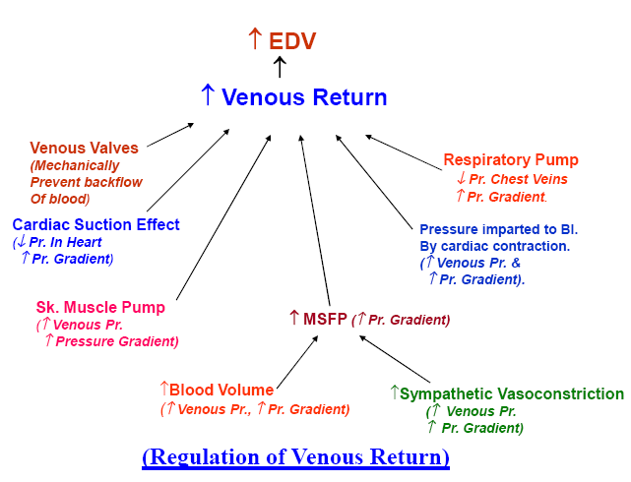
Blood pressure in veins
Notes:
Normal RV systolic pressure is 20–30 mmHg and normal diastolic pressure is 3–7 mmHg (Table 2).
LV – 130-9

Slide 13
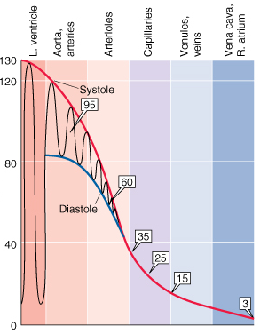
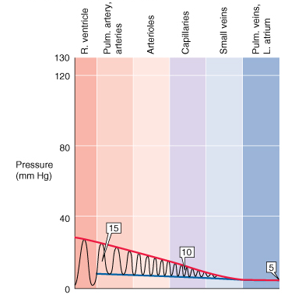
Large circle
Small circle
Blood pressure
Boron and Boulpaep, Medical physiology

Slide 14
Blood pressure regulation
Short-term – neural control – mainly by baroreflex
– chemical substancis
Middle-term – hormonal regulation - renin-angiotensin-aldosterone system (RAAS)
Long-term – hormonal regulation of blood volume

Slide 15
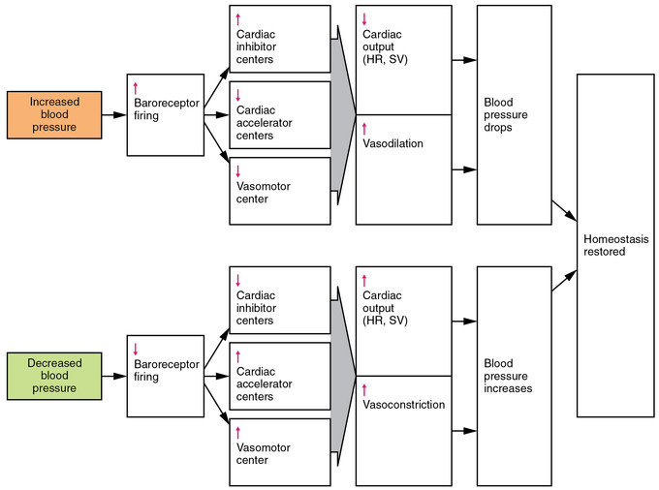
Short-term BP control – baroreflex
Notes:
https://www.ncbi.nlm.nih.gov/books/NBK538509/

Slide 16
BP control – substances
vasoconstrictors
  ATP, epinephrine, norepinephrine, antidiuretic hormone, and angiotensin II
vasodilators
  epinephrine, atrial natriuretic peptide, histamin, arginine (→NO), and lactic acid (metabolic reaction)

Slide 17
Blood pressure changes
Short-term influences
  blood volume – influence on cardiac output (bleeding, dehydration)
  external pressure to the vessels – intrathoracic and intraabdominal pressure (cough, defecation, childbirth, artificial ventilation)
  position – orthostasis/clinostasis: redistribution of blood due to gravity
  CNS – emotions, mental stress, …
  physical exercise – BP changes depend on intensity, duration and type of exercise
  heat (↓ TPR), cold (↑ TPR)
  alcohol, drugs,…
Long-term influences
  age (the fastest changes during childhood and adolescence, in adults slow increase in SBP)
  sex (men have higher BP)
  genetic background

Slide 18
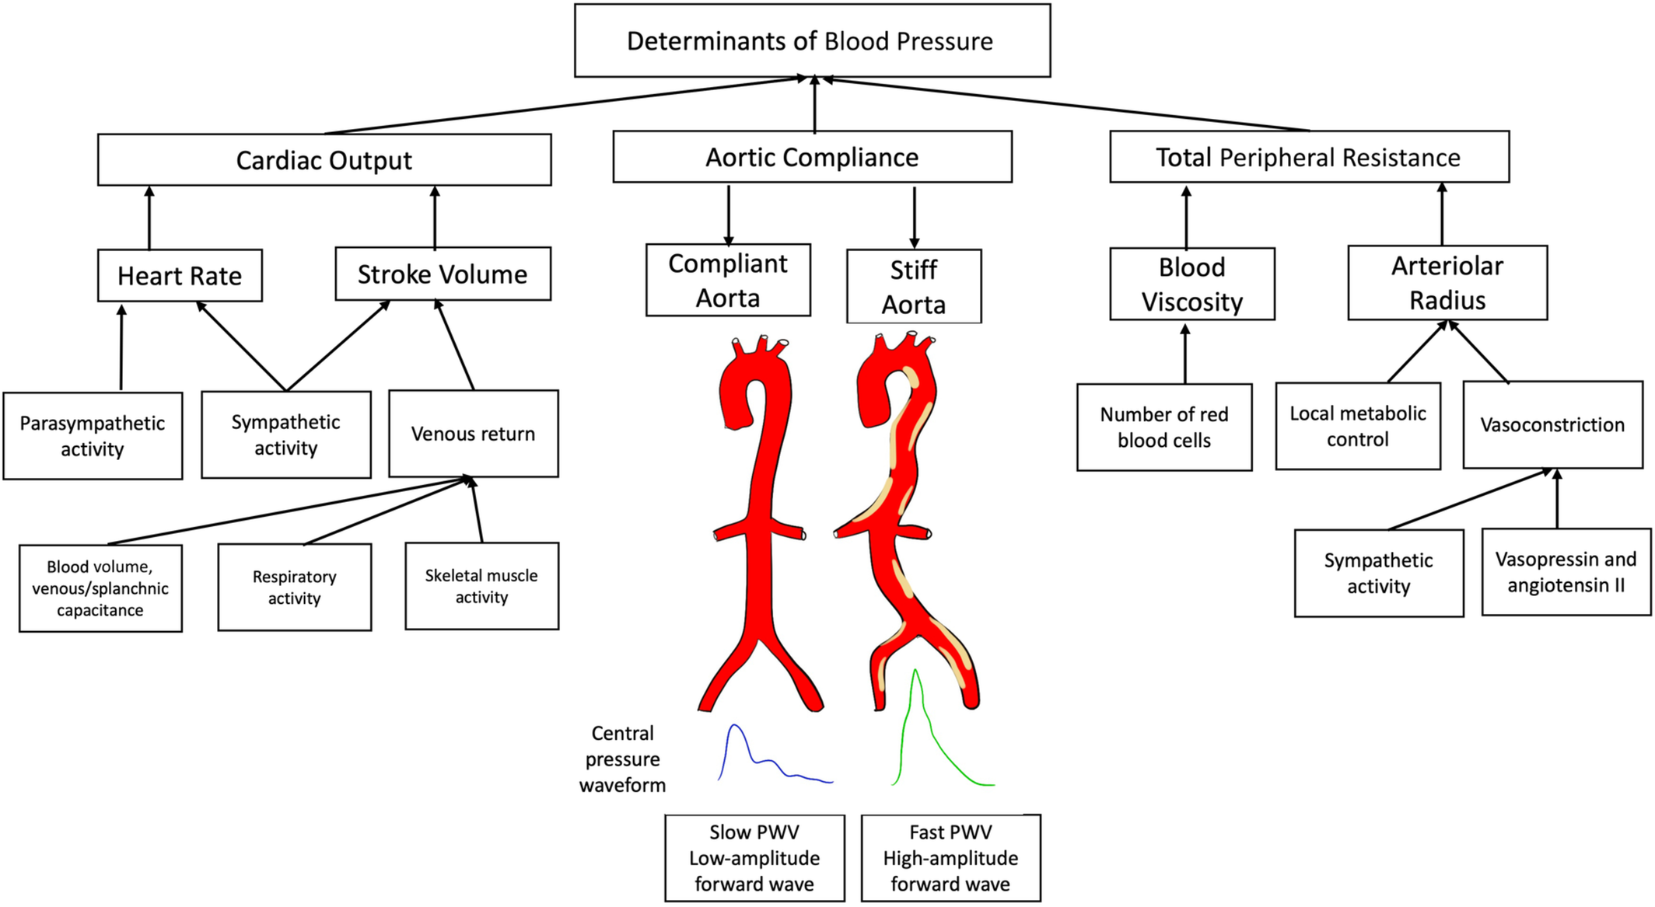

Slide 19
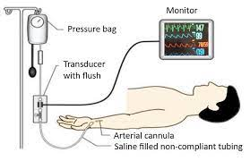
Methods of the arterial BP measurement
Invasive
  arterial catether

Slide 20
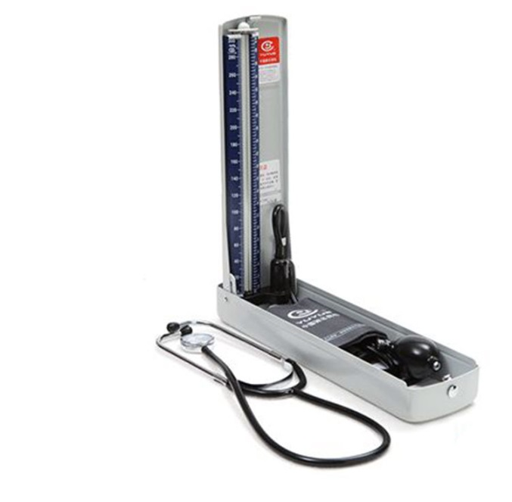
Methods of the arterial BP measurement
Invasive
  arterial catether
Non-invasive
  Auscultatory (sphygmomanometer, stethoscope)

Slide 21
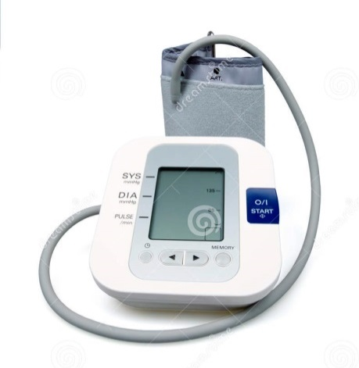
Methods of the arterial BP measurement
Invasive
  arterial catether
Non-invasive
  Auscultatory (sphygmomanometer, stethoscope)
  Oscillometric

Slide 22
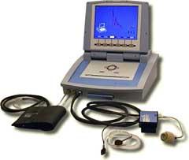
Methods of the arterial BP measurement
Invasive
  arterial catether
Non-invasive
  Auscultatory (sphygmomanometer, stethoscope)
  Oscillometric
  Photoplethysmographic/Peňáz/volume-clamp method

Slide 23
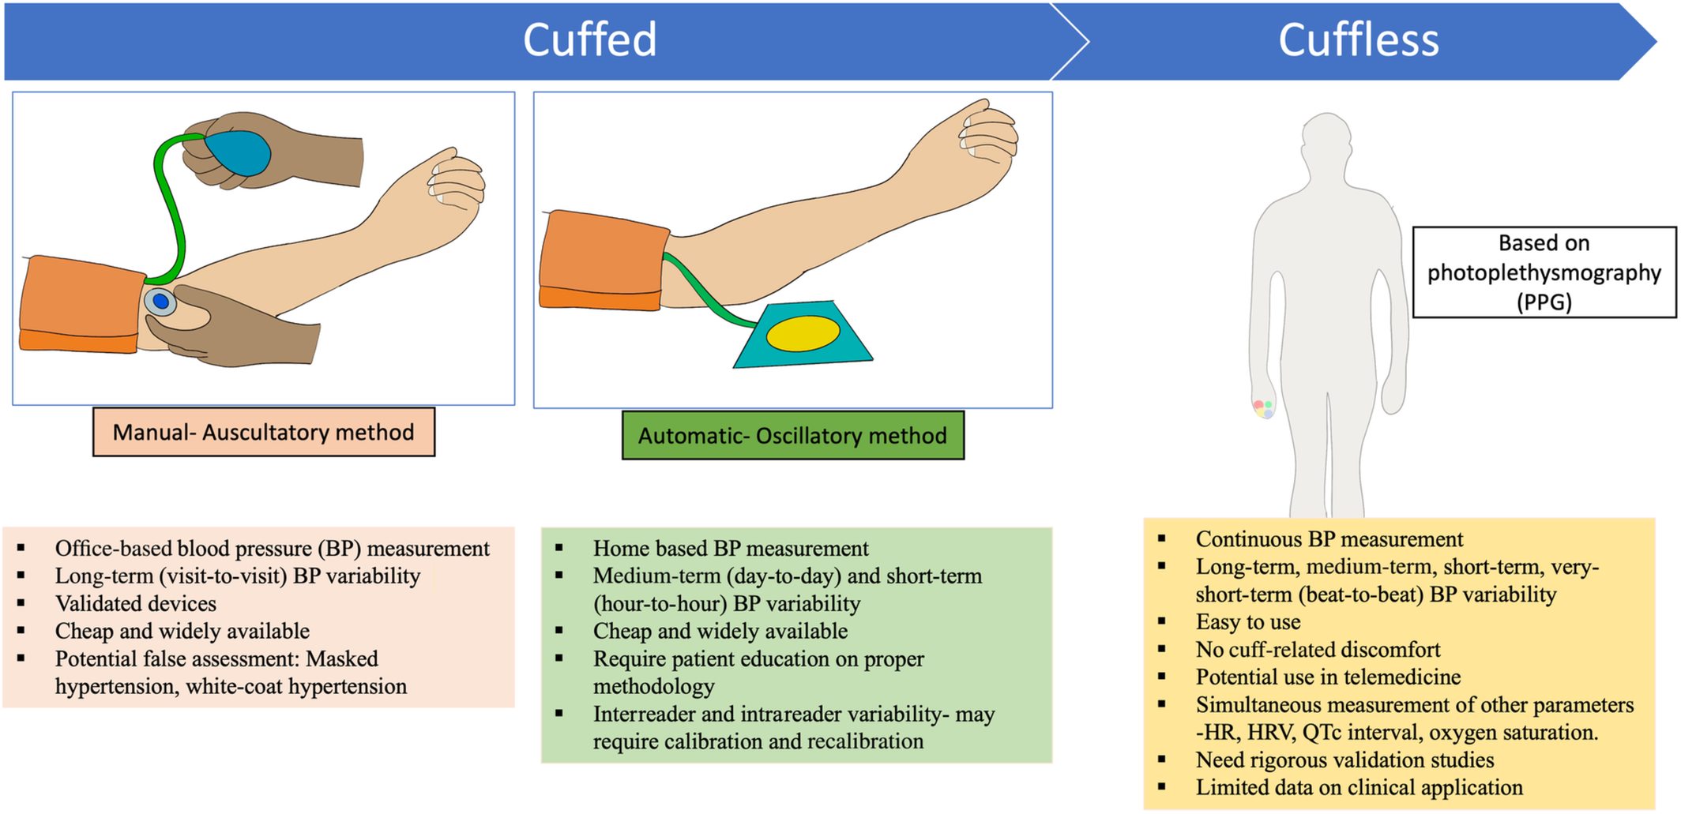
Methods of the arterial BP measurement
Invasive
  arterial catether
Non-invasive
  Auscultatory (sphygmomanometer, stethoscope)
  Oscillometric
  Photoplethysmographic/Peňáz/volume-clamp method

Slide 24
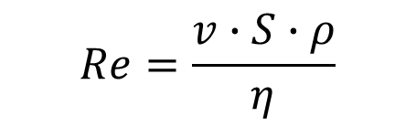
Basic principle: Laminar / turbulent flow
(Korotkoff sounds in auscultatory method; oscillation in oscilometric method).
$$Re=\frac{v∙S∙ρ}{η}$$
laminar flow Re < 2000
turbulent flow Re > 3000
Reynolds number Re: predicts the transition from laminar to turbulent of flow
v: velocity of blood flow
S: area of vascular lumen (π.r²)
ρ: density of blood
η: viscosity of blood
(lower in anemia)
cuff
a. brachialis
Re₂
r₁
r₂
v₂
v₁
Re₁
laminar flow
turbulent flow

Slide 25
Principles of BP measurement
SBP
MAP
DBP
Korotkoff sound
(auscultatory method)
Pressure in the cuff
SBP
DBP
Pressure oscillations in the cuff
(oscillometric method)
Continually measured BP
Blood flow in the artery

Slide 26
Photoplethysmographic/Peňáz/volume-clamp method
Peňáz method - it is based on clamping the volume of finger arteries by fast changes of pressure in a special cuff equipped with a photoelectric plethysmograph to measure the vascular volume
Photopletysmography - an optical method for measuring the amount of light that is absorbed or reflected by blood vessels in living tissue. The amount of light absorbed or reflected in photoplethysmography depends on the amount of blood in the optical path.

Slide 27
Assesmemt of BP varaibility
Very short term – from continous BP measurement
  Neurohormonal factors (baroreflex, sympathetic activation)
  Nitric oxide, renin‐angiotensin‐aldosterone system
  Enviromental, behavioral, and emotional factors
Short tem (within 24-h)
  Neurohormonal factors (baroreflex, sympathetic activation)
  Environmental, behavioral, and emotional
  Circadian rhythm
Notes:
https://www.ahajournals.org/doi/full/10.1161/JAHA.122.029297

Slide 28
Assesmemt of BP varaibility
Medium term (day to day)
  drugs
  vascular factors (endothelial damage, arterial compliance)
  age
Long tern (visit to visit)
  drugs
  seasonal changes
  vascular factors (endothilial damage, arteriál compliance)
  age

Slide 29
method | advantages | disadvantages | measured value
auscultatory | exact estimation of SBP/DBP easy, it doesn´t require electricity | subjective, experience is necessary SBP/DBP from different IBI | SBP and DBP
oscillometry | exact estimation of MAP automatic, fast BP can be measured by layman, cheap (home measurement) | DBP/SBP is calculated (dependence on model, influenced by a shape of pulse wave) SBP/DBP from different IBI false values during arrhythmia | MAP, sometimes SBP (it depends on a device)
24-hour BP monitoring | BP record from whole day diagnosis of white-coat hypertension | disruptive influence of measuring (during sleeping) SBP/DBP from different IBI | BP is measured each 15–60 min
photople-thysmography (Peňáz) | continual BP record possibility of beat-to beat SBP/DBP calculation (BP variability analysis) | measurement on a finger, brachial BP is calculated expensive device | continual BP record

Slide 30
Rules for BP measurement
Environment: pleasant room temperature, quiet surroundings
Position: the patient sits with his back leaning backwards, both legs are on the floor, forearm rests on a surface
Reasonable cuff size, correct positioning at heart level
The measurement happens at rest and starts after 5 – 10 minutes of sitting down
Measurement by auscultatory method
  Inflate the cuff to a pressure 30 mmHg higher than the pressure at which the radial pulse disappeared
  The pressure reduction rate in the cuff is 2 – 3 mmHg/s
  The pressure value is determined with 2 mmHg accuracy
The BP should be measured 3 times at least five minutes apart and the final BP value is a mean value of the last two measurements

Slide 31
Diagnosis of hypertension
 | blood pressure | SBP [mmHg] | DBP [mmHg] | possible complications
normal | optimal | <120 | <80
 | normal | 120 – 129 | 80 – 84
 | high normal | 130 – 139 | 85 – 90
hypertension | stage | 140 – 159 | 90 – 99 | without organ changes
 | 2. stage | 160 – 179 | 100 – 109 | hypertrophy of L ventricle, proteinuria, angiopathy, ...
 | 3. stage | > 180 | > 110 | morphological and functional changes of some organs, retinopathy, heart and renal insufficiency, ischemia of CNS, bleeding in CNS
Isolated systolic hypertension: SBP> 140 and DBP <90 mmHg
High normal BP – annual monitoring recommended
Home measurement to exclude white coat hypertension
Hypertension is diagnosed when:
  average BP from 4–5 examinations is > 140/90 mmHg
  BP during a home measurement repeatedly > 135/80 mmHg
  mean BP from 24-hour monitoring is > 130/80 mmHg

