Slide 1
Arterial stiffness.

Slide 2
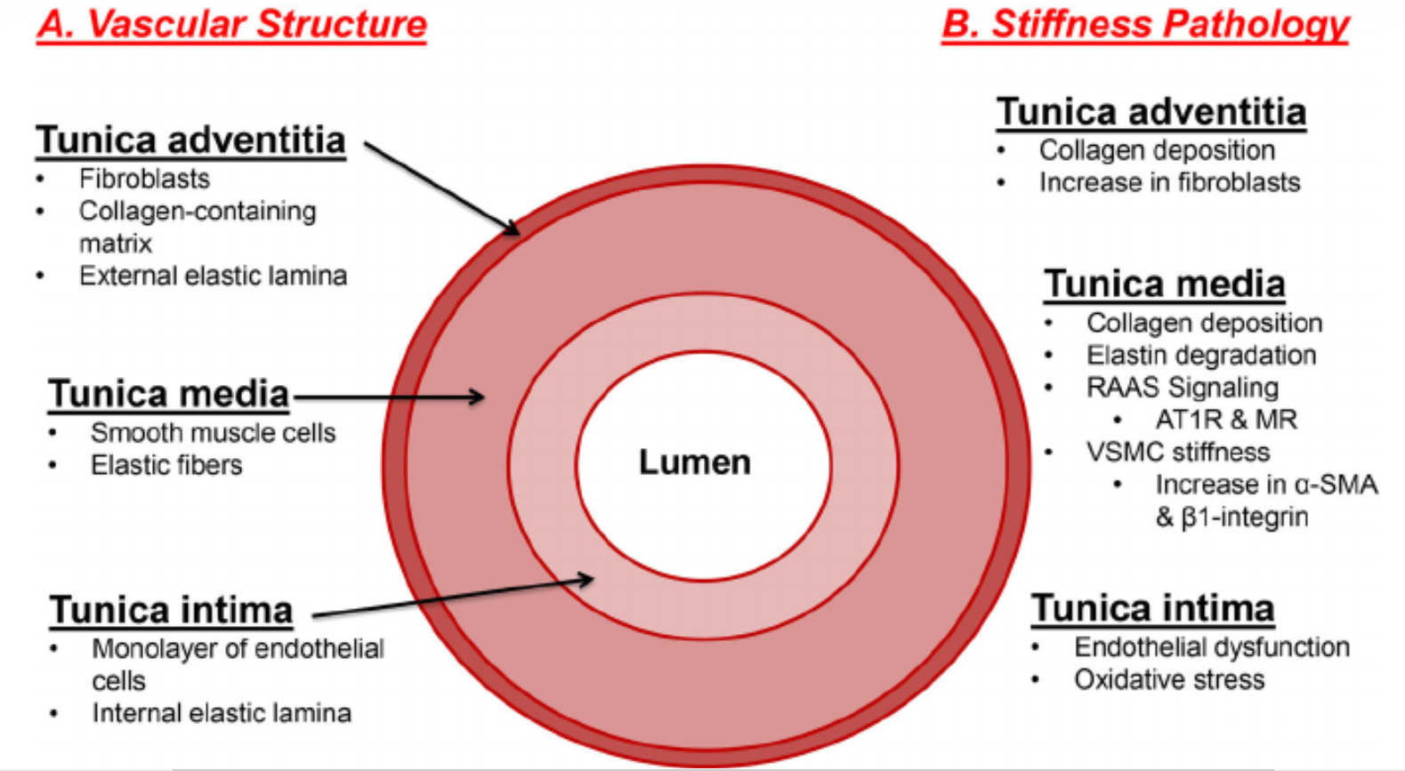
Factors of arterial stiffness changes
!
Elastin degradation
Collagen deposition
Endothelial dysfunction

Slide 3
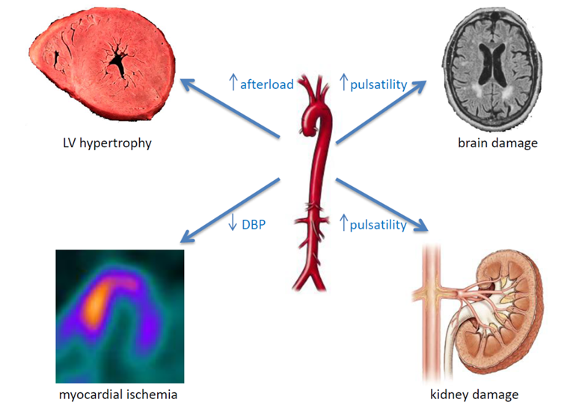
Complications of the higher arterial stiffness

Slide 4
Pulse wave
P[mmHg]
Forward systolic wave
t [s]
Reflected wave

Slide 5
Pulse wave
P[mmHg]
P[mmHg]
SBP/P₁
P₂
DBP
t [s]
t [s]
Forward systolic wave
PP=SBP – DBP
mBP=DBP+1/3PP
AP=P₂ – P₁
Reflected wave
SBP – systolic blood pressure, DBP – diastolic blood pressure, P₁ – pressure at peak of systolic flow, P₂ – pressure of the reflected wave, PP – pulse pressure, mBP – mean blood pressure, AP – augmented pressure

Slide 6
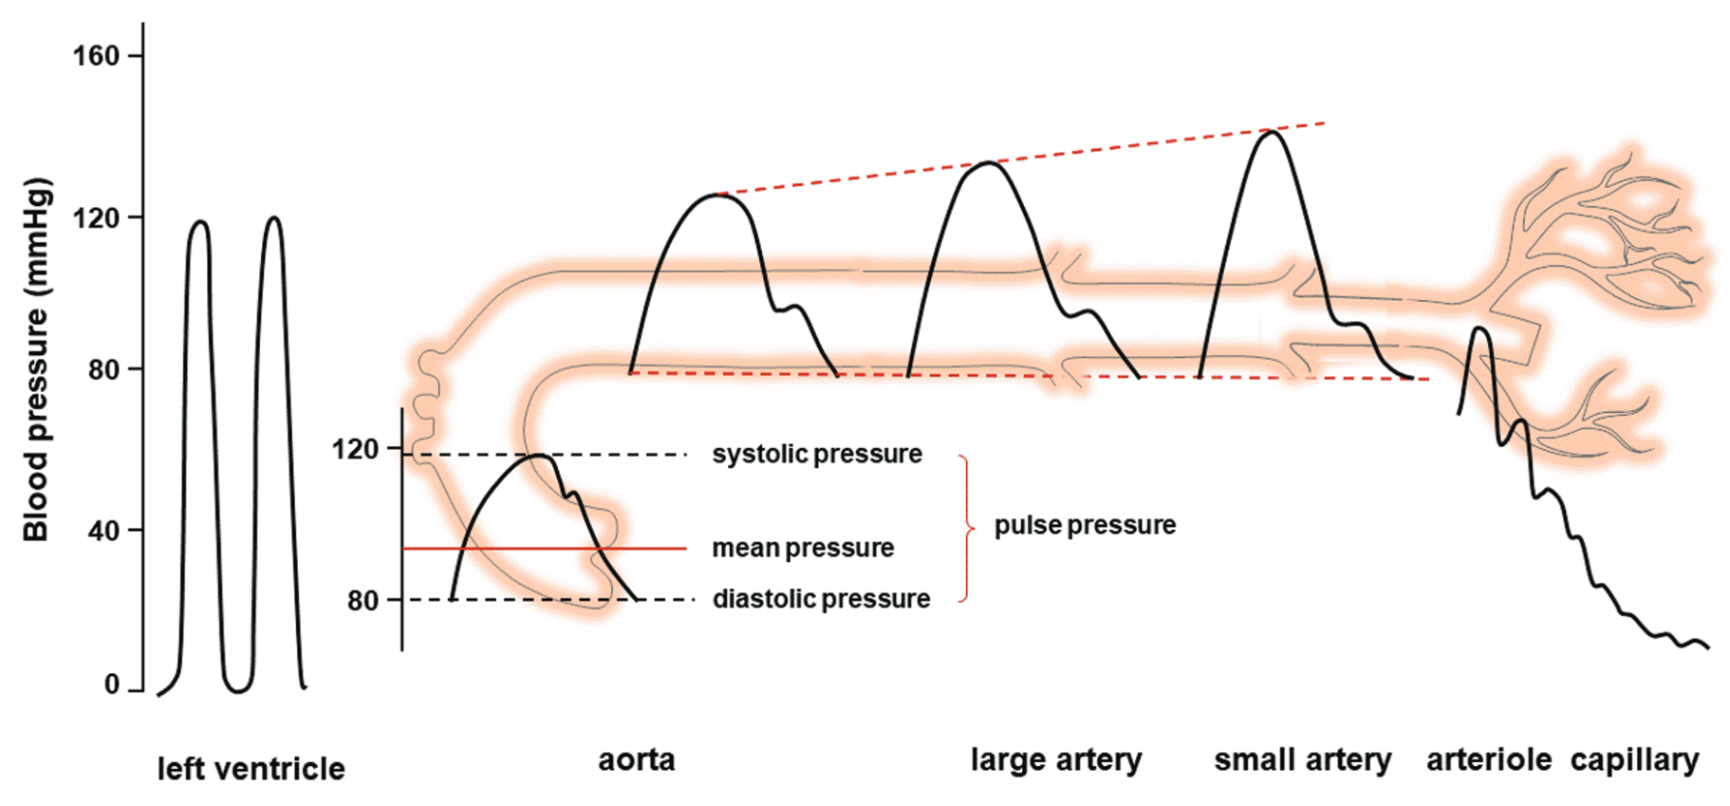
Pulse wave at different vascular segments

Slide 7
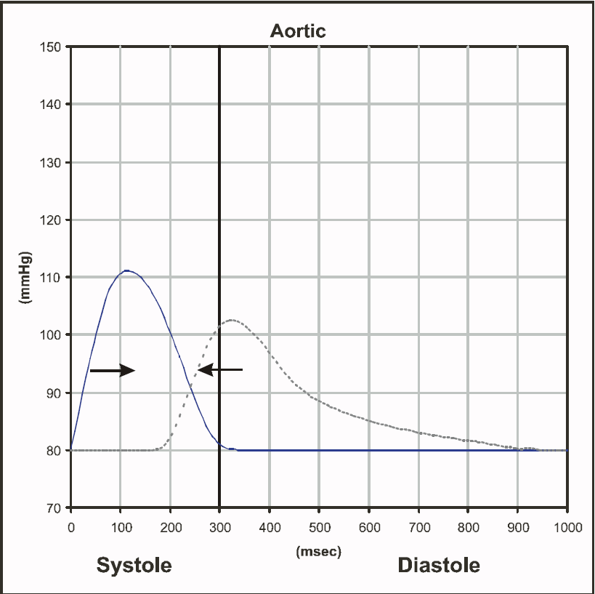
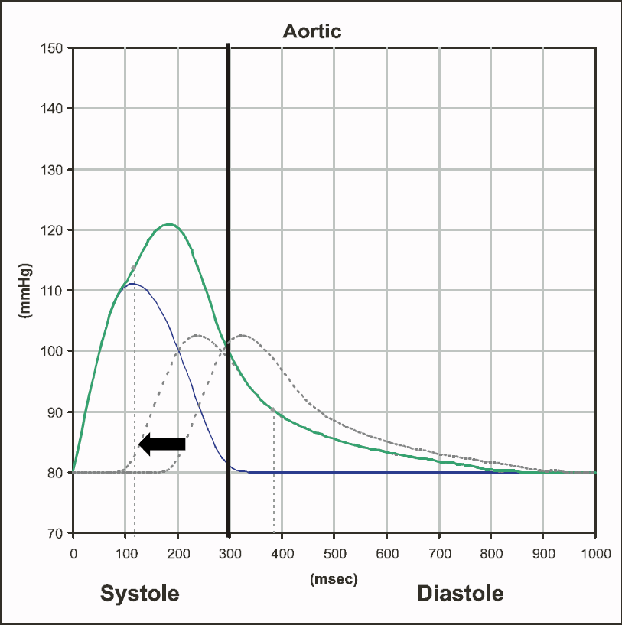
Pressure wave reflection

Slide 8
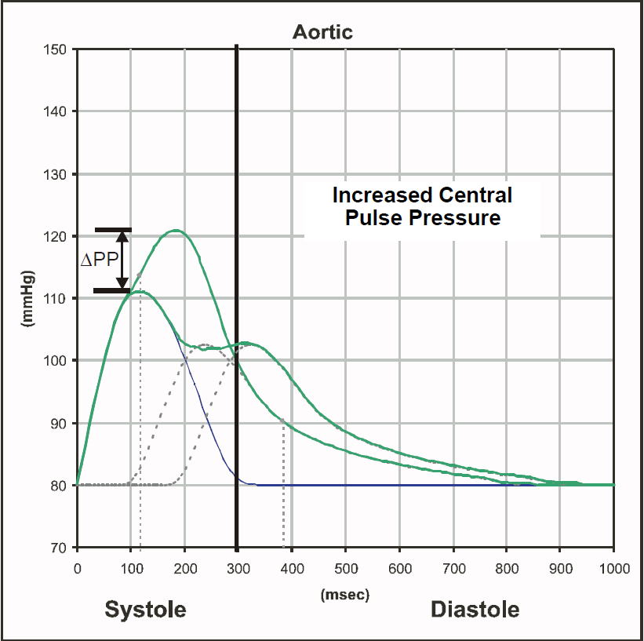
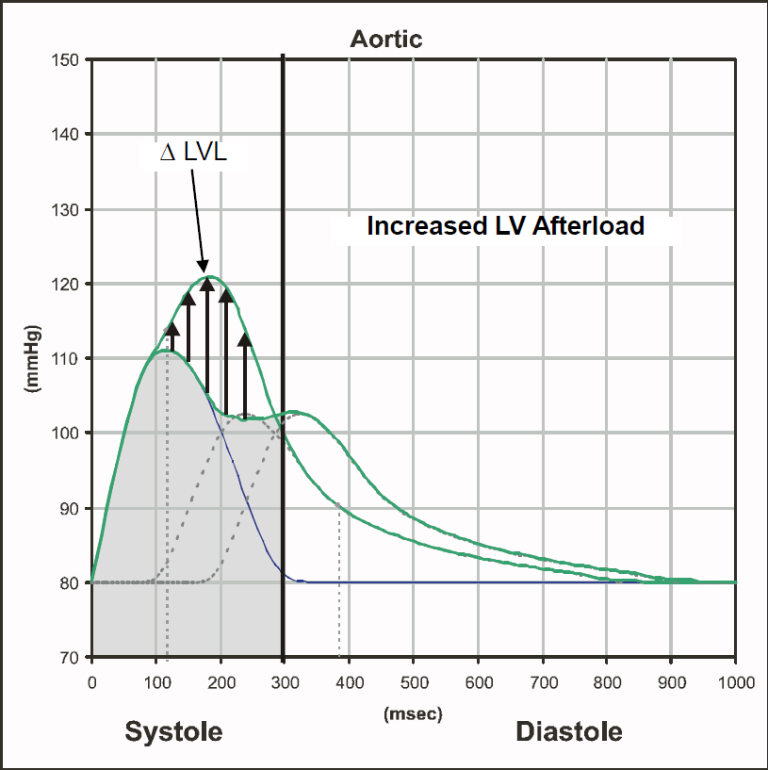
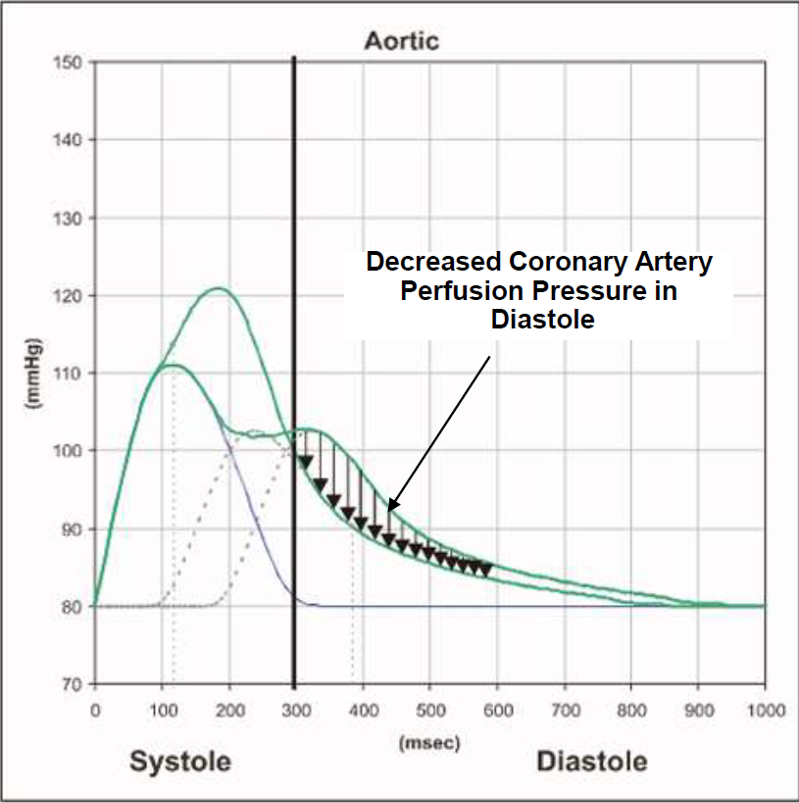
Pressure wave reflection

Slide 9
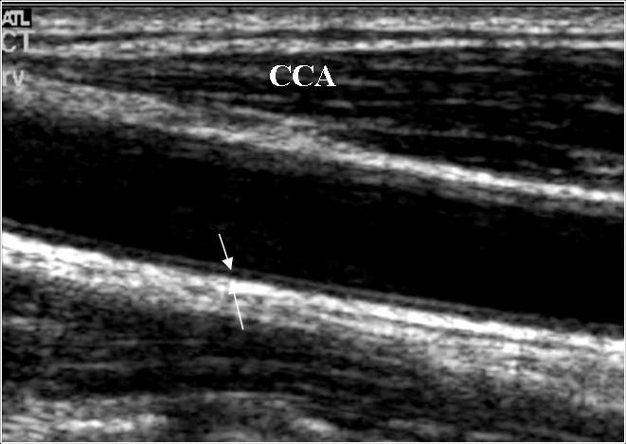
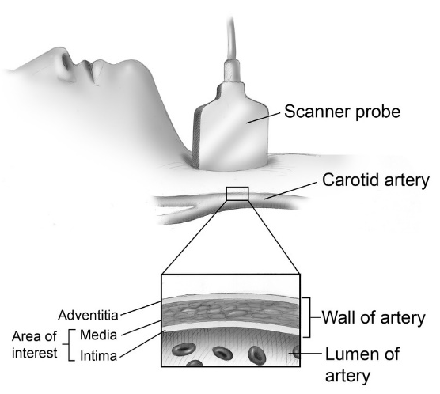
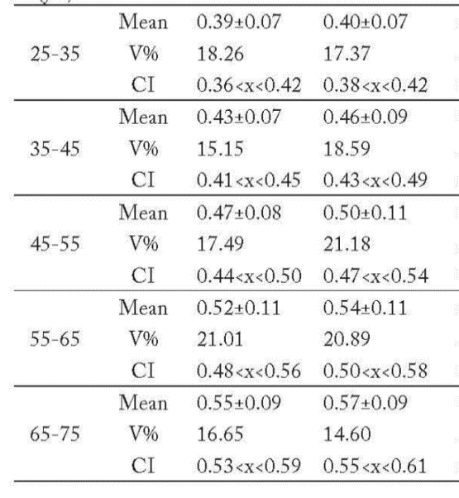
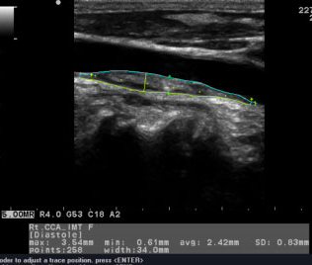
Ultrasound measurement
age
IMT_{R} (mm)
IMT_{L} (mm)

Slide 10
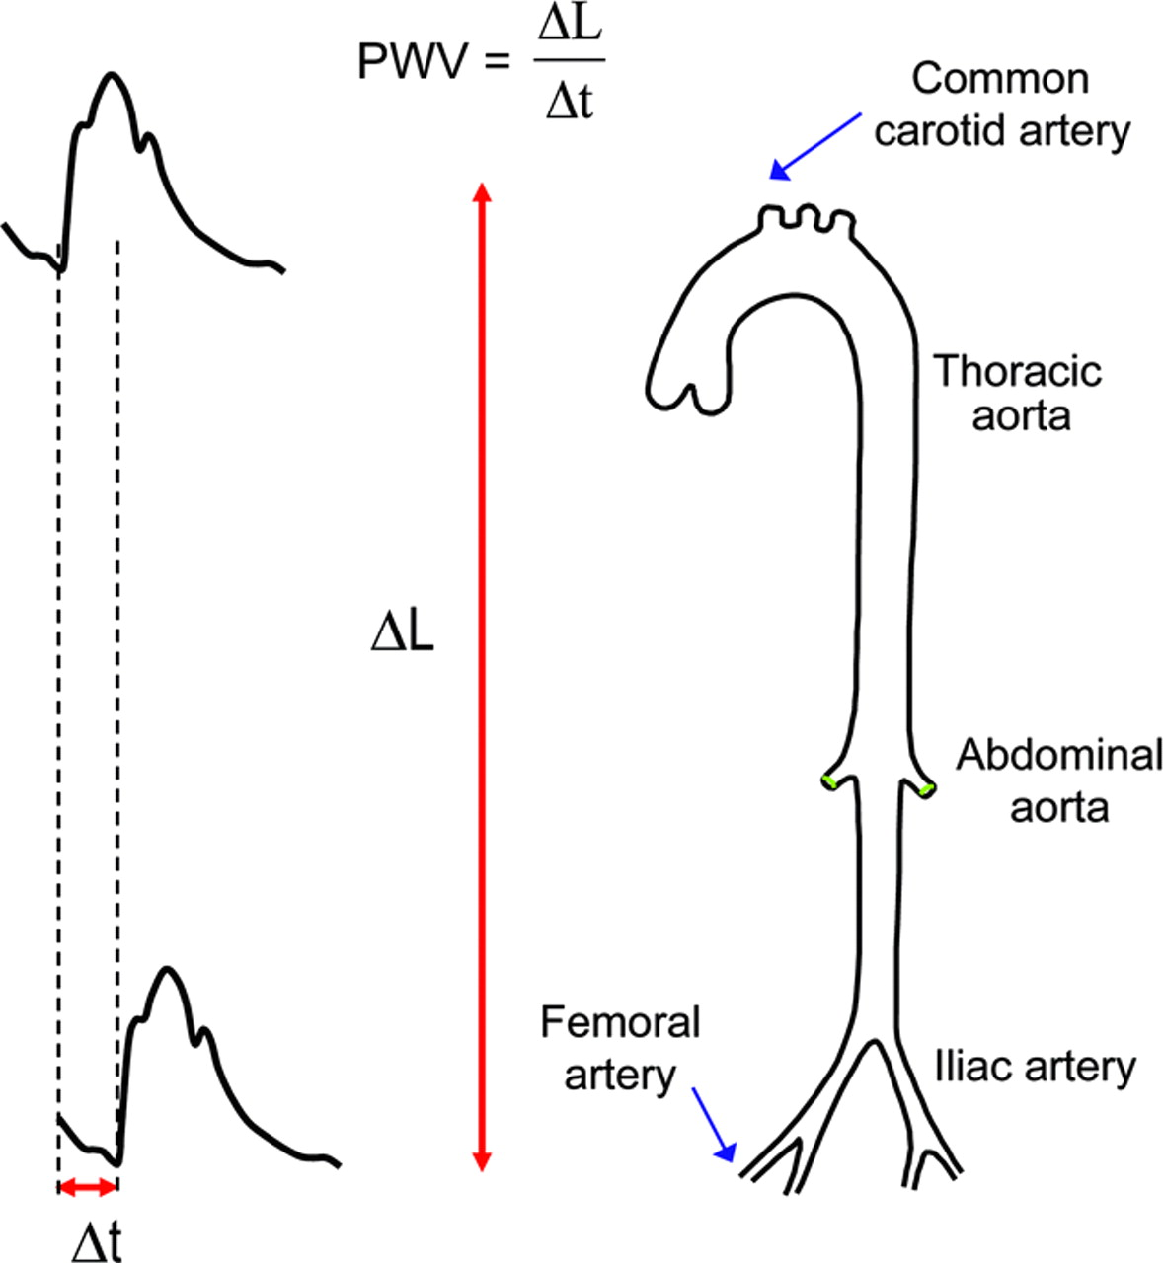
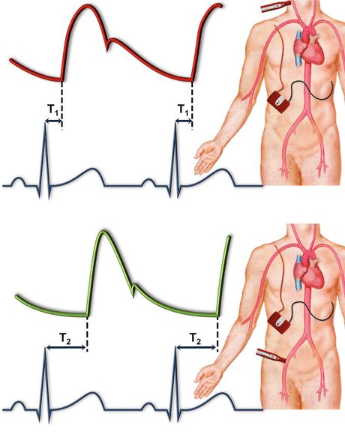
PWV measurement
A highly compliant aorta has a relatively low PWV (< 6 m/s)

Slide 11
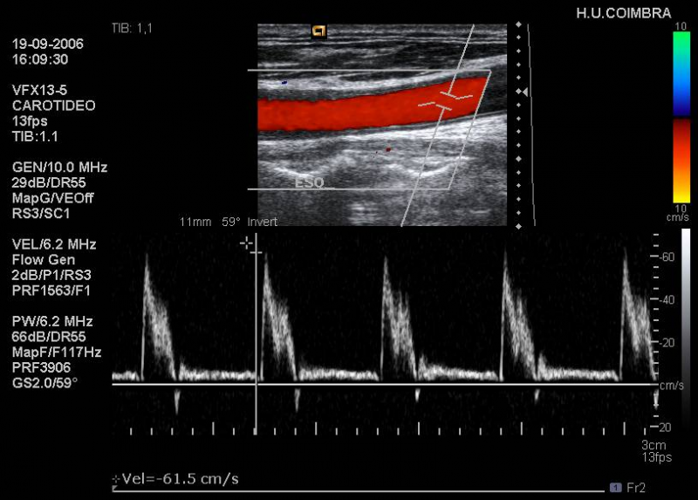
Ultrasound measurement (β – index).

Slide 12
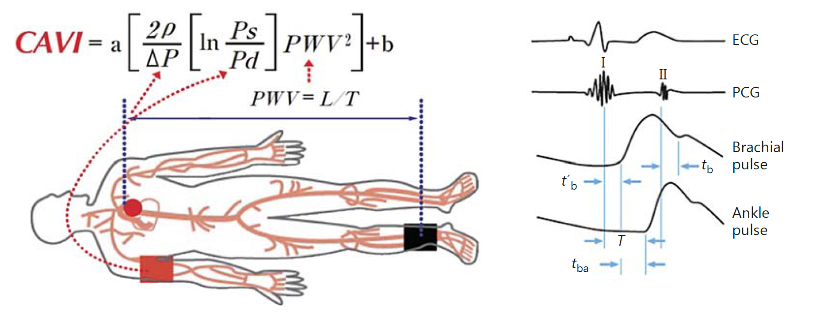
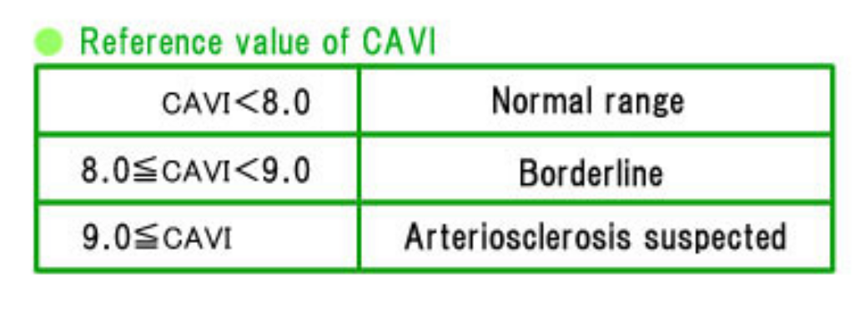
CAVI measurement

Slide 13
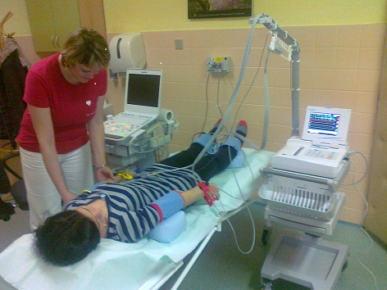
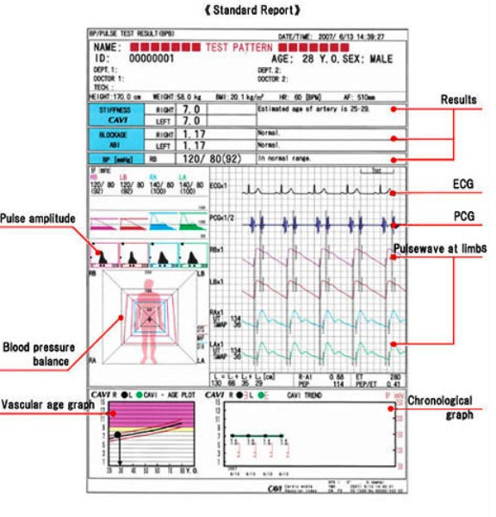
CAVI measurement

Slide 14
Thank you for your attention
Find a mistakes)))))

