Slide 1

ORTHODONTICS
Etiology of orthodontic anomalies
MUDr. Alena Bryšová, Ph.D.

Slide 2
ORTHODONTICS
Stomatological specialisation dealing with prevention, diagnostics and therapy of irregular tooth position, relationship of tooth arches and jawbones

Slide 3
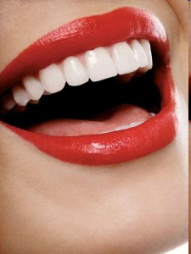
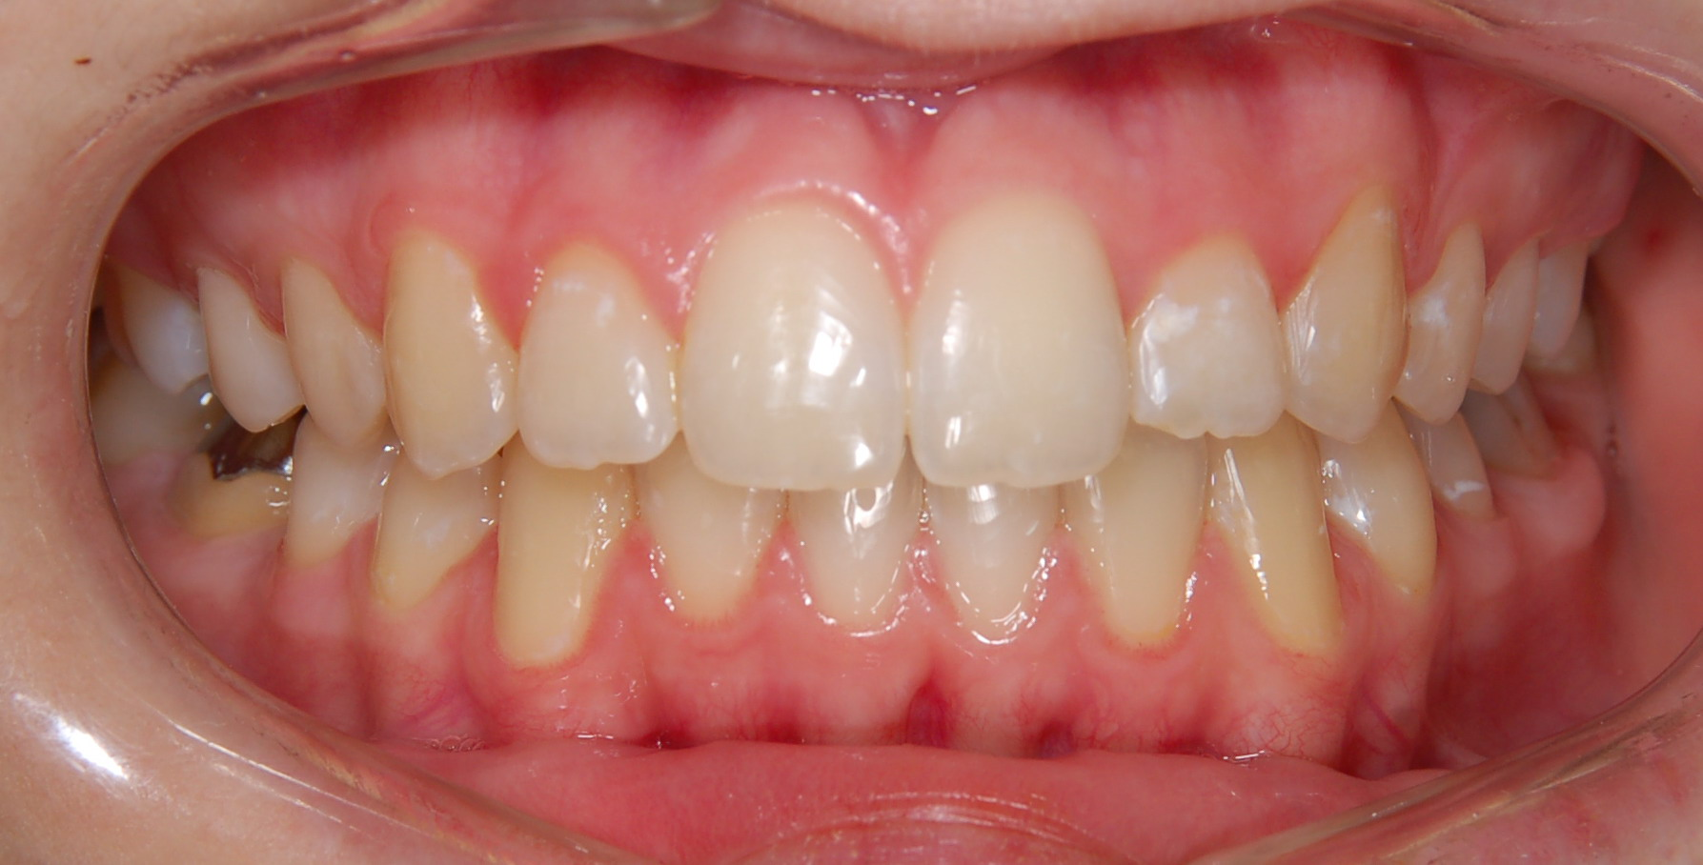
Etiology of orthodontic anomalies
Ideal set of teeth can be seen in aprox. 25% of population
40% need treatment

Slide 4
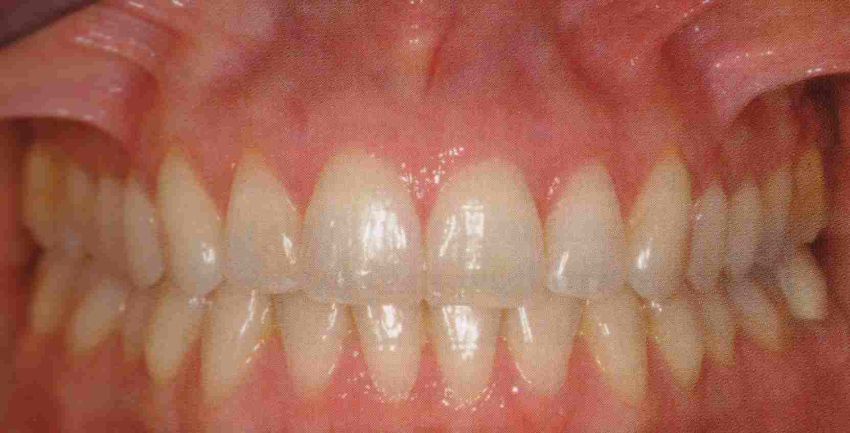
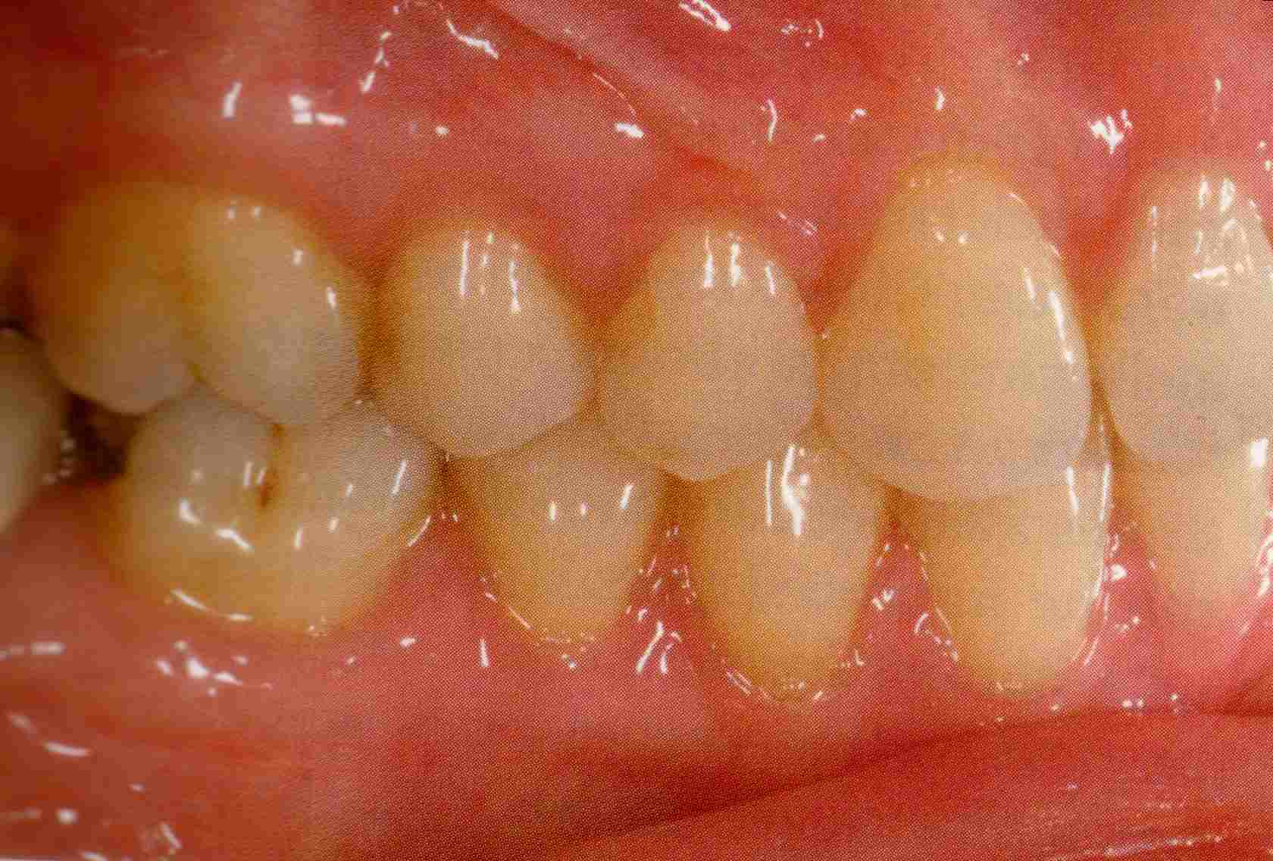
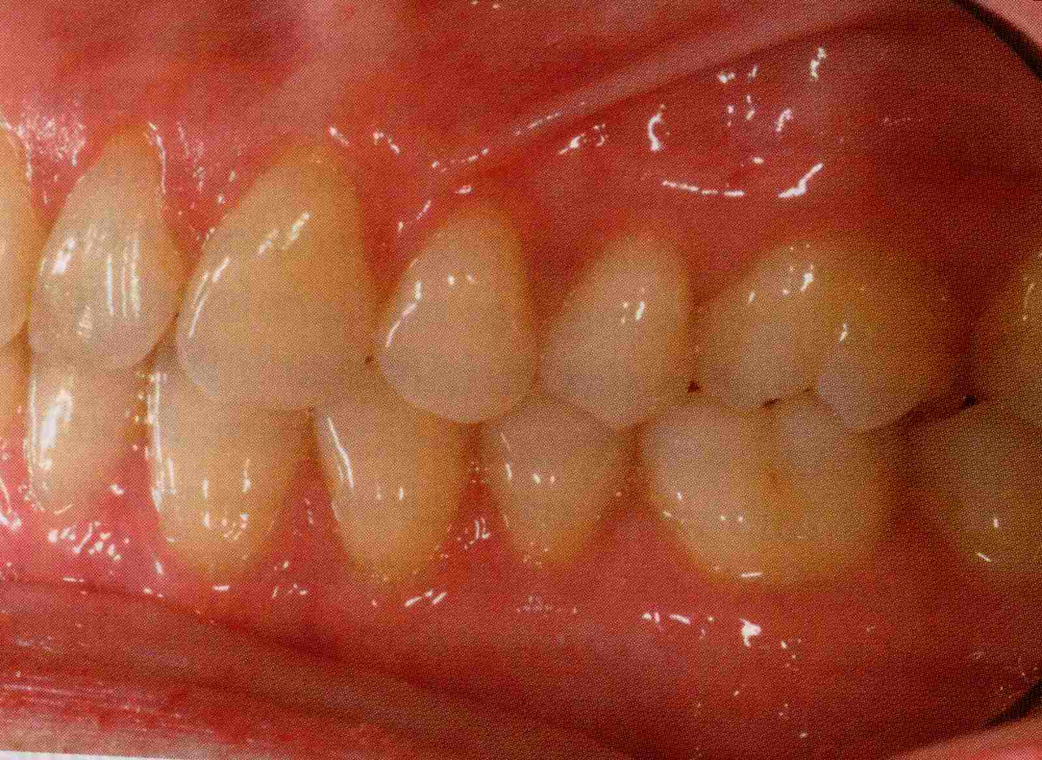
Etiology of orthodontic anomalies
Ideal occlusion

Slide 5
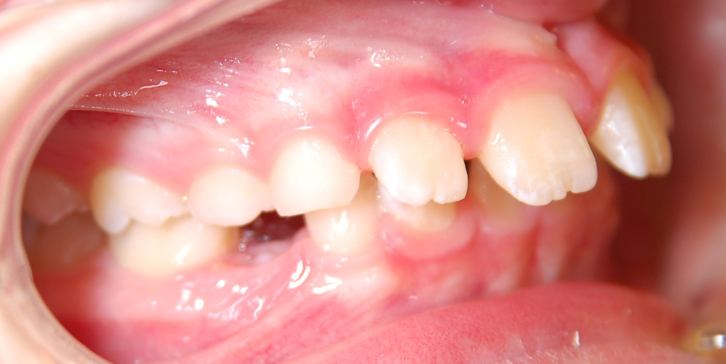
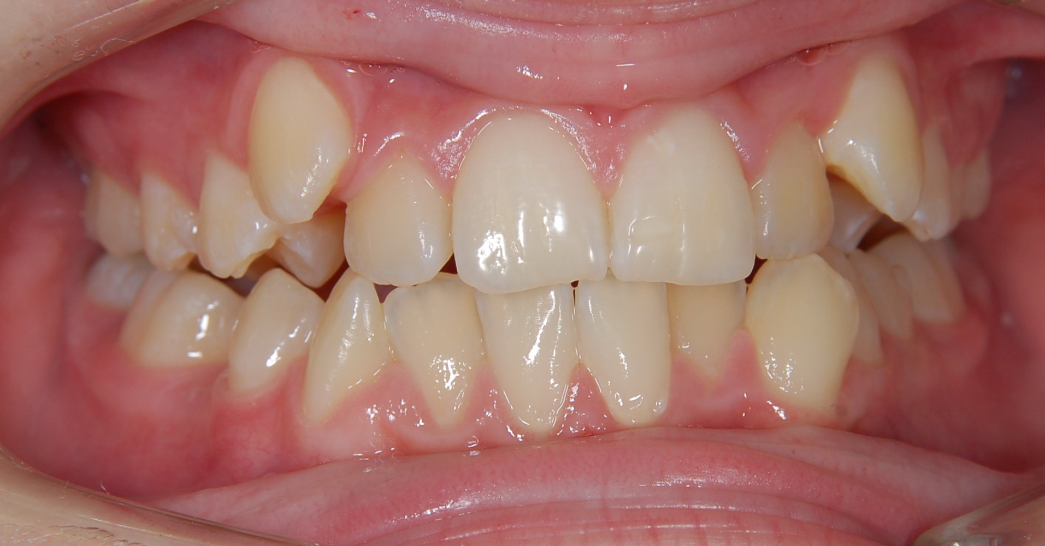
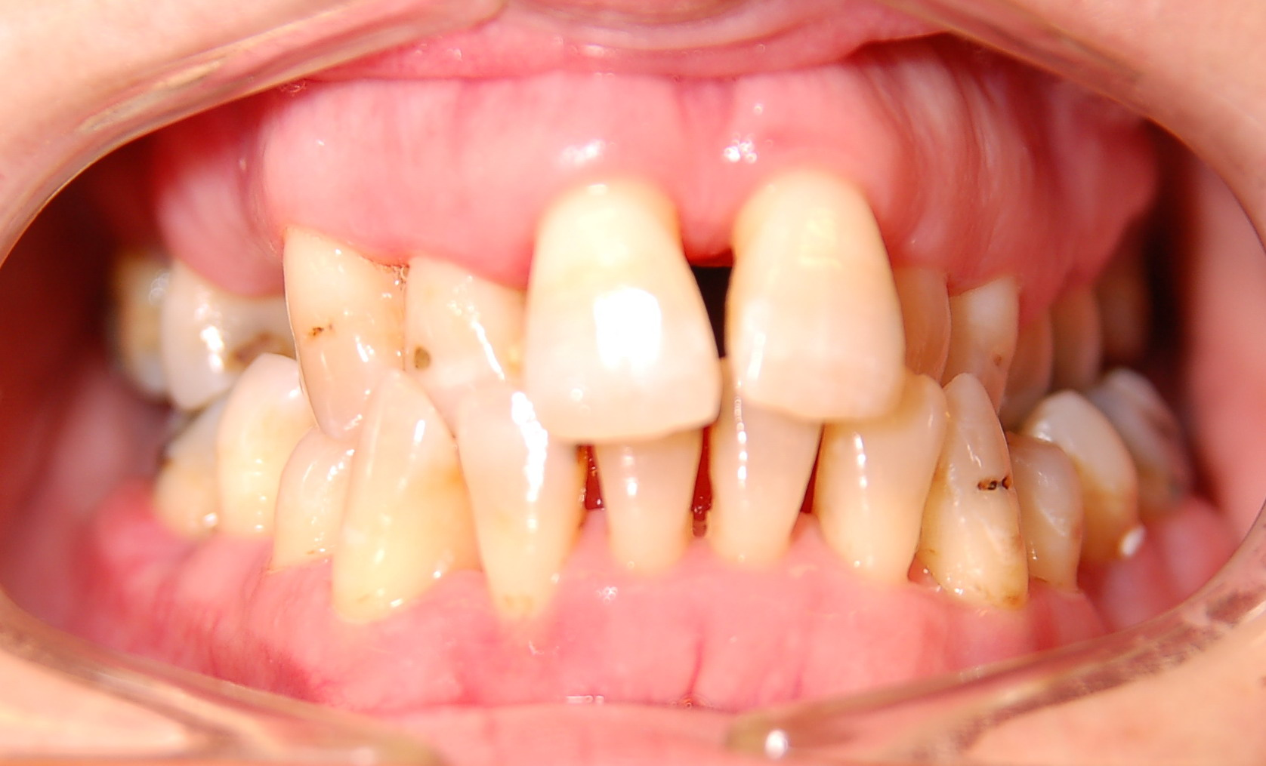
Etiology of orthodontic anomalies
Malocclusion is a manifestation of genetic and environmental interaction on the development of orofacial region

Slide 6
Etiology of orthodontic anomalies
The etiological factors:
1. genetic influences
2. prenatal factors
3. postnatal, environmental influences

Slide 7
Etiology of orthodontic anomalies
1. genetic influences:
Heredity is supposed to be of the polygenic type. A feature is determined by a certain number of minor genes. The influence of the parents genes may be combined. If the same or a similar feature is found in the parents, disposition to heredity is assumed.

Slide 8
Etiology of orthodontic anomalies
Hereditary are mainly:
Shape and size of tooth
Teeth number
Shape and size of jawbones
Time of teeth eruption
Time and type growing jawbones

Slide 9
Etiology of orthodontic anomalies
Mainly hereditary anomalies:
True mandibular progenia
Skeletal open bite
Skeletal deep bite
Primary crowding
Skeletal class II and III
Hypodontia, hyperodontia
Deep bite with retrusion of incisors
Retention or impaction of teeth
clefts

Slide 10
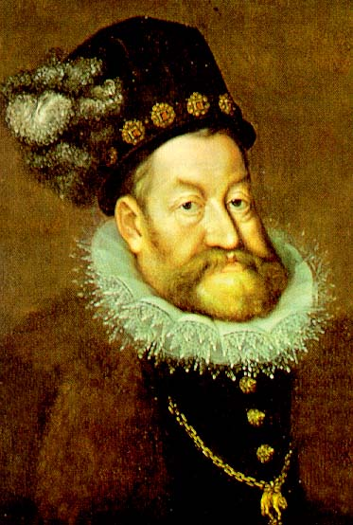
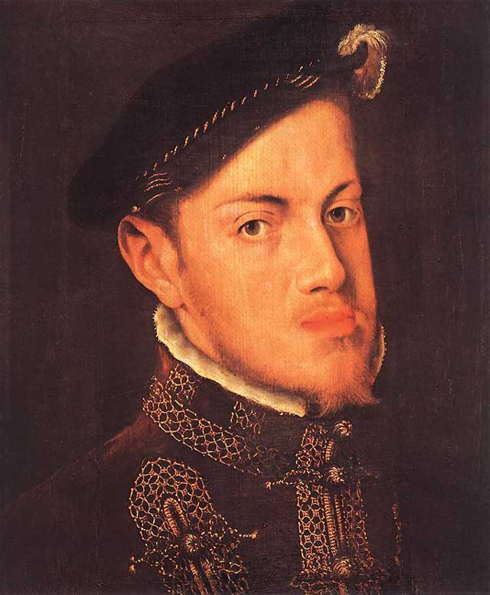
Etiology of orthodontic anomalies
Mainly hereditary anomalies- mandibular prognatism in the Hapsburg family

Slide 11
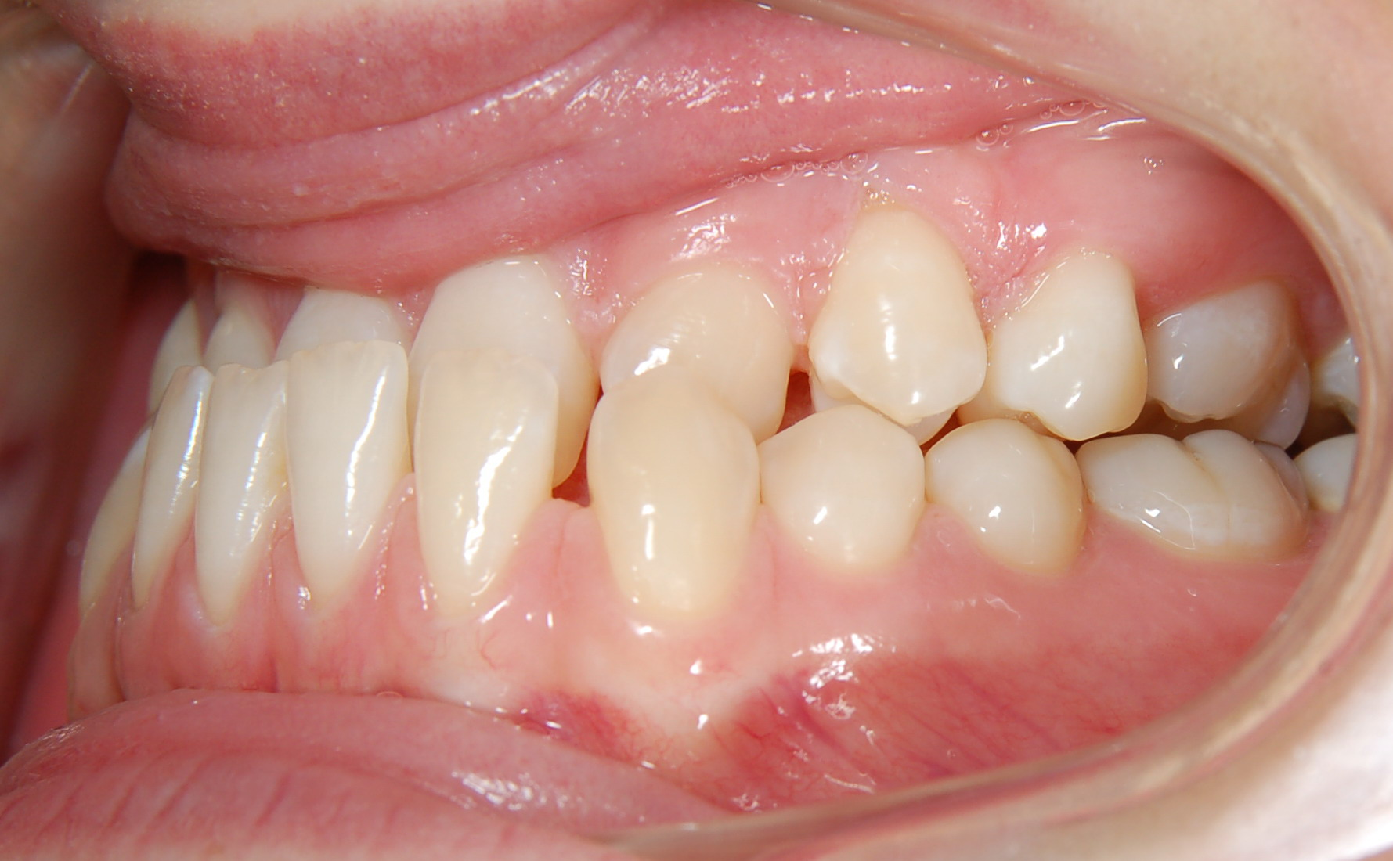
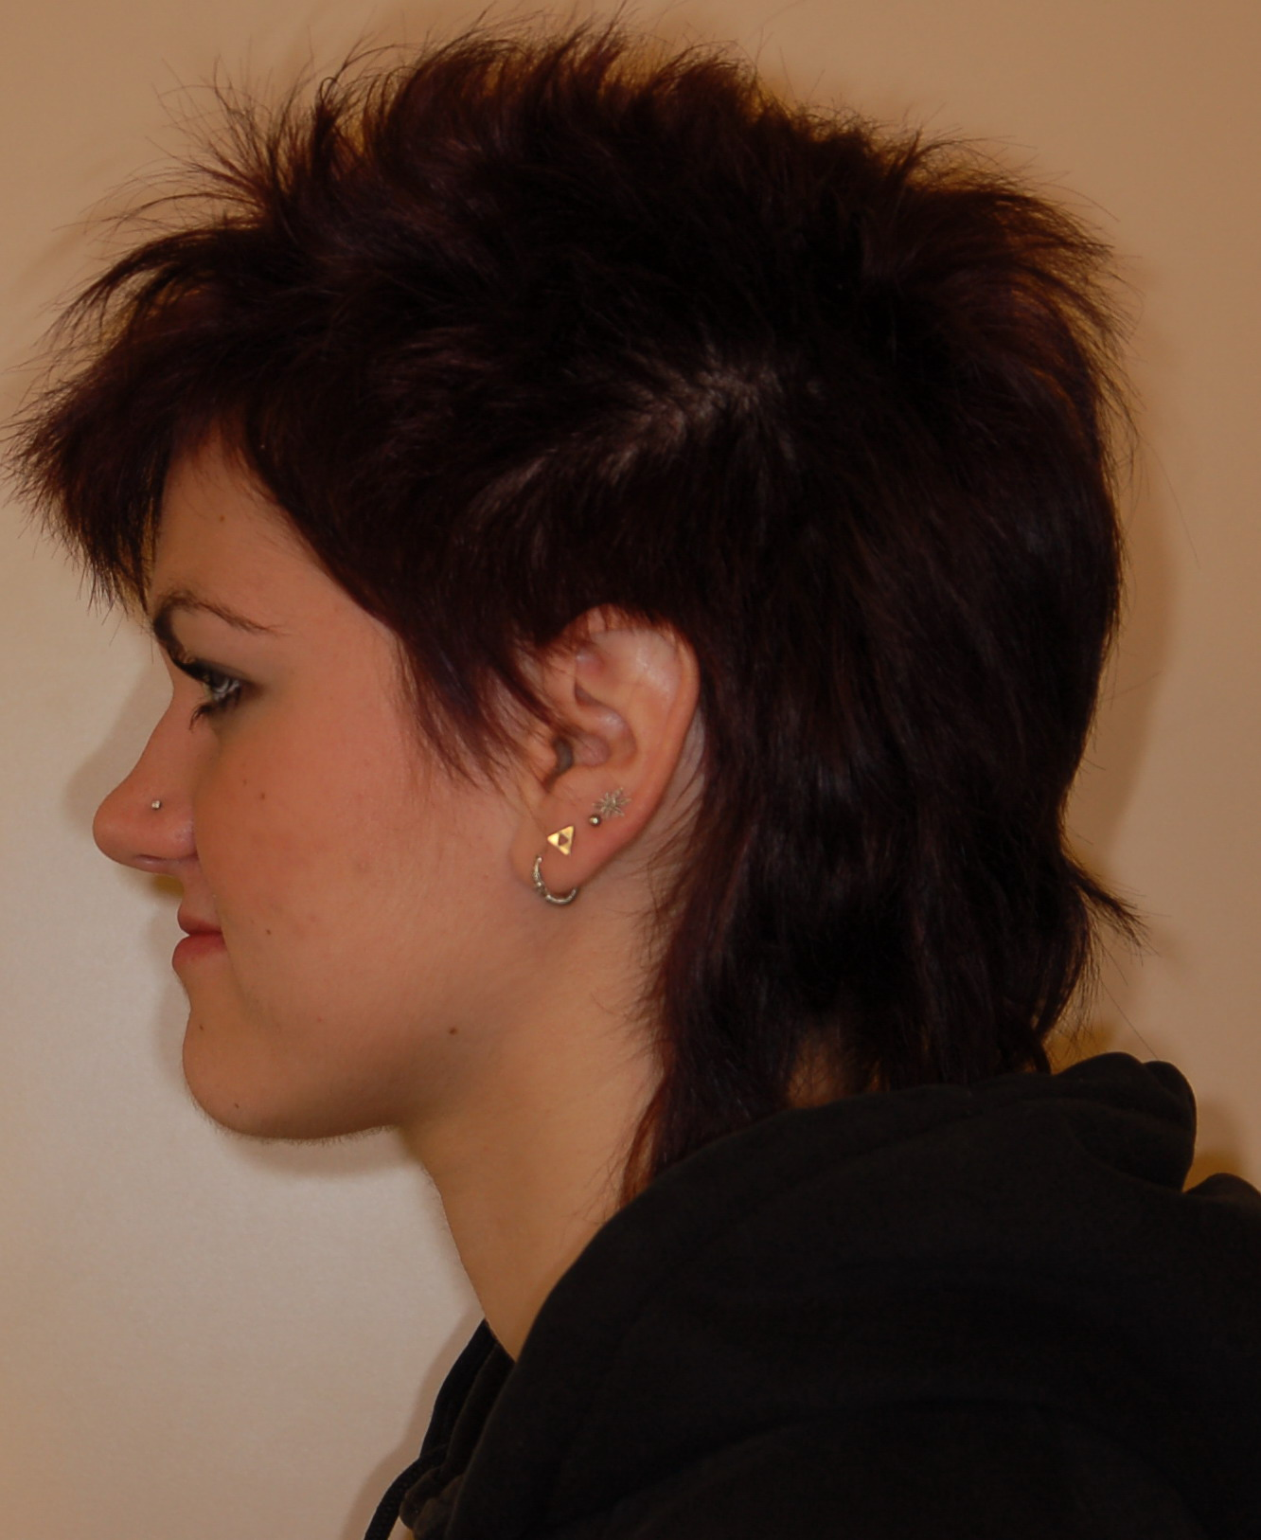
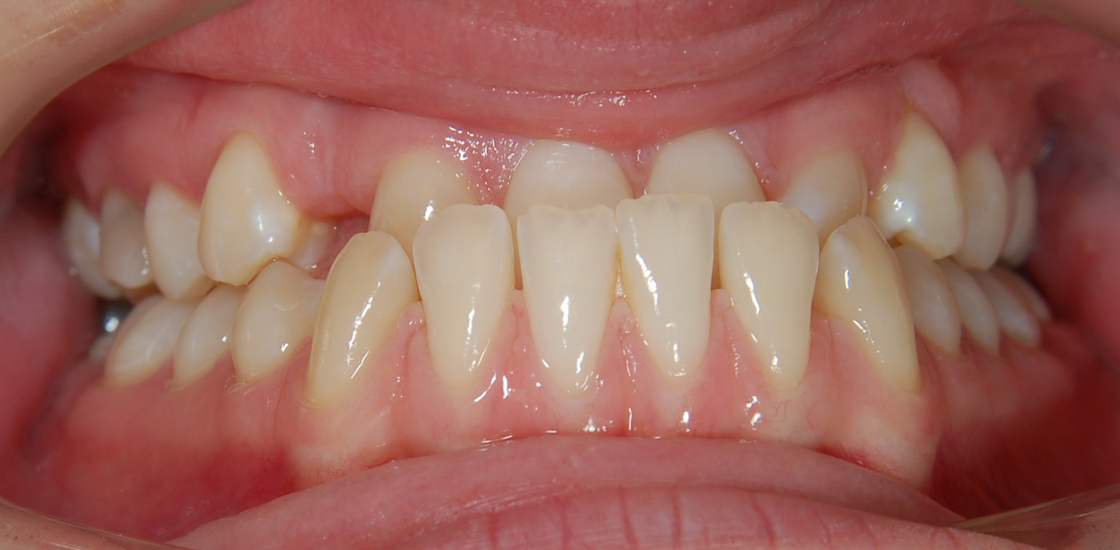
Etiology of orthodontic anomalies
Mainly hereditary anomalies – skeletal class III

Slide 12
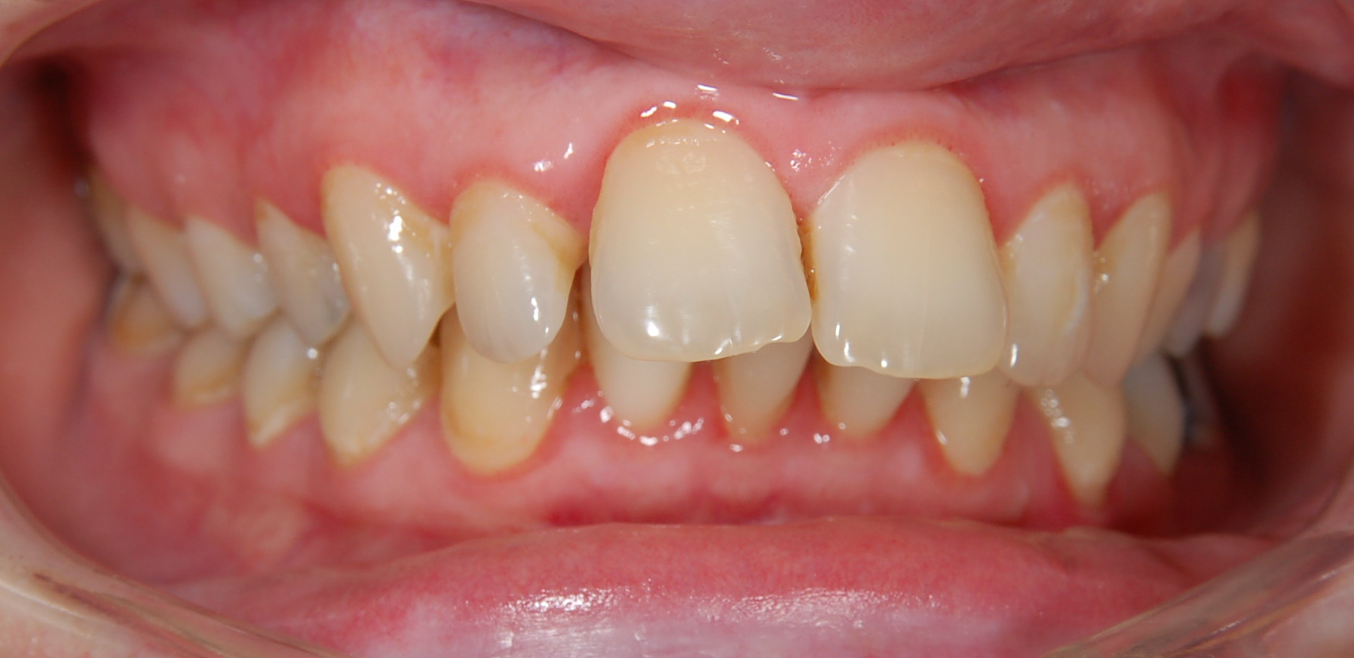
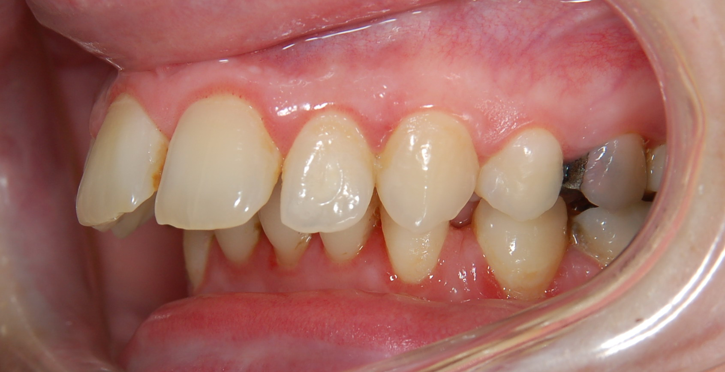
Etiology of orthodontic anomalies

Slide 13
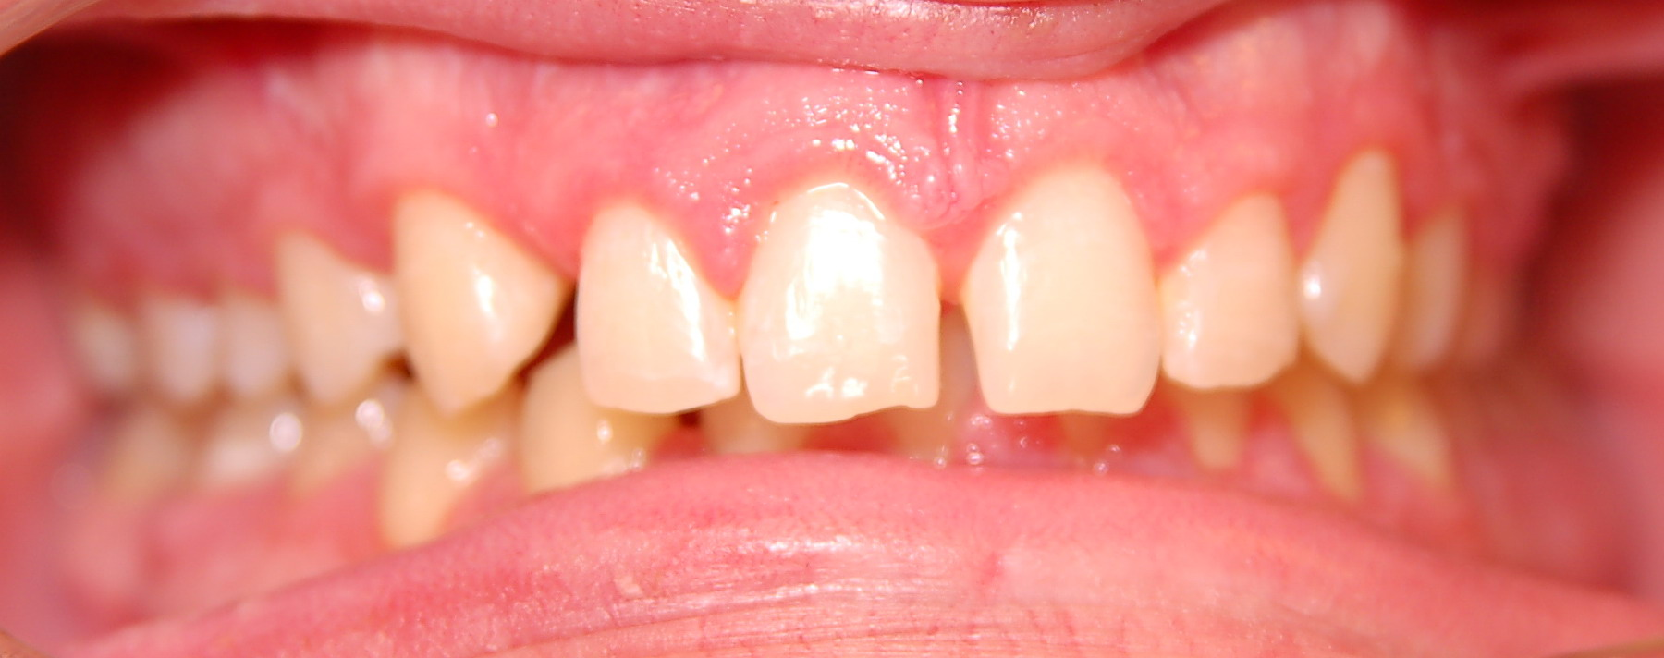
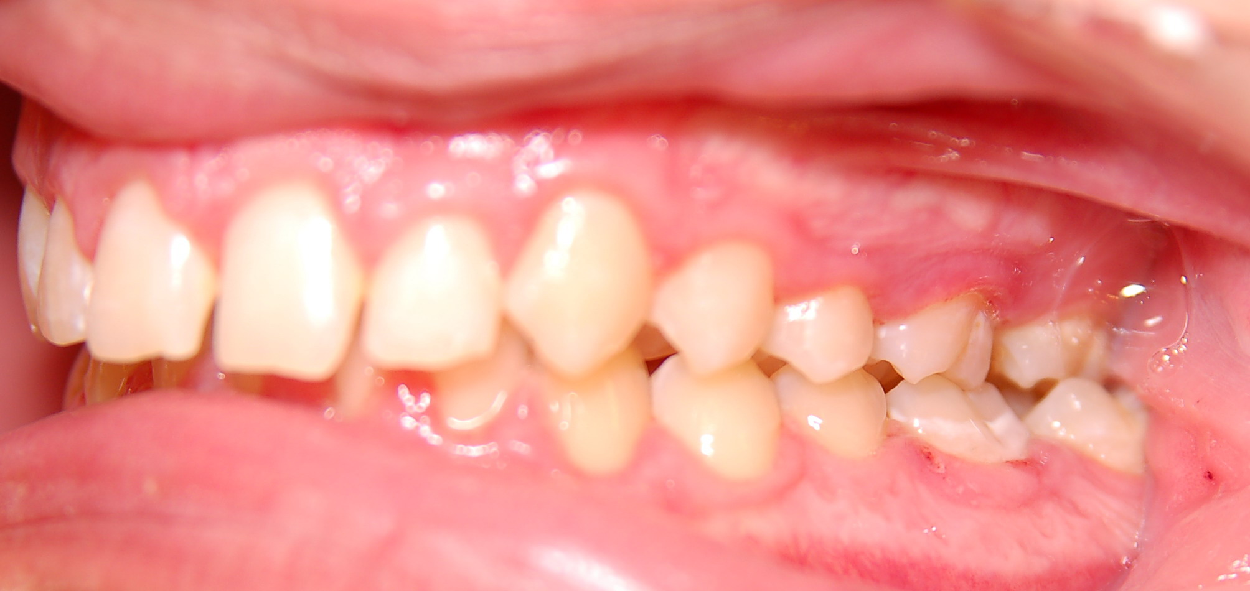
Etiology of orthodontic anomalies
Mainly hereditary anomalies – skeletal deep bite

Slide 14
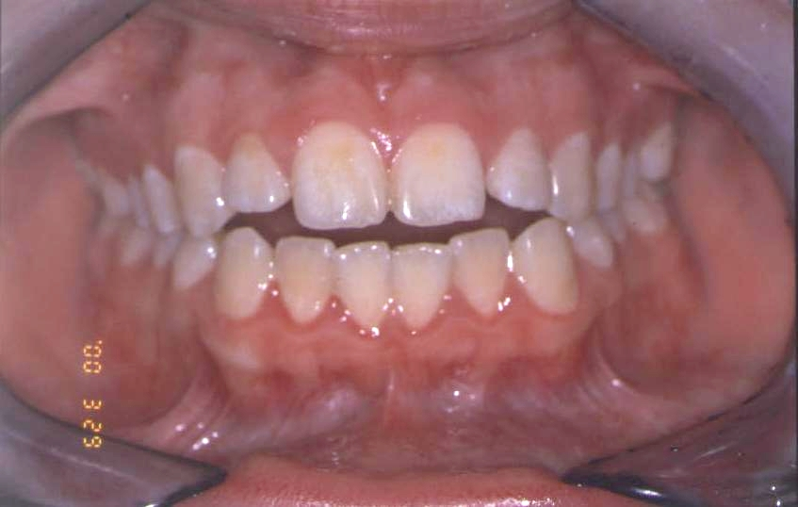
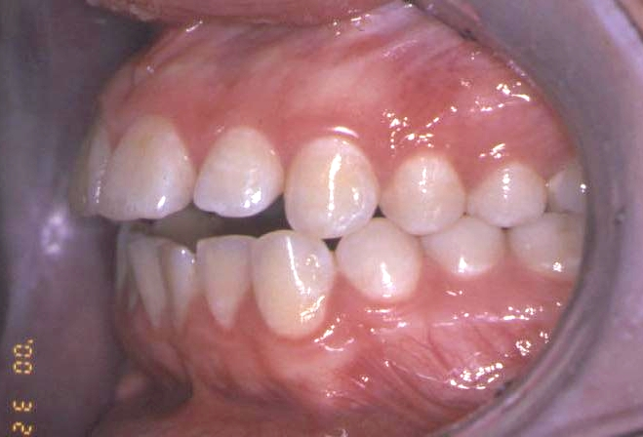
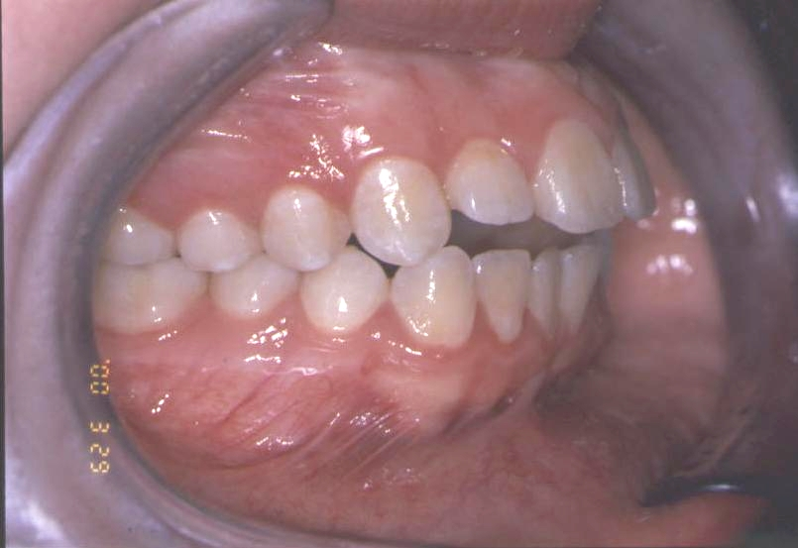
Etiology of orthodontic anomalies
Mainly hereditary anomalies- skeletal open bite

Slide 15
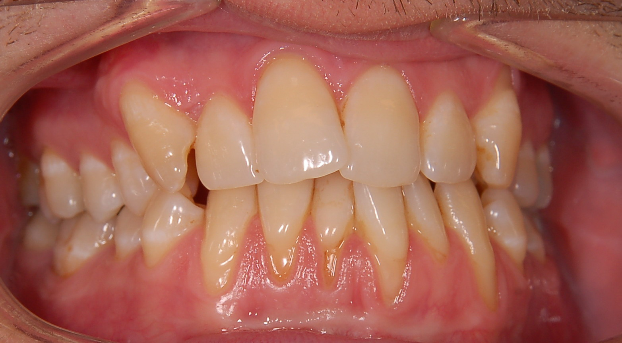
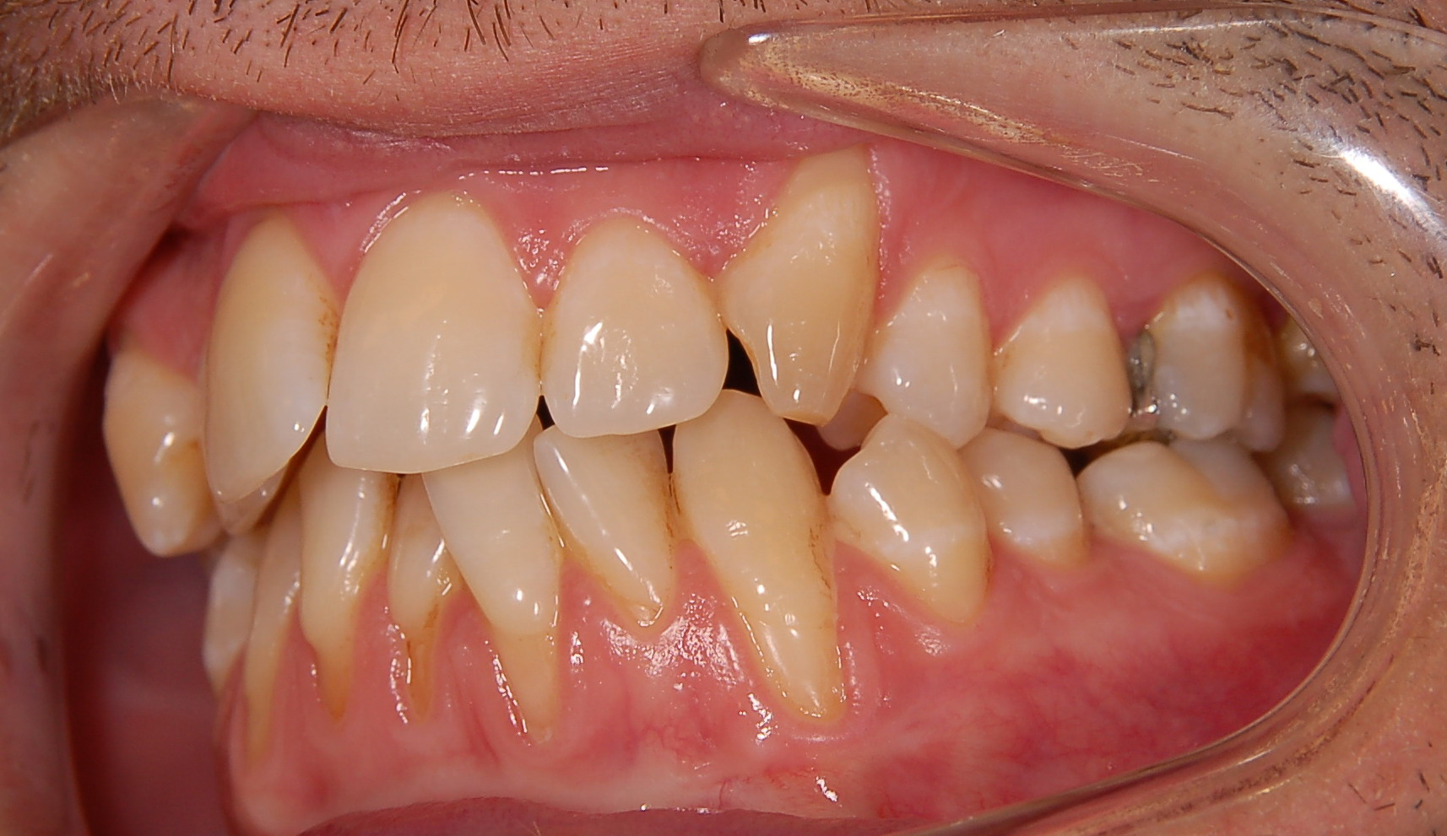
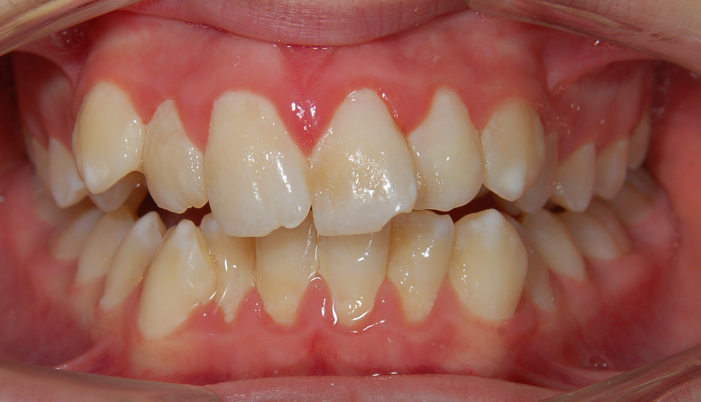
Etiology of orthodontic anomalies
Mainly hereditary anomalies – primary crowding

Slide 16
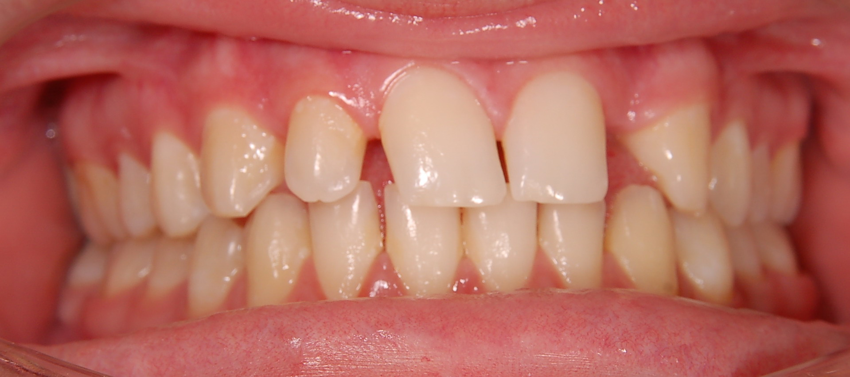
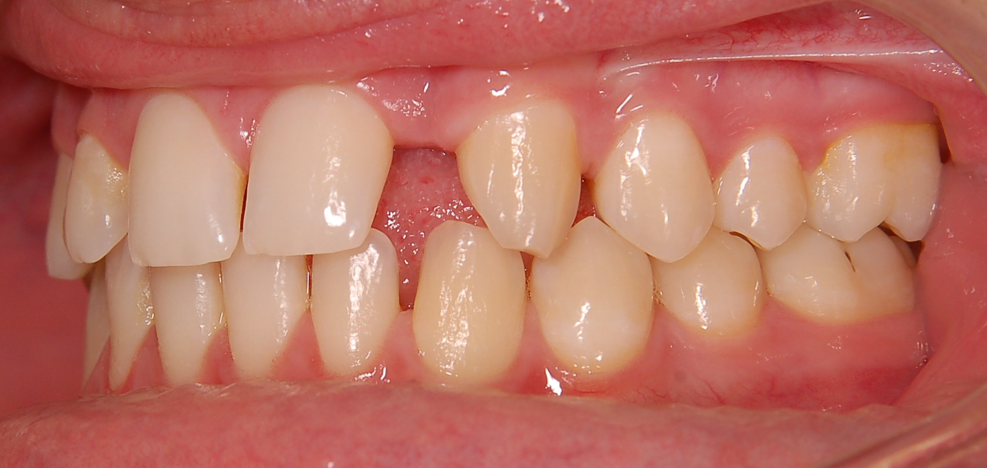
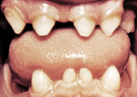
Etiology of orthodontic anomalies
Mainly hereditary anomalies- hypodontia

Slide 17
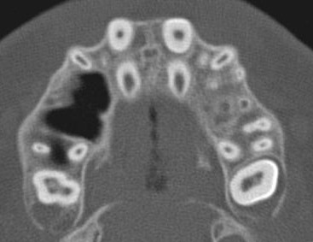
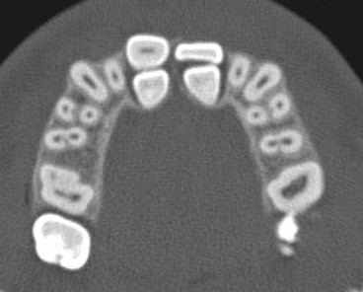
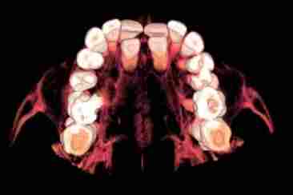
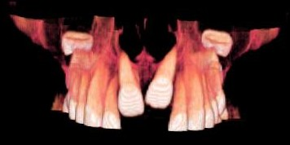
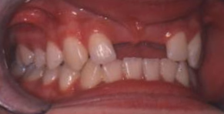
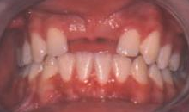
Etiology of orthodontic anomalies
Mainly hereditary anomalies- hyperodontia

Slide 18
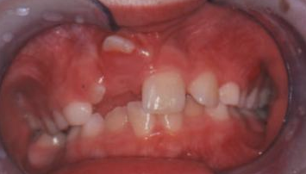
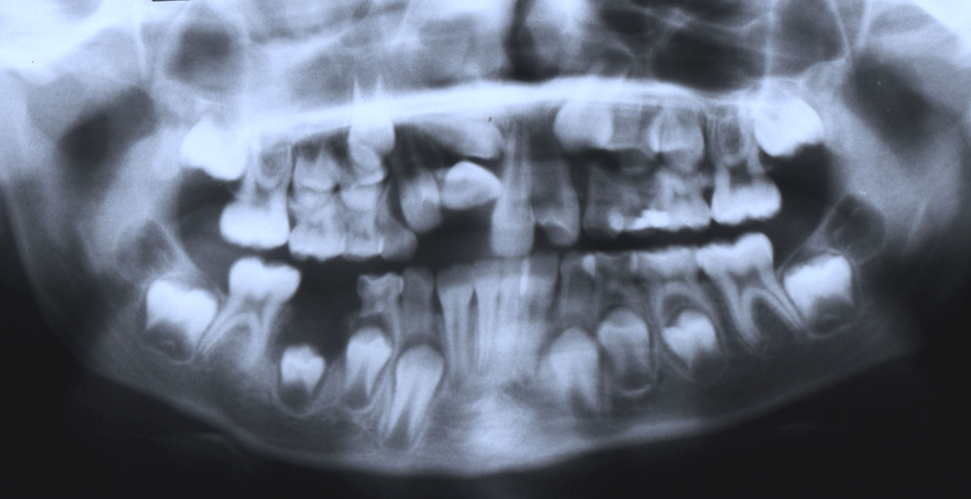
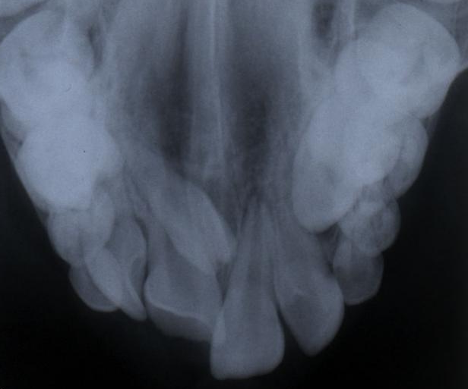
Etiology of orthodontic anomalies hyperodontia

Slide 19
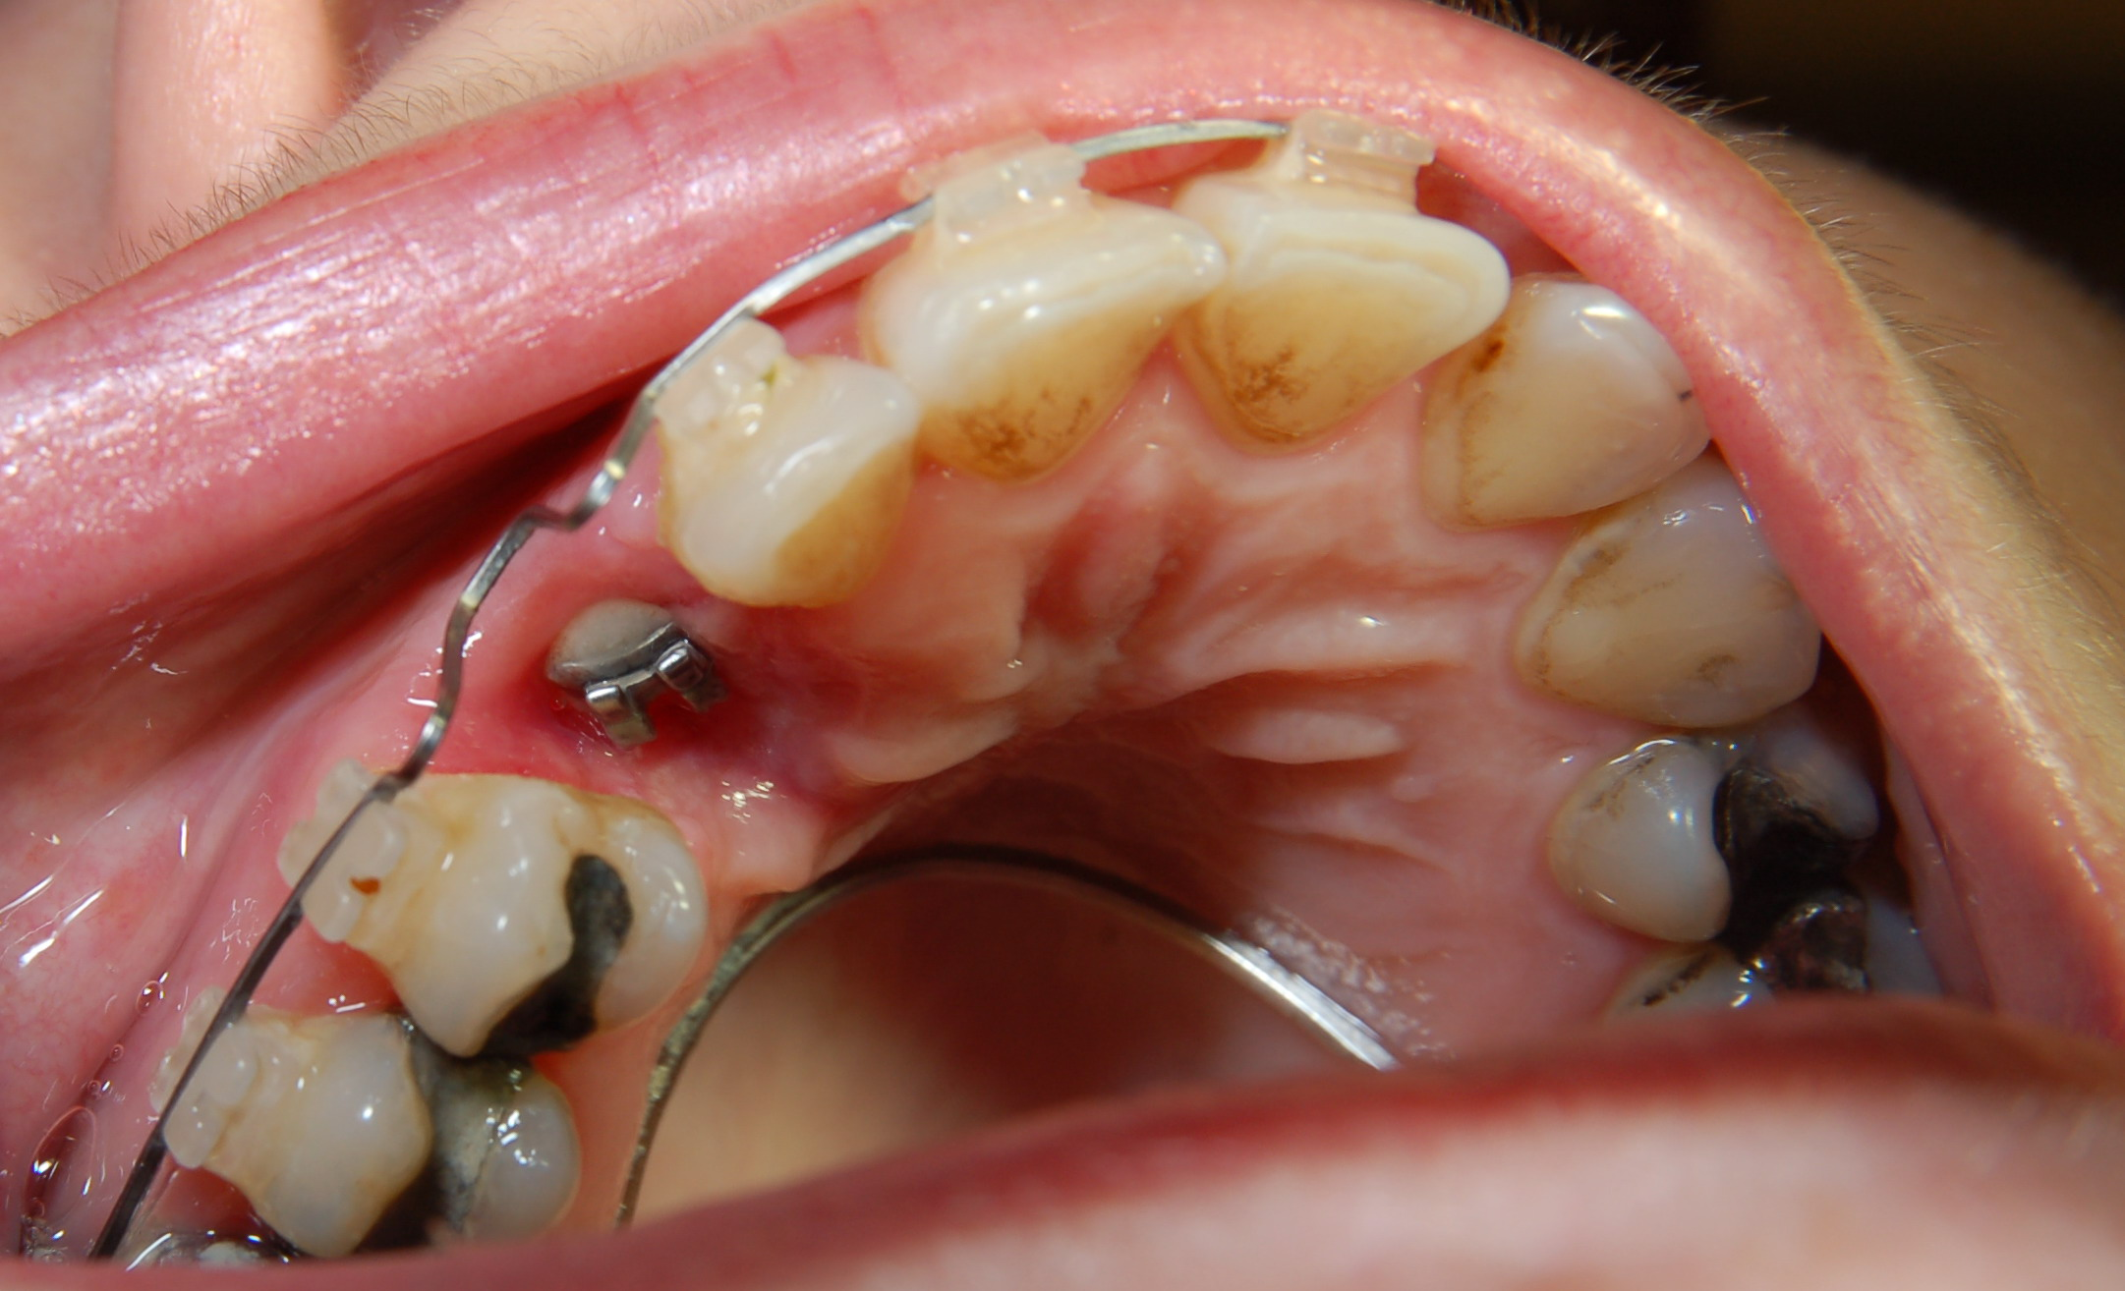
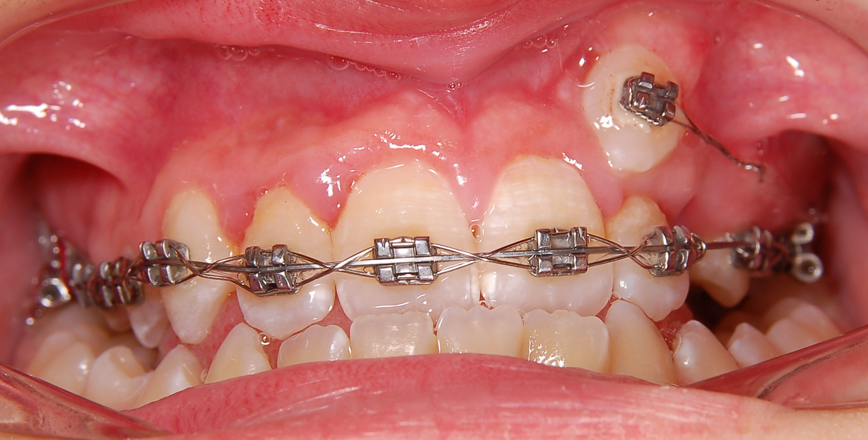
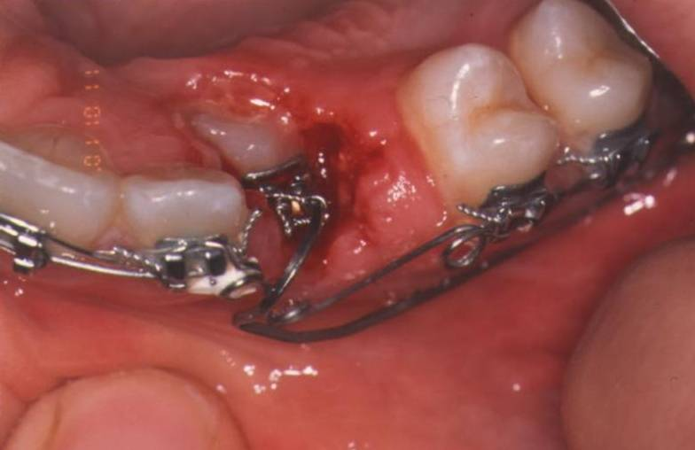
Etiology of orthodontic anomalies ektopic canine

Slide 20
Etiology of orthodontic anomalies
2. Prenatal factors
A.- teratogens
influence of physical, chemical and infectionals effects during gravidity- if acting in critical time

Slide 21
Etiology of orthodontic anomalies
A.- teratogens affecting dentofacial development
Teratogens Effect
Aspirin, Valium cleft lip and palate
Cigarette smoke[hypoxia] cleft lip and palate
Cytomegalovirus microcephaly, hydrocephaly
Ethyl alcohol central mid-face deficiency
6-Mercaptopurin cleft palate
Rubella virus microftalmia, cataracts
Thalidomide hemifacial microsomia
Toxoplasma microcephaly, Hydrocephaly
X-radiation microcephaly
Vitamin D excess premature suture closure

Slide 22
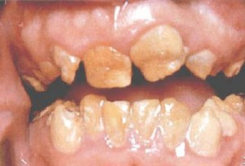
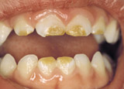
Etiology of orthodontic anomalies
Anomalie -Developmental defects - amelogenesis

Slide 23
Etiology of orthodontic anomalies
2. Prenatal factors
-B - Syndromes of the first and second branchial arches include symetric and asymetric congenital malformations of the eyes, ears,mid-face region, jaws and teeth combined with extreme defects on the soft tissue,mastication muscles-mandibular dysostosis,hemifacial microsomia, clefts
- Synostosis syndromes – result from premature closure of the sutures between the cranial and facial bones in the later foetal developmental period

Slide 24
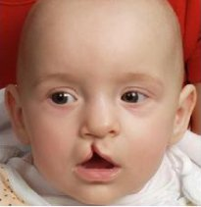
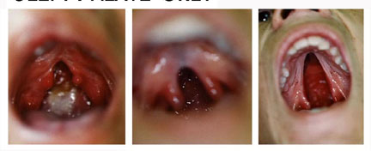
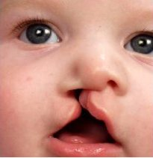
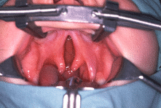
Etiology of orthodontic anomalies
Clefts lip and palt

Slide 25
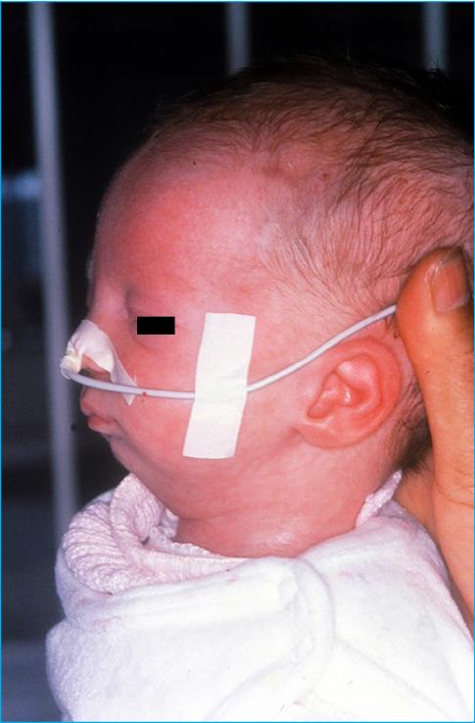
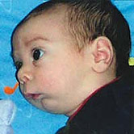
Etiology of orthodontic anomalies
Syndromes – Pierre Robin syndrome

Slide 26
Etiology of orthodontic anomalies
3. Postnatal influences
Type of initial nourishment – brest-feeding[suckling] or bottle-feeding
Bad habits – sucking of finger, thumb,, biting of lips, cheeks. They may unfavourably influence position of teeth and the shape of alveolar ridges.
Breathing through the mouth cause by chronic inflamation of the nasal mucosa associated with allergies or chronic infection tonsils and adenoids

Slide 27
Etiology of orthodontic anomalies
3. Postnatal influences
- masticatory function – anthropological studies indicate that changes in dental occlusion and an increase in malocclusion occur along with transition from a primitiv to a modern diet and lifestyle. Malooclusion can be labelled as a „disease of civilisation“
- Premature loss of deciduous teeth as same as permanent teeth, due to dental caries, injury, or their agenesis may lead to formation of anomalous shifts and inclinations of the other teeth, lack of place for the teeth and the crowding in the dentition

Slide 28
Etiology of orthodontic anomalies
3. Postnatal influences
Trauma – undiagnosed fractures of the mandibular condyles can cause disorders of the growth of the mandibular ramus =asymmetry
Hormonal disorders – growth hormone deficiency, thyroid hormone deficiency – can contribute to the origin of acquired anomalies

Slide 29
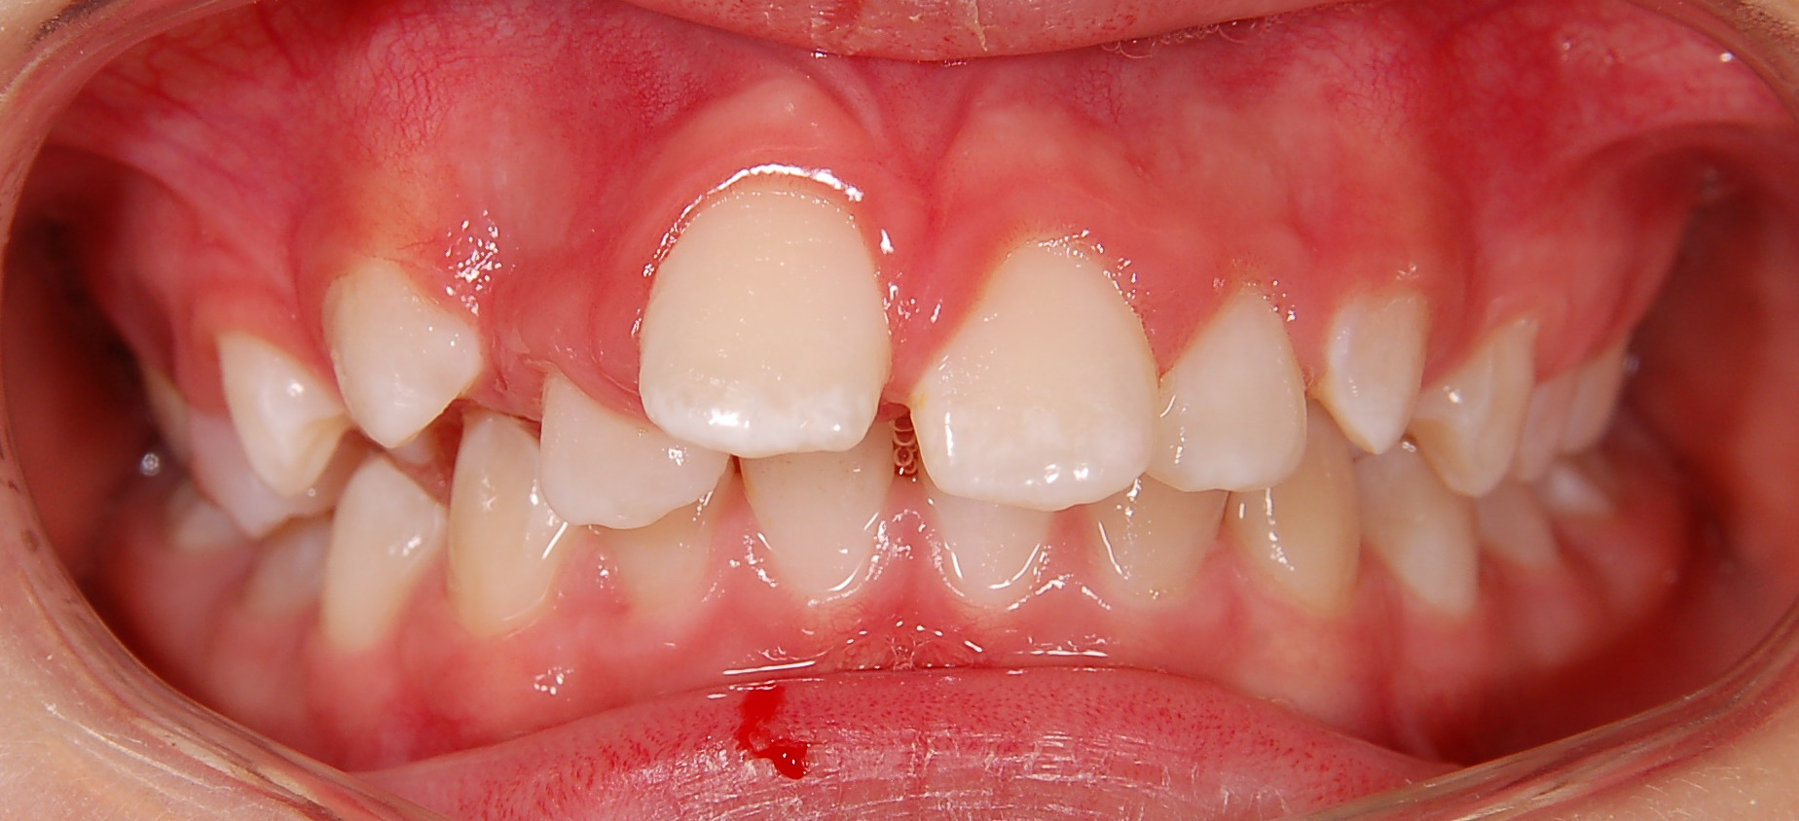
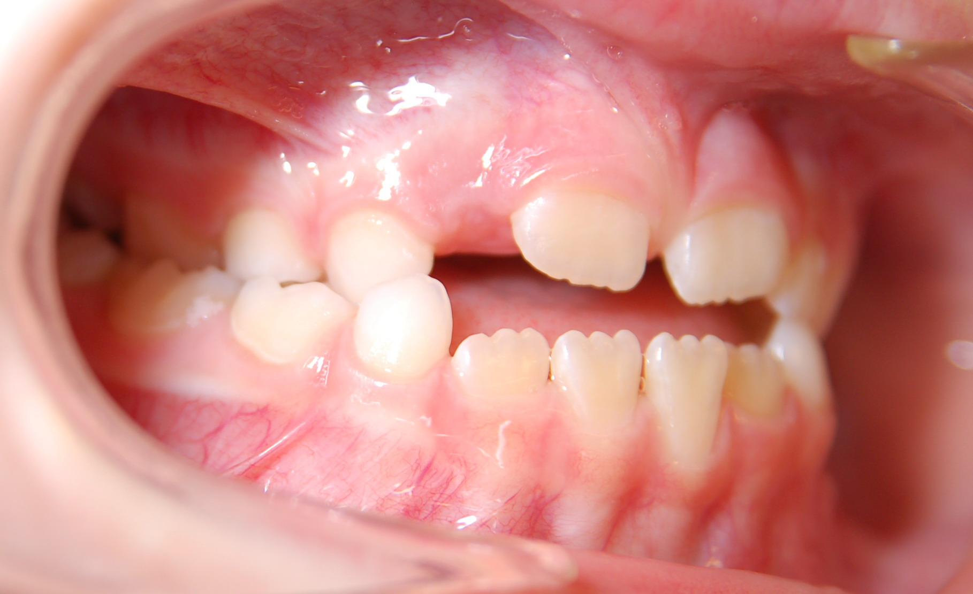
Etiology of orthodontic anomalies
Postnatal influences – bad habits-sucking of finfers

Slide 30
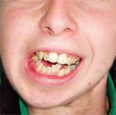
Etiology of orthodontic anomalies
Postnatal influences – trauma – fracture of the mandibular condyle

Slide 31
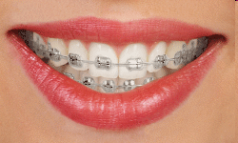

Thank You four Your attention
Questions – email – alena.brysova@fnusa.cz
Consultation – Orthodontic department - St. Anne's Hospital, building D2b – Thursday 1-2 p.m.

