Slide 1
Examination techniques in ophthalmology
V. Matušková

Slide 2
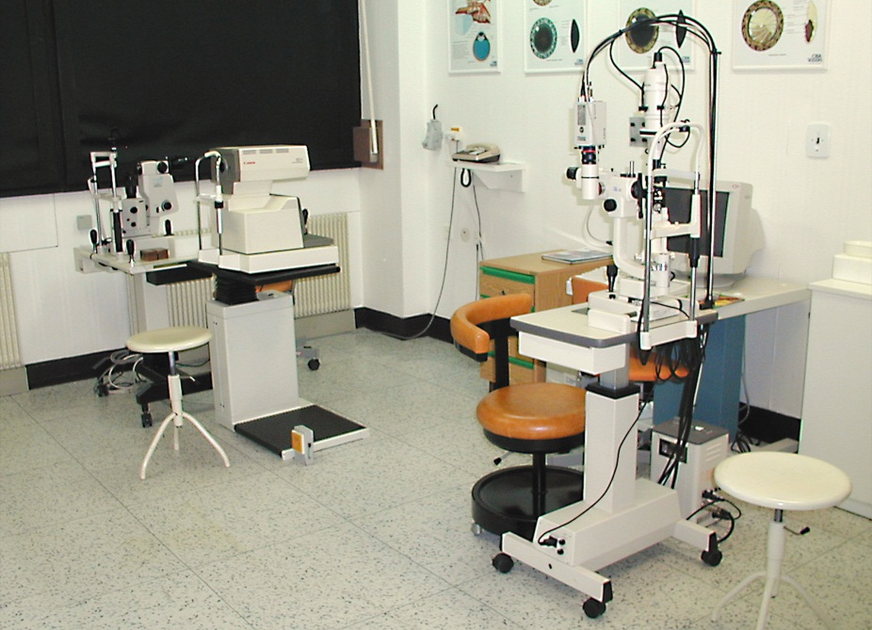
Basic examination techniques
Visual acuity (natural, best corrected)
Measurement of intraocular pressure
Slit lamp examination
Fundus examination

Slide 3
Visual acuity
Visual acuity (natural, best corrected)
Distance vision
Near vision
Charts
Snellen
Landolt ring
Pictures
ETDRS
Jaeger

Slide 4
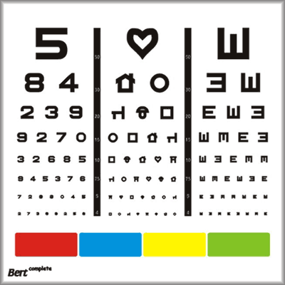
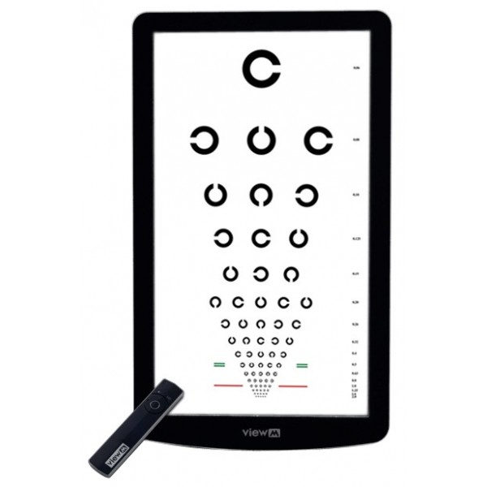
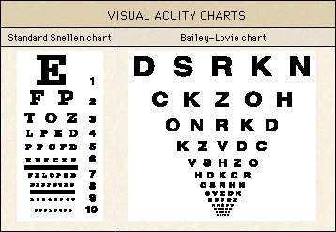
Charts

Slide 5
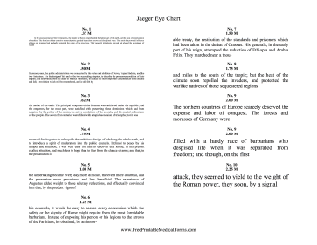
Near vision
Jaeger chart
VODS: s +2,5 Dsf J.No. 1

Slide 6
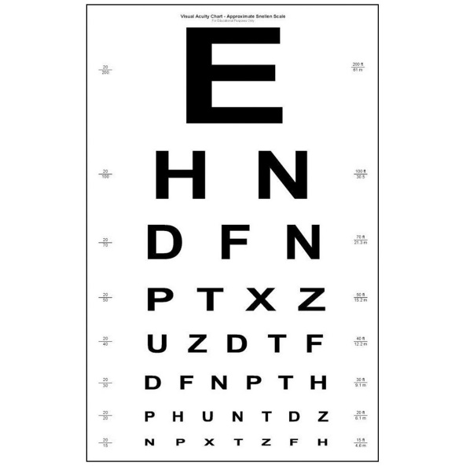
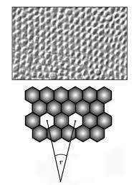
Visual Acuity
5/50 (metres, feet 20/200)
0,1
Minimum separabile – minimum angle of resolution

Slide 7
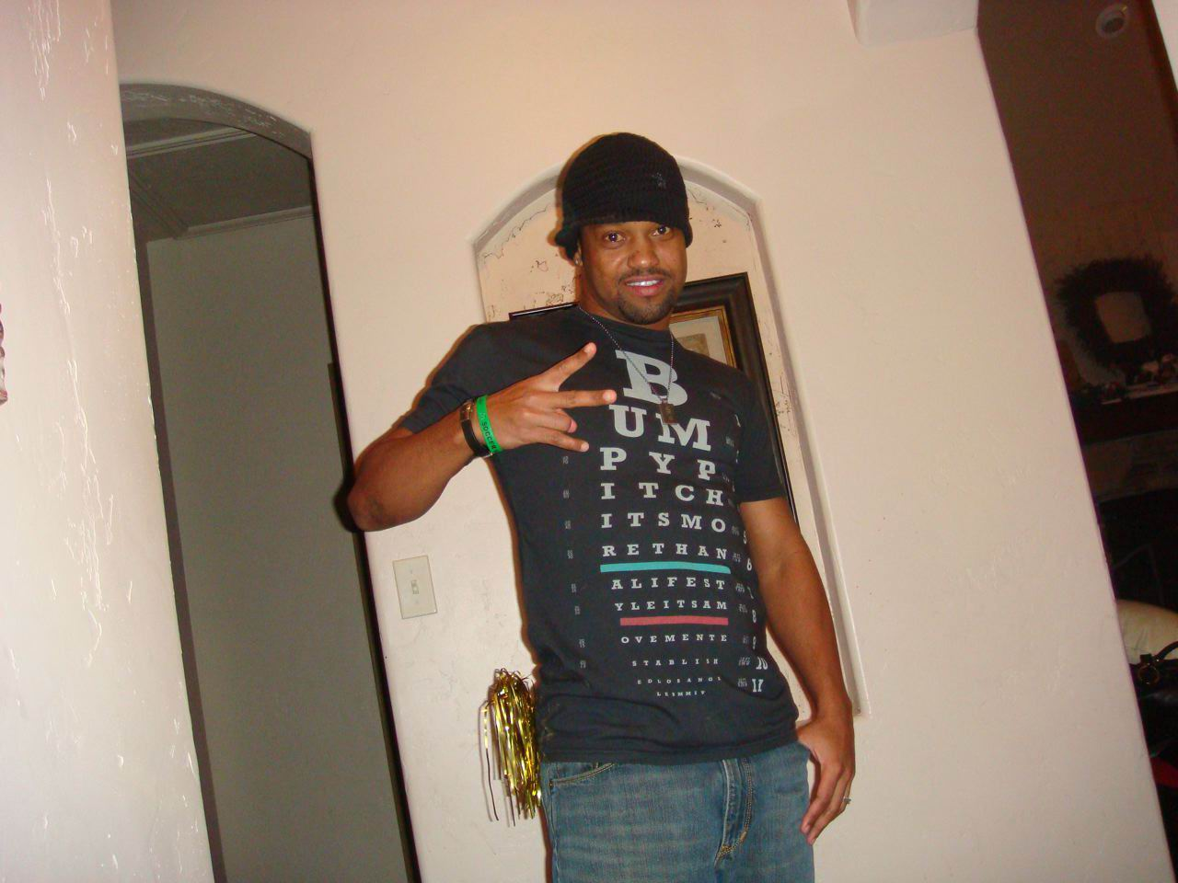
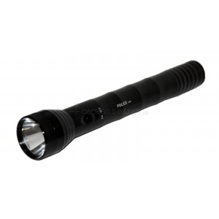
Visual acuity
Counting finger (metres )
Hand movement
Light perception
Amaurosis
Practical blindness

Slide 8
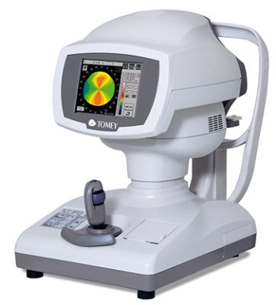
Refraction
Refractive error is an optical abnormality in which the shape of the eye fails to bring light into sharp focus on the retina, resulting in blurred or distorted vision.
In optometry, a "refraction" procedure is the measurement of refractive error
Autorefractor

Slide 9
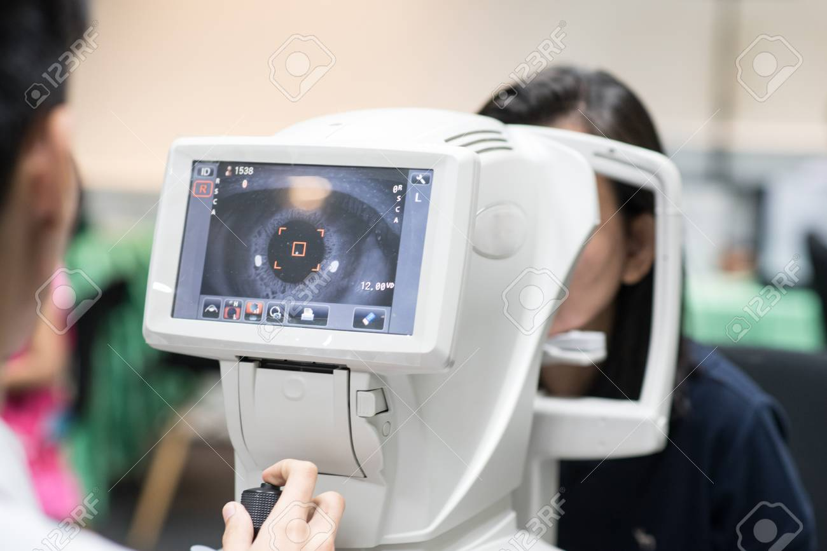
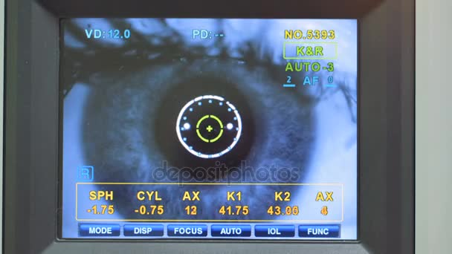
Autorefractor

Slide 10
Visual acuity
VOD: 5/50, s – 2,0 Dsf a -1,0 Dcyl ax 90 5/5
VOS: 5/30, s – 2,5 Dsf a -1,5 Dcyl ax 100 5/7,5,
VOD: visus oculi dextri
VOS: visus oculi sinistri
Dsf: dioptry sferic
Dcyl: dioptry cylindric
Ax: axis

Slide 11
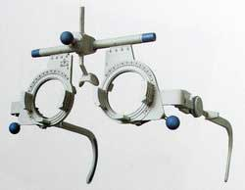
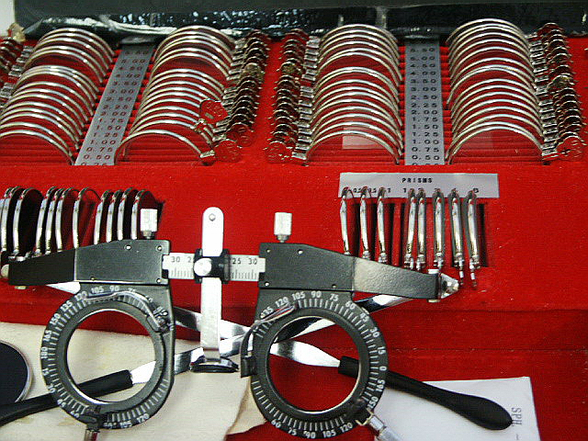
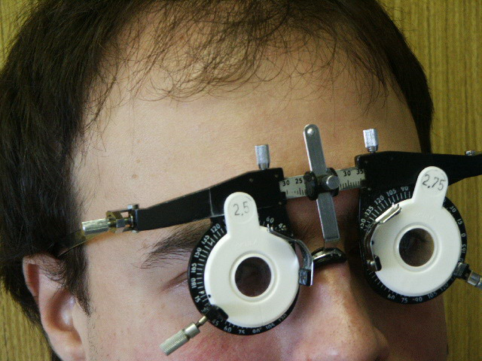
Visual acuity
Frame
Lenses
Axis

Slide 12
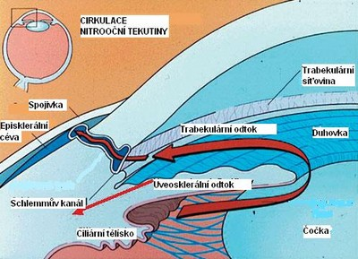
Tonometry
Contact techniques
Schiötz tonometry
Goldmann applanation tonometry
Non contact techniques
Jet air (air puff)

Slide 13
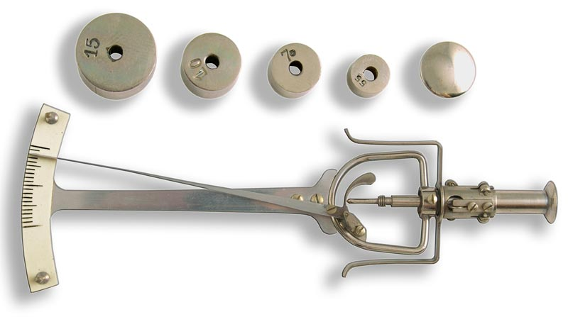
Schiötz tonometry
7/7,5
Topical anestesia

Slide 14
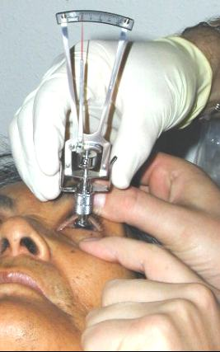
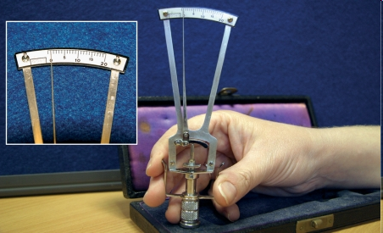
Schiötz tonometry

Slide 15

Goldmann tonometry
The normal range is 10-21 mmHg
Topical anestesia, fluorescein
Force required to flatten the cornae

Slide 16
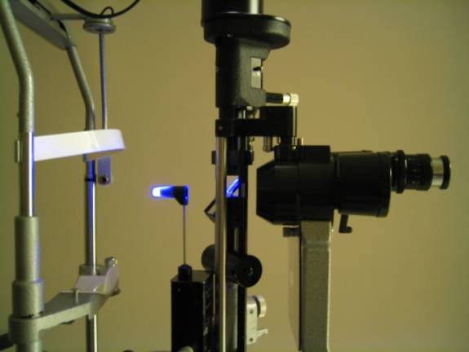
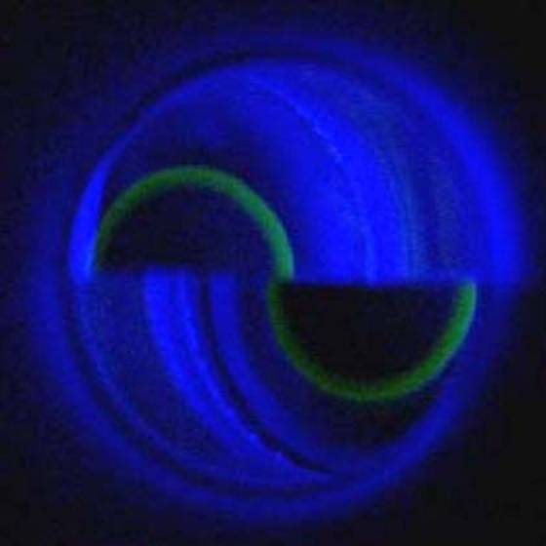
Goldmann tonometry

Slide 17
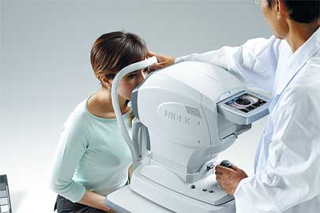
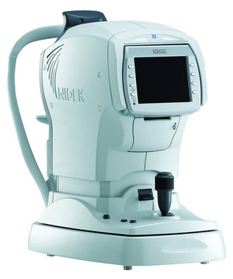
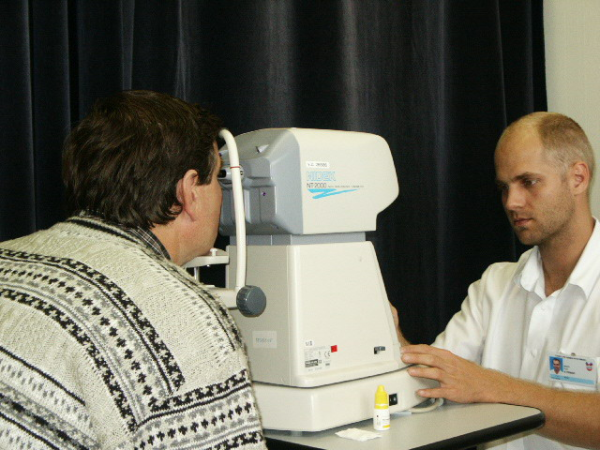
Non contact tonometry

Slide 18
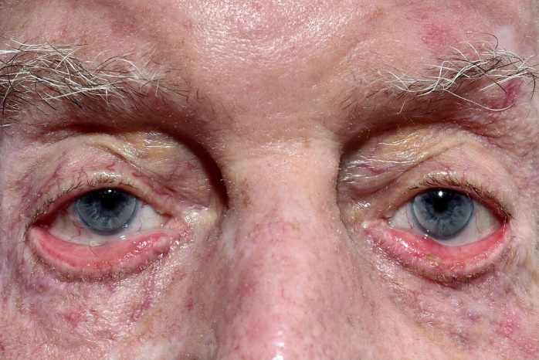
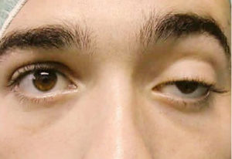
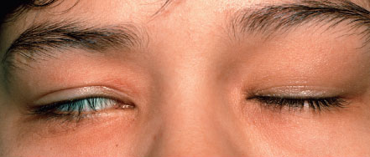
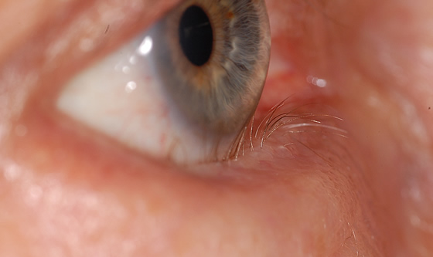
Examination of anterior segment
Aspection
Ectropium
Ptosis
Lagophtalmus
Entropium

Slide 19
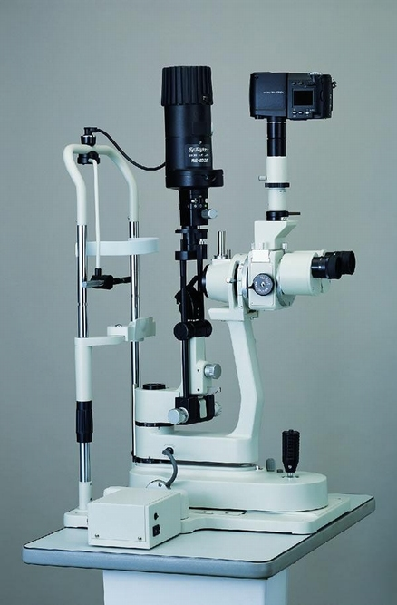
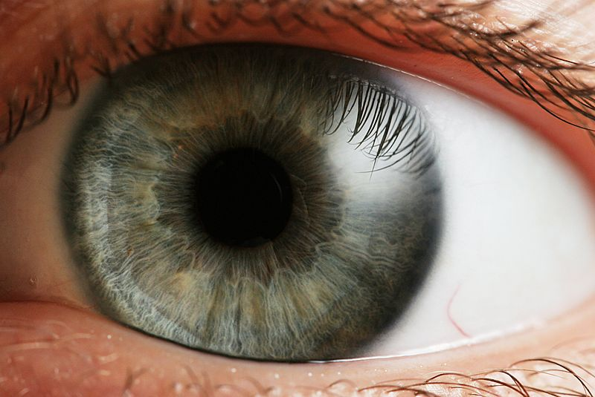
Slit lamp biomicroscopy
table mounted microscope with a special adjustable illumination source attached

Slide 20
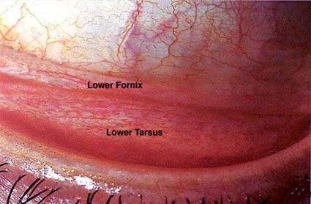
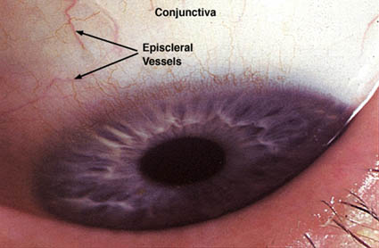
Slit lamp biomicroscopy

Slide 21
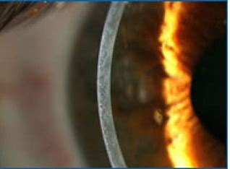
Slit lamp biomicroscopy

Slide 22
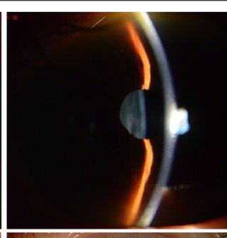
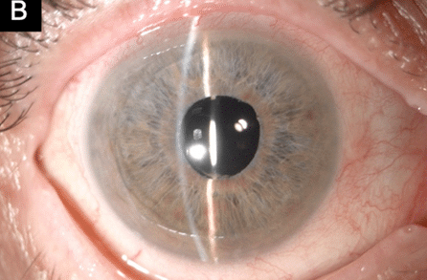
Slit lamp biomicroscopy

Slide 23
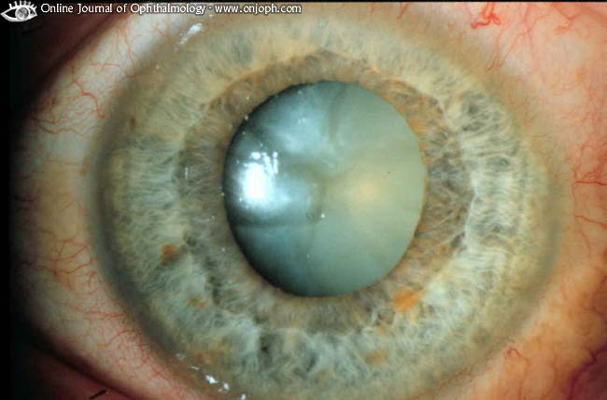
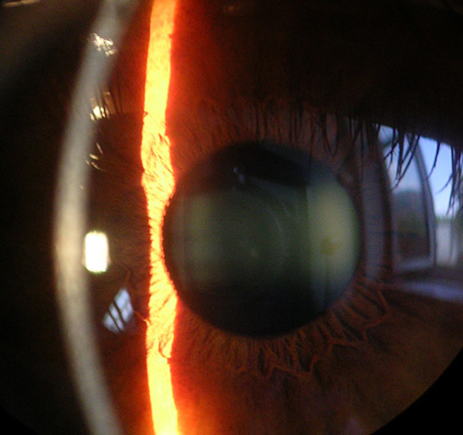
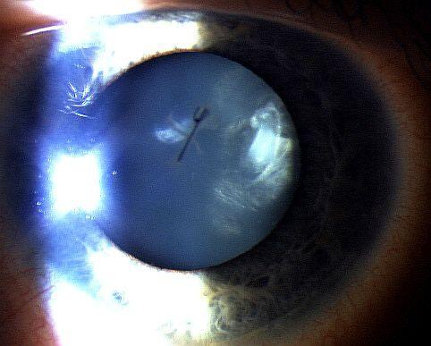
Slit lamp biomicroscopy
,

Slide 24
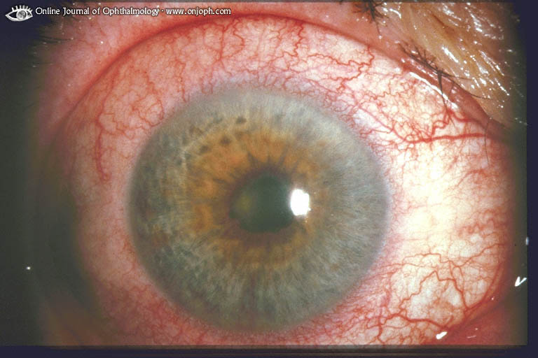
Synechiae posterior

Slide 25
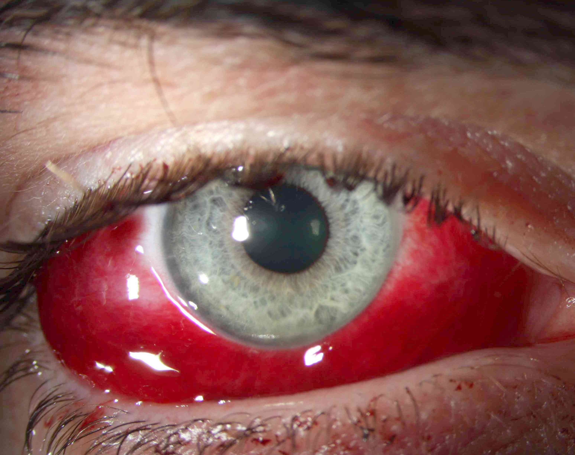
Sunconjunctival haemorrhage

Slide 26
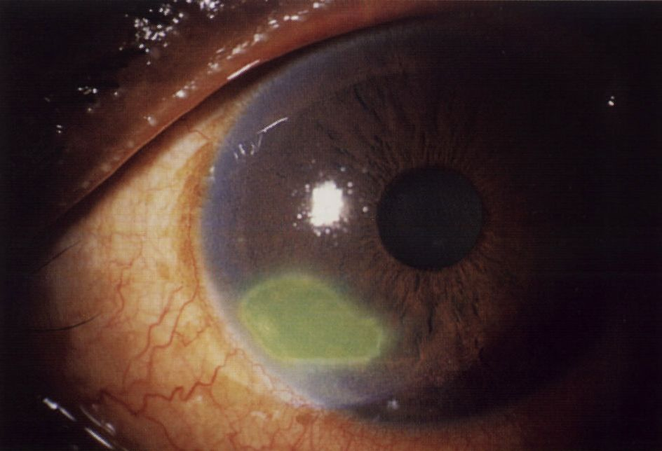
Corneal abrasion

Slide 27
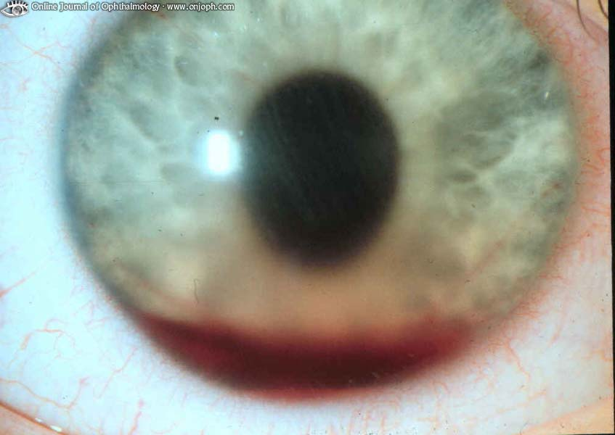
Hyphema

Slide 28
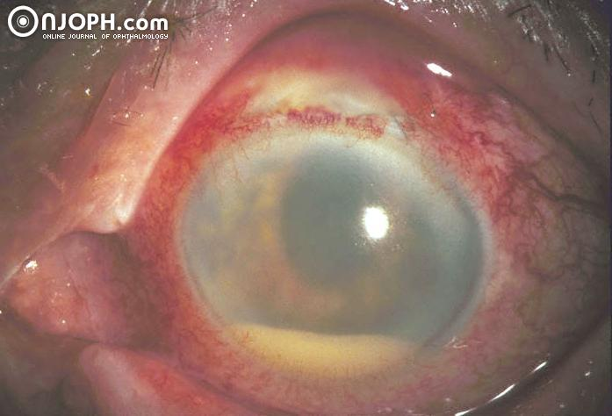
Hypopyon

Slide 29
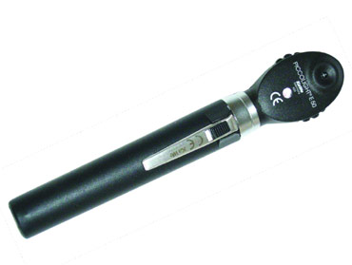
Examination of fundus
Ophthalmoscopy - direct (no steropsis, worse for periphery)
- indirect
Slit lamp biomicrocsopy
(high power convex lens, the image is vertically inverted
and laterally reversed)
Mydriasis is neccesary !

Slide 30
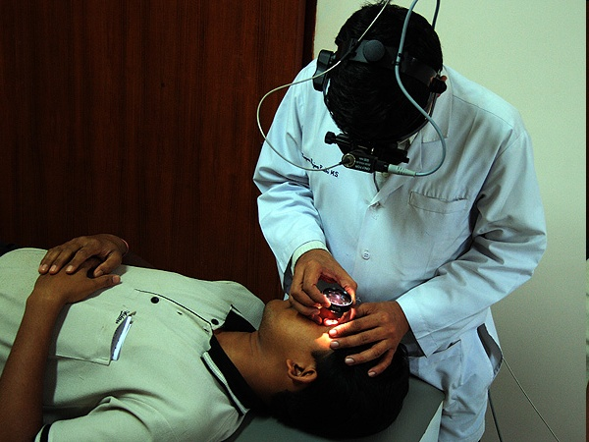
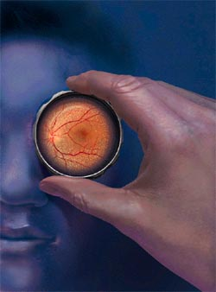
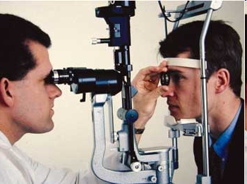

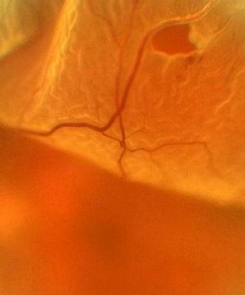
Notes:
30

Slide 31
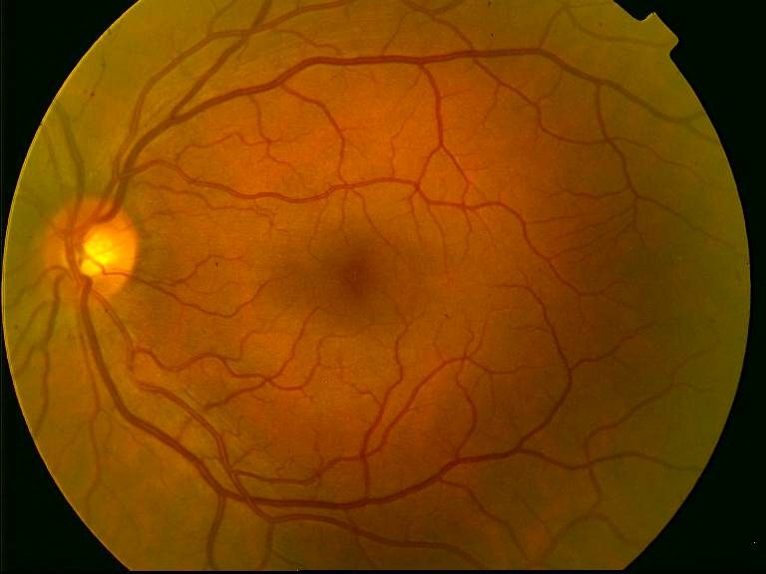
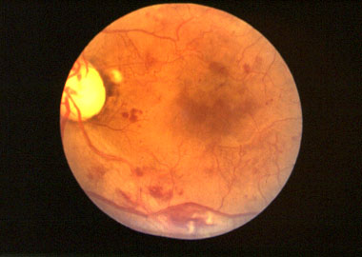
Ocular fundus

Slide 32


Status of the lens
Phakic eye (own lens)
Pseudophakic eye (arteficial intraocular lens)
Aphakic eye (without any lens)

Slide 33

Farmacology
Pilocarpin - parasympatomimetics
Atropin – parasympatolyticum (anticholinergicum)
Scopolamin, tropikamid

Slide 34
Special examination techniques

Slide 35


Gonioscopy
Gonio lens ( mirrors)
Angle structures
Fundus examination
Notes:
35

Slide 36


Notes:
36

Slide 37




Slide 38




Optical coherence tomography

Slide 39


Fluorescein angiography

Slide 40
Electrophysical tests
ERG (electroretinography)
diagnosis of functional defects of retina
Record of an action potential produced by the retina when it is stimulated by light
VEP (visual evoked potential)
-diagnosis of functional defects of visual pathways
Record of electrical activity of the visual cortex created by stimulation of the retina

Slide 41


Electrophysical tests

Slide 42

Electrophysical tests

Slide 43



Ultrasound

Slide 44


Ultrasound
Non transparent optical media
UBM- high frequency ultrasound – imaging of anterior segment

Slide 45


Ultrasound
A scan ( biometry)
B scan

Slide 46




Ultrasound

Slide 47


Color vision – HUE test

Slide 48




Hertl exoftalmometry

Slide 49

Děkuji za pozornost!

